Slide 1
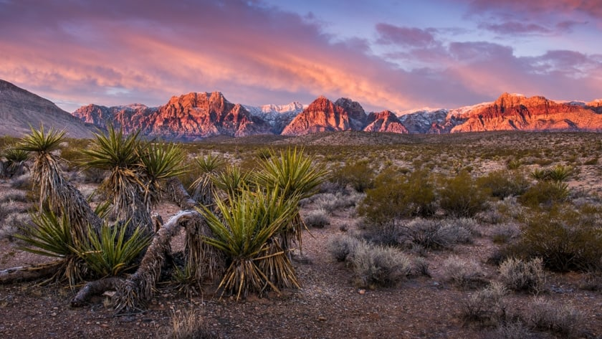
Mojave
Mojave by Victoria
By Victoria

Slide 2
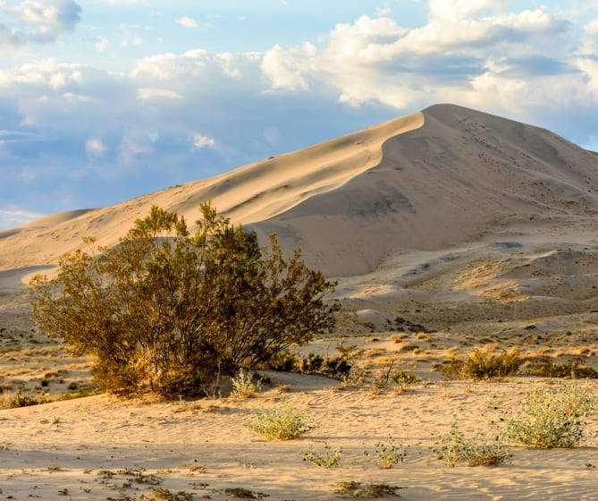
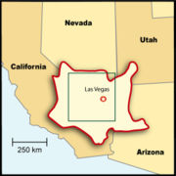
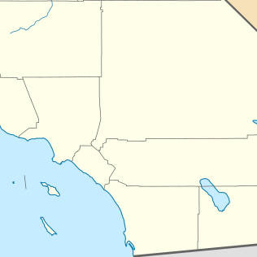
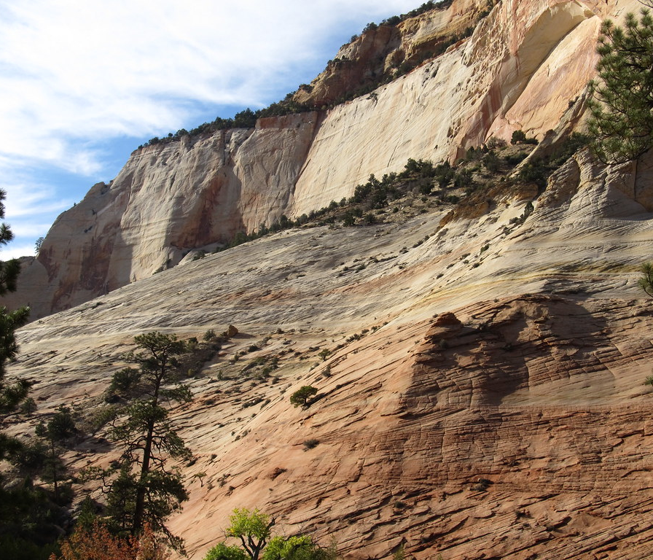
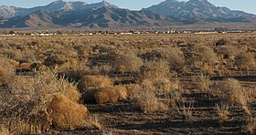
Geographical Location
The Mojave tribe lives by the Colorado River.
They also live by the mountains with a hot climate.
They live in the southern part of California.
This Photo by Unknown author is licensed under CC BY-NC-ND.
This Photo by Unknown author is licensed under CC BY-NC-ND.
This Photo by Unknown author is licensed under CC BY-SA.
This Photo by Unknown author is licensed under CC BY-SA.
This Photo by Unknown author is licensed under CC BY-SA.

Slide 3
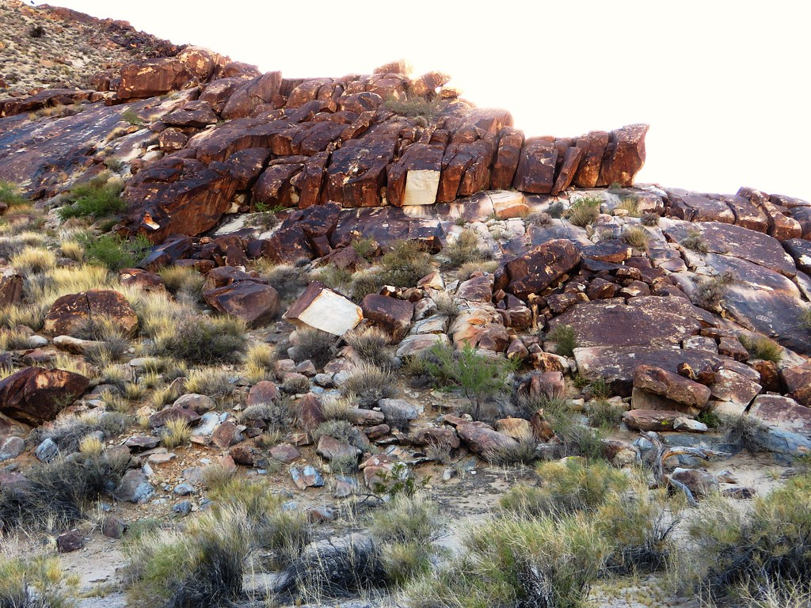
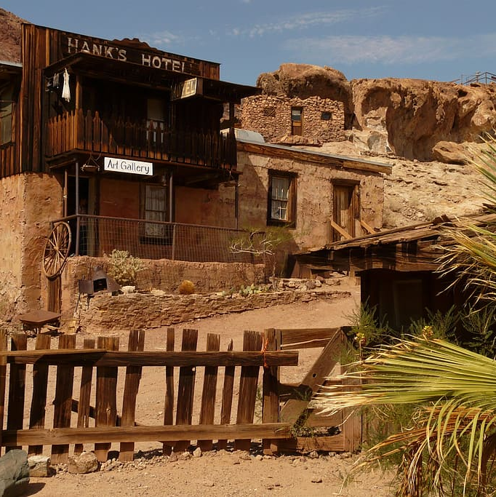
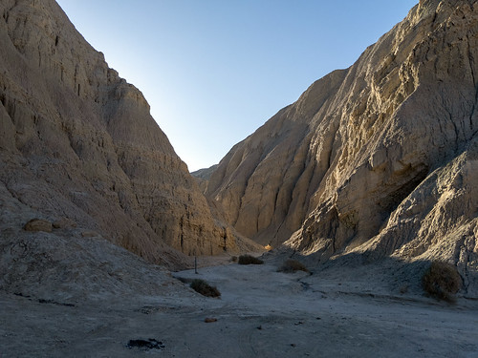
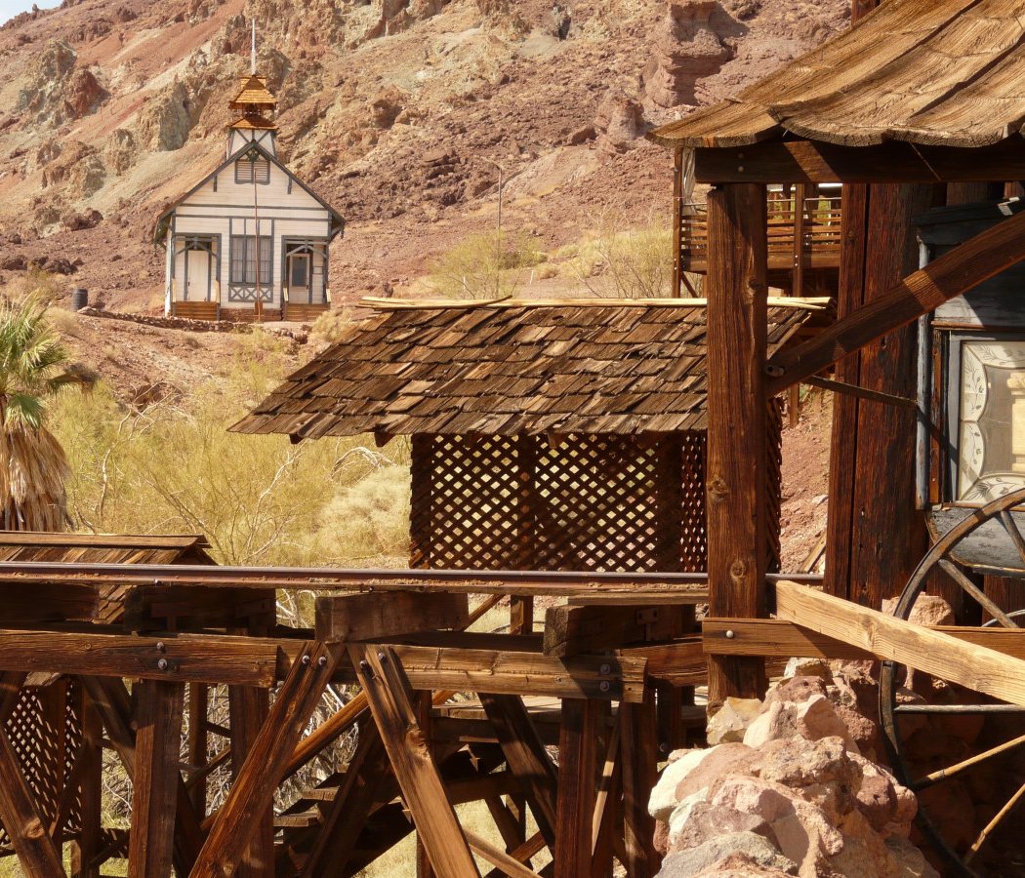
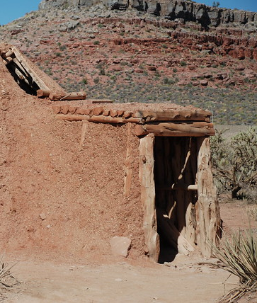
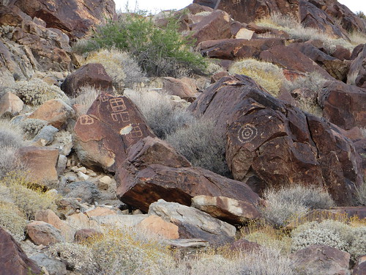
Shelter
The Mojave people put traps and nets around their houses.
They live in thatched Huts off the ground with stilts.
They also make sturdier earth lodges to keep them warm in winter and cool in summer.
This Photo by Unknown author is licensed under CC BY-SA.
This Photo by Unknown author is licensed under CC BY-SA.
This Photo by Unknown author is licensed under CC BY.
This Photo by Unknown author is licensed under CC BY-SA-NC.

Slide 4
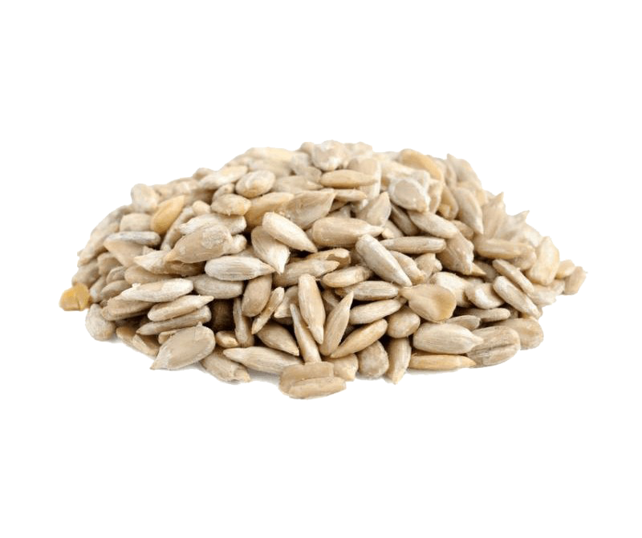
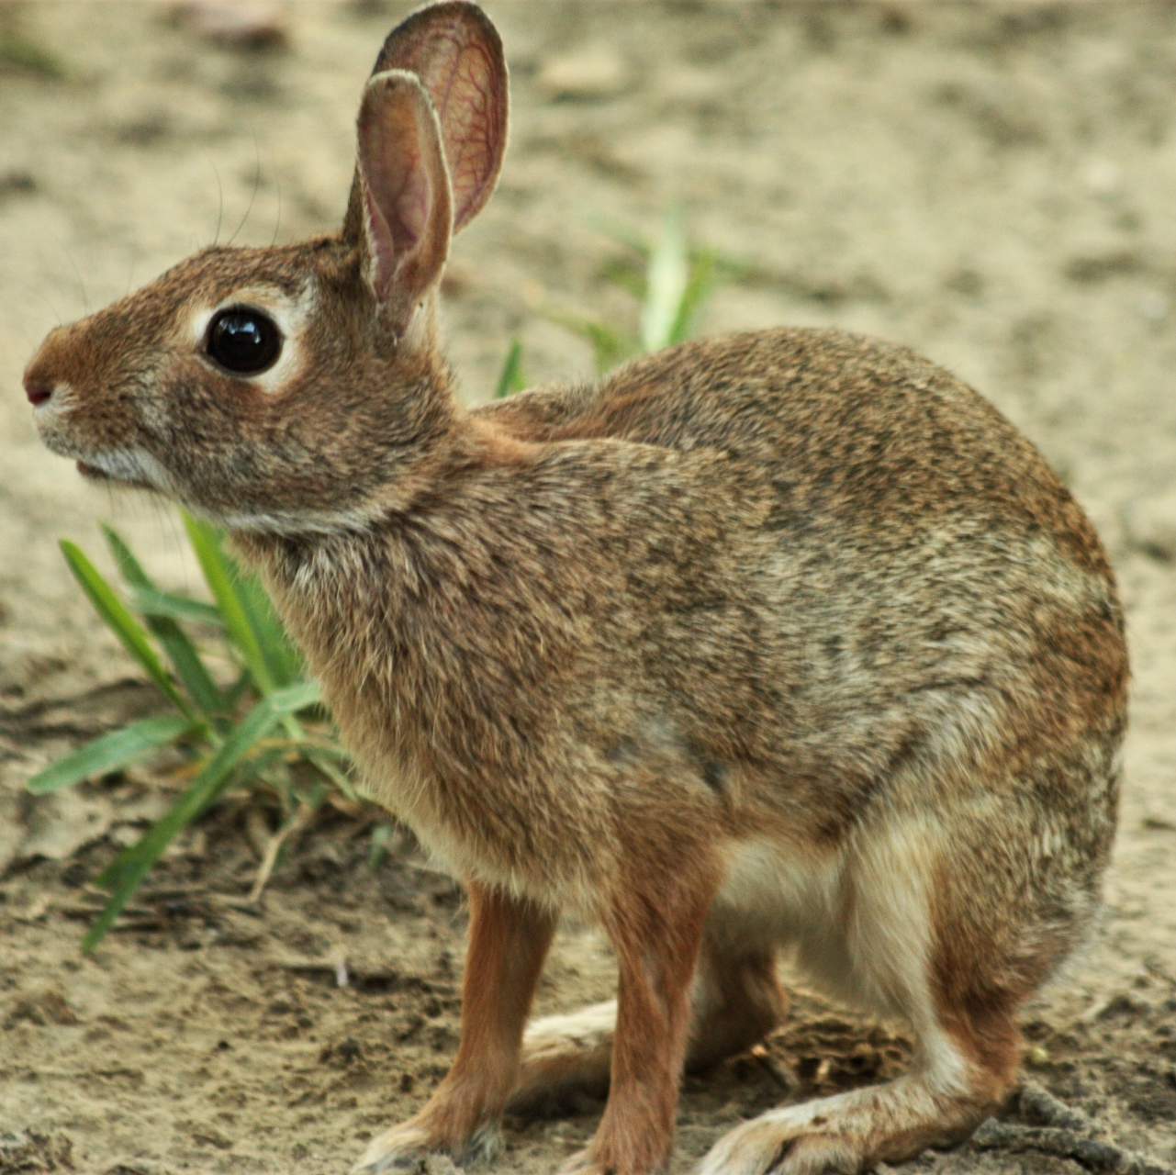
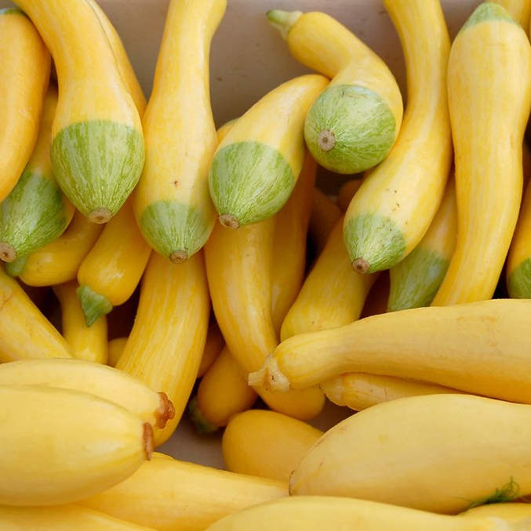
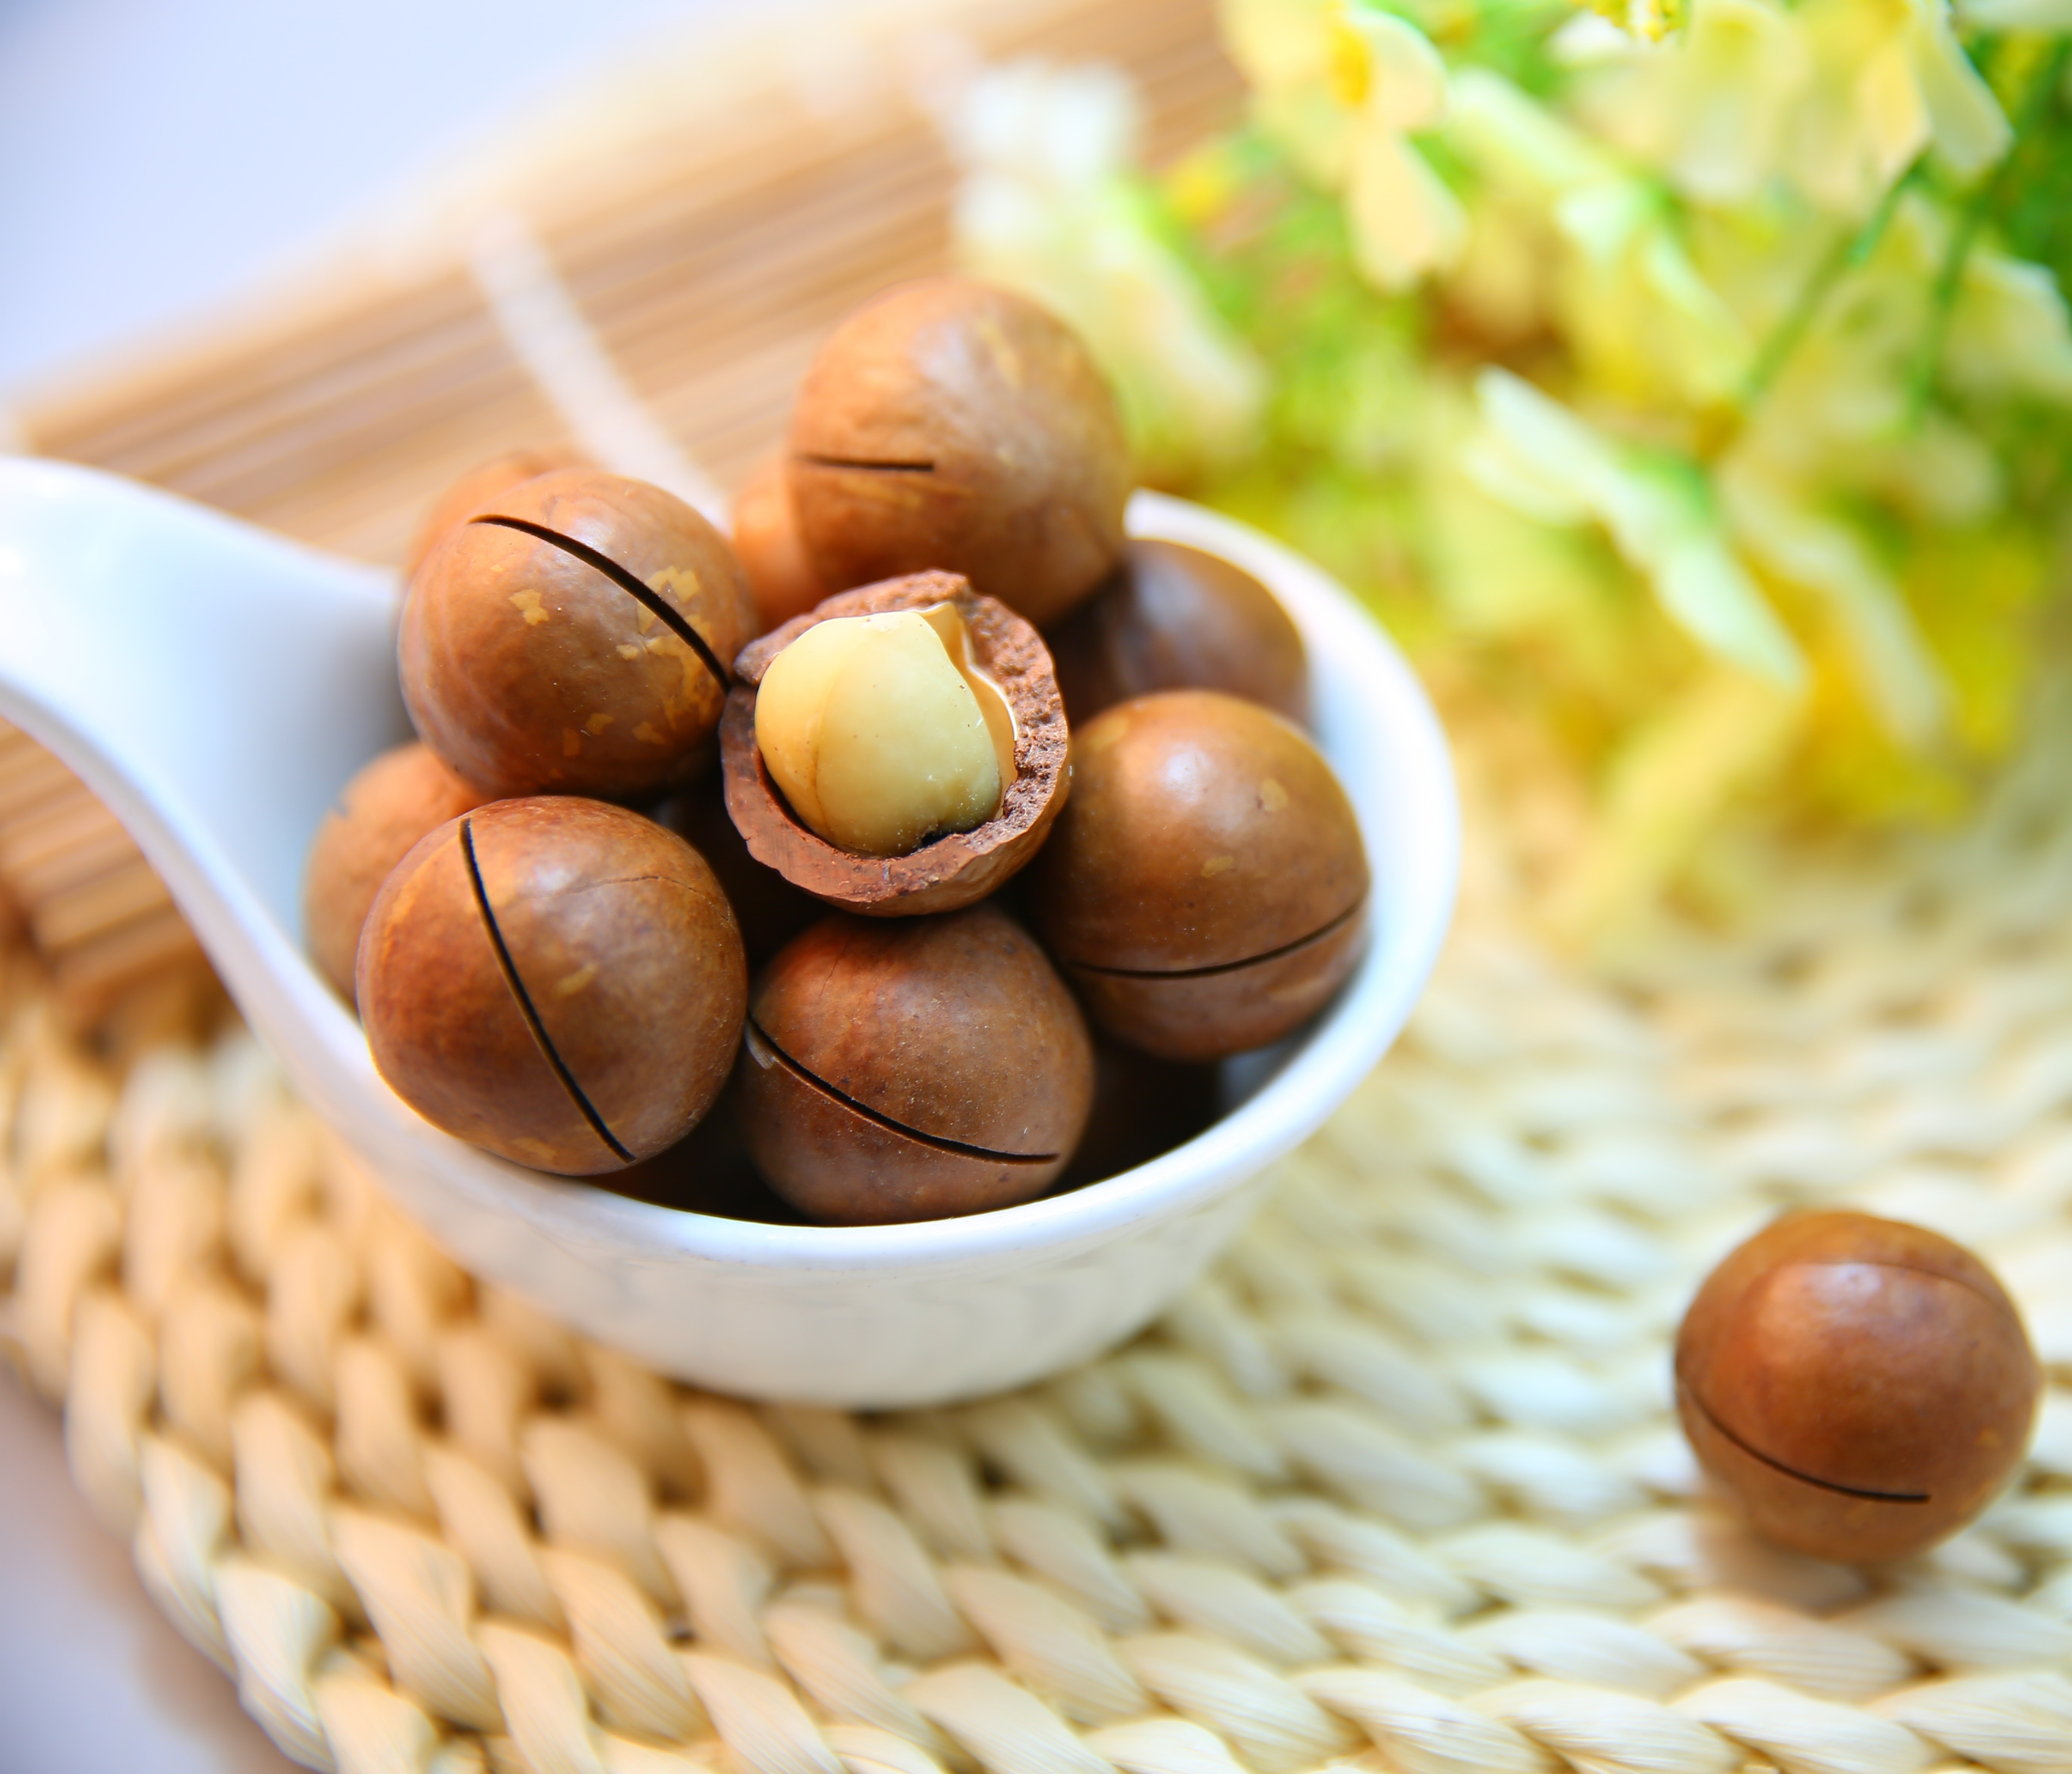
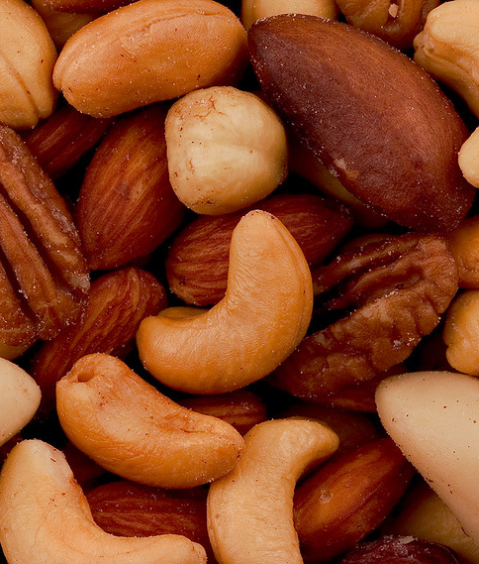
Food
The Mojave tribe ate seeds, pumpkins, corn, and strawberries.
The men hunted rabbits, fished, and gathers nuts.
Women gathered nuts, fruits, and herbs.
This Photo by Unknown author is licensed under CC BY.
This Photo by Unknown author is licensed under CC BY-NC.
This Photo by Unknown author is licensed under CC BY.

Slide 5
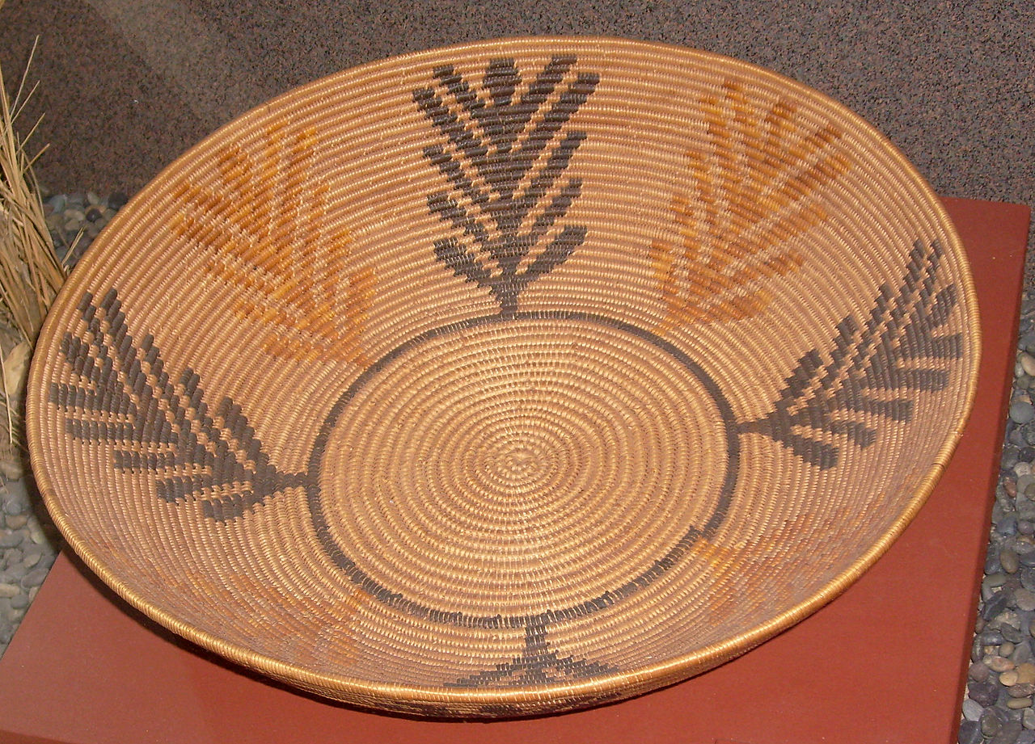
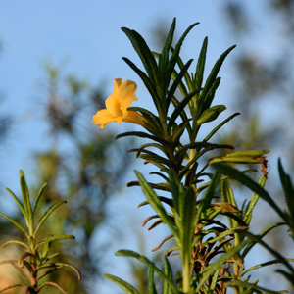
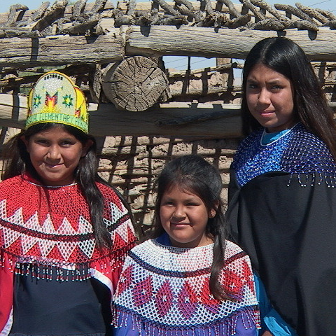
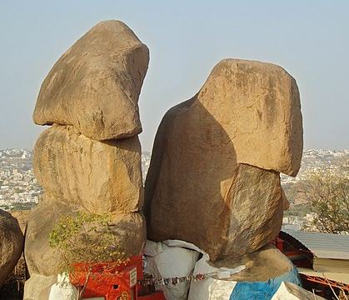
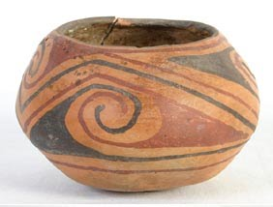
Culture
The Mojave tribe performs art and music.
The women and men plant and harvest.
The Mojave tribe practices traditional medicine.
This Photo by Unknown author is licensed under CC BY-NC-ND.
This Photo by Unknown author is licensed under CC BY-SA.
This Photo by Unknown author is licensed under CC BY-SA-NC.
This Photo by Unknown author is licensed under CC BY-ND.
This Photo by Unknown author is licensed under CC BY-SA-NC.

Slide 6
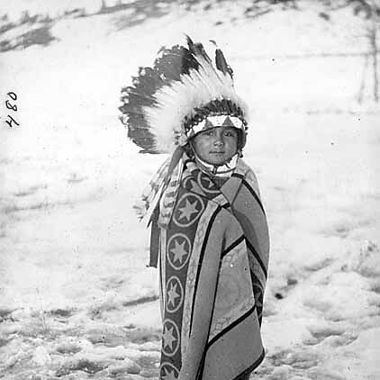
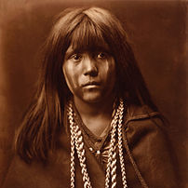
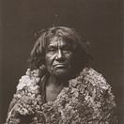
People
This Photo by Unknown author is licensed under CC BY.
This Photo by Unknown author is licensed under CC BY-SA.
This Photo by Unknown author is licensed under CC BY-SA.

Slide 7
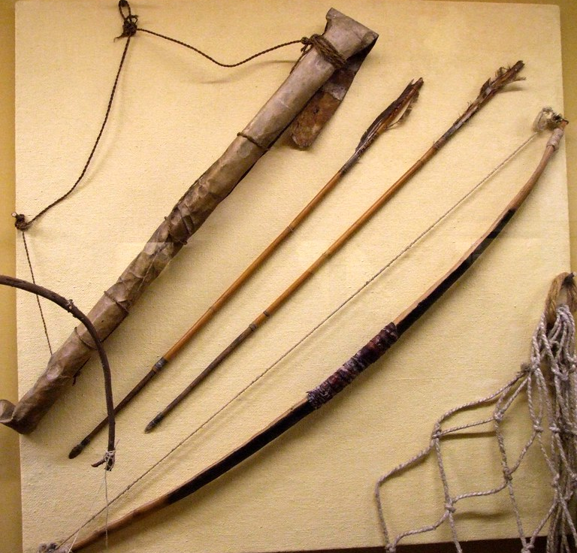
Tools
This Photo by Unknown author is licensed under CC BY-NC.

Slide 8
Pottery
This Photo by Unknown author is licensed under CC BY-ND.
This Photo by Unknown author is licensed under CC BY-SA-NC.

