Slide 1
The Pomo tribe
By:Andru De La Miguel and Brandon Cervantes

Slide 2
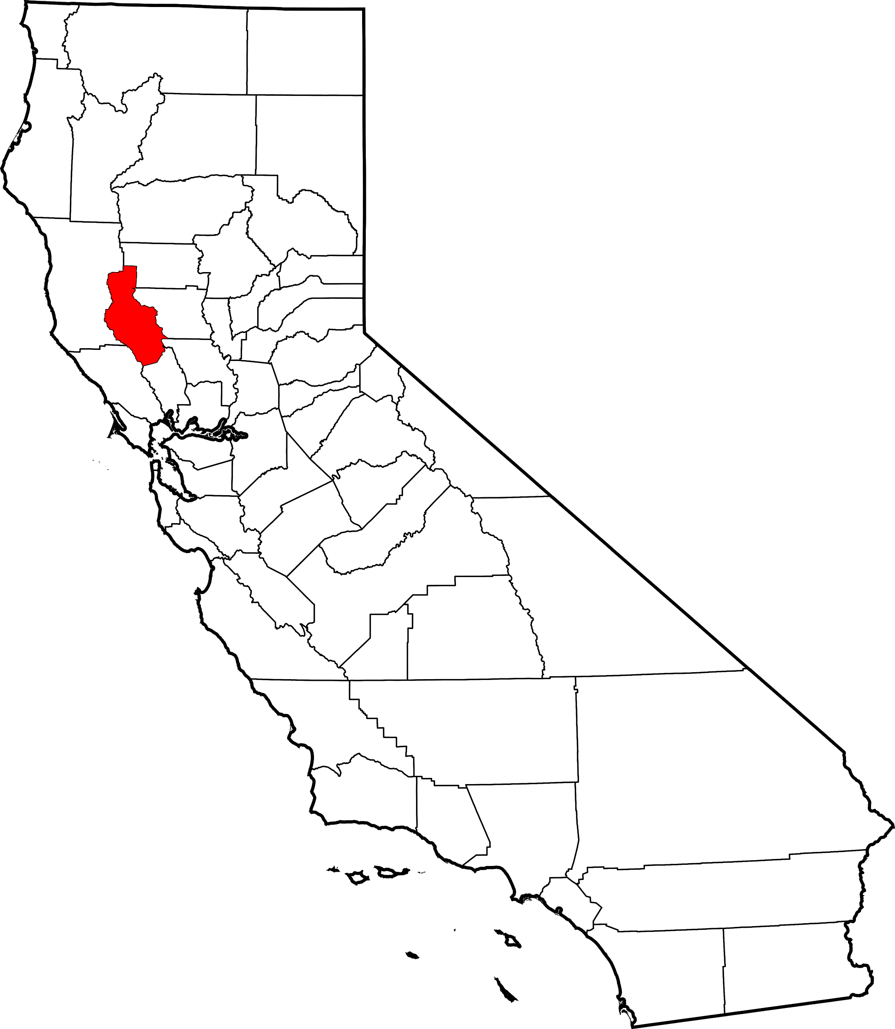
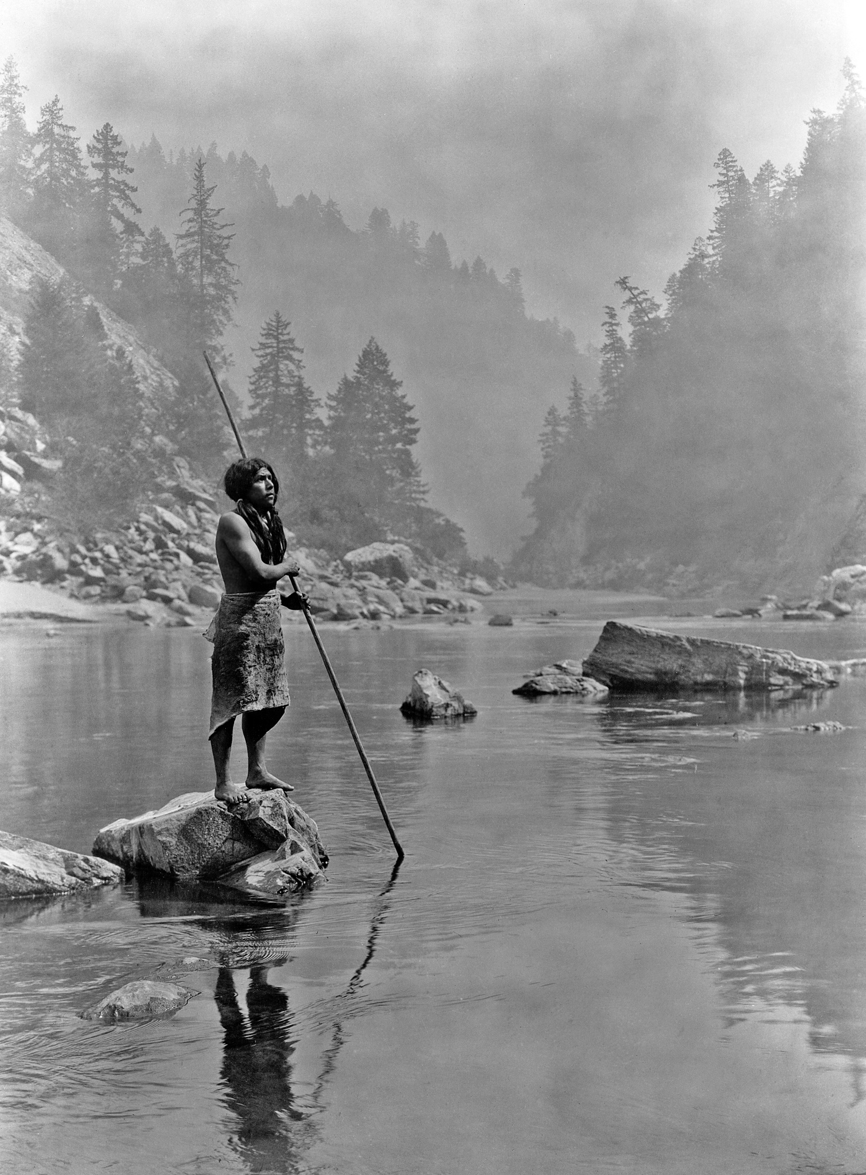
Location
The location of where the Pomo lived.They live in the top side of the map.The Pomo tribe were in separate groups.They lived from the Pacific Ocean from the Clear Lake. Some villages lived near the ocean.
Notes:
Write about the landforms, geographical location, and climate unique to the area.

Slide 3
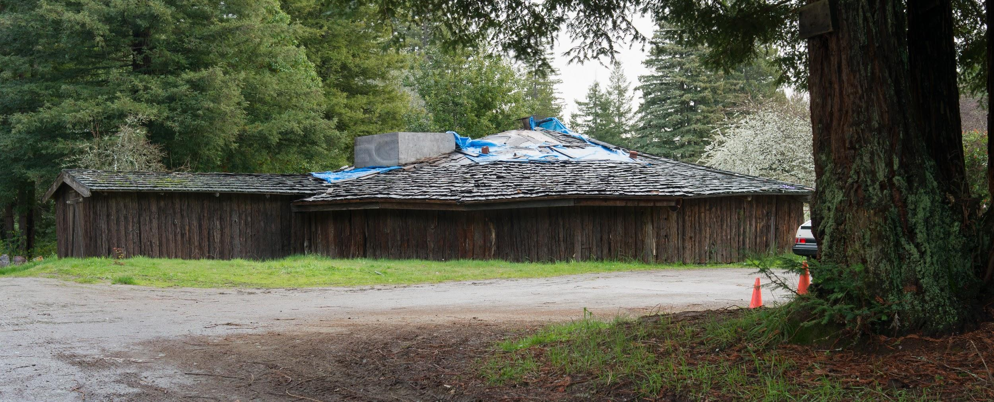
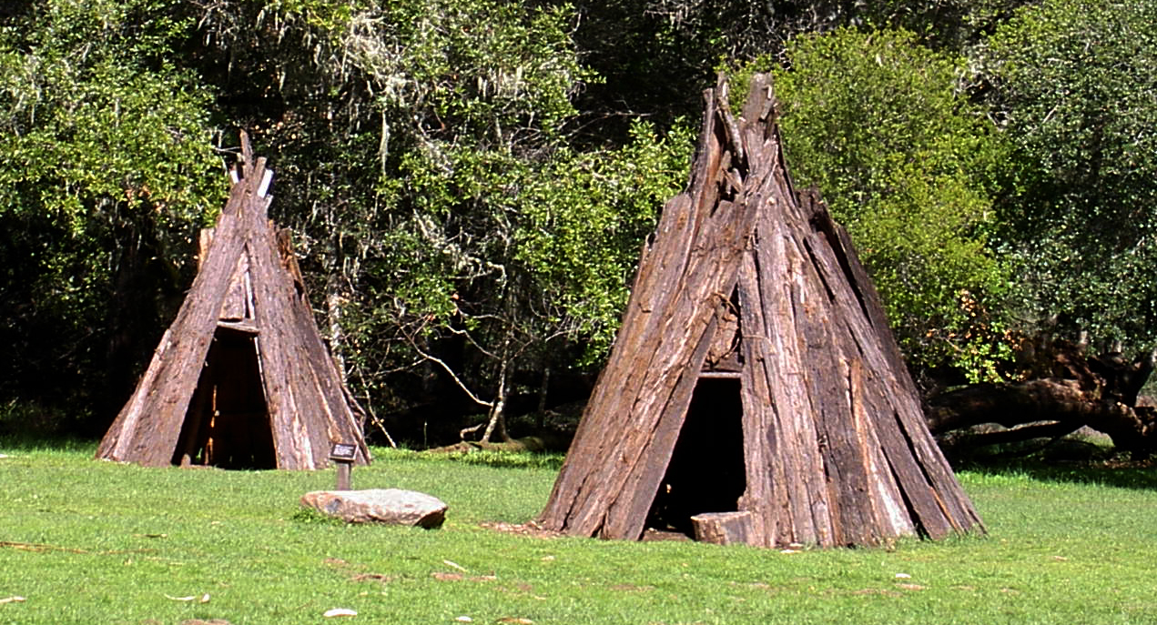
Shelter
Their shelters were made from wood found in the forests.The Pomo tribe shelters looked like a bowl shaped shelter.They also made little tents with sticks and hay. They have a fire in the middle of the house for warmth and cooking.
Notes:
Write about the materials, shape, name, and unique features of the structure.

Slide 4
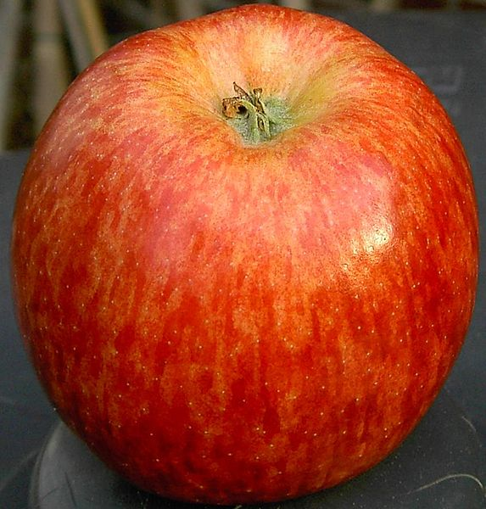
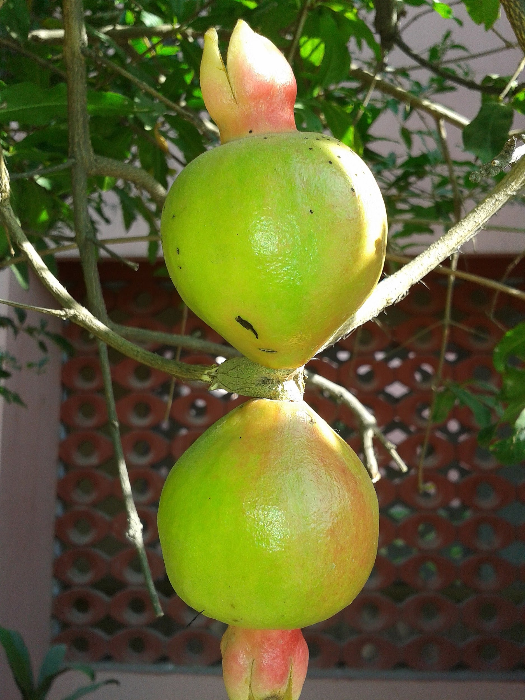
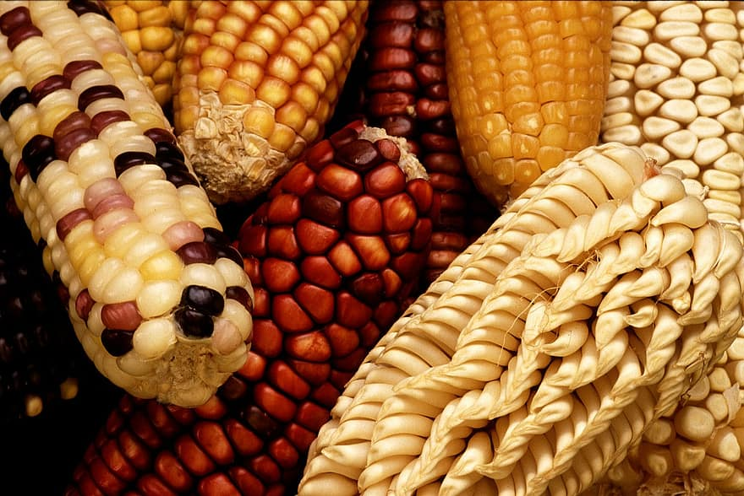
Food
The Pomo ate natural foods.The Pomo tribe made tools to hunt food.The Pomo tribe was never in starvation.They eat apples, and fish they cook it up in a fire or smoke.And there kids help the parents to cook the food and to plant seeds.
Notes:
Write about the food the tribe ate, crops they grew, hunting & gathering skills, and ways to prepare meals.

Slide 5
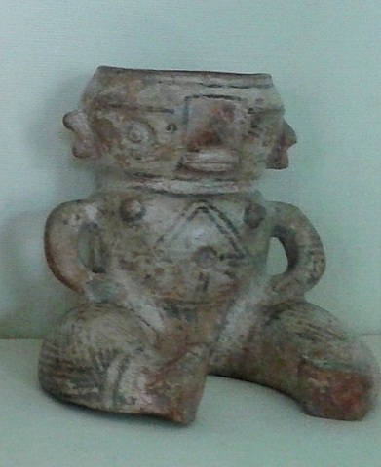
Culture
They used tools such nets, spears, and traps for fishing. They used a bow and arrow for hunting. They were expert basket makers.
Notes:
Write about the art, customs, ceremonies, and responsibilities of the men, women and children.

Slide 6
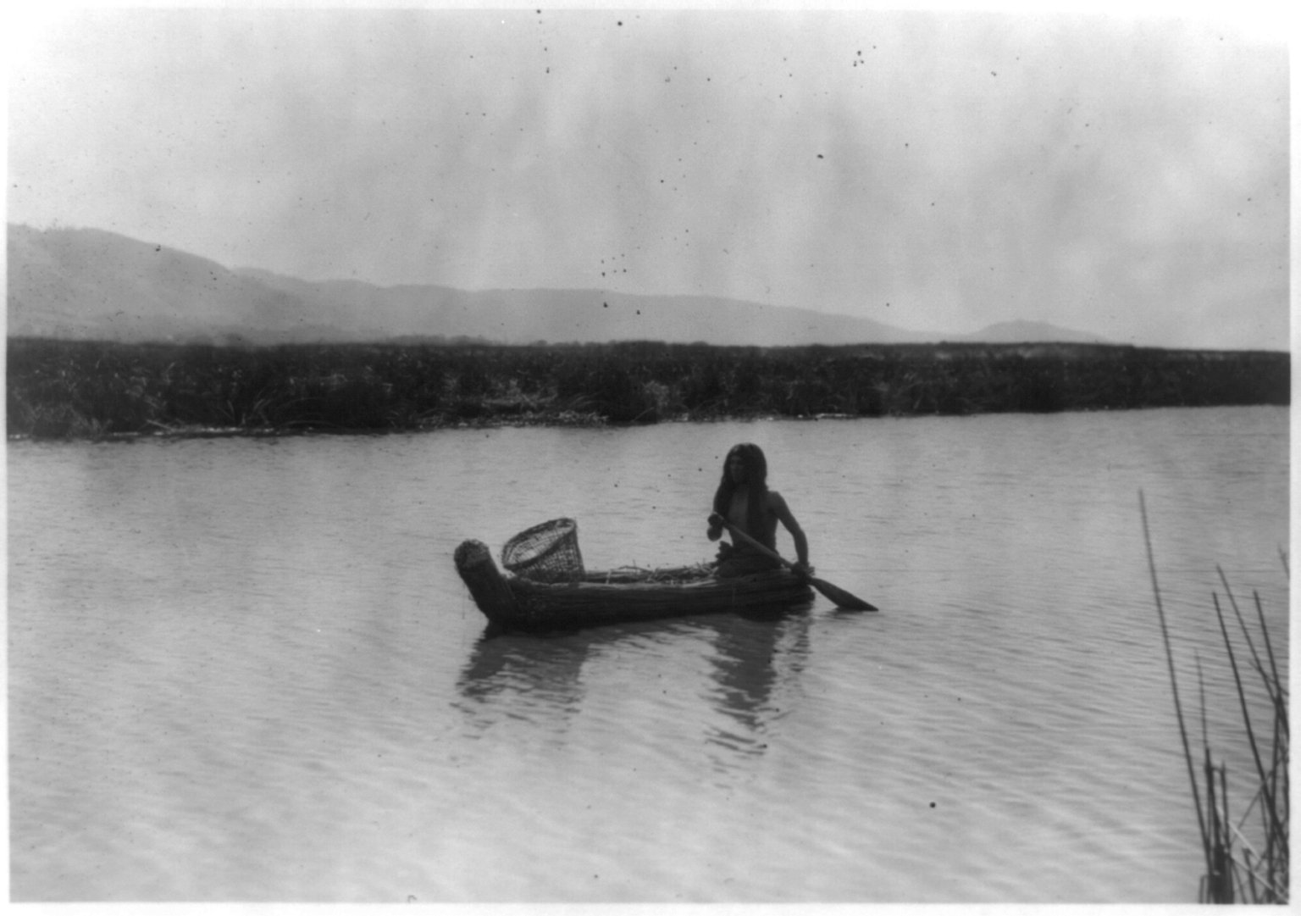
All in all the Pomo tribe is intresting.

