Slide 1
Structure and Principles
Chapter 3 section 1

Slide 2
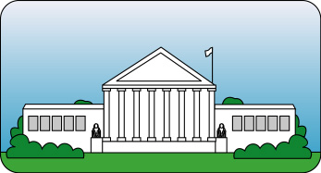
I. Structure
The Preamble explains why the Constitution was written.
The seven articles are the main divisions in the body of the Constitution, each article covering a general topic.
The amendments, which provide for changes in the original document, are the third part of the Constitution.

Slide 3
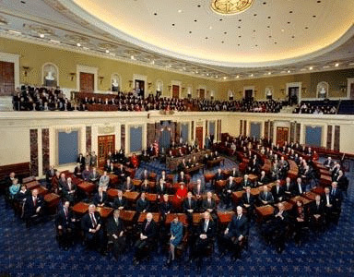
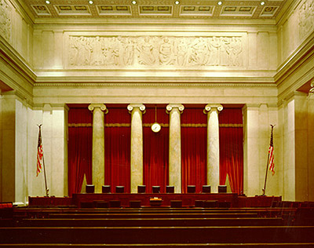
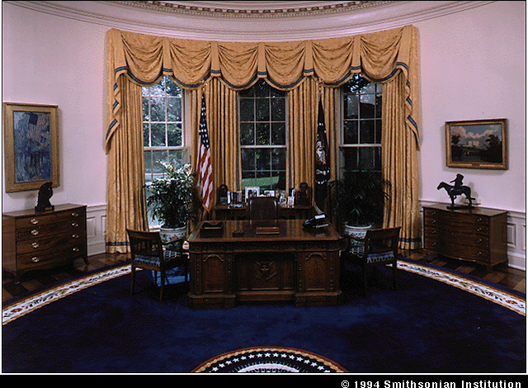
I. Structure
Article I deals with the legislative branch. The creation of Congress and its duties are outlined.
Article II deals with the executive branch that carries out the laws Congress passes.
Article III establishes the Supreme Court.

Slide 4
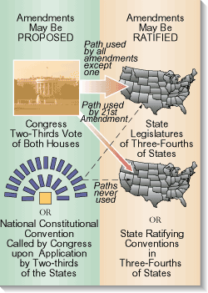
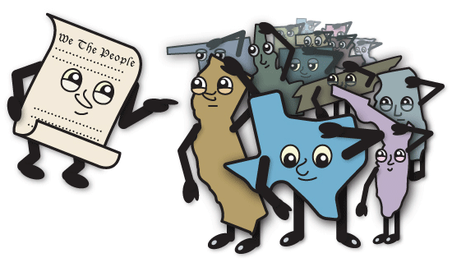
I. Structure
Article IV defines the relationship of the states with each other and to the national government.
Article V gives directions for changing the Constitution.
Article VI establishes the federal government’s supremacy in the country.
Article VII addresses the ratification process.

Slide 5
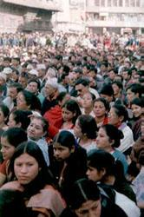
II. Major Principles
Popular sovereignty, or rule of the people, is the cornerstone of the Constitution.
Federalism, in which power is divided between national and state governments, is the government’s basic structure.

Slide 6
II. Major Principles
The Constitution provides for separation of powers among the legislative, executive, and judicial branches.
Checks and balances, the process by which each branch of government exercises some powers over the others, guarantees that no branch of government will become too powerful.

Slide 7
II. Major Principles
Judicial review, or the power of the courts to overturn laws and actions of national, state, and local governments ensures that laws made by Congress and the states do not violate individual rights.

Slide 8
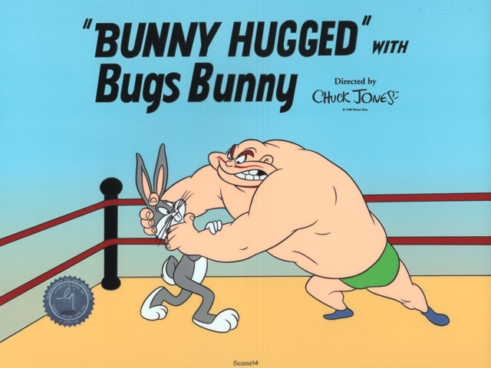
II. Major Principles
Limited government, in which the Constitution limits government actions by specifying its powers and listing powers it does not have, retains for the people the right to govern themselves.

Slide 9
In your notebooks
Both federalism and the separation of powers divide the powers of government. Compare and contrast these two methods of dividing power. Write a paragraph that compares and contrasts the two ideas.

