Slide 1
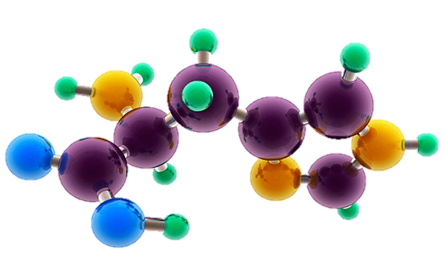
AP Chemistry Exam Review

Slide 2
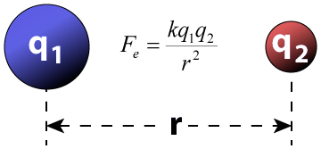
Big Idea #1
Properties of Matter

Slide 3
Ratio of Masses in a Pure Sample
Source
All elements and molecules are made up of atoms
Substances with the same atomic makeup will have same average masses
The ratio of masses of the same substance is independent of size of the substance
Molecules with the same atomic makeup (ex: H₂O) will have the same ratio of average atomic masses
H₂O₂ ratio would be different than H₂O due to the different chemical makeup
H₂O
A 4.5 gram sample of which of the following would have the greatest mass percent of oxygen?
Na₂O (molar mass = 62 g/mol)
Li₂O (molar mass = 30 g/mol)
MgO (molar mass = 40 g/mol)
SrO (molar mass = 104 g/mol)
Answer:
16/62 x 100 = 26 %
16/30 x 100 = 53%
16/40 x 100 = 40%
16/104 x 100 = 15%
Video
108 g/mol
Click reveals answer and explanation.
LO 1.1: Justify the observation that the ratio of the masses of the constituent elements in any pure sample of that compound is always identical on the basis of the atomic molecular theory.

Slide 4
Composition of Pure Substances and/or Mixtures
Source
Percent mass can be used to determine the composition of a substance
% mass can also be used to find the empirical formula
The empirical formula is the simplest formula of a substance
It is a ratio between the moles of each element in the substance
Quick steps to solve!
% to mass, mass to moles, divide by the smallest and multiply ‘til whole!)
The molecular formula is the actual formula of a substance
It is a whole number multiple of the empirical formula
Video
Click reveals answer and explanation.
LO 1.2: Select and apply mathematical routines to mass data to identify or infer the composition of pure substances and/or mixtures.

Slide 5
Identifying Purity of a Substance
Source
Impurities in a substance can change the percent composition by mass
If more of a certain element is added from an impurity, then the percent mass of that element will increase and vice versa
When heating a hydrate, the substance is heated several times to ensure the water is driven off
Then you are simply left with the pure substance and no excess water
Video
The mass percent of oxygen in pure glucose, C₆H₁₂O₆ is 53.3 percent. A chemist analyzes a sample of glucose that contains impurities and determines that the mass percent of oxygen is 49.7 percent. Which of the follow impurities could account for the low mass percent of oxygen in the sample?
n-eicosane (C₂₀H₄₂)
ribose C₅H₁₀O₅
fructose, C₆H₁₂O₆
sucrose C₁₂H₂₂O₁₁
a. has the lowest percent by mass of O
LO 1.3: The student is able to select and apply mathematical relationships to mass data in order to justify a claim regarding the identity and/or estimated purity of a substance.

Slide 6
Mole Calculations
Source
1 mole = 6.02 x 10²³ representative particles
1 mole = molar mass of a substance
1 mole = 22.4 L of a gas at STP
Video
Click reveals answer and explanation.
LO 1.4: The student is able to connect the number of particles, moles, mass and volume of substances to one another, both qualitatively and quantitatively.

Slide 7
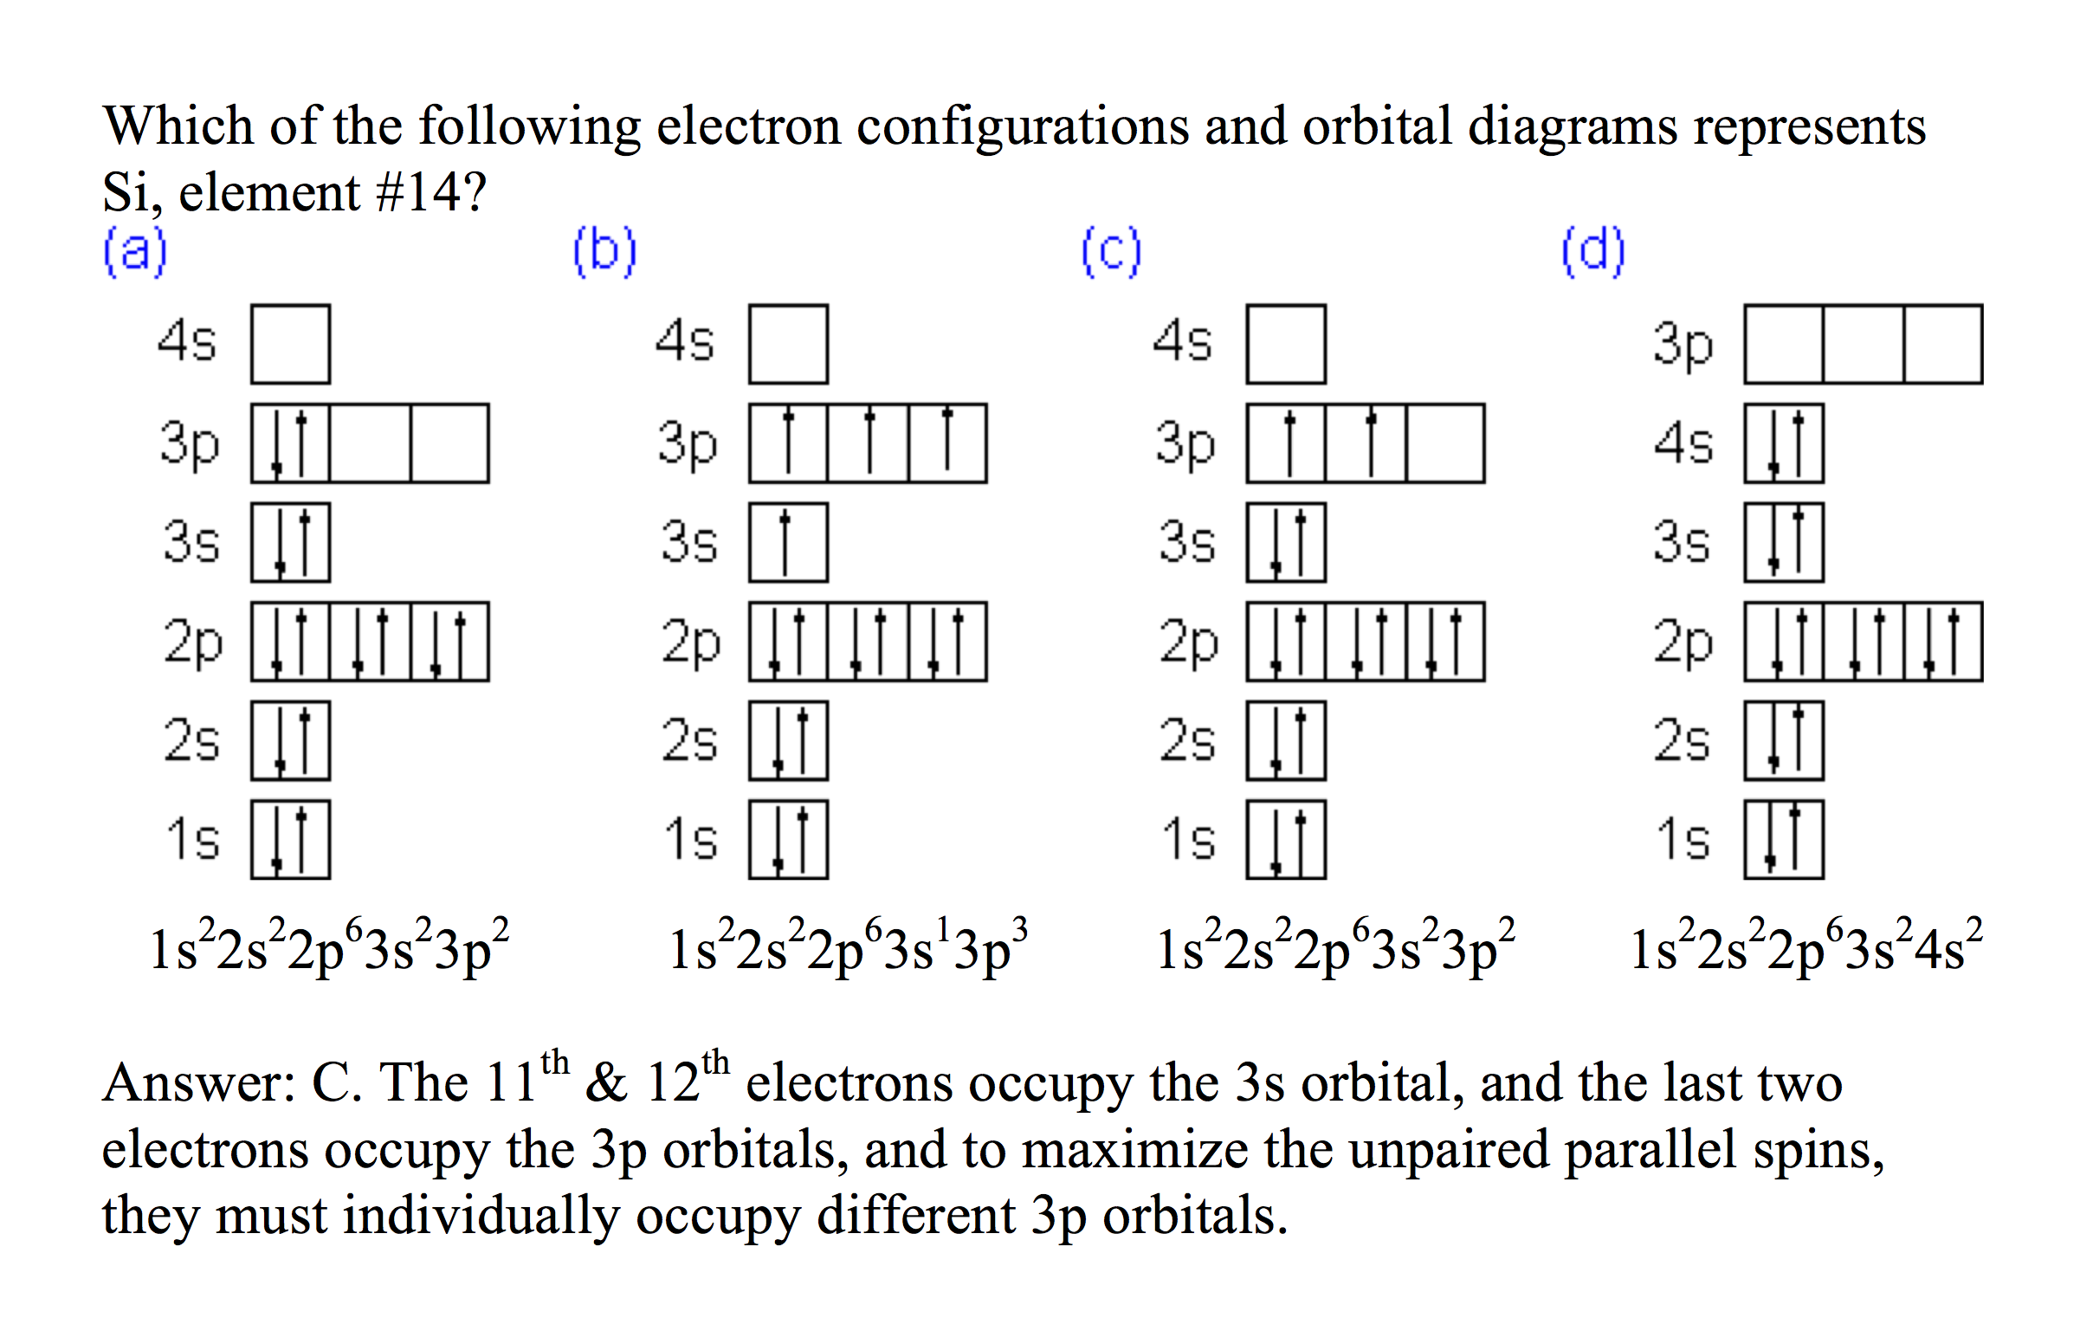
Electronic Structure of the Atom: Electron Configurations
Source
Electrons occupy orbitals whose energy level depends on the nuclear charge and average distance to the nucleus
Electron configurations & orbital diagrams indicate the arrangement of electrons with the lowest energy (most stable):
Electrons occupy lowest available energy levels
A maximum of two electrons may occupy an energy level
Each must have opposite spin (±½)
In orbitals of equal energy, electrons maximize parallel unpaired spins
Video
Click reveals answer and explanation.
LO 1.5: The student is able to explain the distribution of electrons in an atom or ion based upon data.

Slide 8
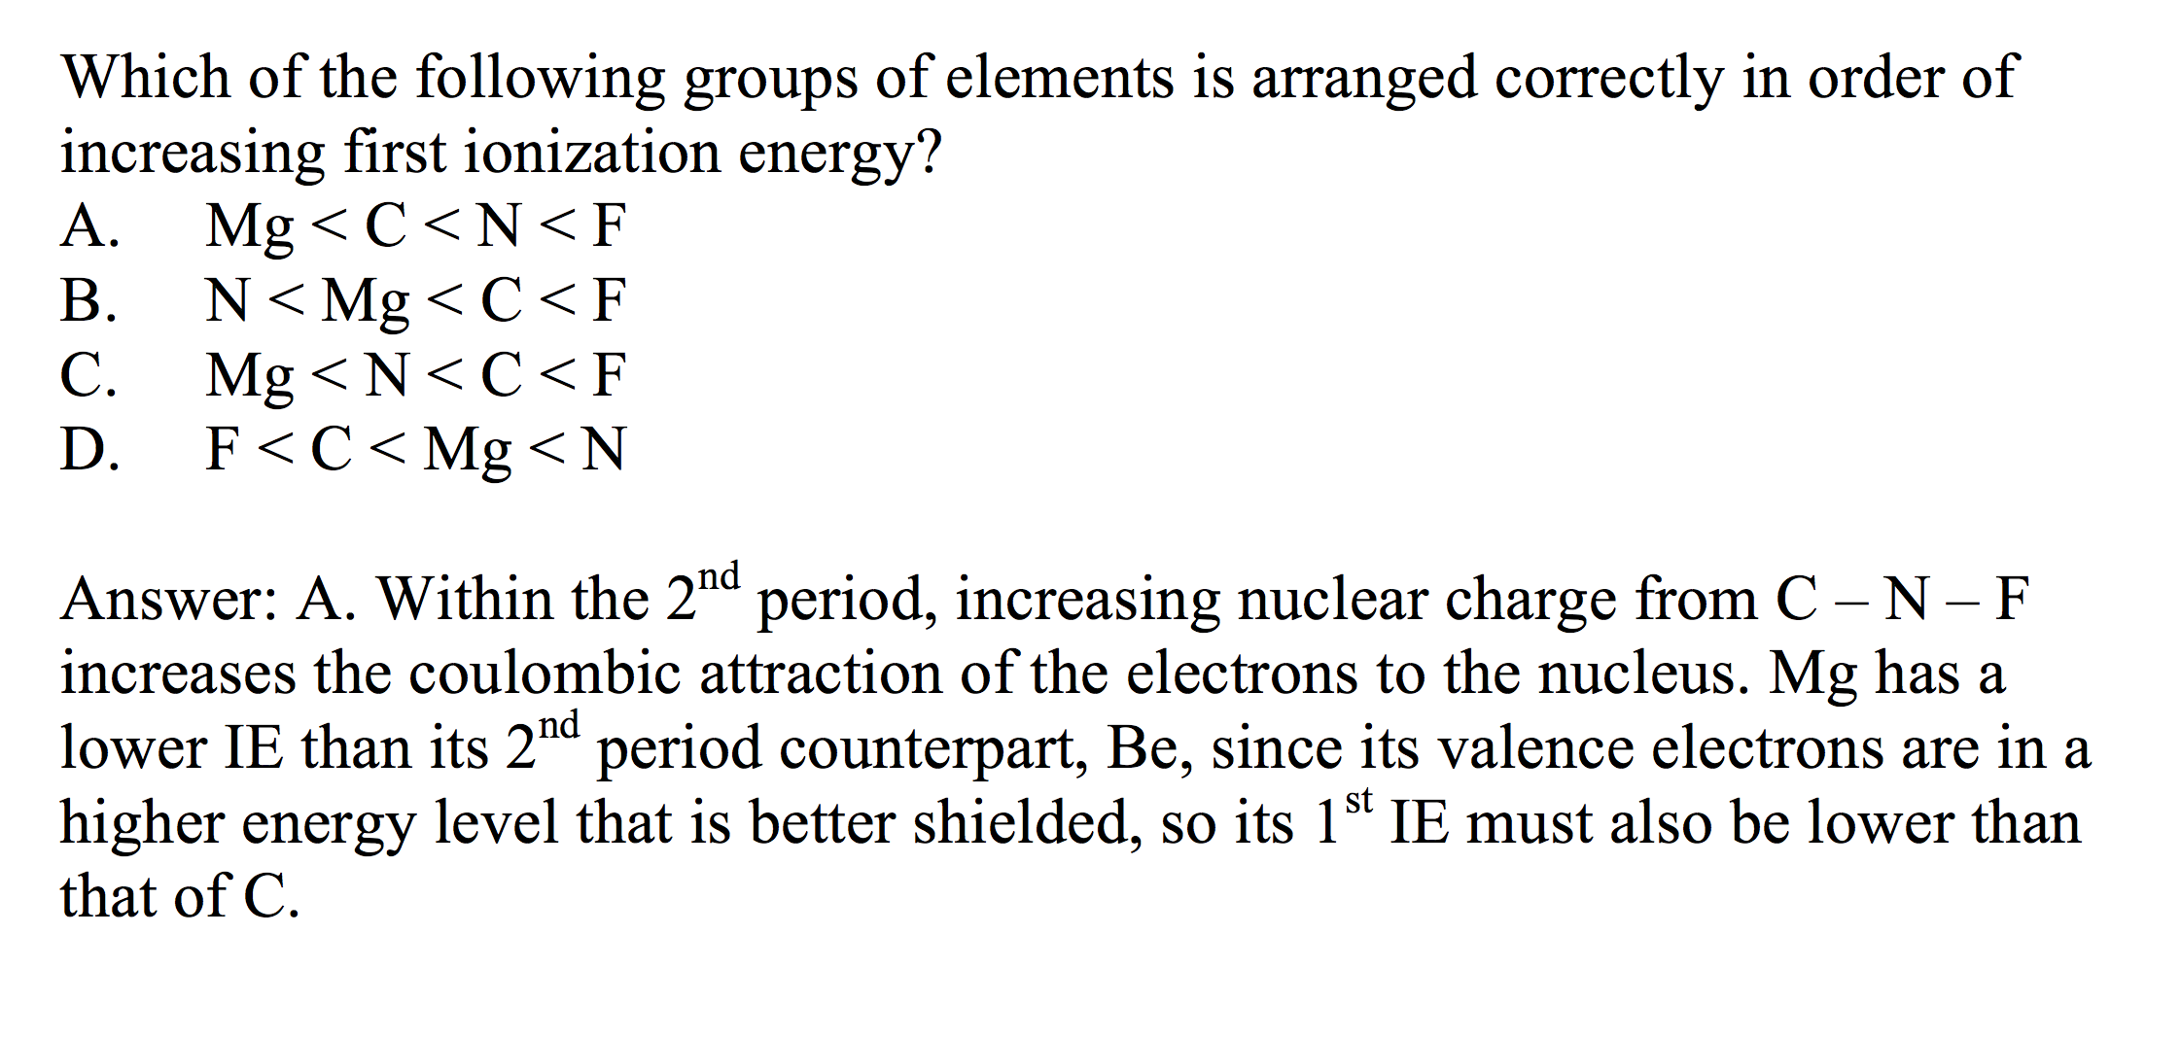
Electronic Structure of the Atom: 1st Ionization Energy
Source
1st Ionization Energy (IE) indicates the strength of the coulombic attraction of the outermost, easiest to remove, electron to the nucleus:
X(g) + IE X⁺(g) + e–
1st IE generally increases across a period and decreases down a group
IE generally increases as #protons increases in same energy level
IE decreases as e– in higher energy level: increased shielding, e– farther from nucleus
Video
Click reveals answer and explanation.
LO 1.6: The student is able to analyze data relating to electron energies for patterns and relationships.

Slide 9
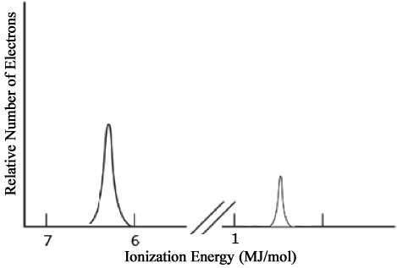
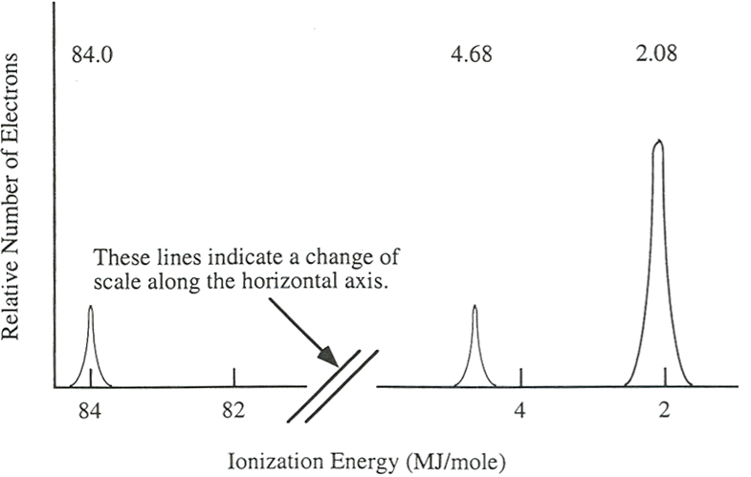
Electronic Structure of the Atom: Photoelectron Spectroscopy (PES)
Source
Li
PES uses high-energy (X-ray) photon to excite random e– from atom
KE of ejected electron indicates binding energy (coulombic attraction) to nucleus:
BE = hϖ_{photon} – KE
Direct measurement of energy and number of each electron
Lower energy levels have higher BE
Signal size proportional to number of e– in energy level
Elements with more protons have stronger coulombic attraction, higher BE at each energy level
1s²
Video
2s¹
Ne
2p⁶
1s²
2s²
Click reveals answer and explanation.
Image from Chemistry: A Guided Inquiry by R. S. Moog and J. J. Farrell, Wiley Publishing
LO 1.7: The student is able to describe the electronic structure of the atom, using PES data, ionization energy data, and/or Coulomb’s law to construct explanations of how the energies of electrons within shells in atoms vary.

Slide 10
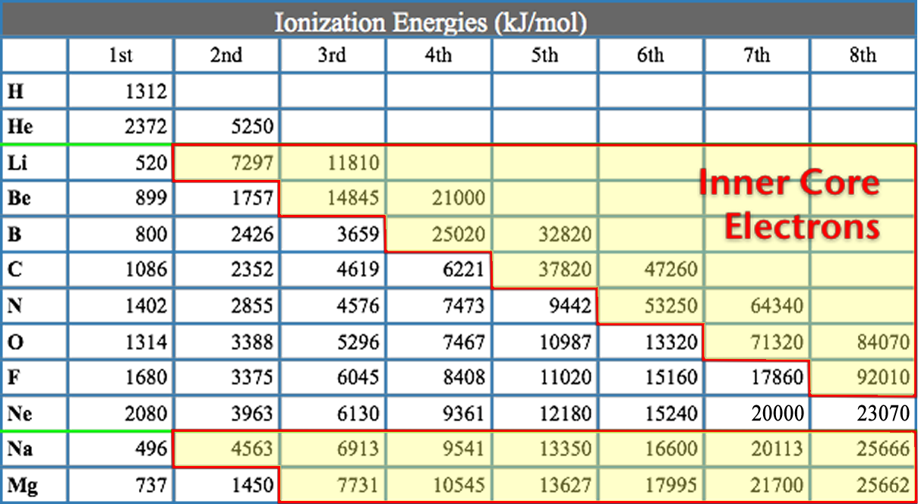
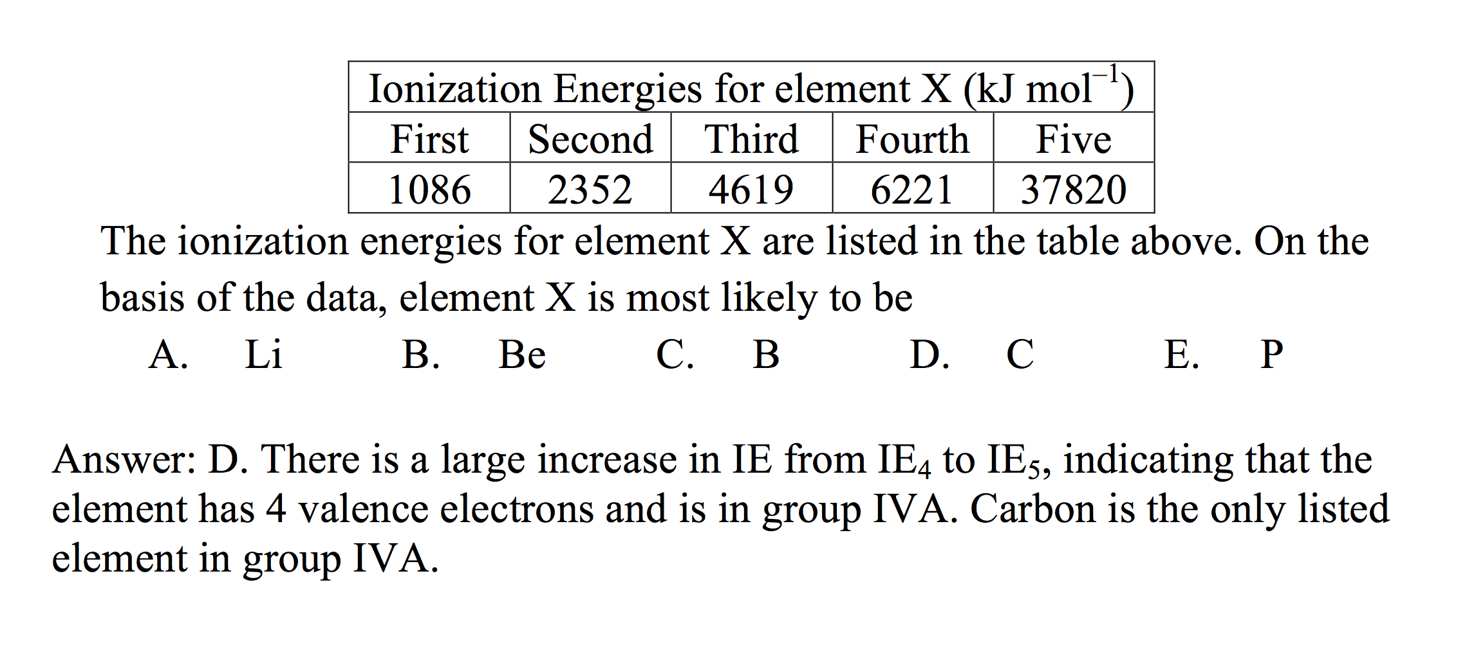
Electronic Structure of the Atom: Higher Ionization Energies
Source
2nd & subsequent IE’s increase as coulombic attraction of remaining e–’s to nucleus increases
X⁺ + IE X²⁺ + e–
X²⁺ + IE X³⁺ + e–
Large jump in IE when removing less-shielded core electrons
Video
Click reveals answer and explanation.
LO 1.8: The student is able to explain the distribution of electrons using Coulomb’s law to analyze measured energies.

Slide 11
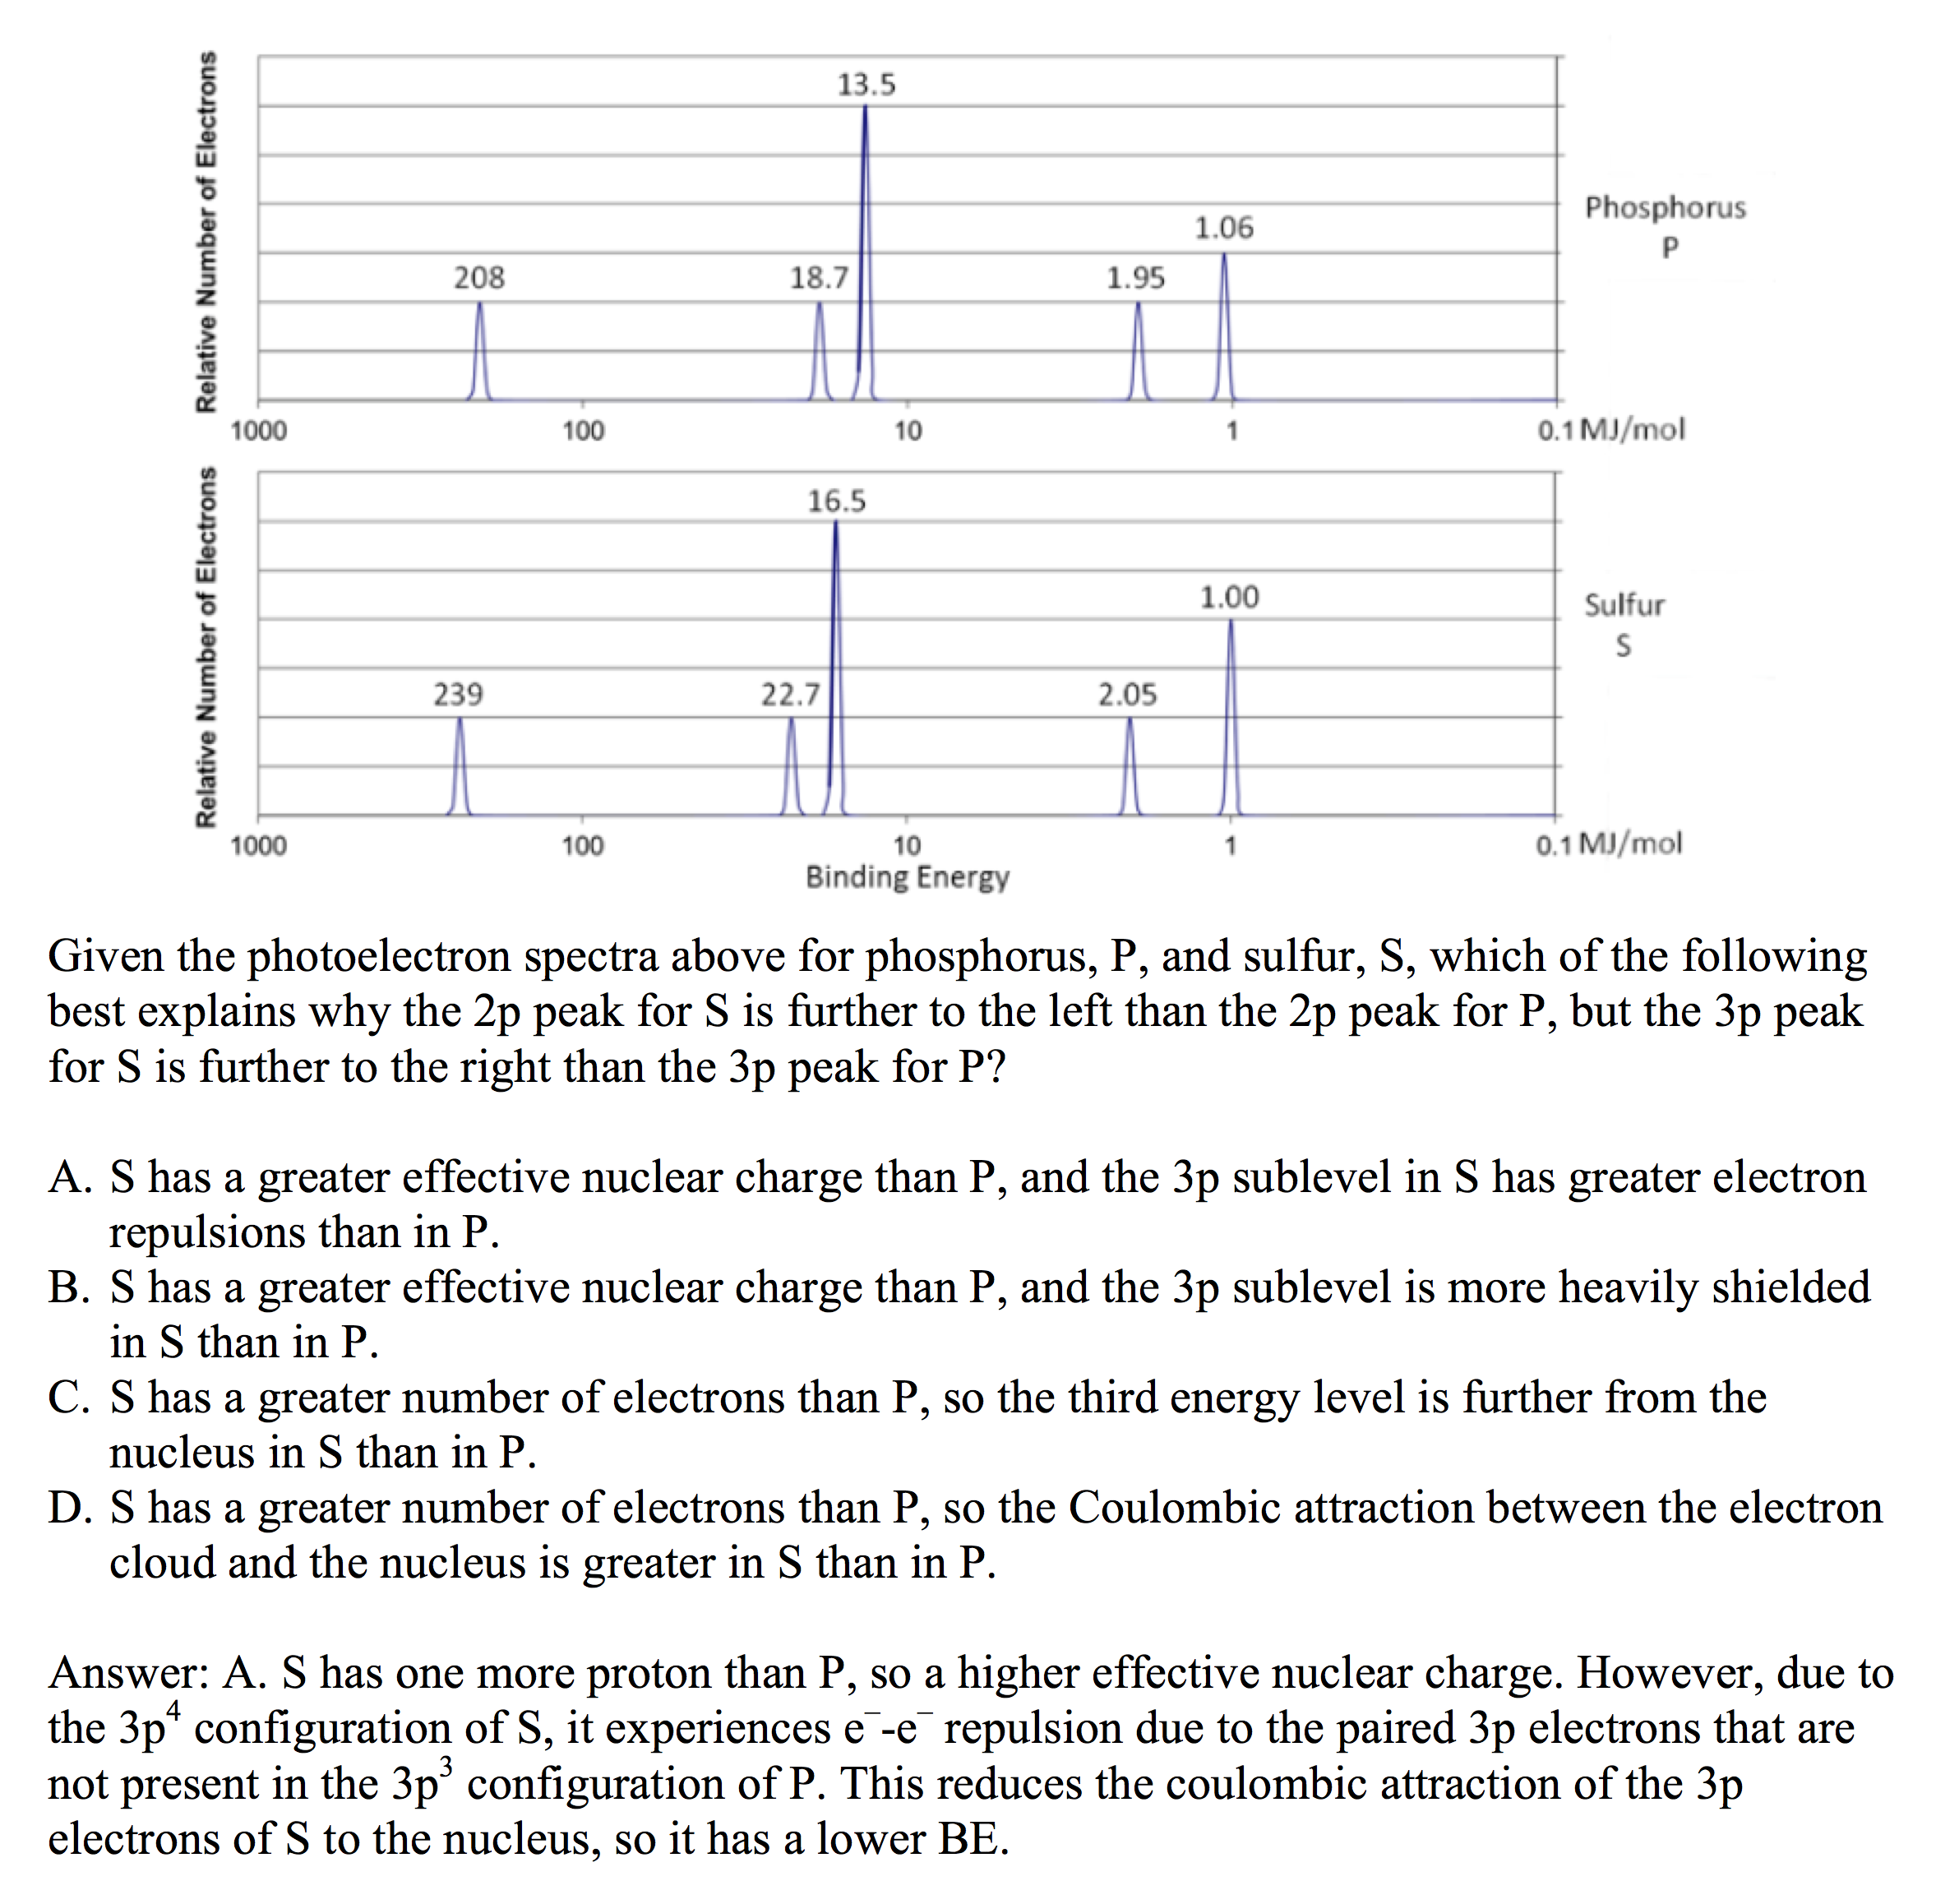
Electronic Structure of the Atom: 1st Ionization Energy Irregularities
Source
1st Ionization Energy Energy (IE) decreases from Be to B and Mg to Al
Electron in 2p or 3p shielded by 2s² or 3s² electrons, decreasing coulombic attraction despite additional proton in nucleus.
Same effect seen in 3d¹⁰-4p, 4d¹⁰-5p and 5d¹⁰-6p
1st Ionization Energy decreases from N to O and P to S
np⁴ contains first paired p electrons, e–-e– repulsion decreases coulombic attraction despite additional proton
Video
Click reveals answer and explanation.
LO 1.8: The student is able to explain the distribution of electrons using Coulomb’s law to analyze measured energies.

Slide 12
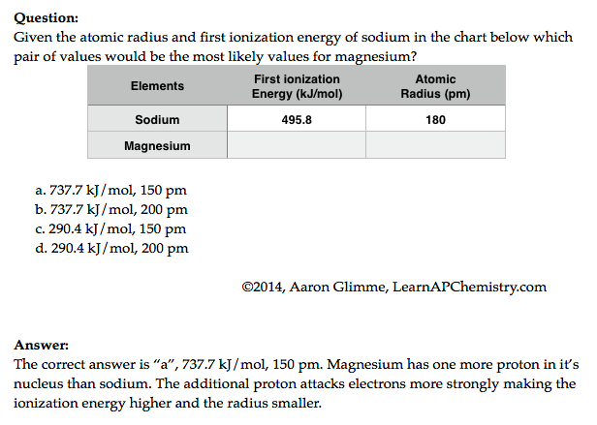
Predictions with Periodic Trends
Sources
Video
The following explains these trends:
Electrons attracted to the protons in the nucleus of an atom
So the closer an electron is to a nucleus, the more strongly it is attracted (Coulomb’s law)
The more protons in a nucleus (effective nuclear force), the more strongly it attracts electrons
Electrons are repelled by other electrons in an atom. If valence electrons are shielded from nucleus by other electrons, you will have less attraction of the nucleus (again Coulomb’s law-greater the atomic radius, the greater the distance)
Click reveals answer and explanation.
its
attracts
L.O. 1.9 The student is able to predict and/or justify trends in atomic properties based on location on periodic table and/or the shell model

Slide 13
Chemical Reactivity
Source
Using Trends
Nonmetals have higher electronegativities than metals --> causes the formation of ionic solids
Compounds formed between nonmetals are molecular
Usually gases, liquids, or volatile solids at room temperature
Elements in the 3rd period and below can accommodate a larger number of bonds
The first element in a group (upper most element of a group) forms pi bonds more easily (most significant in 2nd row, non-metals)
Accounts for stronger bonds in molecules containing these elements
Major factor in determining the structures of compounds formed from these elements
Elements in periods 3-6 tend to form only single bonds
Reactivity tends to increase as you go down a group for metals and up a group for non-metals.
46) Of the elements below, __________ is the most chemically reactive.
A) sodium
B) barium
C) calcium
D) cesium
E) magnesium
Video
L.O. 1.10: Students can justify with evidence the arrangement of the periodic table and can apply periodic properties to chemical reactivity

Slide 14
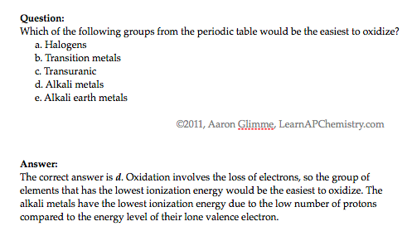
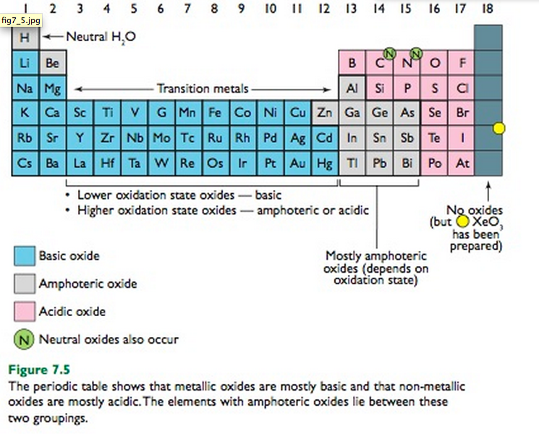
Chemical Properties within a Group and across a Period
Source
Group 1 metals more
reactive than group 2
metals
Reactivity increases as you go down a group
Metals on left form basic oxides
Ex. Na₂O + H₂O → 2 NaOH
Nonmetals on right form form acidic oxides
Ex. SO₃ + H₂O → H₂SO₄
Elements in the middle, like Al, Ga, etc can behave amphoterically
If SiO₂ can be a ceramic then SnO₂ may be as well since both in the same group
Video
Click reveals answer and explanation.
its
attracts
LO 1.11: Analyze data, based on periodicity & properties of binary compounds, to identify patterns & generate hypotheses related to molecular design of compounds

Slide 15
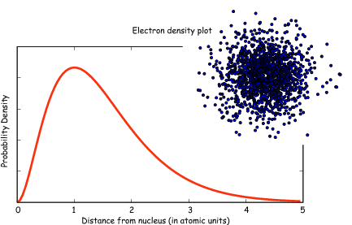
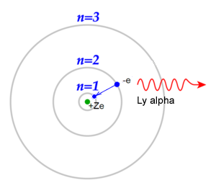
Classic Shell Model of Atom vs
Quantum Mechanical Model
Source
Quantum Mechanical Model
Developed by Schrodinger and the position of an electron is now
represented by a wave equation
Most probable place of finding an electron is called an ORBITAL (90% probability)
Each orbital can only hold 2 electrons with opposing spins (S, P, D & F orbitals)
Evidence for this theory:
Work of DeBroglie and PLanck that electron had wavelike characteristics
Heisenberg Uncertainty Principle - impossible to predict exact location of electron- contradicted Bohr
This new evidence caused the Shell Theory to be replaced by the Quantum Mechanical Model of the atom
Shell Model - Bohr
Developed by Schrodinger and the position of an electron is now
represented by a wave equation
Most probable place of finding an electron is called an ORBITAL (90% probability)
Each orbital can only hold 2 electrons with opposing spins (S, P, D & F orbitals)
Evidence for this theory:
Work of DeBroglie and PLanck that electron had wavelike characteristics
Heisenberg Uncertainty Principle - impossible to predict exact location of electron- contradicted Bohr
This new evidence caused the Shell Theory to be replaced by the Quantum Mechanical Model of the atom
Video
LO 1.12: Explain why data suggests (or not) the need to refine a model from a classical shell model with the quantum mechanical model

Slide 16
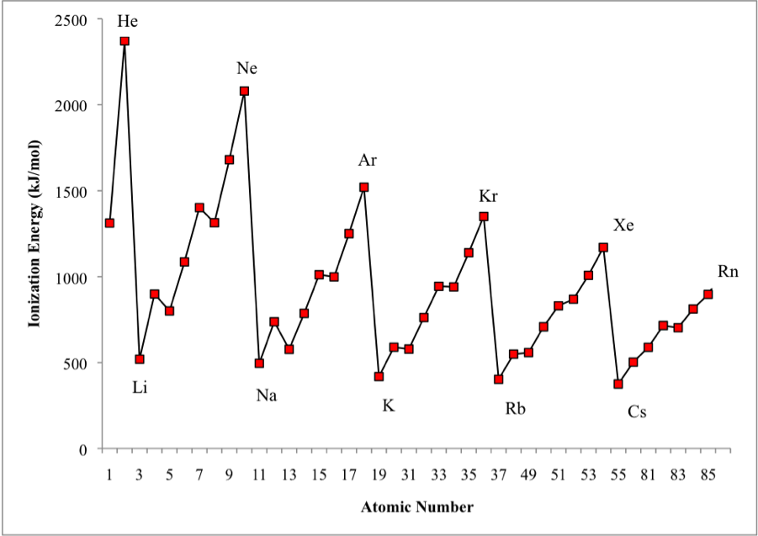
Shell Model is consistent with Ionization Energy Data
Source
The patterns shown by
the IE graph can be
explained by Coulomb’s law
As atomic number increases, would expect the ionization energy to constantly increase
Graph shows that this is NOT observed. WHY NOT?
The data implies that a shell becomes full at the end of each period
Therefore the next electron added must be in a new shell farther away from the nucleus.
This is supported by the fact that the ionization energy drops despite the addition positive charge in the nucleus
Video
LO: 1.13 Given information about a particular model of the atom, the student is able to determine if the model is consistent with specified evidence

Slide 17
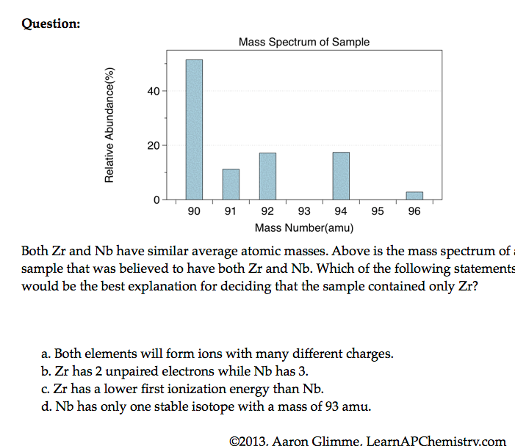
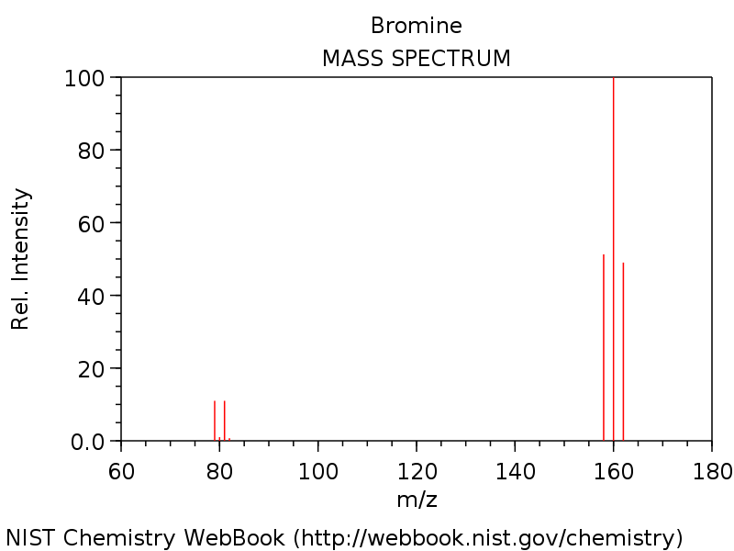
Mass Spectrometry - evidence for isotopes
Source
Mass spectrometry showed
that elements have isotopes
This contradicted Dalton’s early model of the atom which stated that all atoms of an element are identical
3 Br₂ & two Br isotopes shown in diagram
The average atomic mass of the element can be estimated from mass spectroscopy
Video
LO 1.14: The student is able to use the data from mass spectrometry to identify the elements and the masses of individual atoms of a specific element

Slide 18
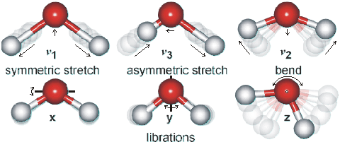
Using Spectroscopy to measure properties associated with vibrational or electronic motions of molecules
Source
IR Video
UV Video
IR Radiation - detects different types of bonds by analyzing molecular vibrations
UV or X-Ray Radiation
Photoelectron Spectroscopy(PES)
Causes electron transitions
Transitions provides info on
electron configurations
LO: 1.15 Justify the selection of a particular type of spectroscopy to measure properties associated with vibrational or electronic motions of molecules

Slide 19
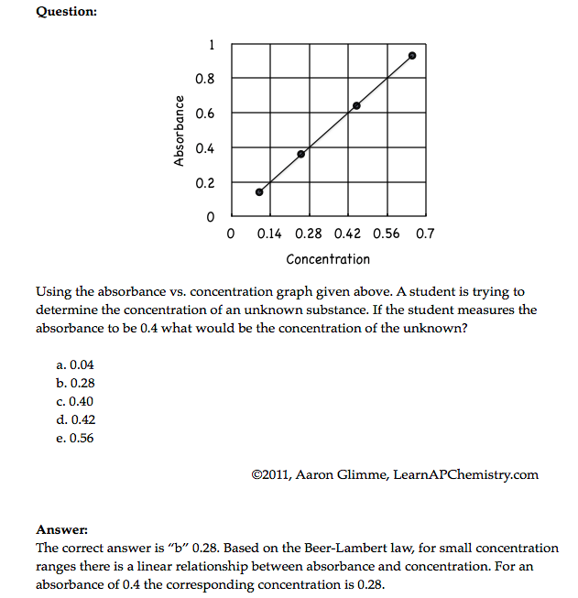
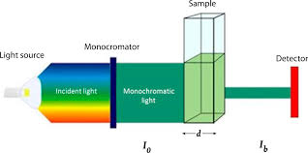
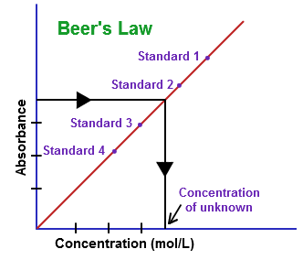
Beer-Lambert Law - used to measure the concentration of colored solutions
Source 1, 2
Video
A = abc
A = absorbance
a = molar absorptivity (constant for material being tested)
b = path length (cuvette = 1 cm)
c = concentration
Taken at fixed wavelength
Click reveals answer and explanation.
LO1.16: Design and/or interpret the results of an experiment regarding the absorption of light to determine the concentration of an absorbing species in solution

Slide 20
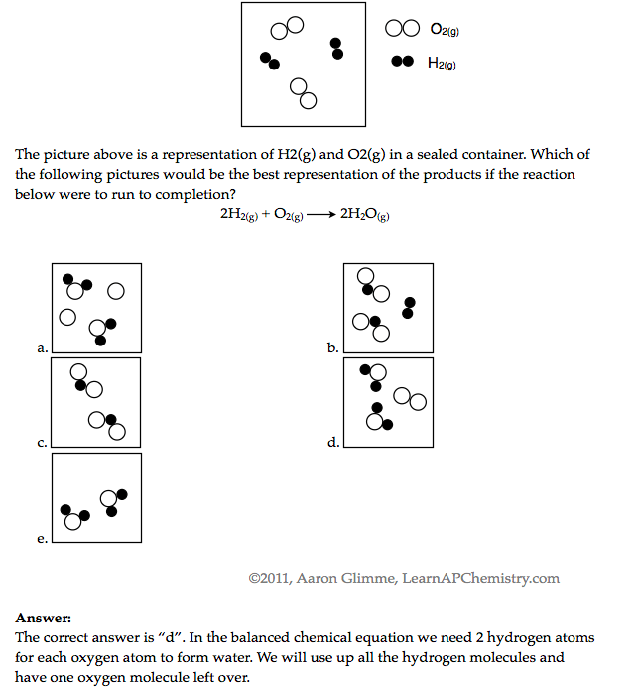
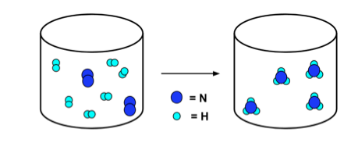
Law of Conservation of Mass
Source
Video
N₂ + 3H₂ → 2NH₃
Click reveals answer and explanation.
LO1.17: Express the law of conservation of mass quantitatively and qualitatively using symbolic representations and particulate drawings

Slide 21
Use Mole Ratio in balanced equation to calculate moles of unknown substance
Source
Video
LO1.18: Apply the conservation of atoms to the rearrangement of atoms in various processes.

Slide 22
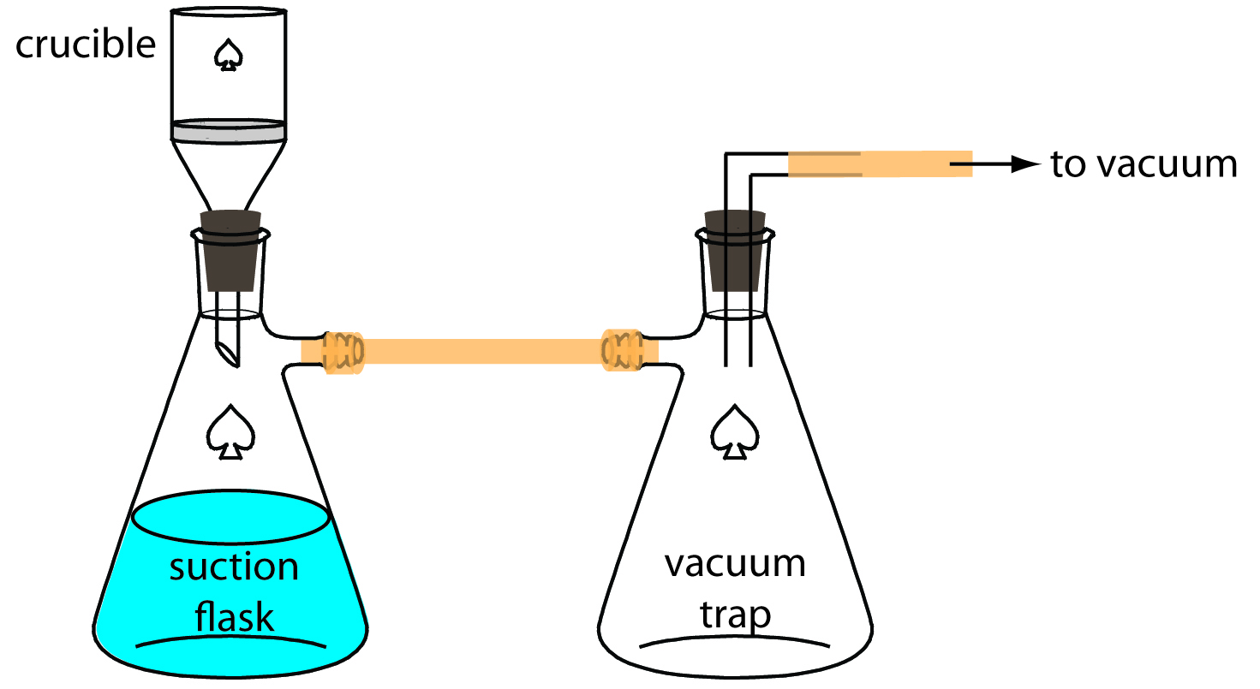
Gravimetric Analysis
Source
Buchner Filtration Apparatus
Video
How much lead
(Pb²⁺) in water?
Pb²⁺(aq) + 2Cl⁻(aq) → PbCl₂ (s)
By adding excess Cl- to the sample, all of the Pb²⁺ will precipitate as PbCl₂
Solid product is filtered using a Buchner Filter and then dried to remove all water
Mass of PbCl₂is then determined
This can be used to calculate the original amount of lead in the water
LO 1.19: Design and/or interpret data from, an experiment that uses gravimetric analysis to determine the the concentration of an analyte in a solution.

Slide 23
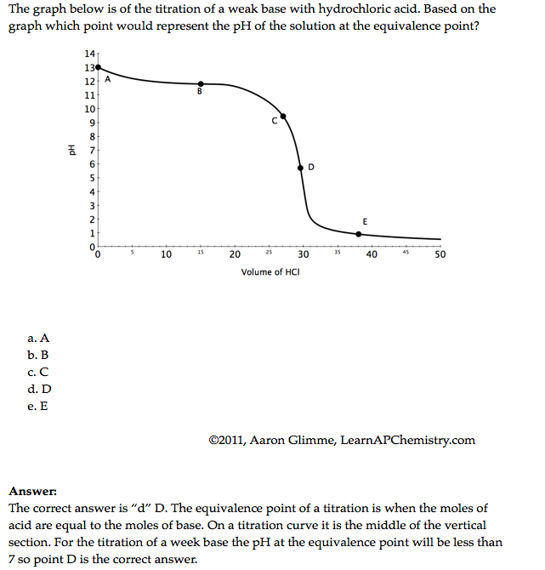
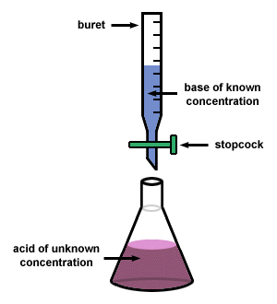
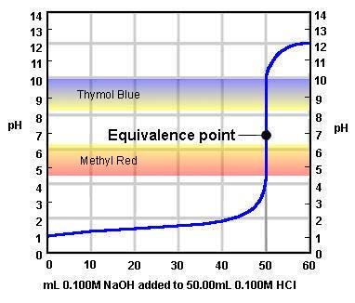
Using titrations to determine concentration of an analyte
Source
Video
At the equivalence point, the stoichiometric molar ratio is reached
Click reveals answer and explanation.
LO1.20: Design and/or interpret data from an experiment that uses titration to determine the concentration of an analyte in a solution.

Slide 24
Big Idea #2
Properties of Matter

Slide 25
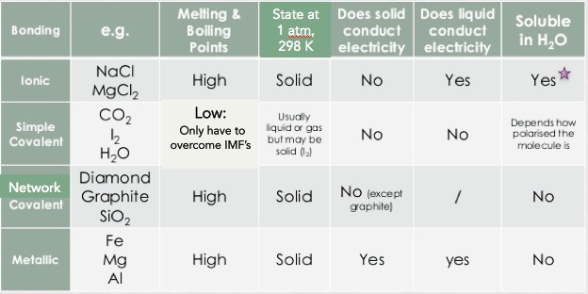
Properties Based on Bonding
Source
Video 1
Video 2
Video 3
Video 4
Visit the Virtual Lab to explore properties based on bond type (click on perform)
Not all ionic compounds are soluble, but those containing ammonium, nitrate, alkali metals, and halogens (except bonded to Ag, Hg and Pb) are typically
LO 2.1: Students can predict properties of substances based on their chemical formulas, and provide explanations of their properties based on particle views

Slide 26
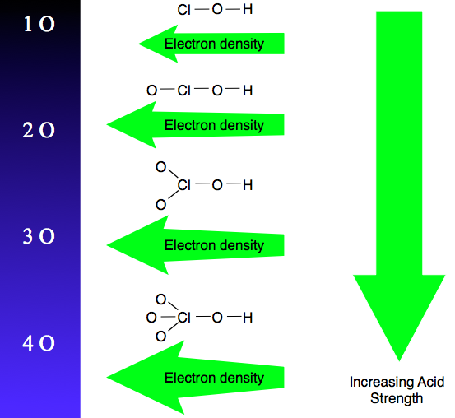
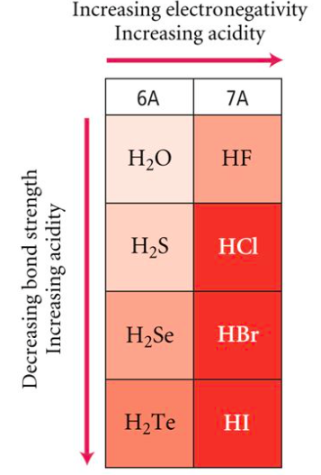
Oxyacid Strength
Binary Acid Strength
Source
LO 2.2: student is able to explain the
relative strengths of acids and bases based on
structure, IMF’s, & equilibrium.
Reading
The increased number of oxygen atoms pulls negative charge away from the O-H bond, weakening the attraction of the proton for the electron pair and thus strengthening the acid.
The greater the size of the negative ion, the weaker its attraction for the proton, and so the stronger the acid, and the weaker the conjugate base. HI is the strongest binary acid.

Slide 27
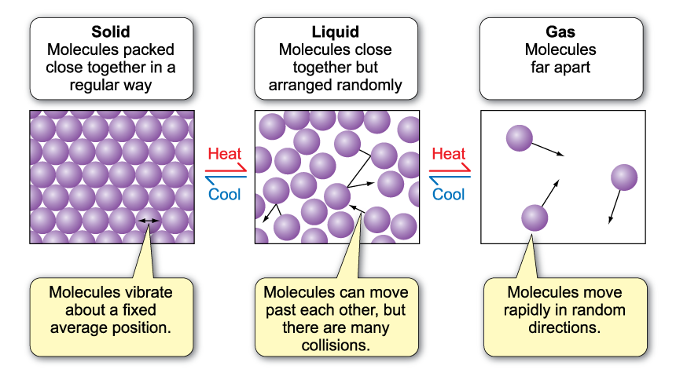
Behaviors of Solids, Liquids, and Gases
Source
Video 1
Video 2
LO 2.3: The student is able to use particulate models to reason about observed differences between solid and liquid phases and among solid and liquid materials.

Slide 28
Kinetic Molecular Theory (KMT)
Source
Video 1
Video 2
IF the temperature is not changed, no matter what else is listed in the problem, the average kinetic energy of a gas does not change. That is the definition of temperature!
All gases begin to act non-ideally (aka real) when they are at low temperatures and/or high pressures because these conditions increase particle interactions
Under the same conditions, the stronger the intermolecular attractions between gas particles, the LESS ideal the behavior of the gas
LO 2.4: The student is able to use KMT and IMF’s to make predictions about the macroscopic properties of gases, including both ideal and non-ideal behaviors

Slide 29
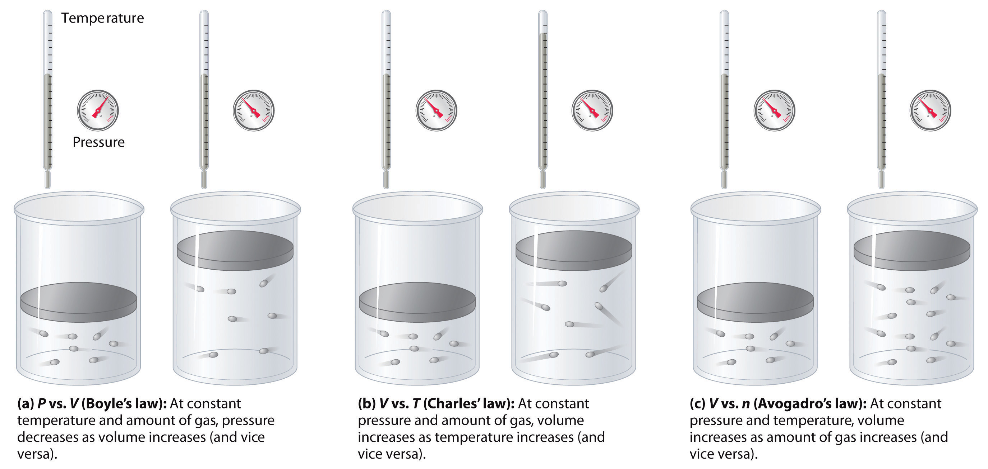
Properties of a Gas - Factors
Source
Don’t worry about individual gas law names, but do worry about the effect of changing moles, pressure and temperature on a sample of gas
Virtual Lab
LO 2.5: Refine multiple representations of a sample of matter in the gas phase to accurately represent the effect of changes in macroscopic properties on the sample

Slide 30
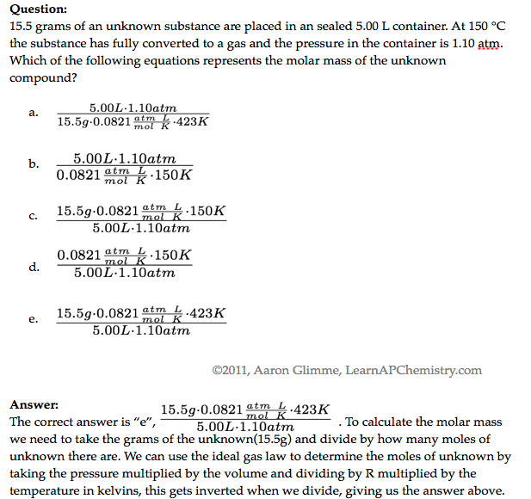
The Ideal Gas Law
Source
Video
LO 2.6: The student can apply mathematical relationships or estimation to determine macroscopic variables for ideal gases
Click reveals answer and explanation.

Slide 31
Chromatography
Source
Video
LO 2.7: The student is able to explain how solutes can be separated by chromatography based on intermolecular interactions.

Slide 32
Dissolving/Dissociation: Solute and Solvent
Source
Video
When drawing solute ions:
pay attention to size (Na⁺ is smaller than Cl⁻)
Draw charges on ion, but not on water
draw at least 3 water molecules around each
the negative dipole (oxygen side) points toward cation and the postive dipoles (H side) points towards the anion
LO 2.8: The student can draw and/or interpret representations of solutions that show the interactions between the solute and solvent.

Slide 33
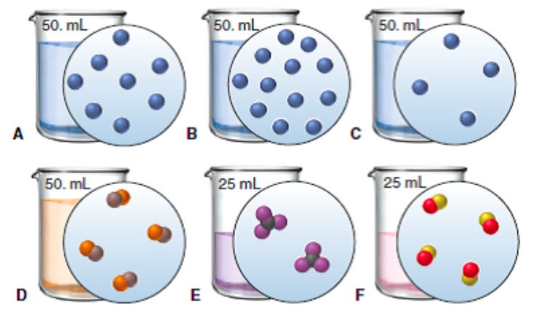
Molarity and Particle Views
Source
Video
QUESTION: Rank the six solutions above in order of increasing molarity. Pay attention to volume, and some have equal concentration
C,D, and E (tied); A and F (tied); most concentrated is B
Click reveals answer
LO 2.9: The student is able to create or interpret representations that link the concept of molarity with particle views of solutions

Slide 34
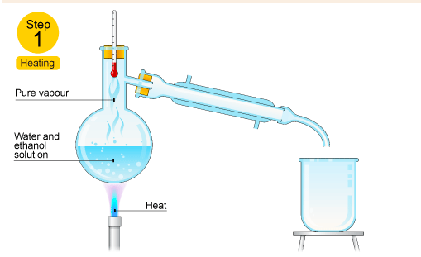
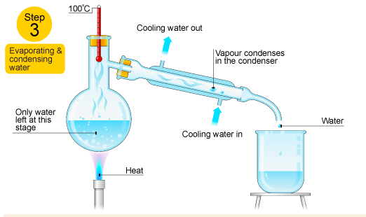
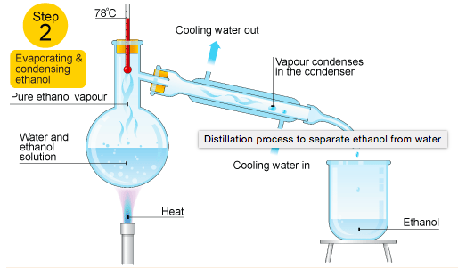
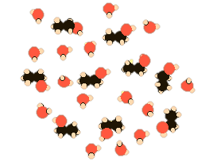
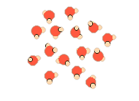
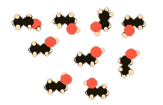
Distillation to Separate Solutions
Source
Video
In the diagram above, ethanol has lower IMF’s and a resulting lower boiling point than water, so it can be heated, vaporized and condensed easily.
Ethanol hydrogen bonds as water does and is polar, but part of the ethanol has only weaker LDF’s because it’s nonpolar resulting in a lower boiling point
LO 2.10: Design/interpret the results of filtration, paper/column chromatography, or distillation in terms of the relative strength of interactions among the components.

Slide 35
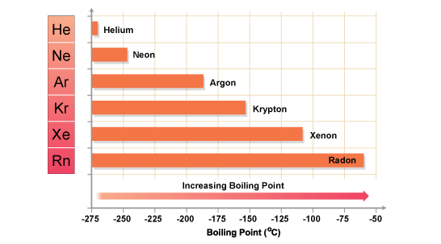
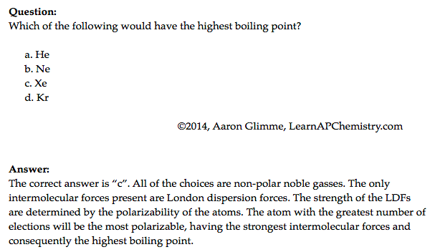
London Dispersion Forces and Noble and Nonpolar Gases
Source
This answer is VITAL! Remember with increased number of ELECTRONS a particle becomes more polarizable, not with increased mass!
Video
Click reveals answer and explanation.
LO 2.11: The student is able to explain the trends in properties/predict properties of samples consisting of particles with no permanent dipole on the basis of LDF’s.

Slide 36
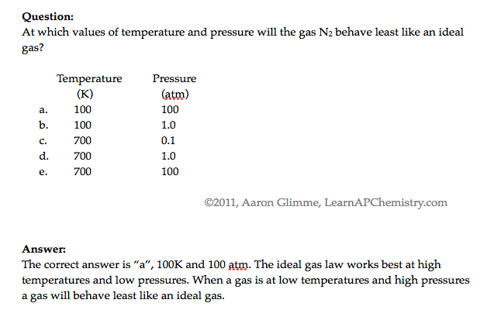
Deviations from Ideal Gas Behavior
Source
Video
When watching the video, don’t concern yourself with Van der Walls – AP Exam focuses on LDF’s instead
Click reveals answer and explanation.
LO 2.12: The student can qualitatively analyze data regarding real gases to identify deviations from ideal behavior and relate these to molecular interactions

Slide 37
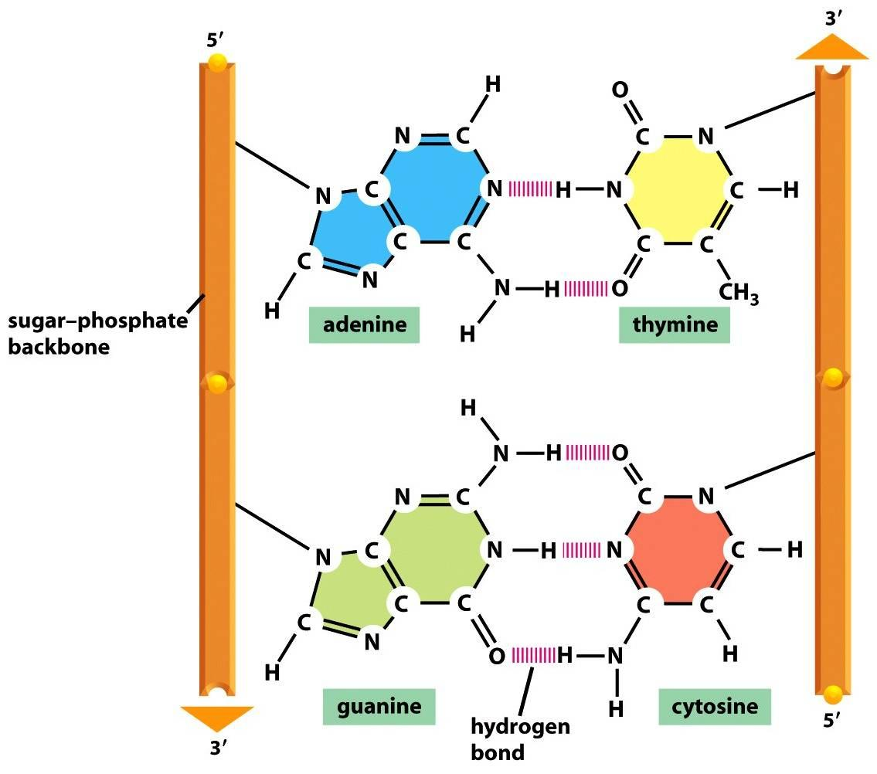
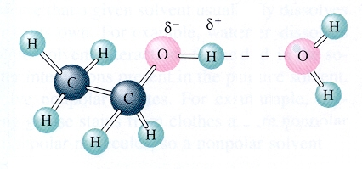
Hydrogen Bonding
Source
Hydrogen bonding is seen in the following molecules: water, DNA, ammonia, HF, and alcohols. H-bonding is an attraction or force not a true intramolecular bond.
Hydrogen bonds are like a sandwich with N, O, and/or F as the bread. H will be in a intramolecular (same molecule) bond with one N, O, and/or F and have an intermolecular attraction (different molecule) with the other.
Video
Remember this tip:
hydrogen bonds just wanna have FON
LO 2.13: The student is able to describe the relationships between the structural features of polar molecules and the forces of attraction between the particles.

Slide 38
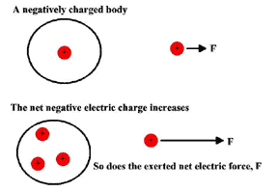
Coulomb’s Law and Solubility
Source
Ionic compounds can dissolve in polar liquids like water because the ions are attracted to either the positive or negative part of the molecule.
There is a sort of tug-of-war involved with species dissolved in water. The water pulls individual ions away from the solid. The solid is pulling individual ions back out of the water. There exists an equilibrium based on how strongly the water attracts the ions, versus how strong the ionic solid attracts the ions.
We can predict the degree of solubility in water for different ionic compounds using Coulomb's law. The smaller the ions, the closer together they are, and the harder it is for the water molecules to pull the ions away from each other. The greater the charge of the ions, the harder it is for the water to pull them away as well.
Video
QUESTION: Predict which of the following pairs should be more soluble in water, based on Coulombic attraction.
LiF or NaF
NaF or KF
BeO or LiF
LO 2.14: Apply Coulomb’s law to describe the interactions of ions, & the attractions of ions/solvents to explain the factors that contribute to solubility of ionic compounds.

Slide 39
Entropy in Solutions
Source
Video
Do NOT say “like dissolves like.” You’ll, like... get no points.
DO refer to LDF’s, hydrogen bonding and dipole-dipole interactions
Generally speaking. There are exceptions
LO 2.15: Explain observations of the solubility of ionic solids/molecules in water and other solvents on the basis of particle views that include IMF’s and entropic effects.

Slide 40
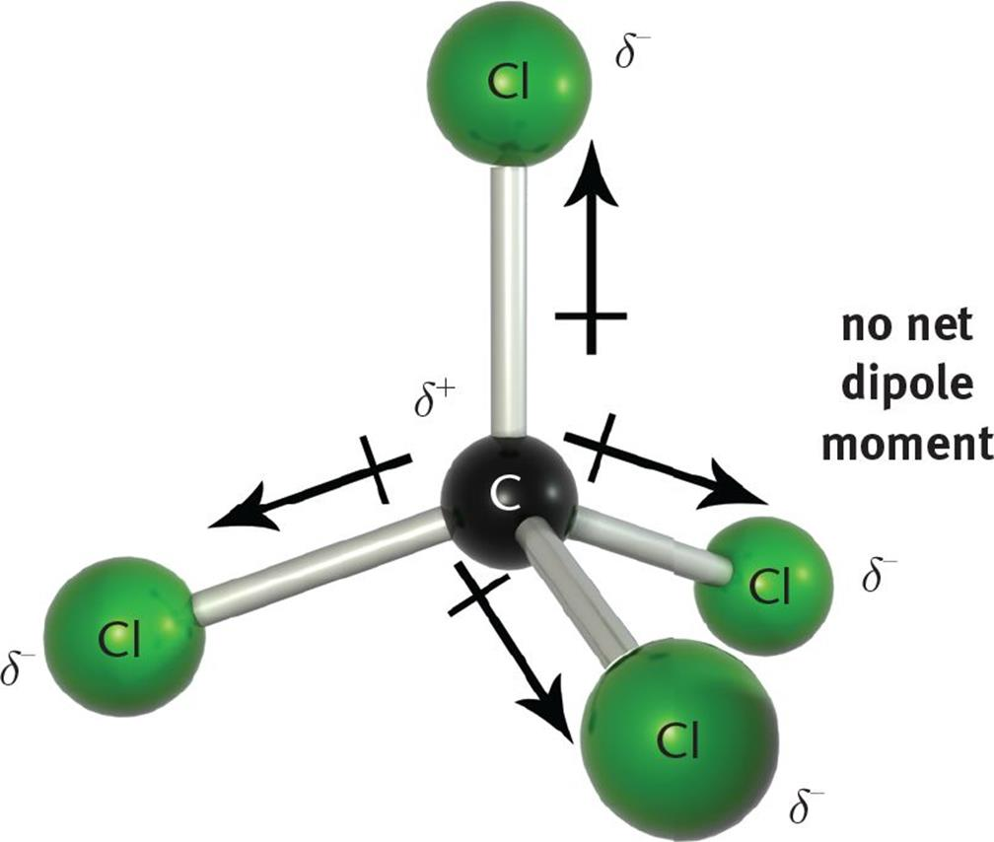
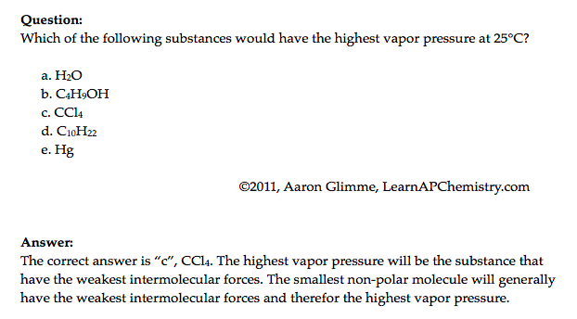
Physical Properties and IMF’s
Source
Video
Hg
Click reveals answer and explanation.
LO 2.16: Explain the properties (phase, vapor pressure, viscosity, etc.) of small and large molecular compounds in terms of the strengths and types of IMF’s.

Slide 41
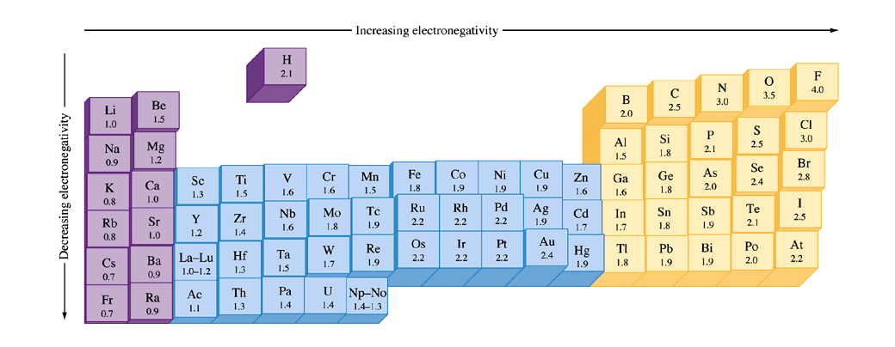
Bonding and Electronegativity
Source
Differences in electronegativities lead to different types of bonding*:
0.0 – 0.4: Bond is generally considered nonpolar
0.5 – 1.7: Bond is generally considered polar
> 1.7: Bond is generally considered ionic
Video
Electronegativities are assigned values and are relative to fluorine. Electronegativity is a function of shielding / effective nuclear charge.
*Values presented are one possibility – other scales exist.
LO 2.17: The student can predict the type of bonding present between two atoms in a binary compound based on position in the periodic table and the electronegativity of the elements.

Slide 42
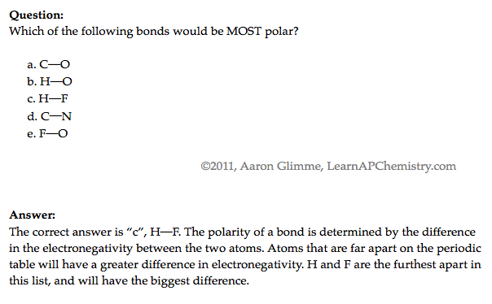
Ranking Bond Polarity
Source
Video
LO 2.18: The student is able to rank and justify the on the ranking of bond polarity on the basis of the locations of the bonded atoms in the periodic table.

Slide 43
Ionic Substances and their Properties
Source
Ionic compounds are brittle. As the crystal structure is struck, the ions become displaced. The displaced ions will repel like charges and fracture.
Video
LO 2.19: The student can create visual representations of ionic substances that connect the microscopic structure to macroscopic properties and/or use representations to connect microscopic structure to macroscopic properties (e.g., boiling point, solubility, hardness, brittleness, low volatility, lack of malleability, ductility, or conductivity).

Slide 44
Metallic Properties – Sea of Electrons
Source
Video
“The metallic bond is not the easiest type of bond to understand, so an analogy may help. Imagine filling your bathtub with golf balls. Fill it right up to the top. The golf balls will arrange themselves in an orderly fashion as they fill the space in the tub. Do you see any spaces between the balls? If you turn on the faucet and plug the drain, the water will fill up those spaces. What you now have is something like metallic bonding. The golf balls are the metal kernals, and the water represents the valence electrons shared by all of the atoms.”
LO 2.20: The student is able to explain how a bonding model involving delocalized electrons is consistent with macroscopic properties of metals (e.g., conductivity, malleability, ductility, and low volatility) and the shell model of the atom.

Slide 45
Lewis Diagrams / VSEPR
Source
Video
LO 2.21: The student is able to use Lewis diagrams and VSEPR to predict the geometry of molecules, identify hybridization, and make predictions about polarity.

Slide 46
Ionic or Covalent? Bonding Tests
Great Lab Example
Properties | Ionic Compounds | Covalent Compounds
Melting/Boiling Points | High | Low except for some giant covalent molecules
Electrical Conductivity | Conduct electricity in molten and in aqueous solution | Does not conduct electricity in any state when pure, may conduct in aqueous solution (i.e., acids)
Solubility in water and organic solvents | Soluble in water Insoluble in organic solvent | Insoluble in water, except for some simple molecule Soluble in organic solvent
Volatility | Not volatile | Highly volatile
As the type of particles and forced of attraction in ionic and covalent compounds differ, their properties also differ!
Video
Source
Click here to do a virtual lab on bonding type (chart pictured below)
Use properties of compounds to differentiate them from one another. Other tests may be performed to positively identify the compound, but are not necessary to observe types of bonds present.
LO 2.22: The student is able to design or evaluate a plan to collect and/or interpret data needed to deduce the type of bonding in a sample of a solid.

Slide 47
Crystal Structure of Ionic Compounds
Source
Video
LO 2.23: The student can create a representation of an ionic solid that shows essential characteristics of the structure and interactions present in the substance.

Slide 48
Crystal Structure of Ionic Compounds
Source
Video
The +2 and -2 ions attract each other more strongly than +1 attracts -1.
The ions Mg⁺² and O⁻² are smaller than Na⁺¹ and Cl⁻¹, therefore the ions can get closer together, increasing their electrostatic attractions.
LO 2.24: The student is able to explain a representation that connects properties of an ionic solid to its structural attributes and to the interactions present at the atomic level.

Slide 49
Alloys and their Properties
Source
Video
LO 2.25: The student is able to compare the properties of metal alloys with their constituent elements to determine if an alloy has formed, identify the type of alloy formed, and explain the differences in properties using particulate level reasoning.

Slide 50
Alloys!
Source
Video
LO 2.26: Students can use the electron sea model of metallic bonding to predict or make claims about macroscopic properties of metals or alloys.

Slide 51
Metallic Solids - Characteristics
Source
Video
LO 2.27: The student can create a representation of a metallic solid that shows essential characteristics of the structure and interactions present in the substance.

Slide 52
Properties of Metallic Solids
Source
Video
LO 2.28: The student is able to explain a representation that connects properties of a metallic solid to its structural attributes and to the interactions present at the atomic level.

Slide 53
Covalent Compounds - Interactions
Source
Graphite are sheets of carbon atoms bonded together and stacked on top of one another. The interactions between sheets is weak, much like the substance itself.
Diamond’s carbon atoms are more connected in a three dimensional structure, adding strength to the network.
Video
LO 2.29: The student can create a representation of a covalent solid that shows essential characteristics of the structure and interactions present in the substance.

Slide 54
Covalent Solids
Source
Video
LO 2.30: The student is able to explain a representation that connects properties of a covalent solid to its structural attributes and to the interactions present at the atomic level.

Slide 55
Molecular Compounds - Interactions
Source
Water (H₂O)
Iodine (I₂)
Video
Polar Covalent compounds align according to dipole-dipole interactions.
Non-Polar Covalent compounds align according to LDF’s as a solid.
LO 2.31: The student can create a representation of a molecular solid that shows essential characteristics of the structure and interactions in the substance.

Slide 56
Molecular Compound Interactions
Source
a. Covalent bonds
b. Hydrogen bonds
c. Dipole-dipole interactions
d. London Dispersion Forces
Video
LO 2.32: The student is able to explain a representation that connects properties of a molecular solid to its structural attributes and to the interactions present at the atomic level.

