Slide 1
Ecology Notes Pages 1-7
By Miley Gavarrete/ Science Period 6

Slide 2
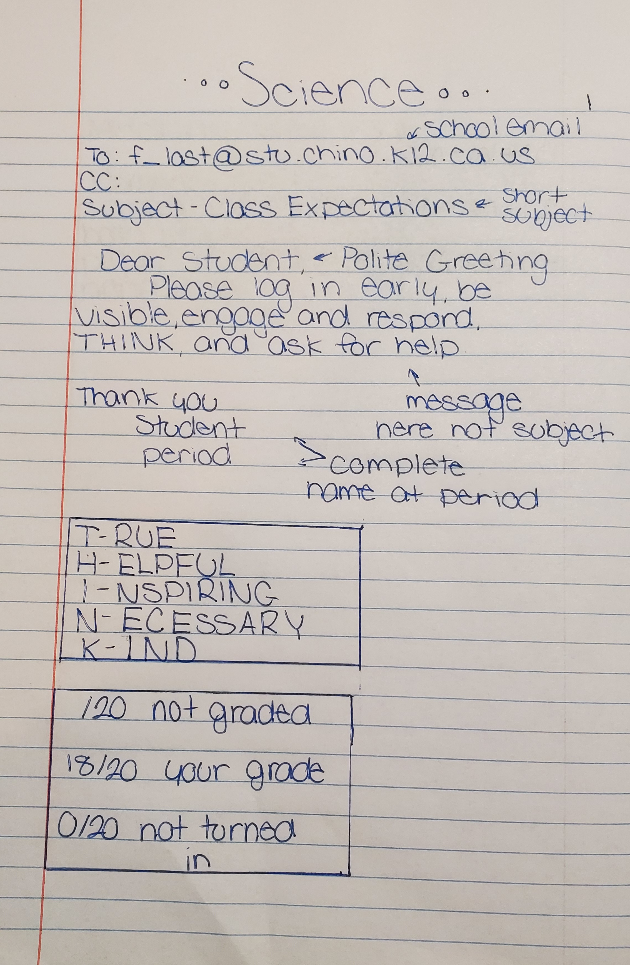
Science
T- RUE
H-ELPFUL
I-NSPIRING
N-ECESSARY
K-IND
/20 -NOT GRADED
18/20 -YOUR GRADE
0/20 -NOT TURNED IN
Always start email with nice greeting. Then add the reason for the message. At the end complete it with name and period.

Slide 3
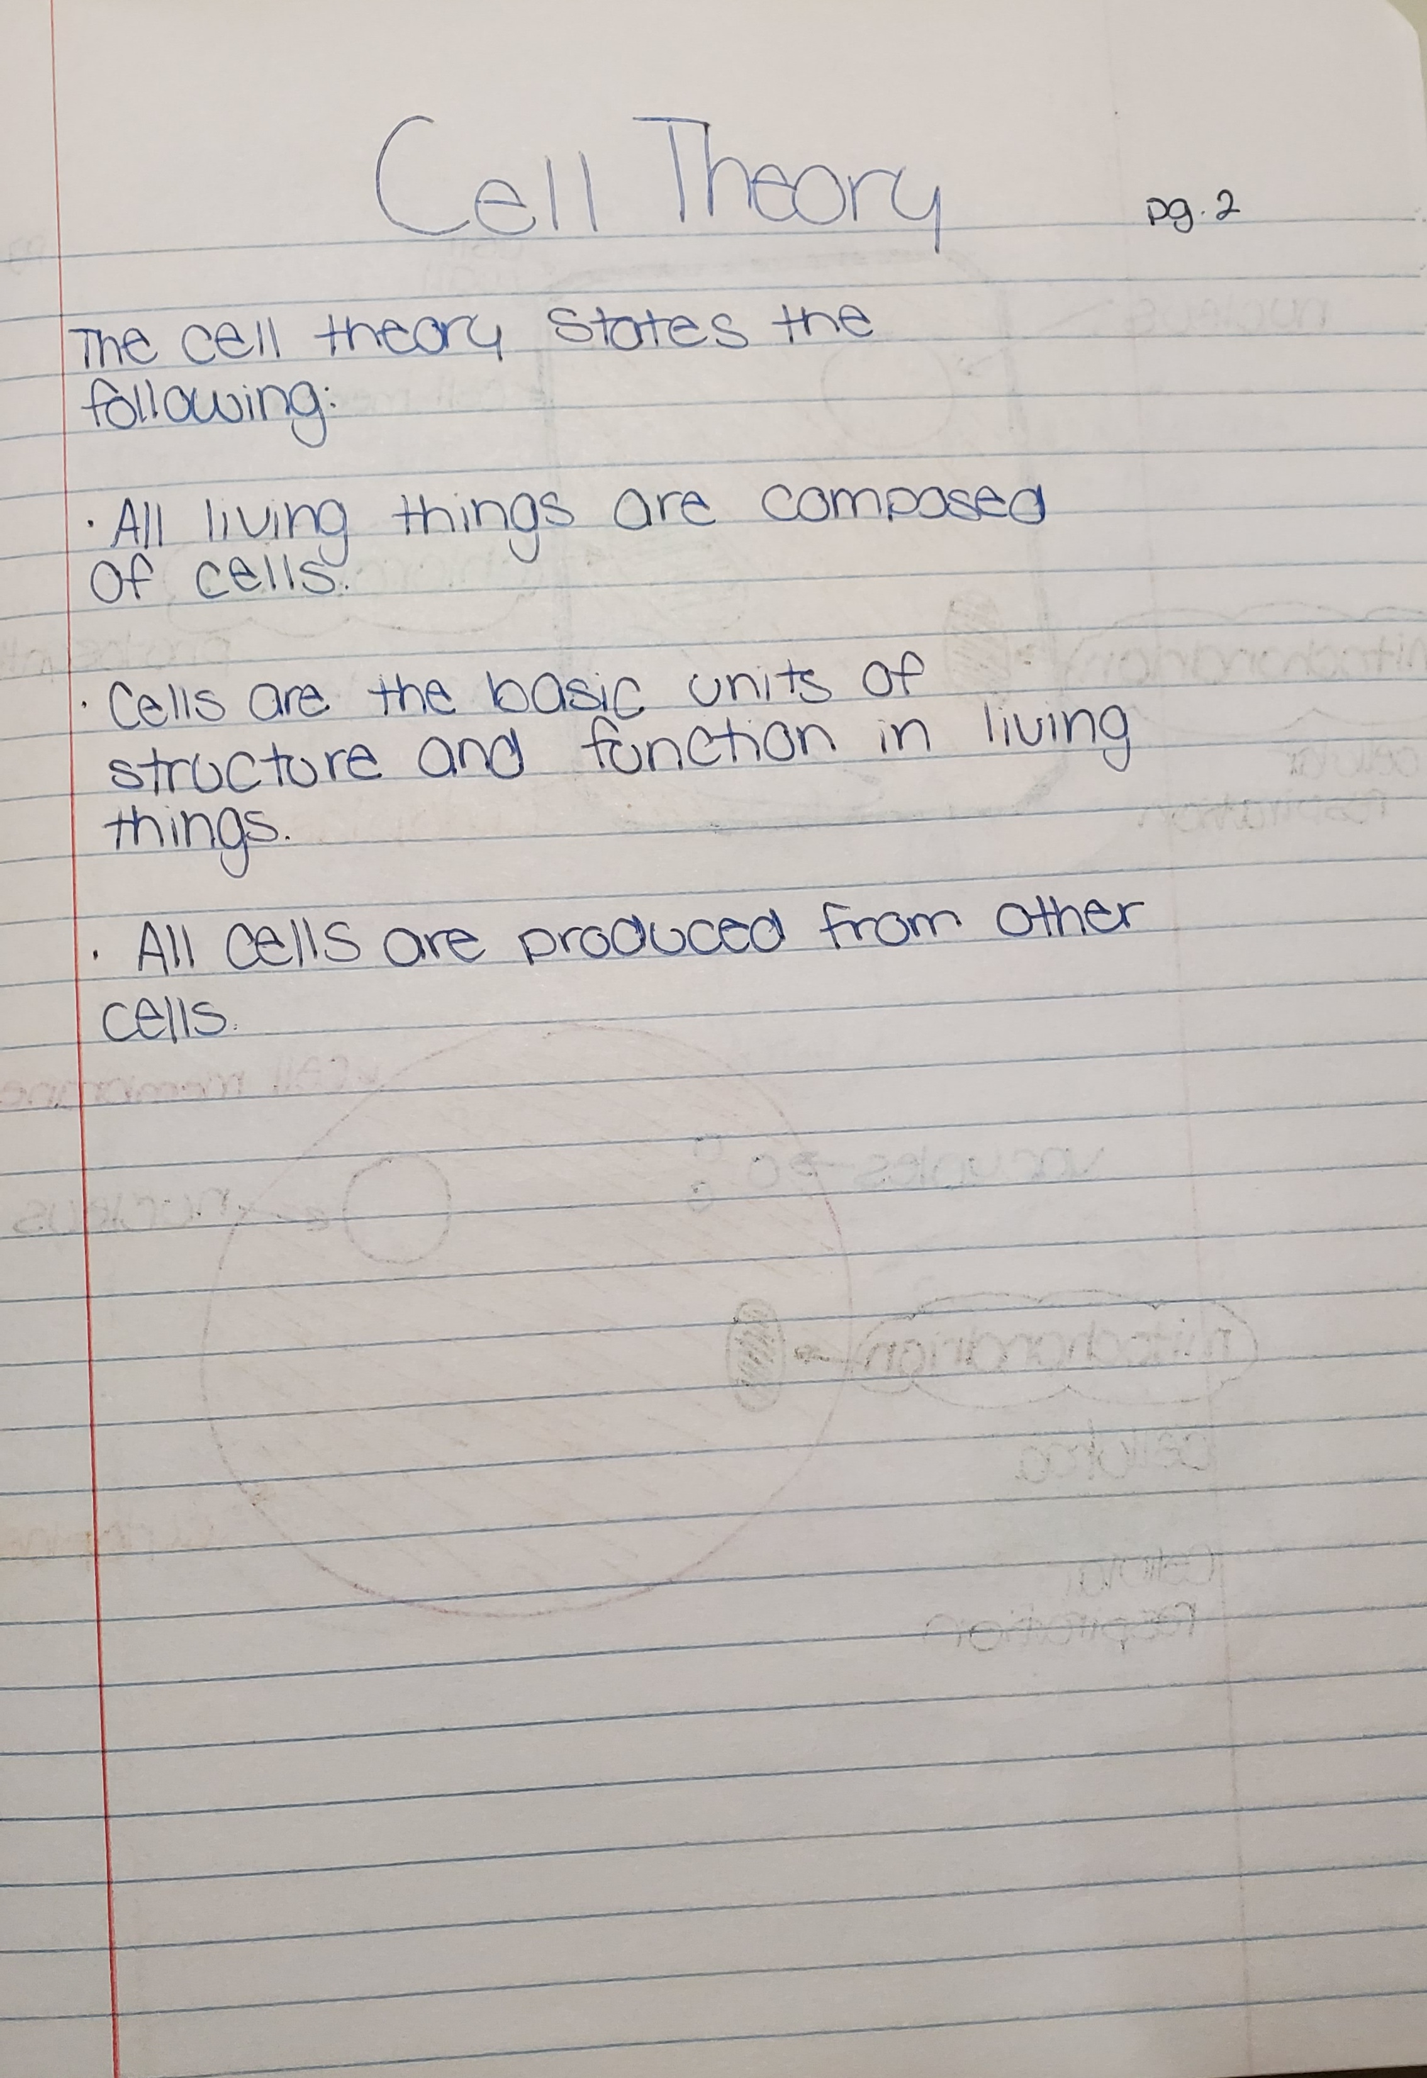
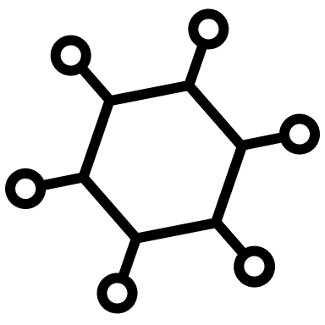
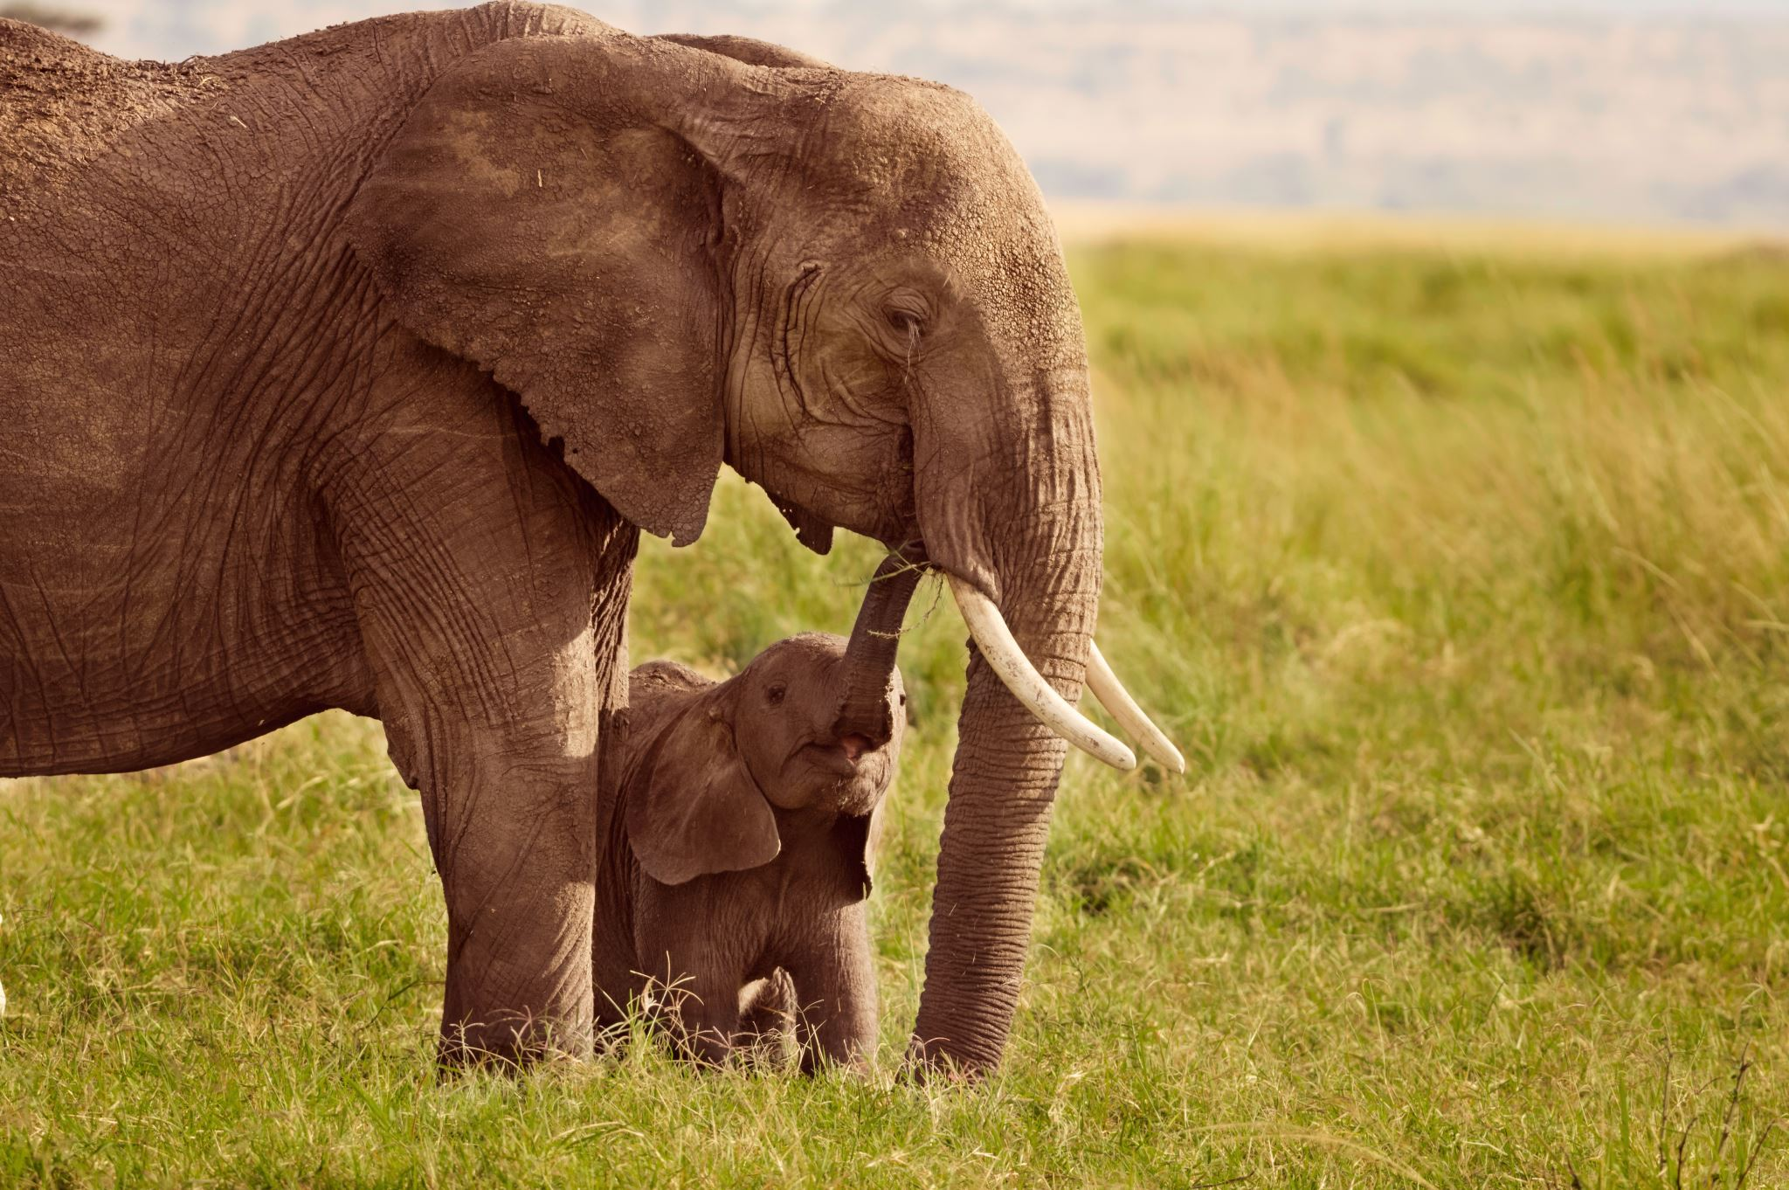
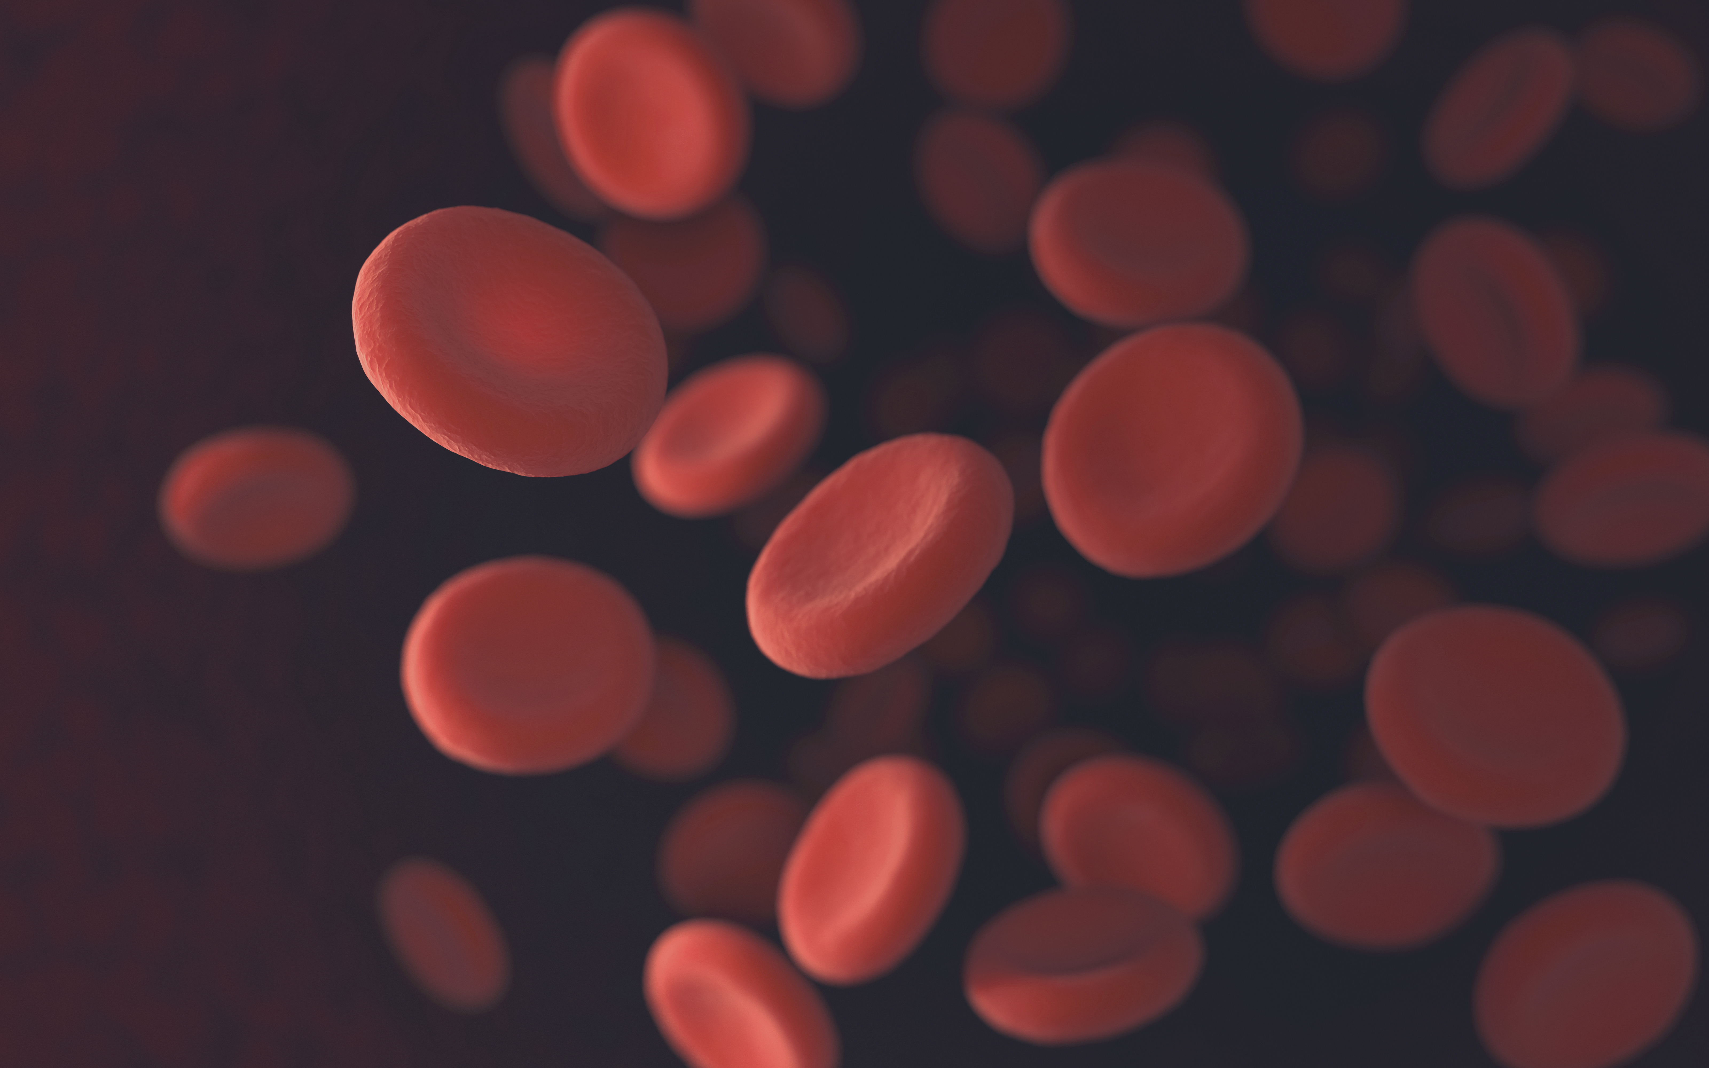
Cell Theory
All living things are composed of cells
Cells are the basic units of structure and function on living things.
All cells are produced from other cells.

Slide 4
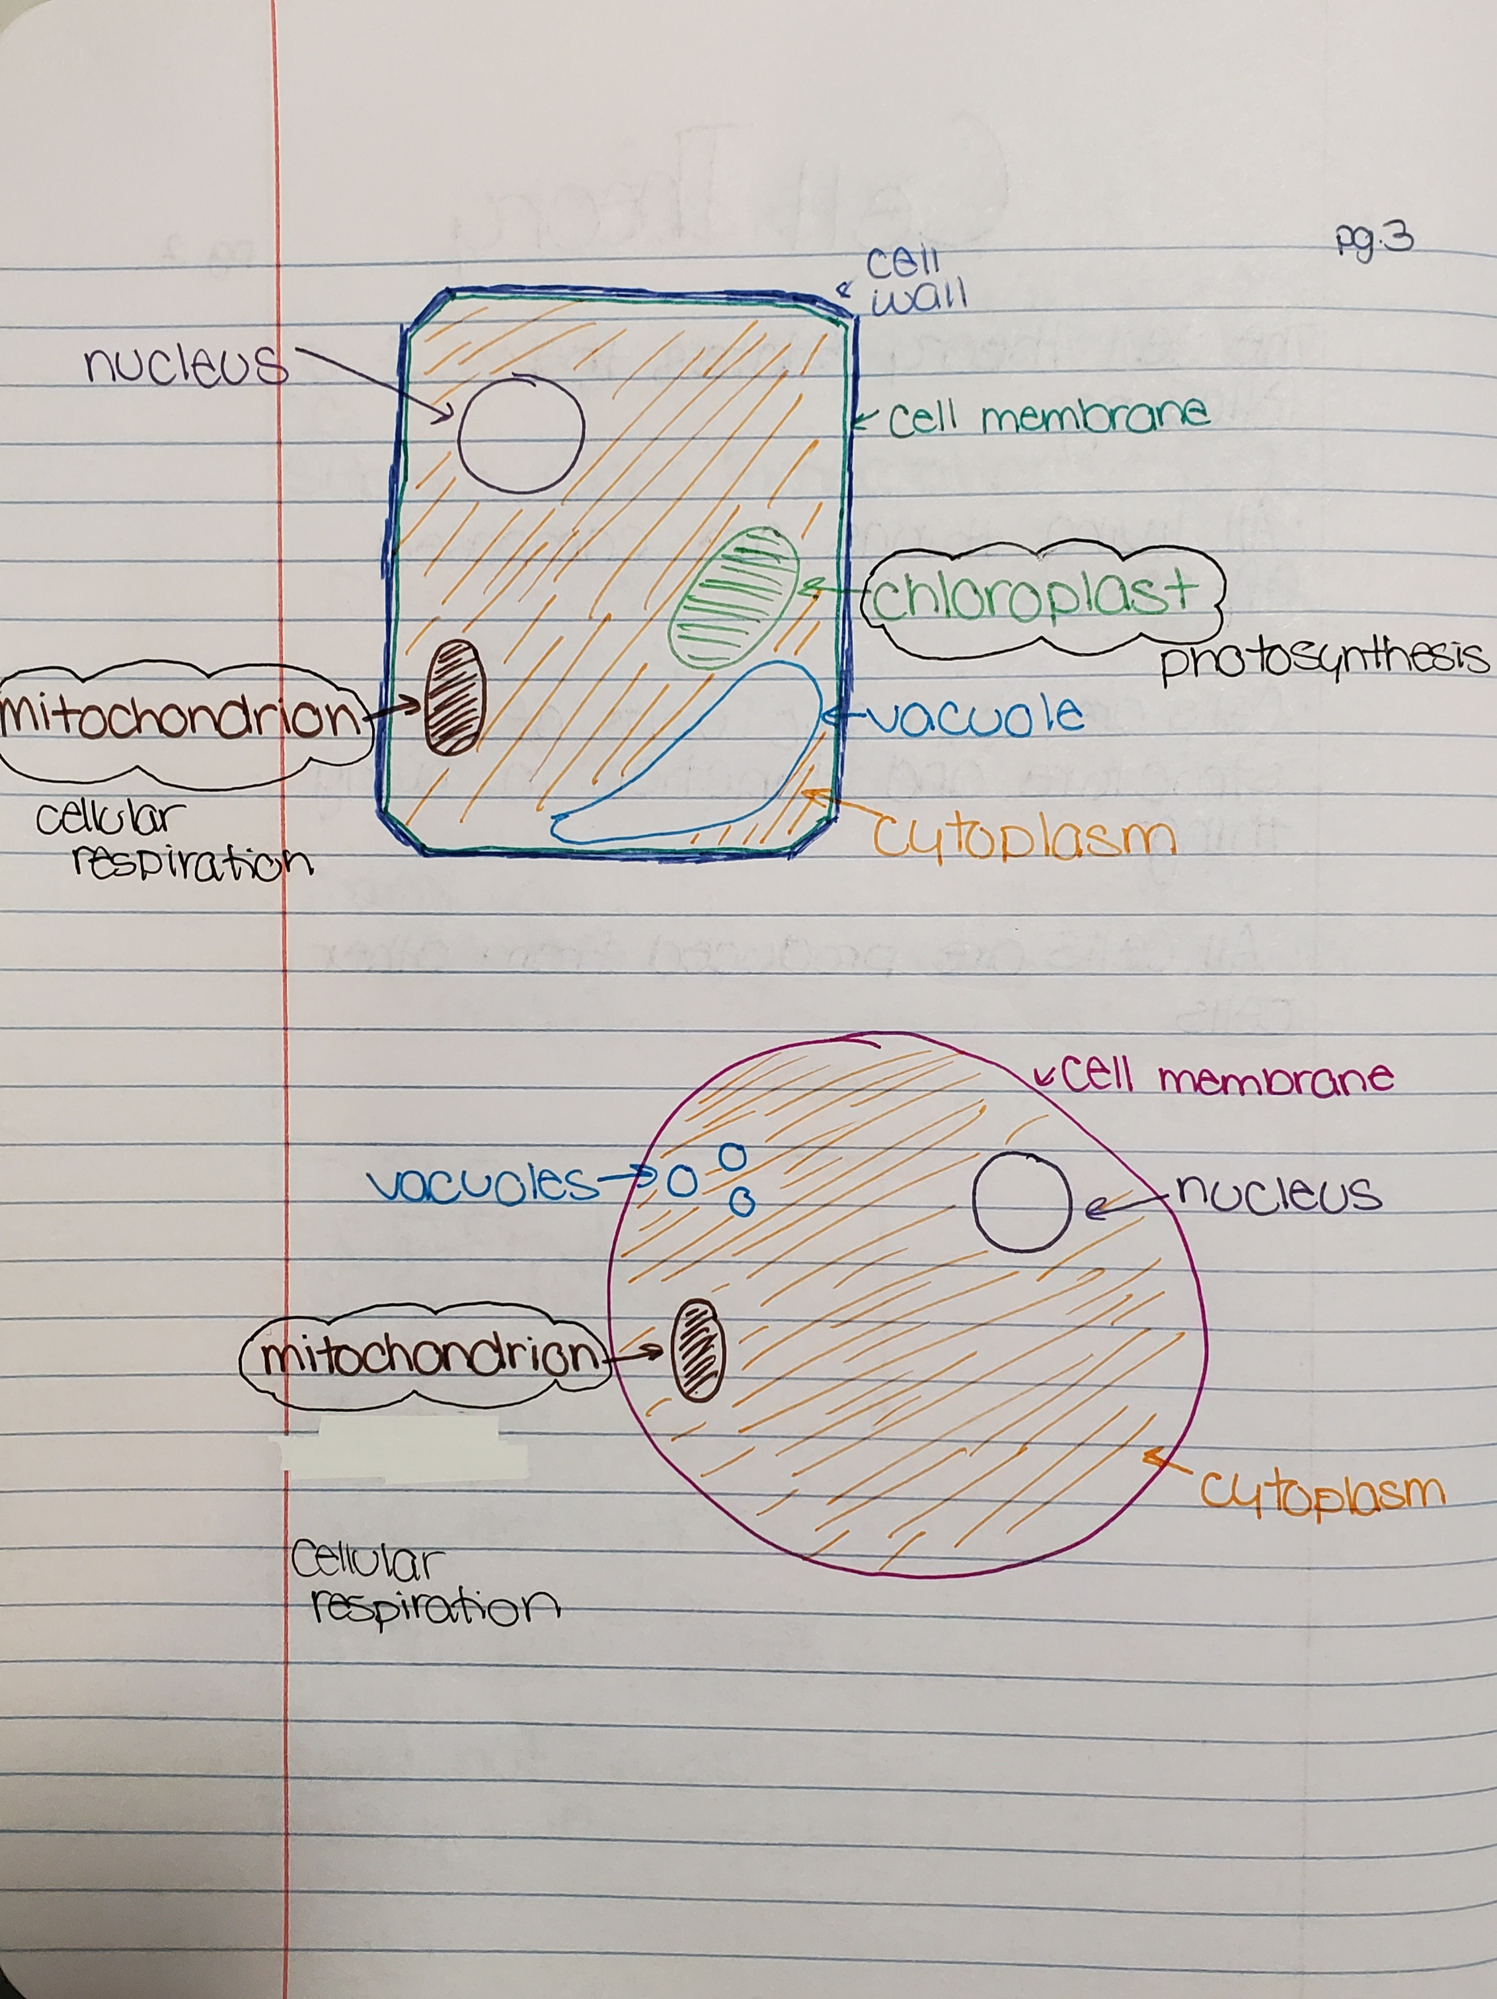
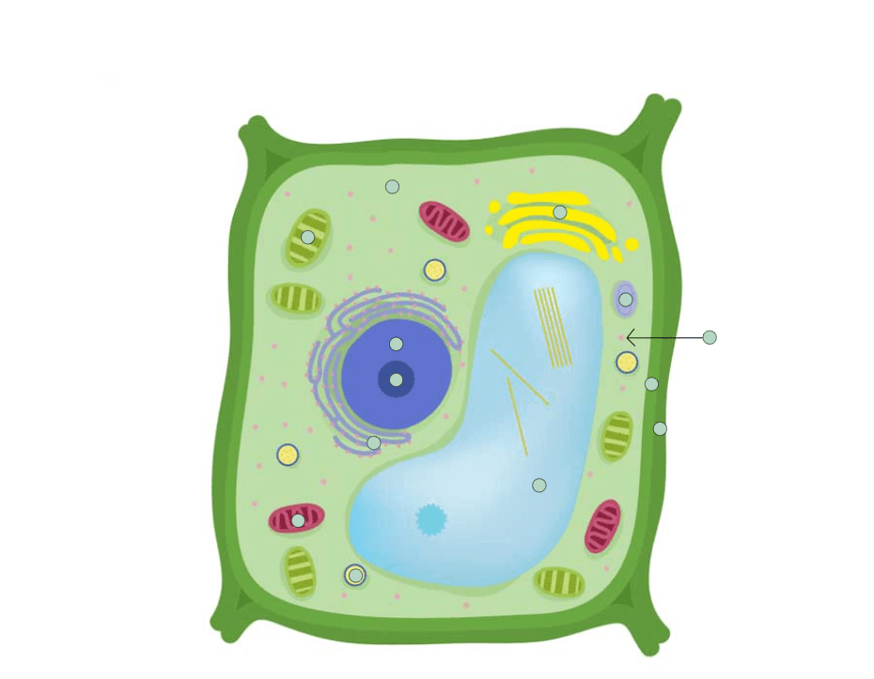
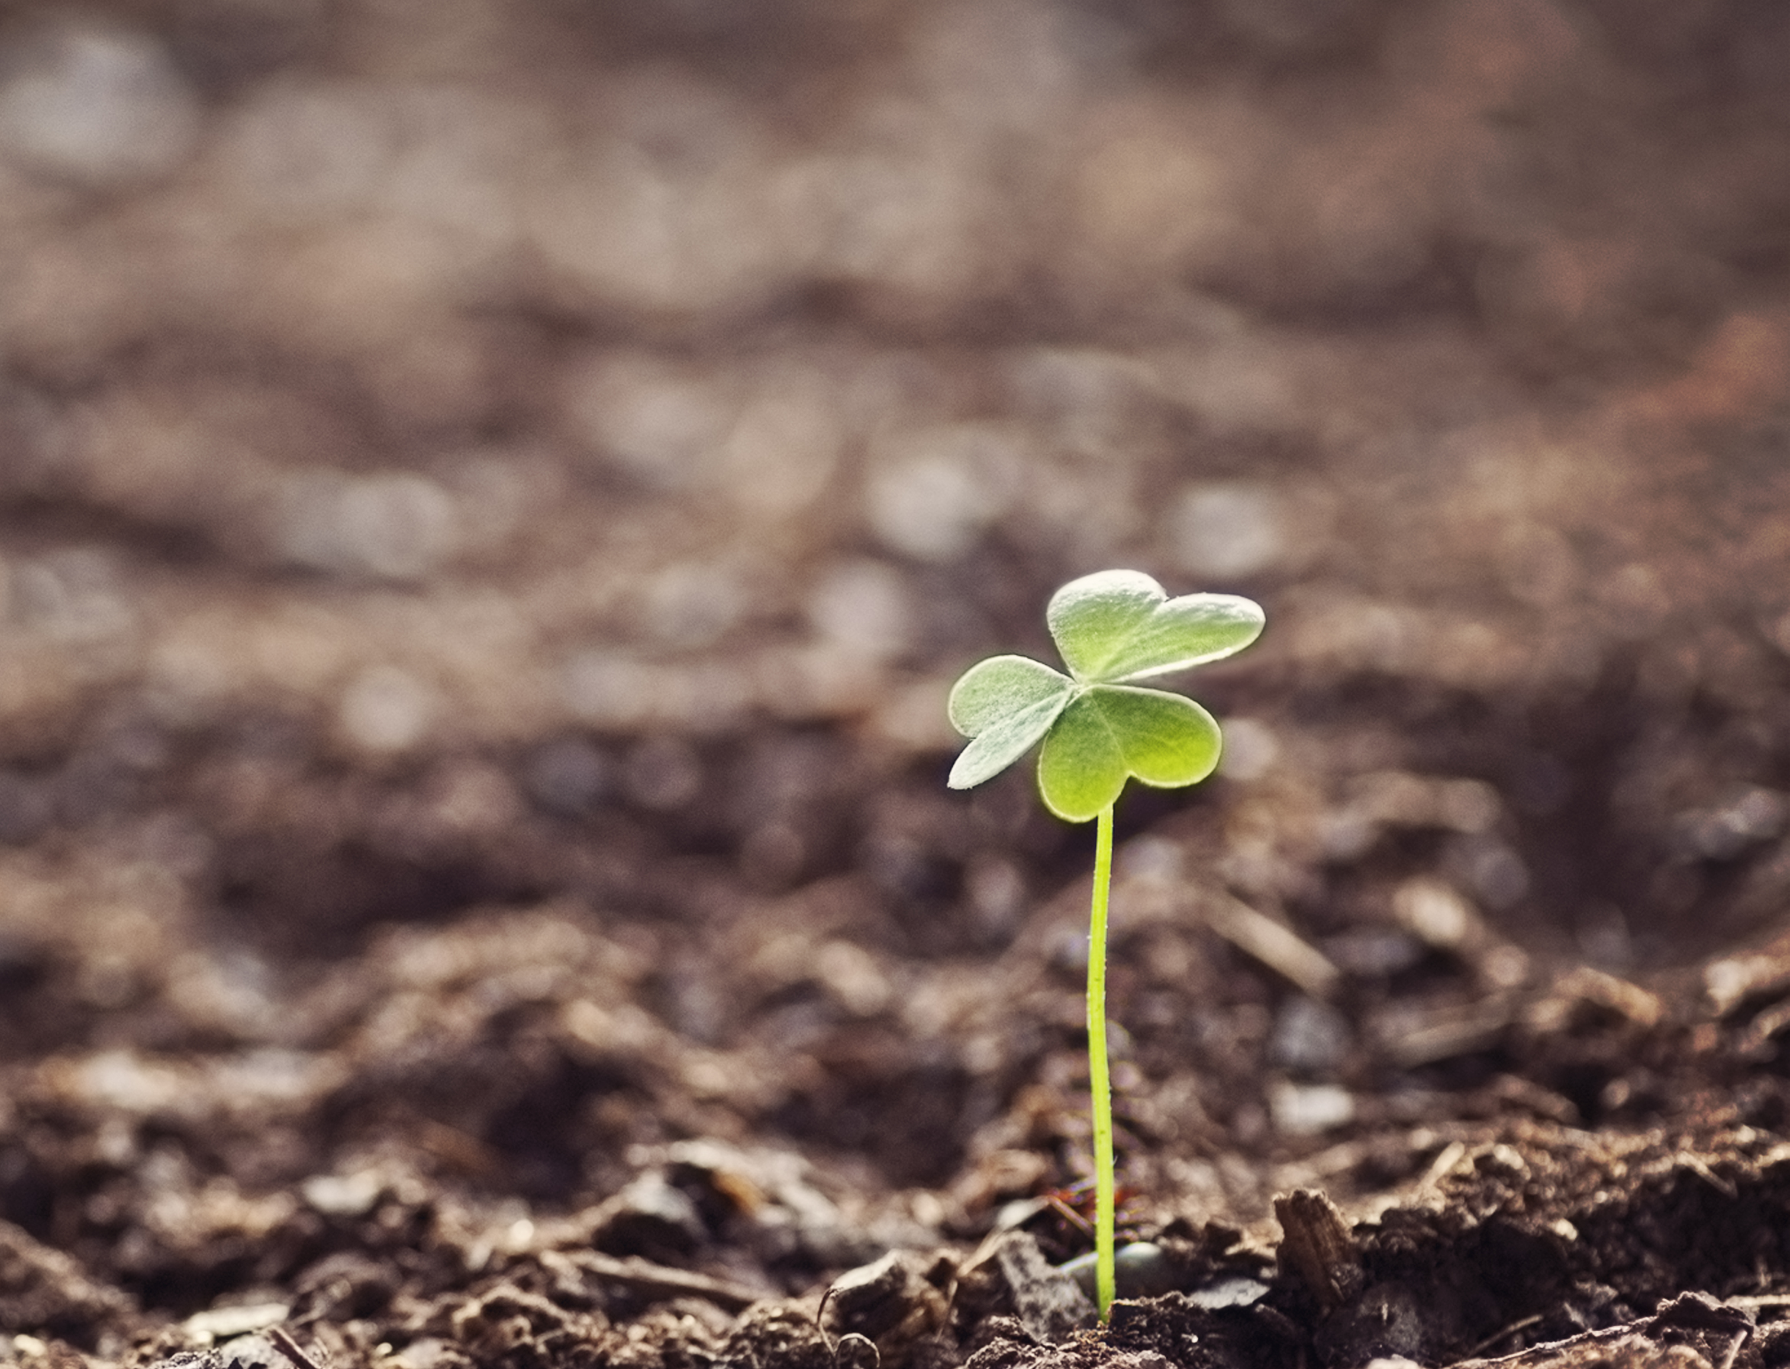
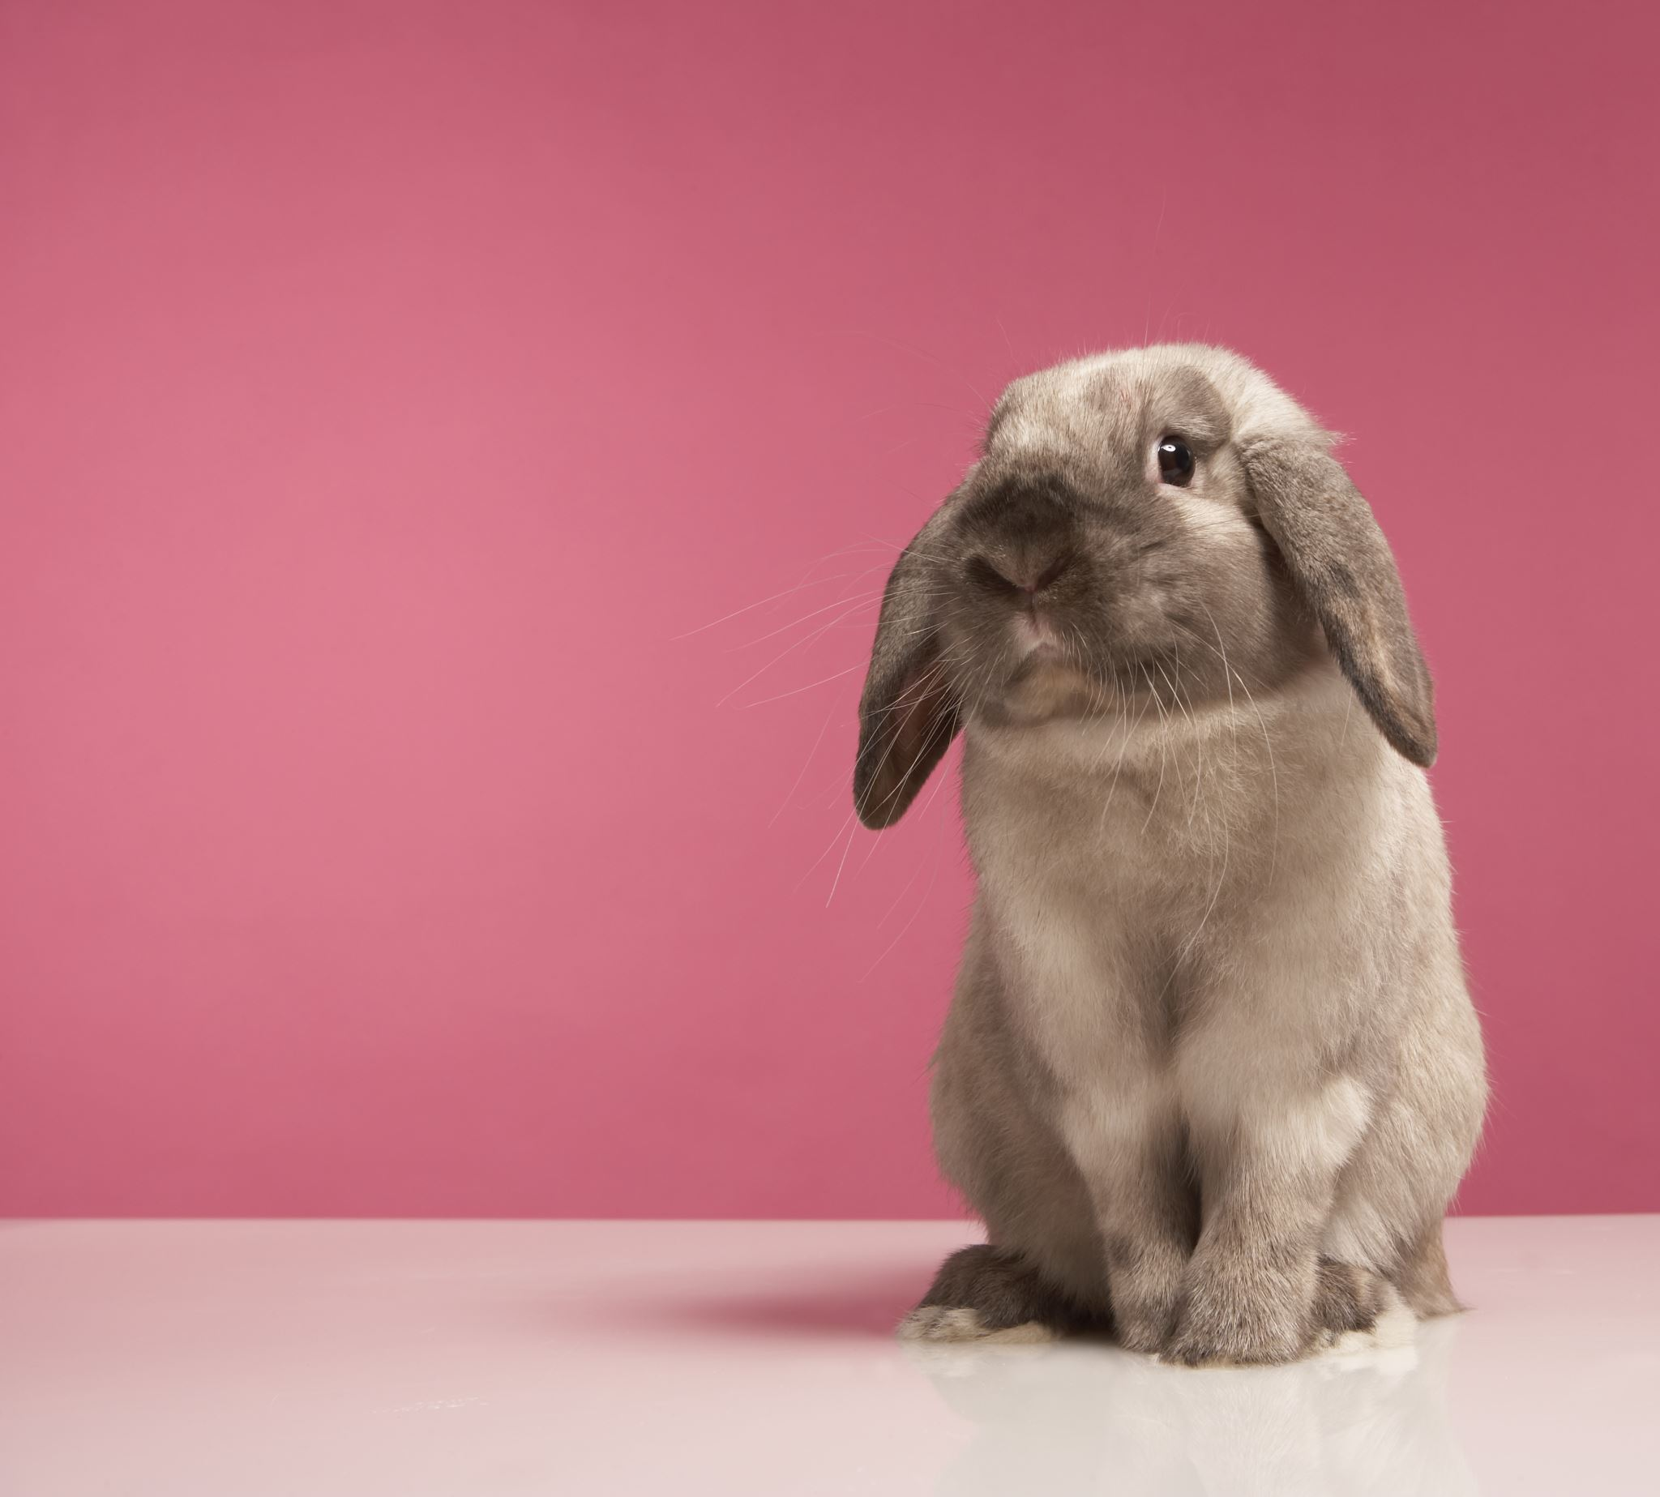
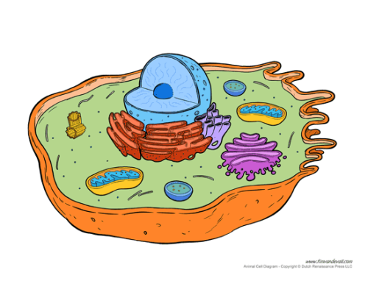
Plant Cell & Animal Cell

Slide 5
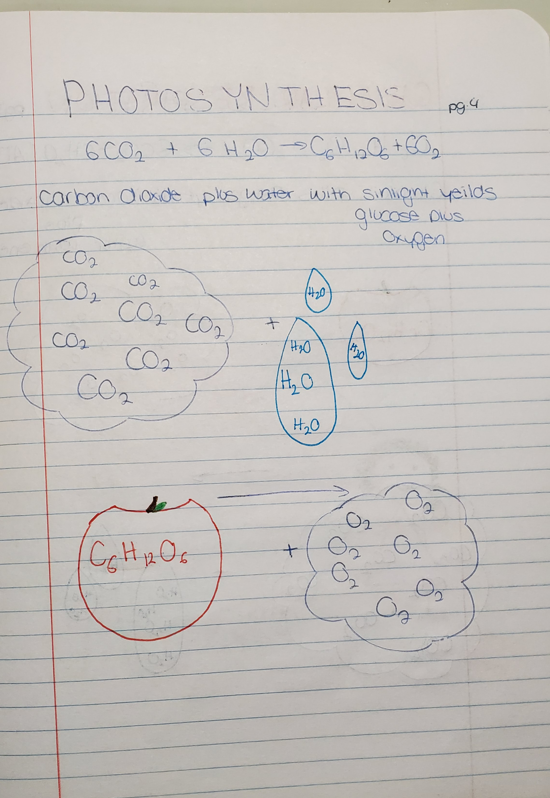
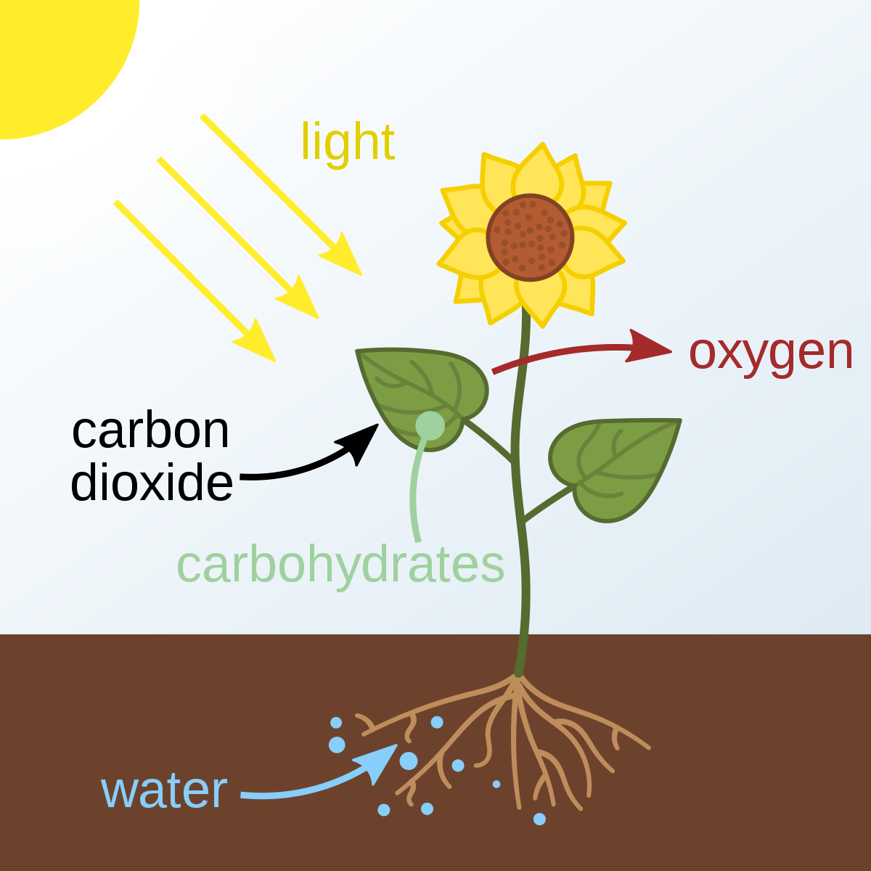
Photosynthesis
Formula- 6CO2+6H2O=C6H12O6+60
Carbon Dioxide plus water with sunlight yields glucose plus oxygen.

Slide 6
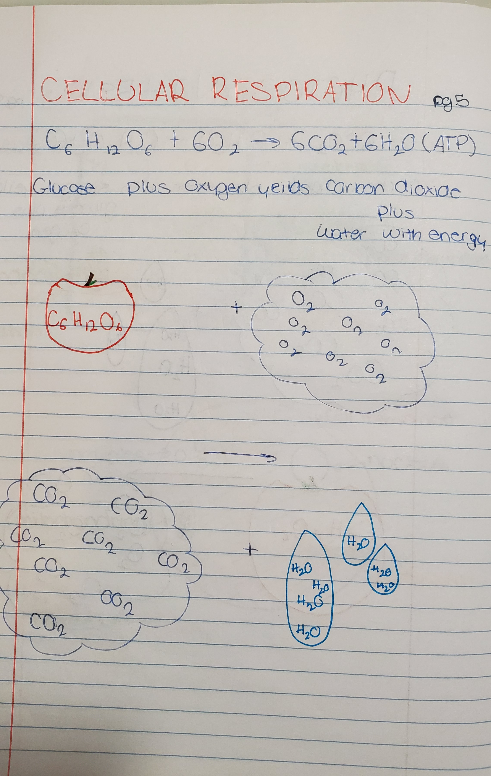
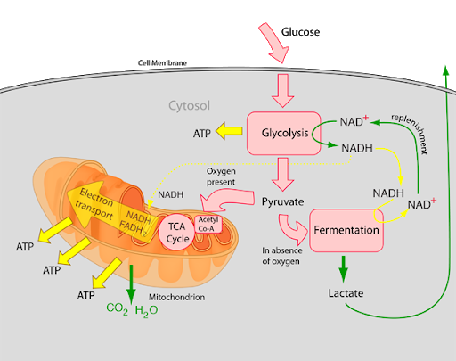
Cellular Respiration
Formula- C6H12O6+6O2=6CO2+6H2O (ATP)
Glucose plus oxygen yields carbon dioxide plus water with energy

Slide 7
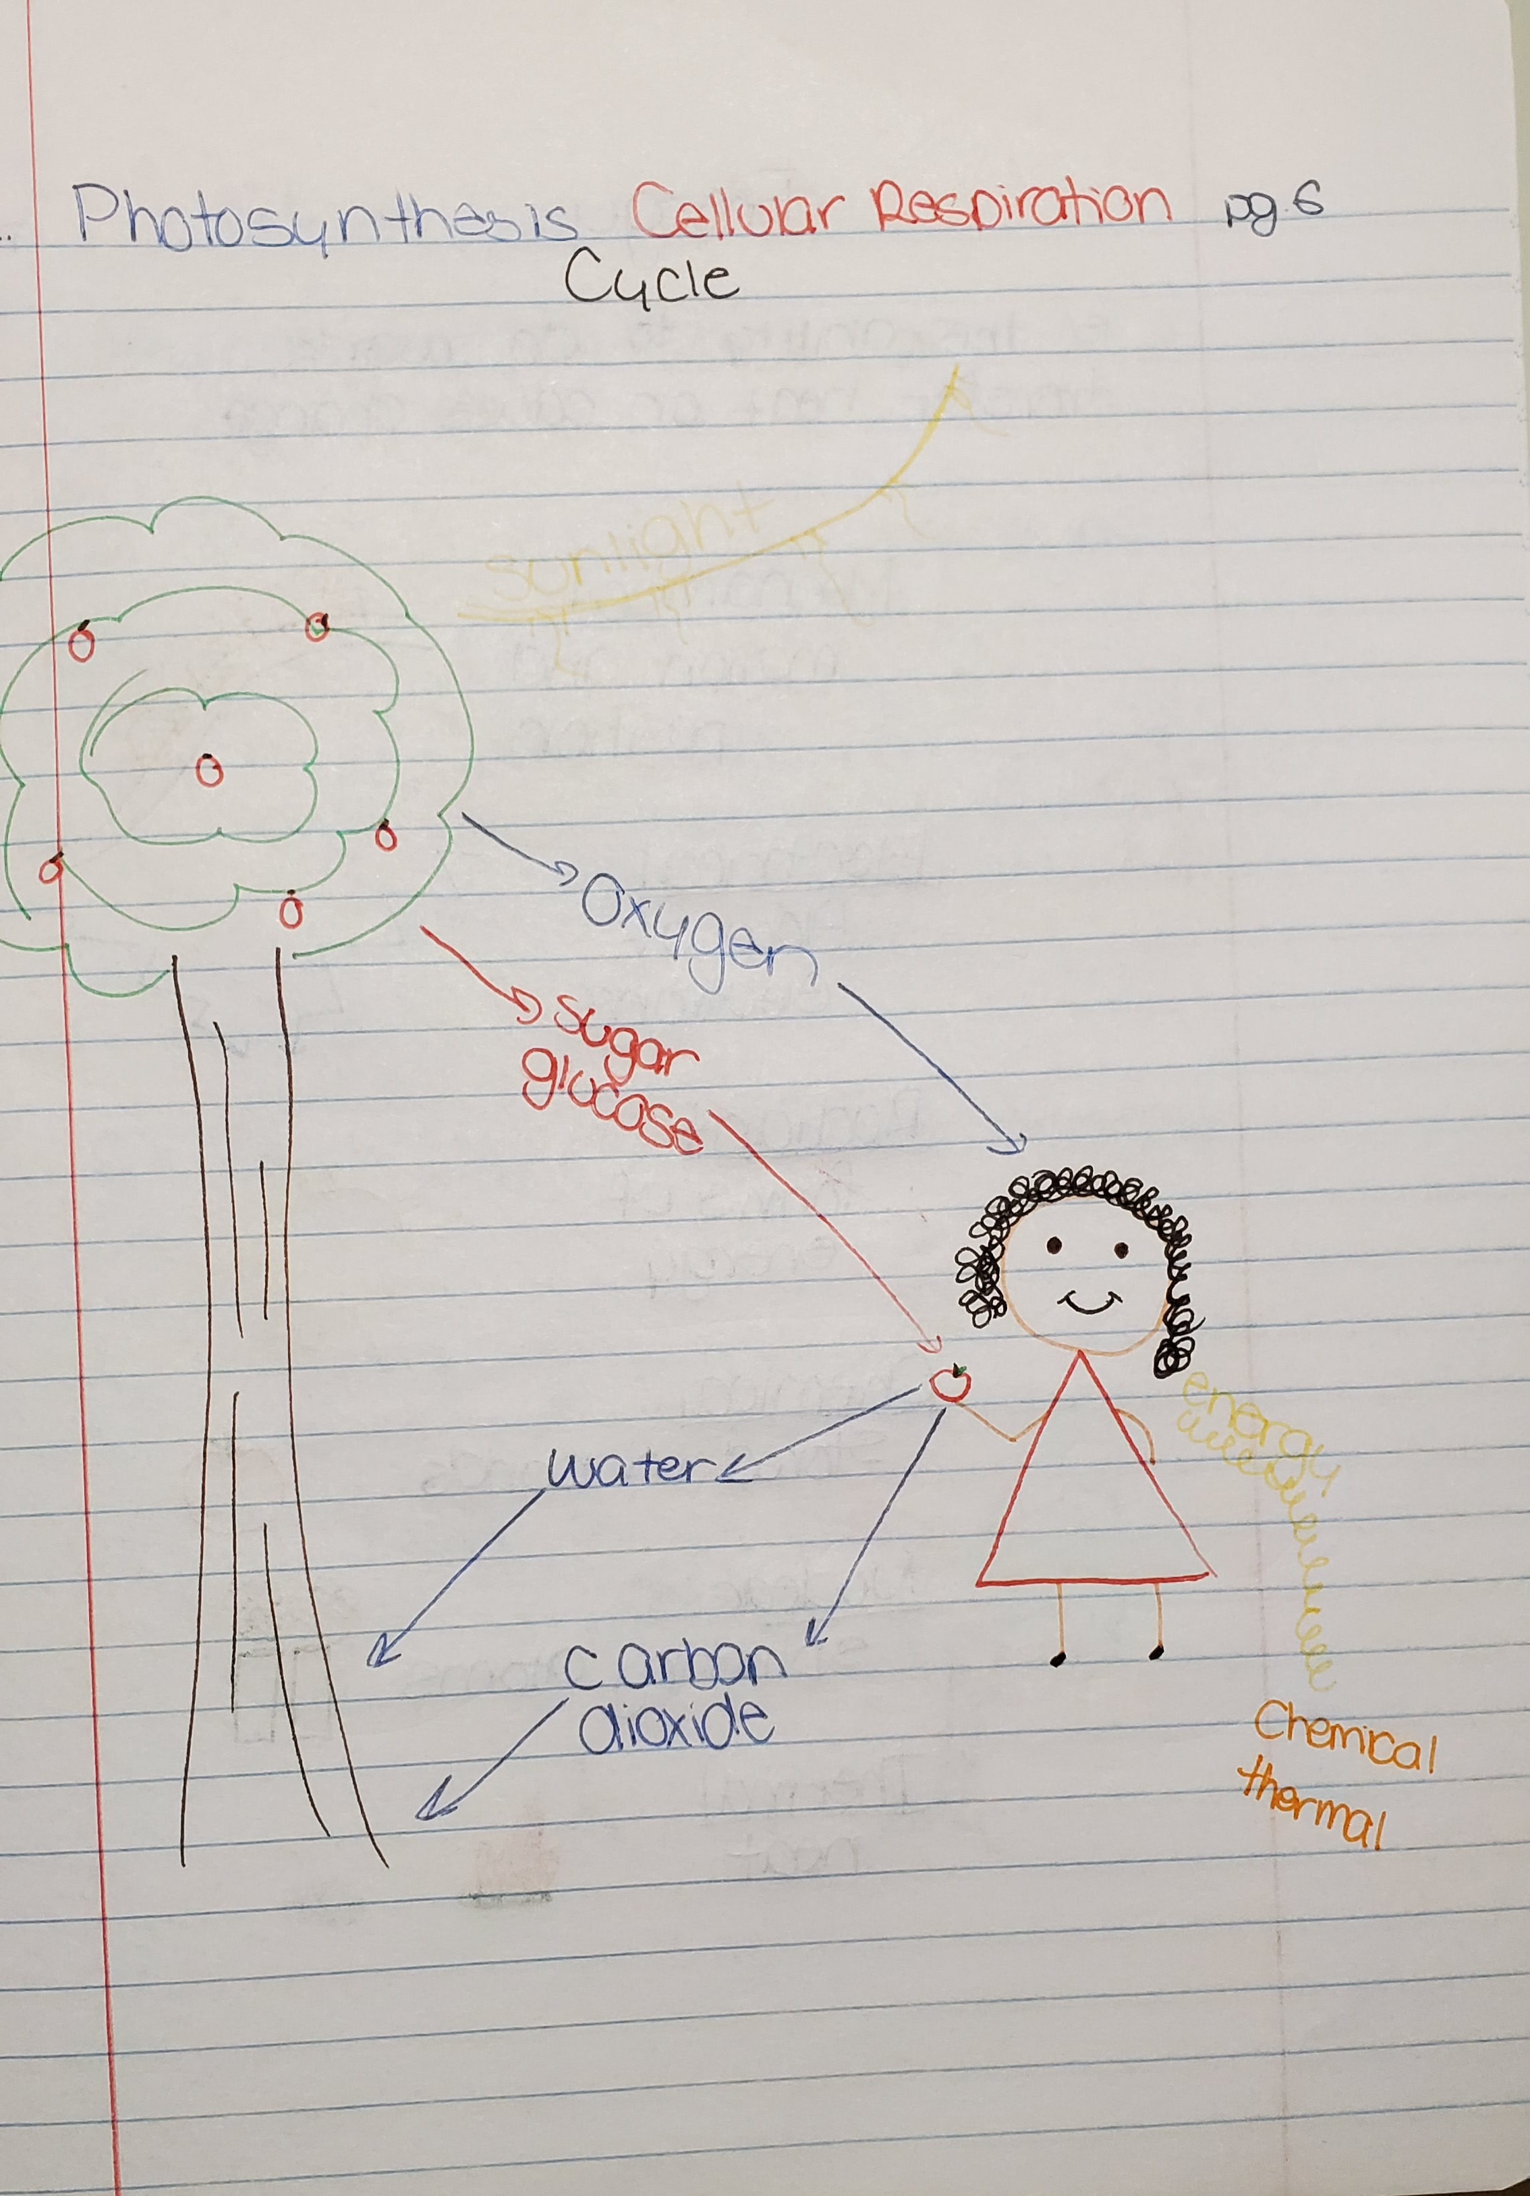
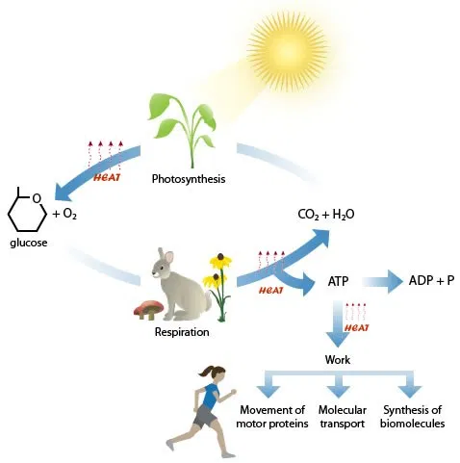
Photosynthesis, Cellular Respiration Cycle

Slide 8
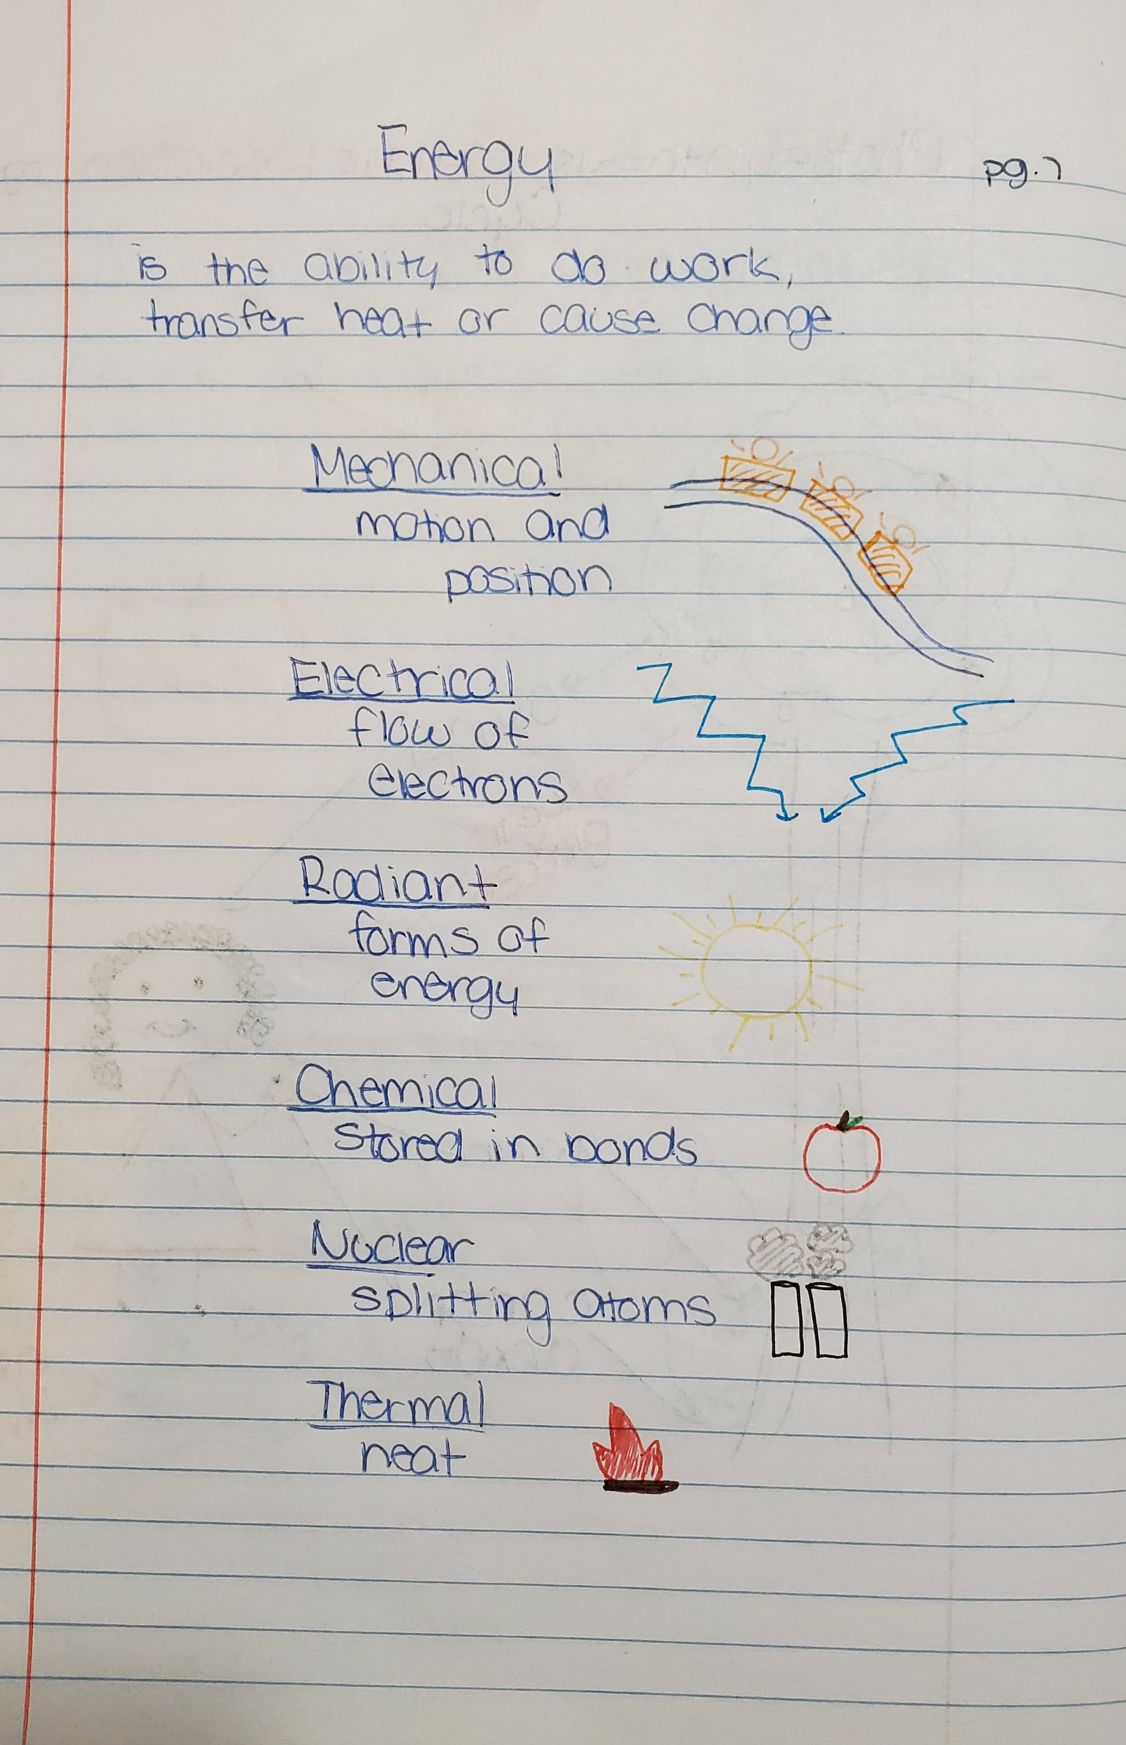
Energy
Energy is the ability to do work, transfer heat, or cause change.
Mechanical- motion and position
Electrical- flow of electrons
Radiant- forms of energy
Chemical- stored in bond
Nuclear- splitting atoms
Thermal- heat

Slide 9
This must be the last page in the PowerPoint
Instructions
Turn your notes into a complete, detailed PowerPoint presentation. You must do more than just insert photos of your notes, but you may include the pictures you drew as part of your presentation. You may use internet pictures as well and you can be creative with the fonts and colors.

