Slide 1
GABRIELINO
by Anthony Almeida and Krystal SOLIS

Slide 2
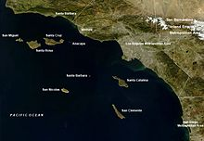
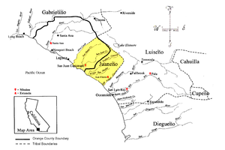
THE GABRIELINO LOCATION
THEY LIVED IN THE SOUTHERN COSTAL PART OF CALIFORNIA
THE GABRIELINO TRIBE LIVED IN THE SOUTHWEST WHICH IS NEAR TO US
THEY'RE LOCATED ON THE WEST COST AROUND WHAT IS NOW LOSANGELES
THE WEATHER WAS COLD IN THE WINTER AND HOT IN THE SUMMER

Slide 3
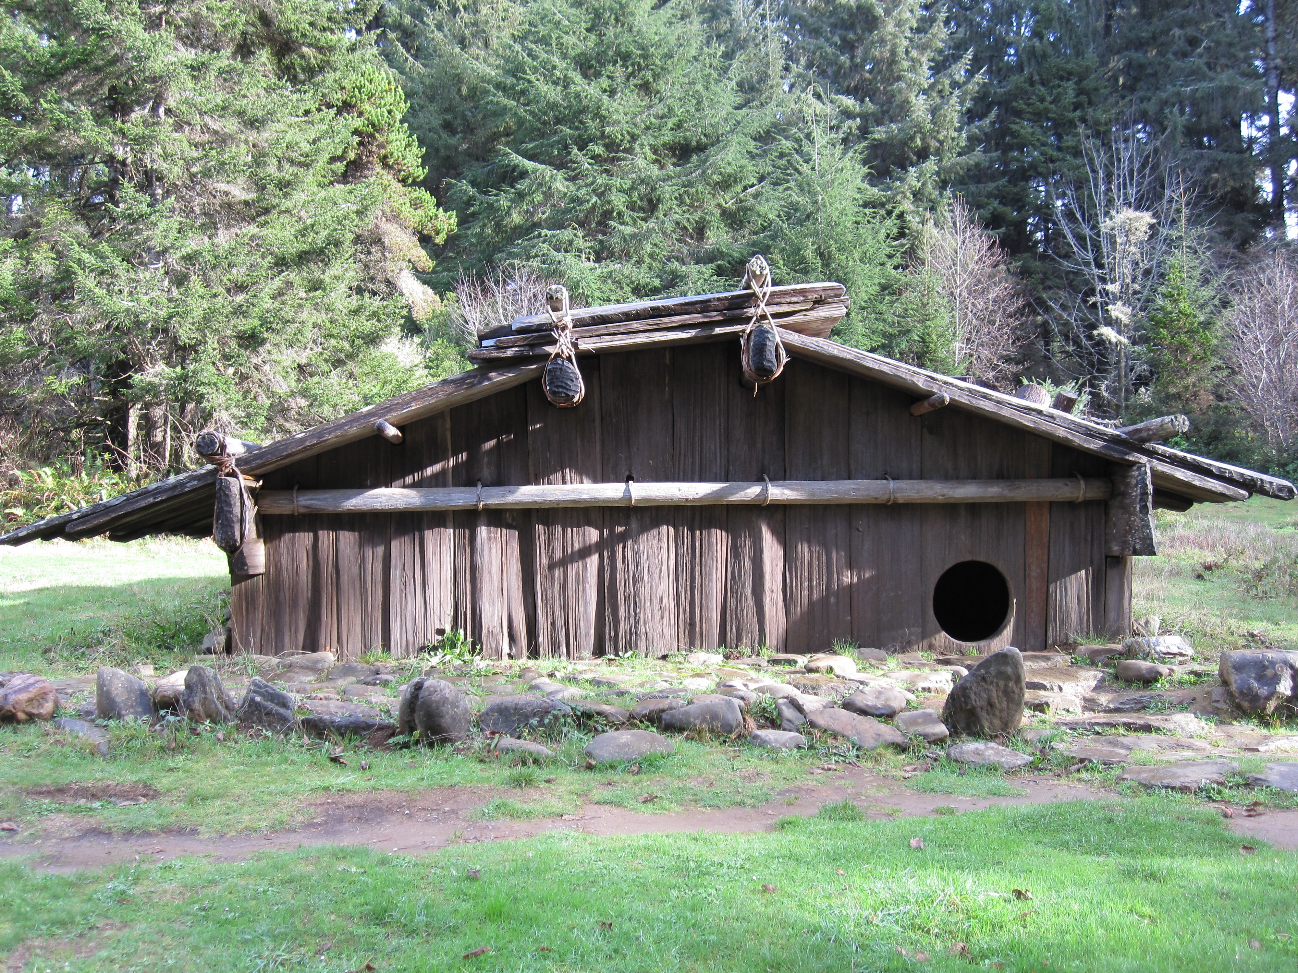
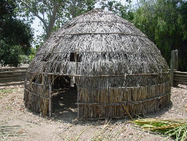
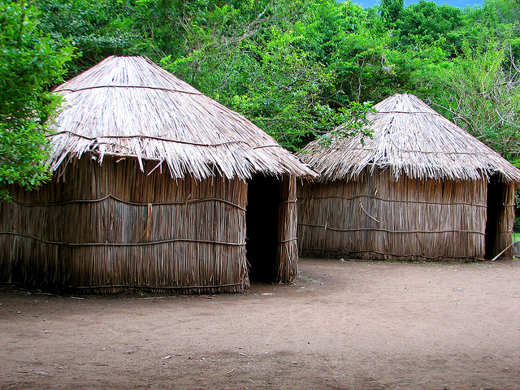
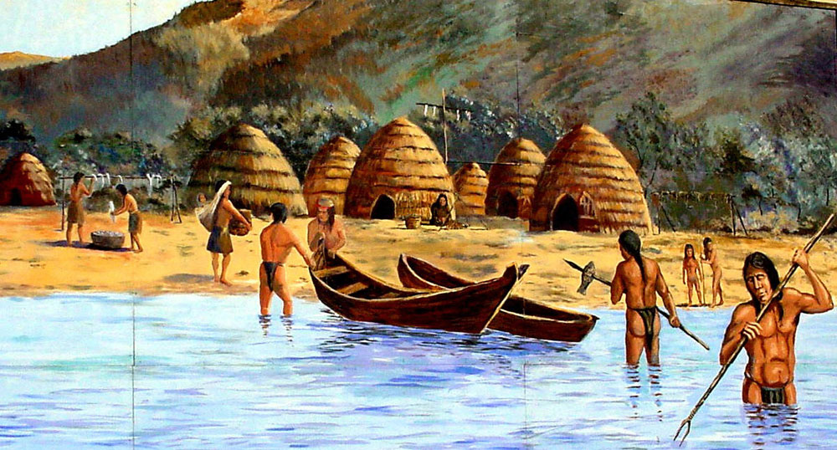
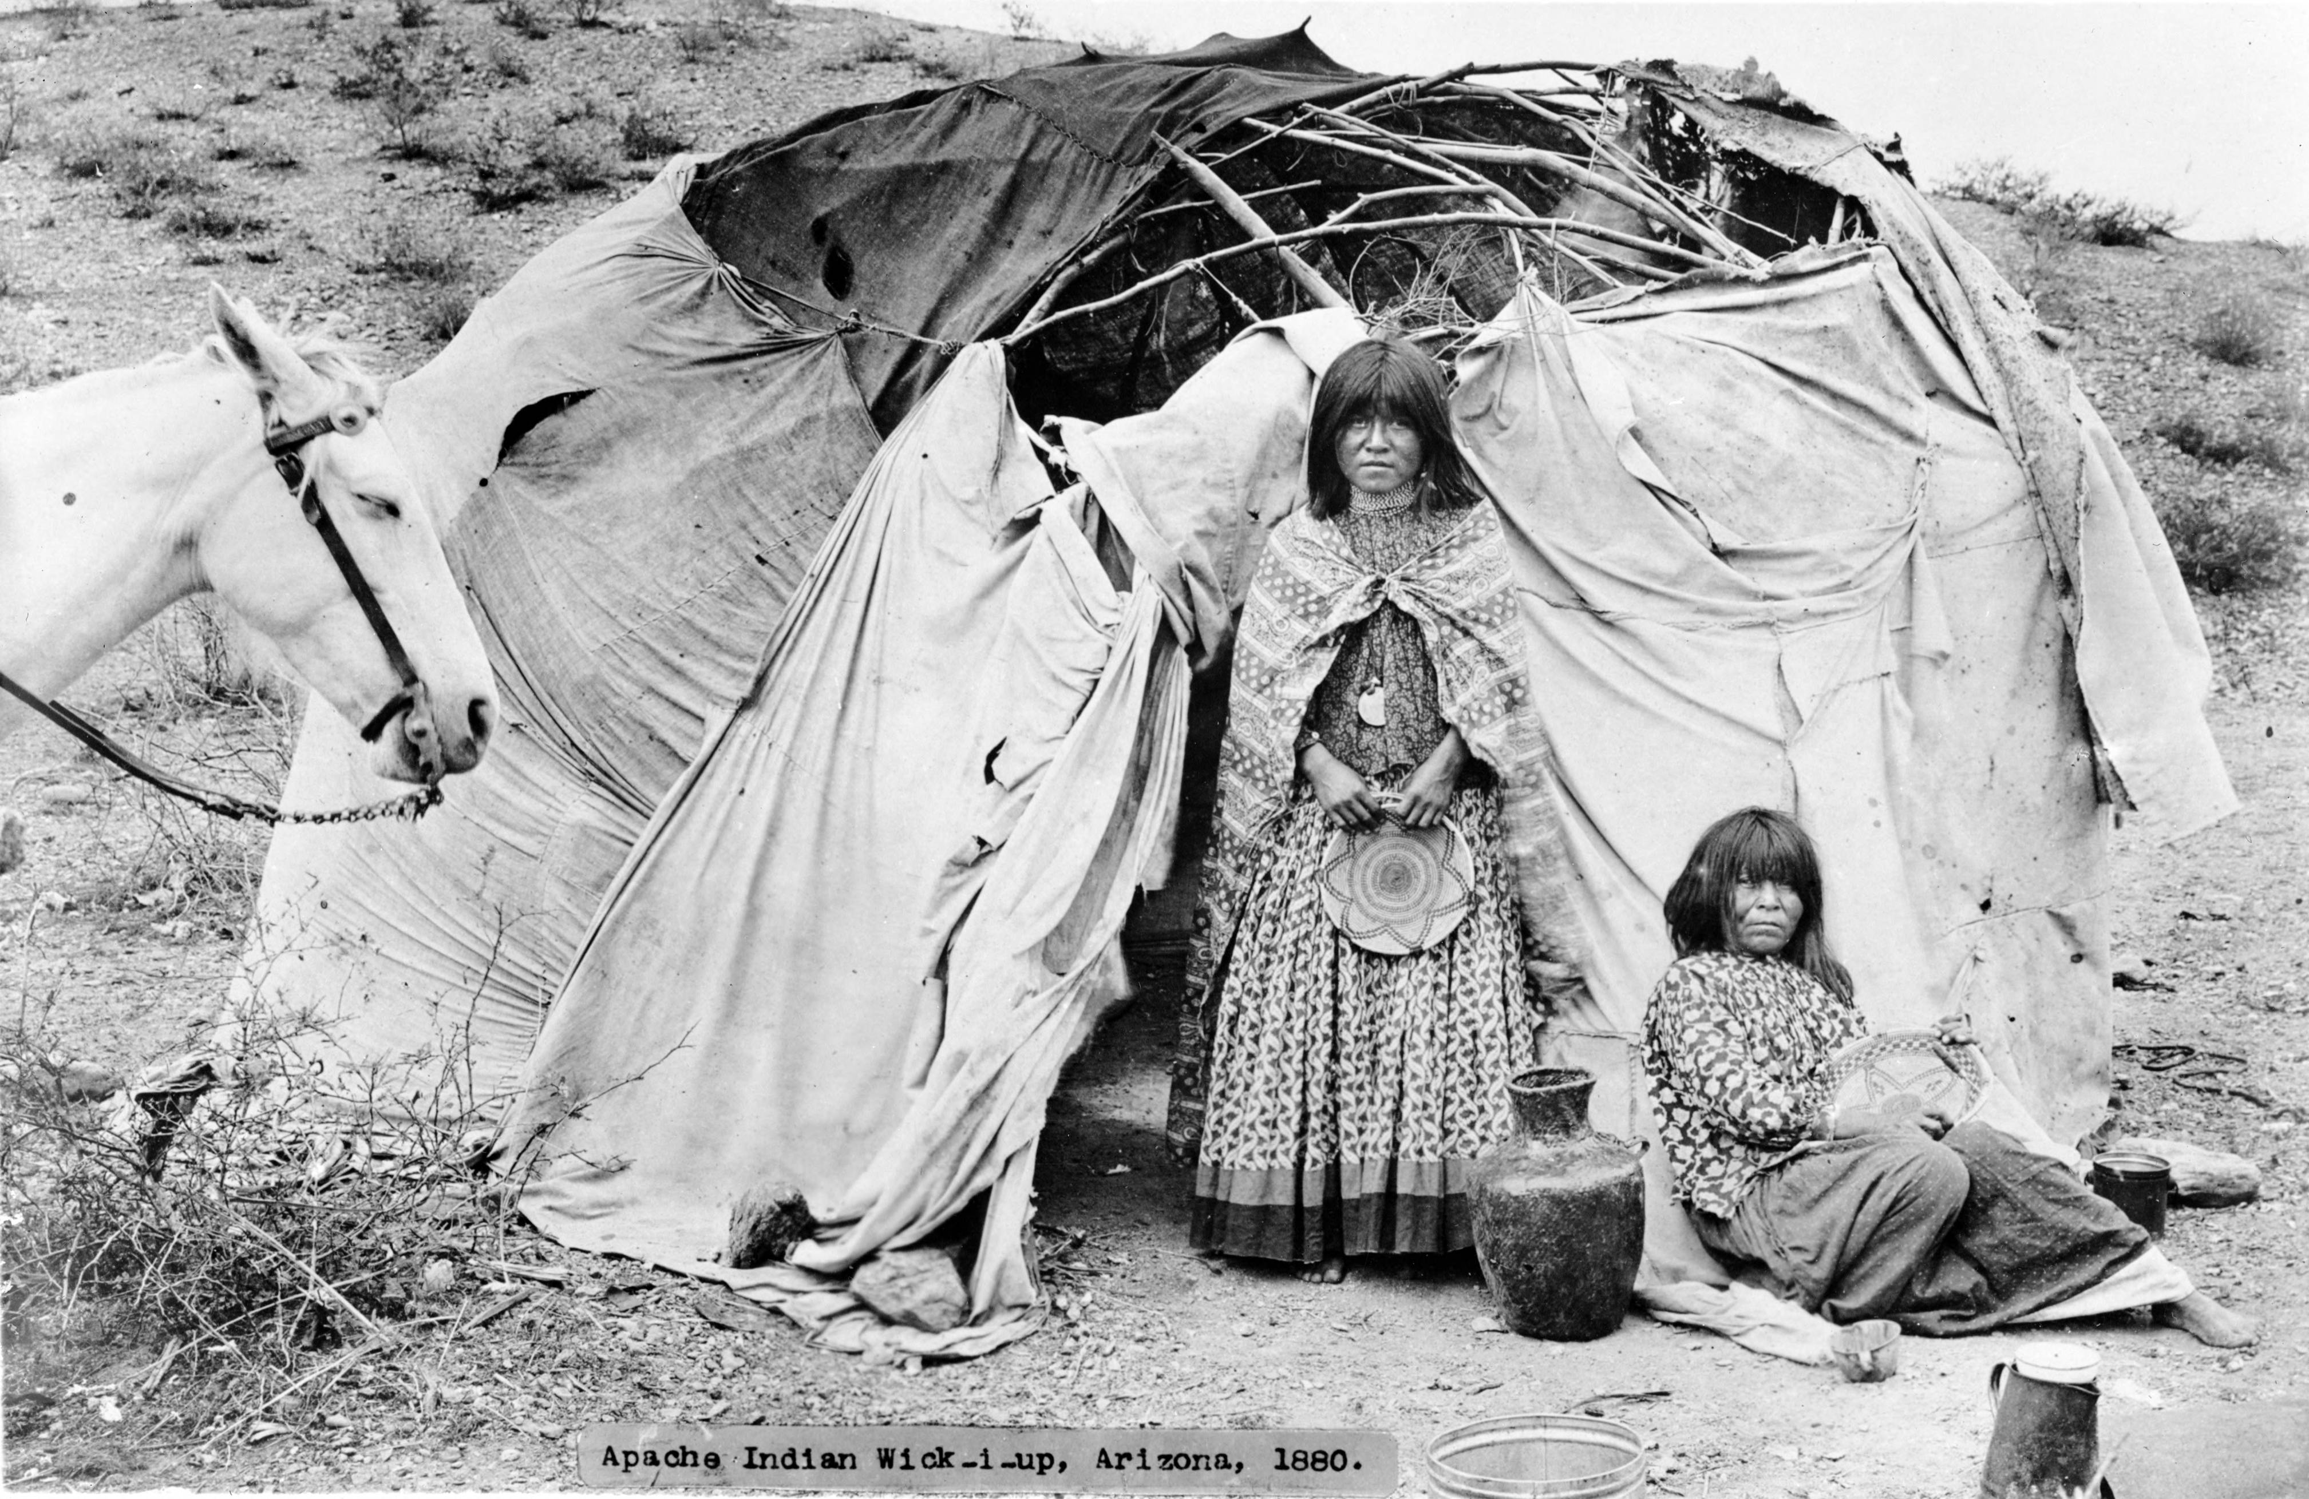
THE GABRIELINO SHELTER
THE HOMES OF THE GABRIELINO TRIBE PROTECTED THEM FROM THE WEATHER
THE FRAMEWORK OF POLES WAS COVERED WITH BUNDLES OF TULE REEDS
THEIR SHELTER FITS 50 OR 60 PEOPLE IN THEIR HOUSE
THE SWEATHOUSE WAS ROUND AND LOW INTO THE GROUND

Slide 4
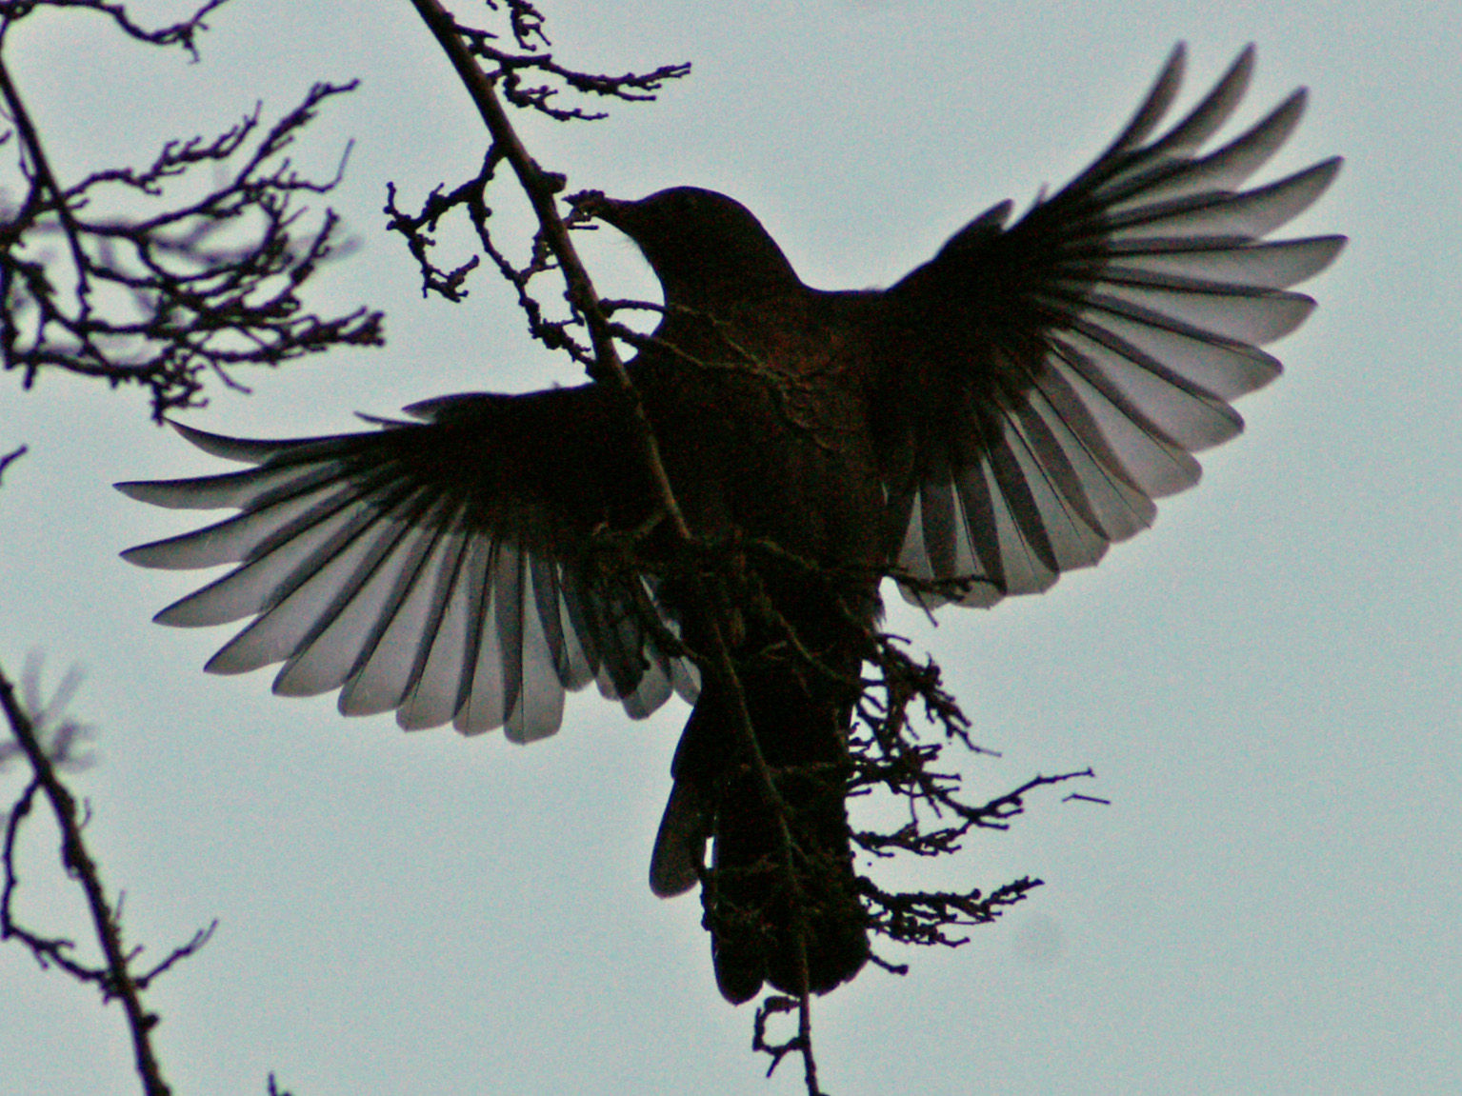
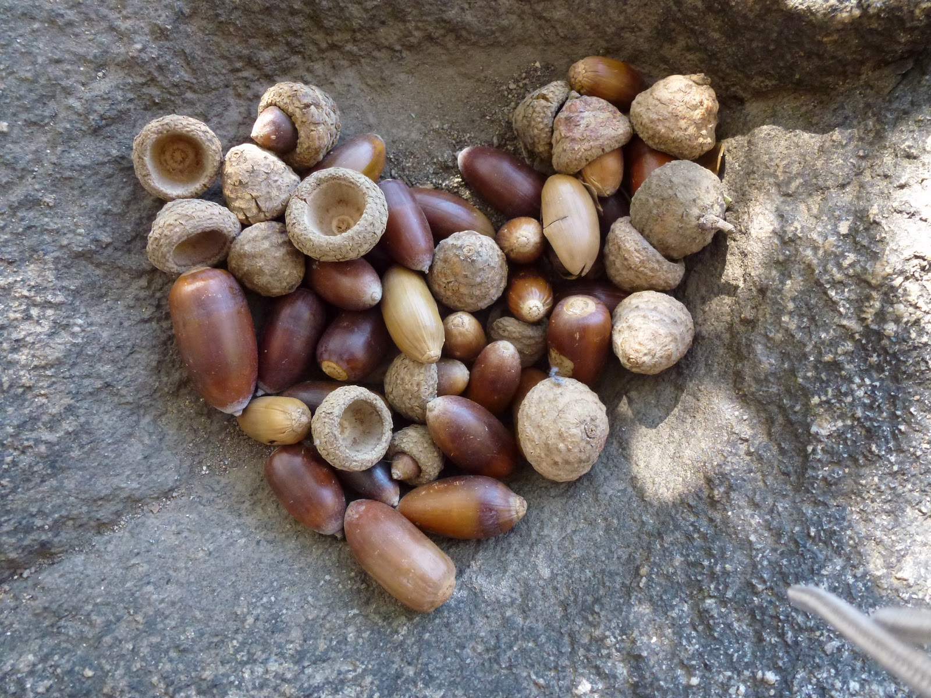
THE GABRIELINO FOOD
THE GABRIELINO TRIBE USED THEIR LAND FARM FOOD IN ORDER TO SURVIVE
THEY USED BOW AND AROW TO HUNT ANIMALS
THEY GATHERED NUTS BLACK BERRIES AND WILD OATS
THEY ATE DEER BLACKBIRDS, SQUIRRELS ,AND RABBITS

Slide 5
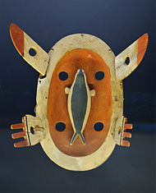
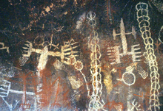
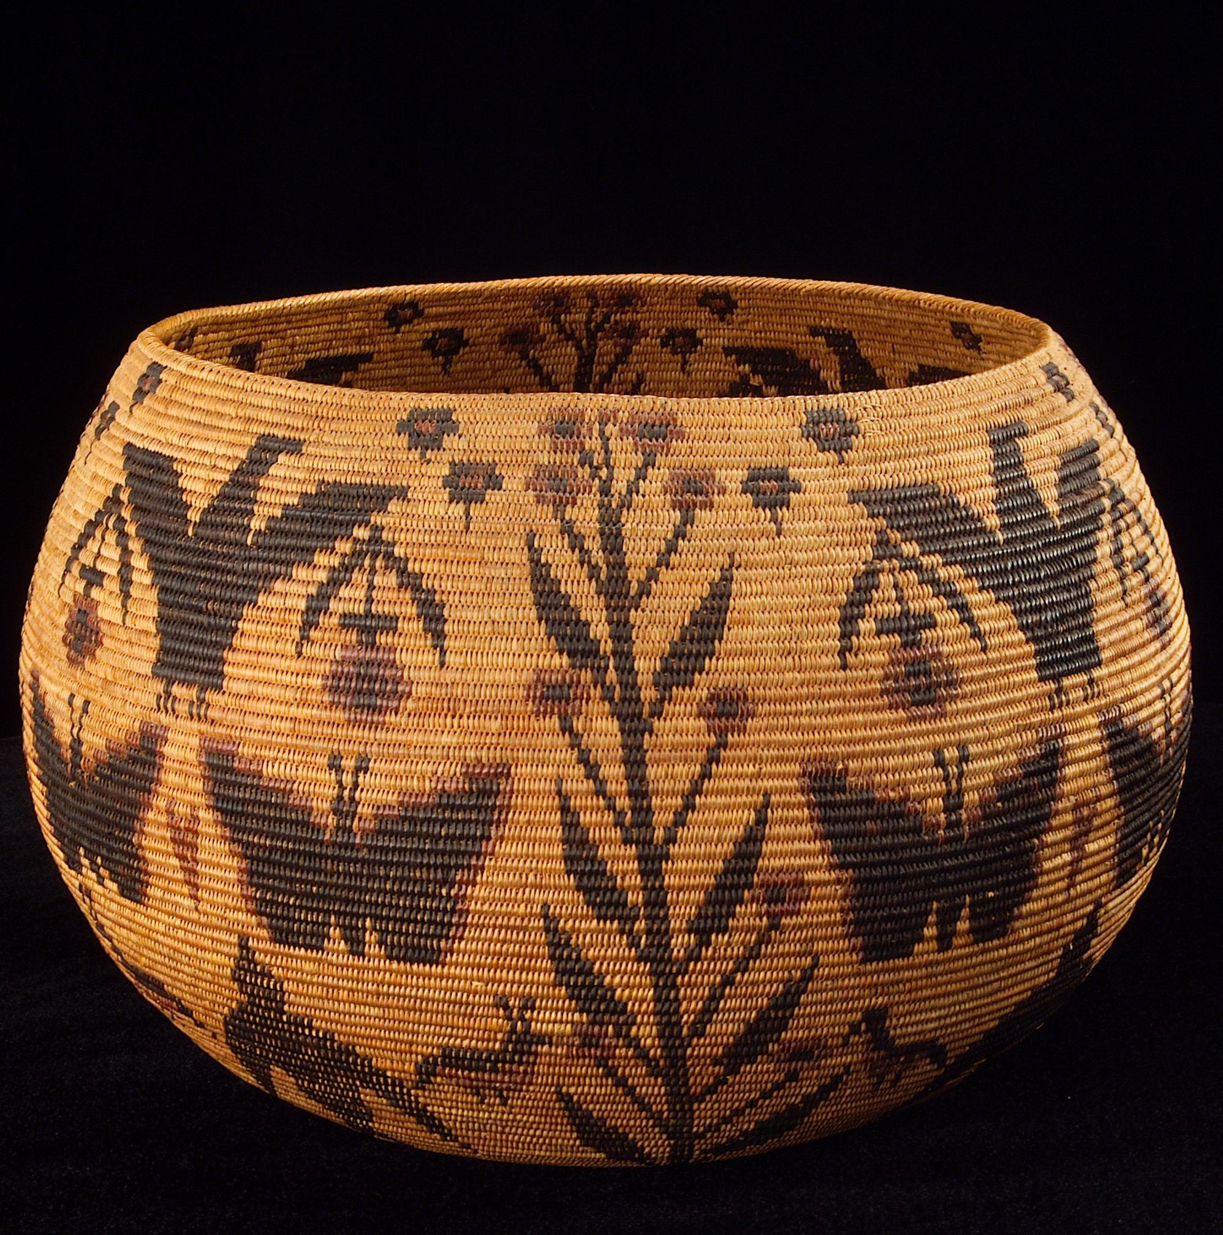
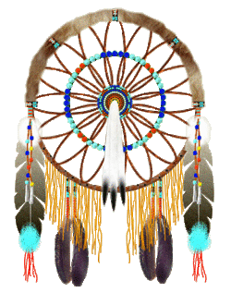
THE GABRIELINO CULTURE
THE GABRIELINO MADE TIME TO BECOME SKILLED INTO CRAFTS
THE CULTURE OF THE GABRIELINO TRIBE WAS UNIQUE AND
INTERESTING
THEY DECORATED THEIR CRAFTS WITH SHELLS AND THEY CARVED AND PAINTED
GABRIELINO WOMEN WORE APRONS MADE OF DEER SKIN AND CHILDREN DID NOT WEAR MUCH CLOTHING

Slide 6
GABRIELINO

