Slide 1
Maidu
By Jack Castaneda

Slide 2
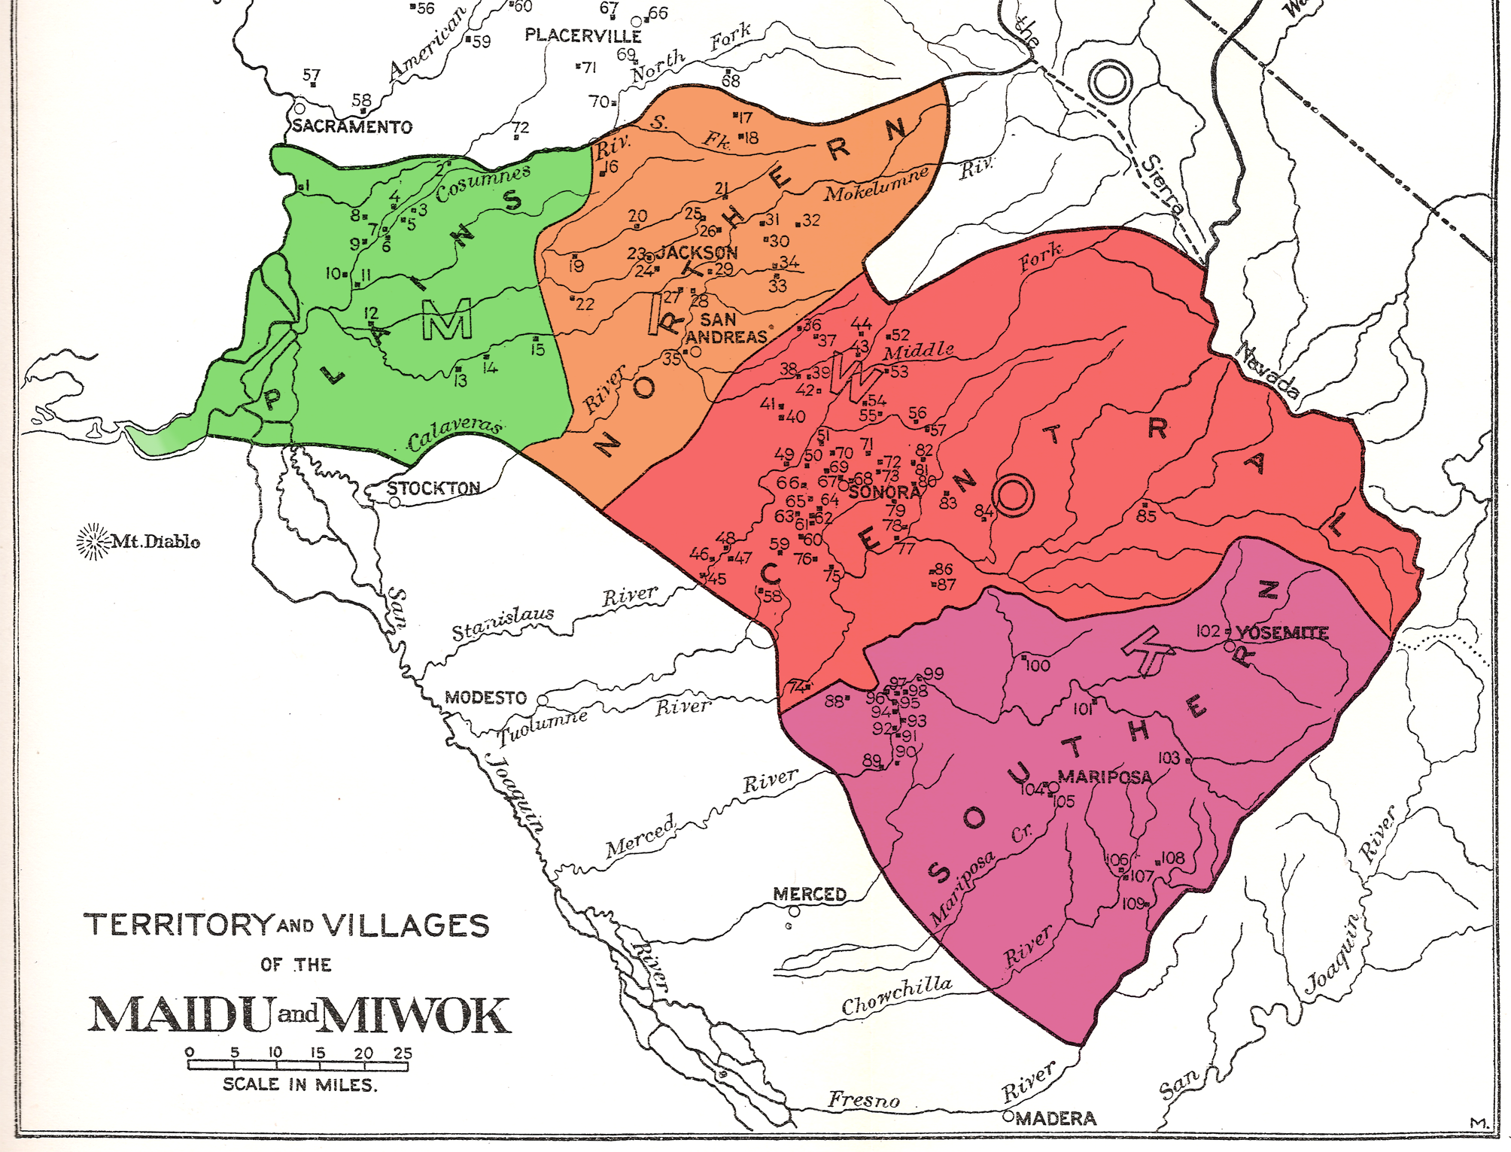
Location
Maidu tribe lived near
hills, valleys, and rivers.
They lived in the northern part of California.
They had cold snowy winters and mild summers.
This Photo by Unknown author is licensed under CC BY-SA.

Slide 3
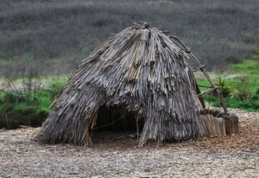
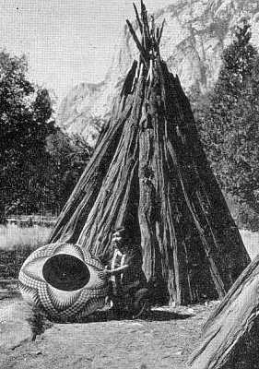
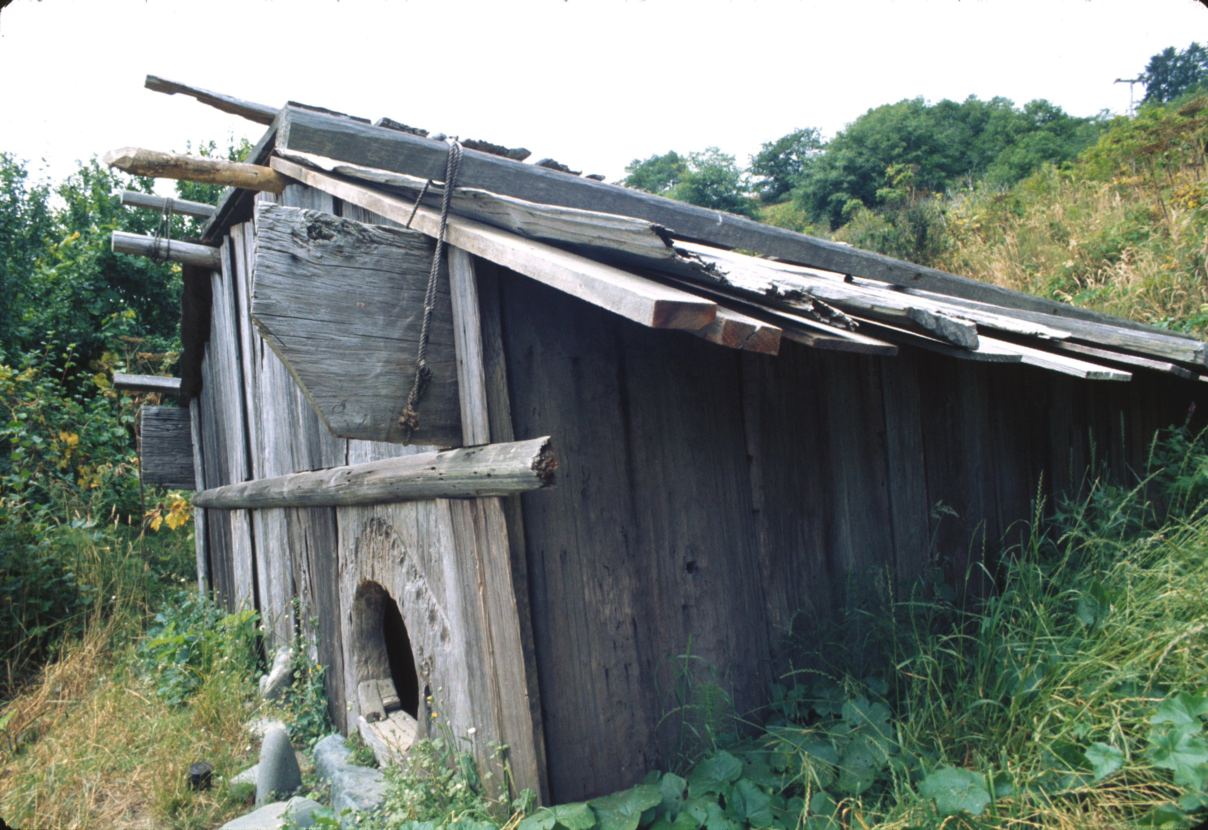
Shelter
Maidu tribe's homes were dug down 4 feet to help keep them warm in the winter.
Their houses were round with diameters of from 20 to 40 feet.
They built round shaped houses from poles covering with bark.

Slide 4
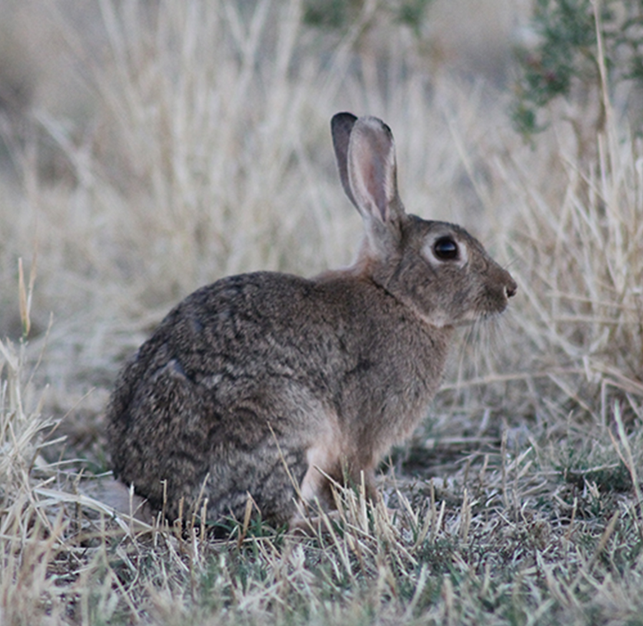
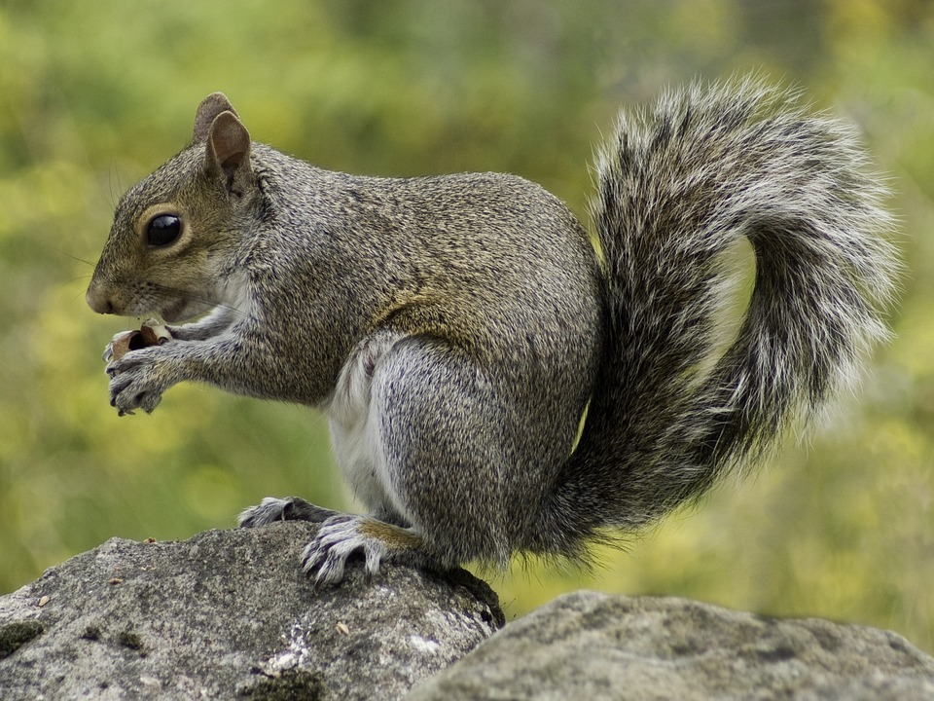
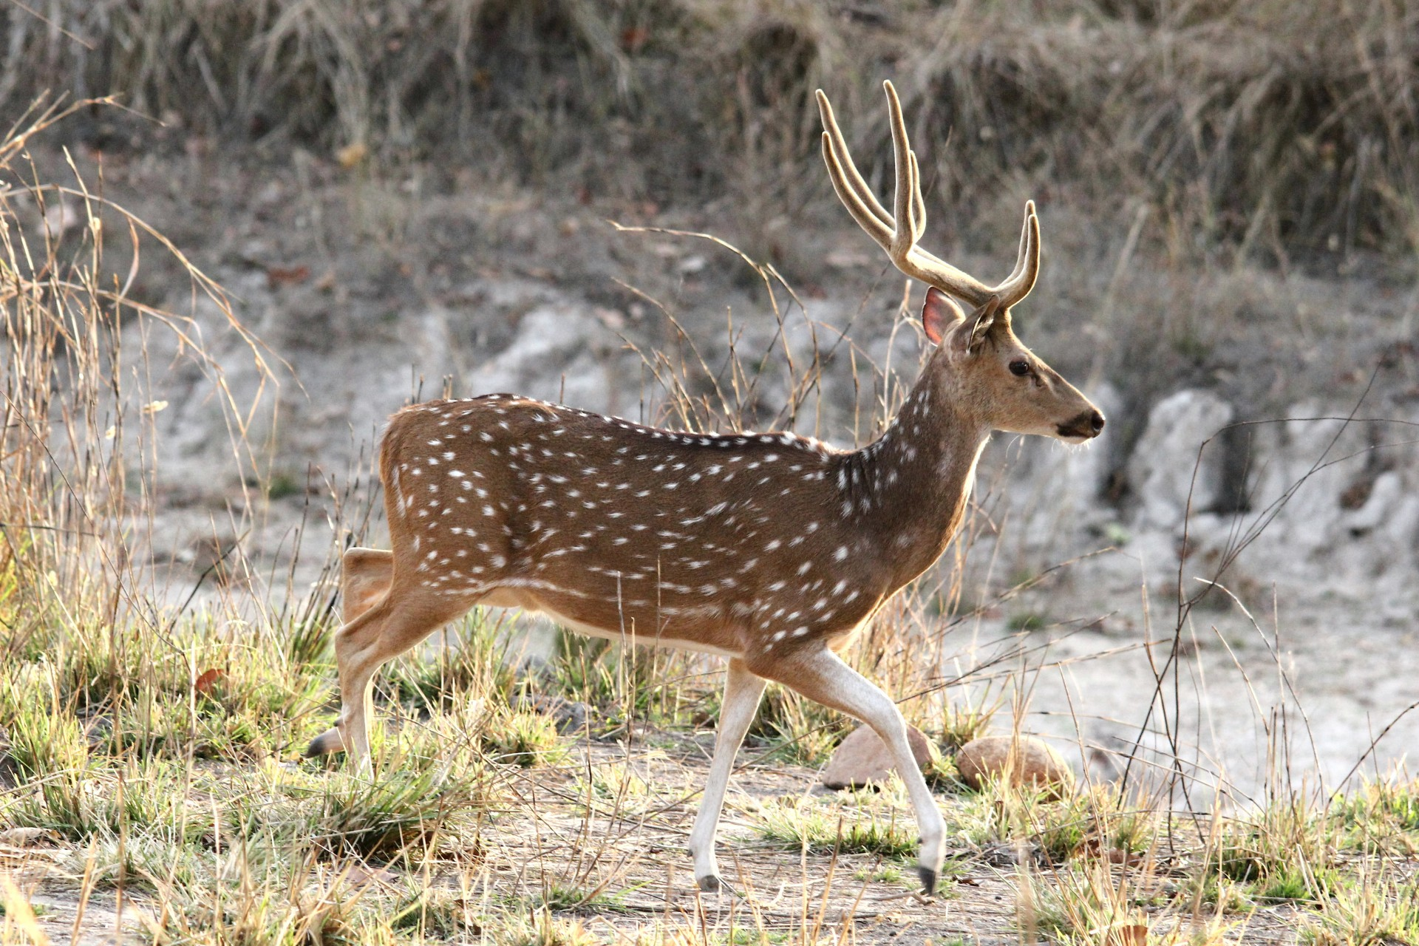
Food
.
They hunted squirrels, rabbits, geese, ducks, and quails.
They ate grasshoppers, crickets, huckleberries, soup, and fish.
Before the meat was eaten, it was roasted over an open fire.

Slide 5
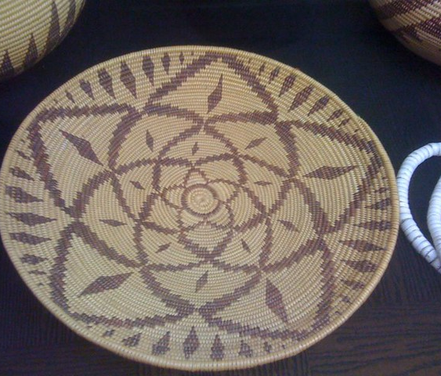
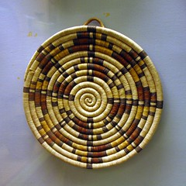
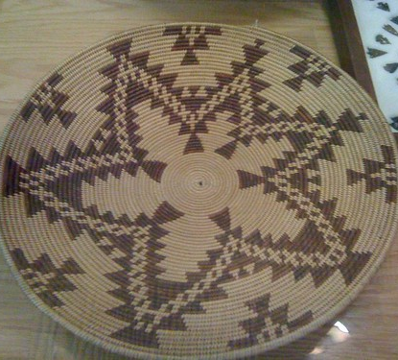
Culture
Men wore deer skin around their hips.
Women wore a double apron one section covering the front and the back.
Dugout canoes made by burning out the middle of logs.
.

Slide 6
This Photo by Unknown author is licensed under CC BY-SA.

