Slide 1
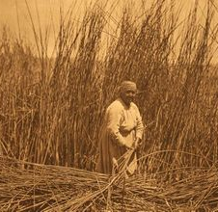
Maidu tribe
By Noah Port and Mathew Serna

Slide 2
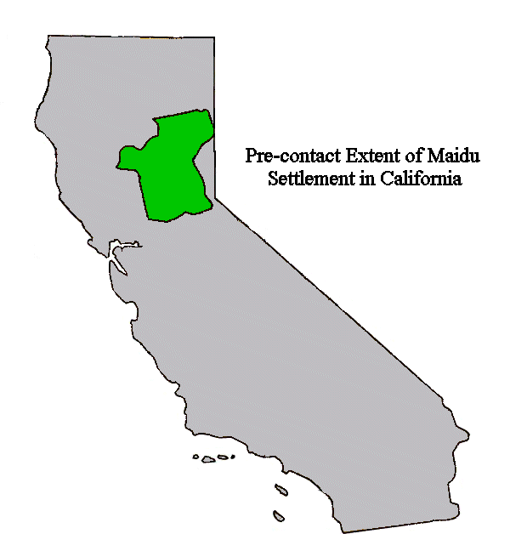
Location
The Maidu are Native American Tribe of California their geographical location shelter food and culture are valley to their tribe. The Maidu lived in the central valley and mountain part of California they live on a hilltop near the river and valleys. The climate it was never to hot or cold.

Slide 3
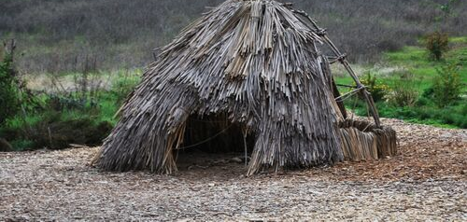
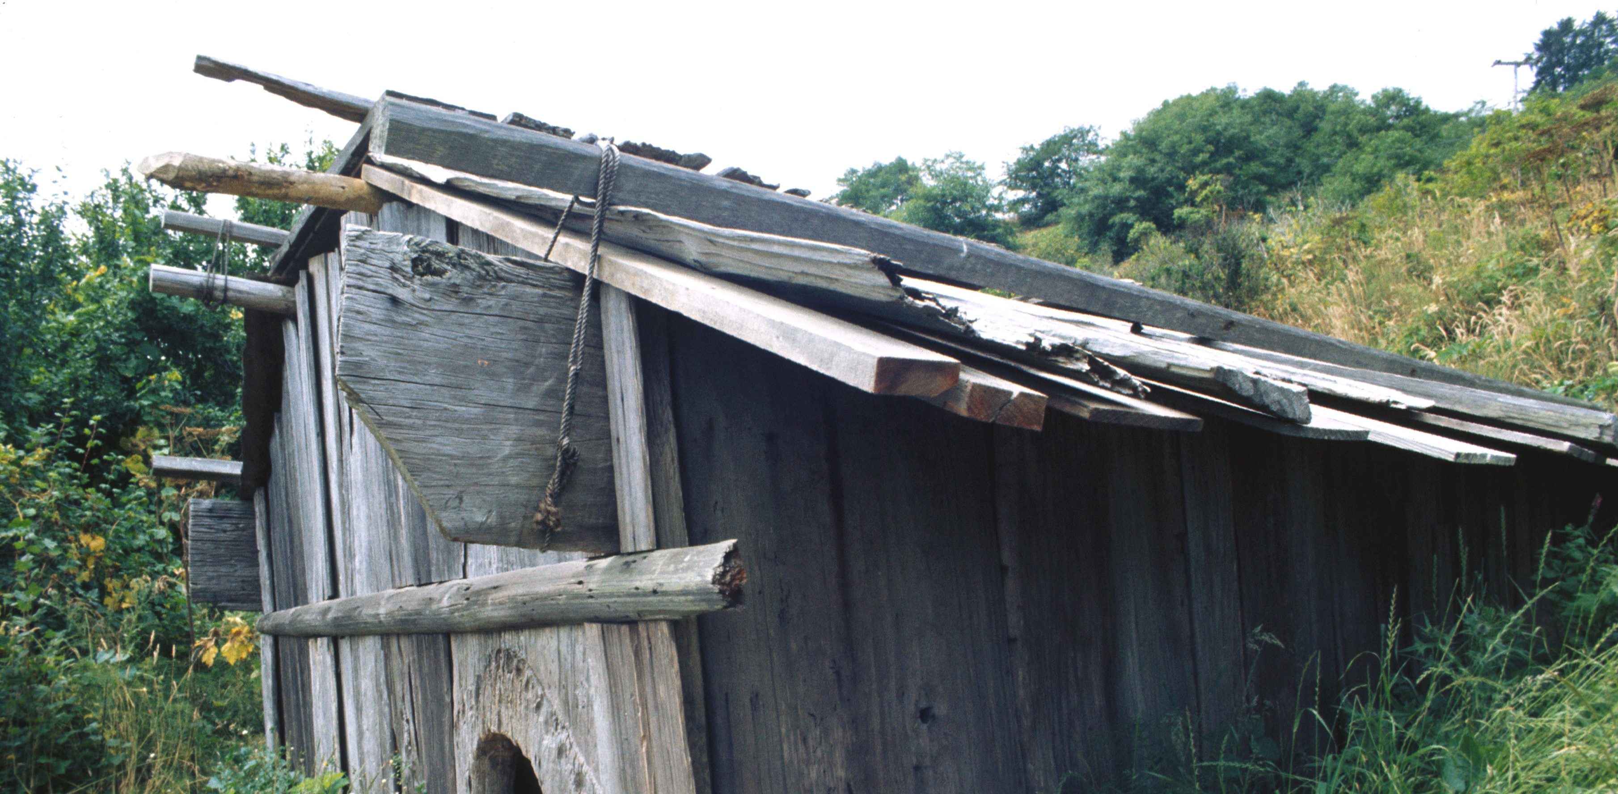
Shelter
The Maidu tribe used their shelters to survive the seasons.
Homes were made of tree bark.
Houses were underground about 4 feet deep during the winter.
.

Slide 4
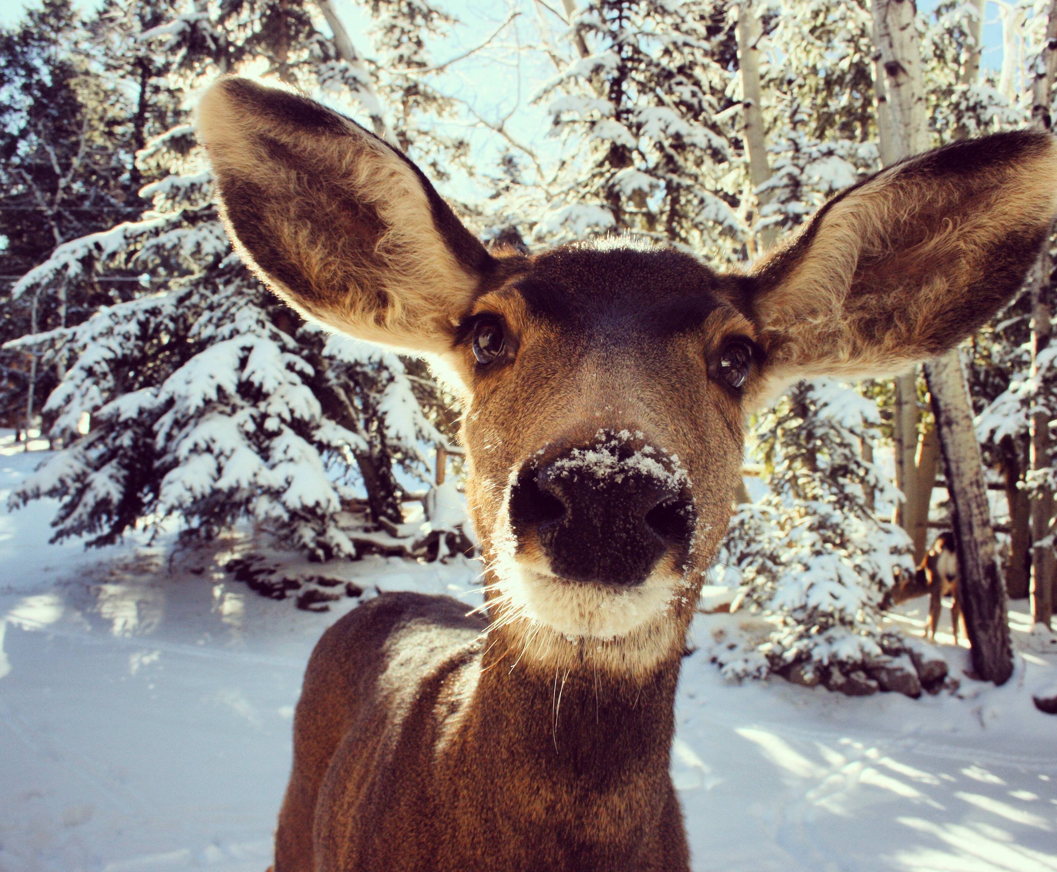
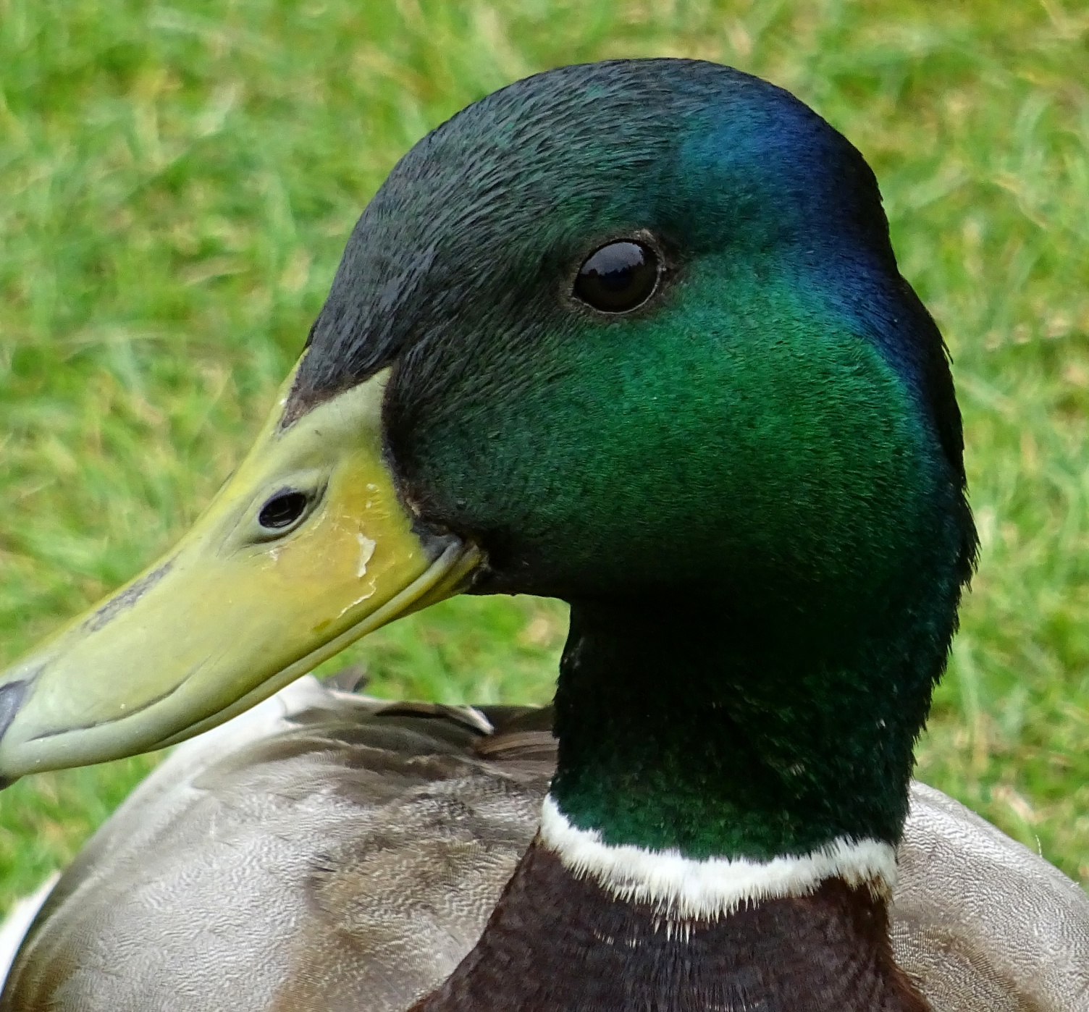
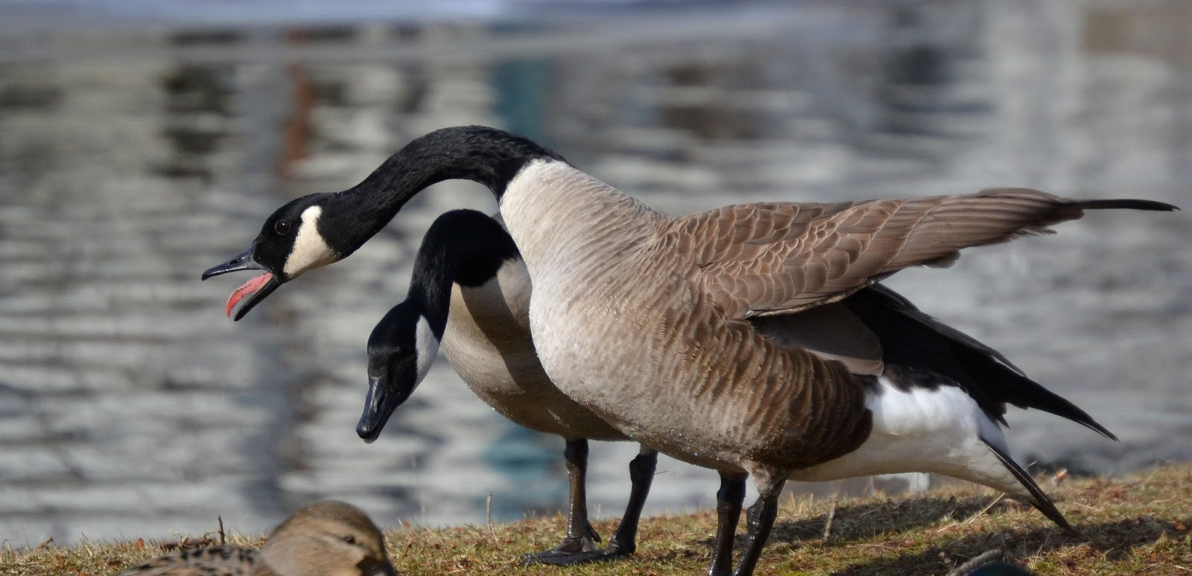
Food
They hunted ducks, elk, deer, geese, quails, and squirrels.
They gathered acorns, nuts, and seeds.

Slide 5
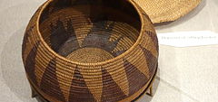
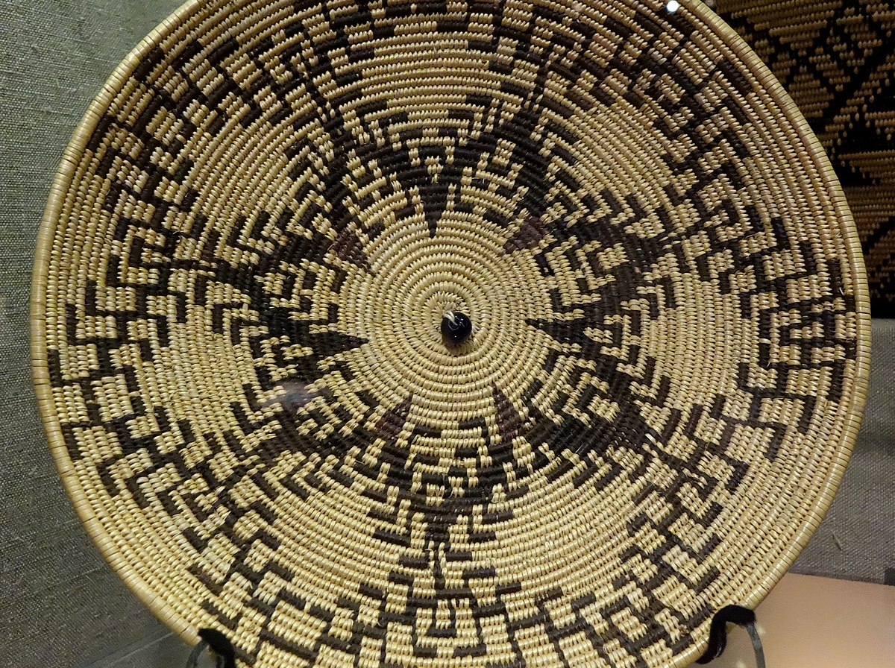
Culture
The culture of the Maidu tribe was unique and interesting. Their language was called Pen utian. They held many dances for special cere monies and for fun. They make baskets and bowls.

Slide 6
