Slide 1
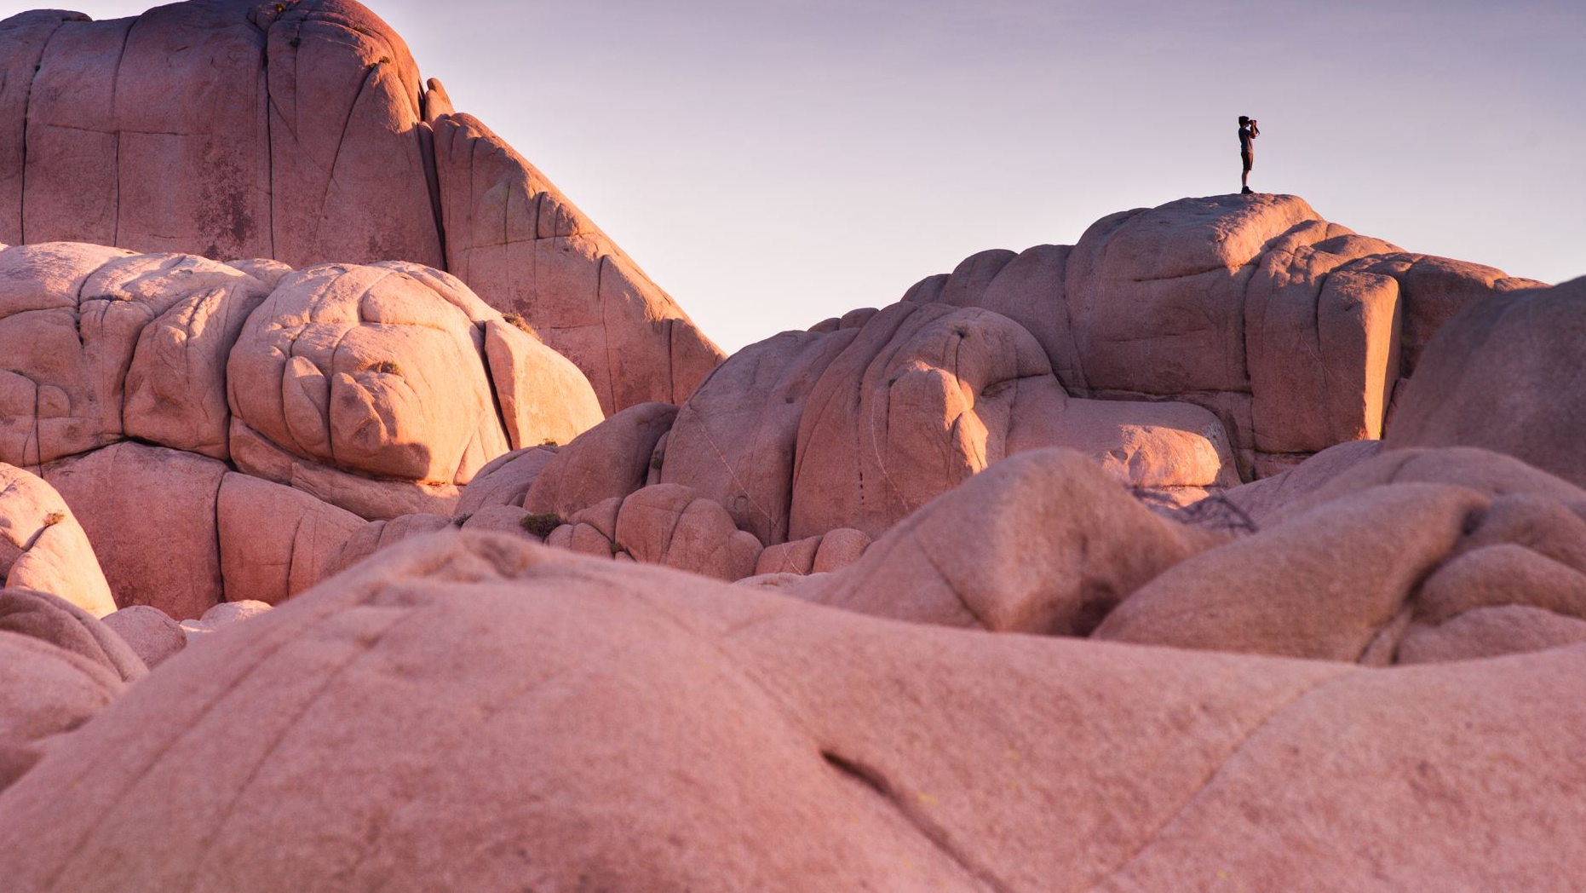
The Mojave by Charlie

Slide 2
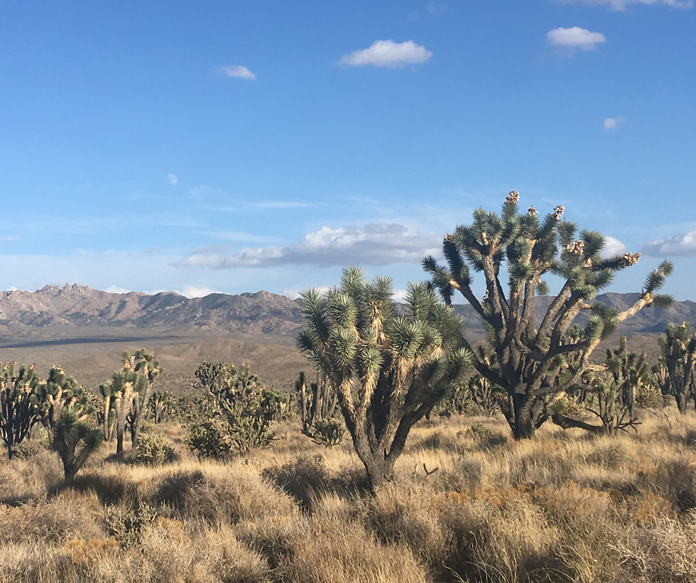
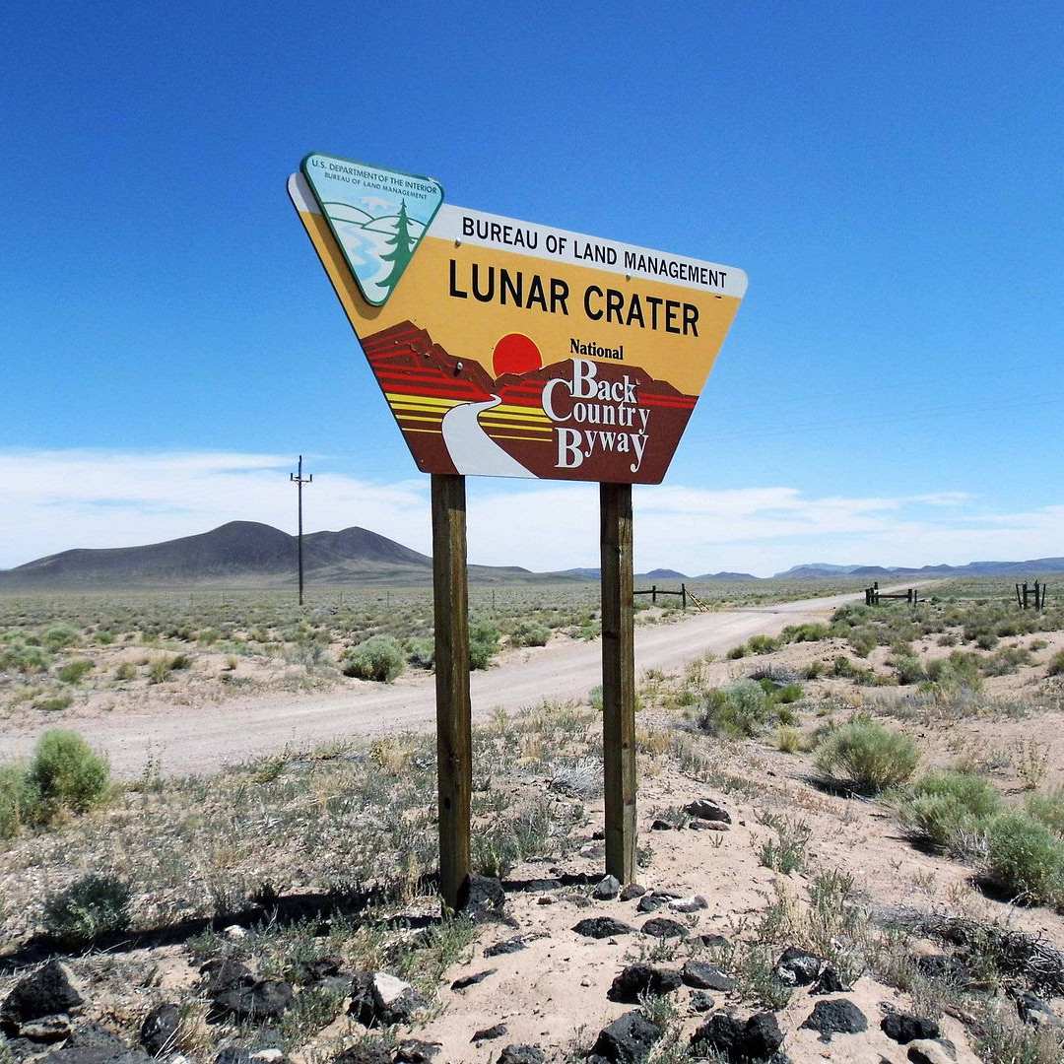
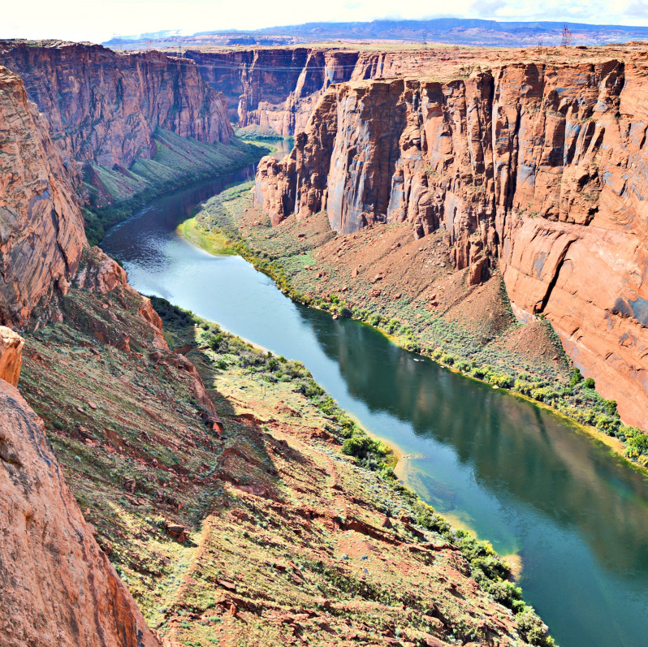
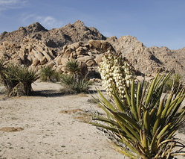
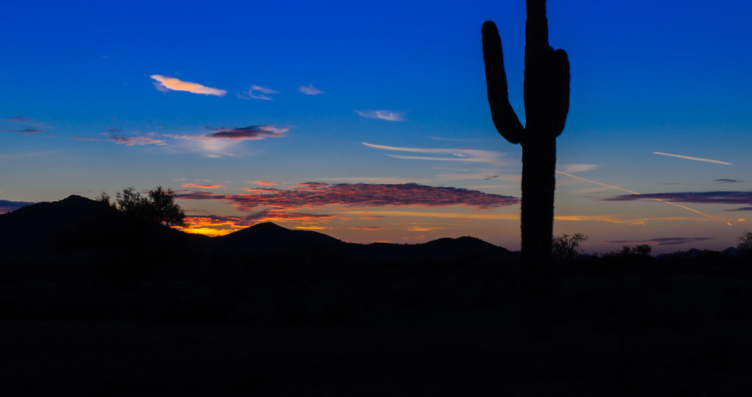
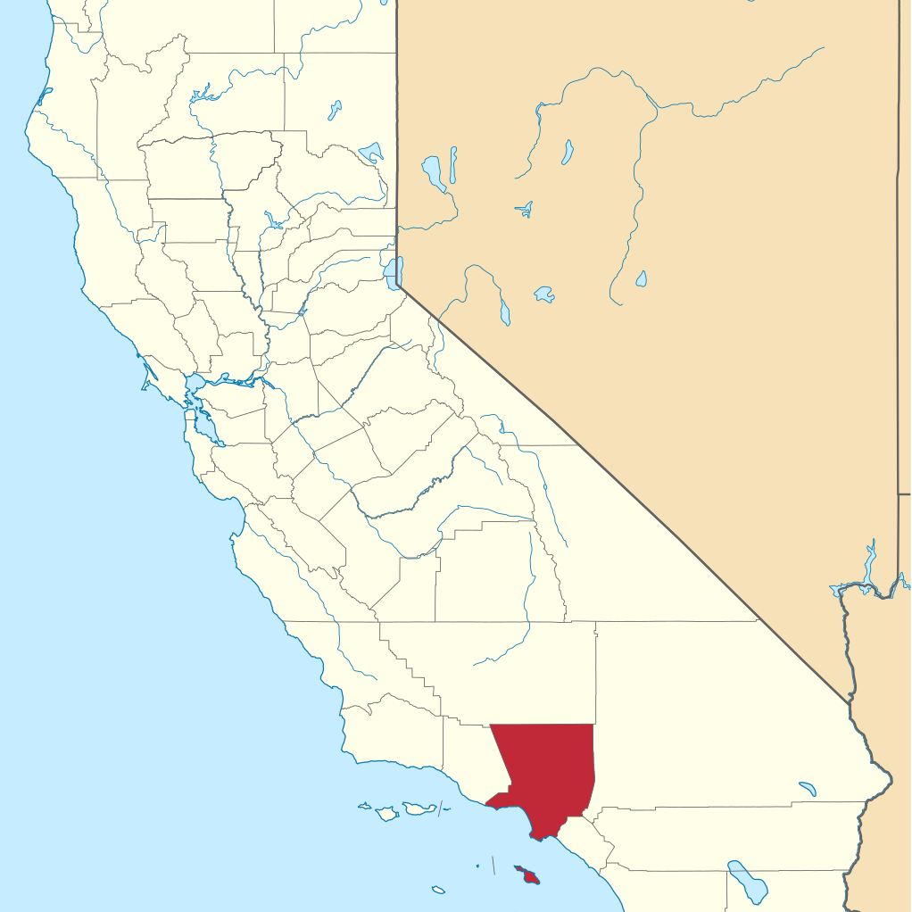
Location
The Mojave tribe lived in the southern part of California. The Mojave tribe live near the Colorado River. Some lived in Nevada and Arizona. They lived in hot and dry places because they lived in the desert, so it is always hot.
This Photo by Unknown author is licensed under CC BY.
This Photo by Unknown author is licensed under CC BY-SA.
This Photo by Unknown author is licensed under CC BY-NC-ND.
This Photo by Unknown author is licensed under CC BY-NC-ND.
This Photo by Unknown author is licensed under CC BY-SA.

Slide 3
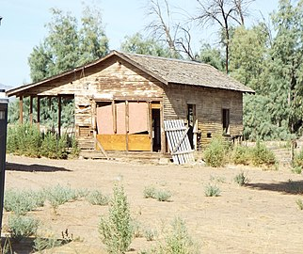
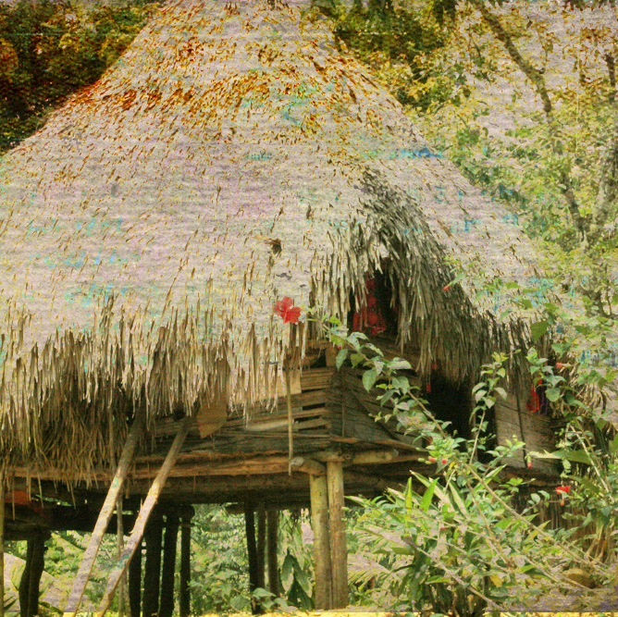
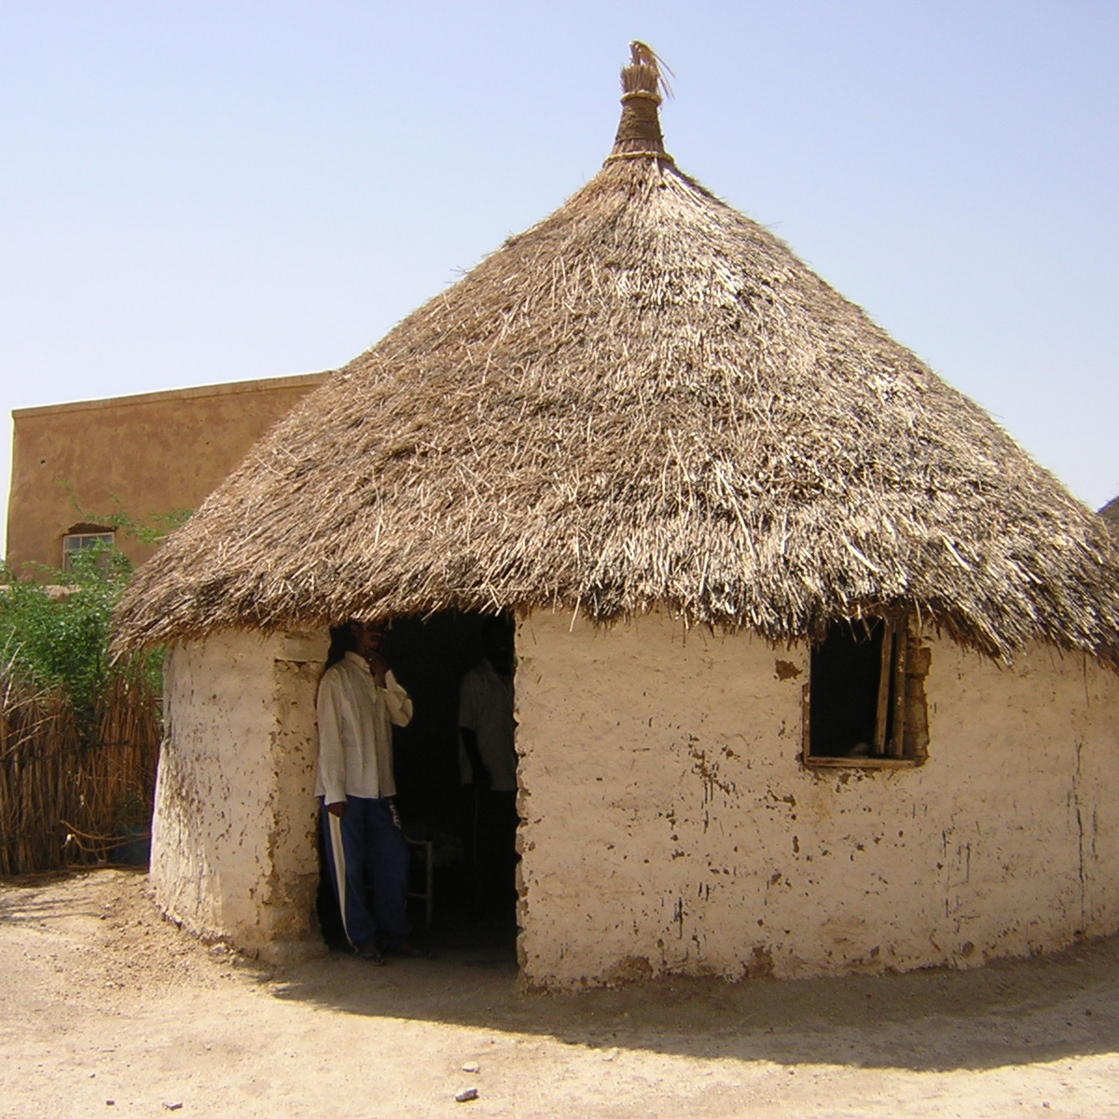
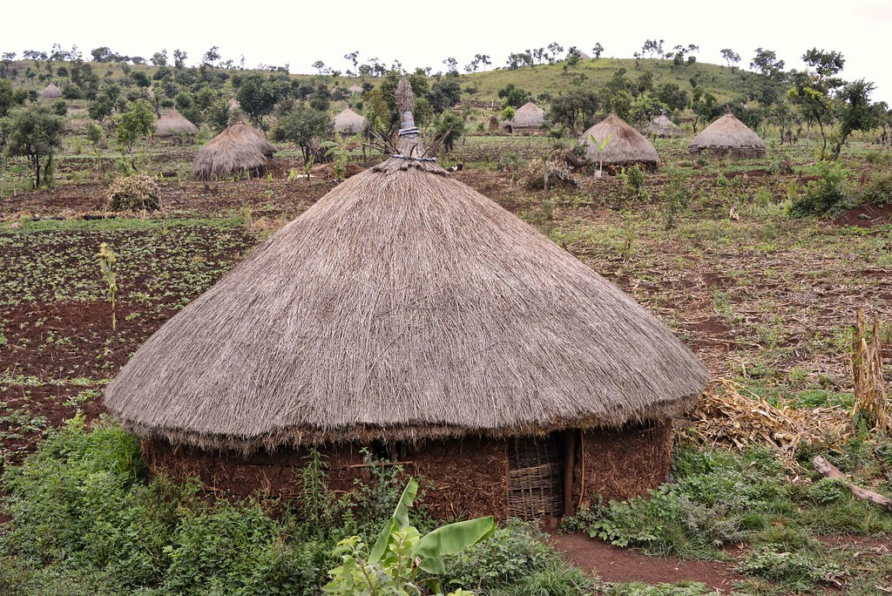
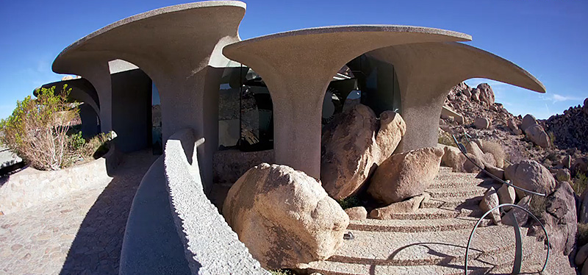
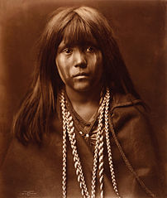
Shelter
The homes of the Mojave tribe protected them from the environment. The Mojave people made their shelter with hay and some of the top of the houses look like a tipi. Some of the houses were made of sticks and mud. Some of them were shaped like a round ball.
This Photo by Unknown author is licensed under CC BY-SA.
This Photo by Unknown author is licensed under CC BY-SA.
This Photo by Unknown author is licensed under CC BY-ND.
This Photo by Unknown author is licensed under CC BY-NC-ND.
This Photo by Unknown author is licensed under CC BY-NC-ND.
This Photo by Unknown author is licensed under CC BY-SA.
This Photo by Unknown author is licensed under CC BY-SA.

Slide 4
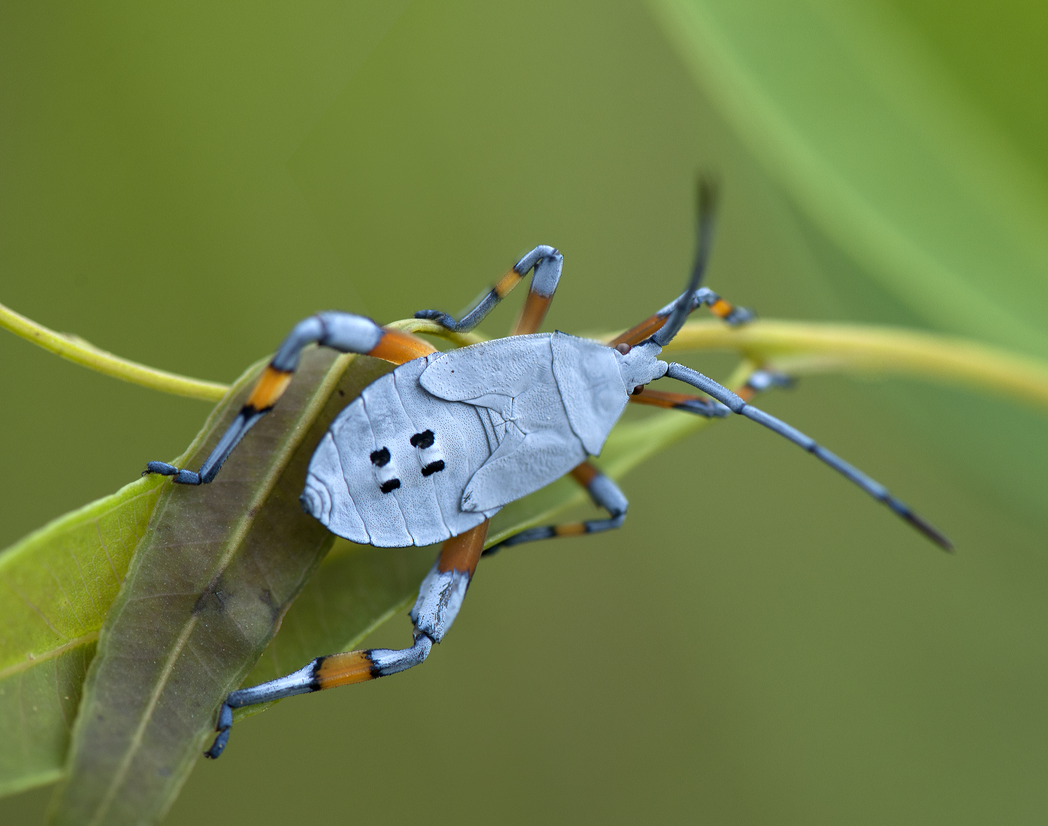
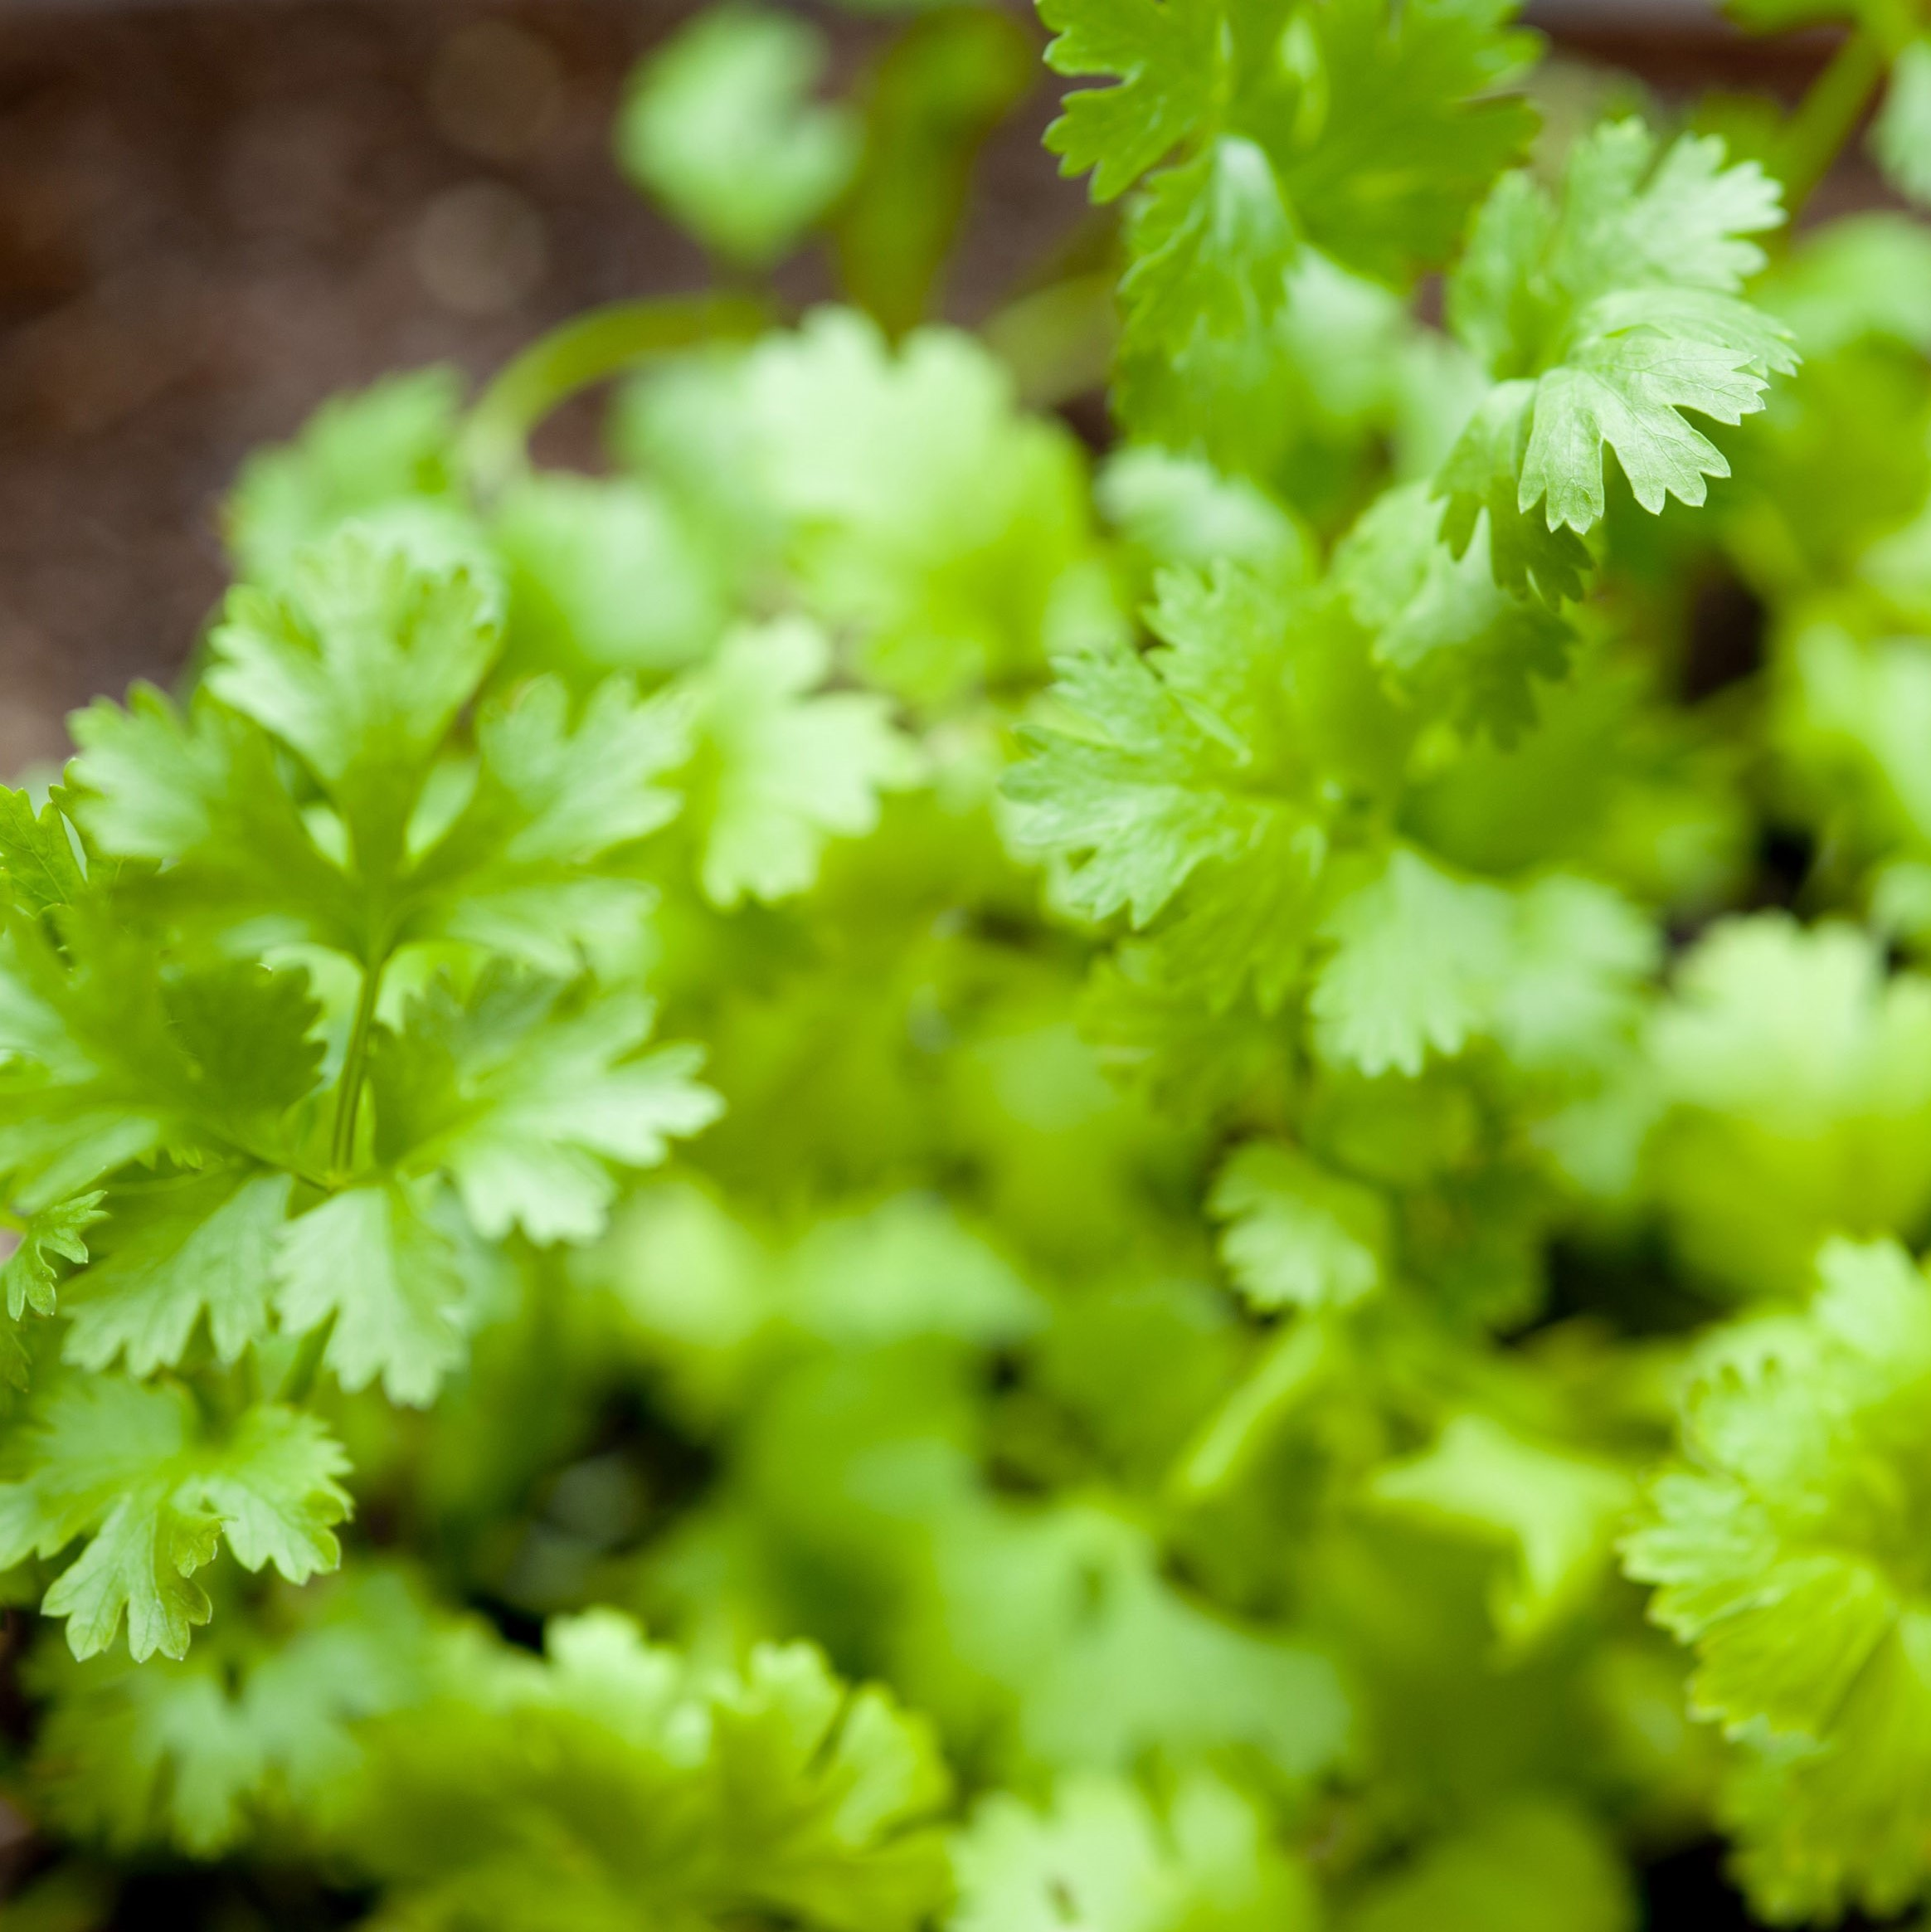
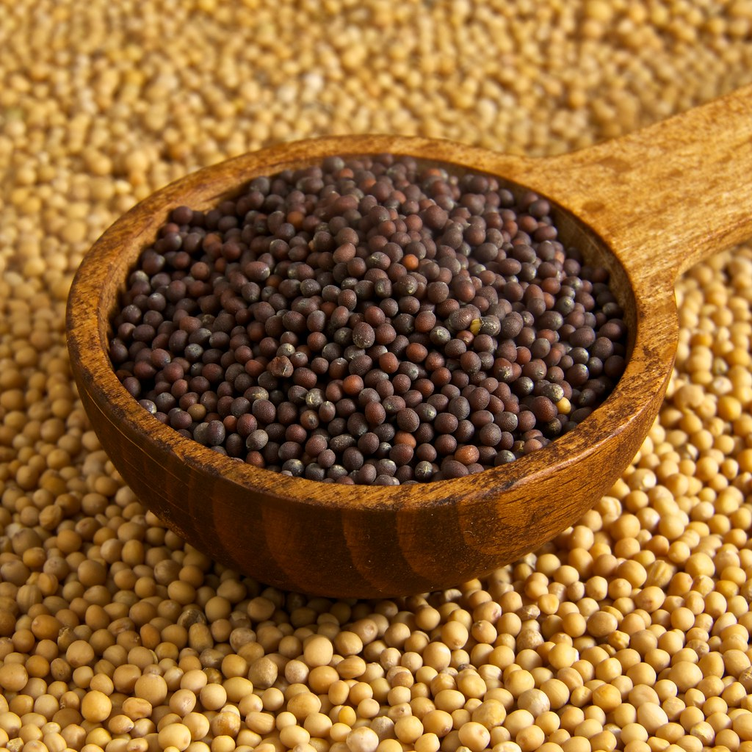
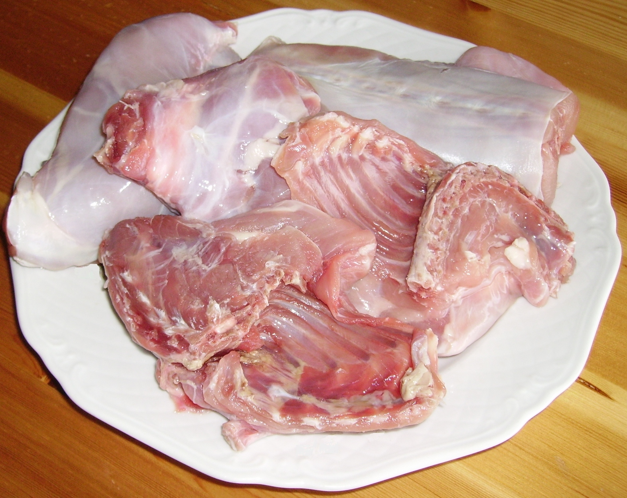
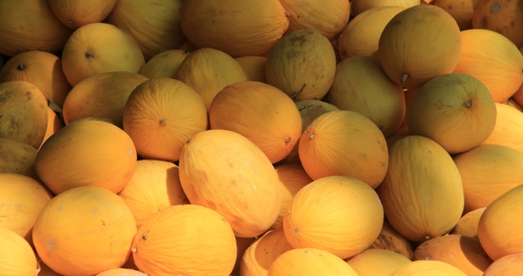
Food
The Mojave tribe used their land to find food in order to survive. They ate fruit, beans, melons, seeds, insects, rabbits, and pumpkins too. The women gathered nuts and herbs.
This Photo by Unknown author is licensed under CC BY.
This Photo by Unknown author is licensed under CC BY-SA.
This Photo by Unknown author is licensed under CC BY-SA-NC.
This Photo by Unknown author is licensed under CC BY.

Slide 5
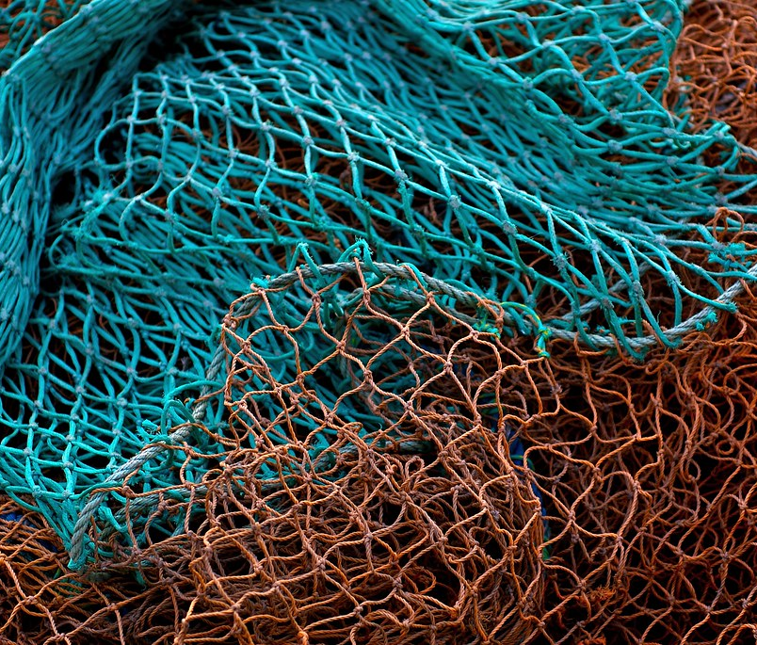
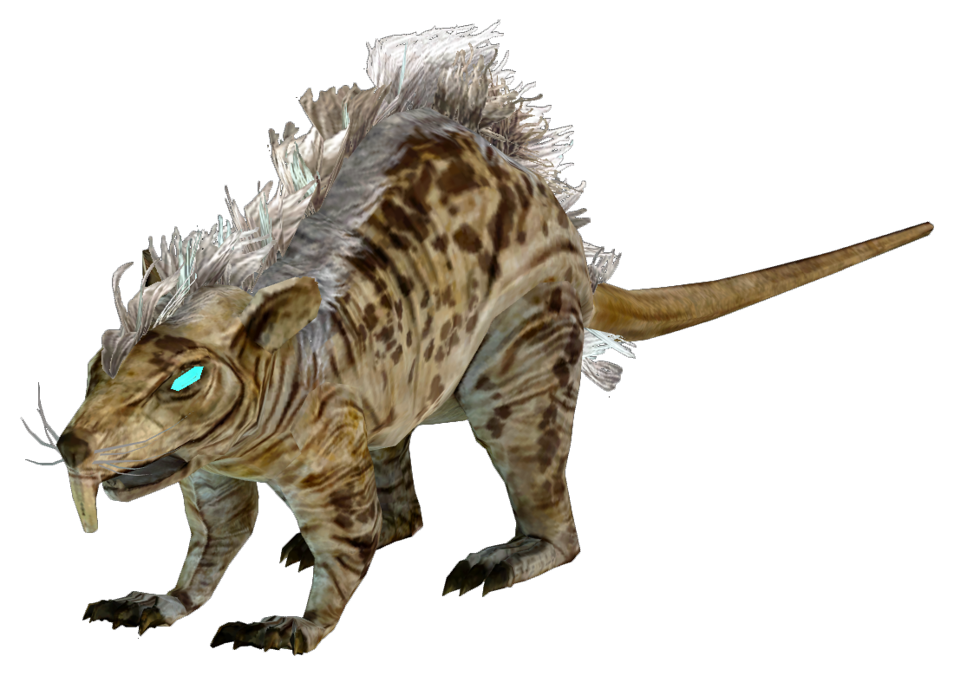
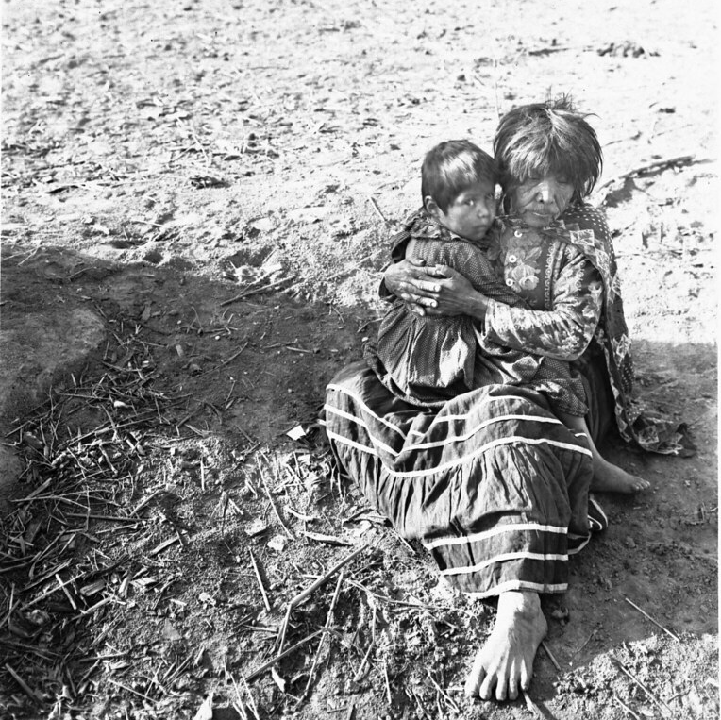
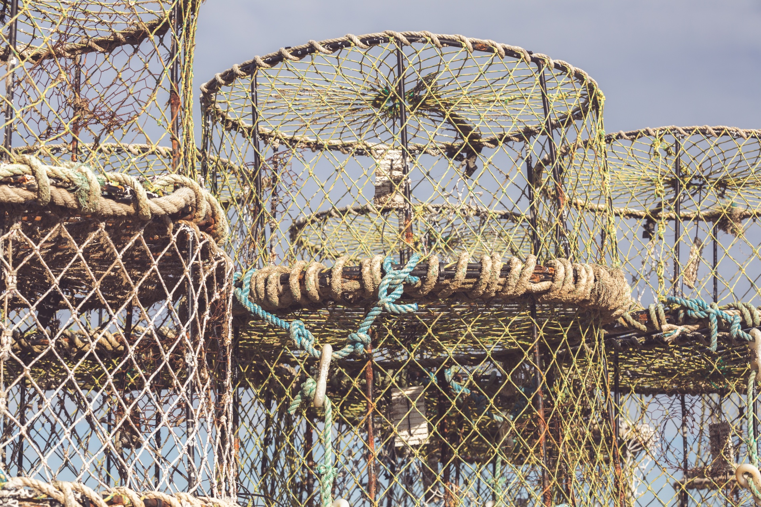
Culture
The culture of the Mojave was unique. The children did not wear clothes like now we have a lot of clothes since it was hot and dry. The nets and the traps that they made were made of cords.
This Photo by Unknown author is licensed under CC BY-SA-NC.
This Photo by Unknown author is licensed under CC BY.

Slide 6
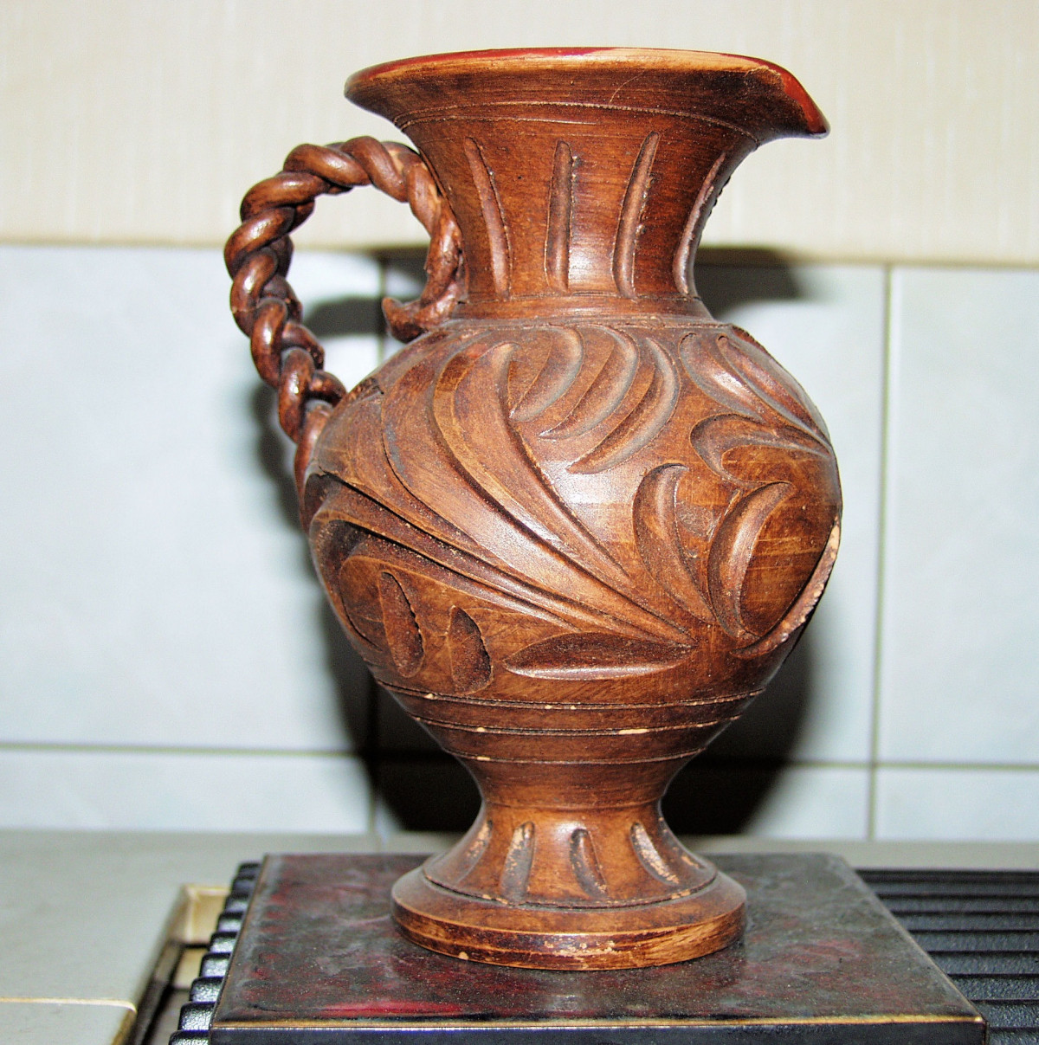
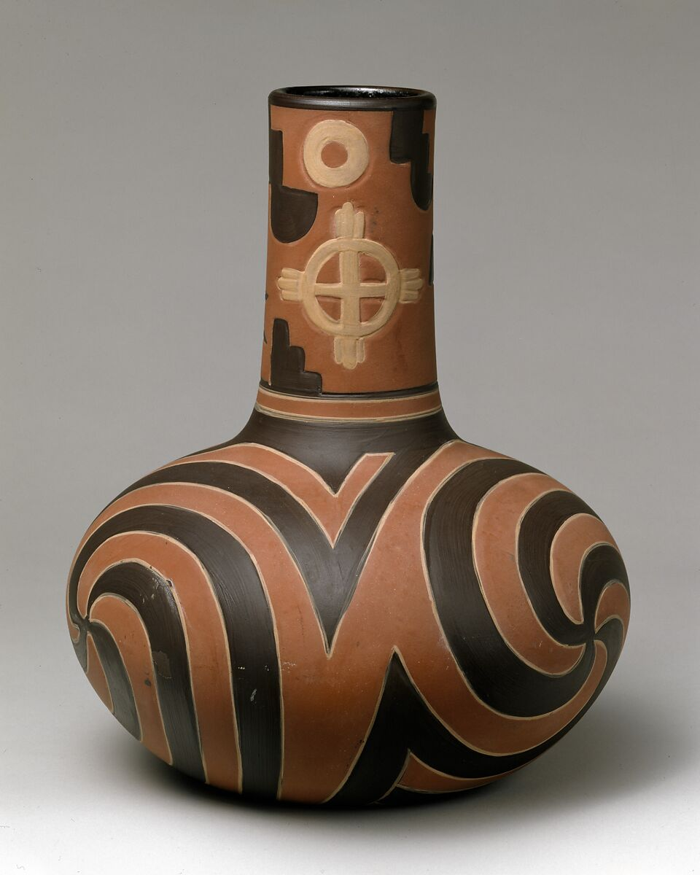
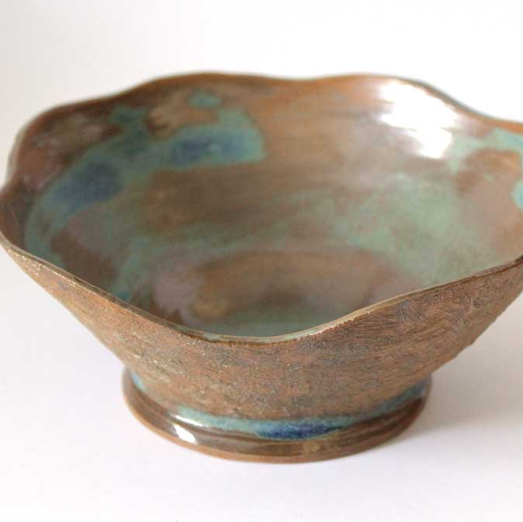
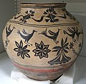
Pottery
This Photo by Unknown author is licensed under CC BY-SA.
This Photo by Unknown author is licensed under CC BY-SA.
This Photo by Unknown author is licensed under CC BY-NC.
This Photo by Unknown author is licensed under CC BY-NC.

Slide 7
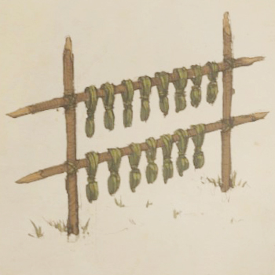
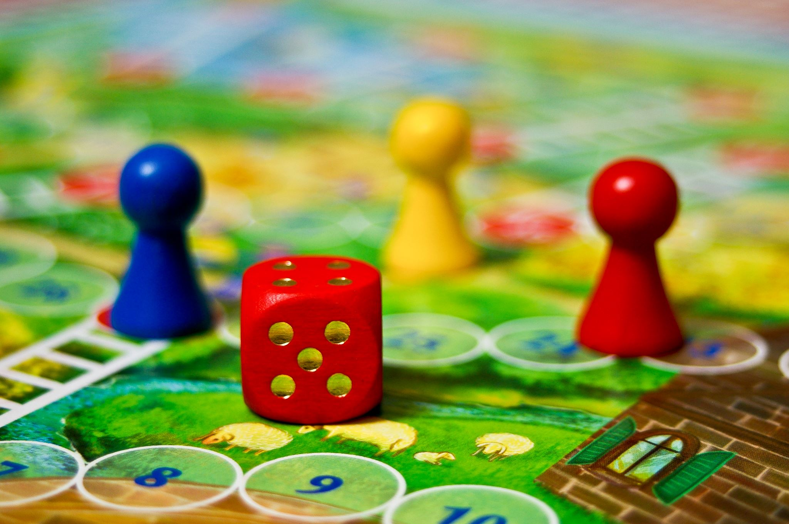
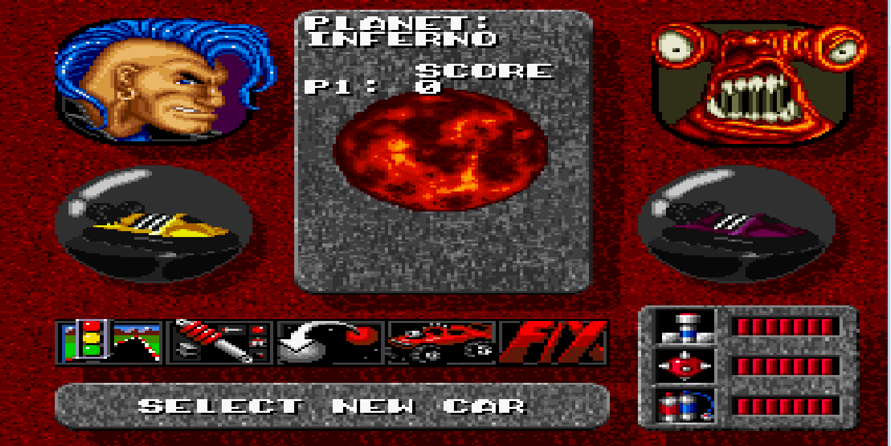
Games
The Mojave people did not have toys so they would play with sticks or mud or rocks because the toys were not evented.
This Photo by Unknown author is licensed under CC BY-NC.
This Photo by Unknown author is licensed under CC BY-SA-NC.

Slide 8
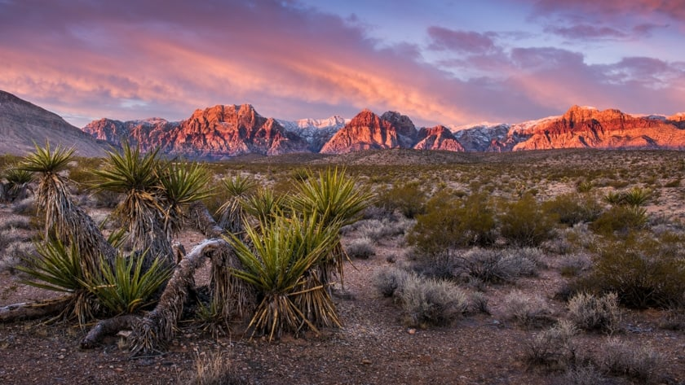
This Photo by Unknown author is licensed under CC BY-NC-ND.

