Slide 1
Gabrielino
Samantha and Daniela
This Photo by Unknown author is licensed under CC BY-SA.
This Photo by Unknown author is licensed under CC BY-SA.

Slide 2
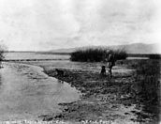
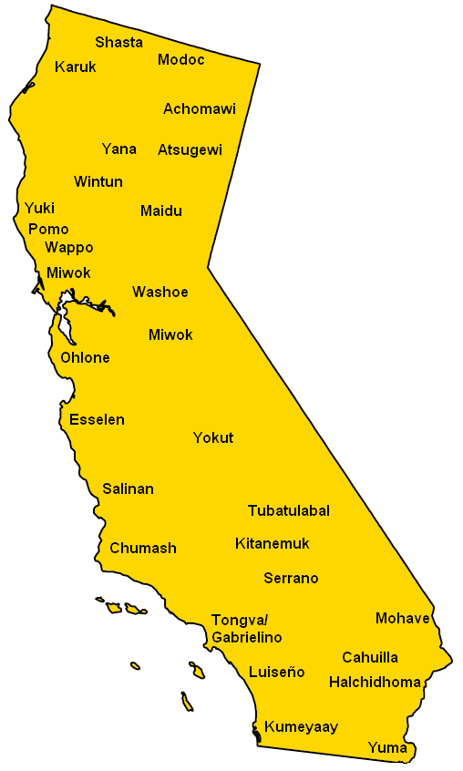
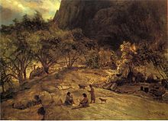
Location
The Gabrielino lived in the southern coast of California.
Their land stretched from Topanga to Laguna Beach.
They also included part of what is now L.A.
It's not too cold or not too hot.
This Photo by Unknown author is licensed under CC BY-SA.
This Photo by Unknown author is licensed under CC BY-SA.
This Photo by Unknown author is licensed under CC BY-SA.

Slide 3
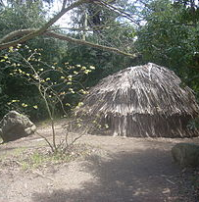
Shelter
Their shelter was very strong ,safe, and helpful.
1
Their shelter was made of bent tree saplings.
2
The shelters were also made of plants.
3
The poles hold it up without falling.
4
This Photo by Unknown author is licensed under CC BY-SA.

Slide 4
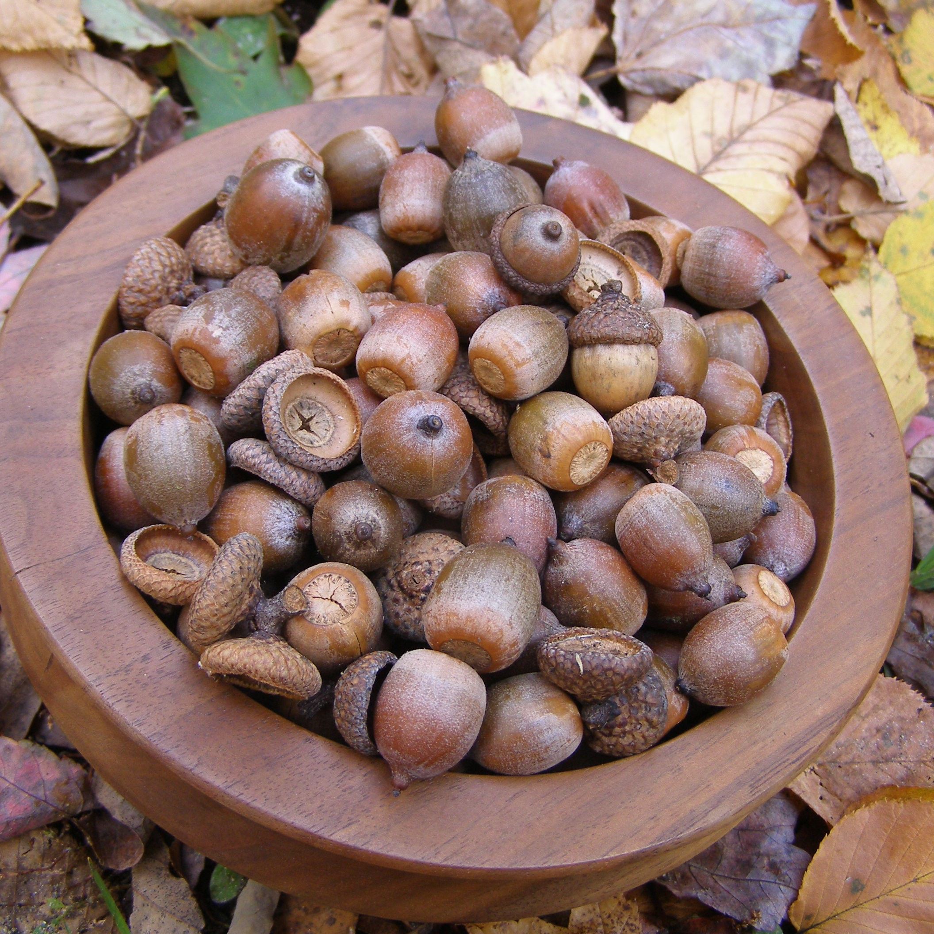
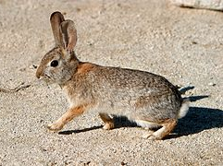
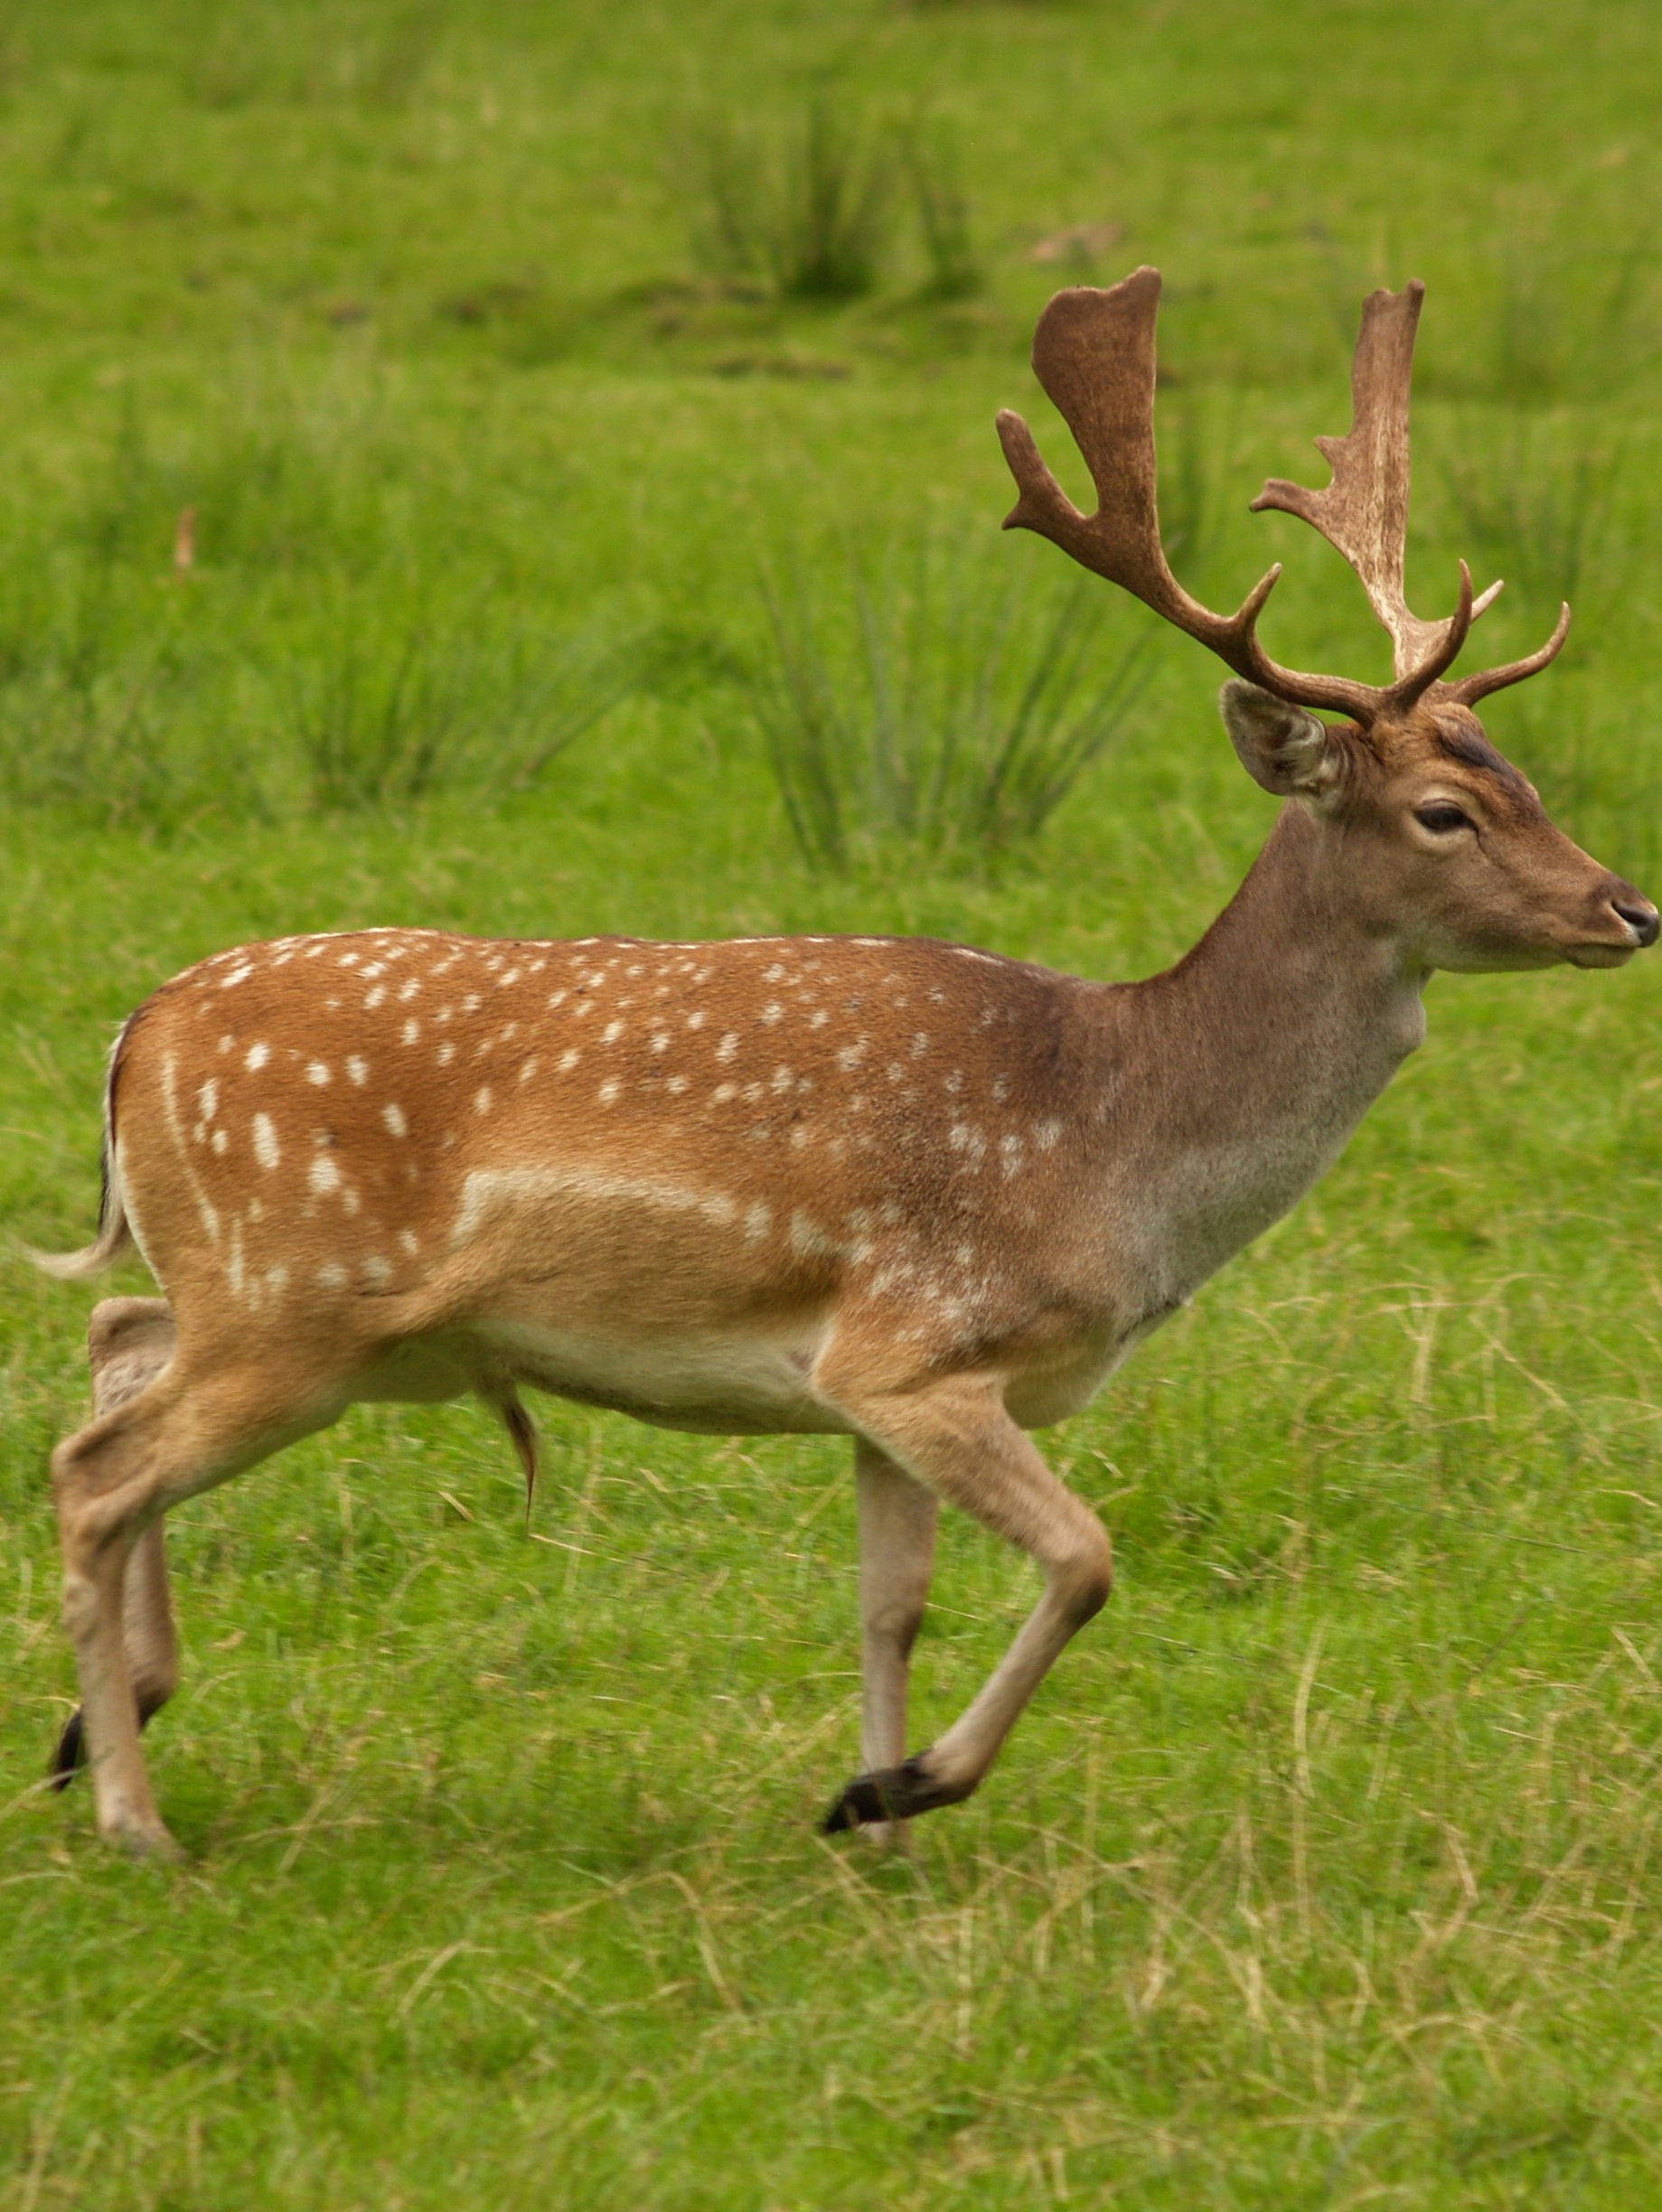
Food
The food is always from nature.
The Gabrielino tribe hunts for food and gathers food to survive.
On land they ate deer, squirrels, and ducks.
From the ocean they ate swordfish, sharks, and seals.
This Photo by Unknown author is licensed under CC BY-SA.
This Photo by Unknown author is licensed under CC BY-SA.
This Photo by Unknown author is licensed under CC BY-SA.
This Photo by Unknown author is licensed under CC BY-SA.

Slide 5
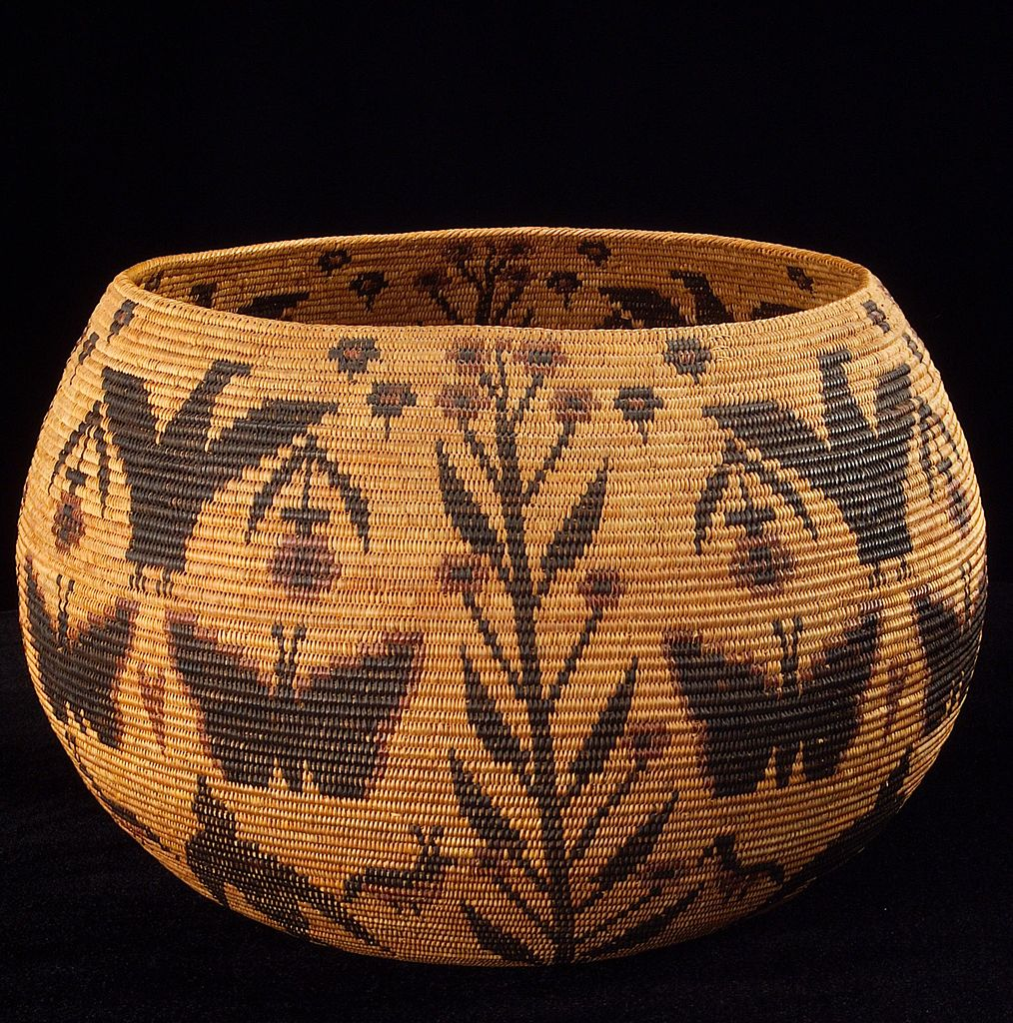
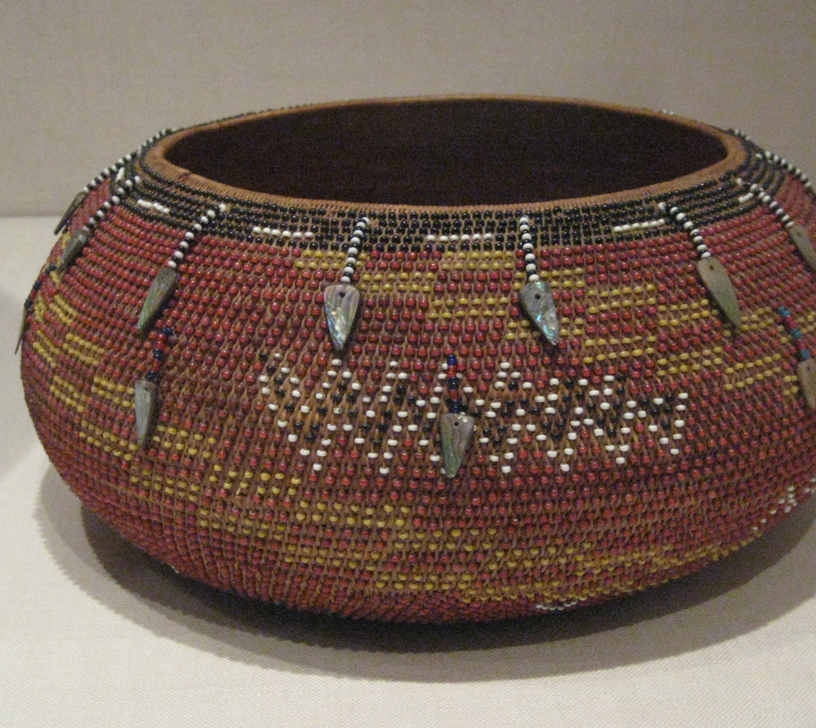
Culture
In Fall,they have a ceremony to have children have the names of ansesters.
They made baskets out of reeds and grasses.
Sometimes the men and kids would wear nothing.
They made whales out of soapstone.
This Photo by Unknown author is licensed under CC BY-SA.
This Photo by Unknown author is licensed under CC BY-SA.

Slide 6
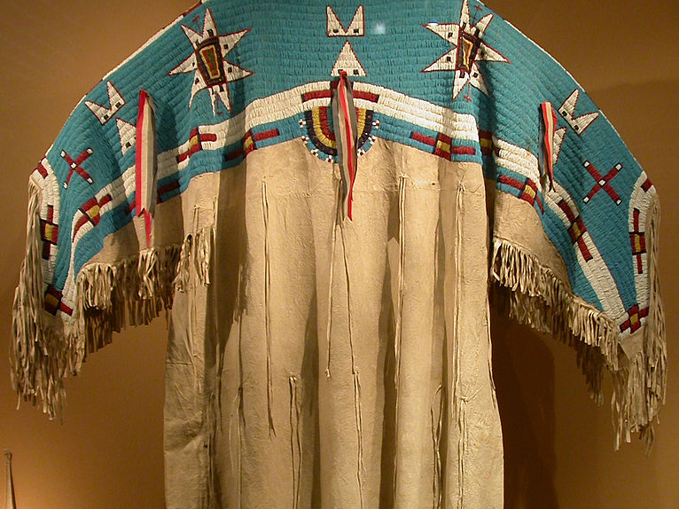
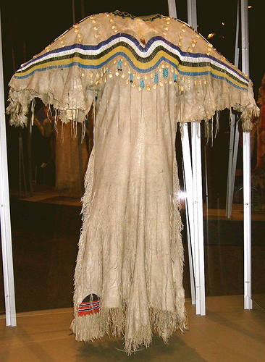
Clothing
The clothes of the Gabrielino were made of deer skin. The beads on the clothing were dried berries. They also had bright colors.

Slide 7
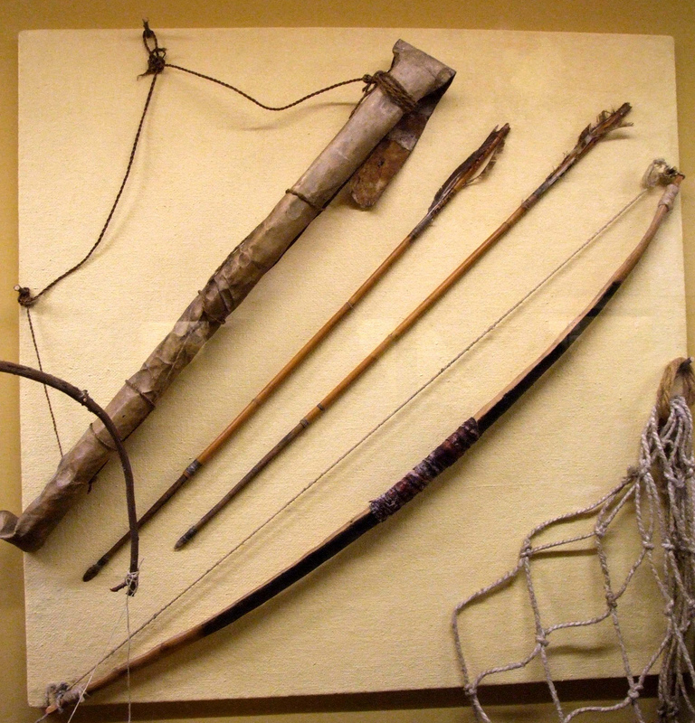
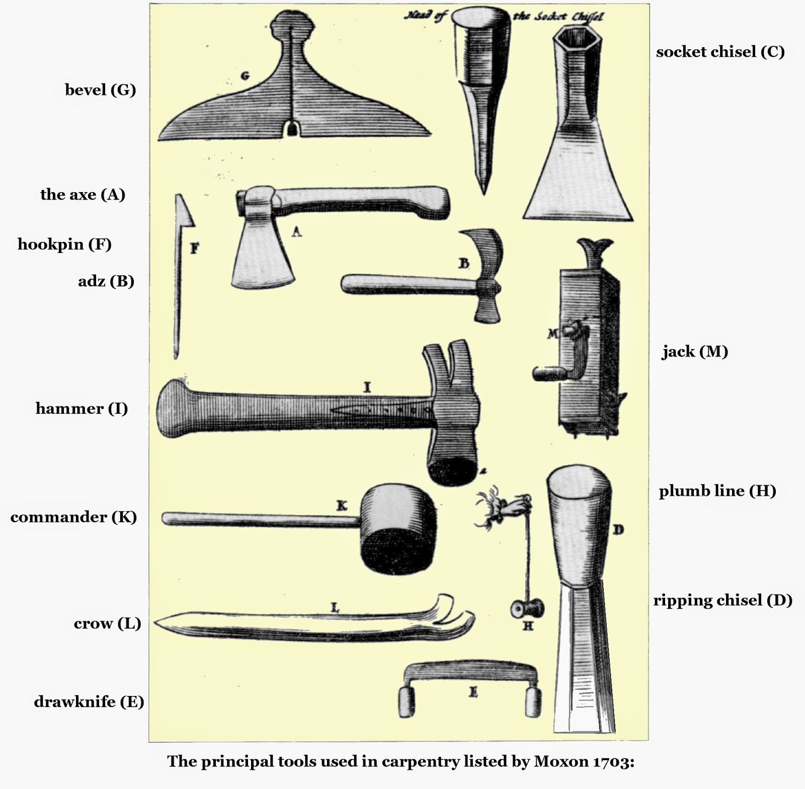
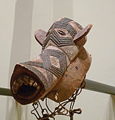
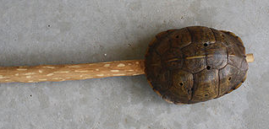
Tools
The Gabrielino's tools were always made of nature.
They used some tools for hunting.
They used the tools for carving.
This Photo by Unknown author is licensed under CC BY-SA-NC.
This Photo by Unknown author is licensed under CC BY-NC.
This Photo by Unknown author is licensed under CC BY-SA.
This Photo by Unknown author is licensed under CC BY-SA.

Slide 8
This Photo by Unknown author is licensed under CC BY-ND.

