Slide 1
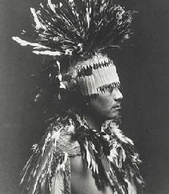
Maidu
By Kalmiya and Kylie

Slide 2
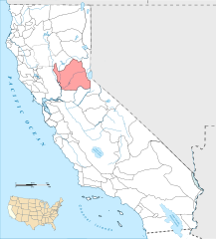
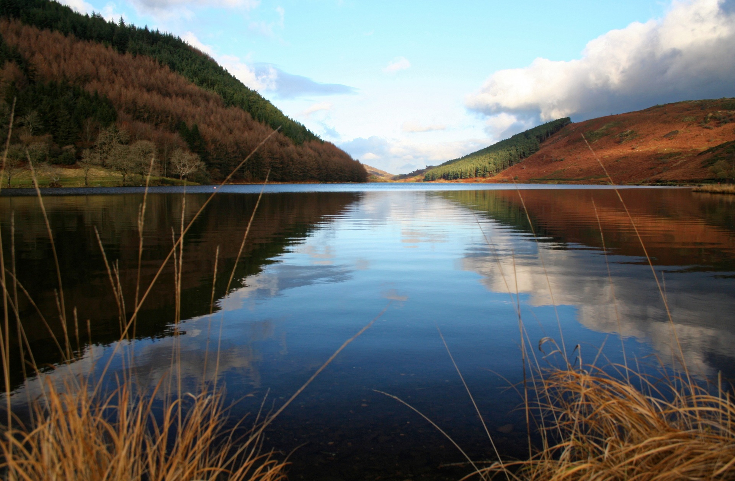
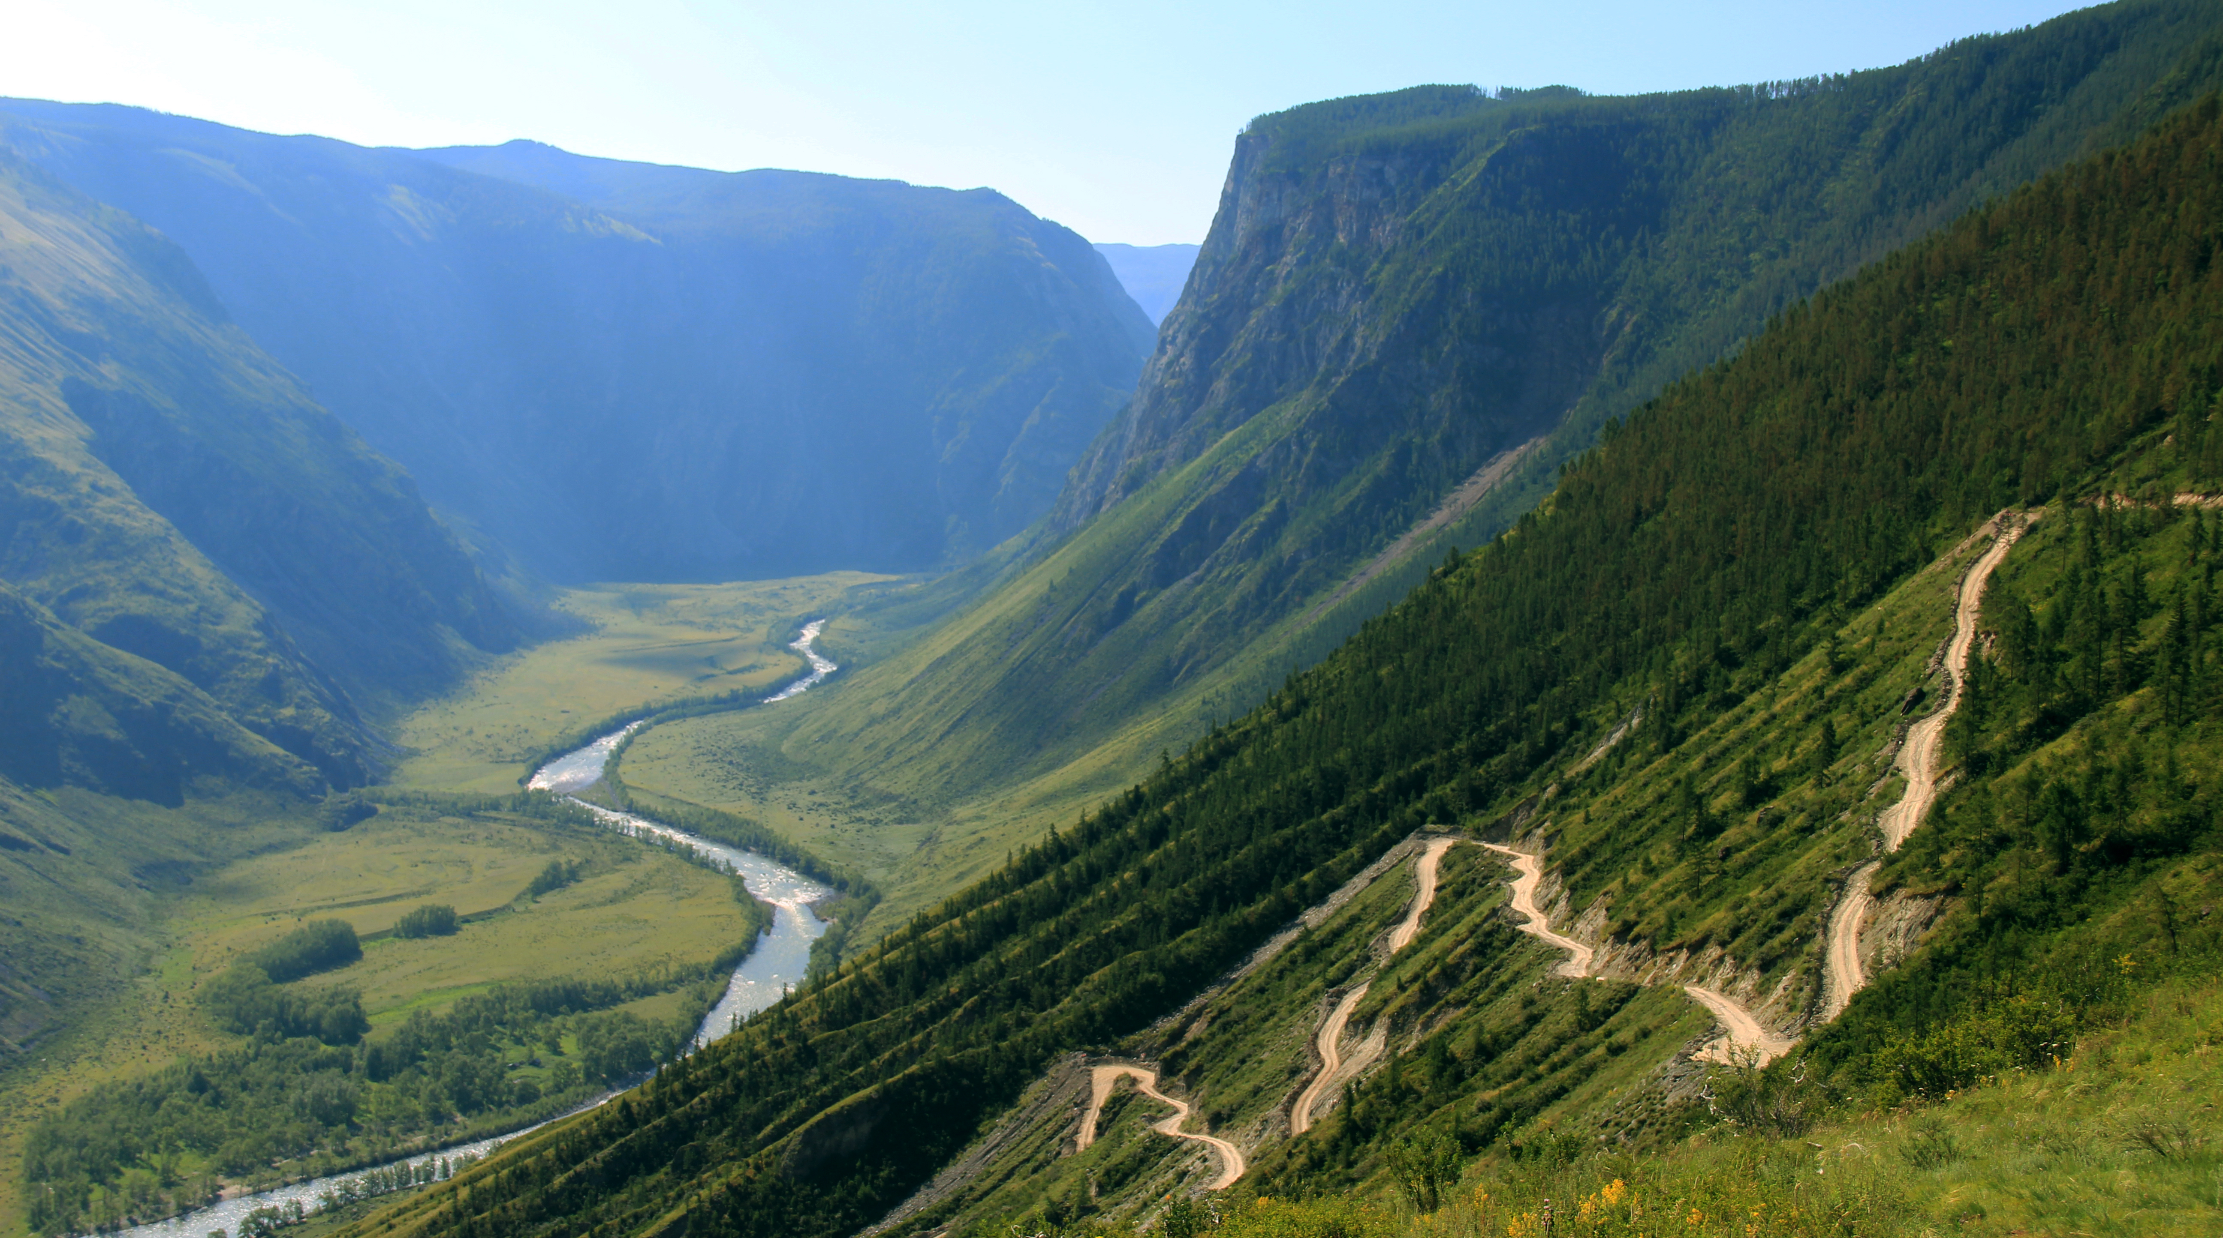
Location
The Maidu lived in the Northern part of California. The Maidu tribe lived in mountains and valleys. Sometimes this area had a mild, temperate climate. They also sometimes live near rivers and lakes.

Slide 3
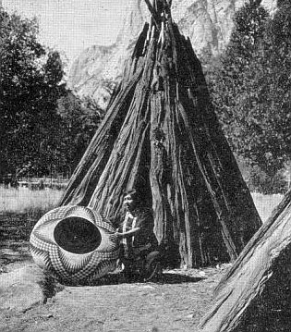
Shelter
The homes of the Maidu tribe protected them from the environment. Their houses had a round shape and some of them have cone shaped houses. The materials used to build the house are bark, poles, oak branches, and leaves. The poles were used to make the house stand up. The houses were partly underground during the winter, to help keep them warm.

Slide 4
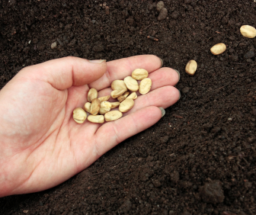
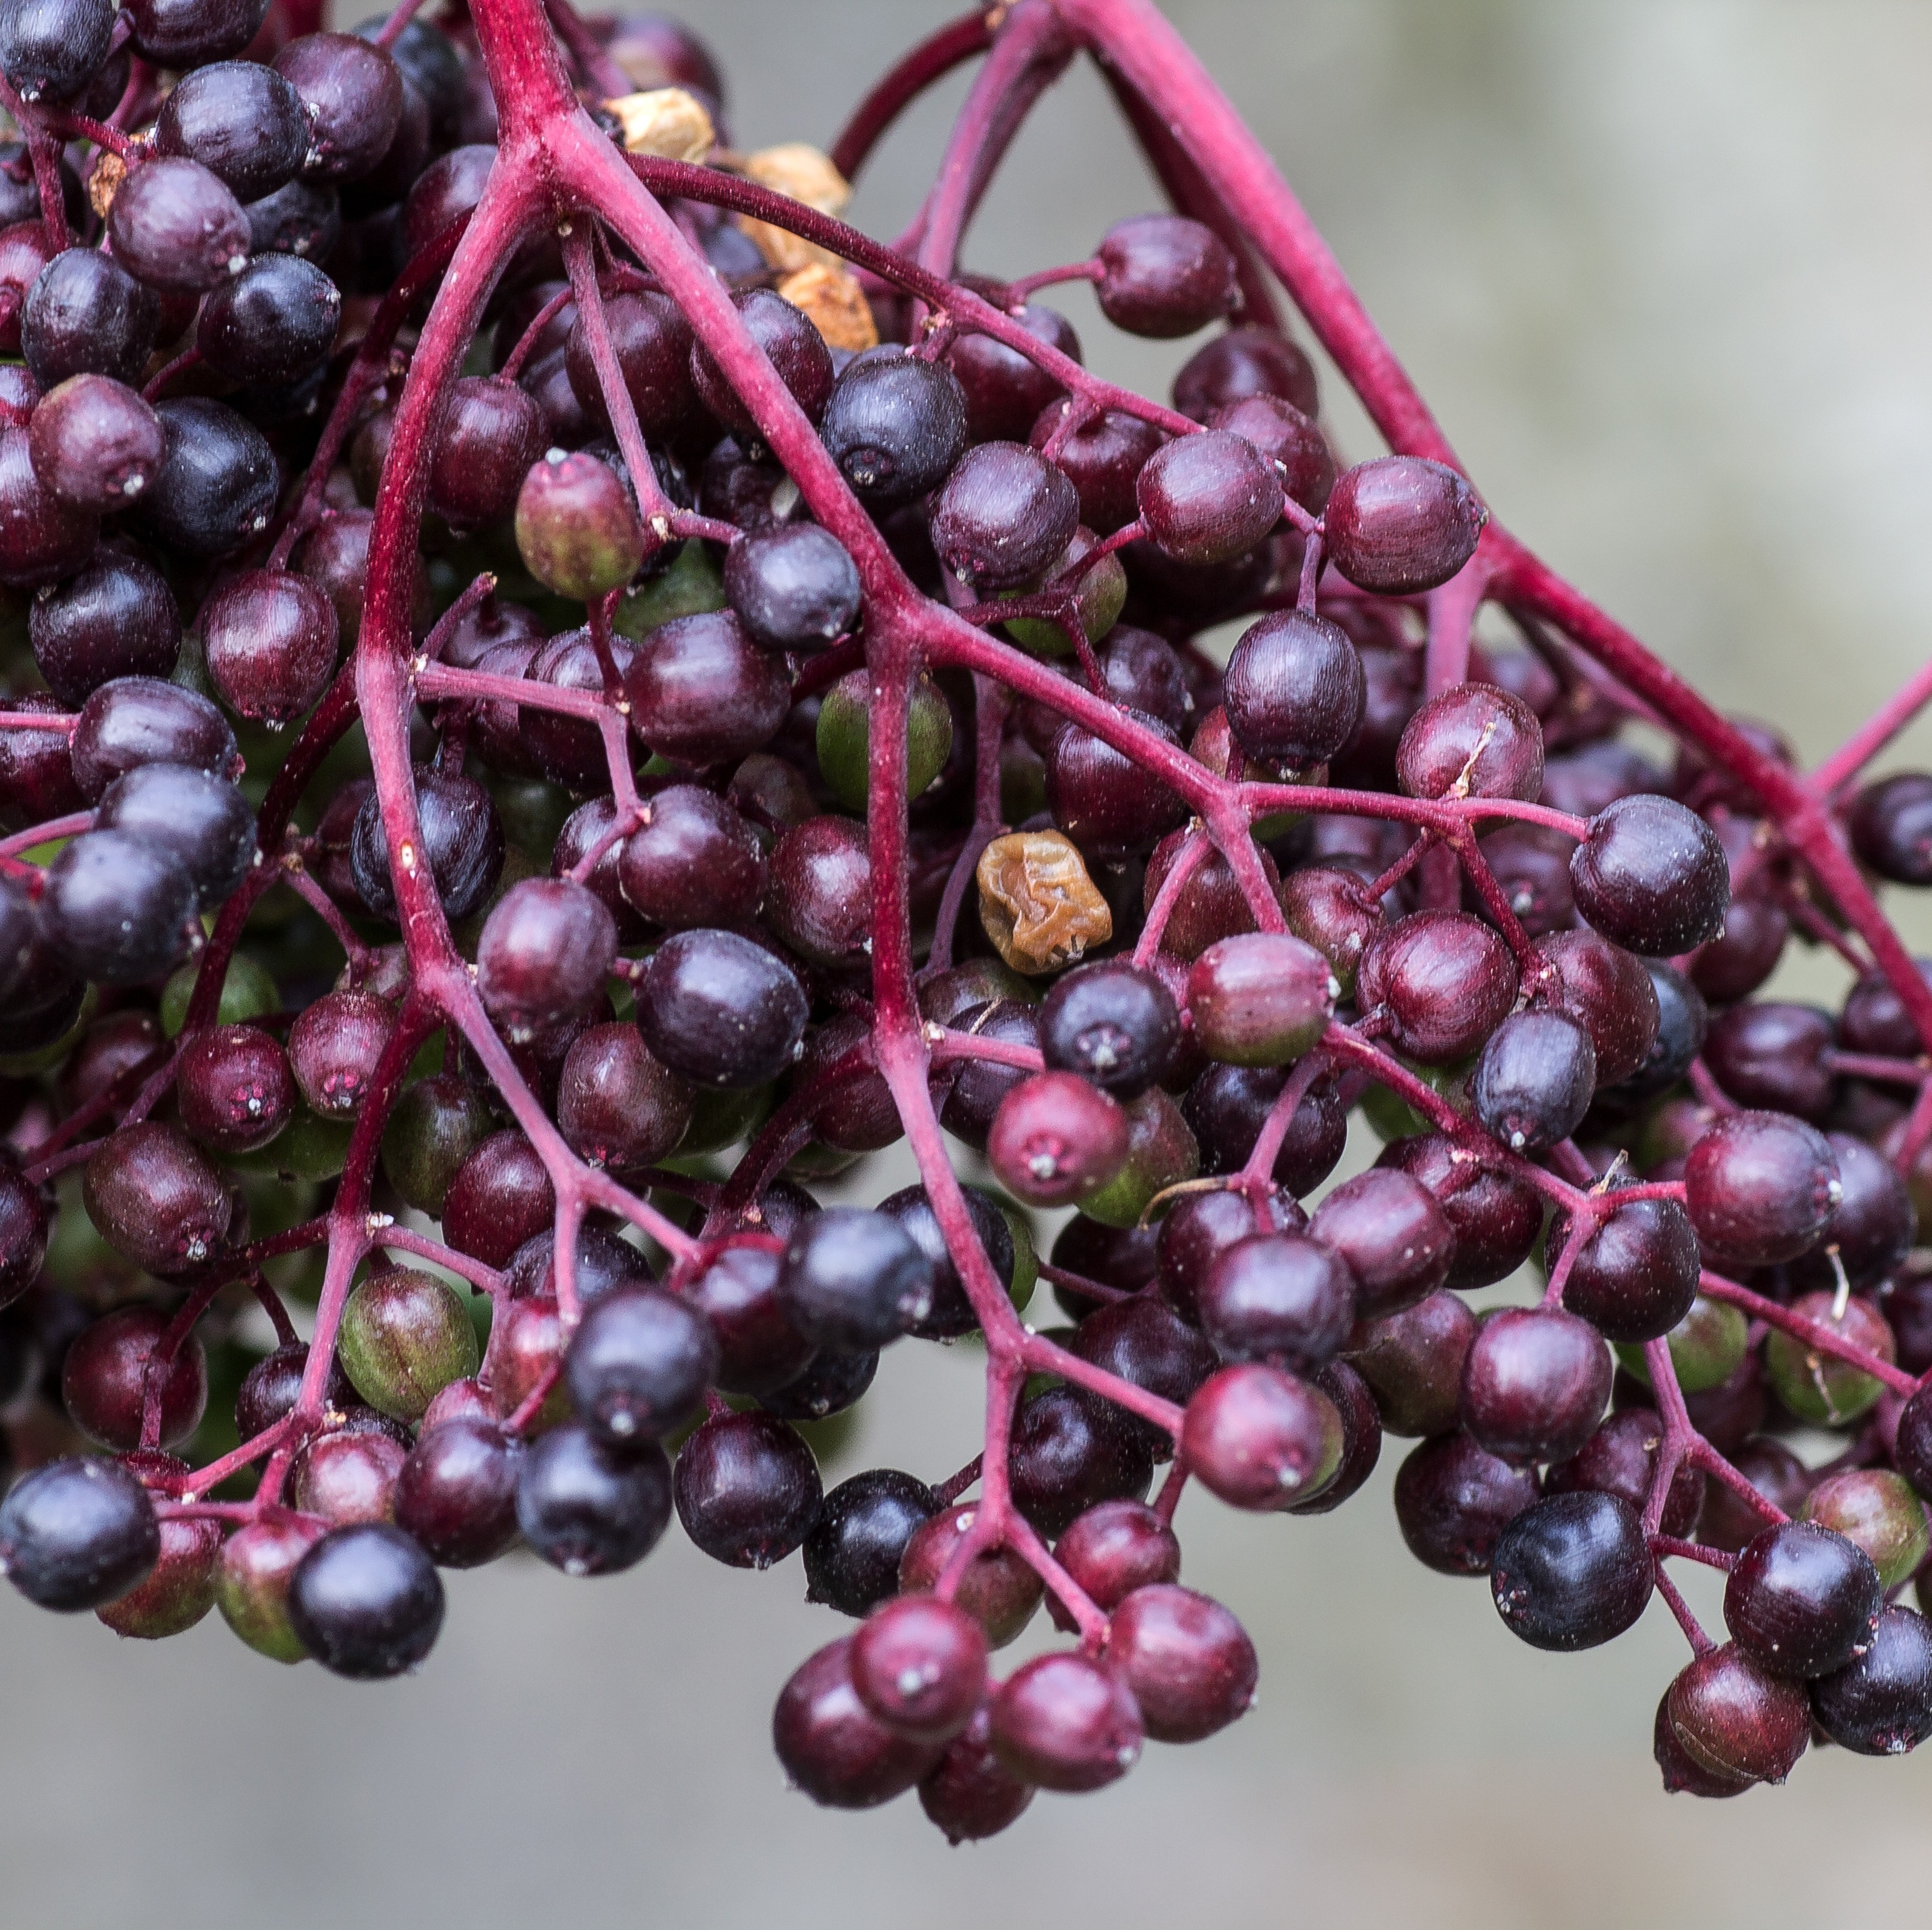
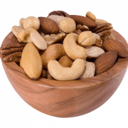
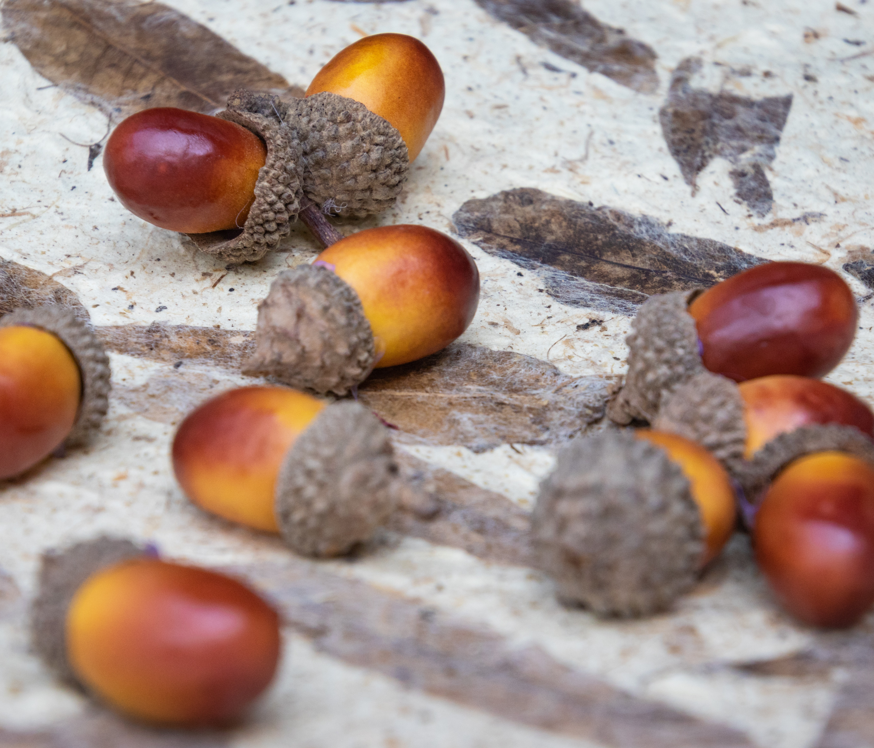
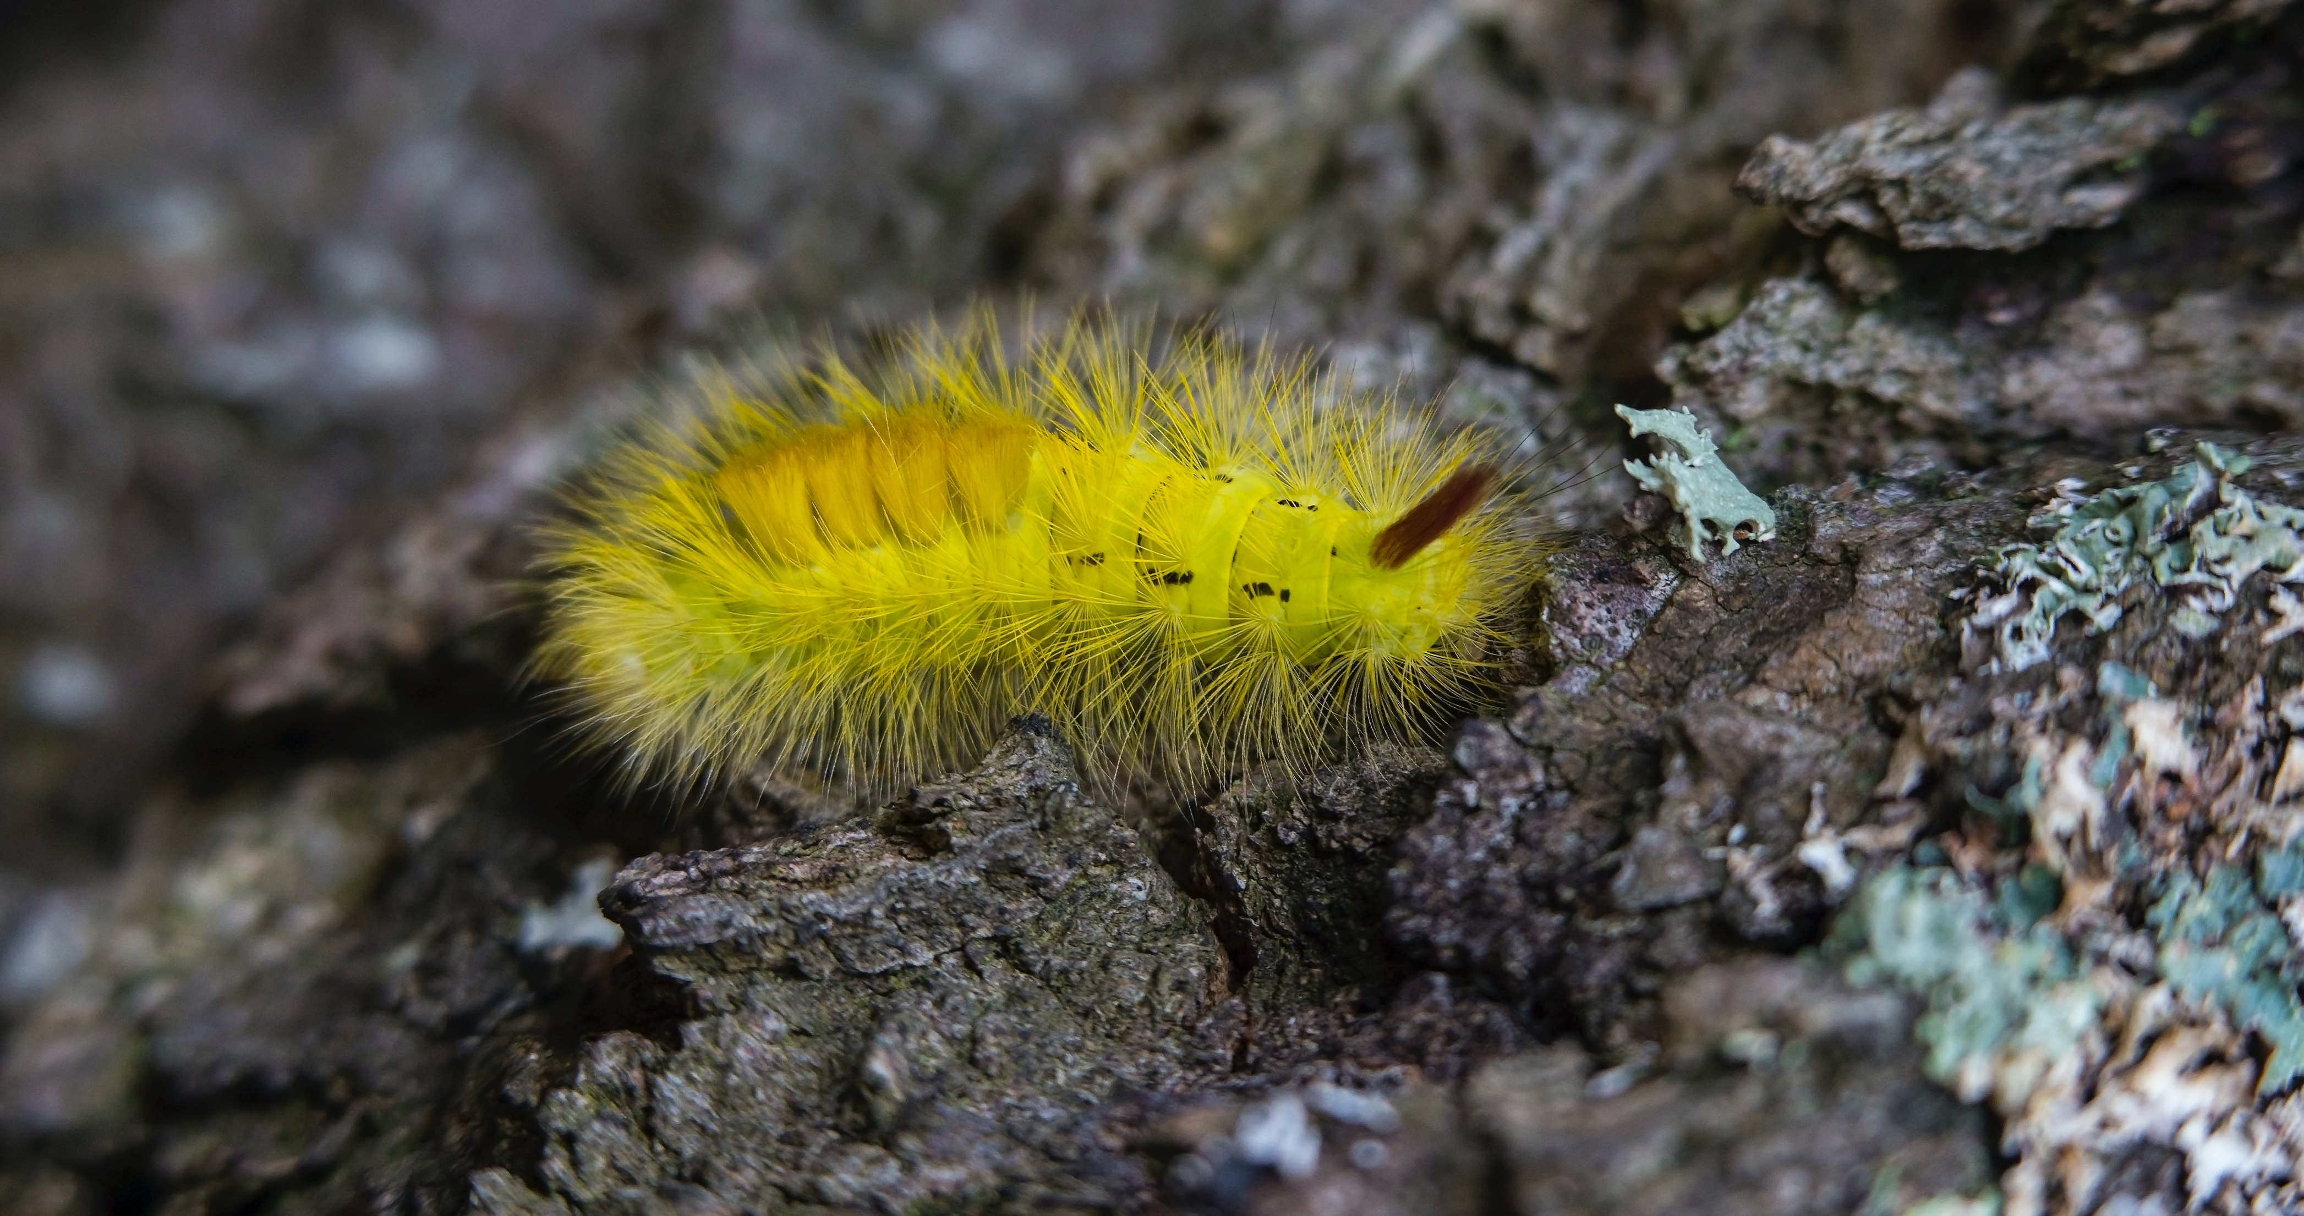
Food
The Maidu tribe used their land to find food in order to live. The Maidu tribes had hunting dogs to help in a hunt looking for food. When they found food, they roasted it in an open fire or oven. They gathered seeds, berries, nuts, acorns and insects. They used their land to grow plants for food to eat and to survive.
This Photo by Unknown author is licensed under CC BY-NC-ND.
This Photo by Unknown author is licensed under CC BY-NC.

Slide 5
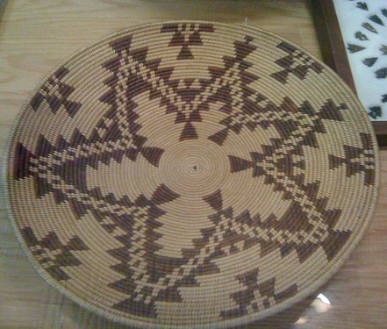
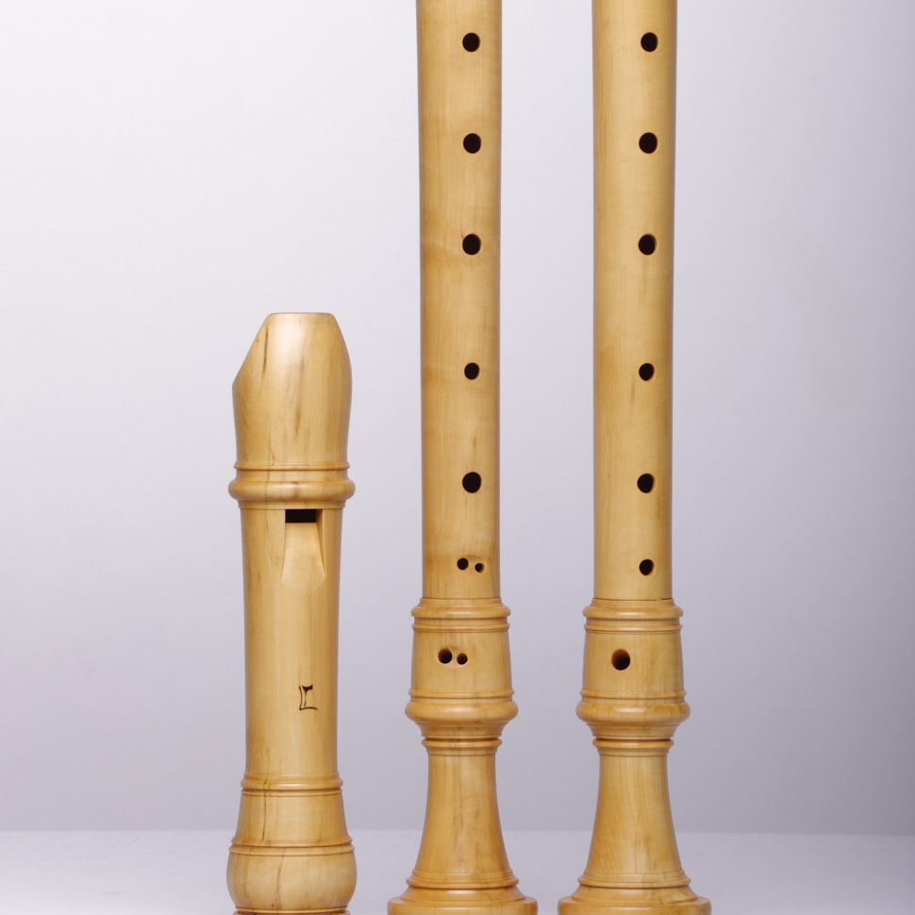
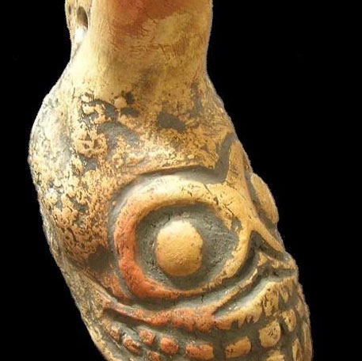
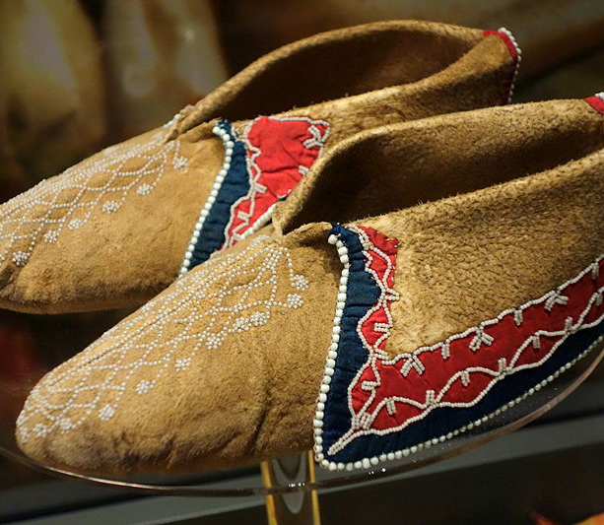
Culture
The culture of the Maidu tribe was unique and interesting. They used log rafts to go to the other side. When they dance for the ceremonies, it's called Wasoso. They used flutes and whistles for the ceremonies. They use poles to paddle their boats. The woman wore double aprons made from deerskin. In the winter, the Maidu people wore moccasins on their feet. They use baskets to get food to eat. The Maidu tribe wore hair that is long and hanging loose.

Slide 6
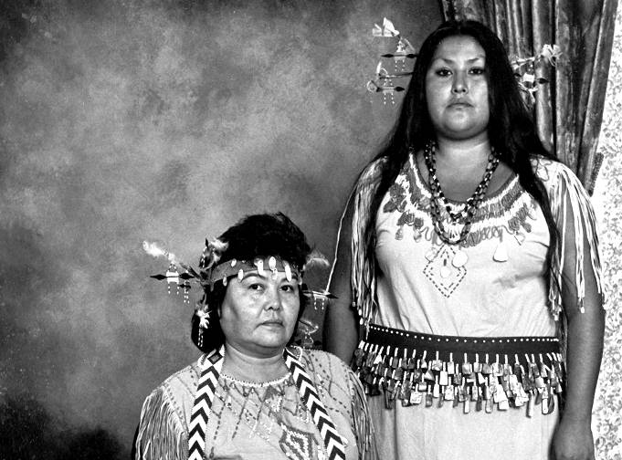

Slide 7
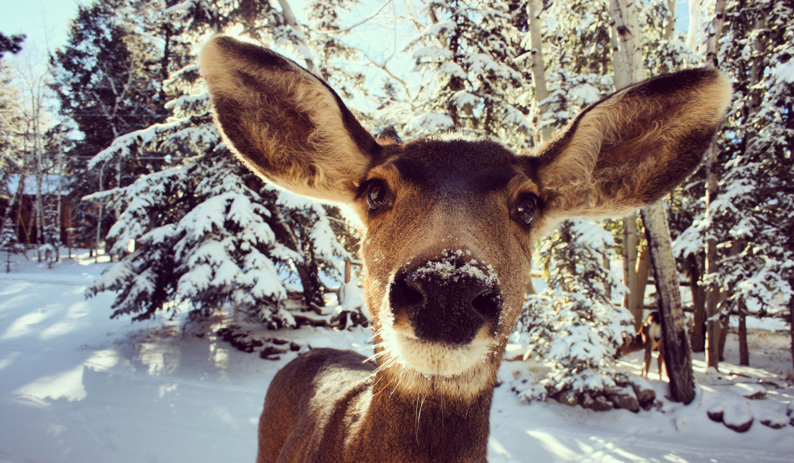
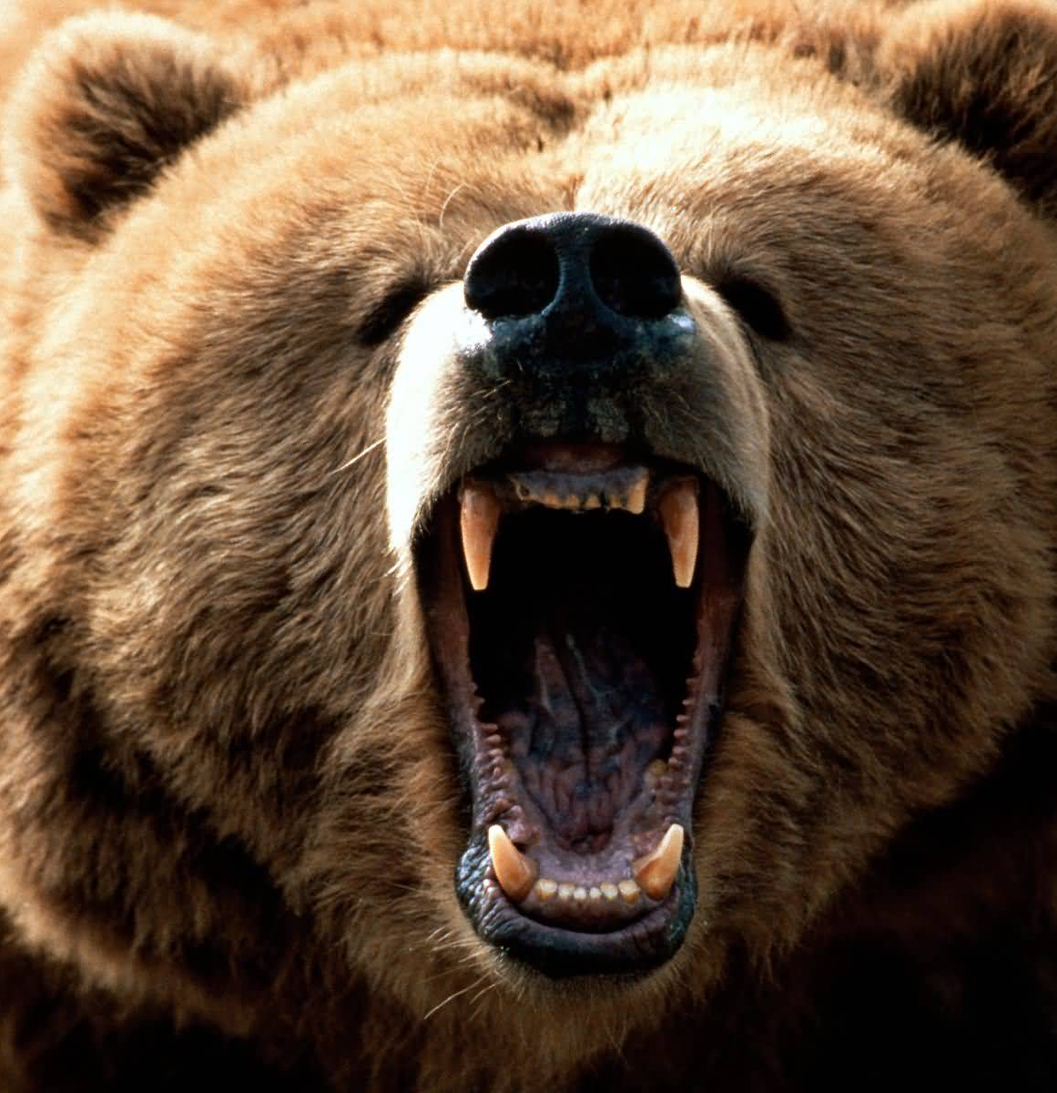
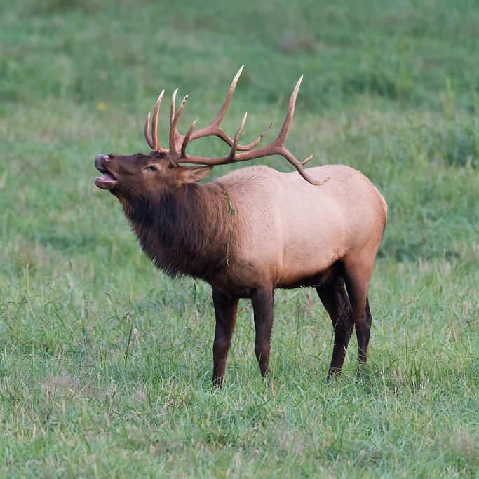
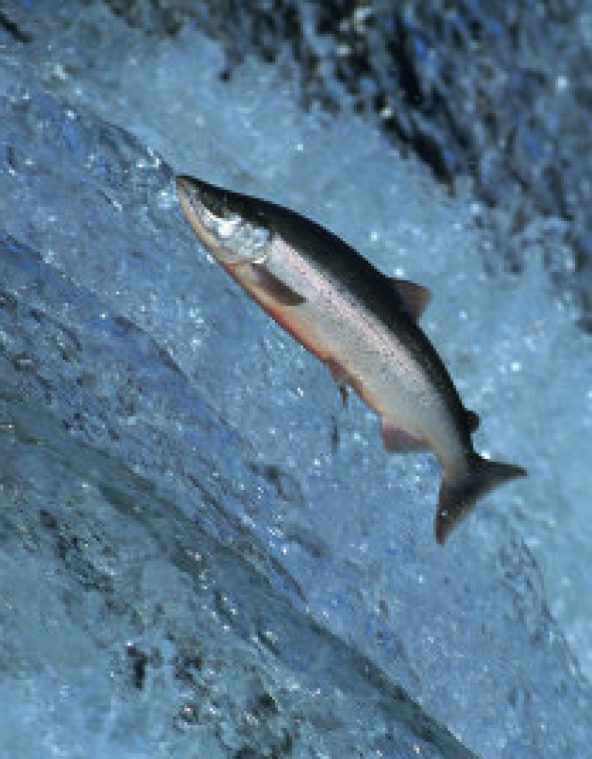
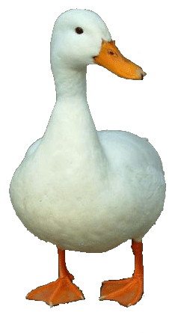
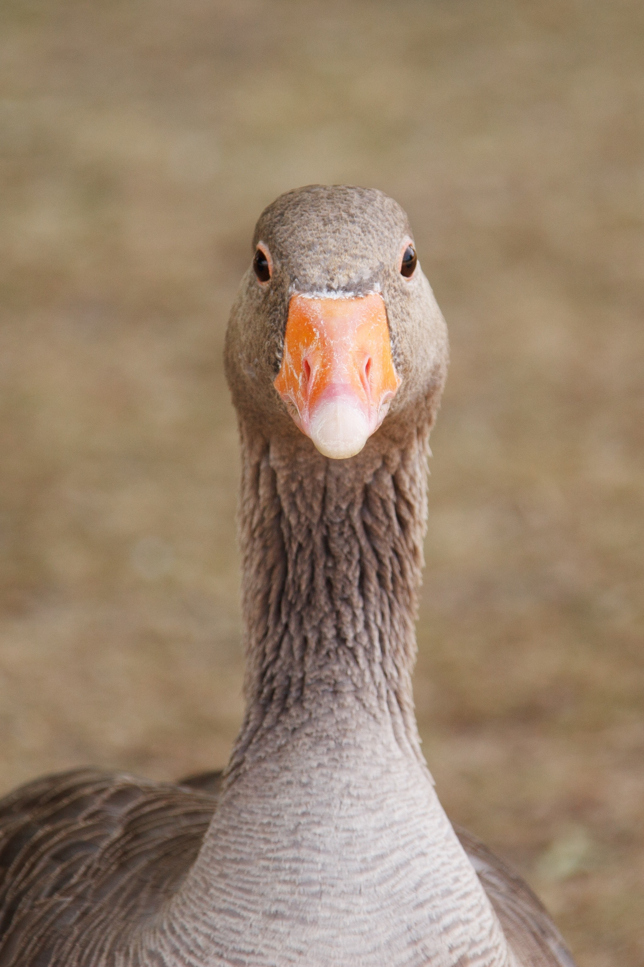
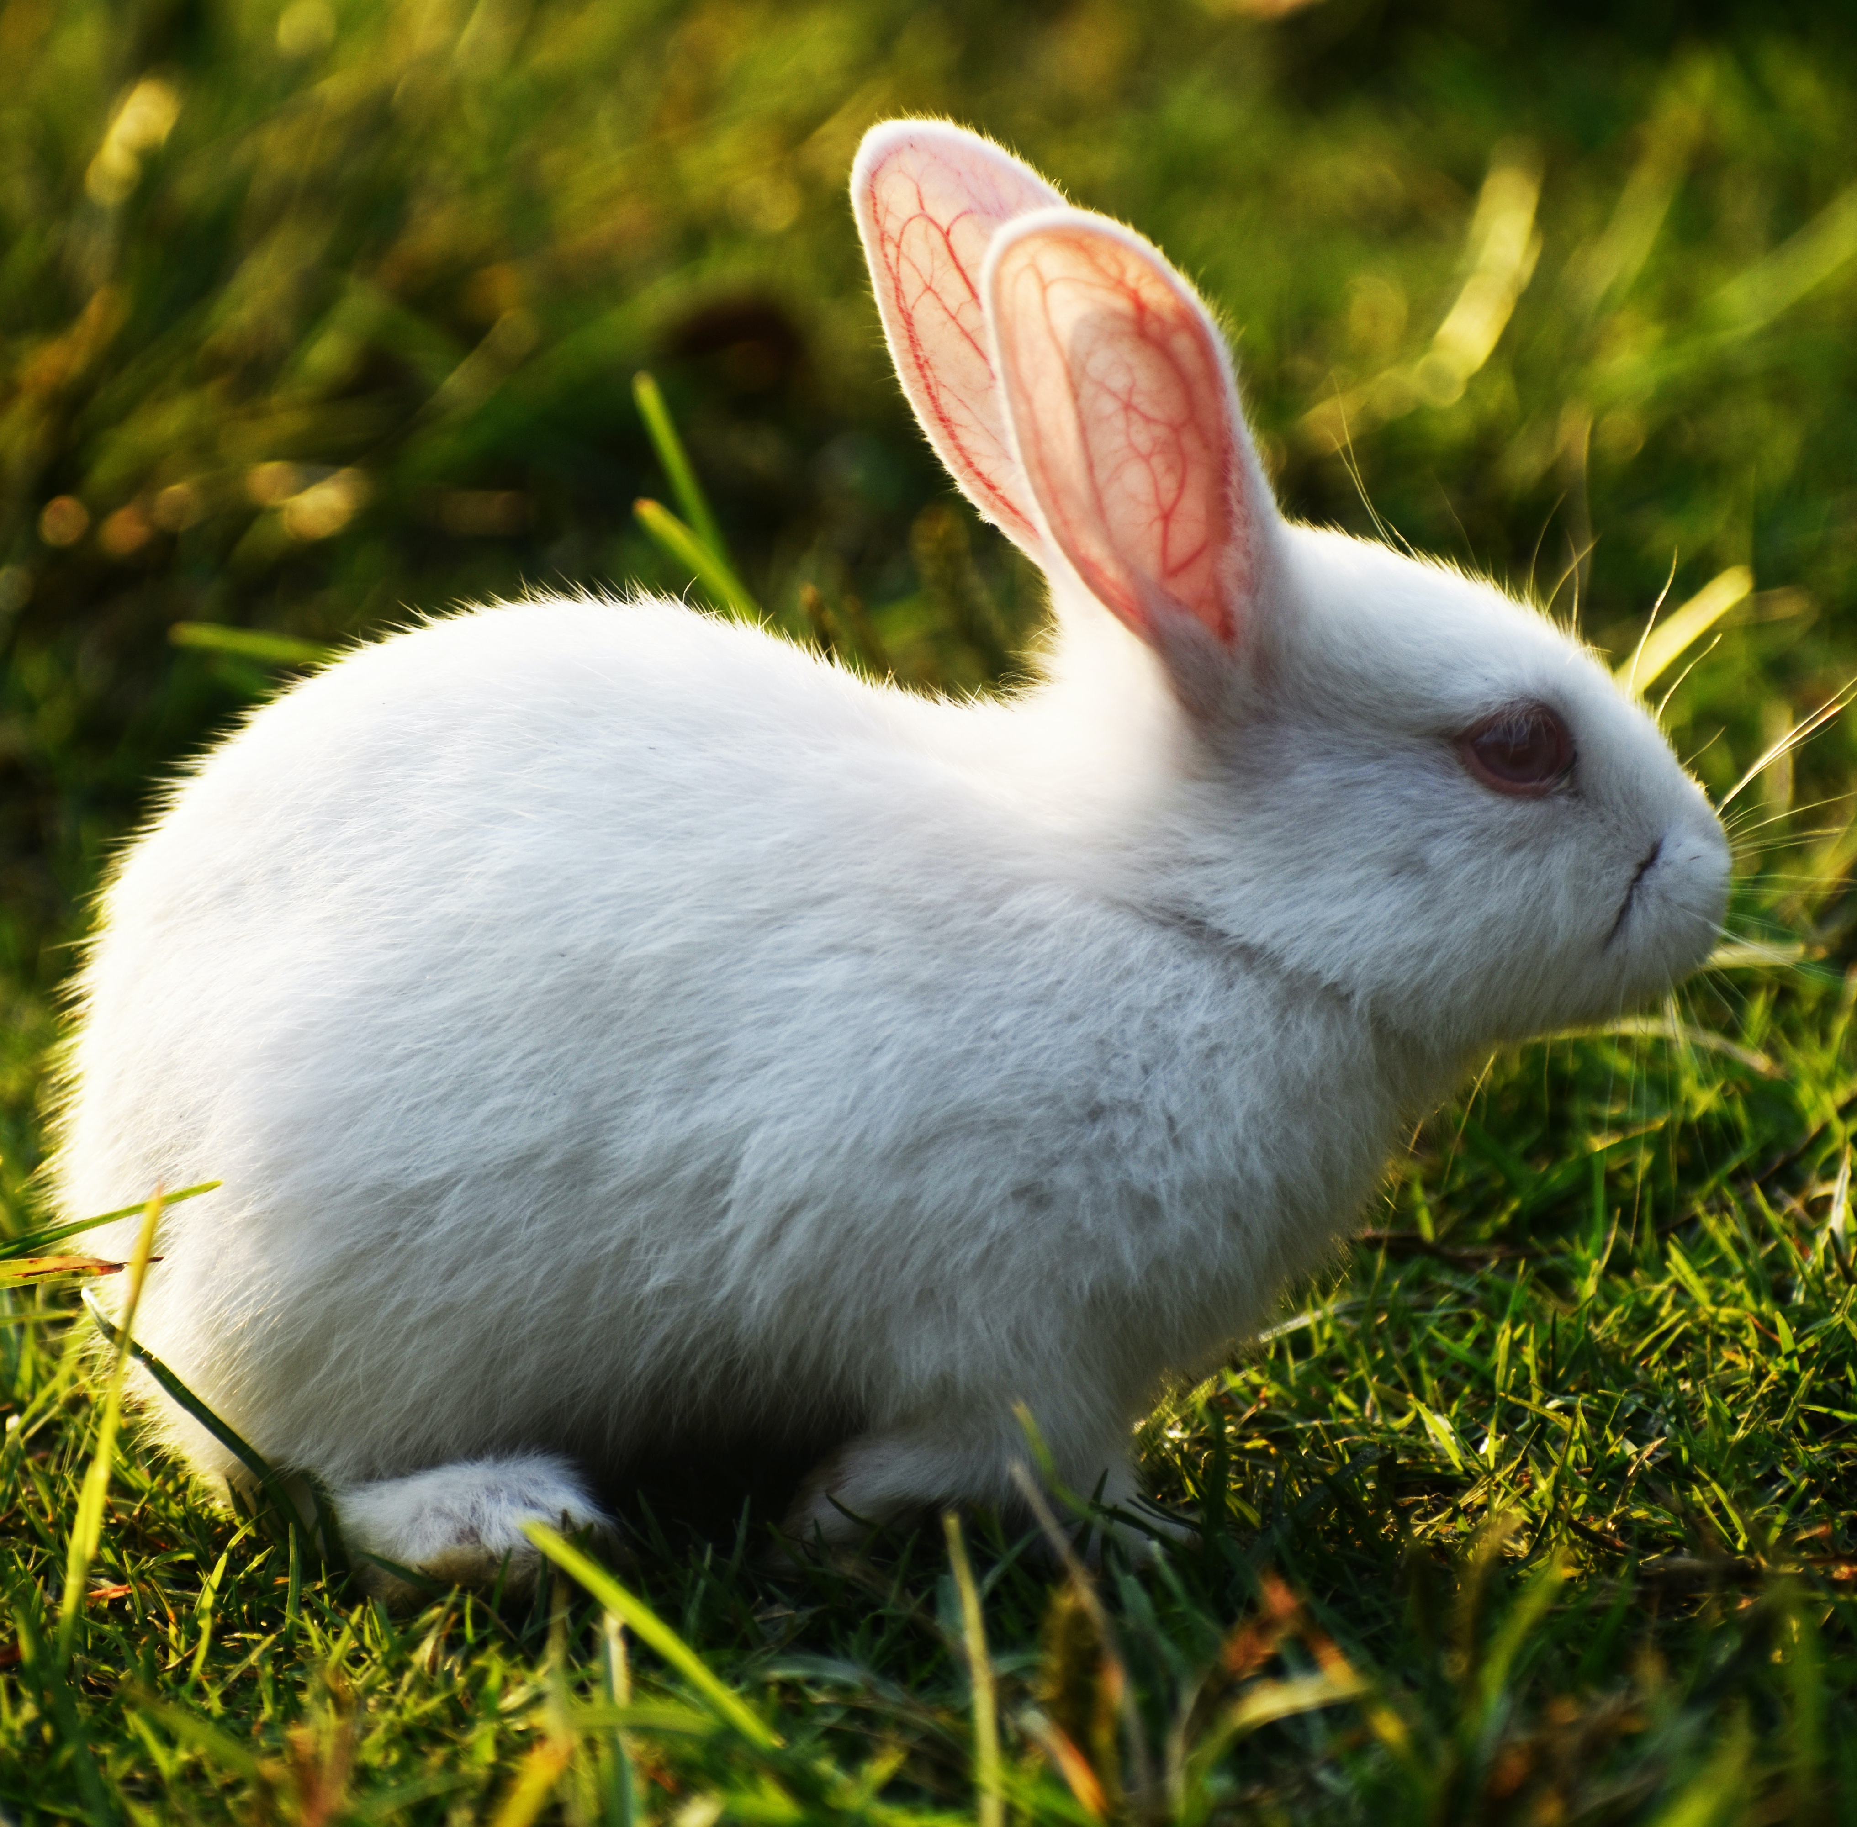
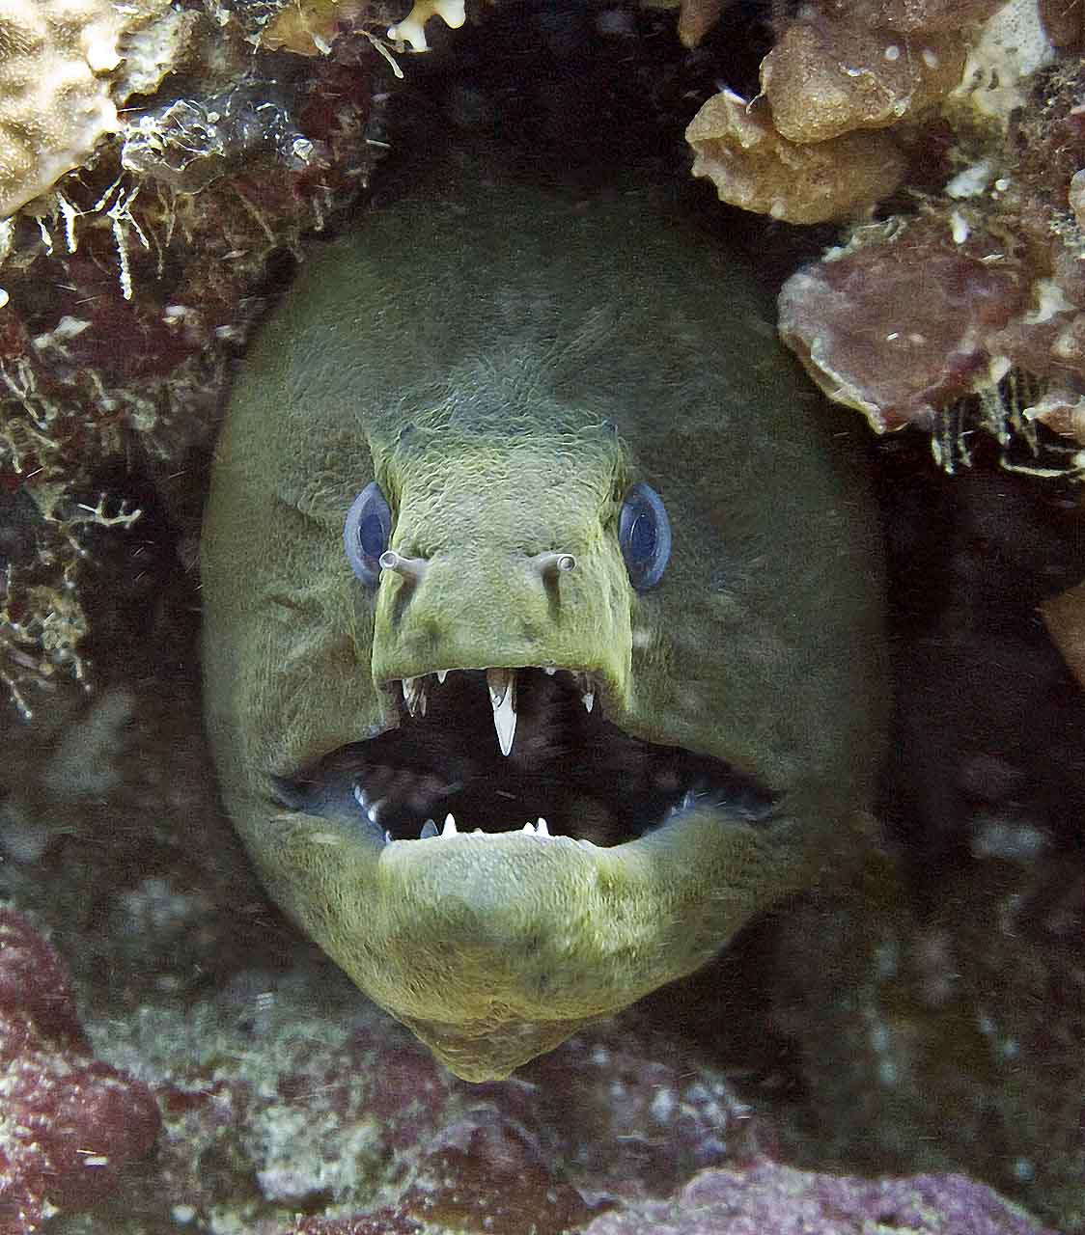
Extra Maidu foods

Slide 8
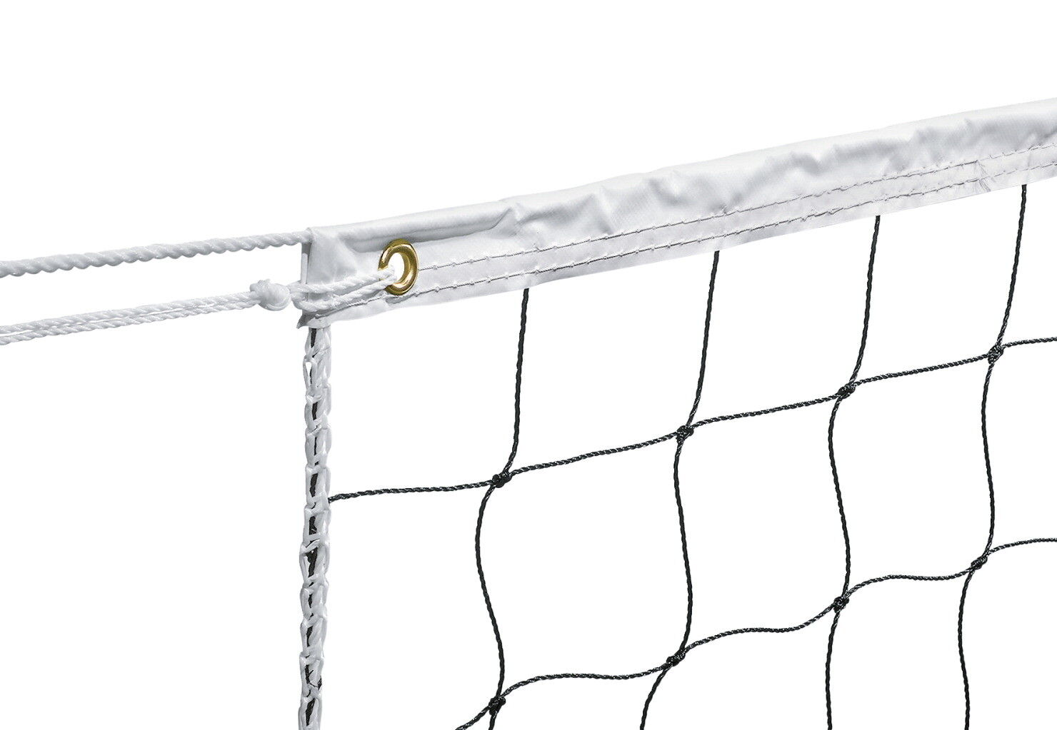
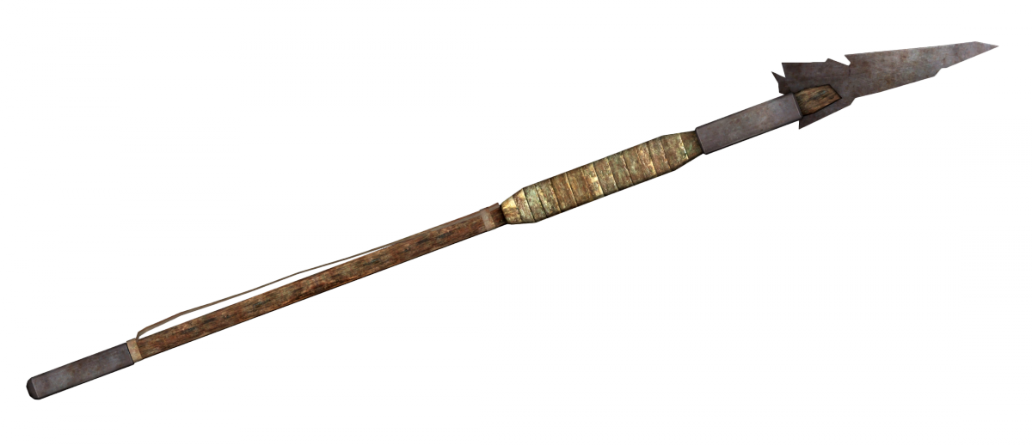
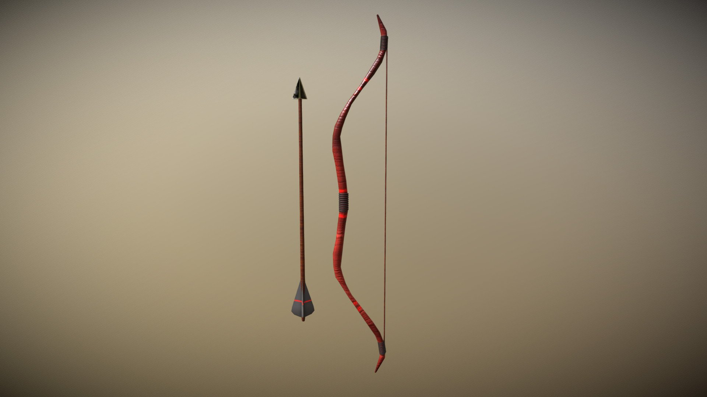
Extra culture items!

