Slide 1
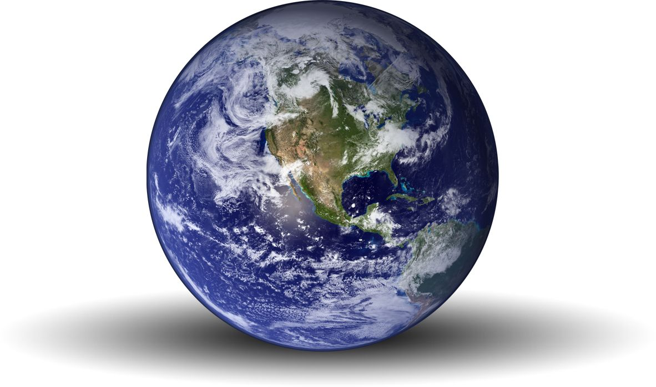
The Wonderful World Of Weather And Climate
By Riley Stabio and Sarah Nolazco

Slide 2
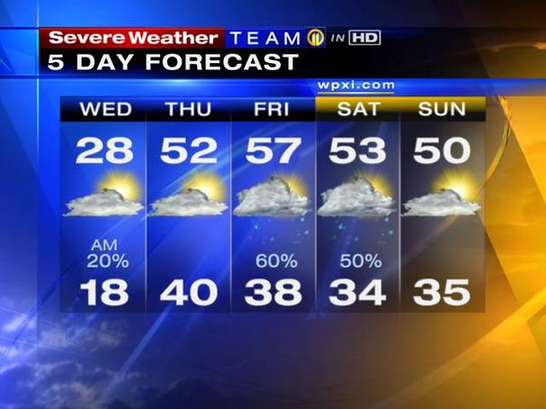
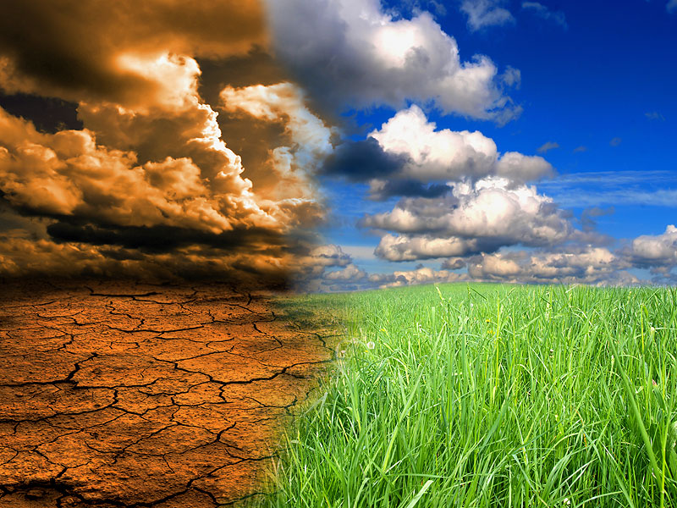
The difference between weather and climate
Weather determines what you wear on any day and climate is the weather pattern found in a specific place over many years.

Slide 3
Tropical Climate Zone
Very hot and humid
Sun hits directly above all year
All plants grow easily
Water evaporates during day , cools, then rains daily
Tropical zone is closest to the equator
Tropical zone does not have seasons

Slide 4
Temperate Climate Zone
Most people live in the Temperate Zone. In the Temperate Zone there are 4 seasons . In the Temperate Marine Zone there is a lot of green land.

Slide 5
Desert Climate Zone
The ground gets so hot that it heats the air.
The rain water turns into vapor or gas before it even reaches the ground. During the winter months , deserts get very little rain.
.

Slide 6
Polar Climate Zone
Located in the Arctic and Antarctic
Climate extremely cold most of the year
Summers short and cold
Winters cold and dark

Slide 7
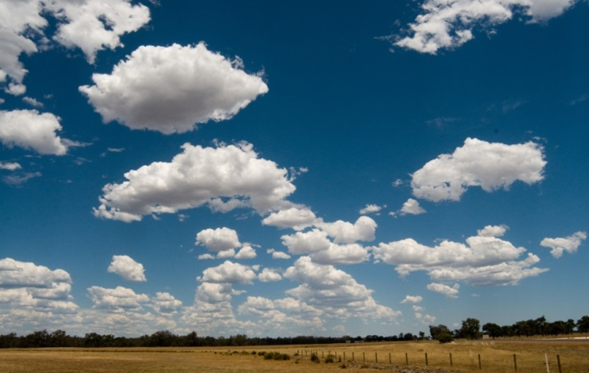
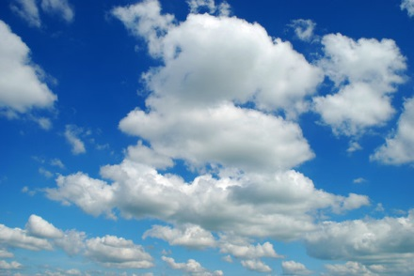
Cumulus
Cumulus clouds are fluffy
Nice weather and no storms
Can change into Cumilonimbus

Slide 8
Cumulonimbus
Cumulonimbus clouds are real tall and fluffy
Brings rain and lightning
Storm lasts under an hour

Slide 9
Stratus
Stratus - a spread out cloud
Gloomy skies , but no storm
Can change into a stratonimbus

Slide 10
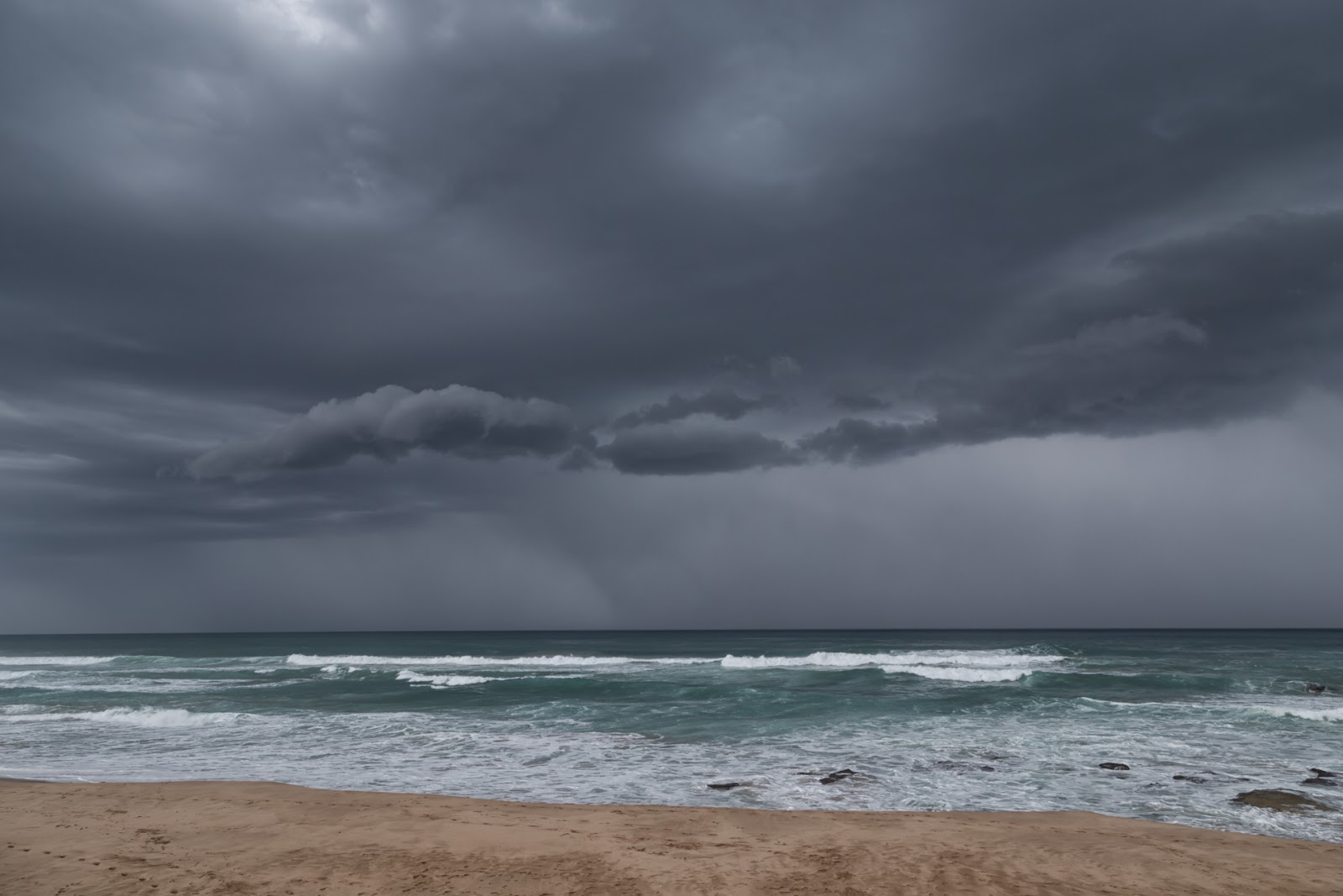
Stratonimbus
Dark
Spread out
Brings storm
Can last all day

Slide 11
Tsunami
Earthquakes can hit the middle of the ocean. The tsunamis can kill a lot of people and animals. They carry great energy. They destroy houses and buildings.

Slide 12
Tornades
Funnels of powerful wind
Starts if cold wind and hot wind mix together
Cause destruction to houses, buildings, cars, and the land

Slide 13
Floods
Rains a couple days in a row and rivers get over flowed
Floods cause death to large animals and people
People have tried to prevent floods by digging deeper holes in rivers.

Slide 14
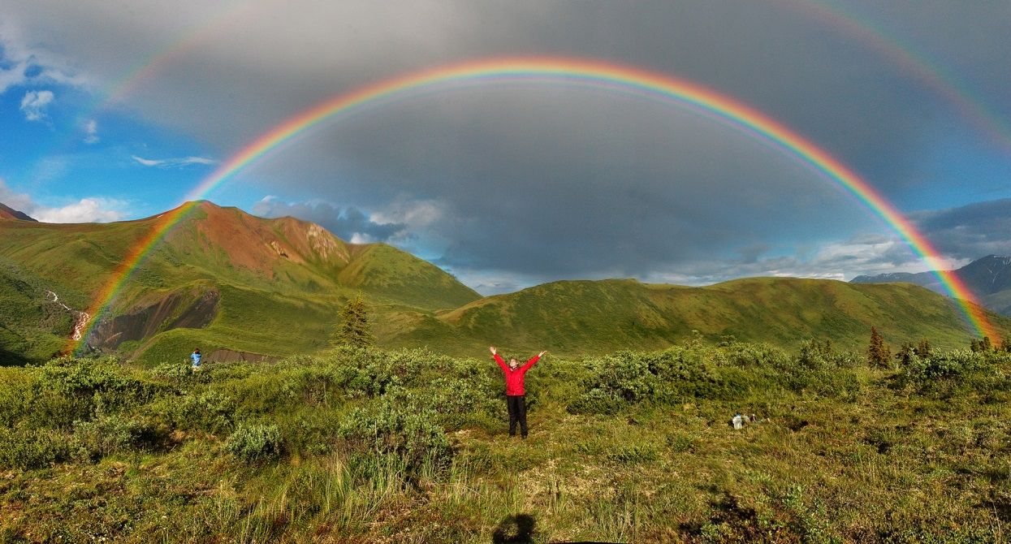
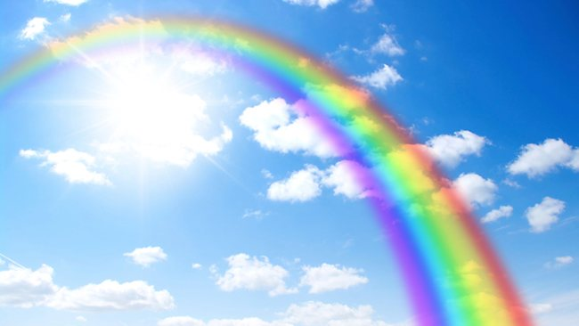
How Rainbows Are Made.
Rainbows are made when rain and sunlight combine in a specific way. The beams of sunlight separate into the colors we see in the rainbow as they enter a raindrop.

Slide 15
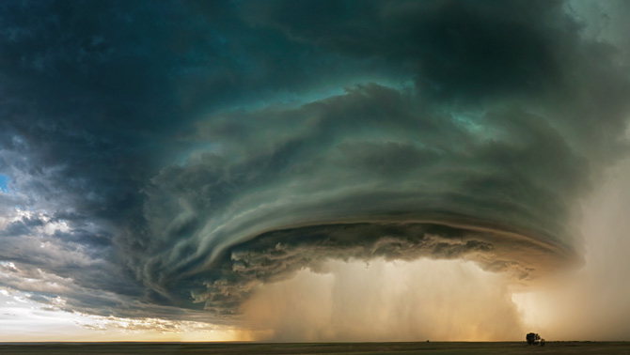
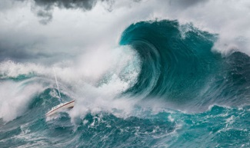
Extreme Weather

Slide 16
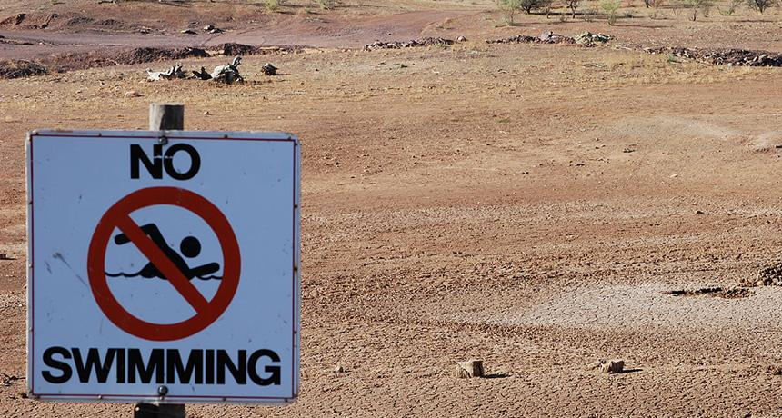
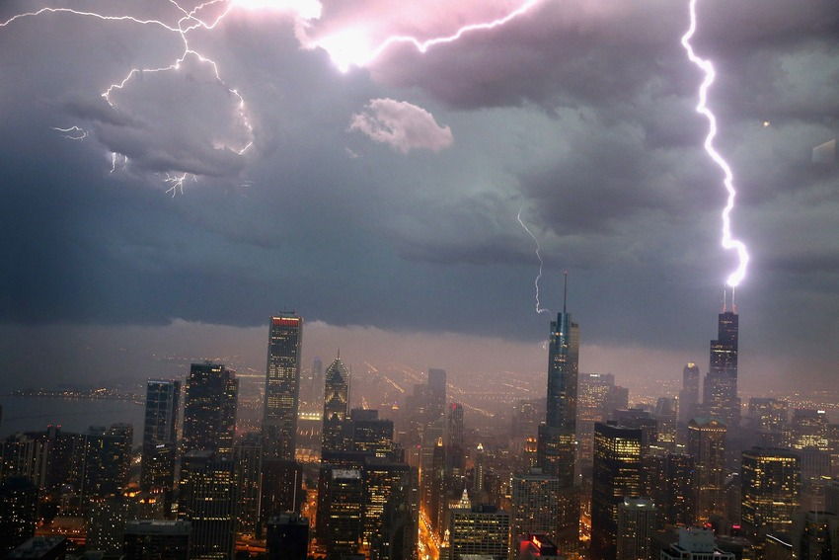

Slide 17
The End

