Slide 1
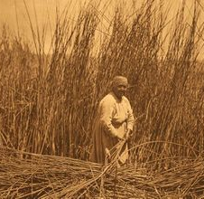
Pomo
This Photo by Unknown author is licensed under CC BY-SA.
By: Camila and Savannah

Slide 2
Location
The Pomo lived in the North central part of California. Thay lived from the Pacific Ocean to Clear lake ( Mendocino Sonoma and lake counties). Thay also lived near the mountains and forests. Thay preferred to live away from the ocean by some miles along a river on creek.
This Photo by Unknown author is licensed under CC BY-SA.

Slide 3
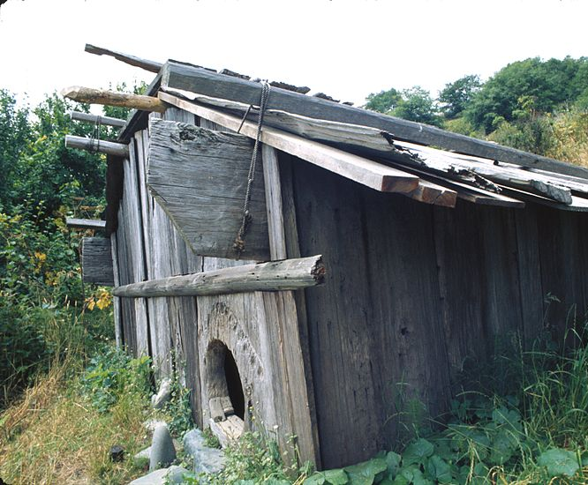
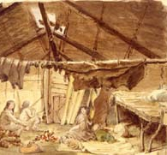
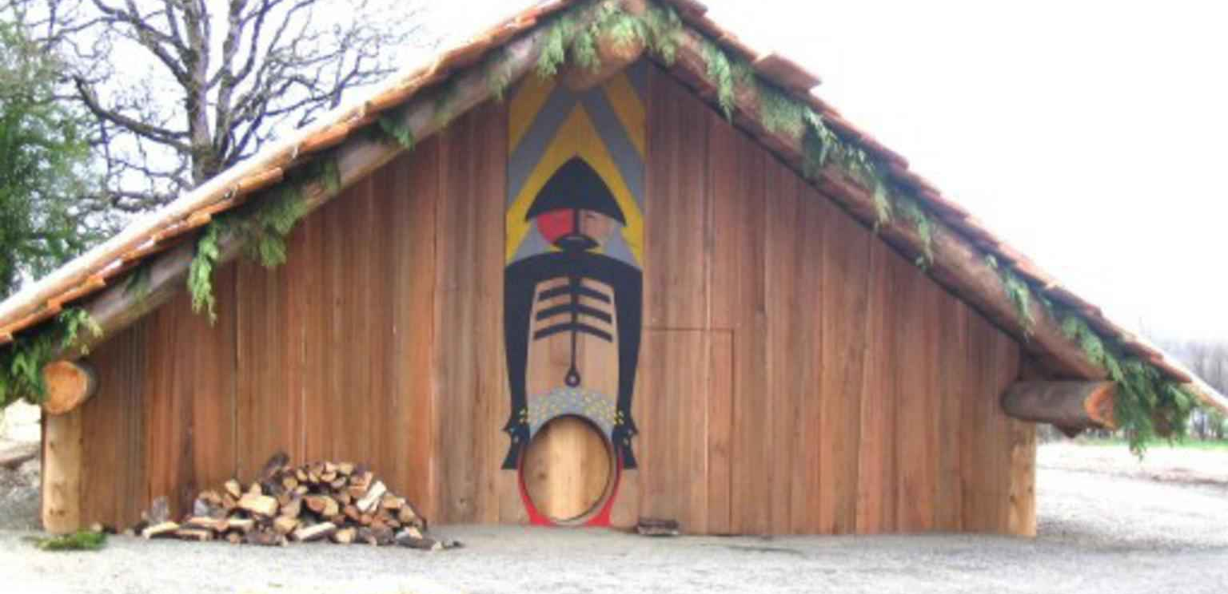
Shelter
The homes of the Pomo tribes protected them from the environment. There were several types of houses build by the Pomo, depending on where the group lived. Eastern and South​eastern Pomo used the tule reeds that Gerwin marshy areas around clear lake . The tules were tied in bundles and then tied to poles that farmed a circular or oval shaped building. They are called plank houses.
This Photo by Unknown author is licensed under CC BY-SA.
This Photo by Unknown author is licensed under CC BY-NC-ND.

Slide 4
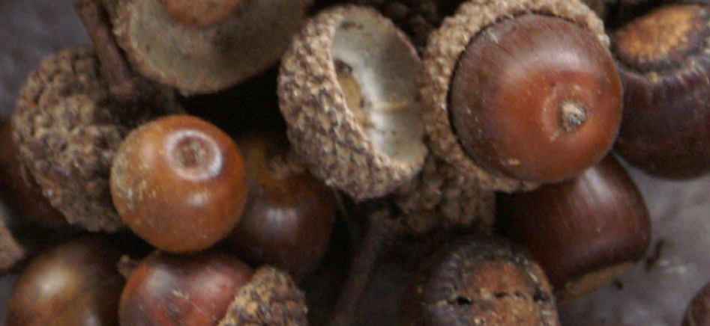
Food
The Pomo tribe used the land to find food in order to survive. The coastal area had fish, shellfish, seaweed, seals, and sea lions from the ocean. Dried seaweed and kelp were especially liked and were traded to those who lived in the island valleys. They hunted deer, elk, and smaller animal from the redwood forests.
This Photo by Unknown author is licensed under CC BY-SA.

Slide 5
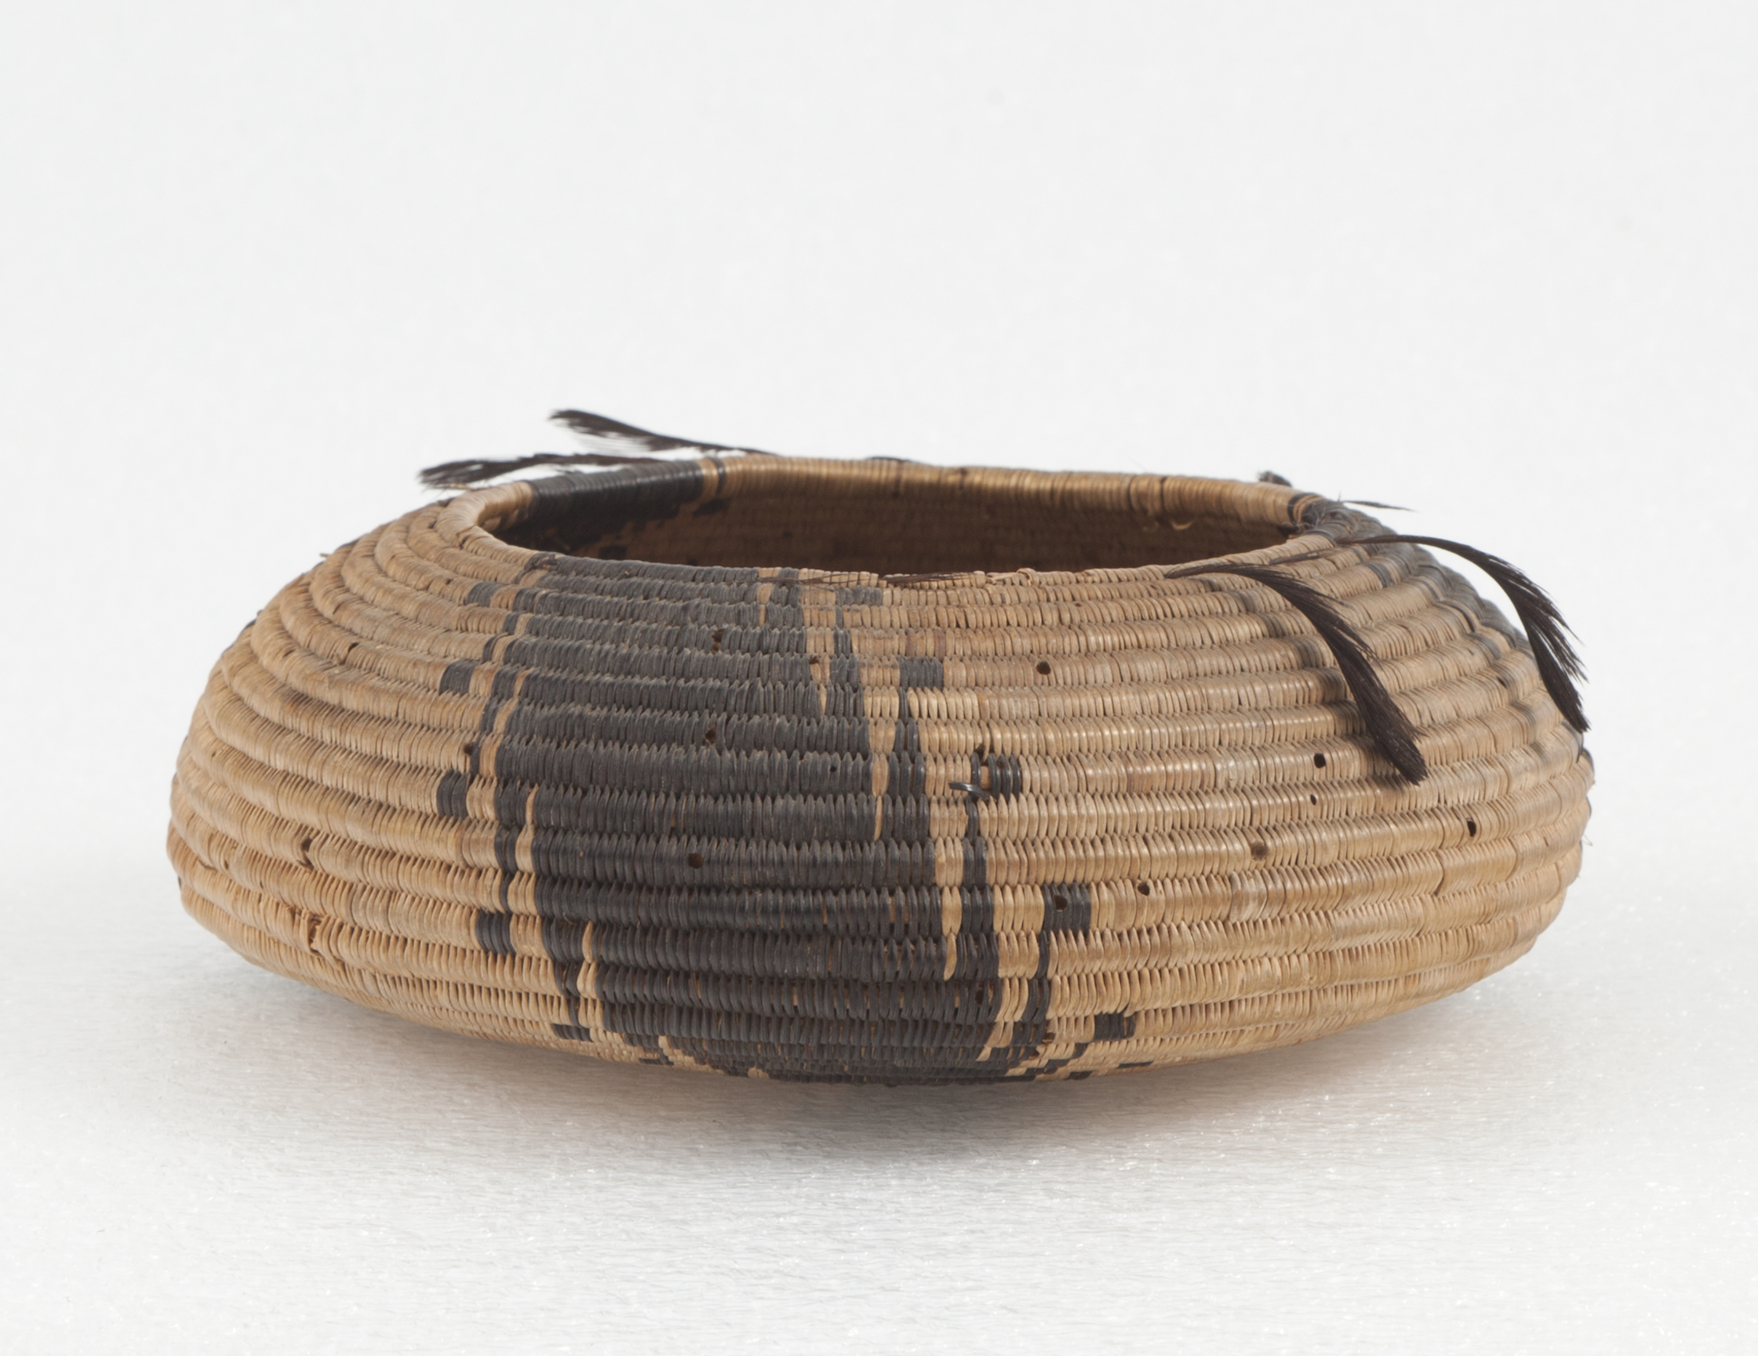
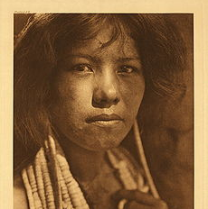
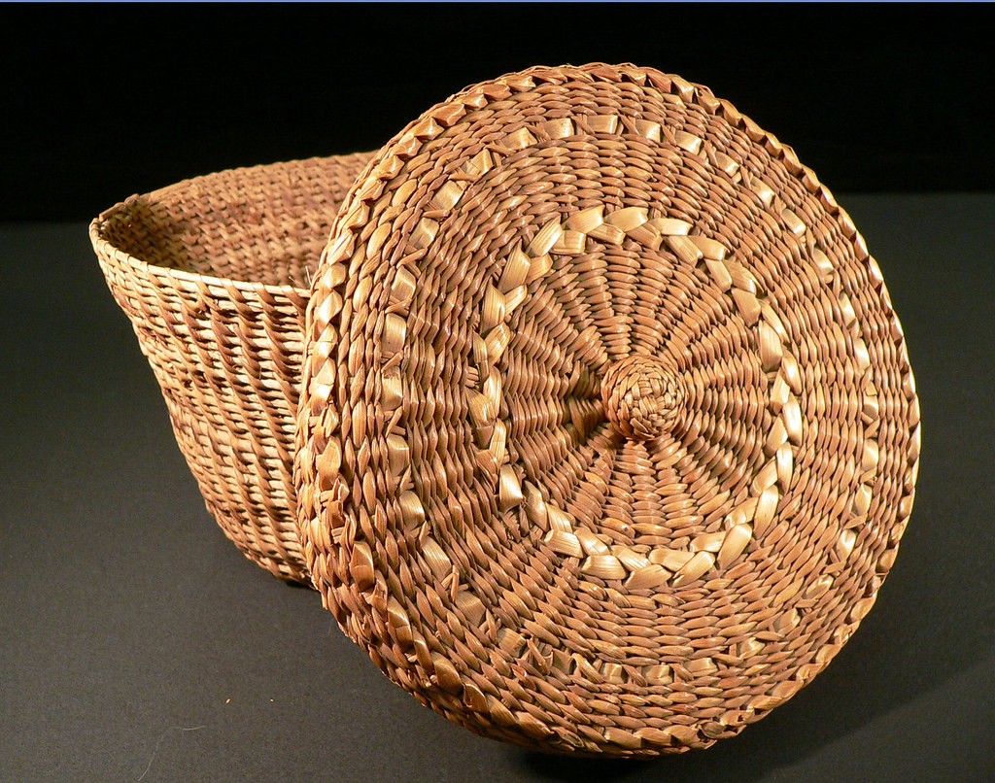
Culture
Thin clothing
They made baskets out of plants.
Women would wear colorful costumes for ceremonies.
This Photo by Unknown author is licensed under CC BY-SA.
This Photo by Unknown author is licensed under CC BY.
This Photo by Unknown author is licensed under CC BY-NC-ND.

Slide 6
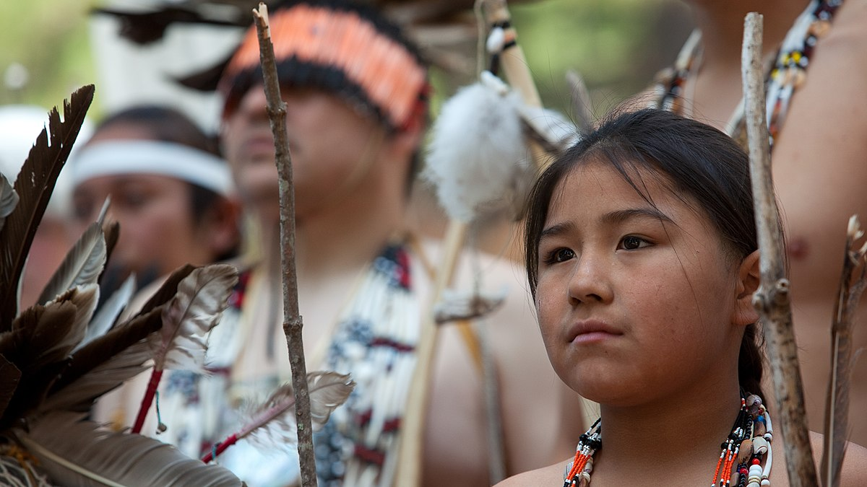
This Photo by Unknown author is licensed under CC BY-SA.

