Slide 1
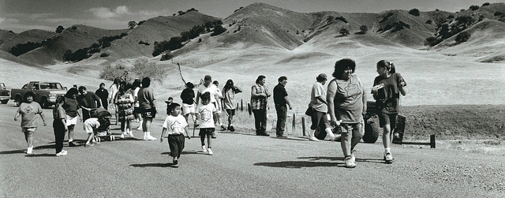
The Maidu tribe
This Photo by Unknown author is licensed under CC BY.
Noah D. and Brandon
This Photo by Unknown author is licensed under CC BY-SA.

Slide 2
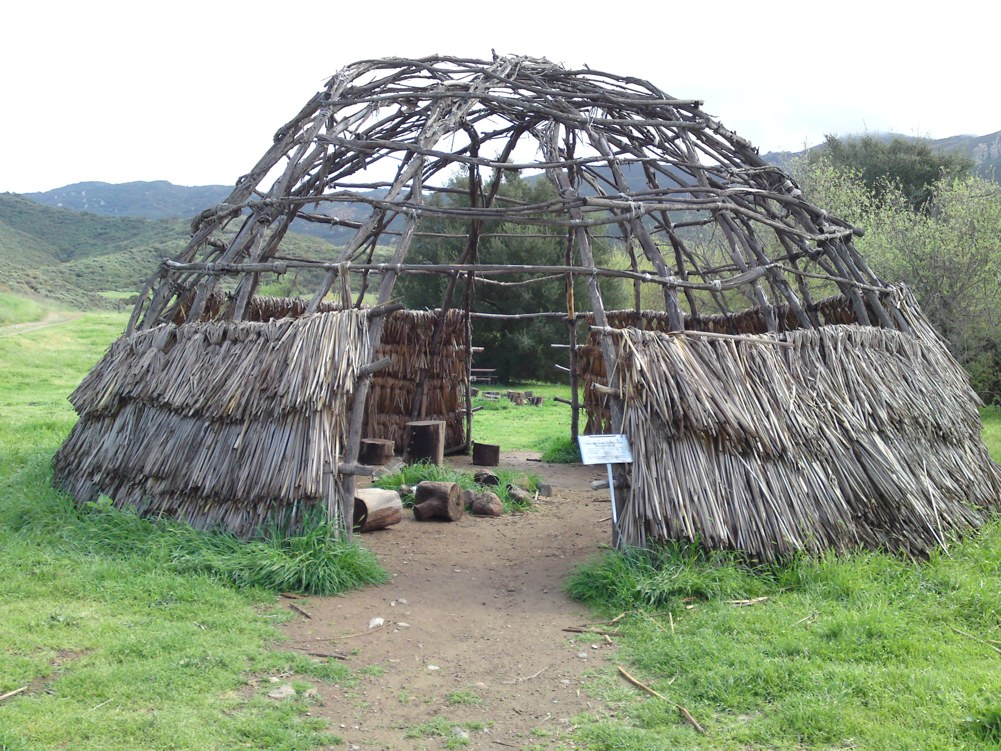
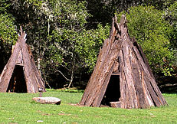
Shelter
The homes of the Maidu were simple. Some were cone shaped covered with trees, plants, and dirt. They were partly underground to keep warm in the winter.
This Photo by Unknown author is licensed under CC BY-SA.
This Photo by Unknown author is licensed under CC BY-SA.
This Photo by Unknown author is licensed under CC BY-SA.

Slide 3
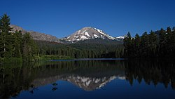
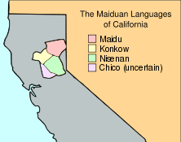
Location
They lived in the Northern part of California. Up in the valleys they had a mild climate. The Maidu tribe has the largest population. They also have the most land of California. The villages are along the edges of the valleys.
This Photo by Unknown author is licensed under CC BY-SA.
This Photo by Unknown author is licensed under CC BY-SA.

Slide 4
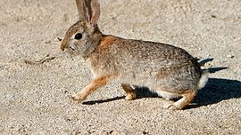
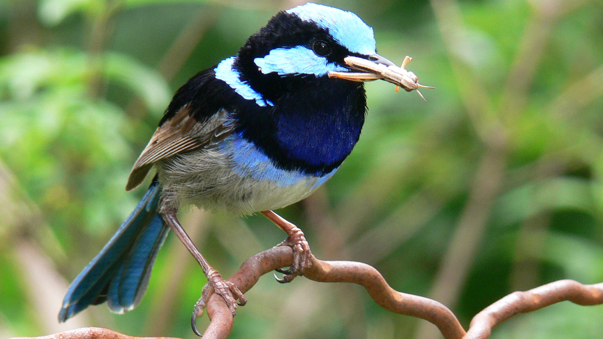
Food
They ate deer, squirrels, and rabbits. They also ate grasshoppers, crickets, roots, stems, leaves, elk, birds. They gathered seeds. They hunted with spears made of rocks. They also ate bears.
This Photo by Unknown author is licensed under CC BY-SA.
This Photo by Unknown author is licensed under CC BY-SA.
This Photo by Unknown author is licensed under CC BY-SA.

Slide 5
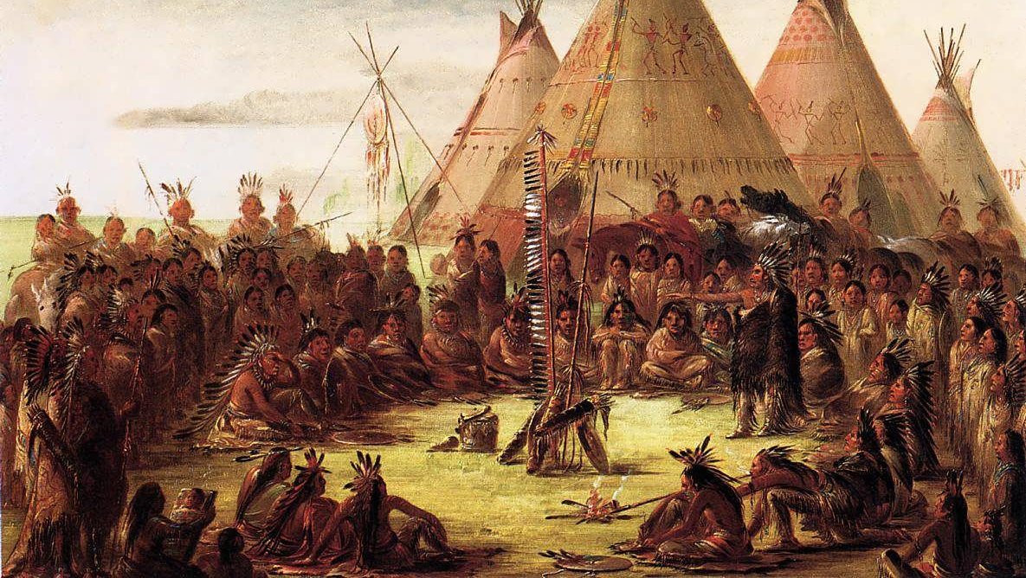
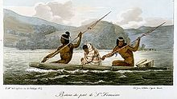
culture
The headman's job was to give advice to the people. In their culture they put grass in their shoes to keep warm. Tools were made from volcanic glass found in the area. They made rattles flutes, and whistles and used them for music.
This Photo by Unknown author is licensed under CC BY-SA.
This Photo by Unknown author is licensed under CC BY-SA.
This Photo by Unknown author is licensed under CC BY-SA.
This Photo by Unknown author is licensed under CC BY-SA.

Slide 6
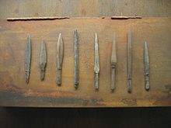
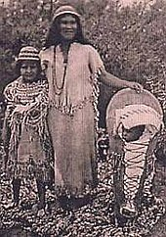
This Photoby own author is licensed under CC BY-SA.

