Slide 1
THE GABRIELINO TRIBE
Andrew and Daniel

Slide 2
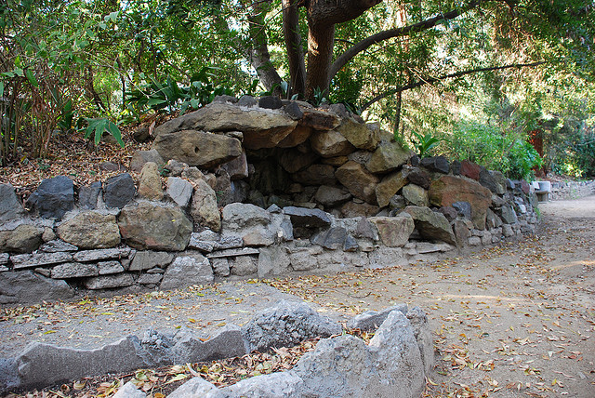
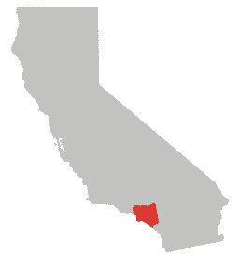
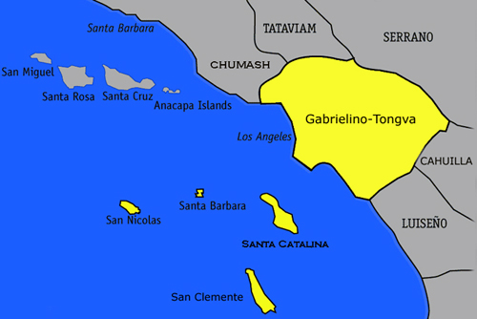
Location
The Gabrielino lived around the southern coast of California. They lived around the Los Angeles River and Laguna Beach. Some of the Gabrielino lived on islands.

Slide 3
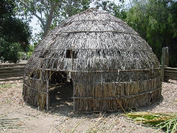
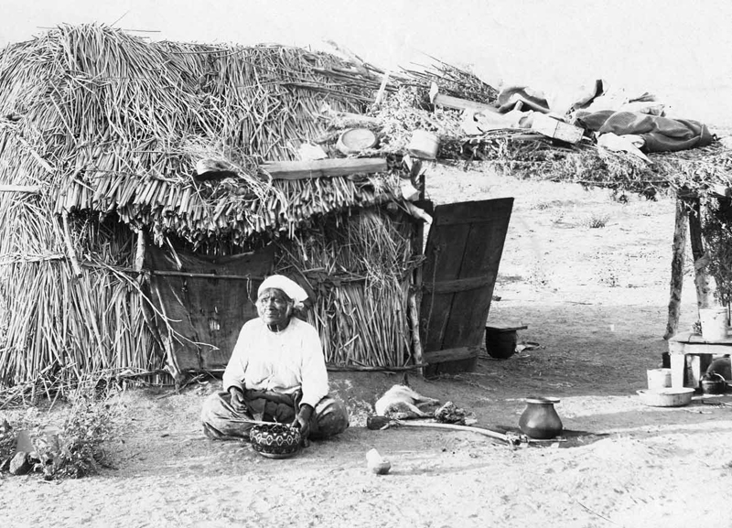
Shelter
The Gabrielino called their houses Temescales. They made their houses out of tule reeds and ferns. The shelters of the Gabrielino protected them from rodents.

Slide 4
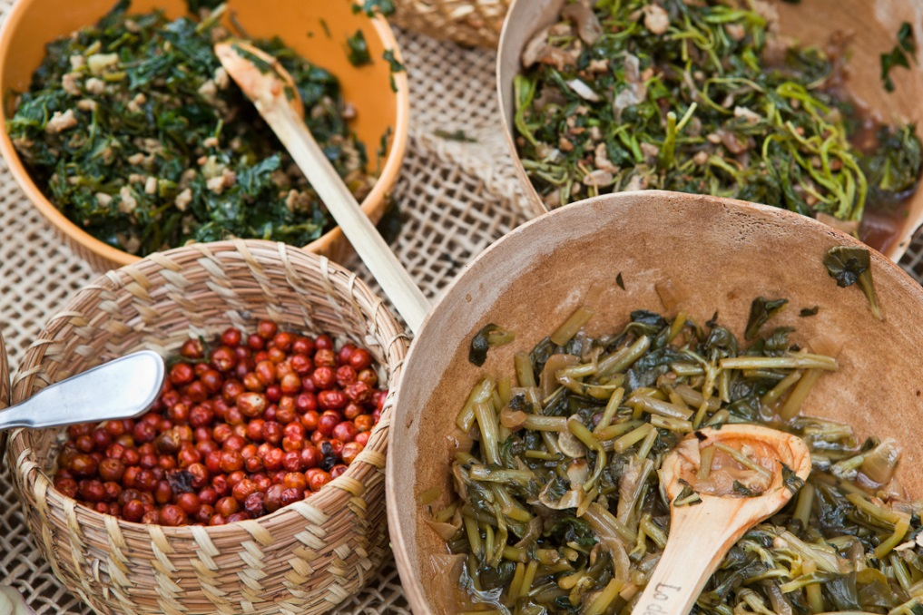
Food
The Gabrielino made food out of acorns and berries. They hunted deer, rabbits, fish, and rodents. The Gabrielino smoked fish and meat to preserve it for later.

Slide 5
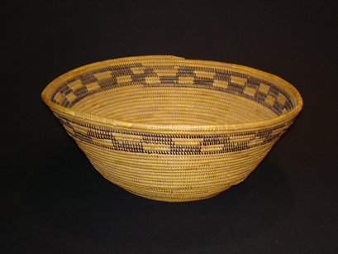
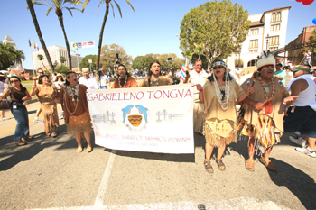
Culture
The Gabrielino were expert basket makers. They made crafts like boats. They made art out of stone. The Gabrielino dance and sing for seven days.

