Slide 1
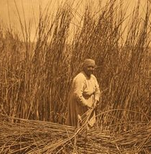
The Maidu tribe
By:
Lailani Nomura
This Photo by Unknown author is licensed under CC BY-SA.

Slide 2
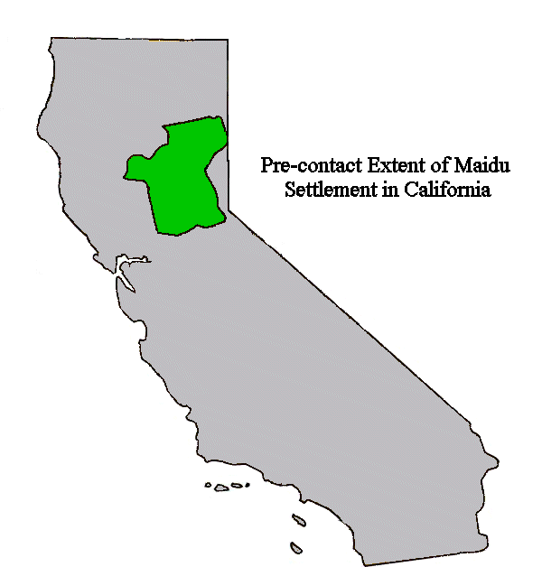
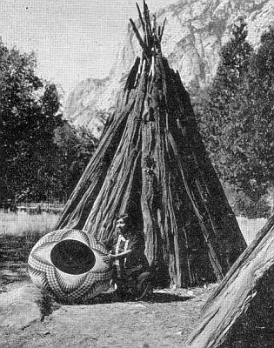
Location
The Maidu lived in the central part of California. They lived near mountains, rivers, and streams. The weather was cold in the winter and warm in the summer. They lived near Sierra Navada west to where Sacramento is today.
This Photo by Unknown author is licensed under CC BY-SA.
This Photo by Unknown author is licensed under CC BY-SA.

Slide 3
Shelter
Their homes were located on the mountain so they can see when strangers are coming.
The homes looked like a big, round mound of earth with a hole in the top.
The hole was the doorway.
This Photo by Unknown author is licensed under CC BY-SA.

Slide 4
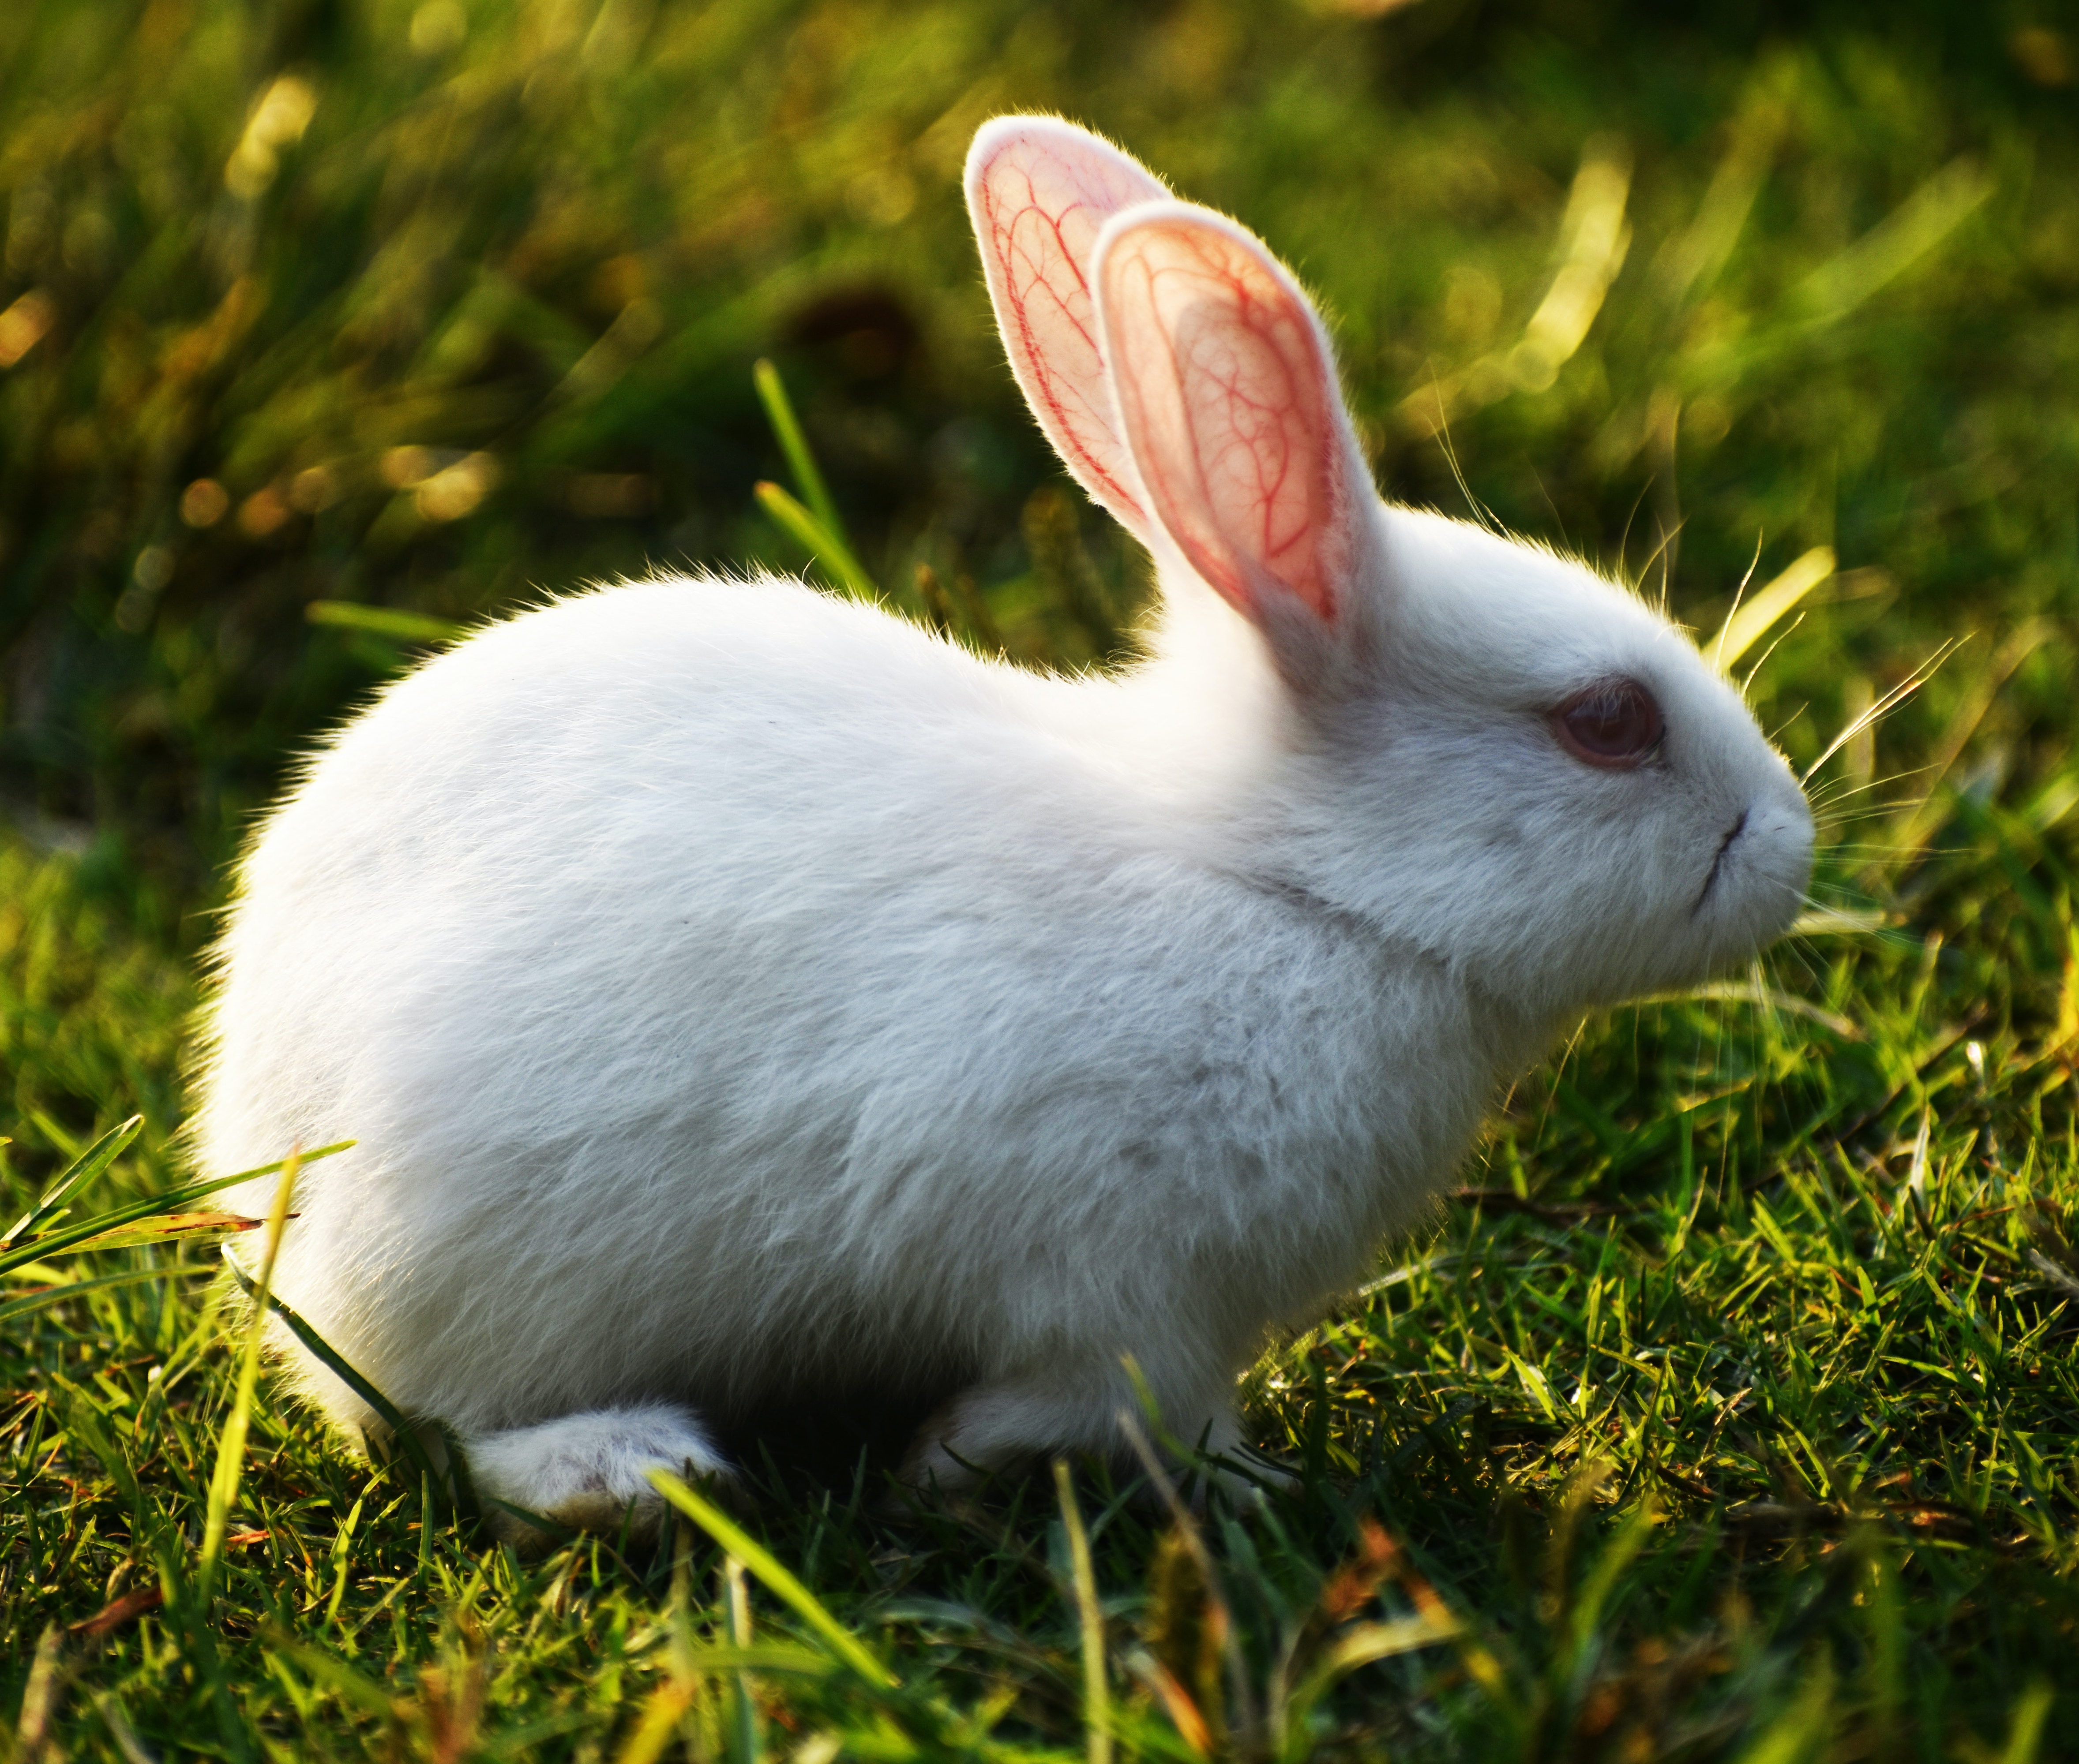
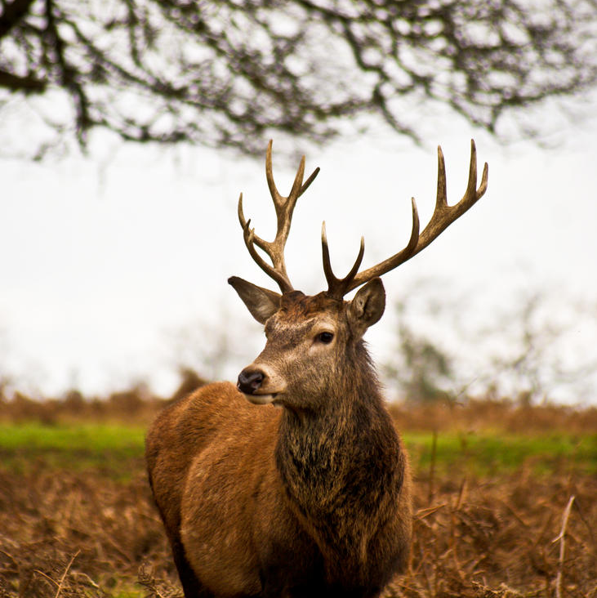
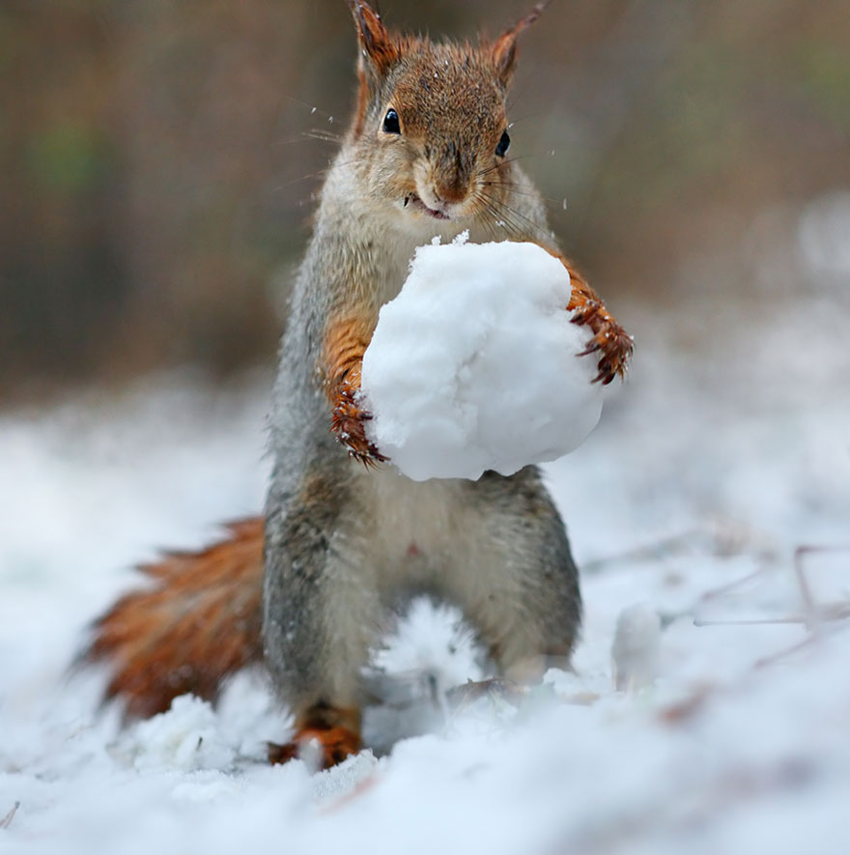
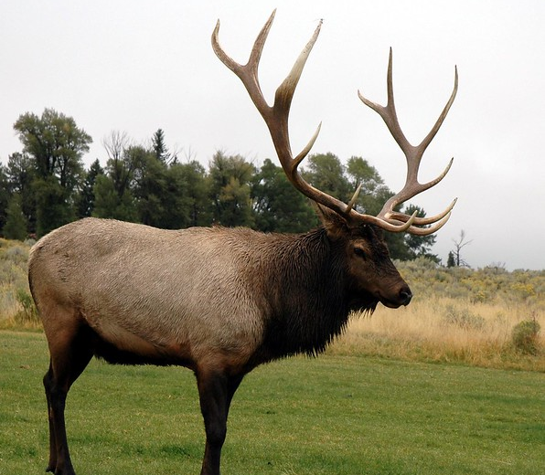
Food
They gathered seeds, roots, leaves, stems. They hunted deer, elk, squirrel, and rabbits. From the sea they ate salmon, trout, and eel.
This Photo by Unknown author is licensed under CC BY.
This Photo by Unknown author is licensed under CC BY.
This Photo by Unknown author is licensed under CC BY.

Slide 5
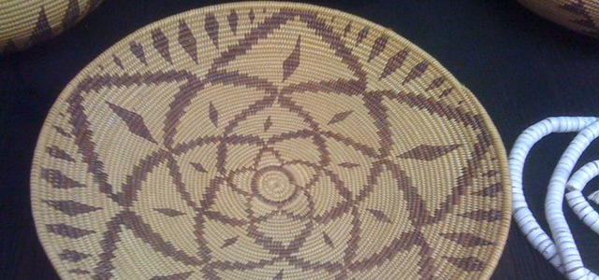
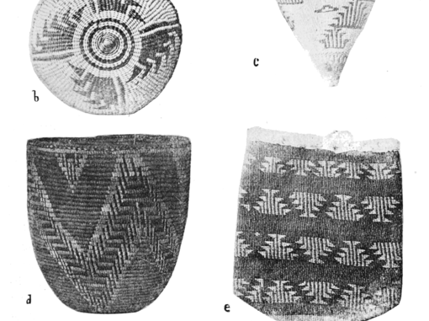
Culture
The culture of the Maidu tribe was unique and interesting. Maidu woman prepared acorns to eat. Men made knives and arrow heads from flint. They tied animal skins around their legs. Maidu carried, stored, and cookedfood in baskets
This Photo by Unknown author is licensed under CC BY-NC.

Slide 6
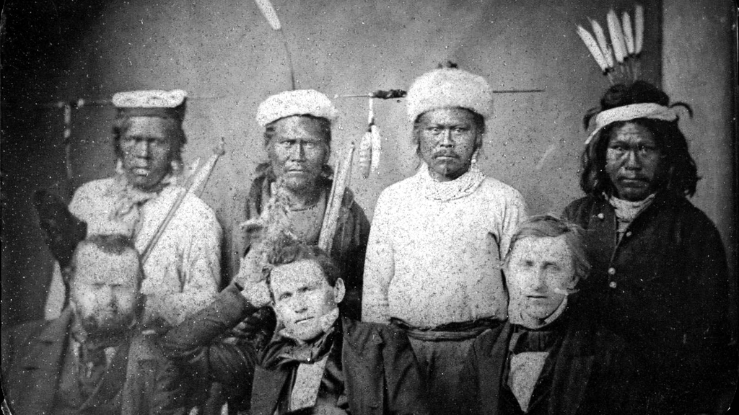
This Photo by Unknown author is licensed under CC BY-SA.

