Slide 1
Gabrielino Tribe
By Aurora and Elijah

Slide 2
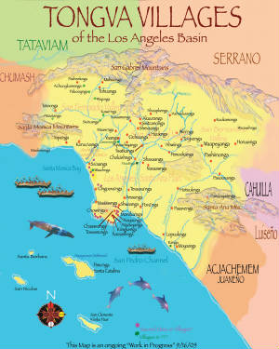
Location
There is the Channel Islands near by. They lived near Los Angeles.

Slide 3
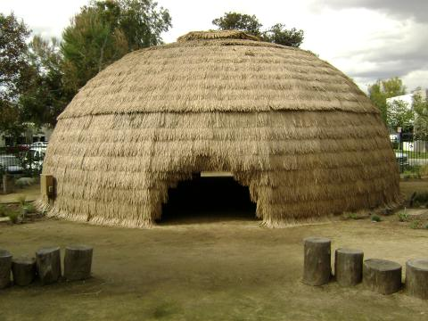
Shelter
A Gabrielino house is made of tree saplings. Their shelter was up to 6 inches thick.

Slide 4
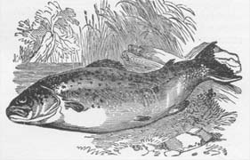
Food
They fished for fish , sword fish , seals , and sharks. They hunted rabbits , squirrels , deer and ducks and gathered pine nuts, and seeds fruit.

Slide 5
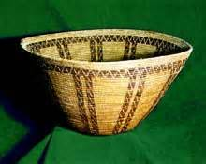
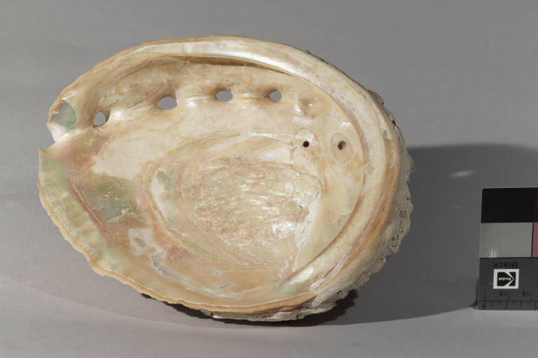
Culture
To beat the berries they used a thing they made called a wicker seed beating tool.

Slide 6
gabrielino

