Slide 1
Chapter 4
Part 1

Slide 2
I. Processing Sensation and Perception
Sensation is the process of bringing in information to be processed by the sensory receptors.
Perception is organizing and interpreting that sensory information that allows us to recognize objects and events.
Bottom-up processing starts with the sensory receptors and goes to higher levels of processing.
Top-down processing is how we interpret the sensory information and give meaning to it.
Notes:
http://www.proprofs.com/flashcards/upload/q7712682.gif

Slide 3
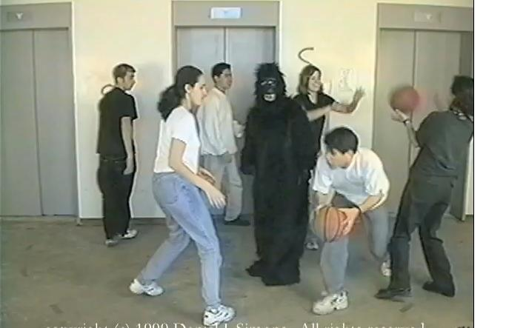
I. Processing Sensation and Perception
We can only focus on one aspect at a time. This is called selective attention. We can shift focus frequently and to many different things, but we still are only focusing on one thing at a time.
When we focus on that one thing, other things do not matter. Inattentional blindness and change blindness reflect that. We won’t notice obvious things that change or occur if they are not related to what we are focused on. It also applies to hearing.
Notes:
https://semilledge.files.wordpress.com/2013/02/gorilla1.jpg

Slide 4
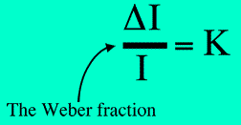
II. Thresholds
All of our senses receive sensory stimuli, transform that into neural impulses, and deliver those to our brain. That transformation of energy from one form to another is called transduction. It is studied in the field of psychophysics.
There is a minimum stimulation that needs to be reached to be detected by our receptors. This is the absolute threshold, and it must be reached at least 50 percent of the time by the stimuli.
There are other factors that also determine whether we detect something or not, and those are studied by signal detection theorists.
Notes:
http://www.cis.rit.edu/people/faculty/montag/vandplite/images/chapter_3/webers.gif

Slide 5
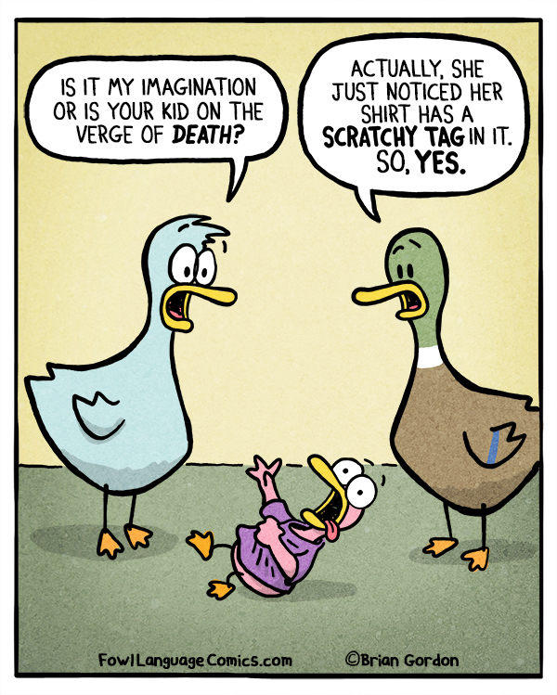
II. Thresholds
The difference threshold is the minimum difference between stimuli that people detect half the time. Weber’s law states that there is a minimum constant percentage difference for us to detect that difference.
Sensory adaptation is our ability to get used to unchanging stimuli so that we become less aware of it. We react to new information and stimuli coming in, and forget about the old.
Notes:
https://www.fowllanguagecomics.com/wp-content/uploads/2015/10/scratchy-tag1.jpg

Slide 6
In your notebooks
Draw a color diagram of the three basic steps to all our sensory systems. Full page.

