Slide 1
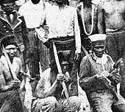
The Maidu tribe
By Isaac Sandoval
This Photo by Unknown author is licensed under CC BY-SA.

Slide 2
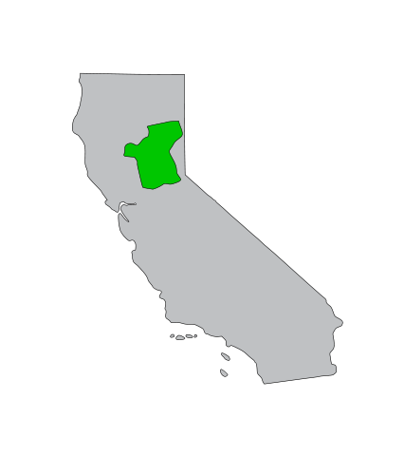
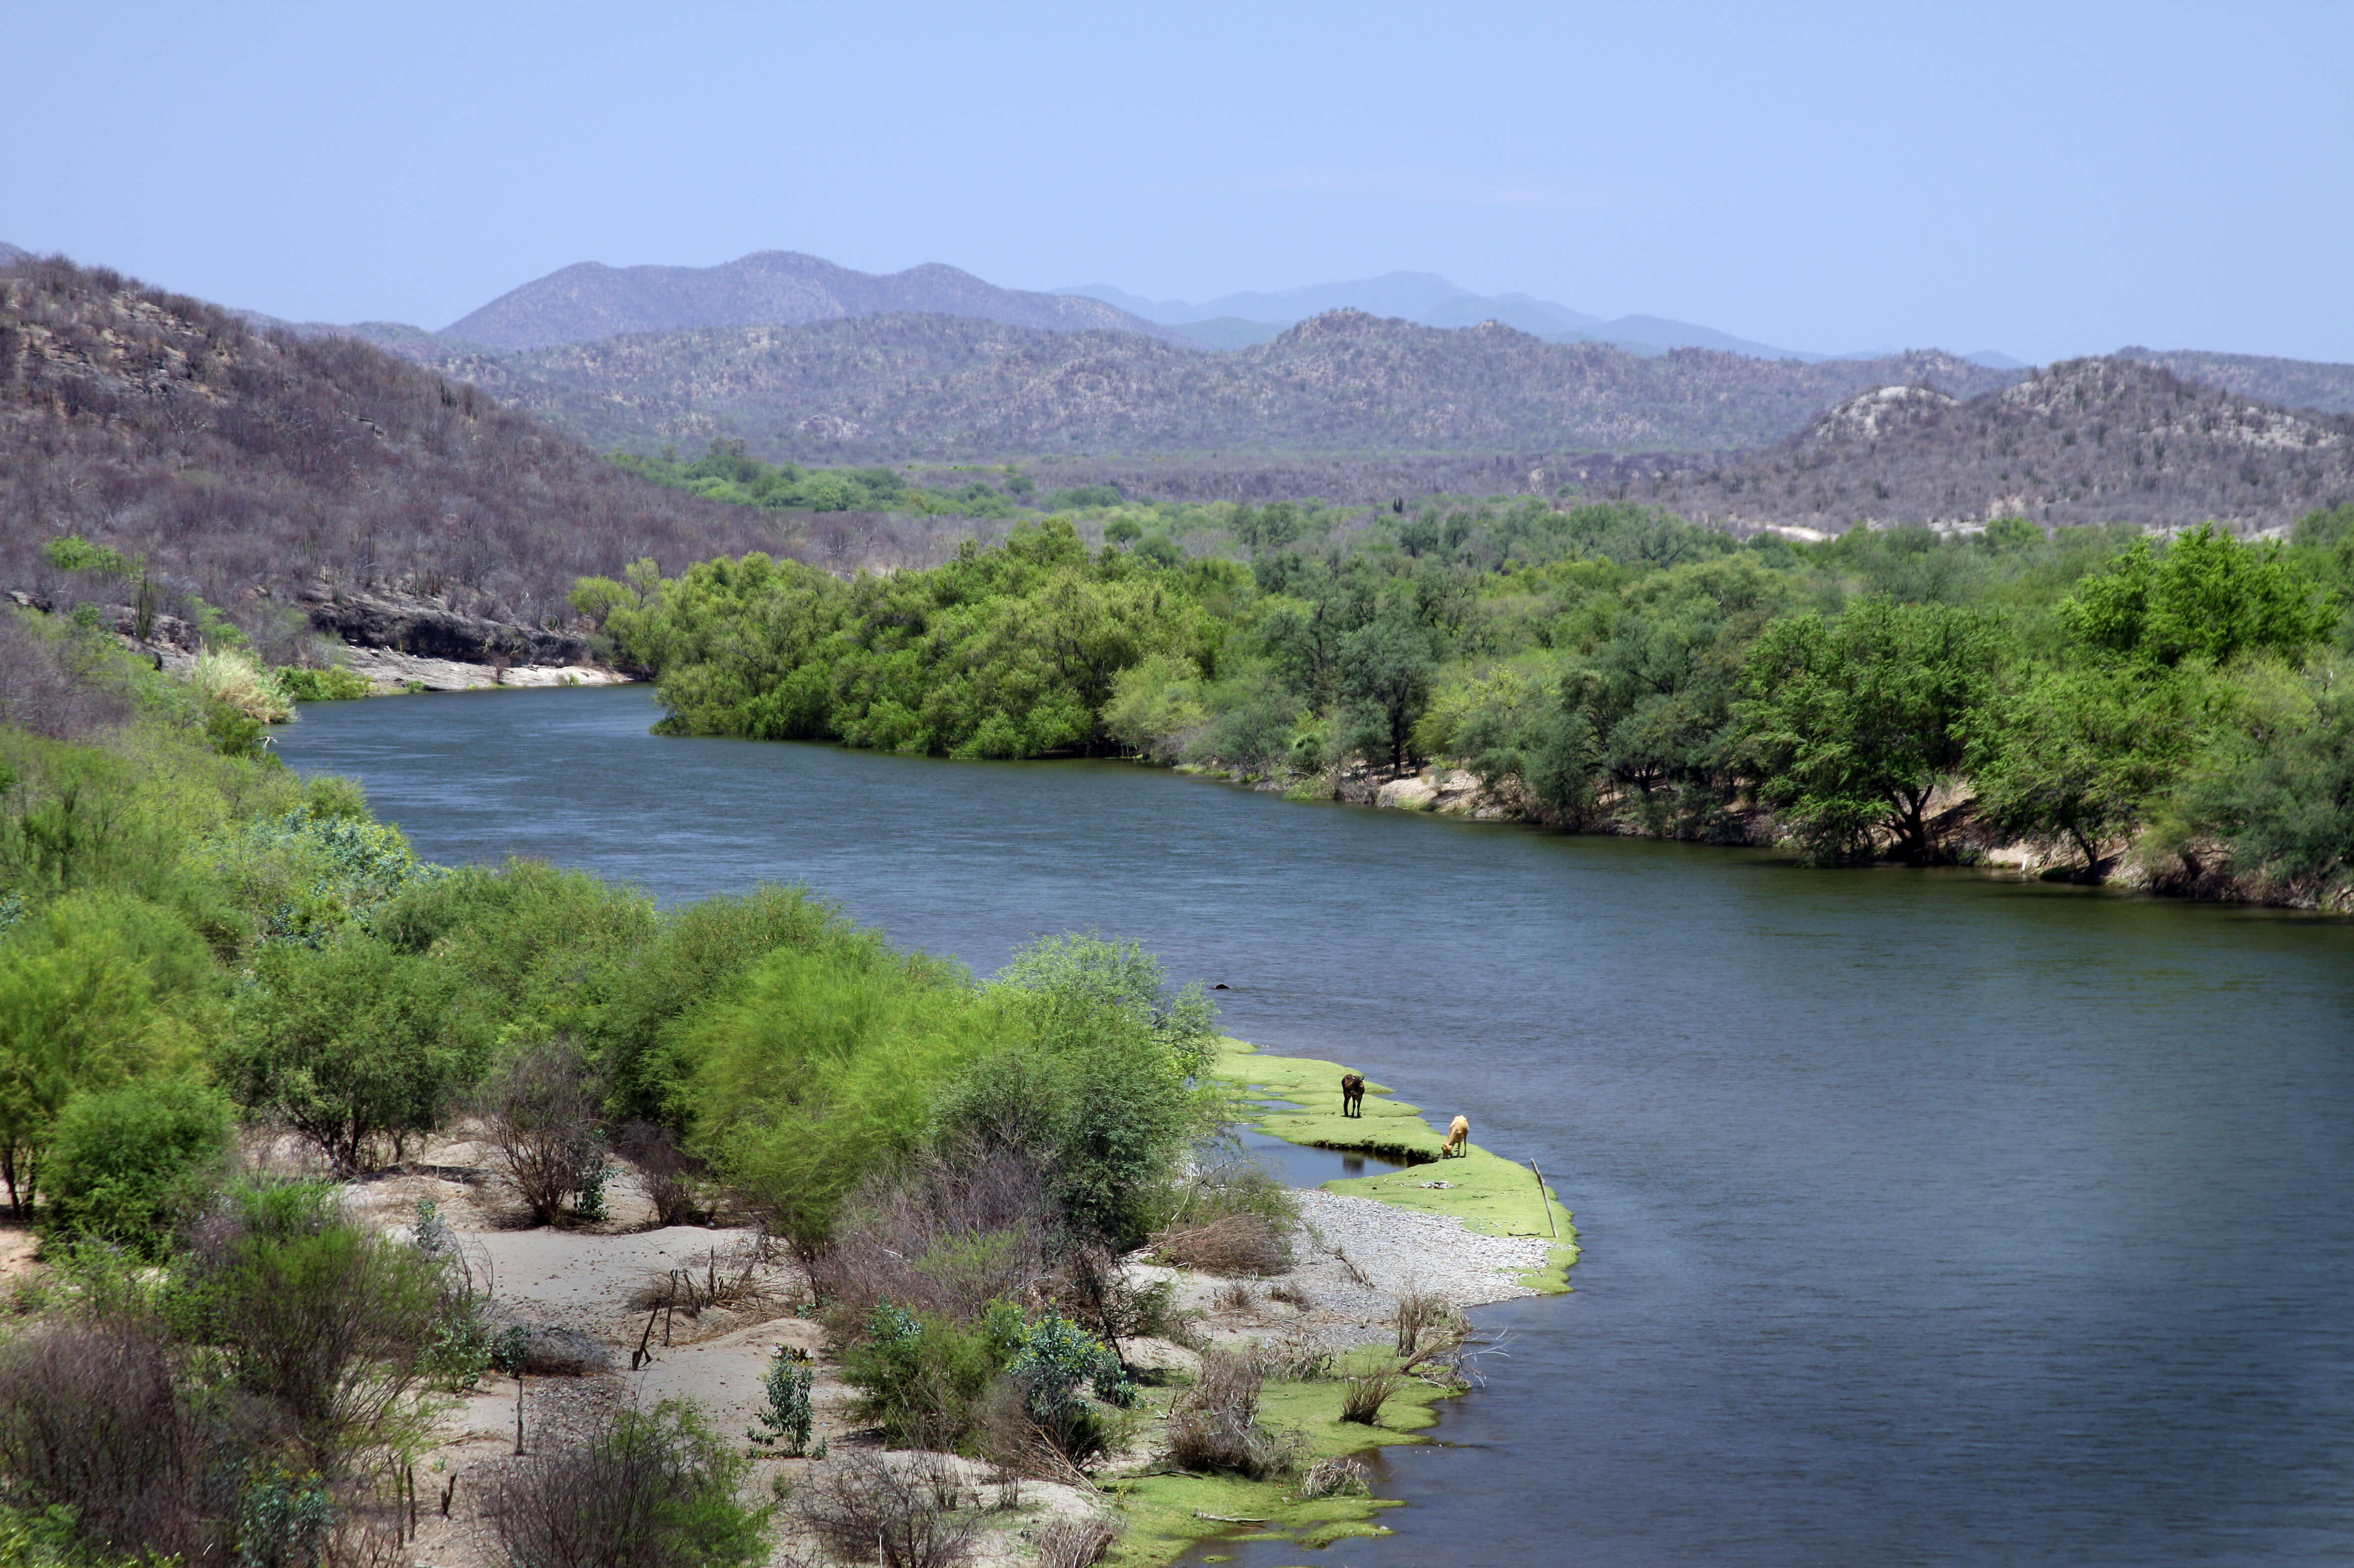
Location
The Maidu tribe lived on the northern part of California near mountains and near cliffs. Also, there is a valley that was 4000 feet long.
This Photo by Unknown author is licensed under CC BY-SA.
This Photo by Unknown author is licensed under CC BY-NC-ND.

Slide 3
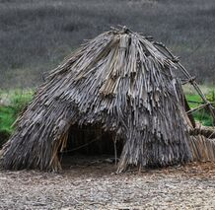
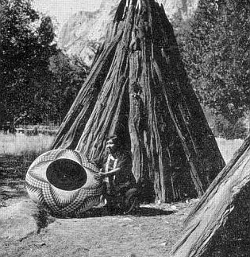
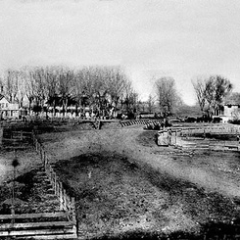
Shelter
The Maidu tribe dug a hole in the ground so they can live in there. It was packed with bark and earth it was around 20 to 40 feet.

Slide 4
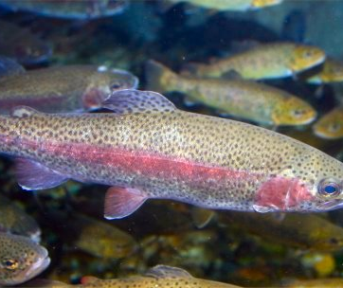
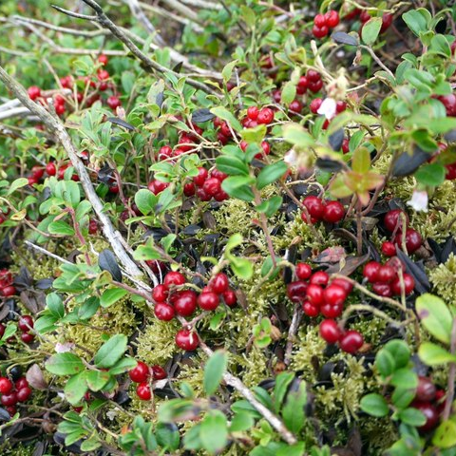
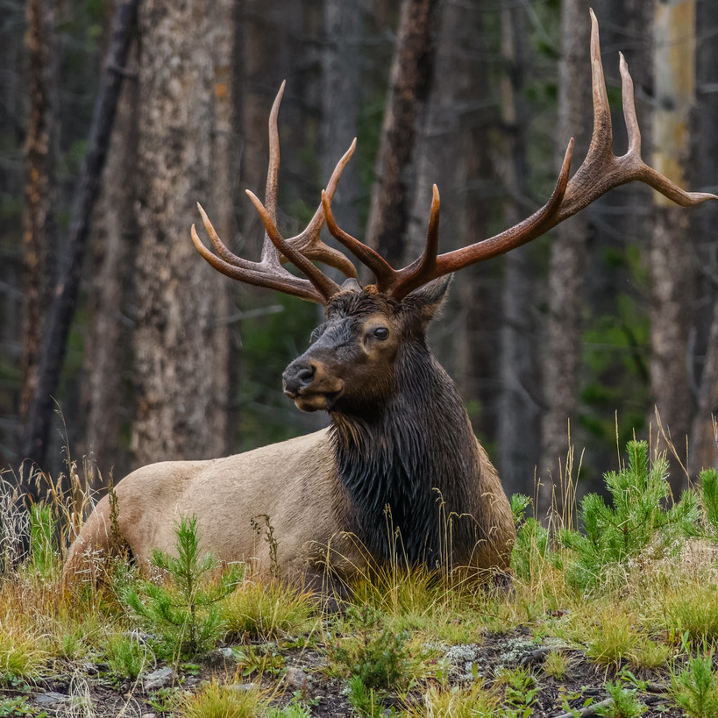
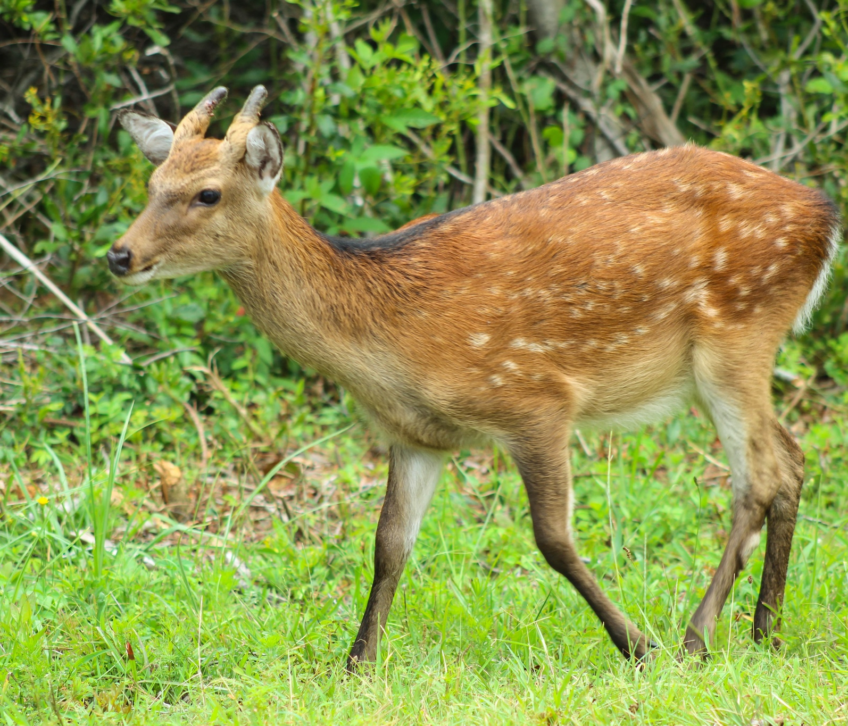
Food
The Maidu tribe used their land to find food. In order to survive they hunted deer, elk, and rabbits. Also, they ate fish. How did the hunter get the fish? First, they sprinkle manzanita berries in the water then the fish think it's food then they get dizzy then the hunter gets the fish.
This Photo by Unknown author is licensed under CC BY-SA.
This Photo by Unknown author is licensd under CC BY-SA.
This Photo by Unknown author is licensed under CC BY.
This Photo by Unknown author is licensed under CC BY-NC.

Slide 5
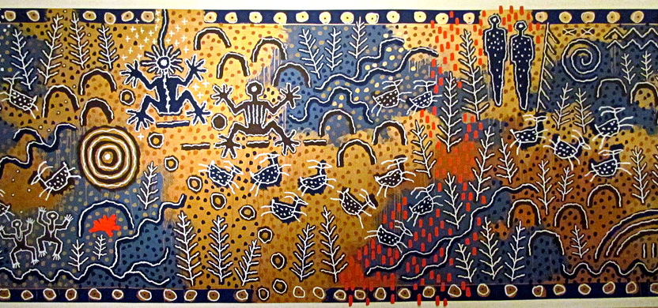
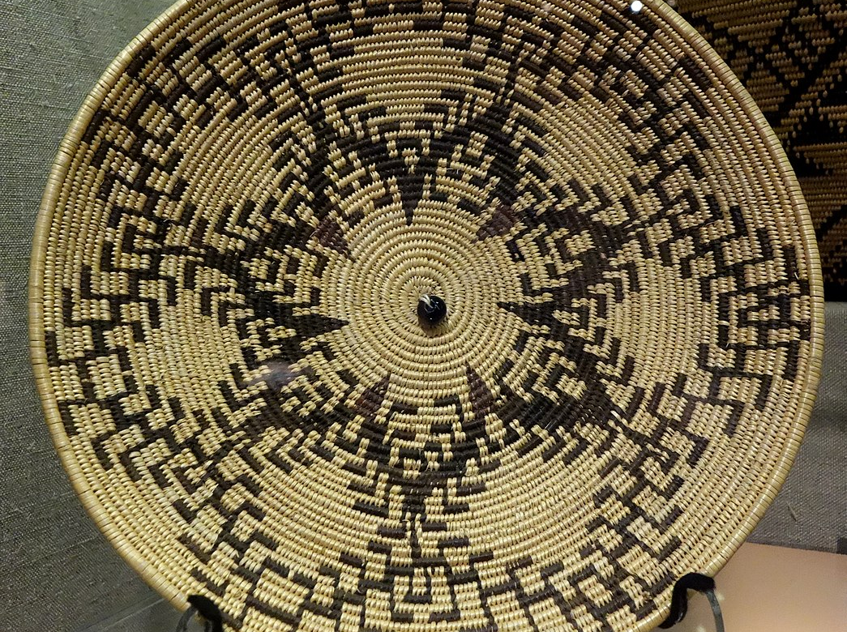
Culture
The Maidu culture is unique and interesting in many ways. One thing is in their culture is a feasting bowl. Also, when the hunter kills deer and elk. They use it as clothes.
This Photo by Unknown author is licensed under CC BY.
This Photo by Unknown author is licensed under CC BY-SA.

Slide 6
This Photo by Unknown author is licensed under CC BY-SA.

