Slide 1
Weather & Climate
By:Rhianna Carr and Emily Helgeson

Slide 2
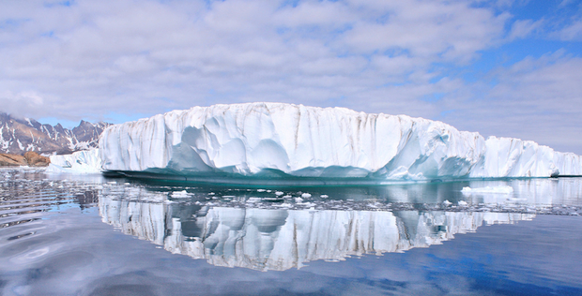
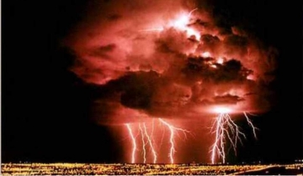
The difference between climate and weather
Weather is minute by minute temperature. Climate is weather over a long period of time. Weather is caused by heat, air pressure, winds, and moisture. Climate is caused by temperature and precipatation.

Slide 3
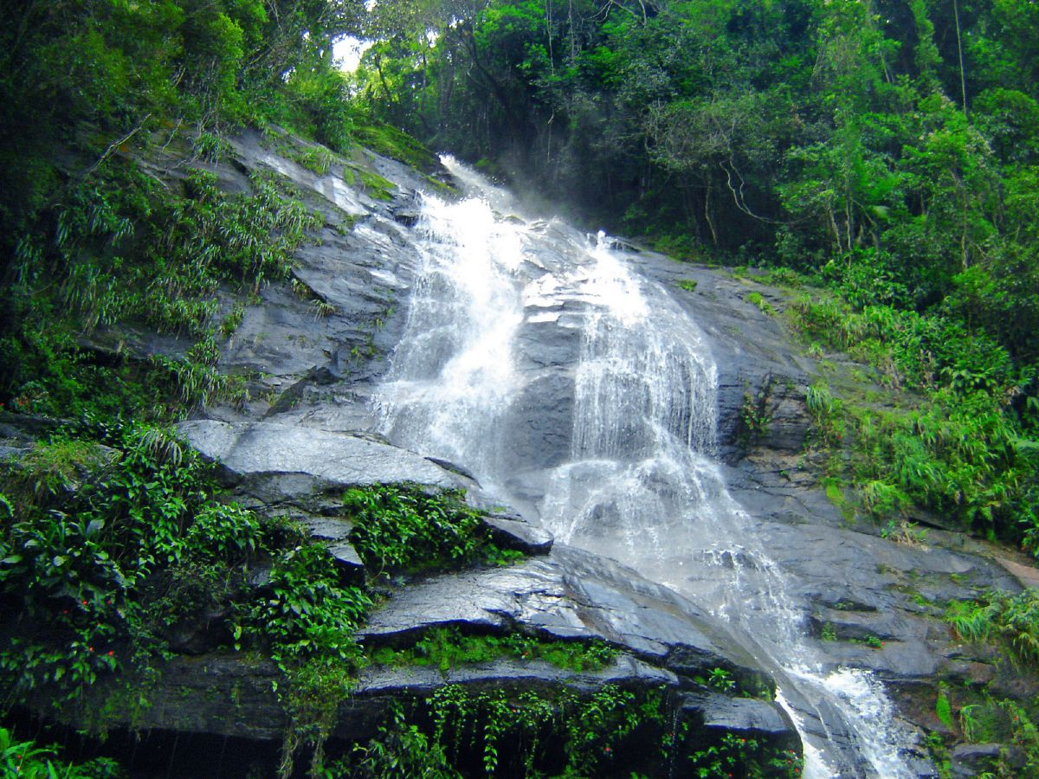
Tropical Climate Zone
Right around the equator is the Tropical climate zone. It is found between the Tropic of Cancer and the Tropic of Capricorn. They get lots of rain.

Slide 4
Temperate Climate Zone
Temperate climates are never too extreme. They are never too hot or cold. Their summers are warm and their winters are cool. Temperate means moderate. Many plants and animals live there.

Slide 5
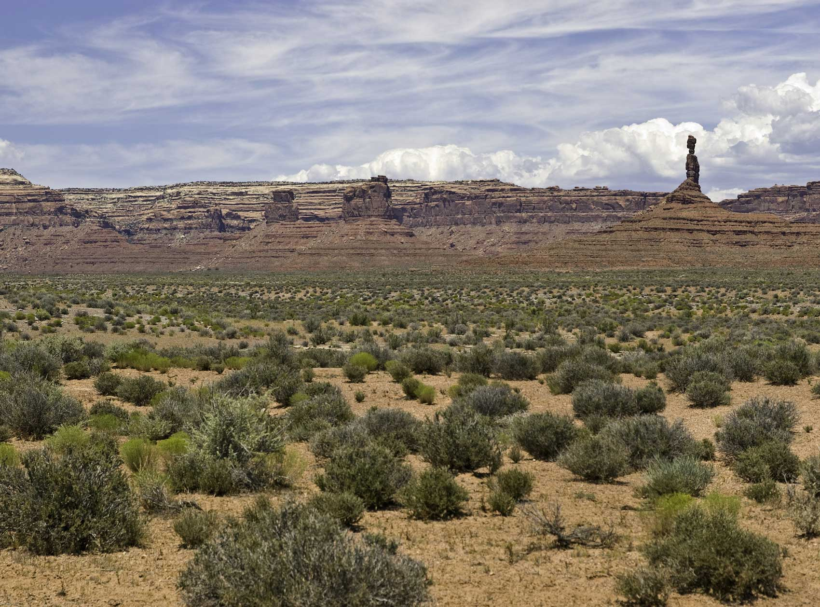
Desert Climate Zone
Deserts do not get a lot of rain. They get less than 10 inches of rain a year. Sometimes it does not rain at all! They are so hot when it rains it evaporates before it even touches the ground!

Slide 6
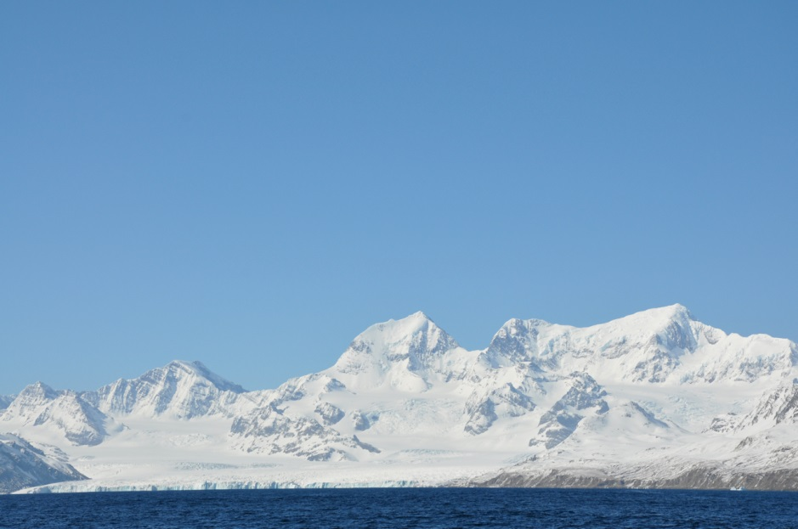
Polar Climate Zone
Polar climates can be very cold because they get less of the sun’s rays. It is the coldest climate. In the winter it is dark for six months straight!

Slide 7
TORNADOES!!
A tornado fast spinning column of air that touches the ground.
There are different types of tornadoes like the Supercell, Funnel Cloud, and Water Spout. A Supercell is a rotating thunderstorm where the strongest toranadoes often form. The Funnel Cloud is a whirling cloud that becomes a tornado if it touches the ground. A Water Spout is a twister that travels over water.

Slide 8
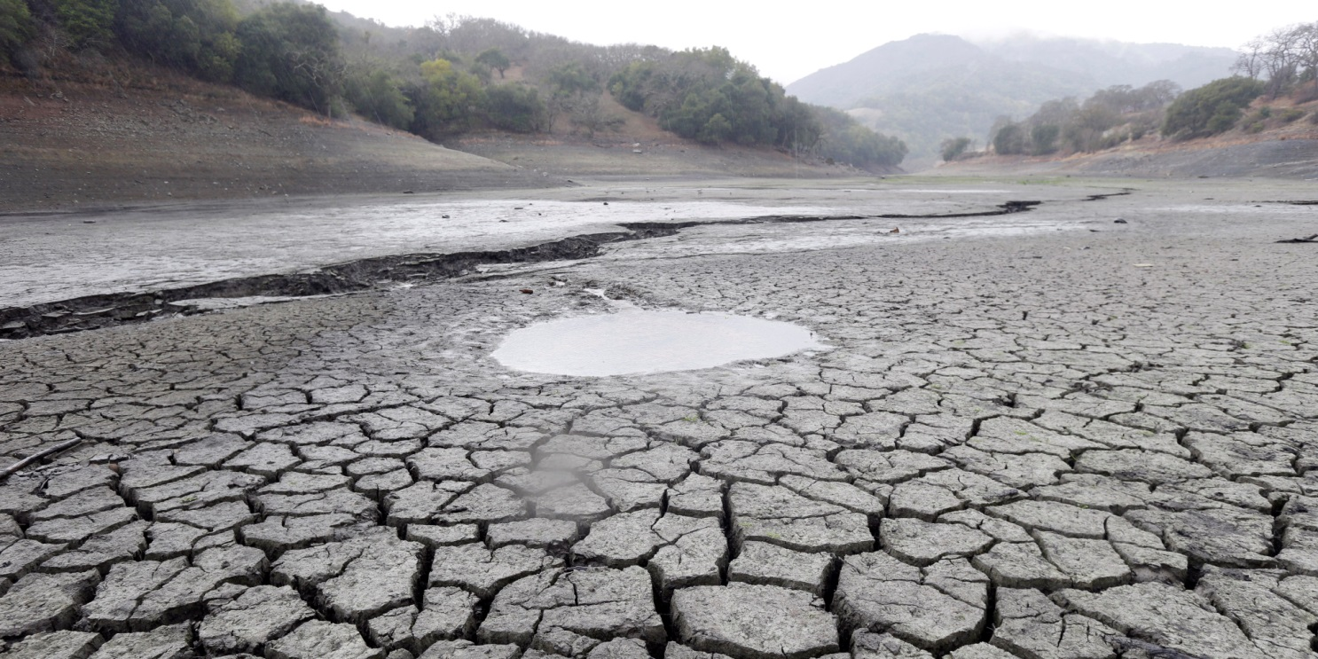
Droughts!!
Droughts are so dry they can dry up water They can last for 3 weeks or 100 years. The ground can become so dry that a fire can start! People can die because the lack of food. Also plants and animals can die.

Slide 9
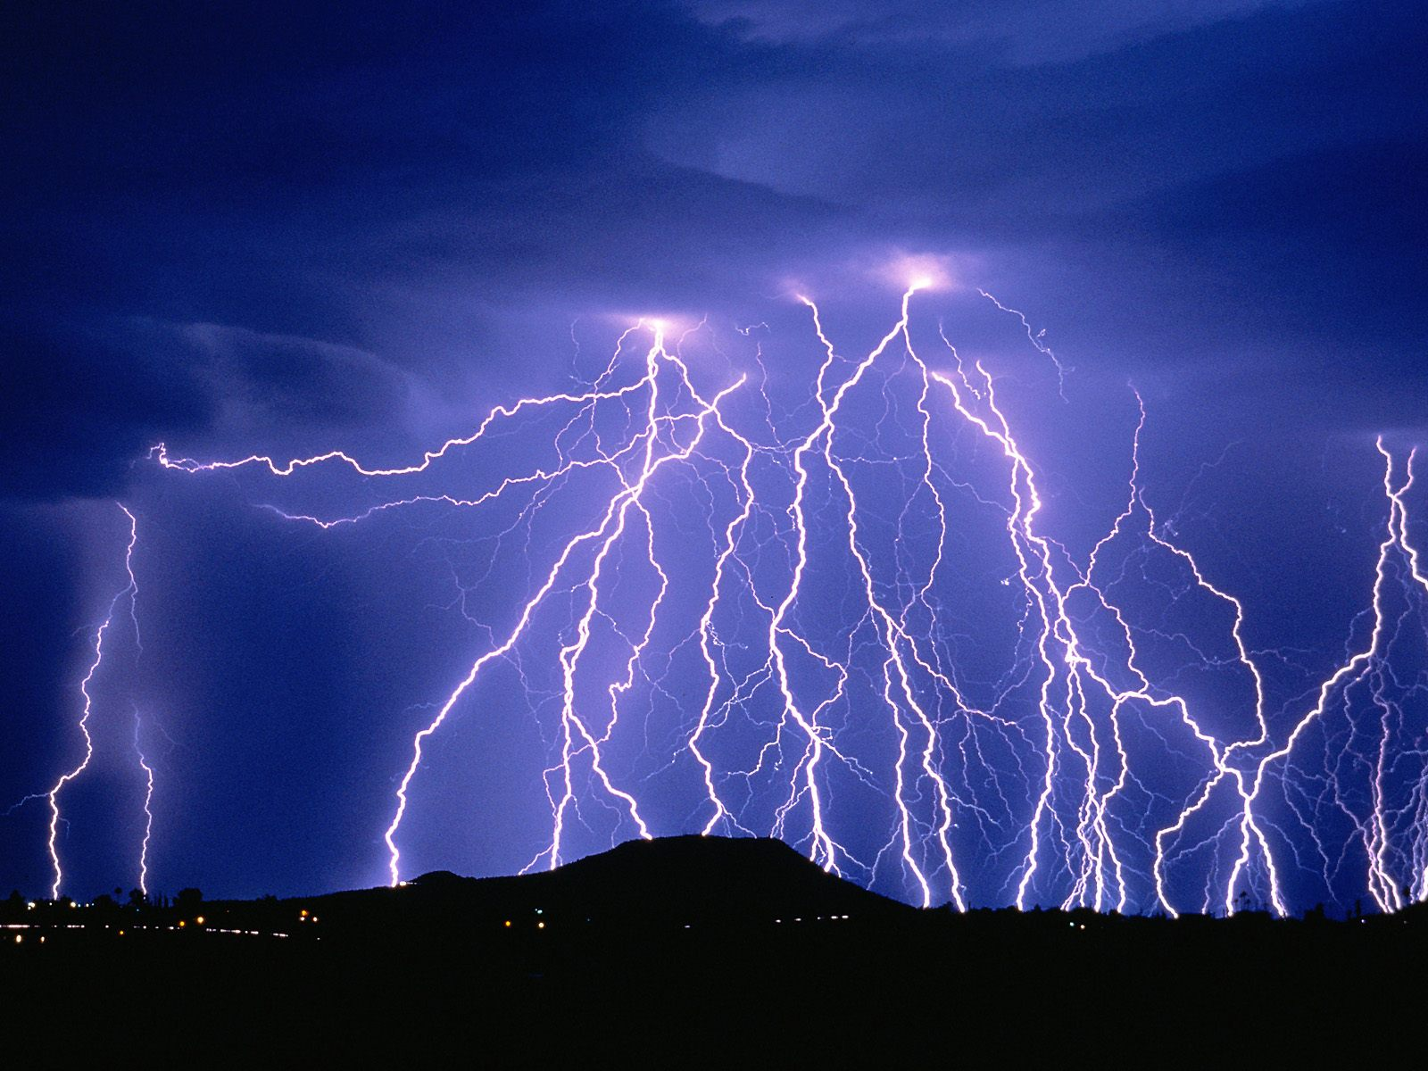
Lightning!!
Lightning is violently moving ice crystals.
Every second of the day more than 100 lightning bolts strike the Earth. The speed of lightning is sixty thousand miles per second.

Slide 10
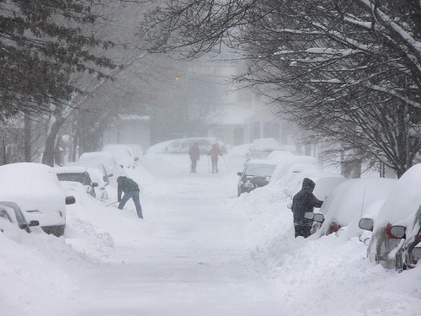
Extreme Weather Blizzards!!
Bilzzards go faster than 35 miles an hour. Temperatures are below zero. 76 inches of snow fell in April 1921 in Silver Lake, Colorodo in just one day! Too much snow can lead to floods when it melts.

Slide 11
Extreme Weather Hurricanes!!
Hurricanes can cause property damage and are dangerous to all living things. They form over hot water in the seas. They are the planets most violent storms.

Slide 12
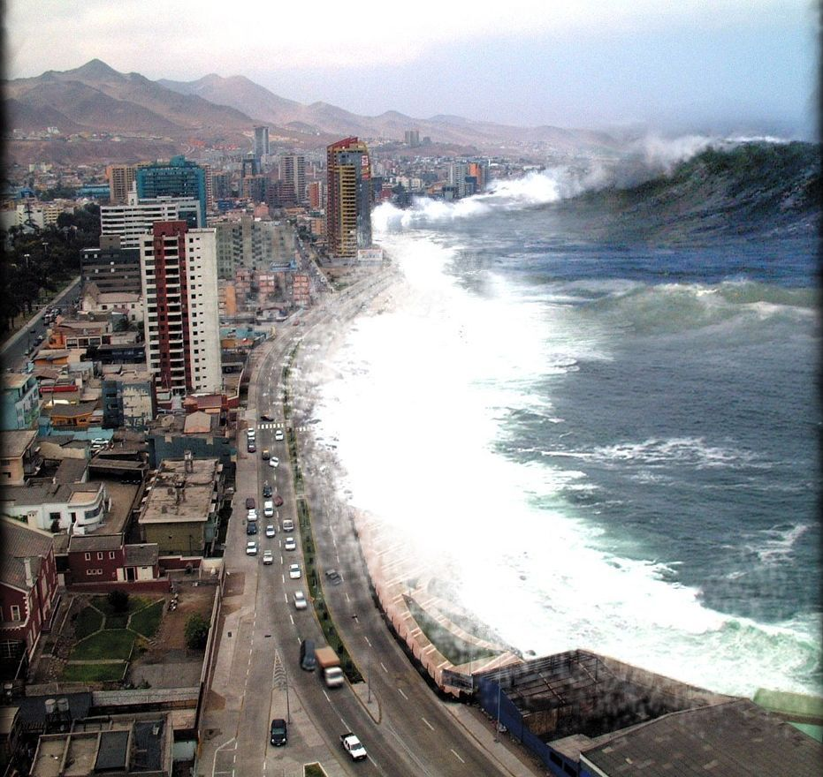
TSUNAMIS!!
A tsunami is a wave that forms after a big earthquake in the land under the ocean water that causes lots of damage. They cause huge waves. And they can flood the land. People can drown because of so much water.

Slide 13
Red Cross
There are tornadoes, blizzards, and much more but the Red Cross is prepared for disasters.The Red Cross helps the people who were hurt during the disasters.

