Slide 1
Ecology Notes Pages 1-7
By Sabastian Esparza Period 6

Slide 2
Science School Email
To: f_last@stu.chino.k12.ca.us
Cc:
Subject: Class expectations <-- short subject
Dear student <-- Polite greeting
Please log on early, be visible engage and respond, think, and ask for help.
Thank you
Student <-- complete name
Period <-- and period
True /20 Not graded
Helpful 18/20 your grade
Inspiring 0/20 not turned in
Necessary
Kind

Slide 3
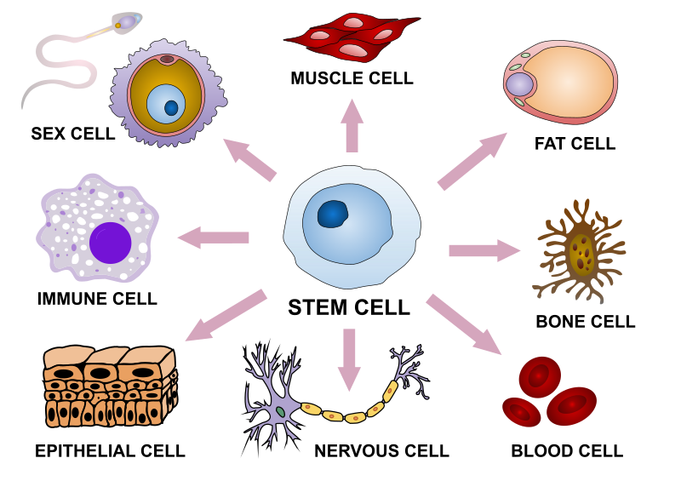
Cell theory
All living things are composed of cells
Cells are the basic units of structure and function living things
All cells are produced from other cells

Slide 4
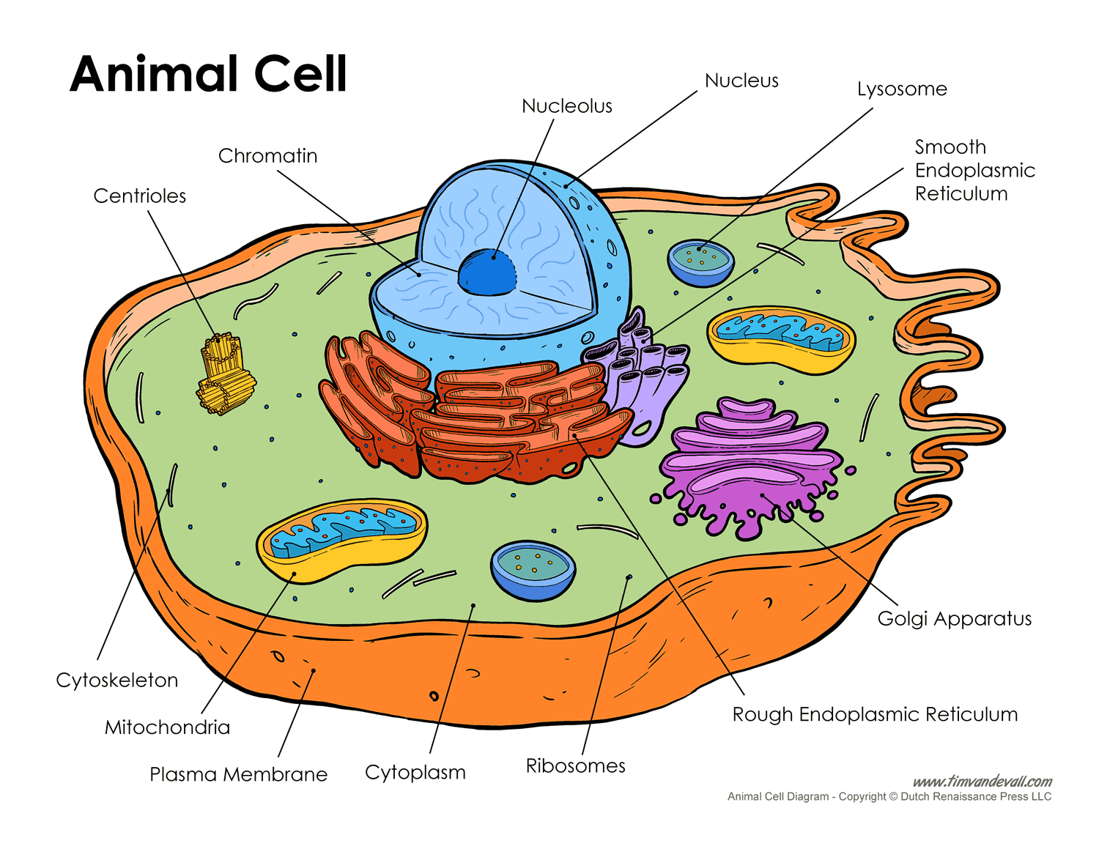
Plant Cell and the Animal Cell

Slide 5
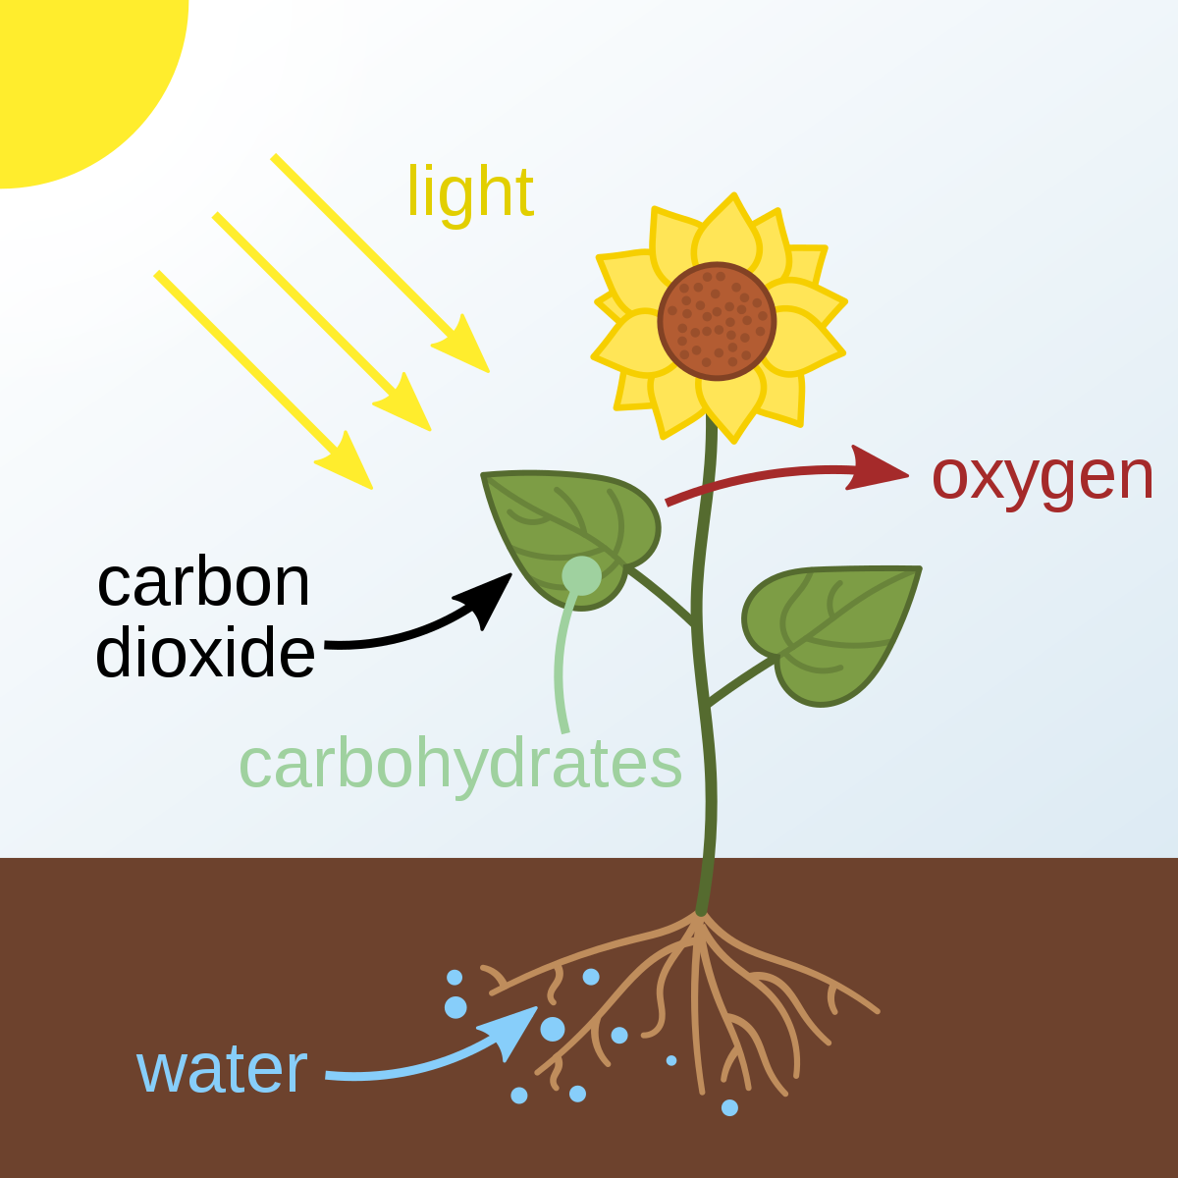
Photosynthesis
6CO2+6H2O--->C6H12O6+6O2
Carbon Dioxide plus water with sunlight yields glucose plus oxygen

Slide 6
Cellular Respiration
C6H12O6+6O2-->6CO2+6H2O (ATP)
Glucose plus oxygen, yields carbon dioxide plus water with energy

Slide 7
Photosynthesis, Cellular Respiration Cycle
Oxygen --------------------->
Sugar glucose ---------------->
<----------Water
<------------Carbon dioxide

Slide 8
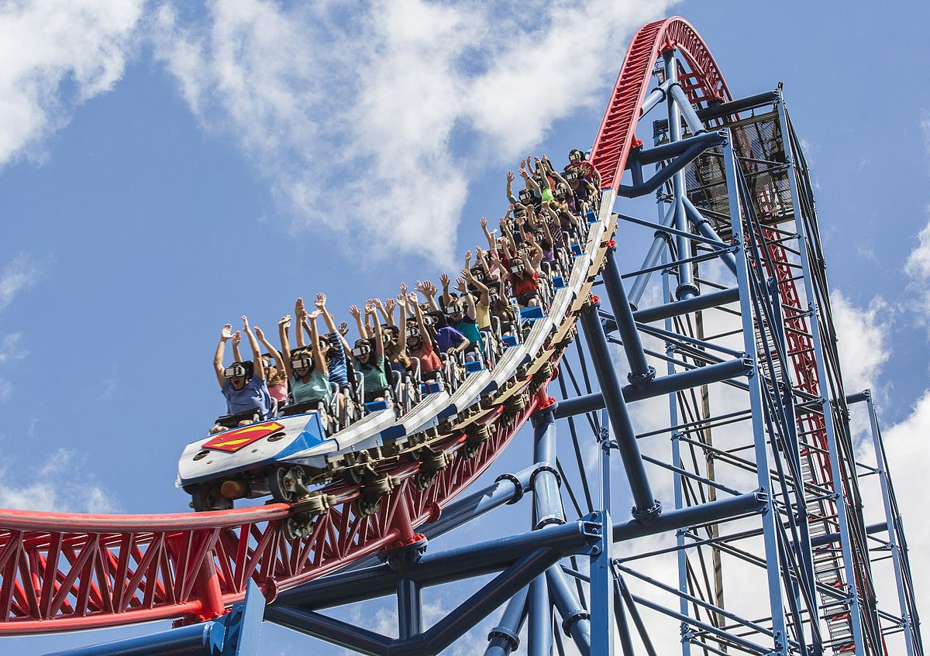
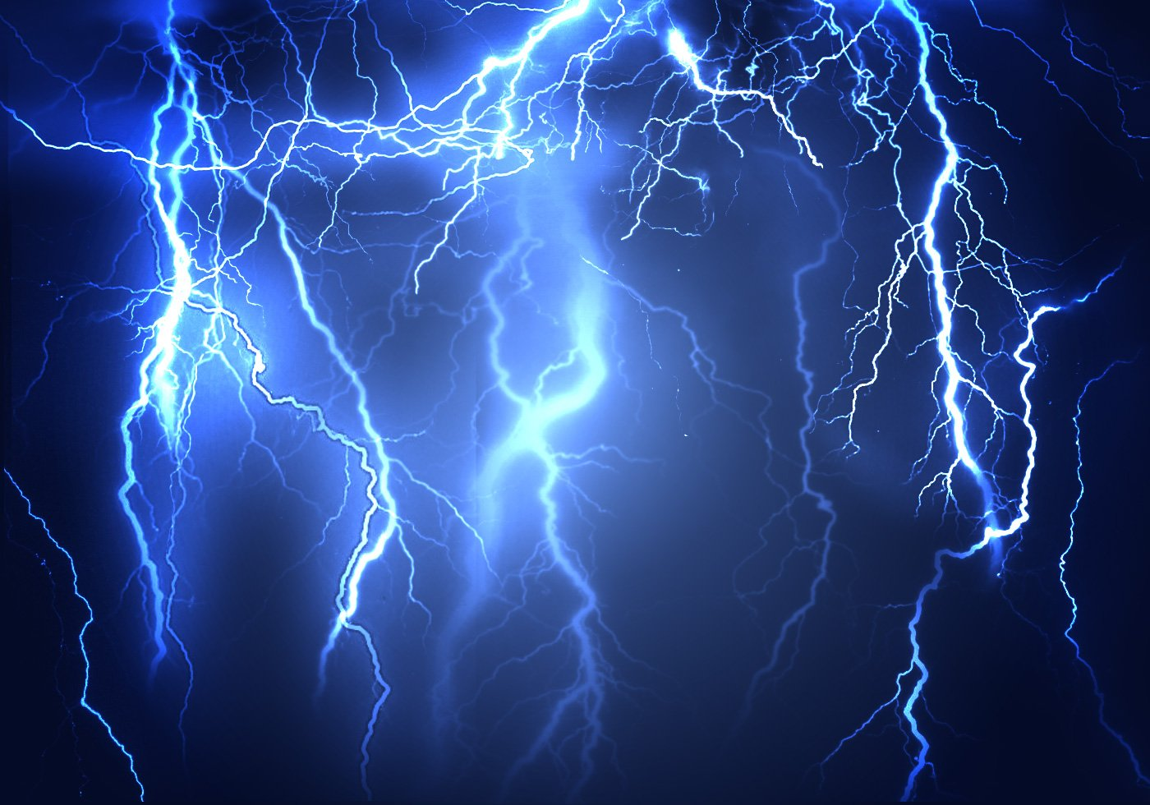
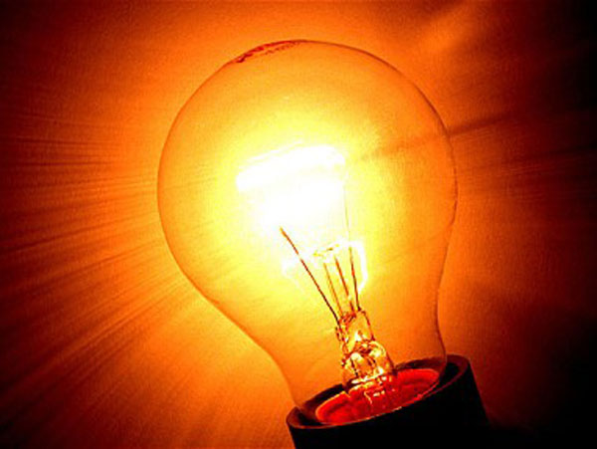
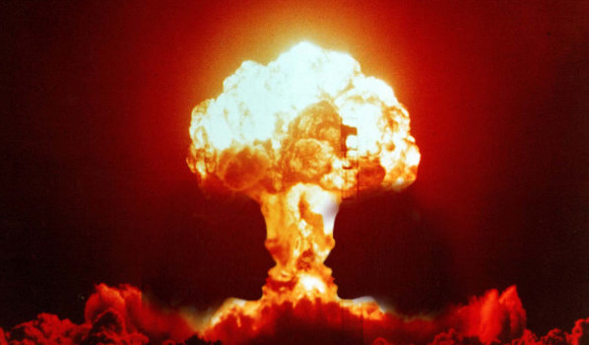
Energy, Is the ability to do work, transfer heat or cause change.
Mechanical
Mechanical, Motion and position
Electrical, flows of electrons
Radiant, forms of light energy
Chemical, stored in bonds
Nuclear, splitting atoms
Thermal, heat
Electrical
Radiant
Chemical
Thermal
Nuclear

Slide 9
This must be the last page in the PowerPoint
Instructions
Turn your notes into a complete, detailed PowerPoint presentation. You must do more than just insert photos of your notes, but you may include the pictures you drew as part of your presentation. You may use internet pictures as well and you can be creative with the fonts and colors.

