Slide 1
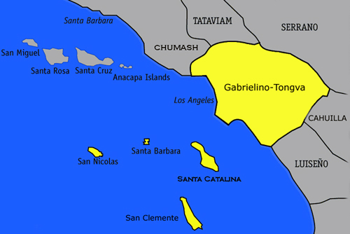
Location
South Topanga to Laguna Beach
Near the Los Angeles River and near the Channel inlands
Lived along the Southwestern Coast of the CA

Slide 2
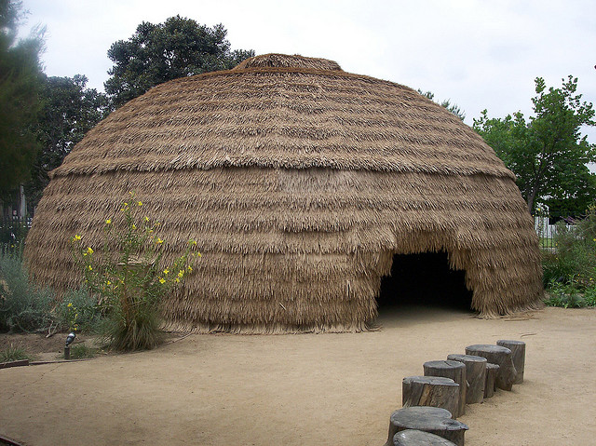
THE GABRIELINO TRIBE
MATT AND VICTORIA

Slide 3
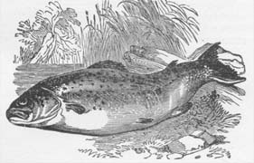
FOOD
They boiled cereal called mush.
They ate pine nuts in their tribe.
They also ate seeds and fruit.
They caught fish, swordfish, and seals.

Slide 4
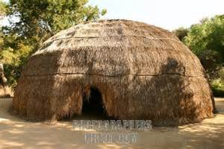
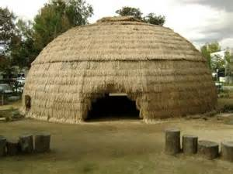
SHELTER
Gabrielino shelter is made of bent tree
saplings covered with tule mats.
Their shelter was up to six inches thick.
The Gabrielino homes are 15 to 50 feet long.

Slide 5
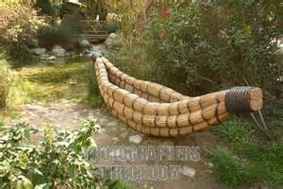
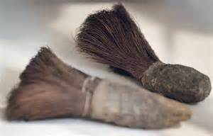
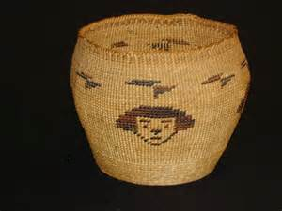
CULTURE
Their biggest ceremony was for the ones who died.
They made wicker seed beating tool.
They were expert basket makers.
They made cleaning tools out of plant roots.

Slide 6
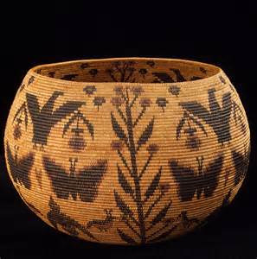
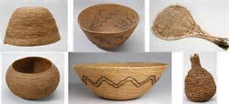
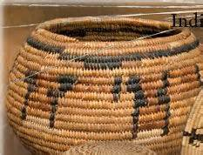
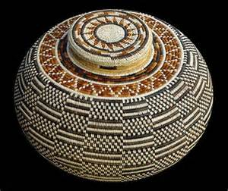
THE END

