Slide 1
The Supreme Court At Work
Ch 12 sec 1

Slide 2
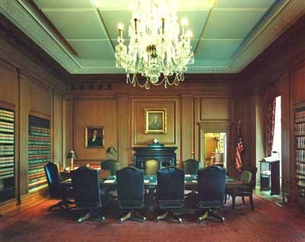
I. The Court’s Procedures
During two-week sessions, justices hear oral arguments on cases from Mondays through Wednesdays, and then meet in secret to make decisions.
Notes:
http://static.howstuffworks.com/gif/supreme-court-appointment-11.jpg

Slide 3
I. The Court’s Procedures
The justices consider arguments in cases they have heard and petitions from plaintiffs who want the Court to hear their cases, and then write opinions for cases they have decided
Notes:
http://www.fotosearch.com/comp/IMZ/IMZ140/pgi0111.jpg

Slide 4
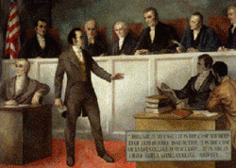
I. The Court’s Procedures
Justices’ written opinions interpret the law and help shape public policy.
Recently, more than 8000 cases were appealed to the Supreme Court. Only 5 percent of those cases were heard.
Notes:
http://content.answers.com/main/content/wp/en/thumb/e/e2/250px-Smdartmouth-case.gif

Slide 5
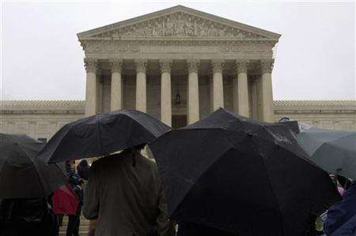
I. The Court’s Procedures
The Court may decide several hundred cases, but not have a full hearing or a written opinion on each case.
Notes:
http://www.sciam.com/media/externalnews/2006-11-29T184948Z_01_NOOTR_RTRIDSP_2_SCIENCE-USA-COURT-WARMING-DC.jpg

Slide 6
II. How Cases Reach the Court
The majority of referred Court cases concern appeals from lower courts.
Most appeals concern cases in which a lower state or federal court has ruled laws unconstitutional. Cases the Court chooses not to hear are dismissed, and the ruling of the lower court becomes final.
Notes:
http://jaytv.com/larrys/images/rejected.jpg

Slide 7
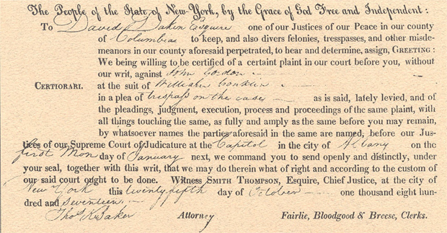
II. How Cases Reach the Court
Most cases reach the Court by writ of certiorari, in which either side petitions that a lower court’s decision involved an error raising a serious constitutional issue.
But even that is no guarantee that the Court will hear the case.
Notes:
http://www.courts.state.ny.us/history/elecbook/duely/images/pg40_cert.jpg

Slide 8
II. How Cases Reach the Court
The chief justice puts worthy certiorari cases on a list for discussion; two-thirds of all certiorari cases never make the list. If four of the nine justices agree, a case is accepted.
Notes:
http://www.longfellow.spps.org/sites/c26e1883-0101-4059-af6f-b84a796e64fa/uploads/stock-hands_03_2_4.jpg

Slide 9
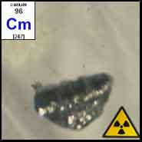
II. How Cases Reach the Court
More than half of the cases are decided by a brief, unsigned per curiam opinion; the rest are given the Court’s full consideration.
Notes:
http://www.webqc.org/elements-photo/Curium.jpg

Slide 10
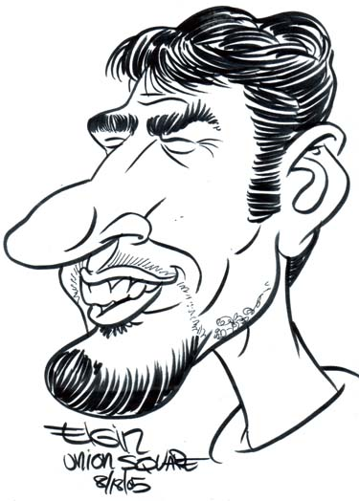
III. Steps in Deciding Major Cases
Each side submits a brief detailing legal arguments, facts, and precedents. Parties not directly involved but with an interest in the case may submit amicus curiae briefs.
Notes:
http://subwaysurfer.com/wp-content/big%20nose%20dude.jpg

Slide 11
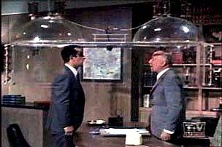
III. Steps in Deciding Major Cases
Lawyers for each side make oral arguments during which justices may ask questions.
On Fridays the chief justice presides over a secret conference, in which each single case is summarized and recommendations for handling it are made.
Notes:
http://www.hojohnlee.com/weblog/wp-content/cone-of-silence.jpg

Slide 12
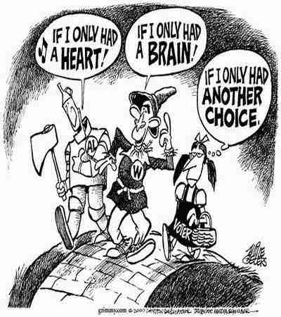
III. Steps in Deciding Major Cases
Justices spend about 30 minutes debating each case. Each justice has one vote; a majority vote is needed to decide a case.
Notes:
http://www.geocities.com/thenightlyreport/Voting.jpg

Slide 13
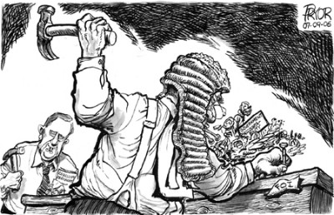
III. Steps in Deciding Major Cases
The justices may issue four kinds of opinions: a unanimous decision, a majority opinion, a concurring opinion, or a dissenting opinion.
Notes:
http://www.sauer-thompson.com/archives/opinion/PryorGA1.jpg

Slide 14
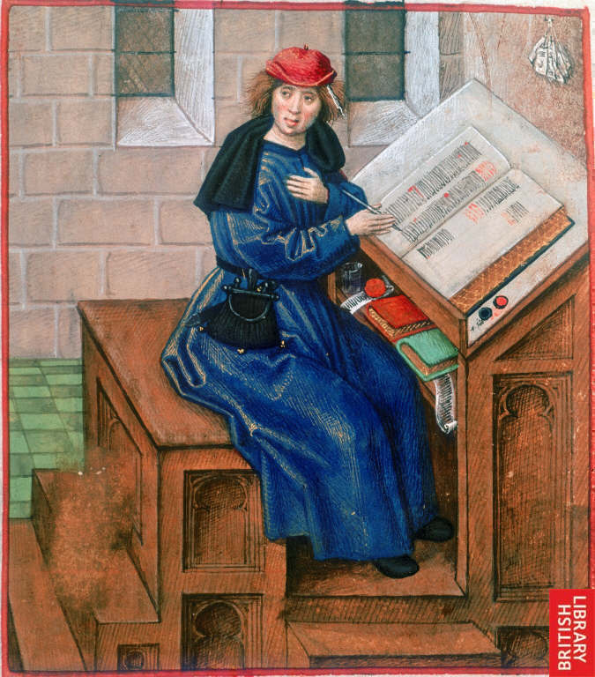
III. Steps in Deciding Major Cases
If the chief justice votes with the majority, he or she assigns a justice in the majority to write the Court’s opinion. If not, the most senior justice with the majority assigns a justice to write the opinion.
Notes:
http://www.imagesonline.bl.uk/britishlibrary-store/Components/15/1500_2.jpg

Slide 15
In your notebook
In what way has a Supreme Court decision affected you, your family, or your community directly?

