Slide 1
The House of Representatives
Ch 5 sec 2

Slide 2
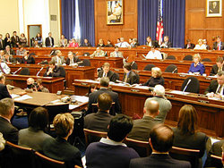
I. Rules for Lawmaking
Each house of Congress has complex rules to help members conduct business.
Congress carries out most of its work by committees. Because of its large membership, committee work is even more important in the House than in the Senate.
Notes:
http://career.utk.edu/dco/images/stack%20of%20books.jpg
http://z.about.com/f/wiki/e/en/thumb/d/d9/US_House_Committee.jpg/250px-US_House_Committee.jpg

Slide 3
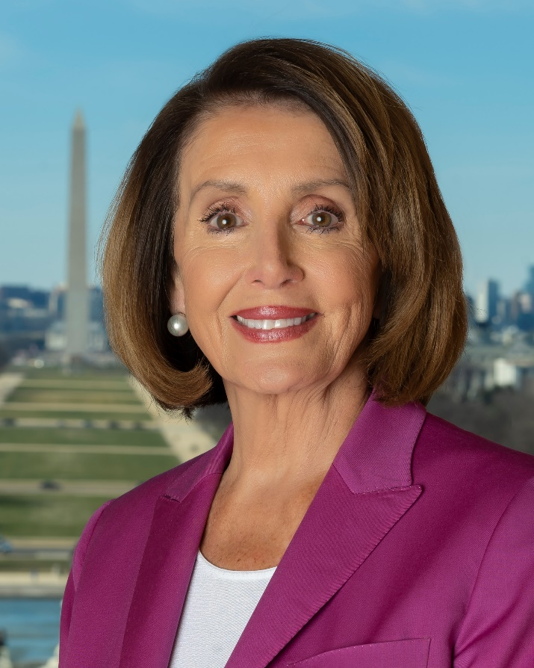
I. Rules for Lawmaking
Party membership guides Congress in its work, since the majority party in each house organizes the committees, appoints committee heads, and can change the rules by which the House operates.
Notes:
https://www.google.com/url?sa=i&rct=j&q=&esrc=s&source=images&cd=&ved=2ahUKEwj4z9Lap93kAhWvGTQIHSamDvUQjRx6BAgBEAQ&url=https%3A%2F%2Fen.wikipedia.org%2Fwiki%2FNancy_Pelosi&psig=AOvVaw2-AcWATIC189kErDTIlUej&ust=1568997068918932

Slide 4
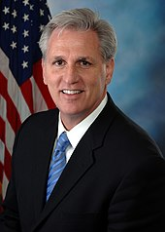
II. House Leadership
The Speaker of the House is leader of the majority party and has great power and influence over its members.
Floor leaders of both the majority and minority parties are party leaders who schedule the work of the House and help steer bills through committees.
Notes:
https://www.google.com/url?sa=i&rct=j&q=&esrc=s&source=images&cd=&ved=2ahUKEwiglNSiqN3kAhUMHTQIHdTkBEgQjRx6BAgBEAQ&url=https%3A%2F%2Fen.wikipedia.org%2Fwiki%2FKevin_McCarthy_(California_politician)&psig=AOvVaw0DFyCEY_SIG8_aSuG3f3-S&ust=1568997216790613

Slide 5
II. House Leadership
Party whips assist the floor leaders in persuading party members to support laws the party favors.
Notes:
http://upload.wikimedia.org/wikipedia/en/7/70/DevoFreedomofChoice.jpg

Slide 6
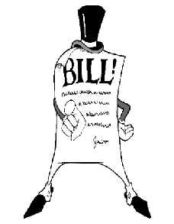
III. Lawmaking in the House
Members attend House floor sessions to vote on legislation.
All laws begin as bills introduced in the House, then go to committee. If approved there, they are put on the proper calendar, listing in order in which they will be considered on the House floor.
Notes:
http://bond.senate.gov/images/bill.gif

Slide 7
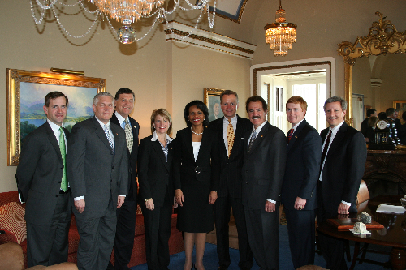
III. Lawmaking in the House
The House Rules Committee receives all bills approved by the various committees of the House.
The Rules Committee determines which bills will be considered by the full House and places them on the House Calendar.
Notes:
http://gingrey.house.gov/UploadedPhotos/MediumResolution/2135da77-1fa5-4455-b02c-a4a44158f6a6.jpg

Slide 8
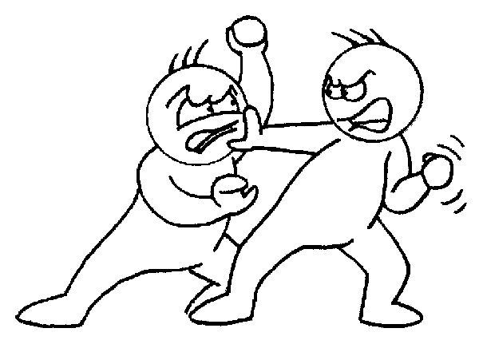
III. Lawmaking in the House
The Rules Committee also settles disputes among other House committees and delays or blocks bills that representatives and House leaders do not want to come to a vote.
Notes:
http://tell.fll.purdue.edu/JapanProj/FLClipart/Verbs/fight.gif

Slide 9
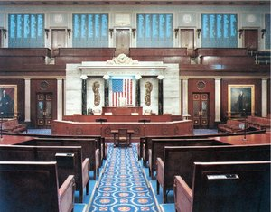
III. Lawmaking in the House
When the Rules Committee sends bills to the floor, the House may sit as a Committee of the Whole, in which 100 members constitutes a quorum, in order to speed up consideration of an important bill, so that the full House can then vote on it.

Slide 10
Assignment
Write down what you think would be the most satisfying part about being a Representative, and the most frustrating part. Explain your answers.

