Slide 1
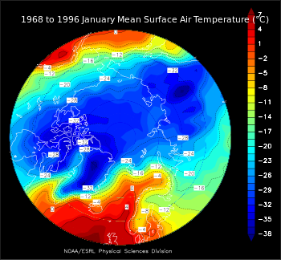
Weather and Climate
By:Yoliet and Jared
This Photo by Unknown author is licensed under CC BY-SA.

Slide 2
Tropical Climate Zone
Tropical Climate Zone
Hot temperatures all year long
Frost free
Sunlight is intense
Only 2 seasons-wet and dry seasons
Humid
This Photo by Unknown author is licensed under CC BY.

Slide 3
Temperate Climate Zone
Good weather not too hot or cold
4 seasons
Mid latitude climate
Far from equator
Mild climate
Widest seasonal changes
Divided into smaller zones
This Photo by Unknown author is licensed under CC BY-SA.

Slide 4
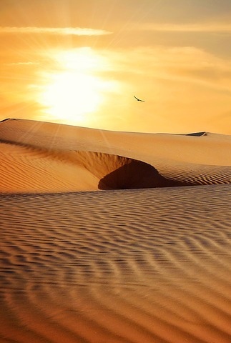
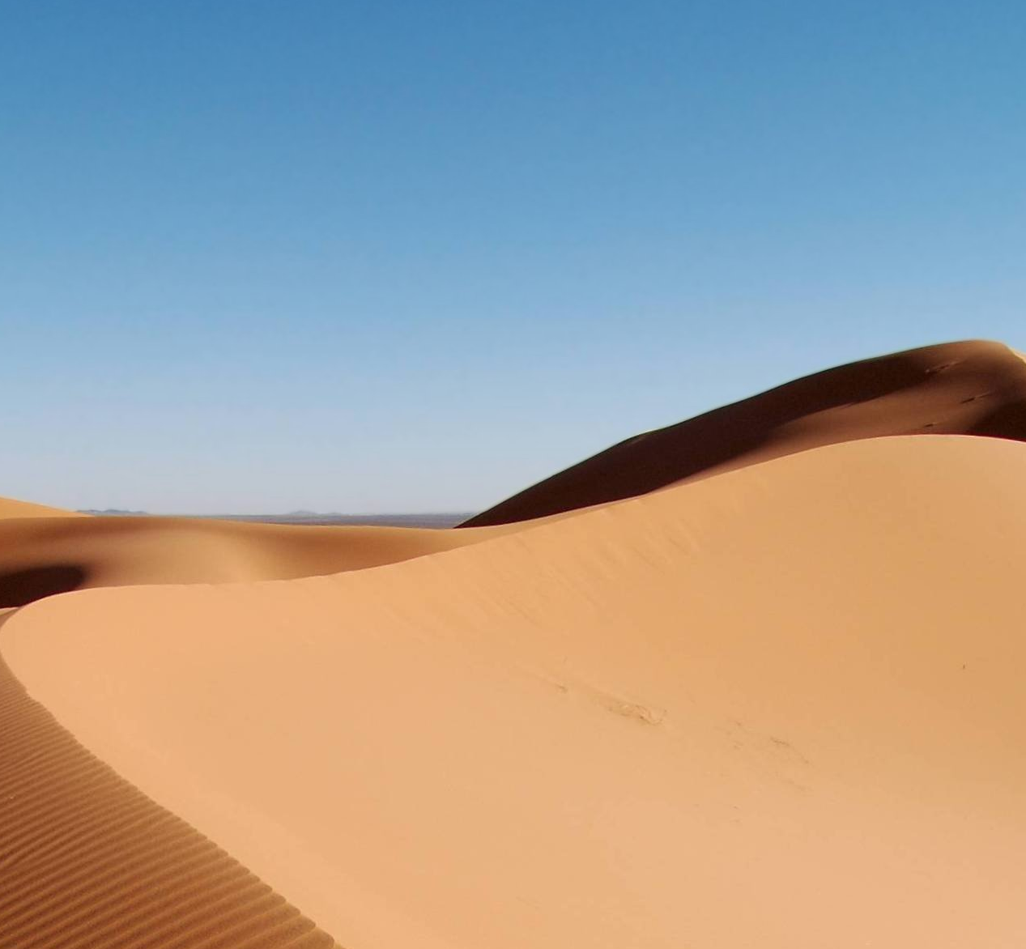
Desert Climate Zone
Very hot and dry temperatures
Gets cold in winter
High temperatures gets to 120 degrees
Covers 14.2% of Earth's surface
Deserts cover Arizona, Nevada, Utah, Colorado, and New Mexico
This Photo by Unknown author is licensed under CC BY-SA.

Slide 5
Polar Climate Zone
The average temperature is below 10 and 50 degrees
Covers 20% of Earth's area
Polar climates are in Antartica and the Arctic
Far from equator
This Photo by Unknown author is licensed under CC BY-SA.
This Photo by Unknown author is licensed under CC BY-SA.

Slide 6
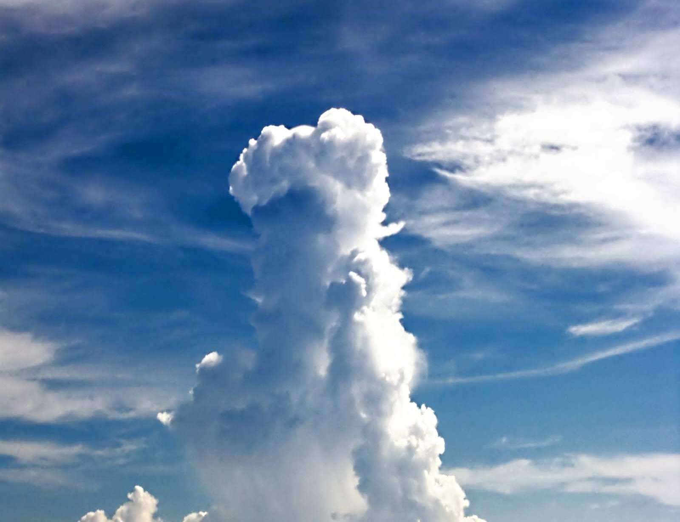
Cumulus Clouds
Bring nice weather
Appear during fair weather
Are piles of white clouds that billow in the sky
Are white and fluffy
Can make shapes
Range from 5,000 to 10,000 feet in the air
This Photo by Unknown author is licensed under CC BY-SA.
This Photo by Unknown author is licensed under CC BY-SA-NC.

Slide 7
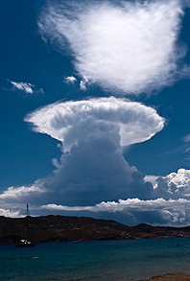
Cumulonimbus Clouds
Are known as thundercloud because they bring thunder
Range up to 20,000 feet
Bring high winds
Forms from water vapor
Typically reach to as much as 12,000 meters
This Photo by Unknown author is licensed under CC BY-SA.
This Photo by Unknown author is licensed under CC BY-SA.

Slide 8
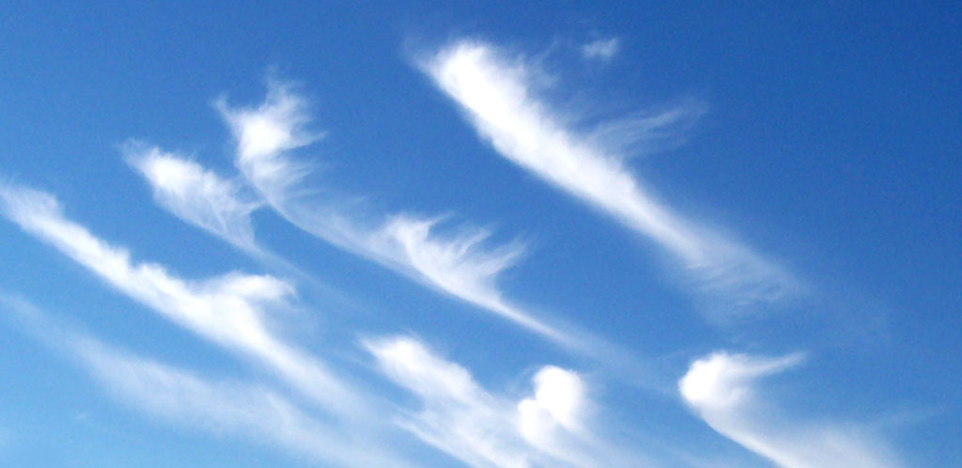
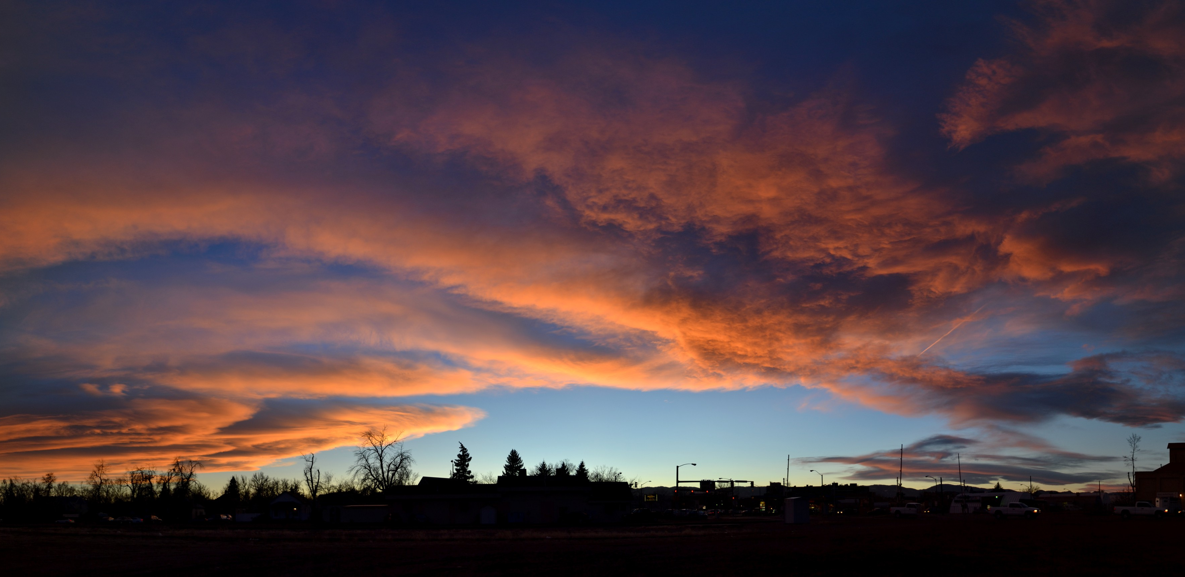
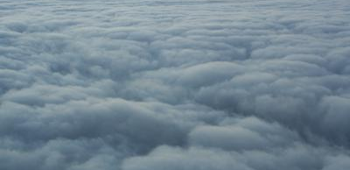
Stratus Clouds
Is a blanket of grey clouds
Doesn't cause rain
Low level clouds
Does not indicate much meteorlogical activity
Can have fog
Produce hazy and grey veil
This Photo by Unknown author is licensed under CC BY-SA-NC.
This Photo by Unknown author is licensed under CC BY-SA.
This Photo by Unknown author is licensed under CC BY-SA.

Slide 9
Stratonimbus clouds
Have rain and snow
Blanket of dark clouds
No lightning
Clouds that form from 2,000 meters
Low based cloud
This Photo by Unknown author is licensed under CC BY-SA.
This Photo by Unknown author is licensed under CC BY-SA.

Slide 10
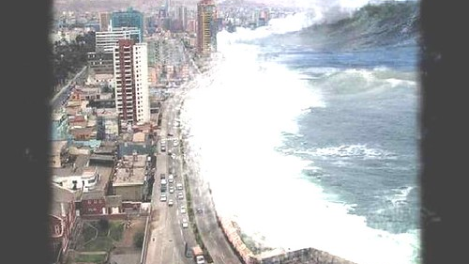
Extreme Weather Tsunami
A Tsunami is a big wave of water by land shifts, volcanoes and earthquakes. Tsunamis mostly happen in Asia. Slow down when they reach land but gets high. Earthquake in India ocean of Indonesia made a tsunami killed 200,000 people in 14 countries.
This Photo by Unknown author is licensed under CC BY-NC.
This Photo by Unknown author is licensed under CC BY-SA-NC.
This Photo by Unknown author is licensed under CC BY-NC-ND.

Slide 11
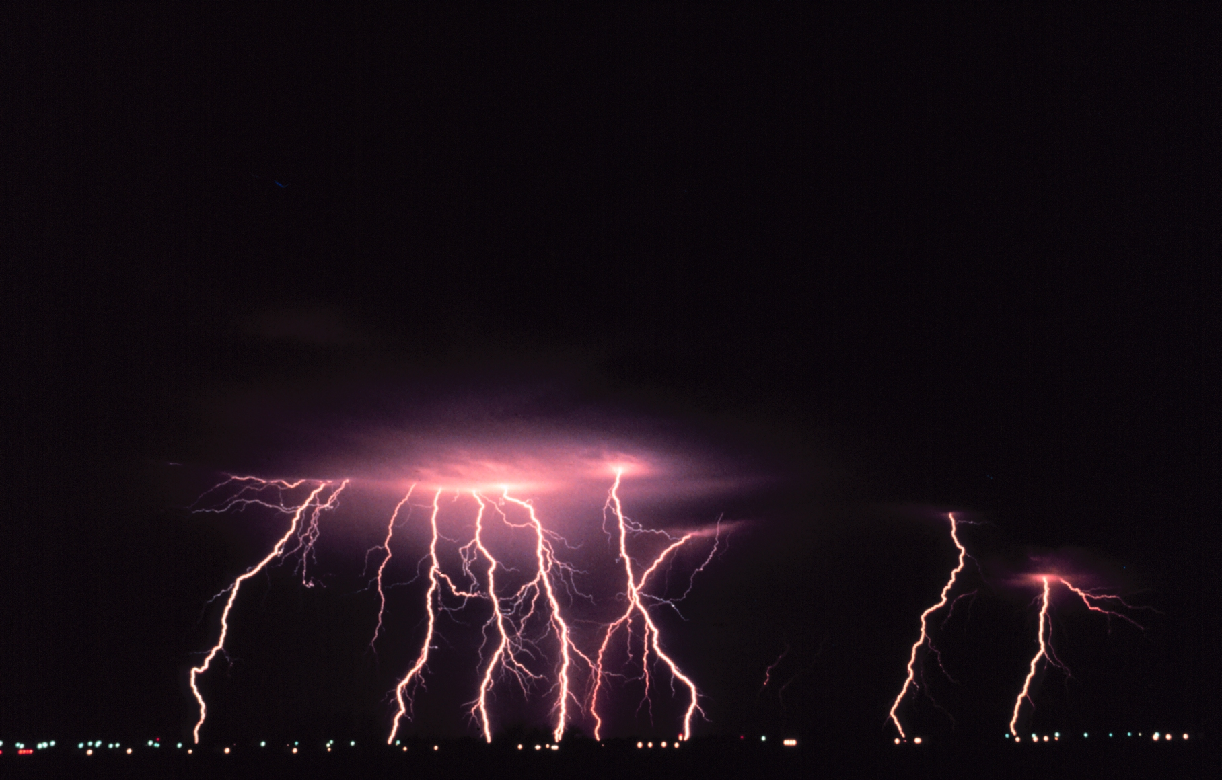
Extreme Weather Lighting
It's a violent Electric discharge. They come usually during thunder storms. It’s a bright flash of electricity. It's as hot as 54,000 degrees F. The color is white and yellow
This Photo by Unknown author is licensed under CC BY-SA.

Slide 12
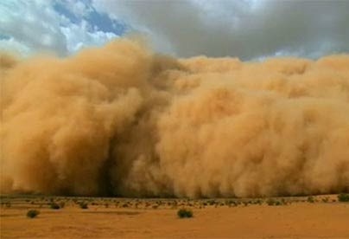
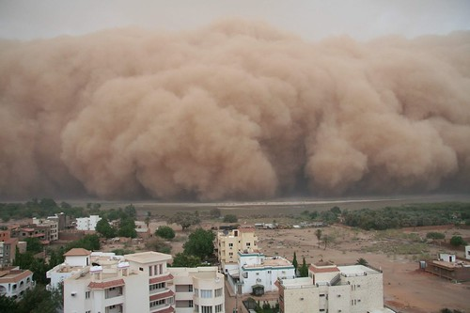
Extreme Weather Dust Storm
They happen in dry area
The wind speed gets up to 25 mph
Air and dust form a dust storm
Dust storms can reach the height of 5000 feet
In order to survive you have to have high ground
This Photo by Unknown author is licensed under CC BY-SA-NC.
This Photo by Unknown author is licensed under CC BY-NC-ND.
This Photo by Unknown author is licensed under CC BY-NC.

Slide 13
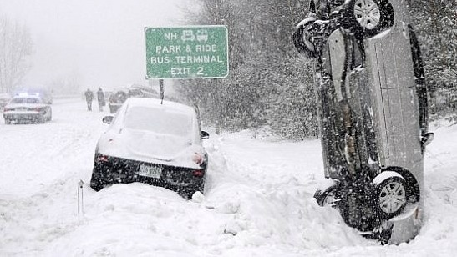
Extreme Weather Blizzards
Is a strong snow storm.
The winds gets up to 56 mph.
Blizzards are caused by cold air, moisture, and lift.
They happen in the NE part of North America.
Wind blows faster than 35mph and it gets colder than 20F.
This Photo by Unknown author is licensed under CC BY-SA-NC.

