Slide 1
Extreme Weather
By Antonio and Alaa

Slide 2
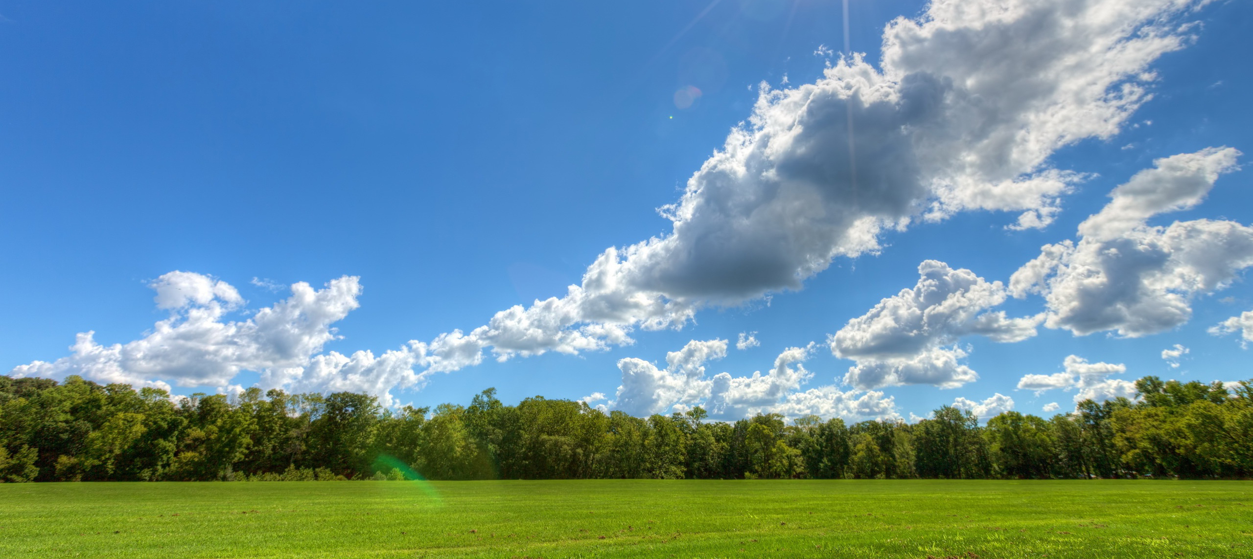
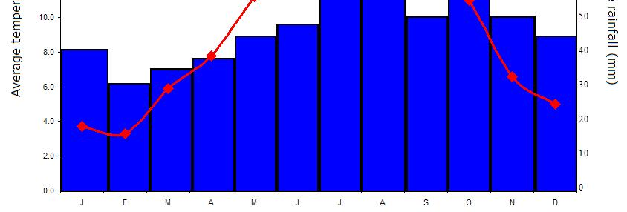
Difference Between Climate and Weather
The difference between climate and weather is that climate affects the health of people, plants, and animals. Climate even affects the soil, the air, and water. Weather is the temperature of many places.

Slide 3
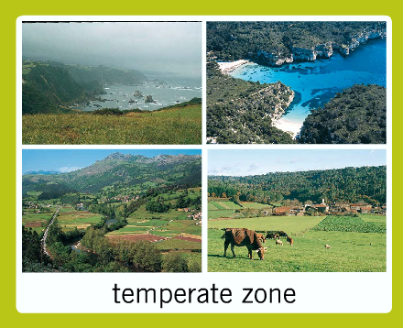
Temperate Climate Zone
The temperate Marine Zone of the Pacific northwest is cool and wet throughout the year. The Pacific Ocean helps create the cool moist weather.

Slide 4
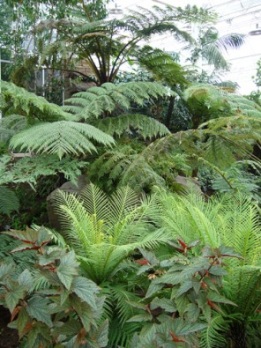
Tropical Climate Zone
This is named for their closeness to the equator. Water evaporates during the day, cools down, then rains daily. It is very hot and humid. The plants grow easily in the tropical climate zone.

Slide 5
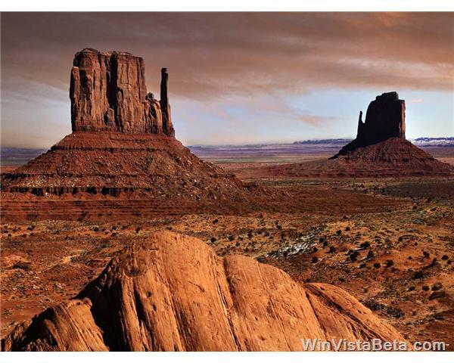
Desert Climate Zone
A desert is a hot area that has little grass and little rain. It is unusually hot in the desert climates. In fact the ground gets so hot that it heats the air. Many deserts are sandy and barren. Very few plants grow there. The desert is located on the edge of the mountain.

Slide 6
Polar Climate Zone
The Artic and Antarctica are similar places at opposite ends of the earth. They are both very cold with lots of snow and ice. Winters are dark and in the summer the sun shines 24 hours a day.

Slide 7
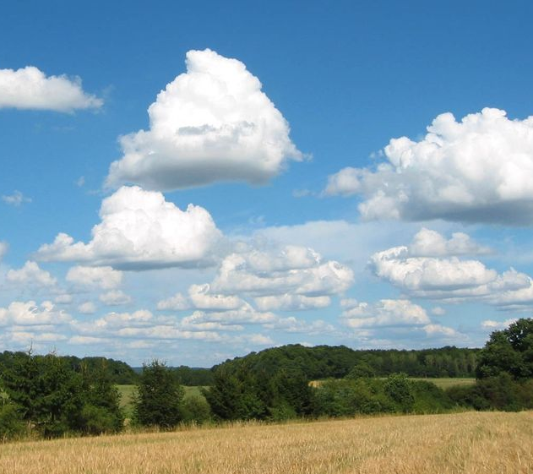
Cumulus
The cumulus clouds are fluffy, harmless, nice weather, and no storms but this cloud can change. The Cumulus cloud is 10,000 feet high up in the air.

Slide 8
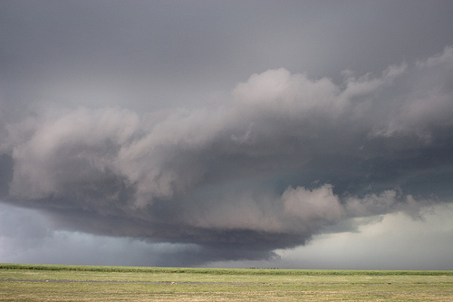
Cumulonimbus
The cumulonimbus cloud brings big storms and rain and lightning, and this storm last less than an hour. The Cumulonimbus cloud is 15,000 feet high in the air.

Slide 9
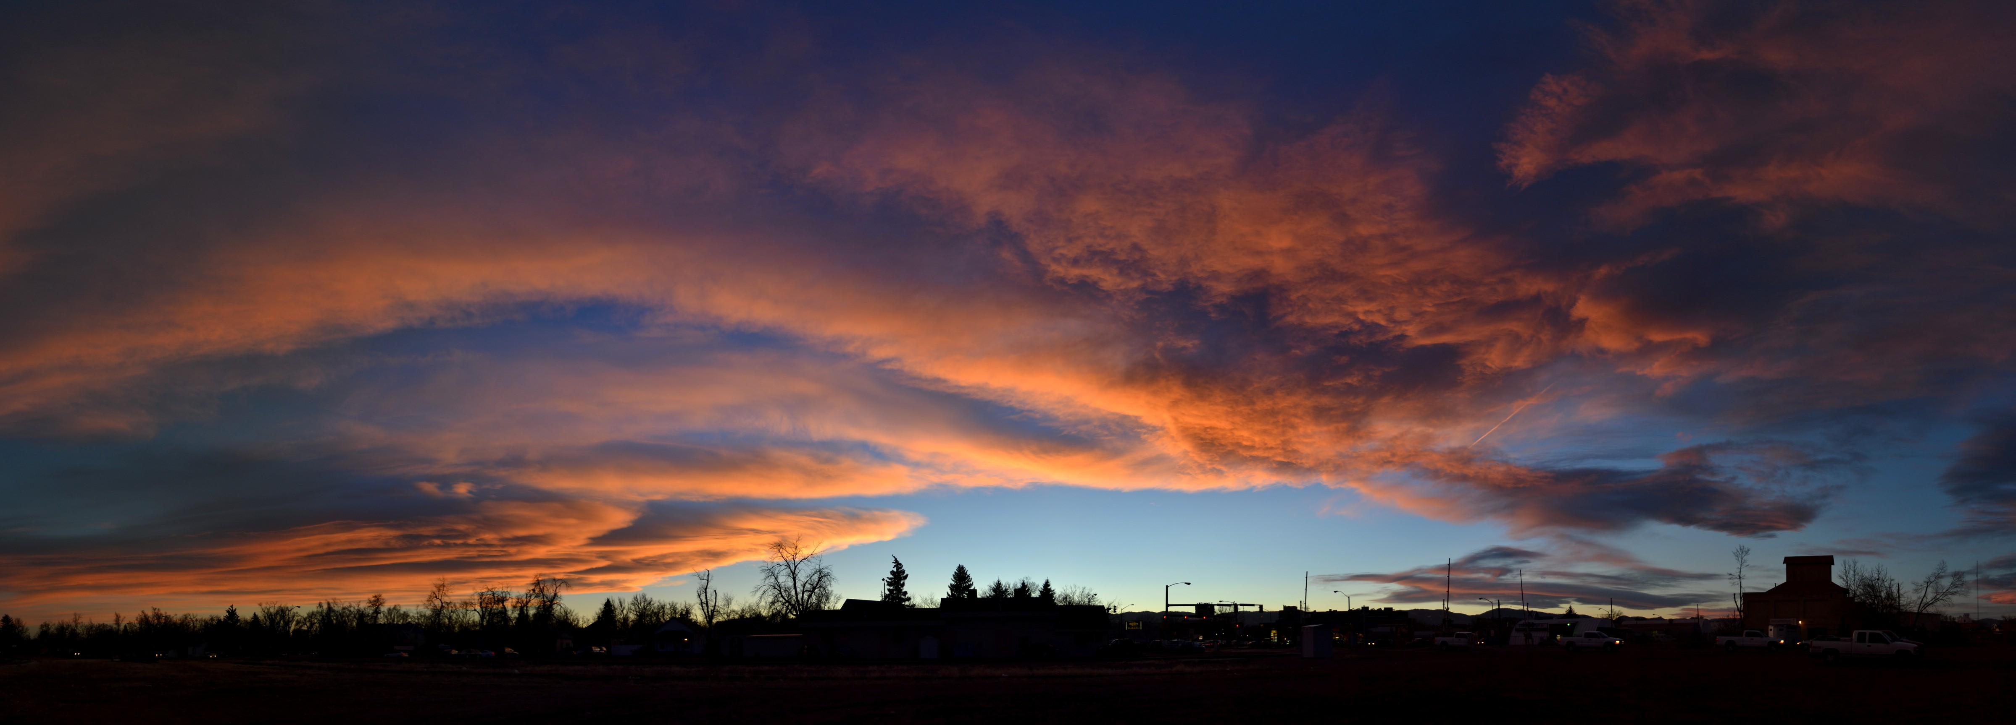
Stratus
The stratus cloud spread out with gloomy skies but no storm, but this cloud can change. The stratus cloud is 5,000 feet up in the air.

Slide 10
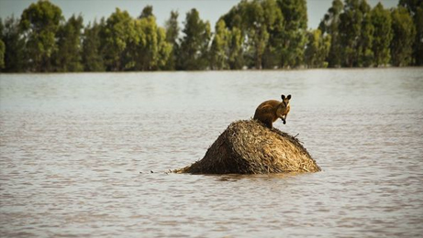
Floods
A flood is when water overflows and goes into land. If it rains a lot in rivers, there can be a flood. Wetlands can be flooded. Floods can cause a lot of people and animals to die. Floods can be very costly natural disasters. Some floodplains can turn into farmland.

Slide 11
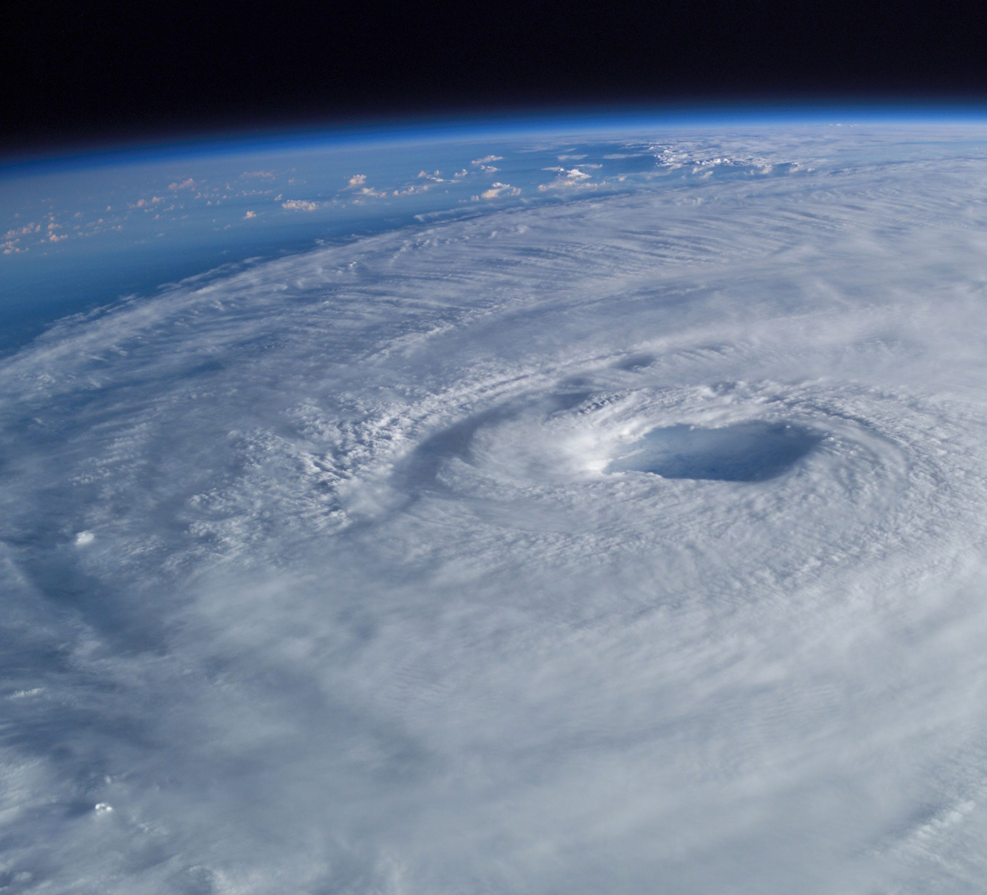
Hurricane
Hurricanes blow strong winds, tall waves crash against the coast. The hurricanes start over the ocean. Clouds form in warm, wet air above the ocean. The clouds grow larger, they begin to turn like a huge wheel. The clouds become a tropical storm.

Slide 12
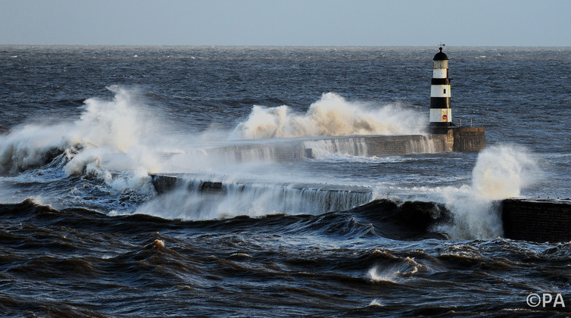
Storm Surge
Storm surge happen when tropical storms come near to shore. A storm surge wave can be several meters high. Thunder can make tornados, flood places, bring hail, and break trees.

Slide 13
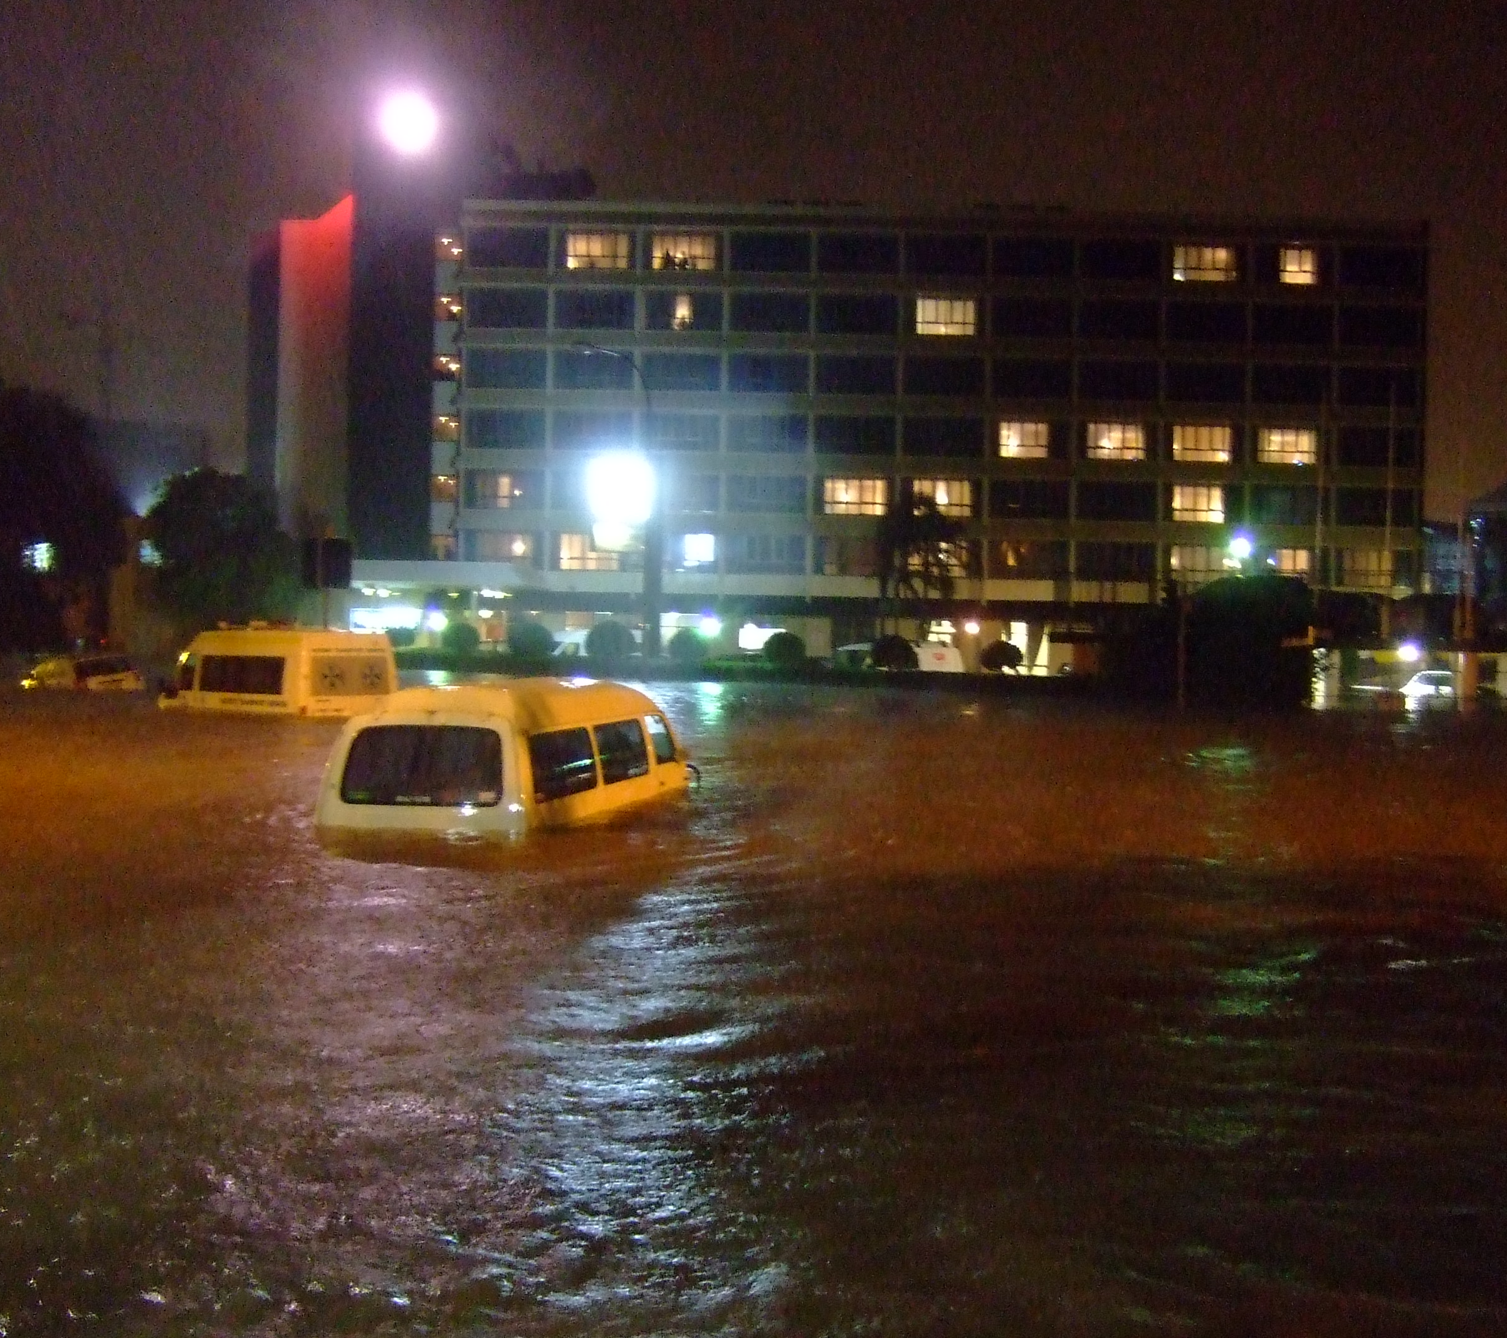
City floods
A flood is a very bad extreme weather. During times of heavy rain rivers can overflow their banks. Wetlands and floodplains help reduce the lower level of floods. River flooding is the most common flood storm.

Slide 14
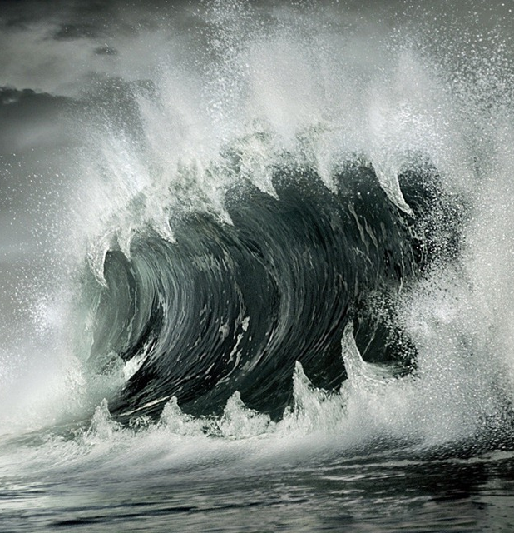
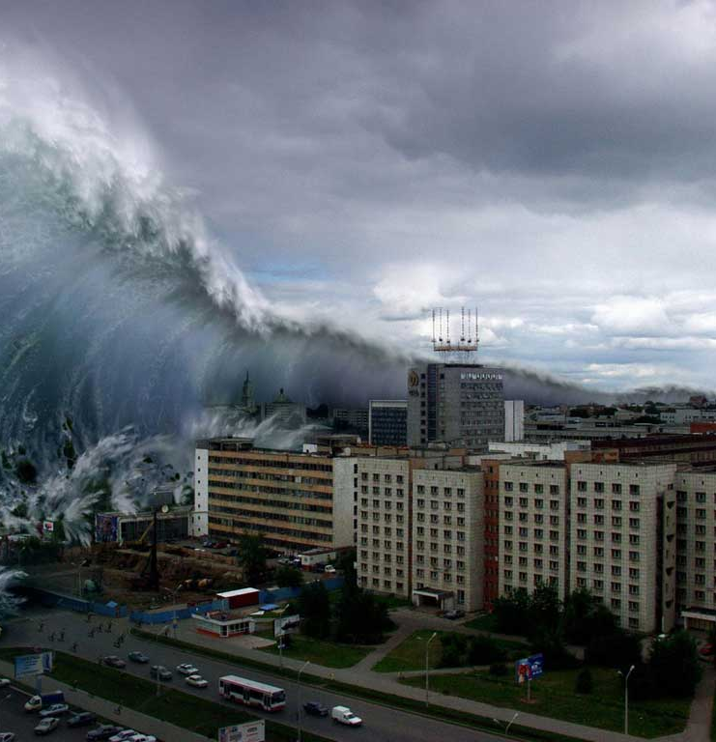
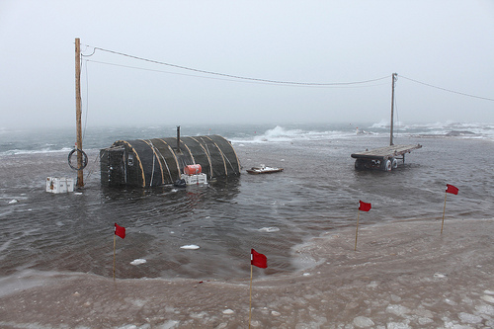
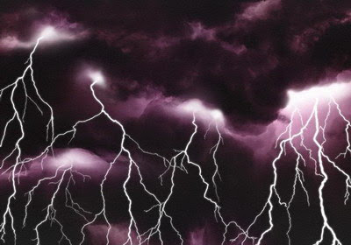

Slide 15
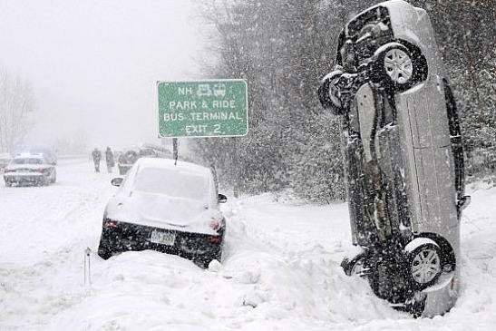
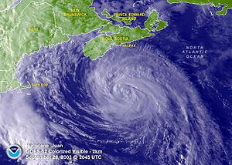
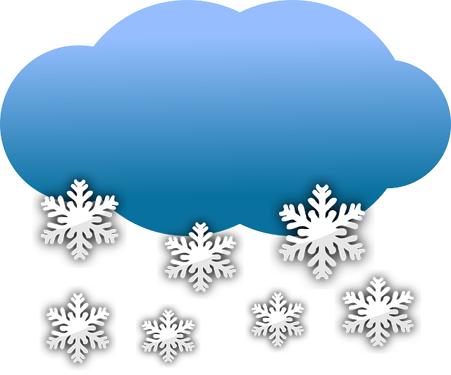
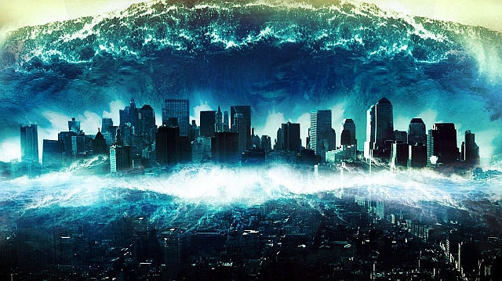
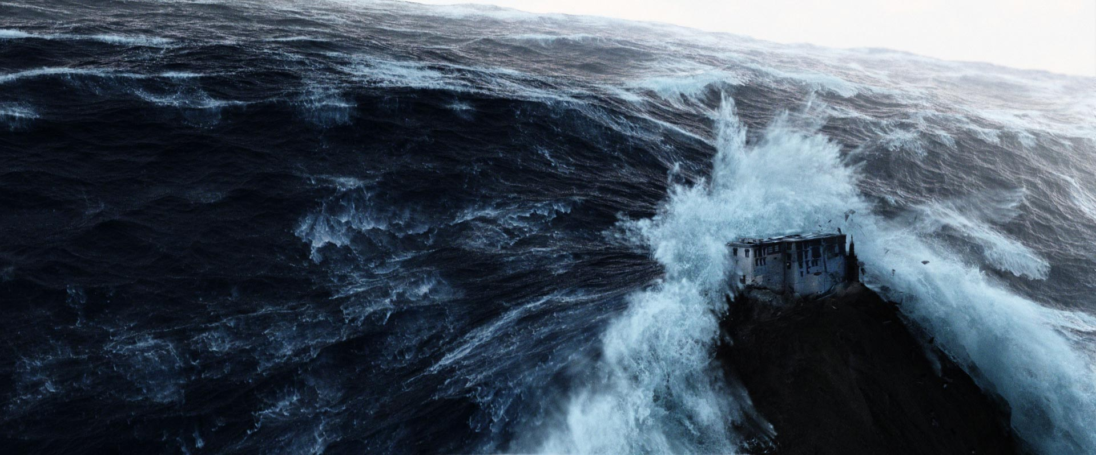

Slide 16
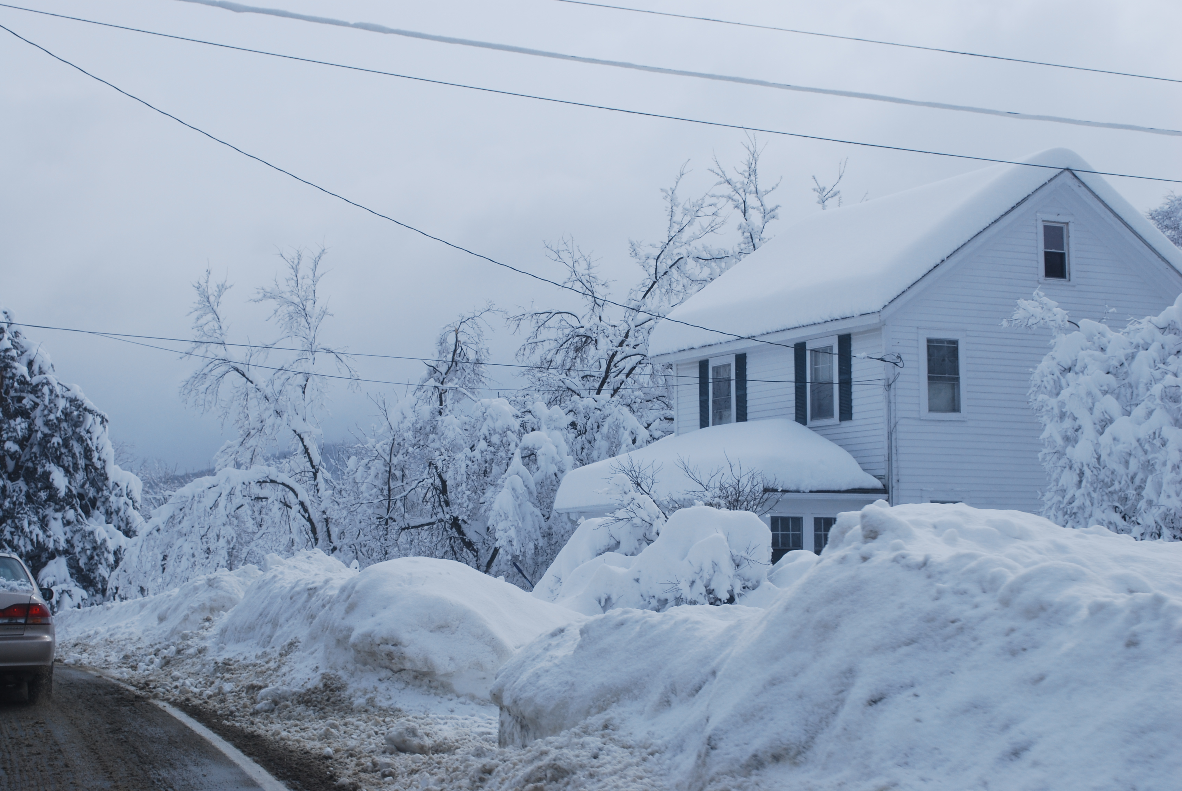
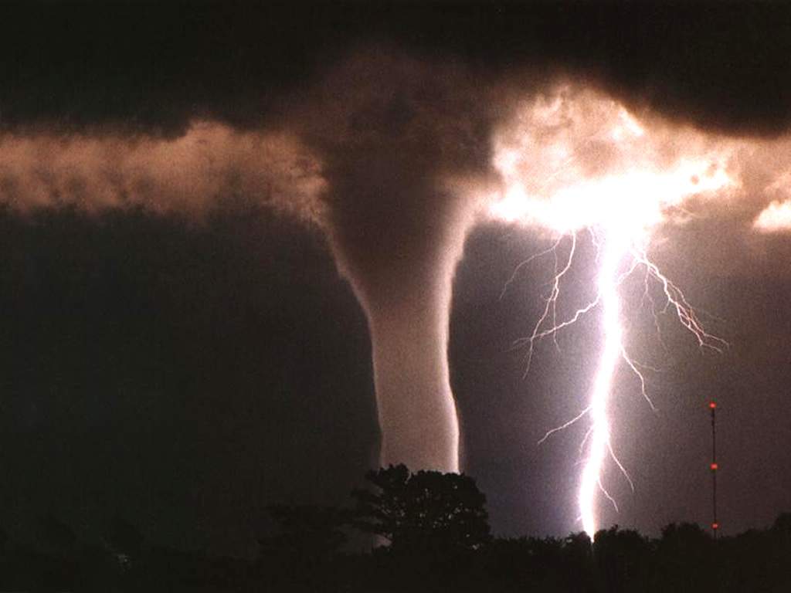
Thanks for watching

