Slide 1
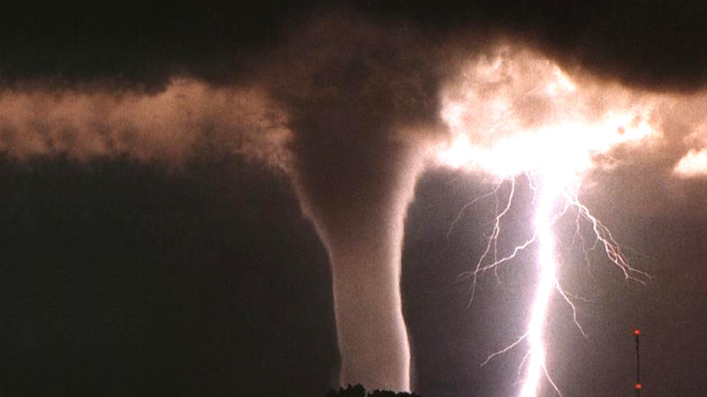
Weather & Climate
By Collin and Xavier

Slide 2
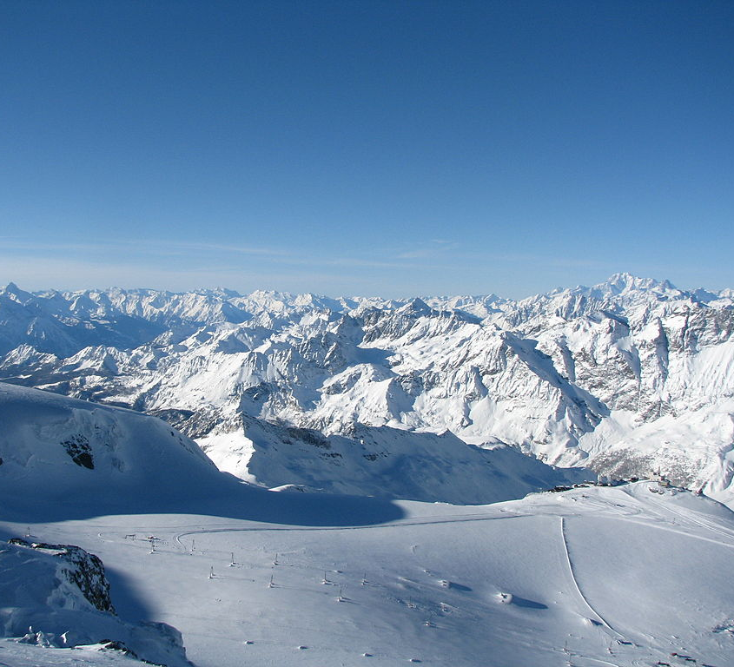
Polar Climate Zone
The polar climate zone is so cold that the temperature reaches 45 to below 0. Barely any animals live there only seals, penguins, and polar bears. These are cold places and they are Antartica, Greenland, Iceland, and the south pole.

Slide 3
Tropical Climate Zone
The Tropical climate zone is a very hot place. It's so hot the water evaporates so fast it rains every day and never snows. It is also so hot that in the morning and night it is warm. Many people live at the tropical zone because of how beautiful the land is. Some countries are in this tropical zone like Brazil and Costa Rica.

Slide 4
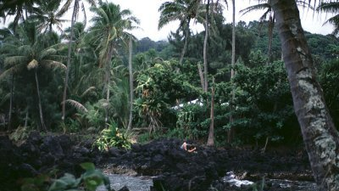
Temperate Climate Zone
The temperate climate zone is hot in the summer and spring and cold fall and winter. Many animals live at the temperate climate zone that I cannot say them all. Some are nocturnal most of the animals are not. But the summer it gets so hot that at night and in the morning it's warm. They are located in places like Canada, USA, and parts of Asia

Slide 5
Desert Climate Zone
Desert climate zones are so hot barely any water goes there which means they will have a drought forever until a whole bunch of water appears. Many animals live in the desert climate zone. But if you go to a desert you can see all the animals are either nocturnal or they are diurnal they get cool by digging underground or stay in shady plants. These deserts are located in California, Death Valley, and Mexico

Slide 6
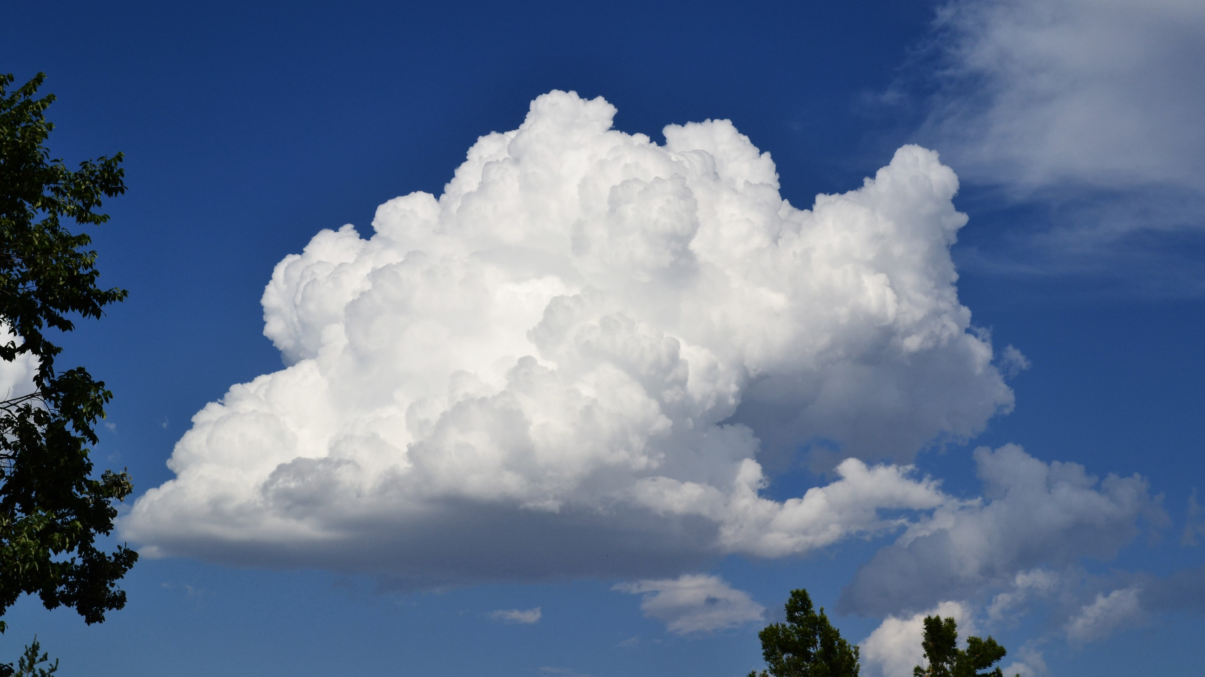
Cumulus Clouds
Cumulus clouds are also called fair weather clouds and look like floating cotton. They have very flat bases. When they are first formed from droplets of water, they have distinct edges, but as they move through the sky the air causes the edges to become more ragged and broken apart.

Slide 7
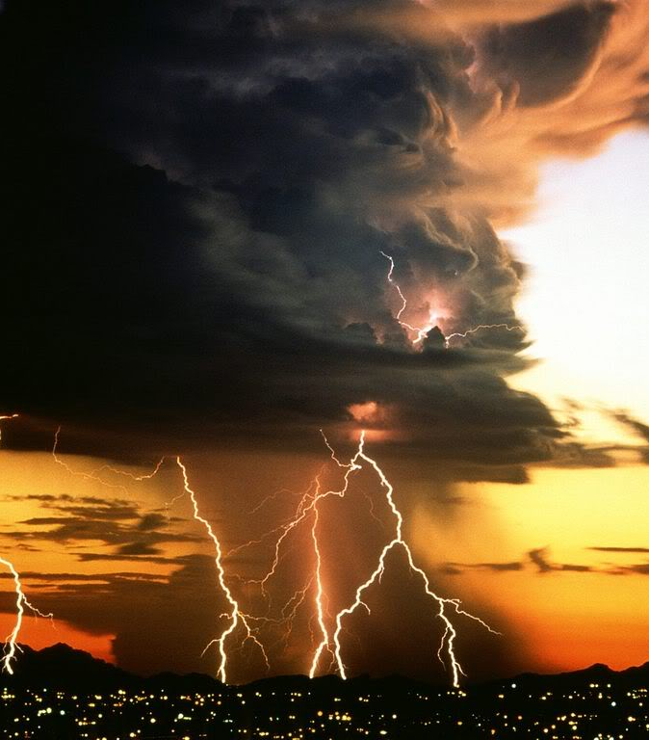
Cumulonimbus Clouds
These cumulonimbus clouds can stretch up to a mile in the sky. It can reach 39,000 feet in the air because it is so strong. These Clouds are made of water but higher elevations, they consist ice crystals. Also cumulonimbus clouds can hurt people or other things badly.

Slide 8
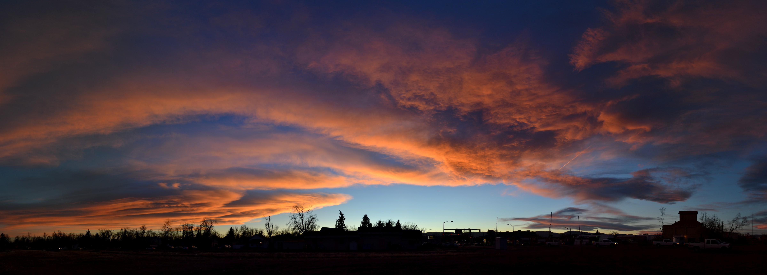
Stratus Cloud
Stratus clouds are among the low lying clouds. They are light gray clouds that cover the entire sky and can be the result of a very thick fog lifting in the cold mornings or it can be a result of a stratonimbus later in the day.

Slide 9
Stratonimbus Cloud
A stratonimbus is a cloud that is dark gray and that can produce falling rain or snow. The rain lasts all day or almost a day.

Slide 10
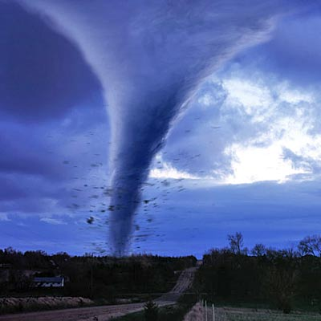
Extreme Weather -Tornados
Tornados are caused by hot air and cold air. The hot and cold air have a big battle creating lots of fog making a funnel destroying life and mankind structure

Slide 11
Extreme Weather -Tsunami
When an earthquake occurs waves get pushed and become bigger and bigger until it hits something making a big mess around cities and human life. Also a tsunami destroys anything in its way until it can't go any further.

Slide 12
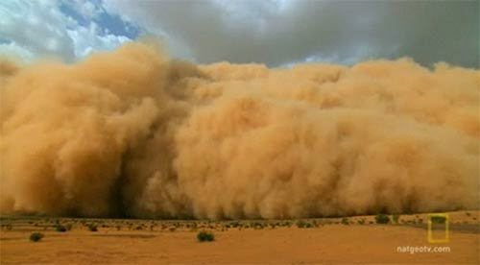
Extreme Weather –Dust Storms
Dust storms are caused by droughts in a hot desert then when a huge patch of wind comes the wind only picks up particles of dirt called dust. Dust storms are bad because the dust gets into your eyes and it hurts another reason is that you can't see anything faraway.

Slide 13
Extreme weather-Hurricanes
A hurricane starts by warm moist air rises and cools then it falls as rain then hurricanes wall builds. The air travels around and in the hurricane making harsh
wind. There is an eye in the middle inside the eye is safe outside the eye is dangerous.

Slide 14
Extreme Weather - Blizzards
Blizzards are caused by lots and lots of snow falling out of the sky because at very cold places when it rains as soon as it falls it freezes to snow. Blizzards cause lots of traffic and car crashes.

Slide 15
