Slide 1
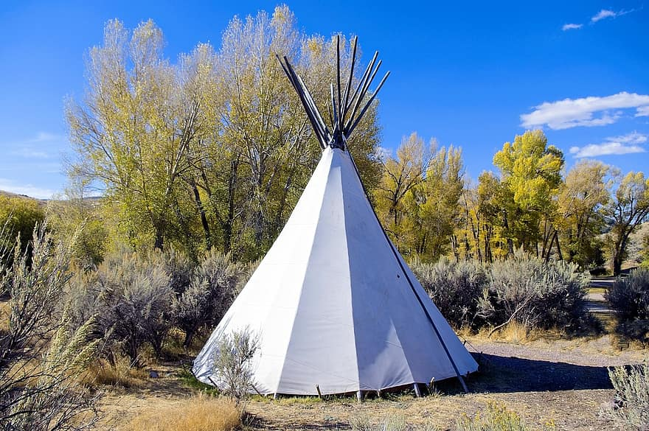
Mojave
By Dominic and Joseph

Slide 2
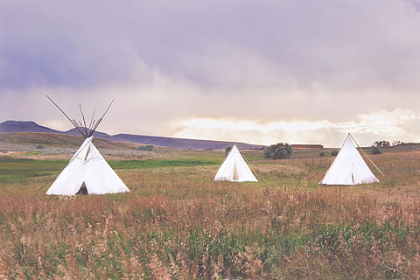
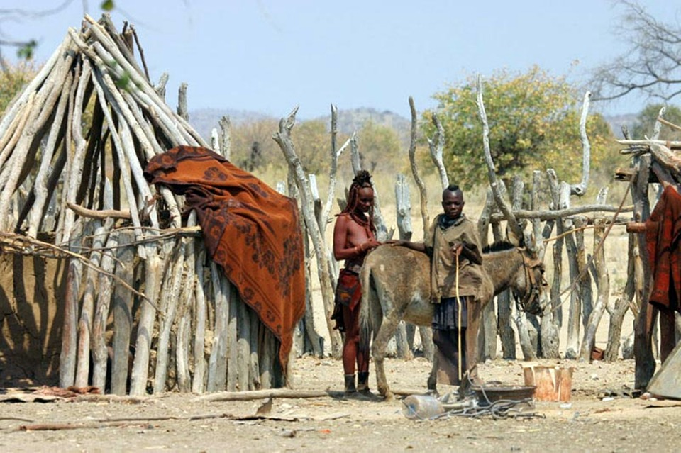
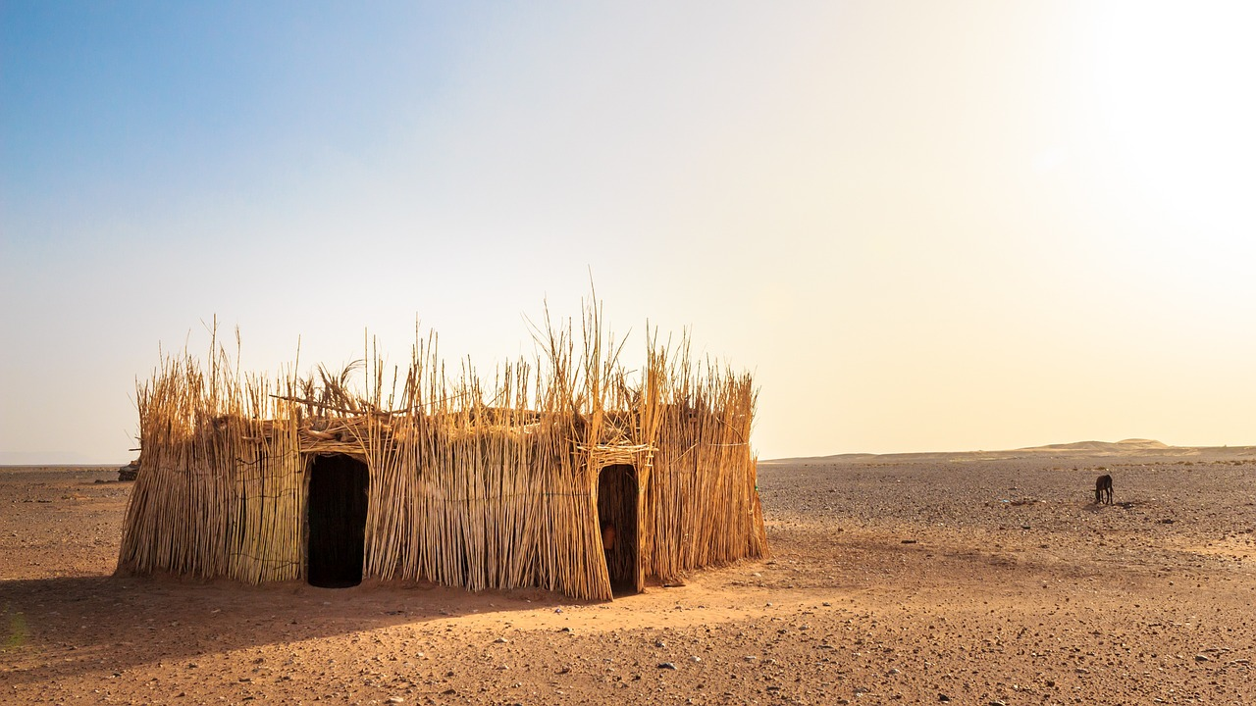
Shelter
The Mojave made shelters from resources found in the desert. They were suited for hot climates. These shelters are especially made by Mojave people. These shelters are made with twigs in the desert. These shelters are also made with other things to make it stable.
Notes:
Write about the materials, shape, name, and unique features of the structure.

Slide 3
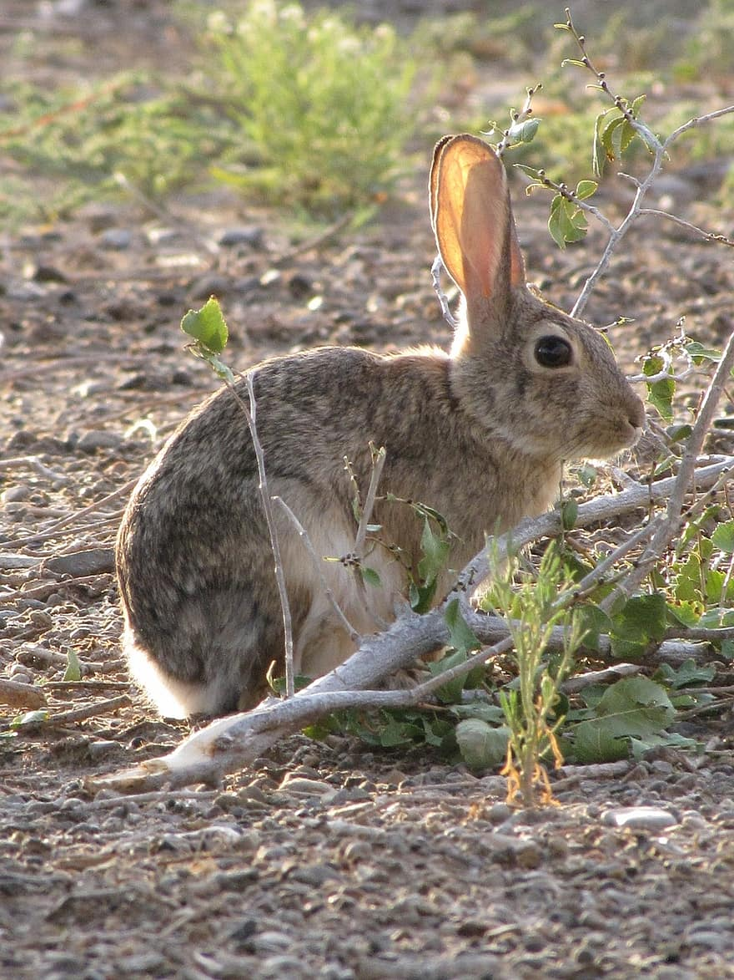
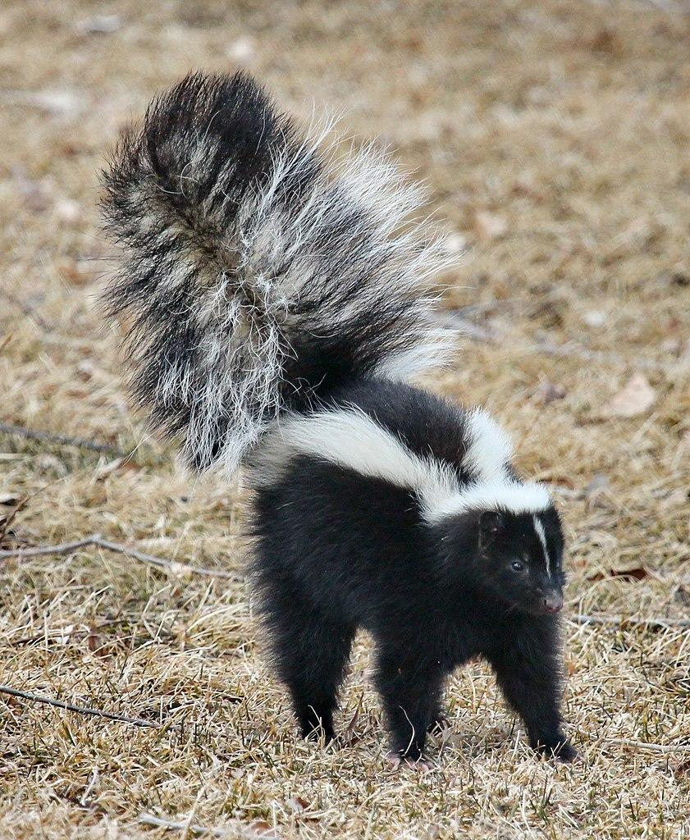
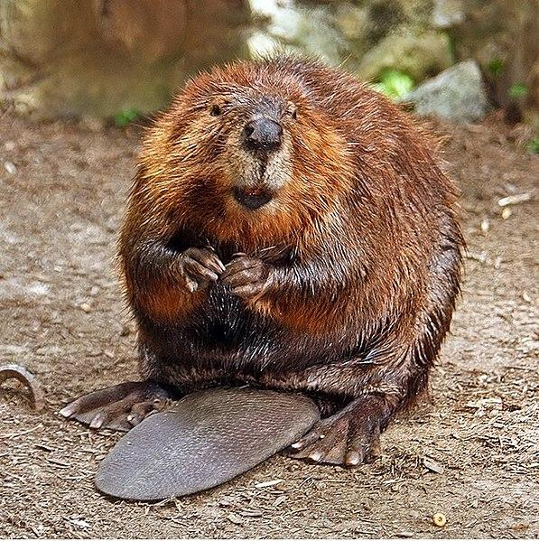
Food
The Mojave got their food by hunting and farming.They traps small animals such as rabbits, skunks, and beavers. The Mojave farmed in the desert from floods that left rich soil and farming was their main food source. Mojave indians farm for good eating like Mojave corn unlike our corn mojave corn is better and colorful our corn is just yellow. If mojaves don’t farm they hunt or pick stuff like berries in the dirt and wash them.
Notes:
Write about the food the tribe ate, crops they grew, hunting & gathering skills, and ways to prepare meals.

Slide 4
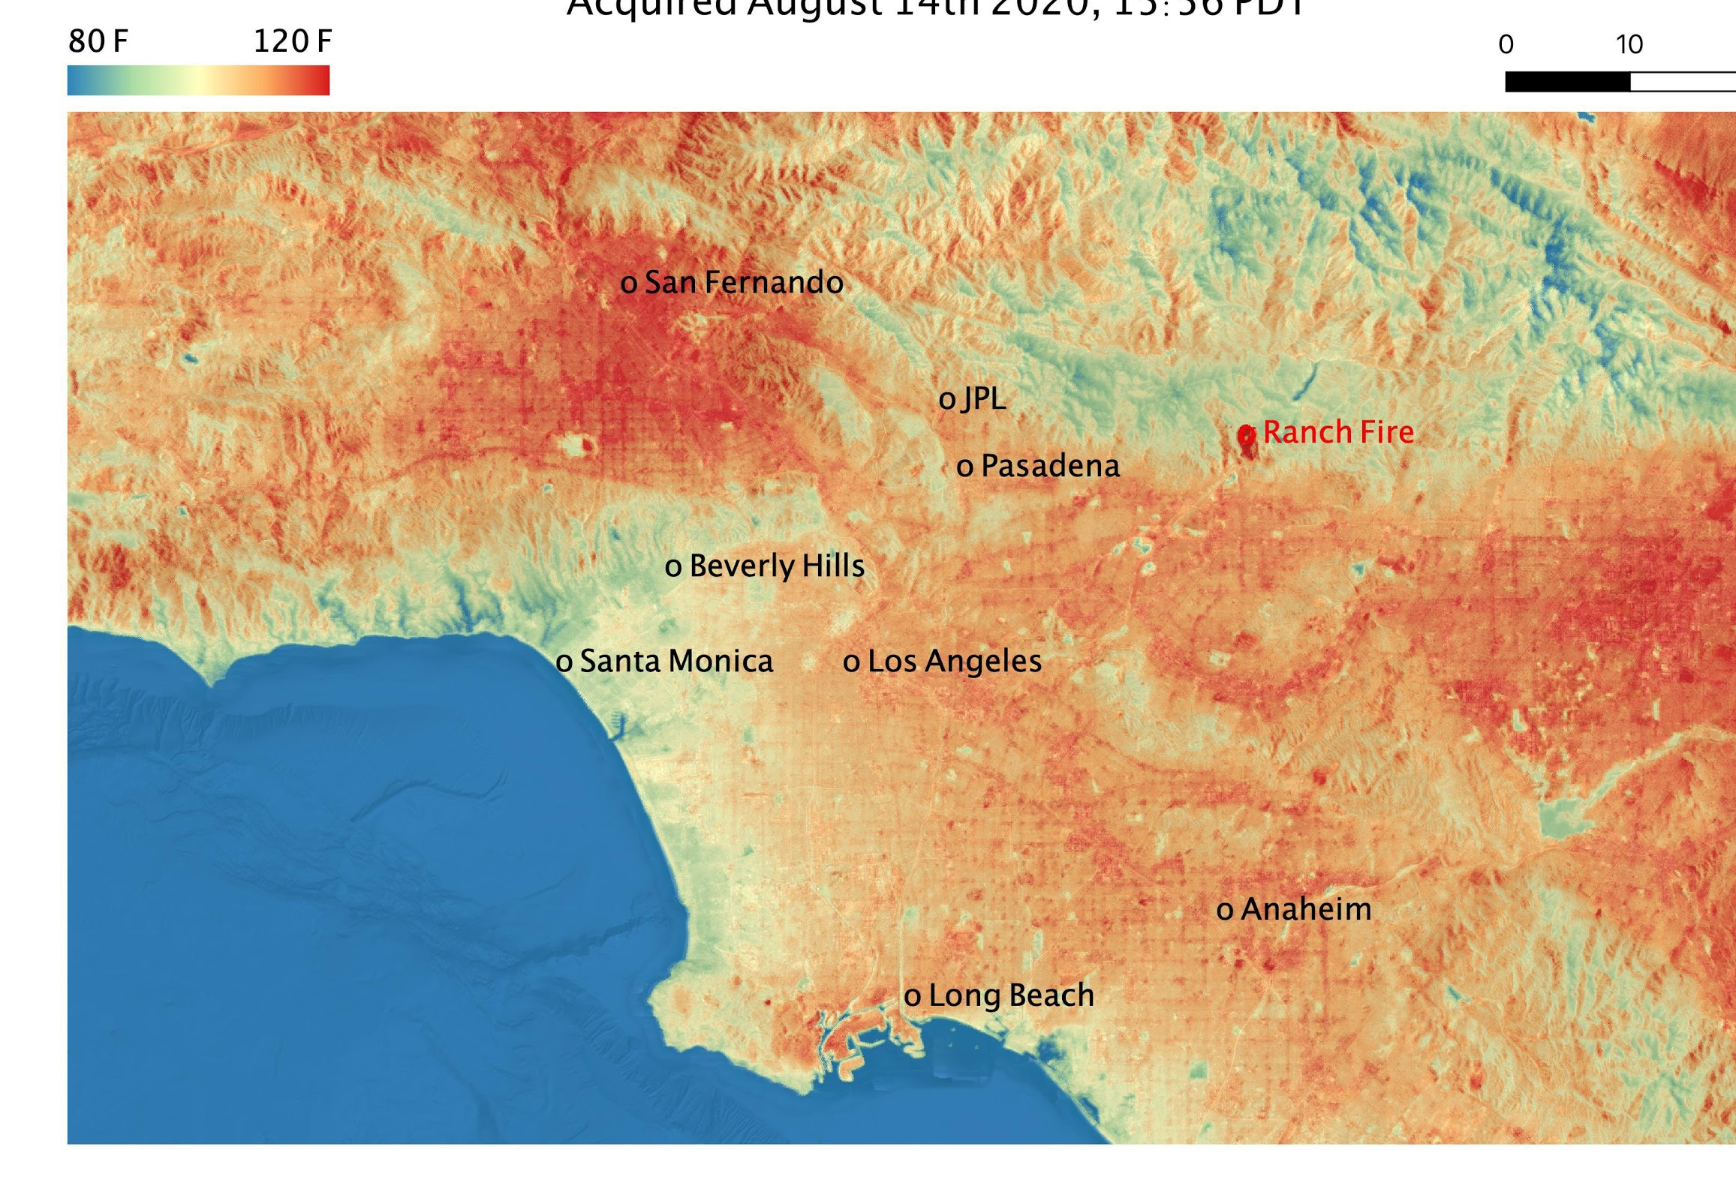
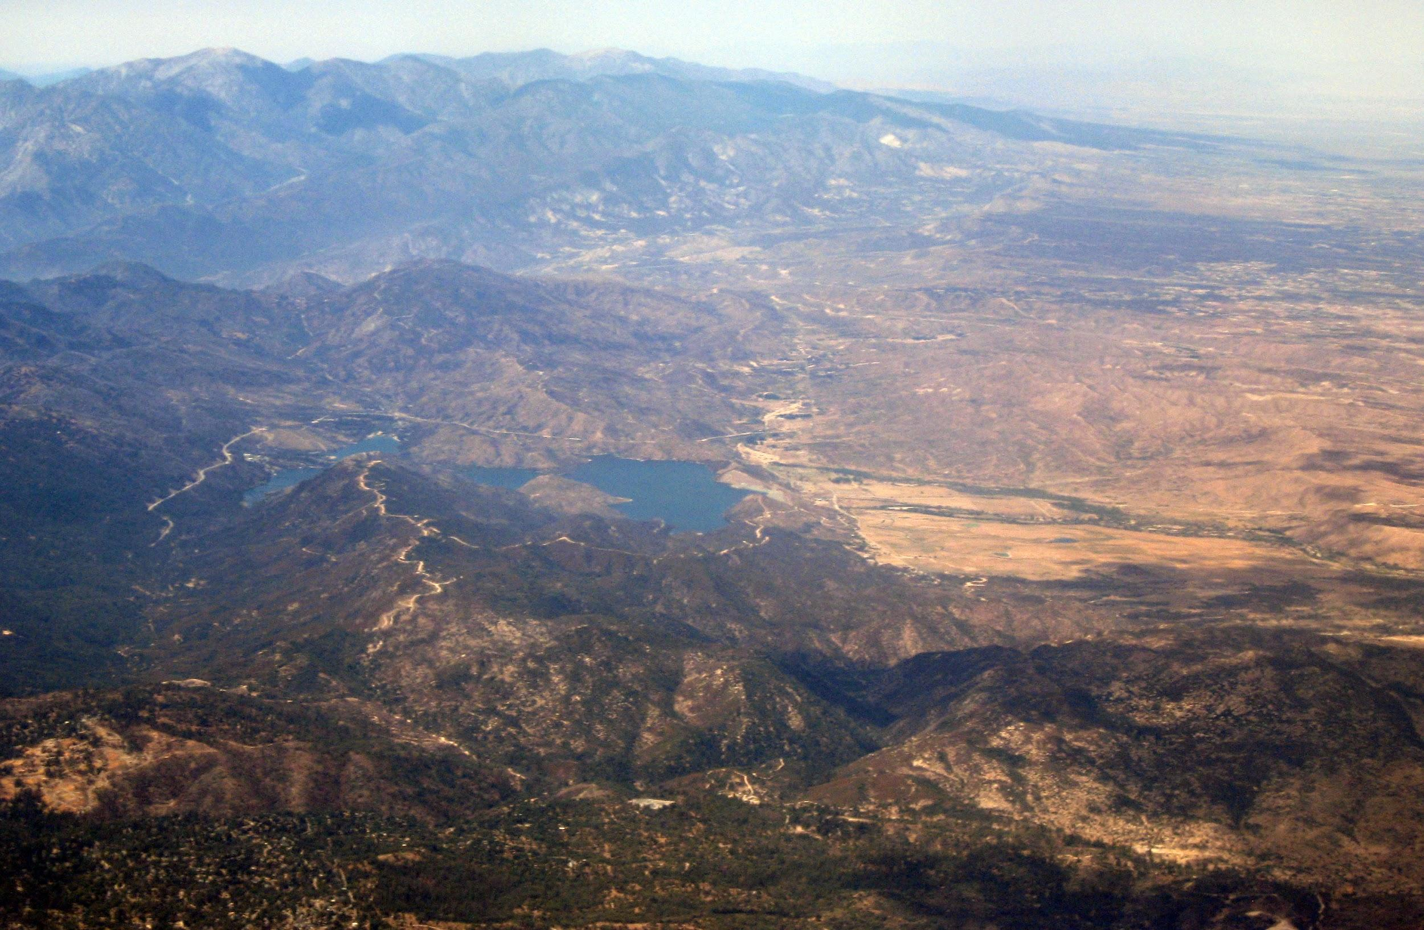
Location
The Mojave lived in deserts which today is now California.They did not live in villages. These native Americans live in the desert of what is now Arizona and California. Indians like native americans live in Arizona and California.

Slide 5
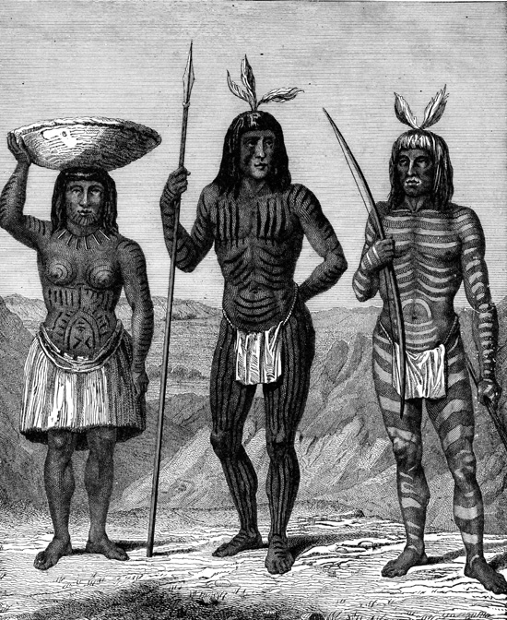
Culture
Mojave culture is certainly different from others . Mojave indians build two different types of houses one for the summer and one for the cold . In spring and summer they’ll go fishing near the colorado river . The houses they built was made out of stilte in case of a flooding .

Slide 6
Ending
Notes:
This slide is the last slide. You can add a picture or several pictures as an ending to your presentation.

