Slide 1
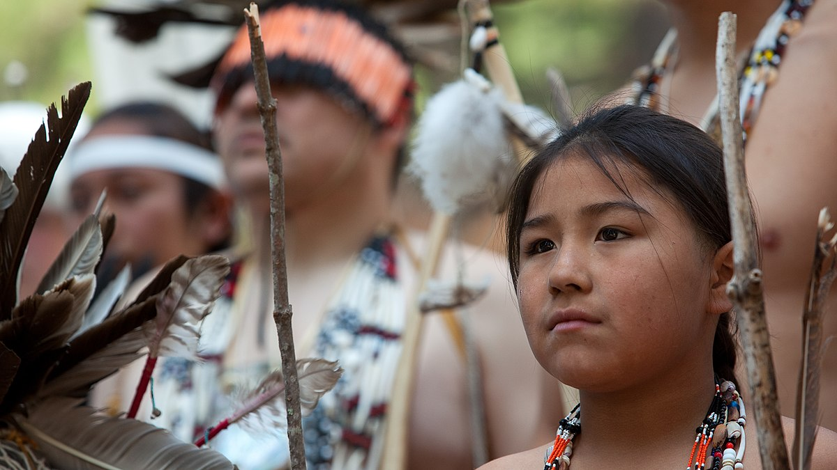
The Pomo
By Ariana
This Photo by Unknown author is licensed under CC BY-SA.

Slide 2
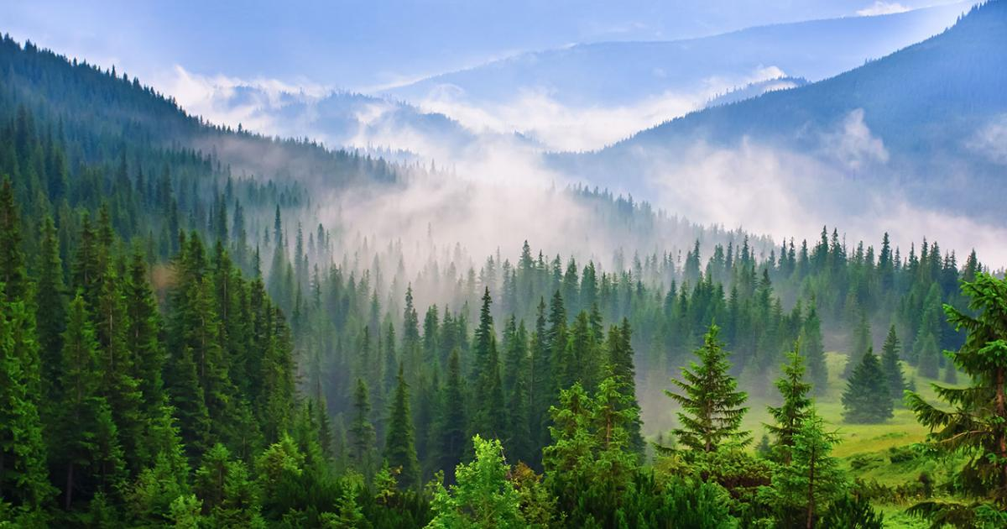
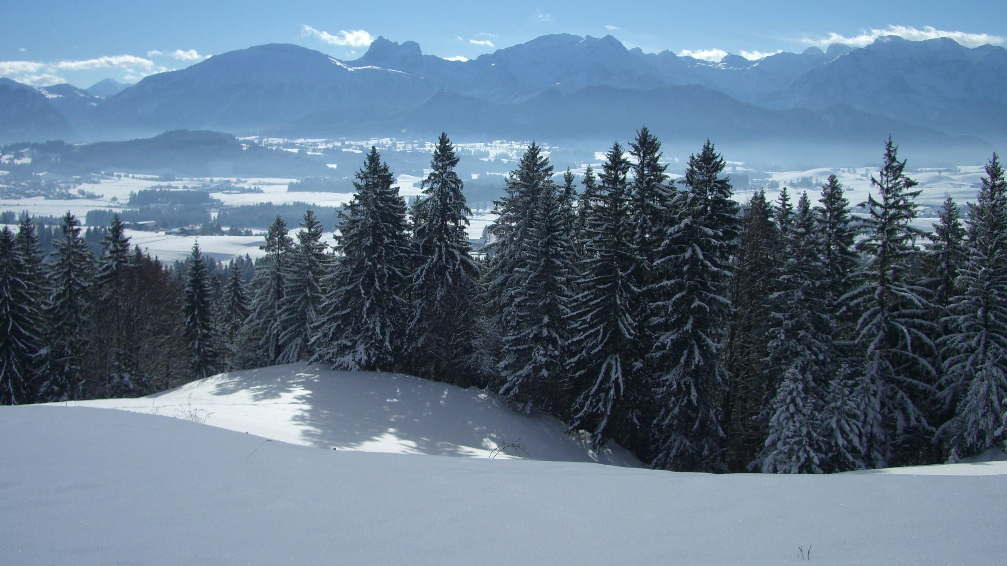
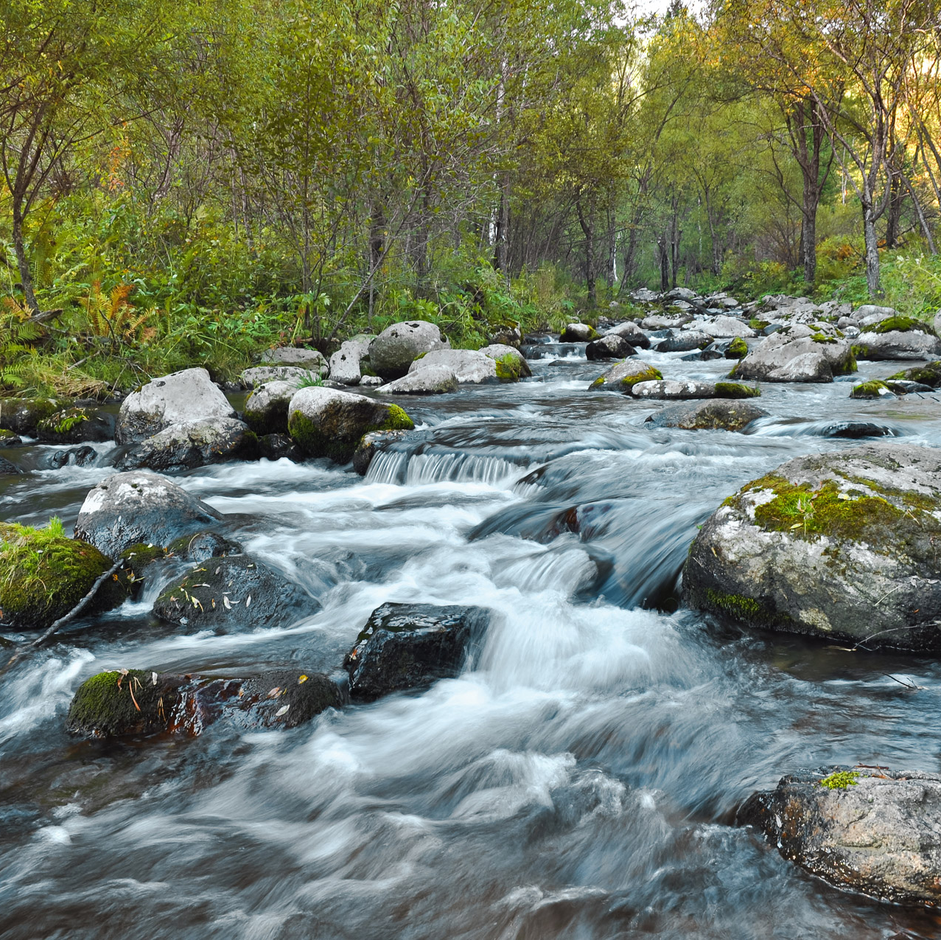
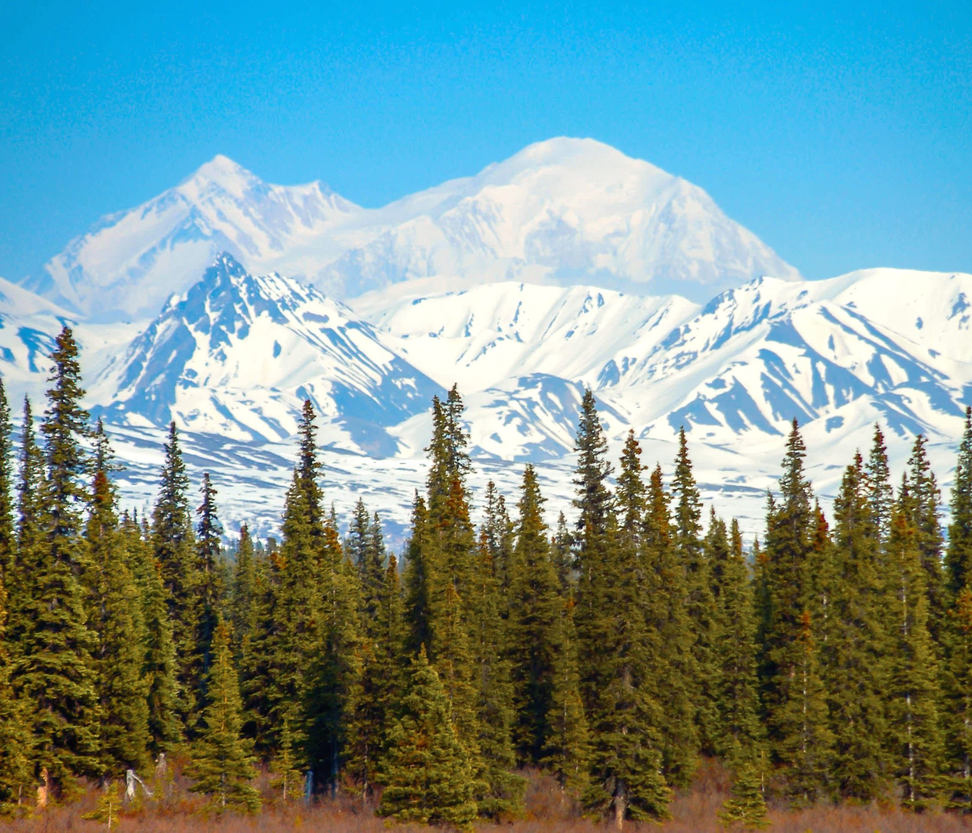
Location
The Pomos lived in the Northen coastal of California. They lived by rivers and forests the weather is cold because on top of the forests are snowy mountains.
This Photo by Unknown author is licensed under CC BY-SA.

Slide 3
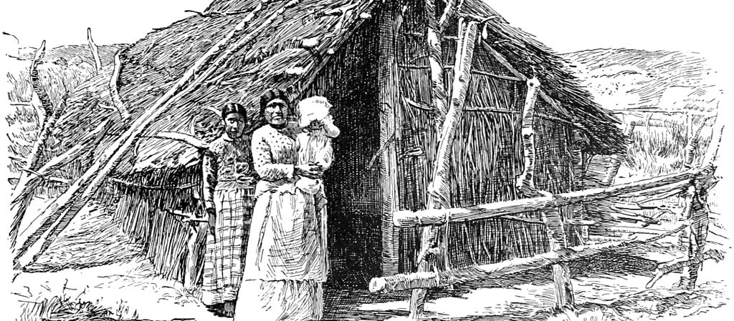
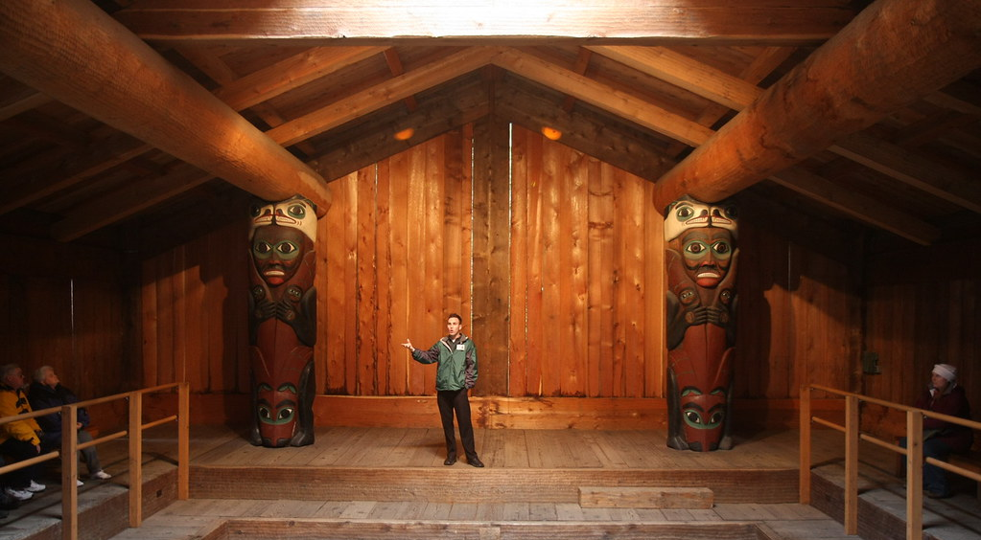
Shelter
The Pomos had plank homes that fit 12 families. They make the homes out of wood. They built several different homes. Some have underground areas of their house too.
This Photo by Unknown author is licensed under CC BY-NC.
This Photo by Unknown author is licensed under CC BY-SA.
This Photo by Unknown author is licensed under CC BY-NC-ND.

Slide 4
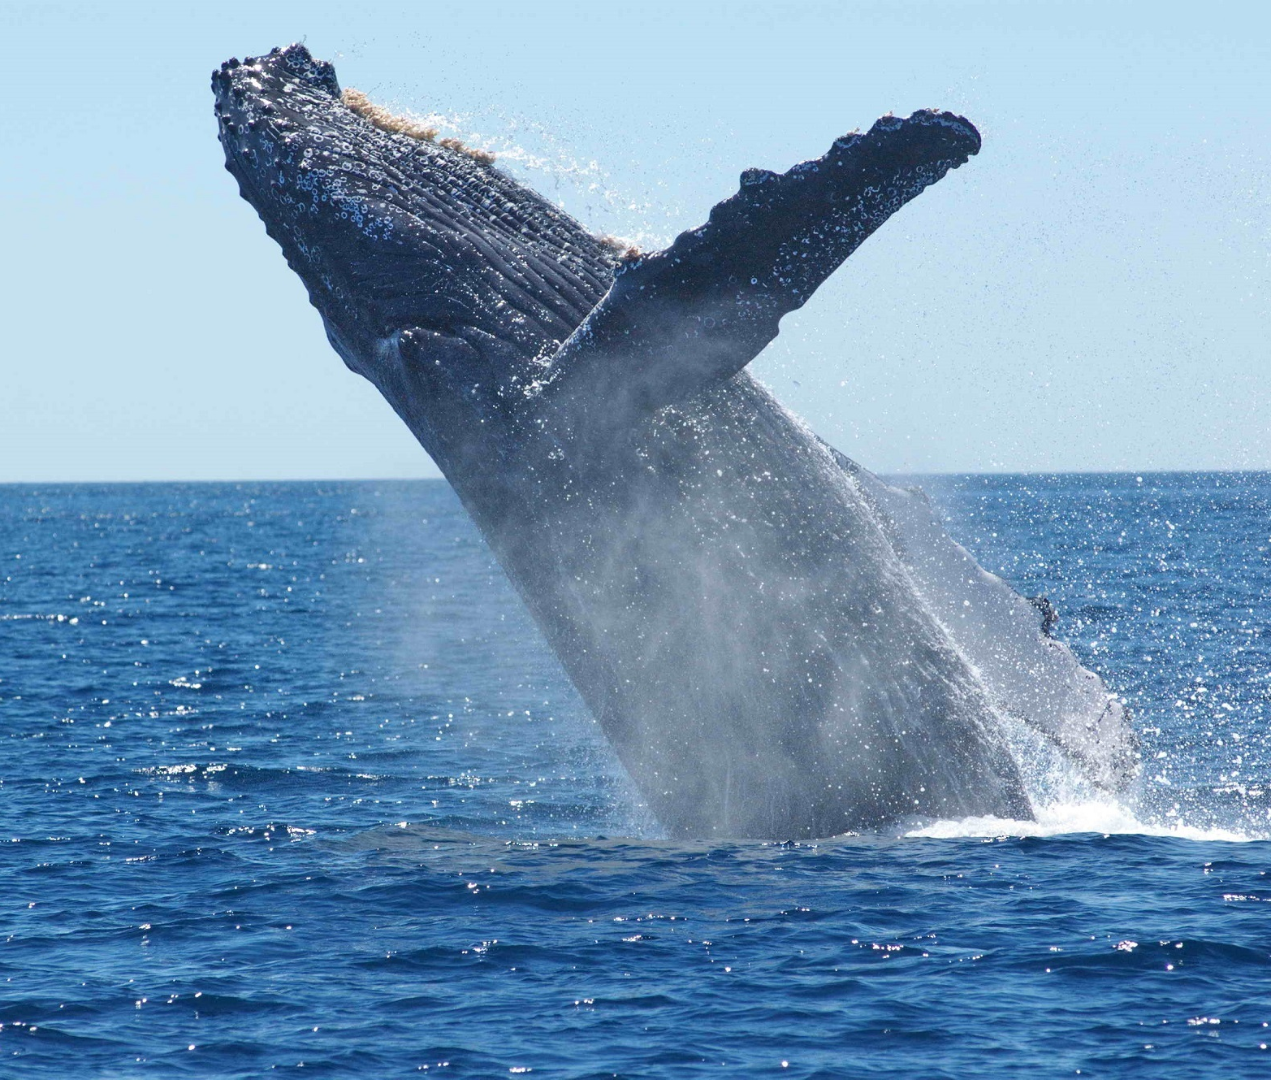
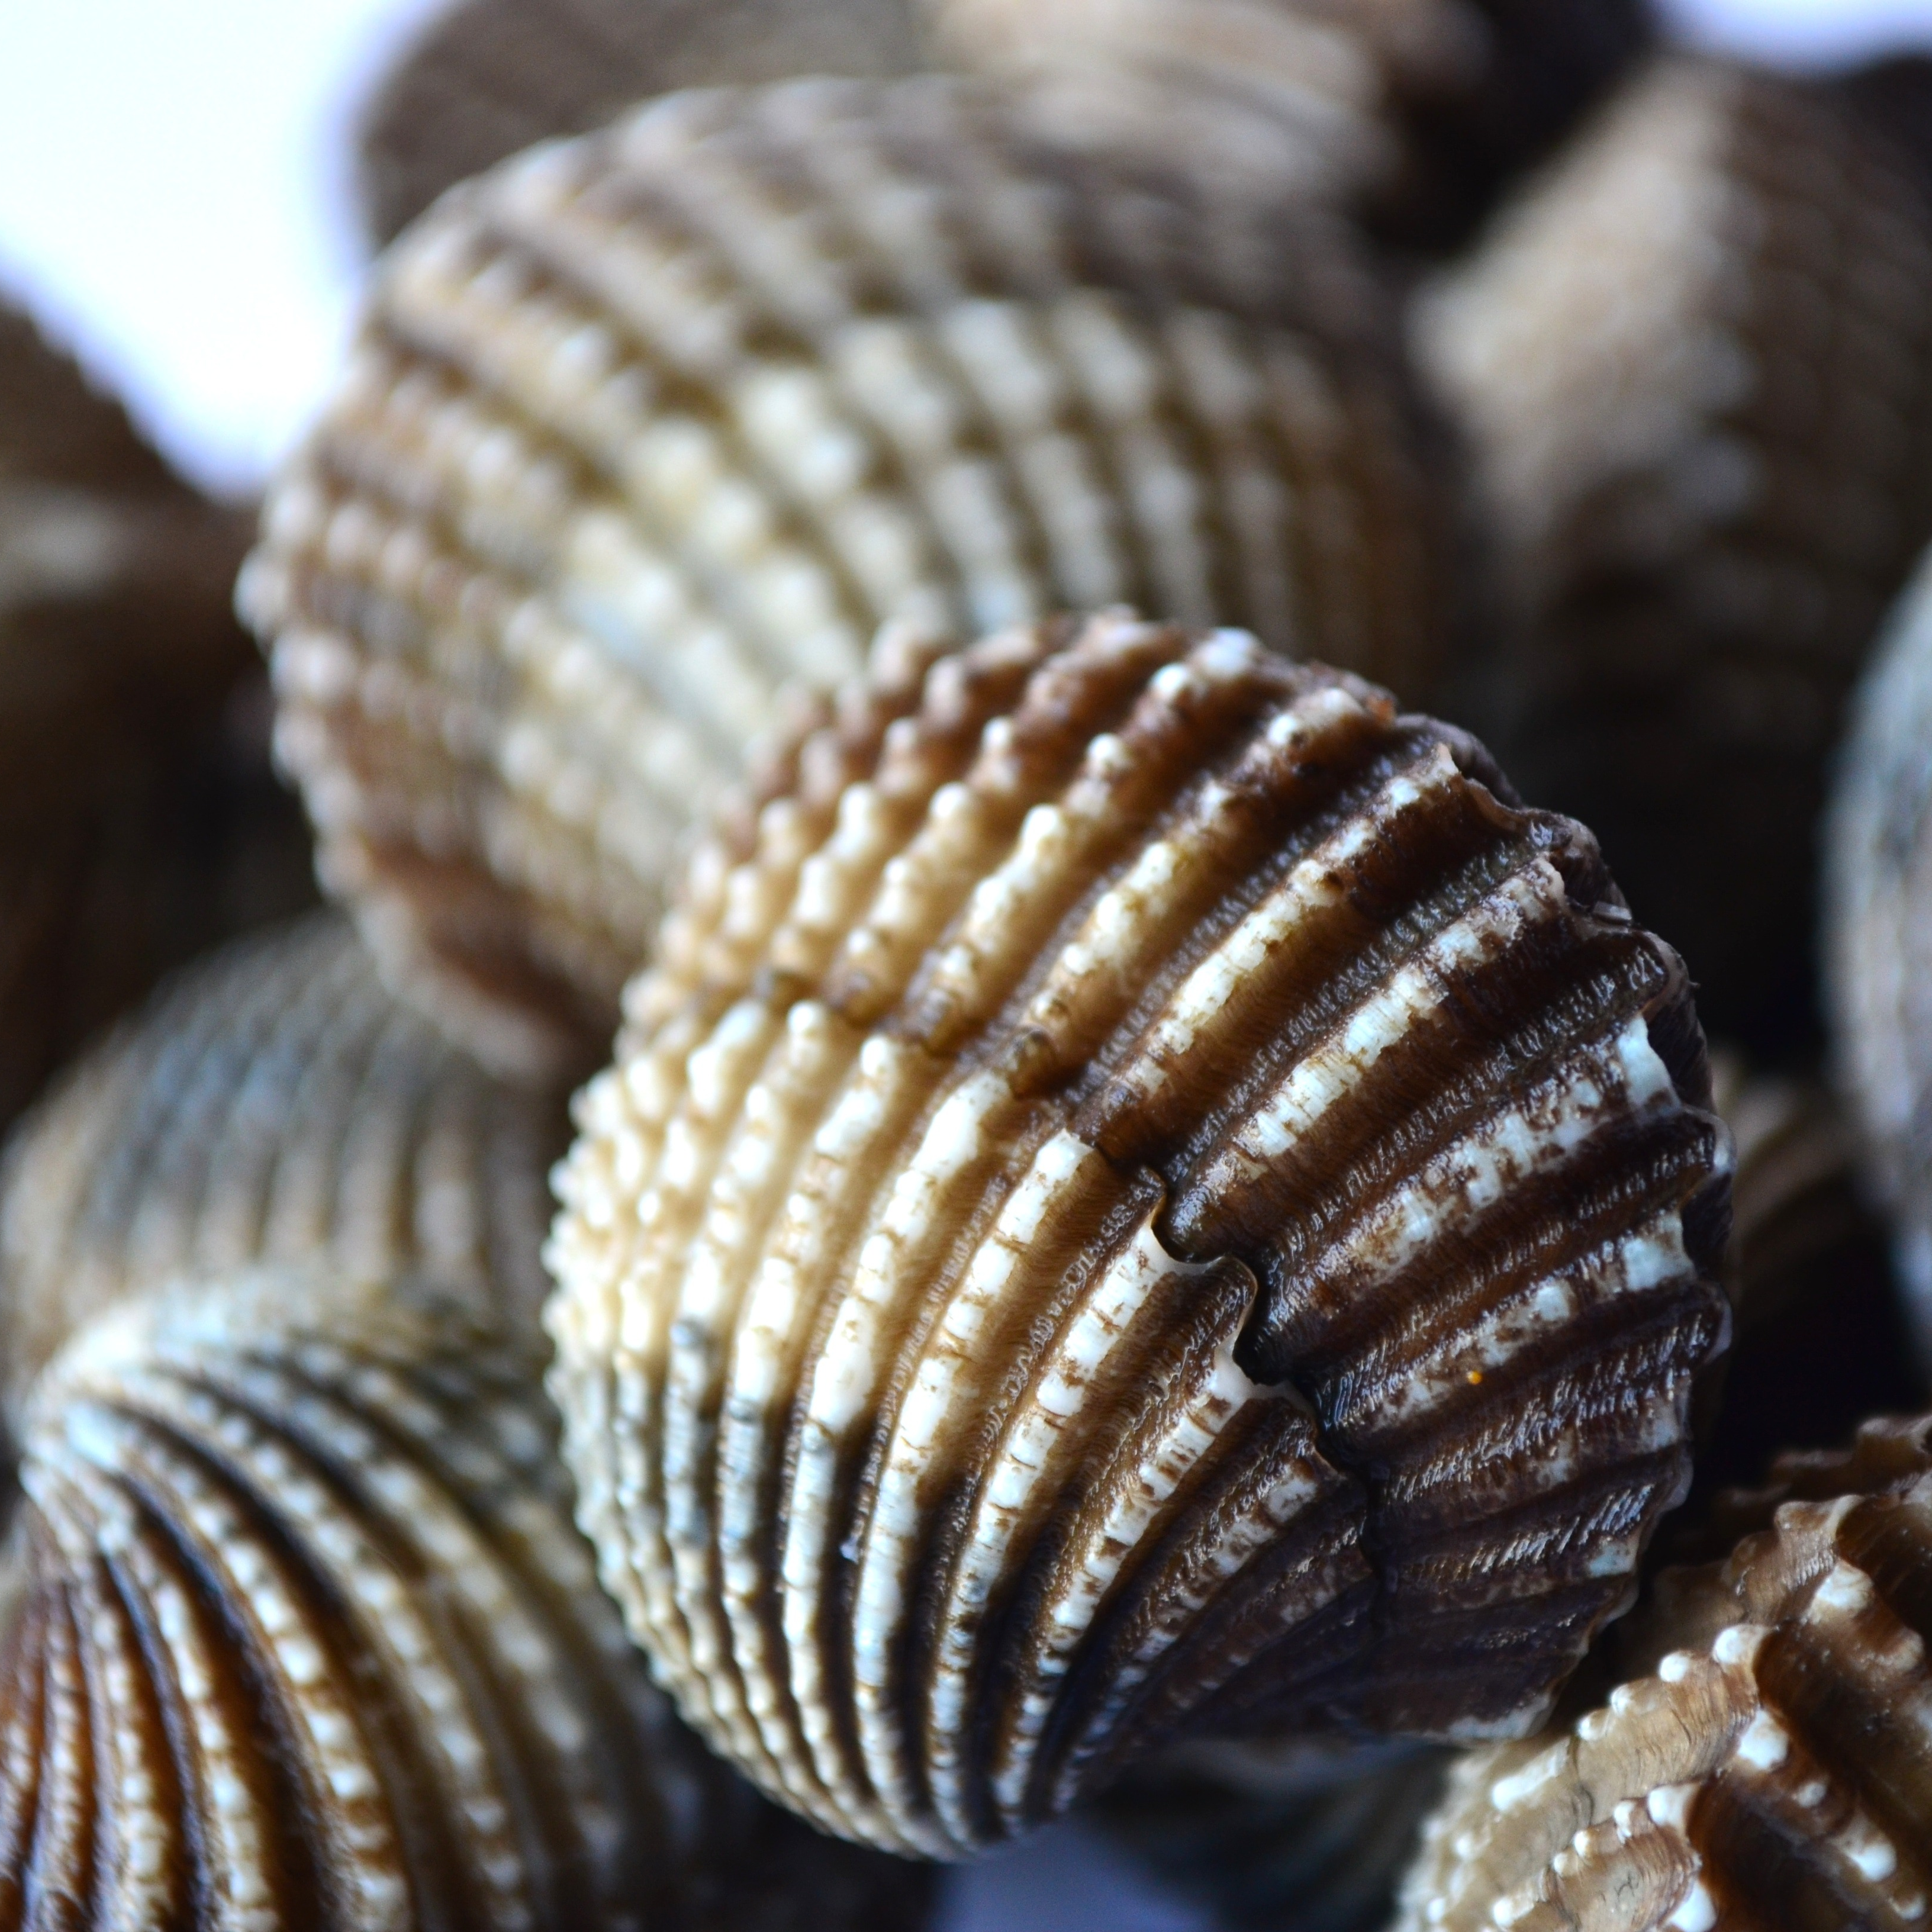
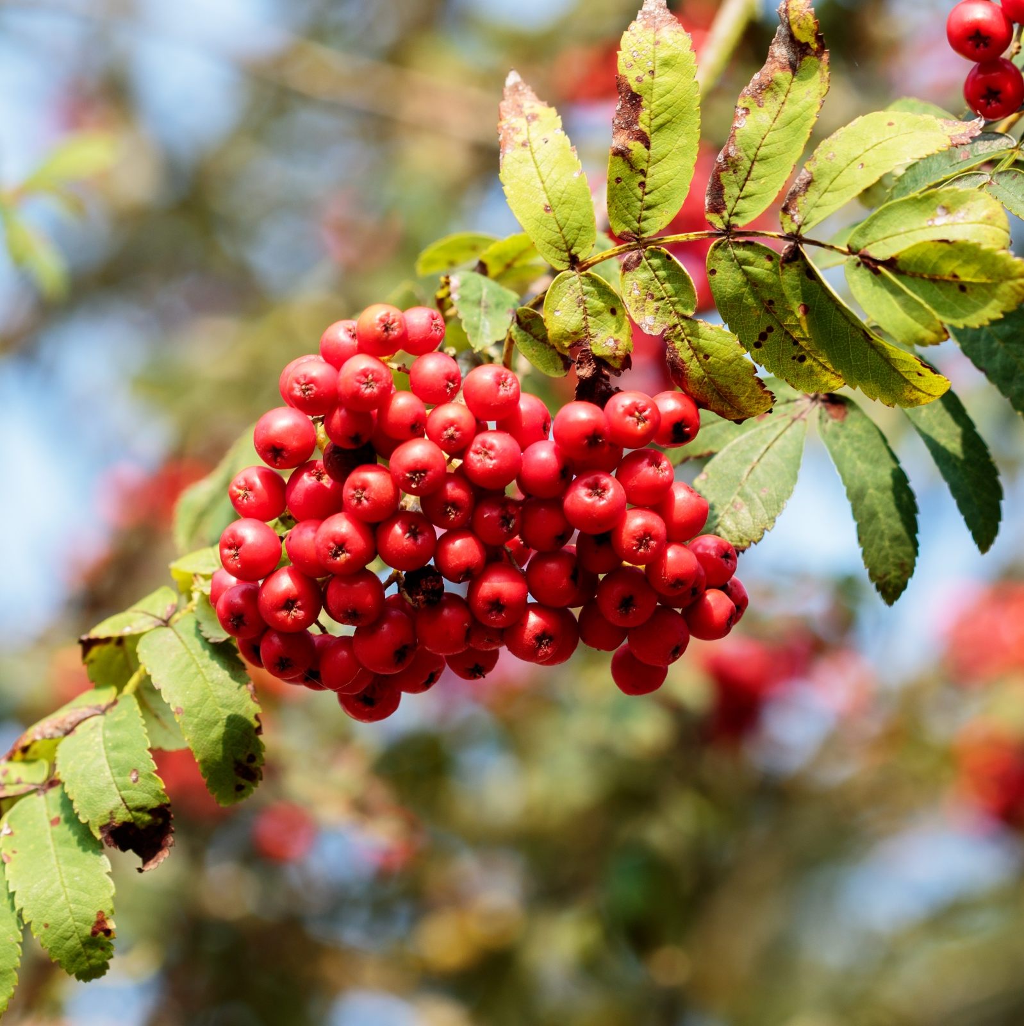
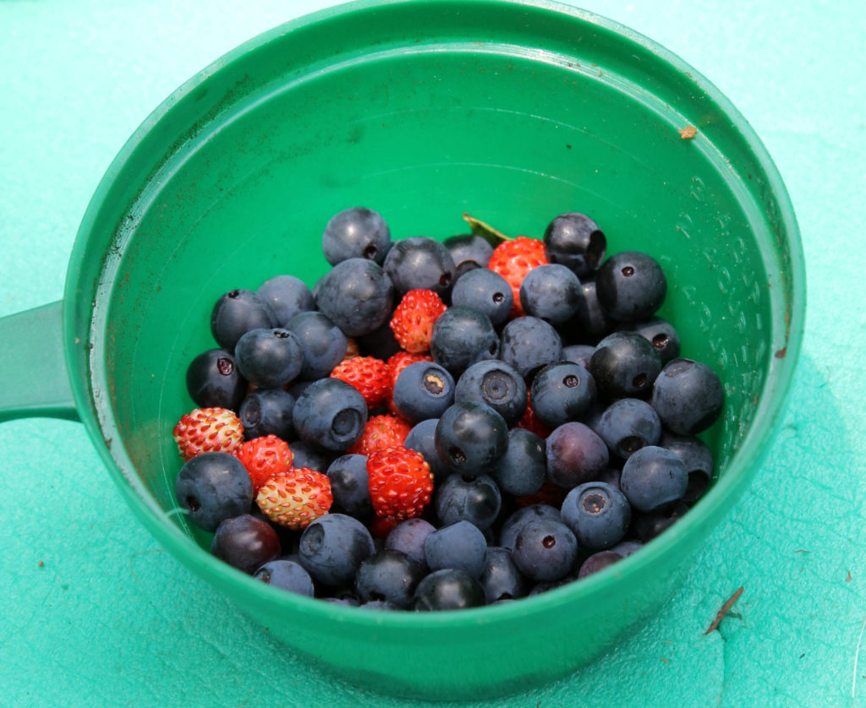
Food
From the ocean they ate whales and shellfish, They hunted deer, elk, antelope, rabbits, squirrels and birds. They gathered seeds, berries, and acorns.
This Photo by Unknown author is licensed under CC BY.

Slide 5
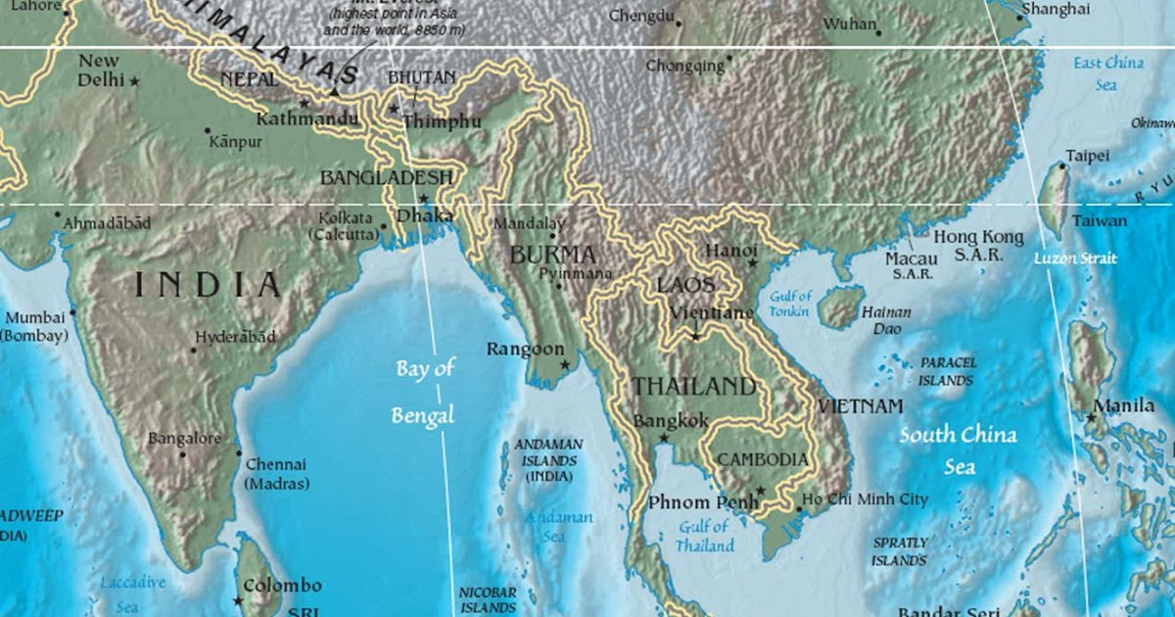
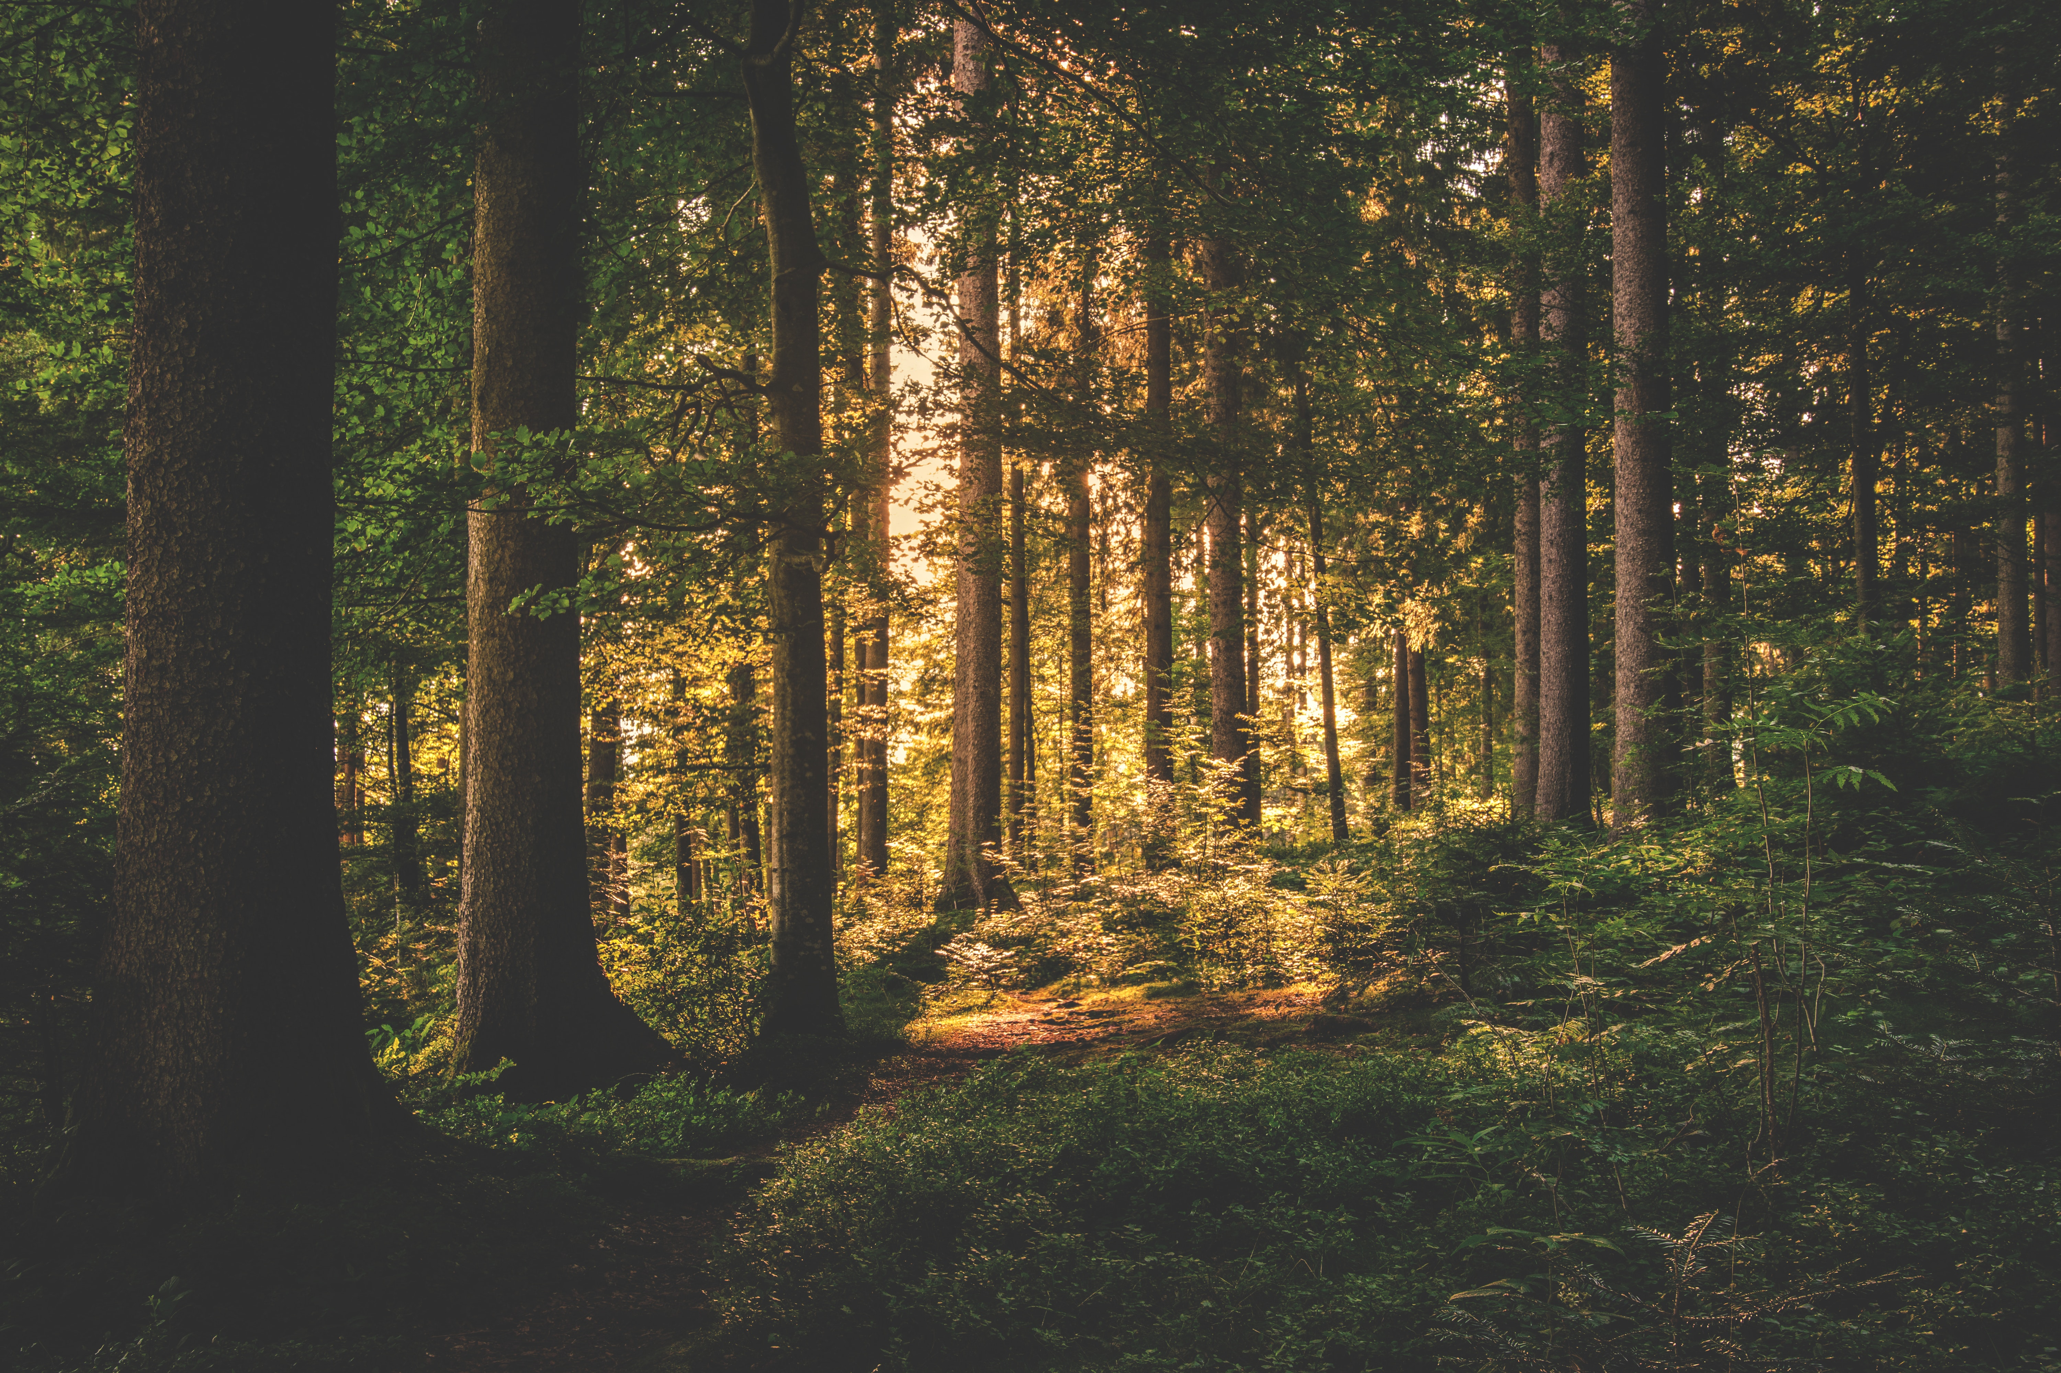
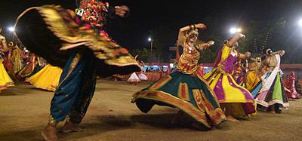
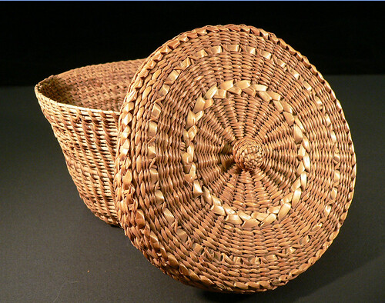
Culture
They made baskets out of plants to collect seeds and acorns. Women would wear colorful costumes. They would do ceremonies every night that included several days of dancing.
This Photo by Unknown author is licensed under CC BY-SA.
This Photo by Unknown author is licensed under CC BY-NC-ND.

Slide 6
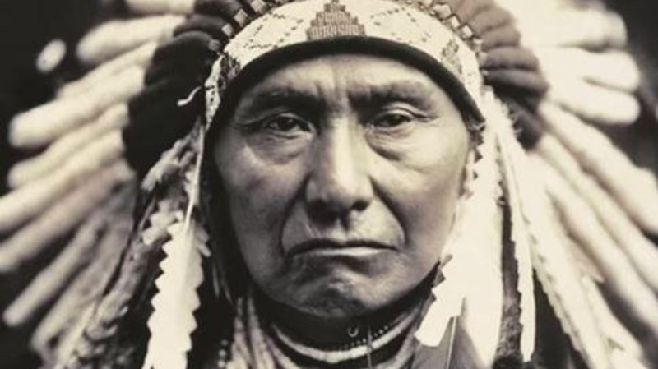
This Photo by Unknown author is licensed under CC BY-NC-ND.
This Photo by Unknown author is licensed under CC BY-SA.

