Slide 1
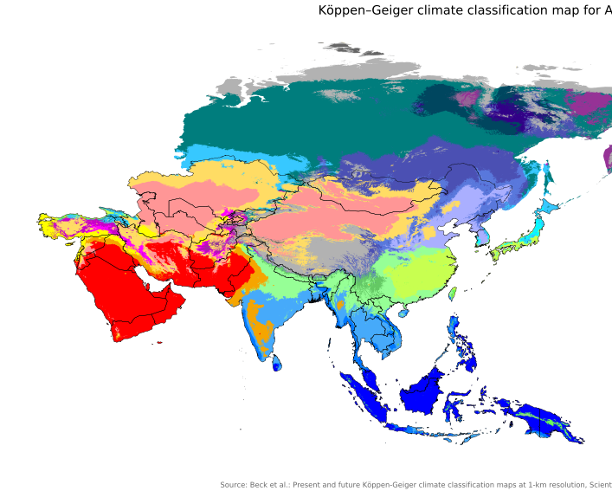
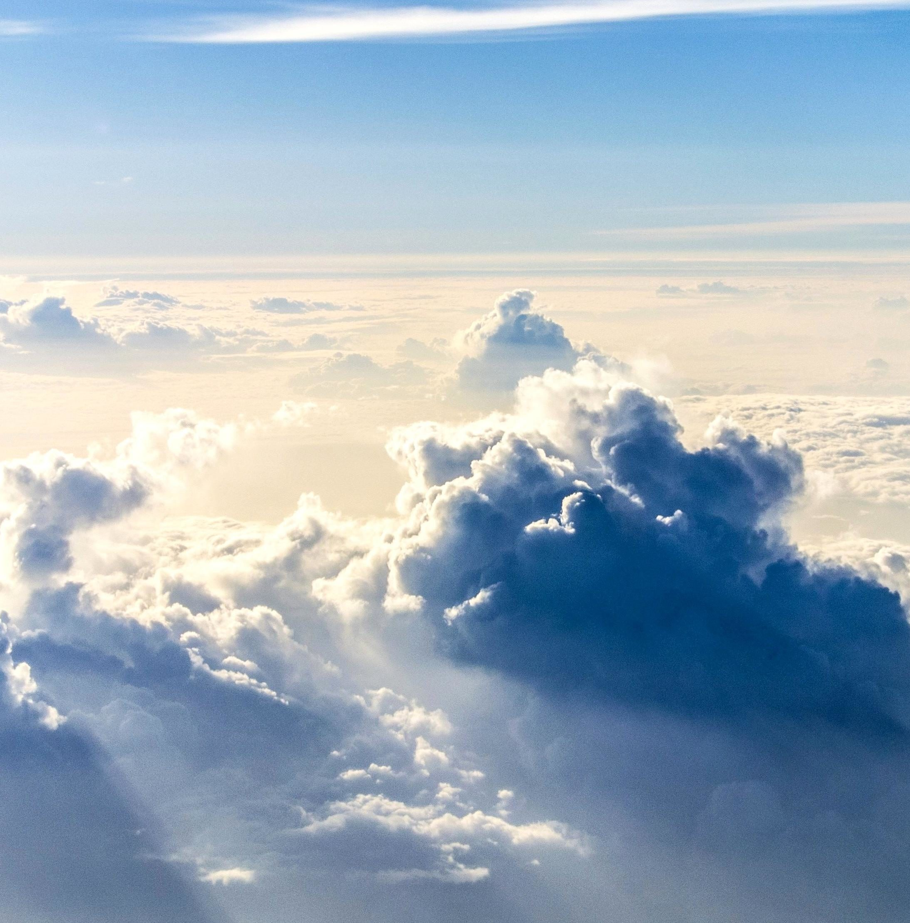
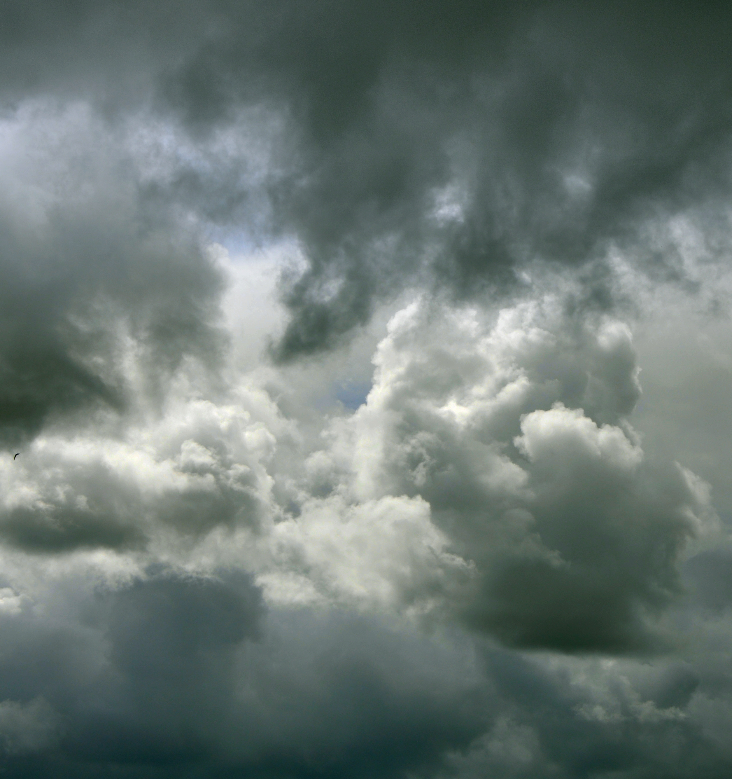
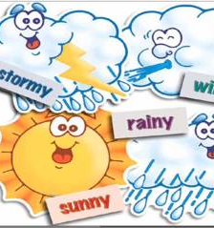
Weather and climate
By: Javier and Alyssa
This Photo by Unknown author is licensed under CC BY-NC-ND.
This Photo by Unknown author is licensed under CC BY-SA.
This Photo by Unknown author is licensed under CC BY-SA.

Slide 2
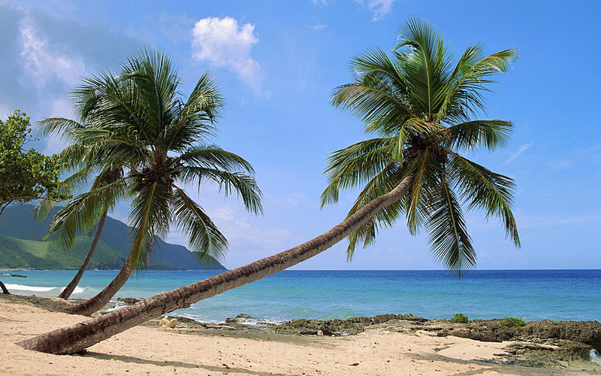
Tropical Climate Zone
The tropical climate has a lot green plants, and it's very hot and humid. They get lots of rain along with sun, you never need to wear pants because it is too hot! There are so many bugs, snakes and other animals. There are lots and lots of flowers.
This Photo by Unknown author is licensed under CCBY-NC-ND.
This Photo by Unknown author is licensed under CC BY-SA.

Slide 3
Temperate Climate Zone
The Temperate zone has a bunch of green plants. The temperate zone is located in the middle of polar and tropical zones. It's never too hot or cold. It sometimes gets snow or rain.
This Photo by Unknown author is licensed under CC BY-SA.

Slide 4
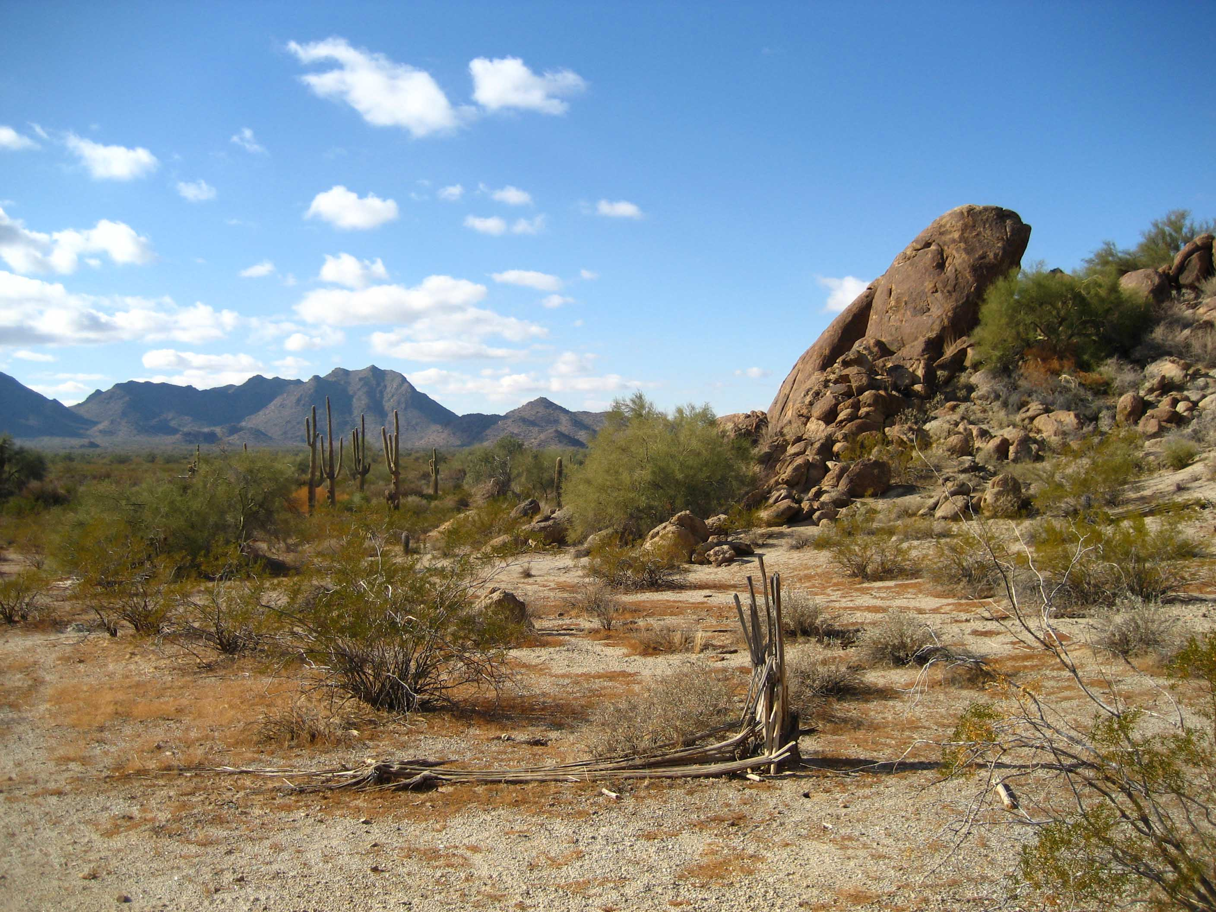
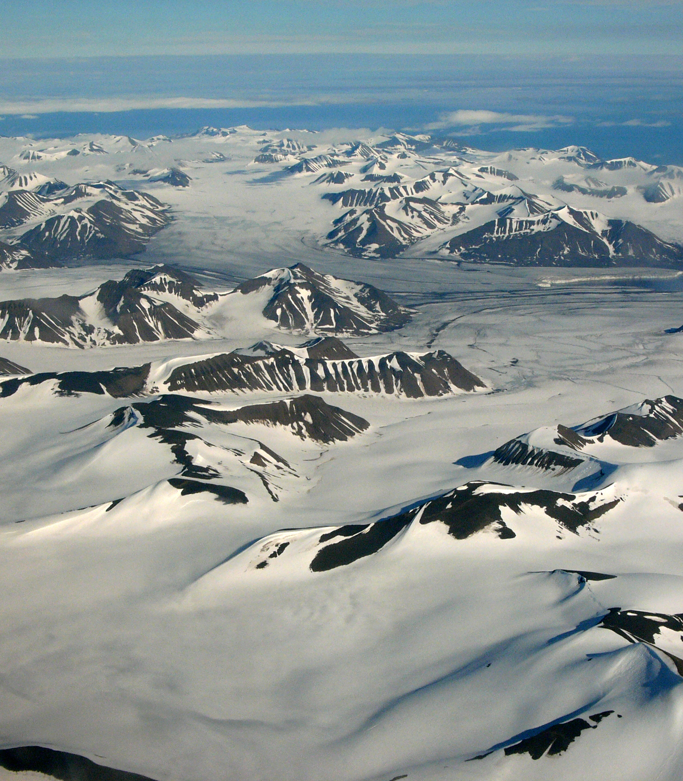
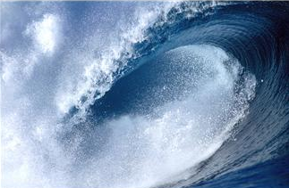
Desert Climate Zone
This Photo by Unknown author is licensed under CC BY-SA-NC.
A Desert is a dry hot land. They do not get a lot of water because where their location is at. It is hot because most sun shines in it and there's less rain a desert can be cold or hot like this place right here
This Photo by Unknown author is licensed under CC BY-SA.
This Photo by Unknown author is licensed under CC BY-SA.
This Photo by Unknown author is licensed under CC BY-SA.
This Photo by Unknown author is licensed under CC BY-NC-ND.

Slide 5
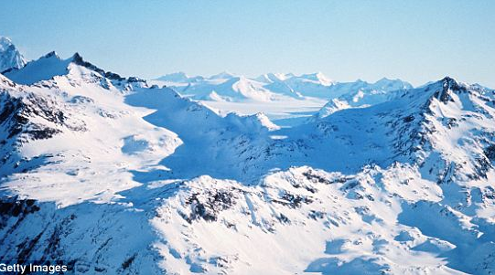
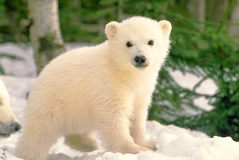
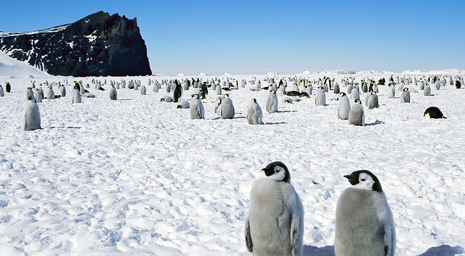
Polar Climate Zone The Polar zone is a cold place where very few plants can grow and animals that have instincts for this cold weather.
This Photo by Unknown author is licensed under CC BY-NC-ND.
This Photo by Unknown author is licensed under CC BY.
This Photo by Unknown author is licensed under CC BY.

Slide 6
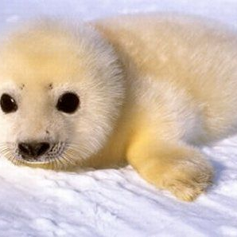
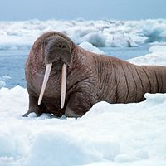
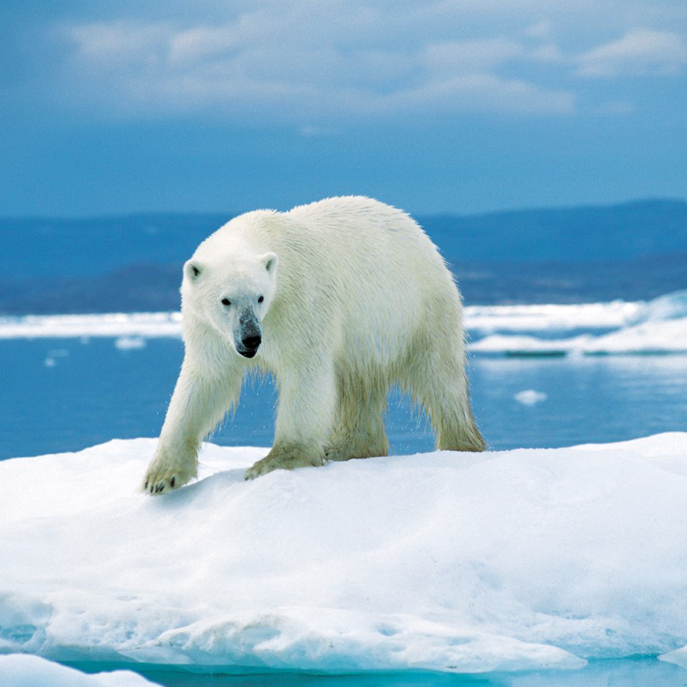
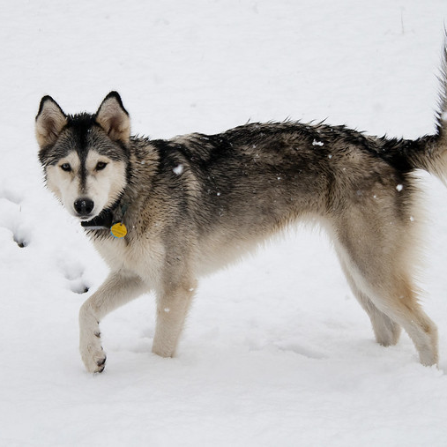
Animals In Polar Zone
This Photo by Unknown author is licensed under CC BY-ND.
This Photo by Unknown author is licensed under CC BY-SA-NC.
This Photo by Unknown author is licensed under CC BY.
This Photo by Unknown author is licensed under CC BY.
This Photo by Unknown author is licensed under CC BY.
This Photo by Unknown author is licensed under CC BY-SA.

Slide 7
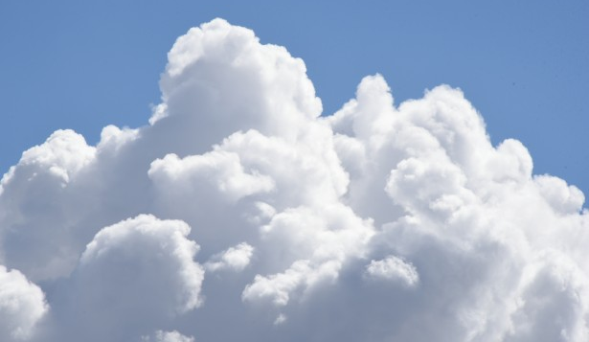
Cumulus Clouds
Cumulus clouds are large piles of white clouds. That are a billow high in the sky. They appear in fair weather. May only be 1000 meters above the ground. The cumulus clouds mostly last for 5 to 40 minutes long. Cumulus clouds meaning is heap or pile.

Slide 8
Cumulonimbus cloud
Cumulonimbus clouds are big giant clouds. That cause destruction. It is started by clouds that mix together and form more water to make it rain.
This Photo by Unknown author is licensed under CC BY-SA.

Slide 9
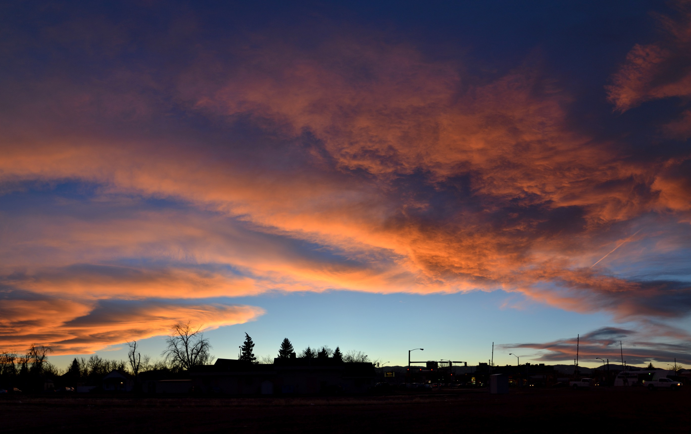
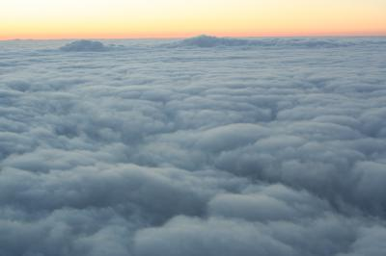
Stratus Cloud
Stratus clouds are spread out, gray cloud. They don’t cause rain.
Stratus clouds resemble fog, but they do not often produce a drizzle. They are spread out like a blanket covering the sky, and the color
This Photo by Unknown author is licensed under CC BY-SA.
This Photo by Unknown author is licensed under CC BY-SA-NC.

Slide 10
Stratonimbus Clouds
Stratonimbus Clouds are a type of cloud that spreads all around the sky. They are dark clouds that cause rain all day.
This Photo by Unknown author is licensed under CC BY-SA.
This Photo by Unknown author is licensed under CC BY-SA.

Slide 11
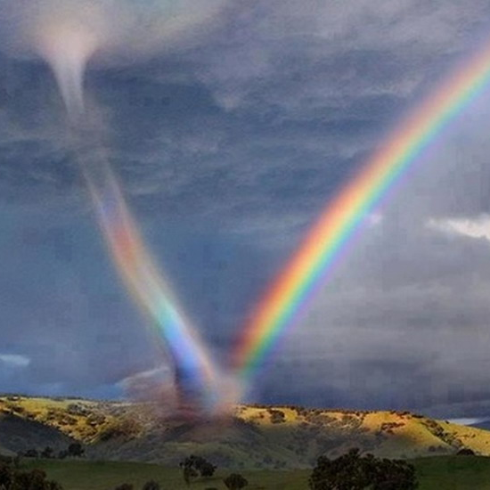
Extreme Weather - Tornadoes
Tornadoes are funnels of powerful wind that form over flat land. Tornado's speed can reach over 400 kilometers. Tornadoes are also called twisters. When warm and cold wind meet in different directions, they form a tornado.
This Photo by Unknown author is licensed under CC BY.
This Photo by Unknown author is licensed under CC BY-NC-ND.
This Photo by Unknown author is licensed under CC BY-NC-ND.

Slide 12
Extreme Weather - Tsunami
A tsunami is a big wave that causes destruction. Tsunamis are made from earthquakes, erupting volcanos, and earth shifting under the ocean.
This Photo by Unknown author is licensed under CC BY-NC-ND.

Slide 13
Dust storm
Winds can pick up dust a, create dust storms. Dust storms are so powerful that they can make power go out. Airplanes cannot land. Car drivers could not see. People's homes and buildings were coverd in dust. Even swimming pools became mud baths.
This Photo by Unknown author is licensed under CC BY-SA-NC.

