Slide 1
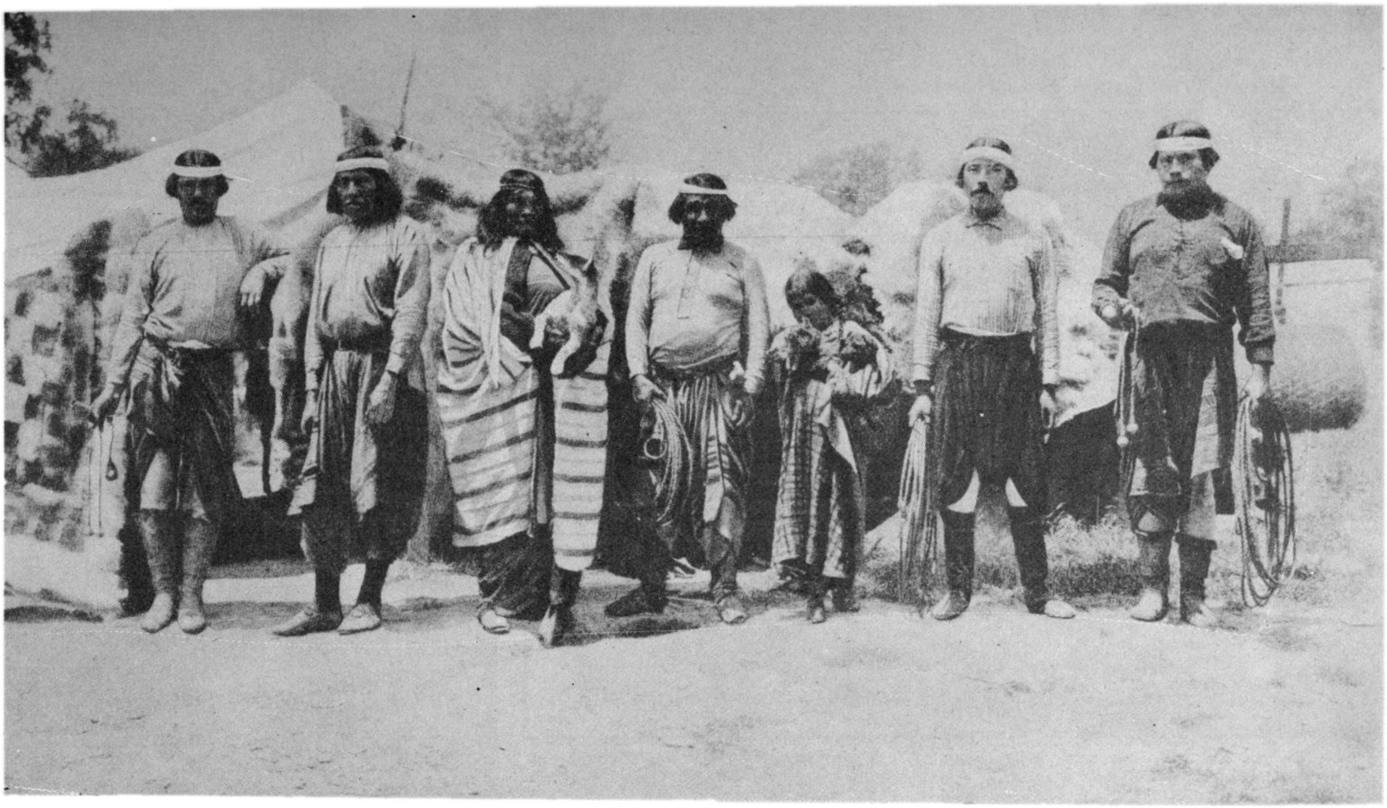
Gabrielino
By: Koda, Marco, and Melody

Slide 2
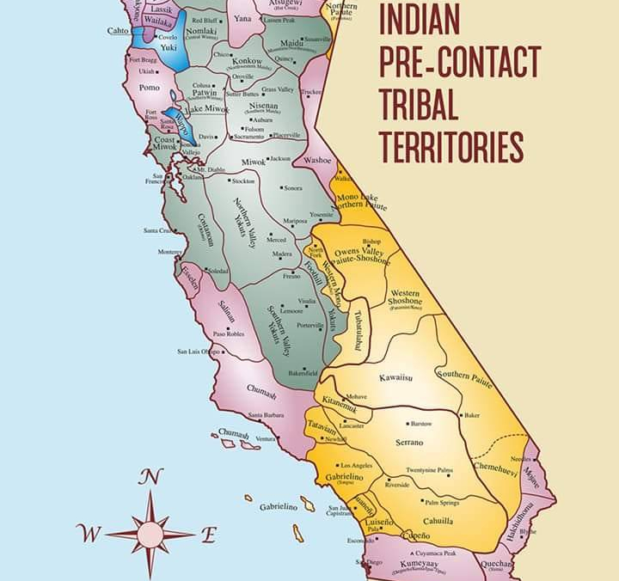
Location
The Gabrielino tribe lived in the southern coast of California. They lived in sheltered bays on the coast, along streams, and river inlands . They also lived near dunes, grassy areas, valleys and mountains.
ThePhoto by PhotoAuthor is licensed under CCYYSA.

Slide 3
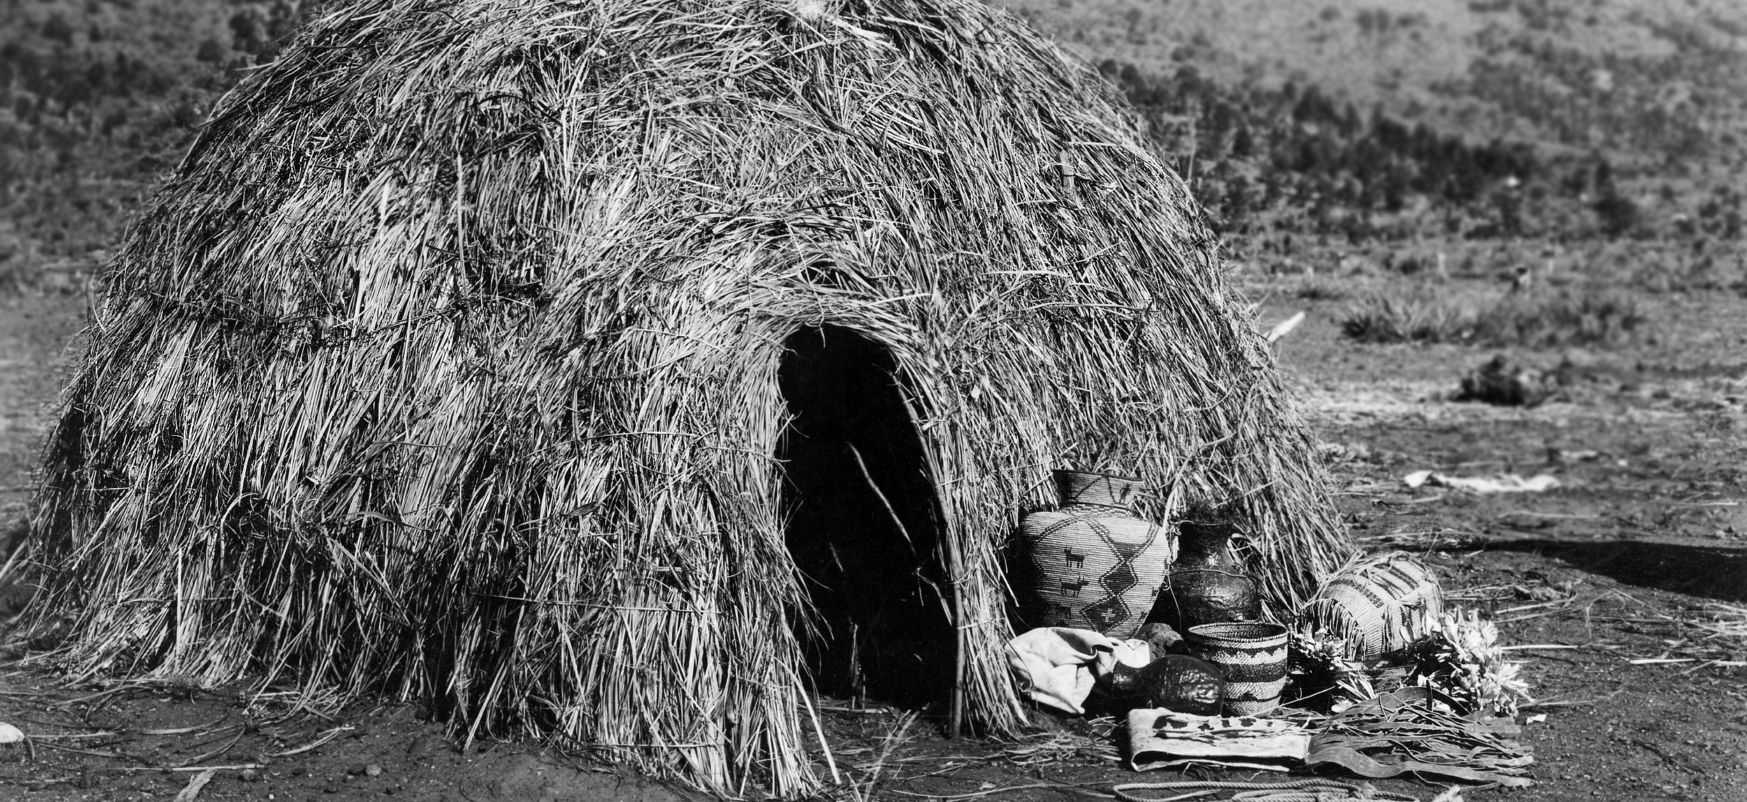
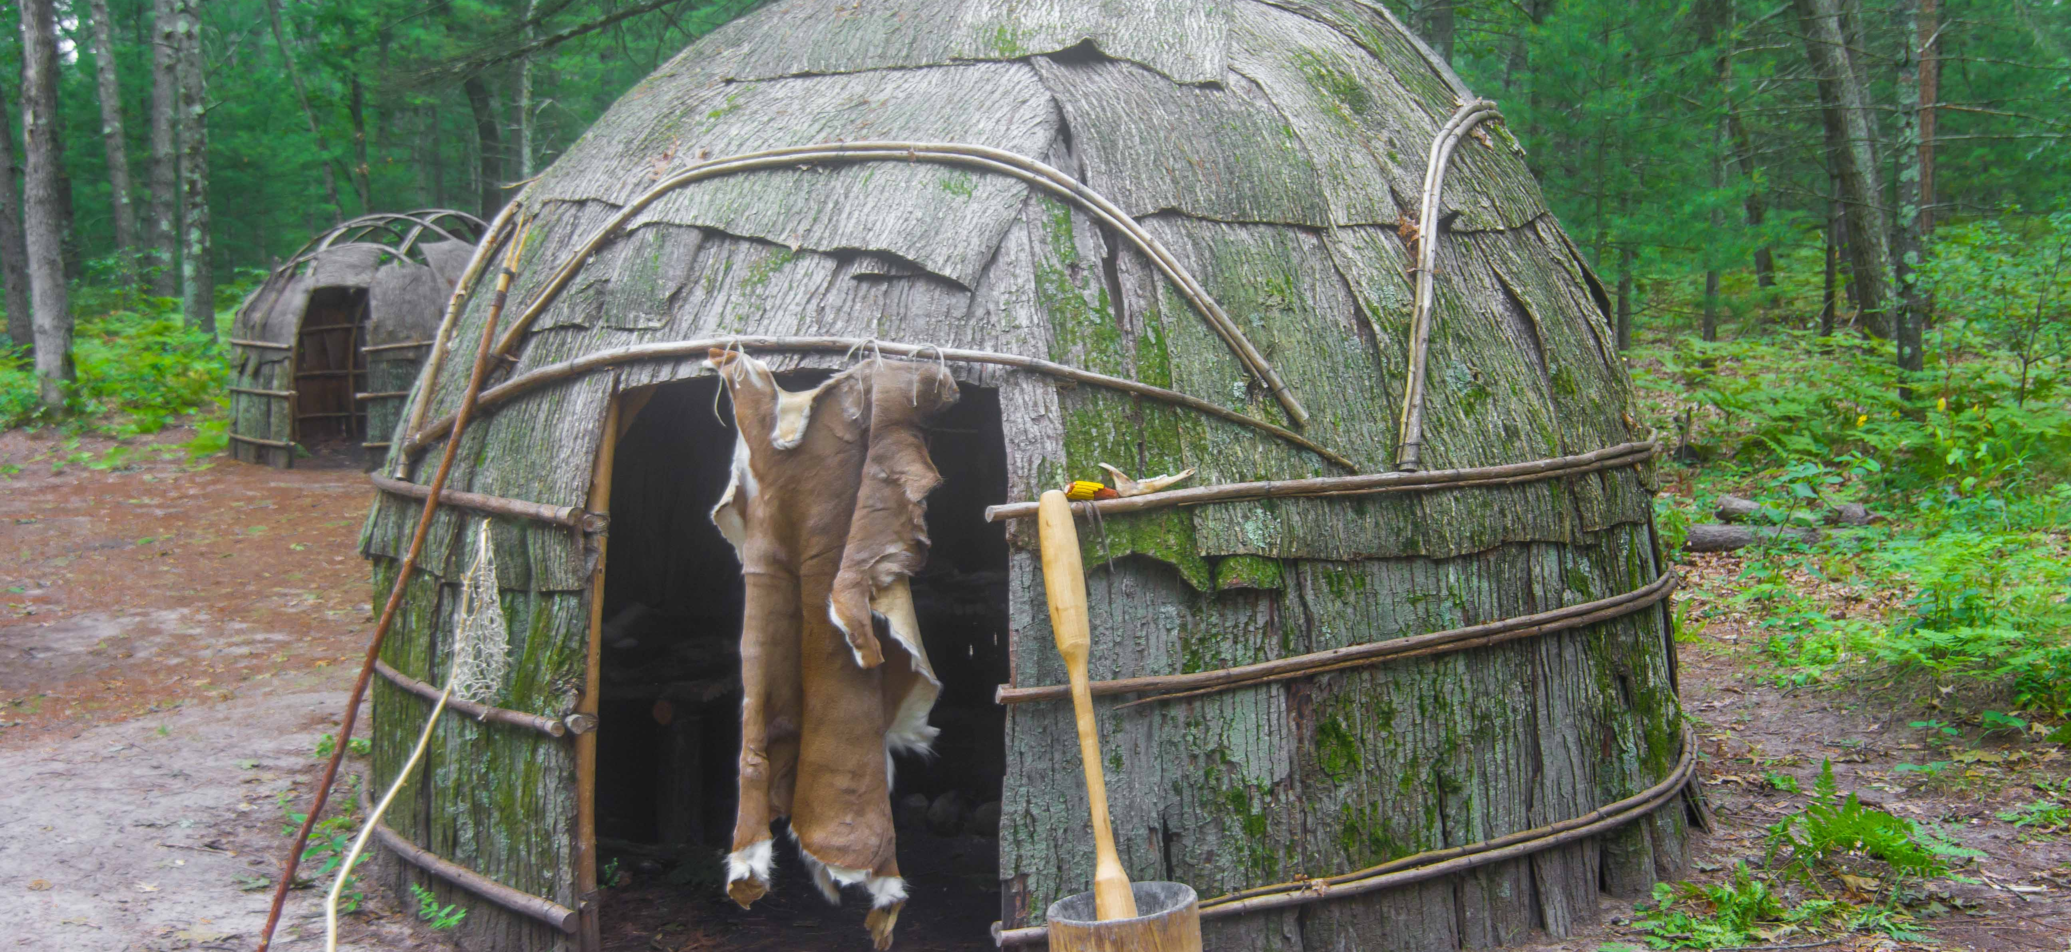
Shelter
The shelter of the Gabrielino protected them from the environment.
They made their shelter out of bent tree of saplings covered with tule mats.
Some houses were large enough to hold 50 or 60 people.
Three to four families would share living spaces.

Slide 4
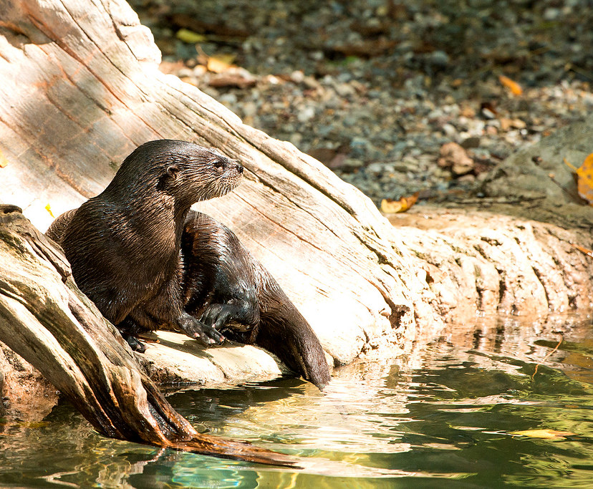
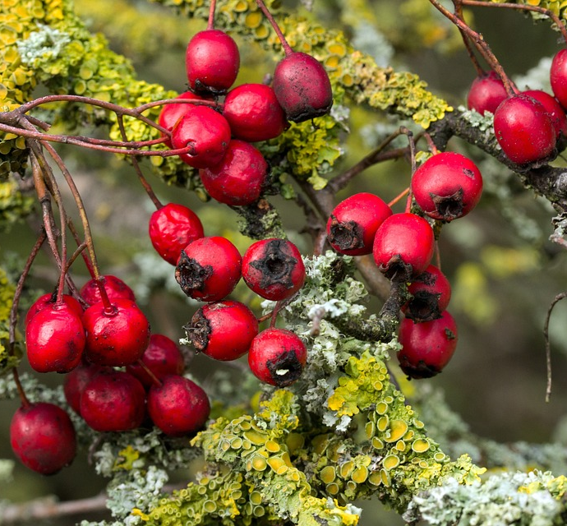
Food
They hunted rabbits, sea lions, otters, seals, and dolphins.
They gathered pine nuts, acorns, berries, and seeds.
From the ocean, they fished sharks, swordfish, and tuna.
ThePhoto by PhotoAuthor is licensed under CCYYSA.

Slide 5
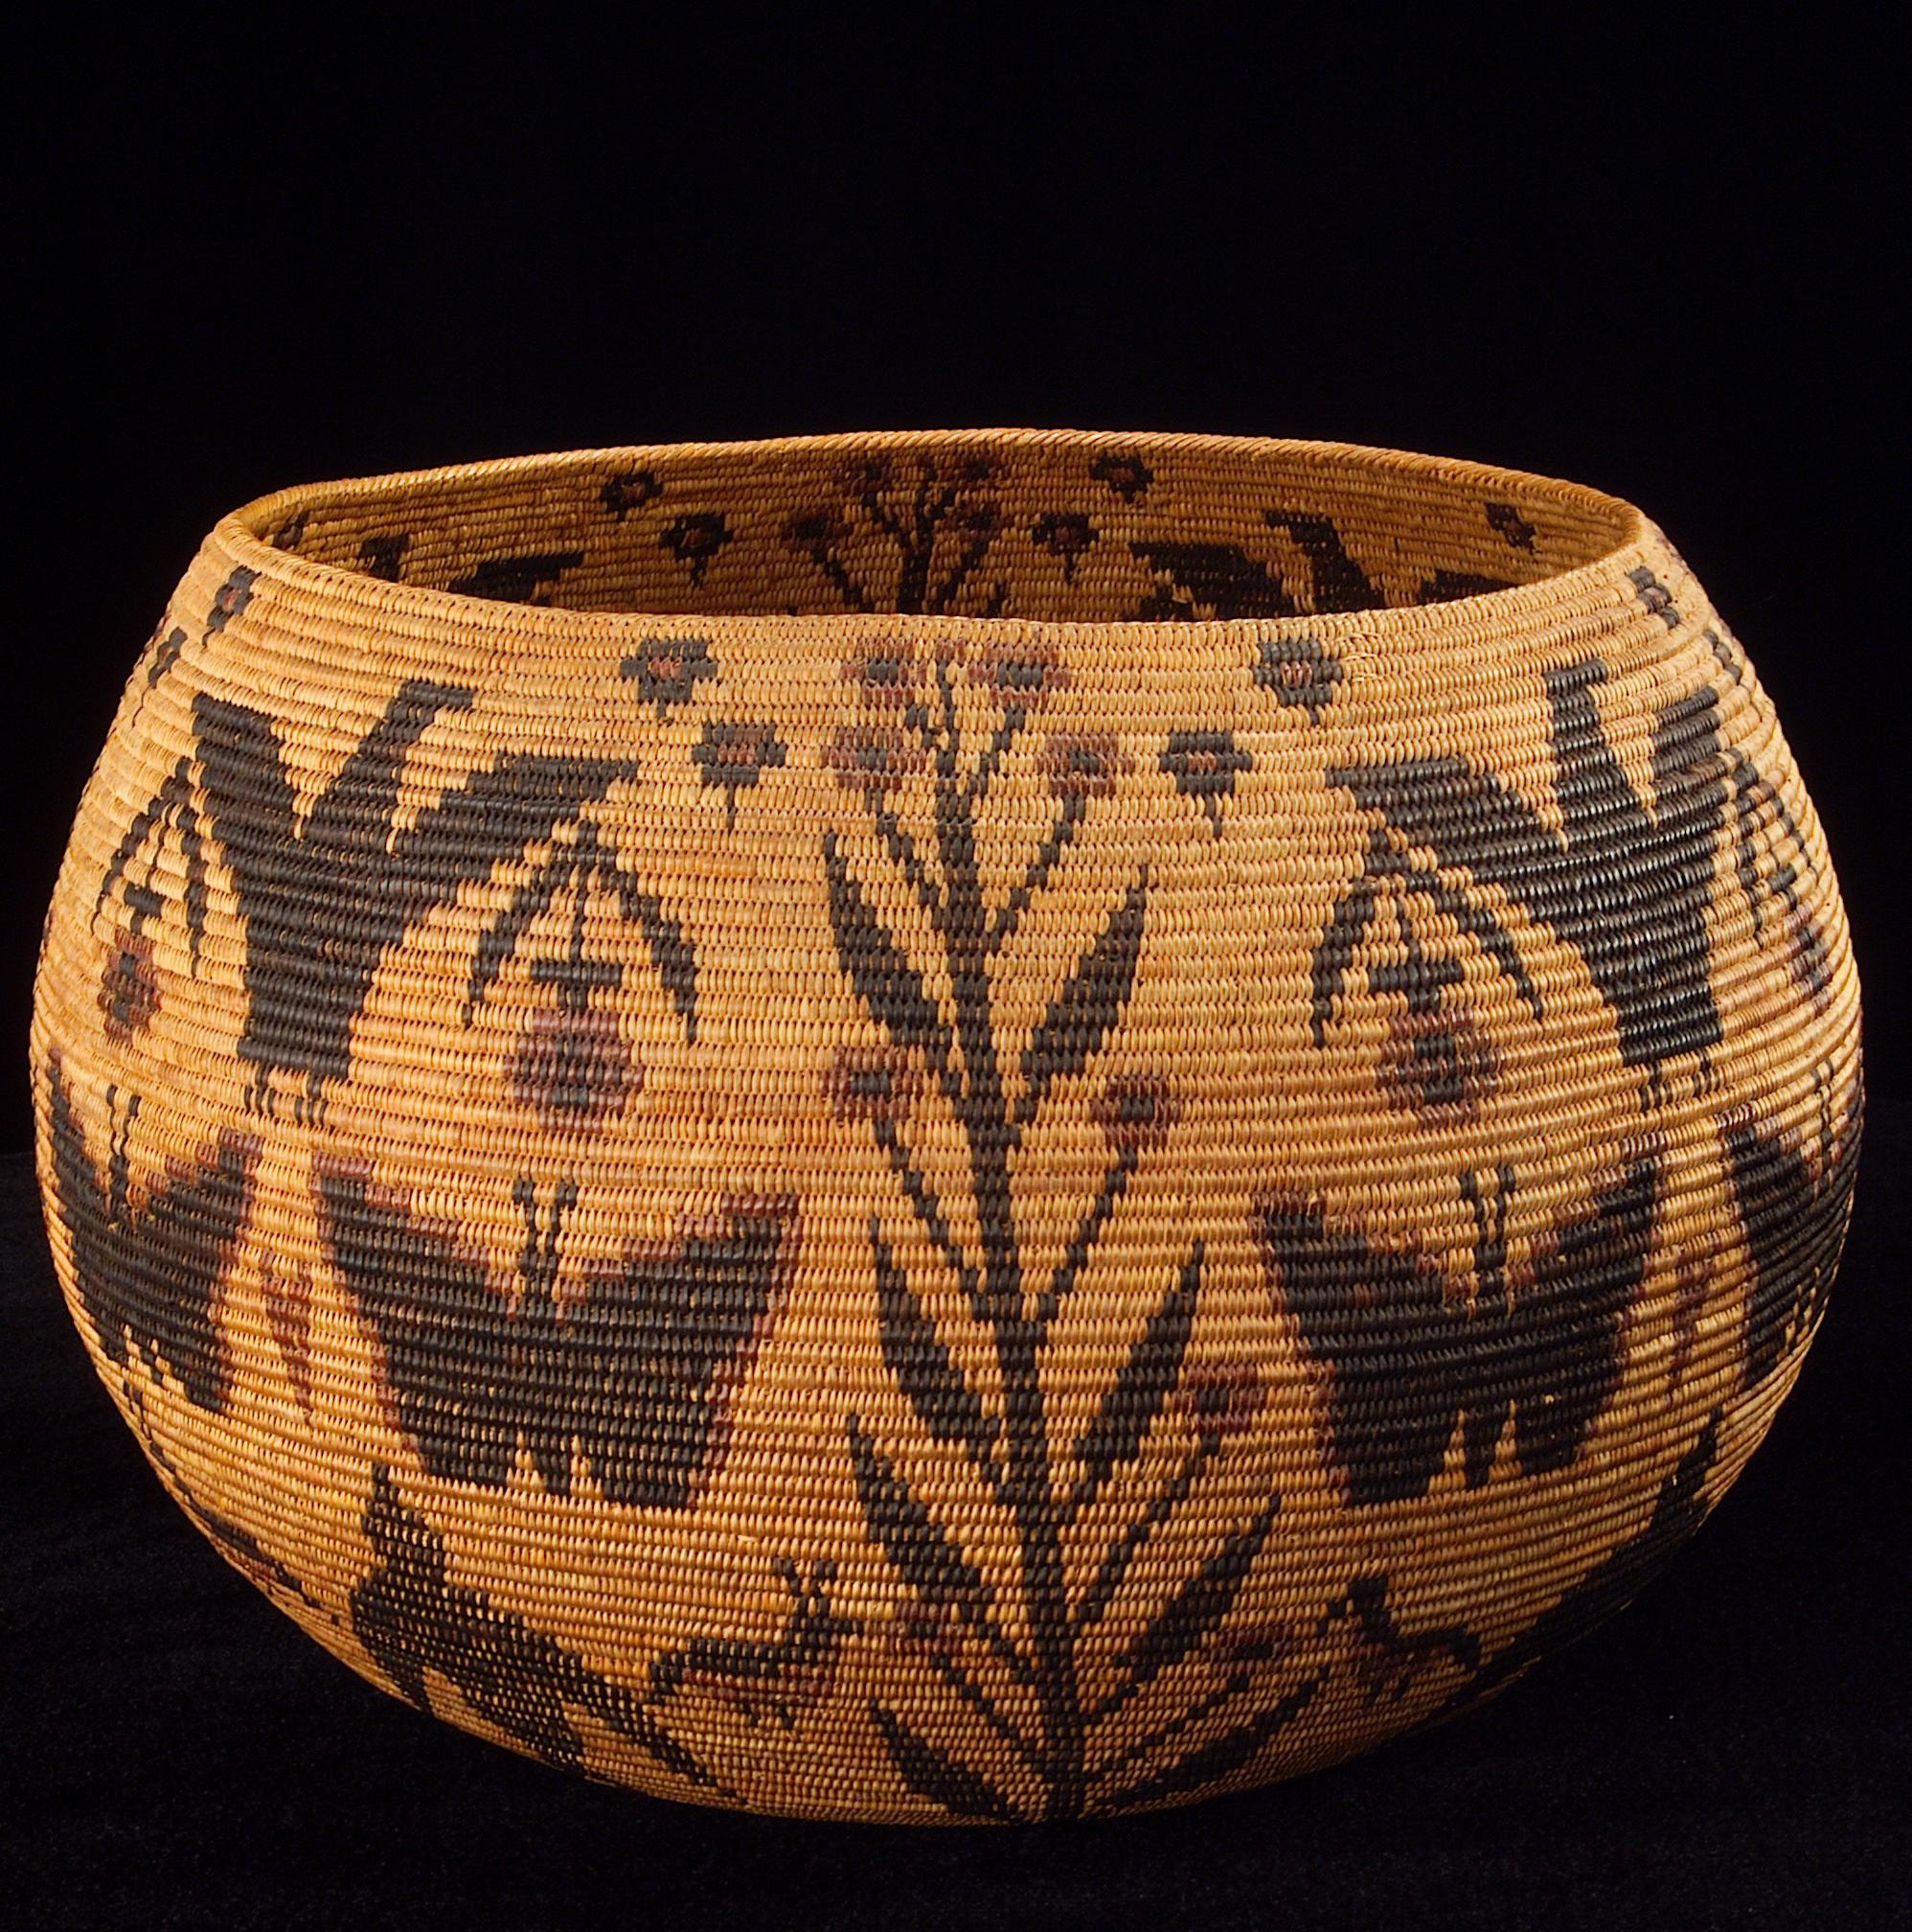
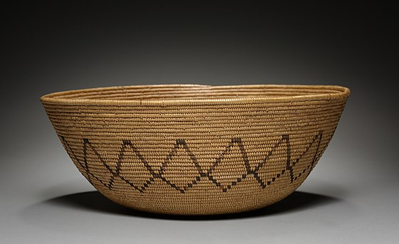
Culture
The Gabrielino culture is unique.
The women were expert basket makers.
Instruments were drums and rattles.
Young girls used red ocher paint on their foreheads for protection from the sun.
ThePhoto by PhotoAuthor is licensed under CCYYSA.

Slide 6
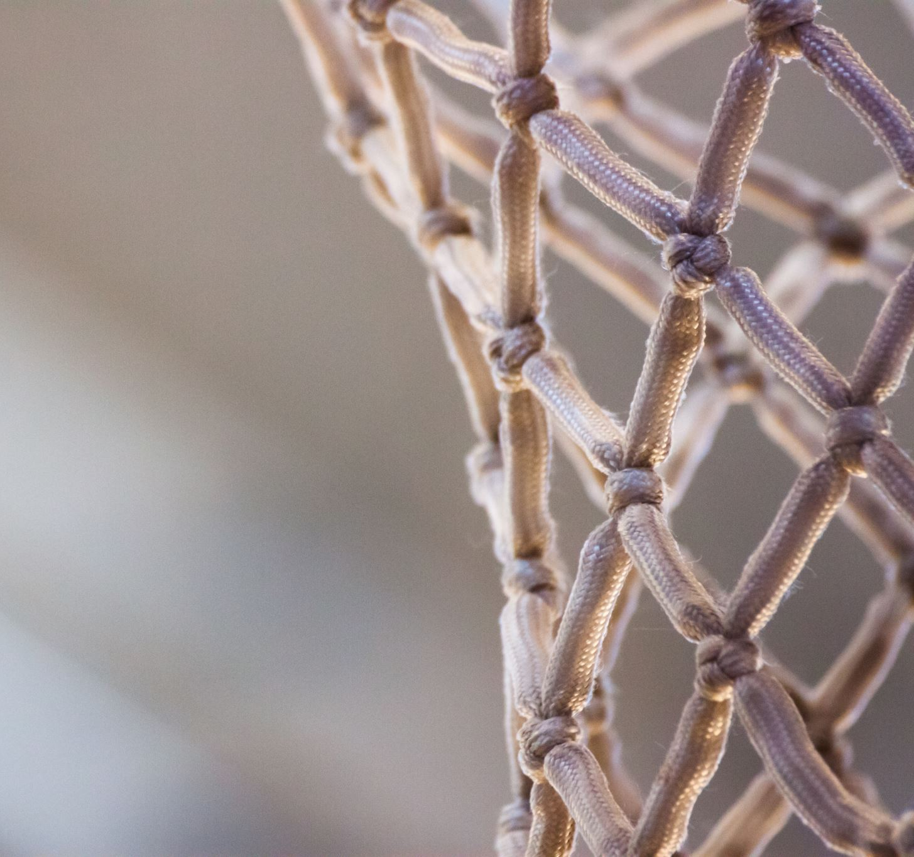
Native American Tools
They used bow and arrows, nets, harpoons and war clubs. They did arts and crafts like baskets and weaving .

Slide 7
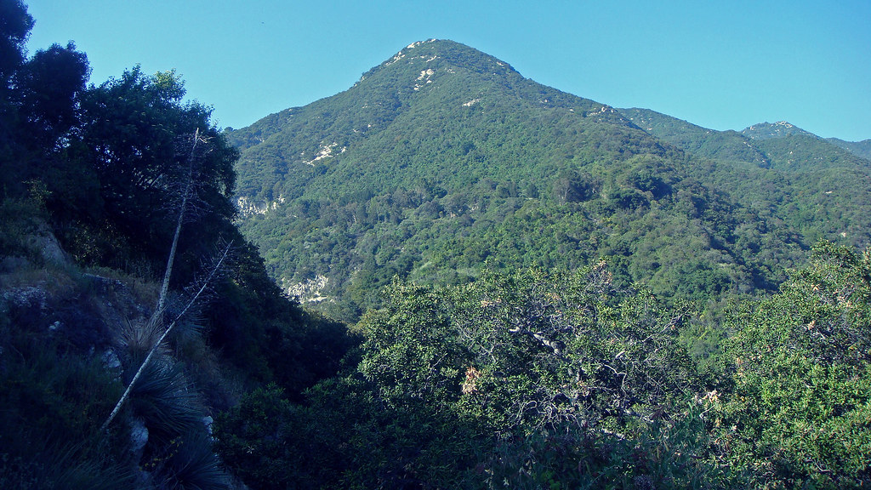
Thank for listening

