Slide 1
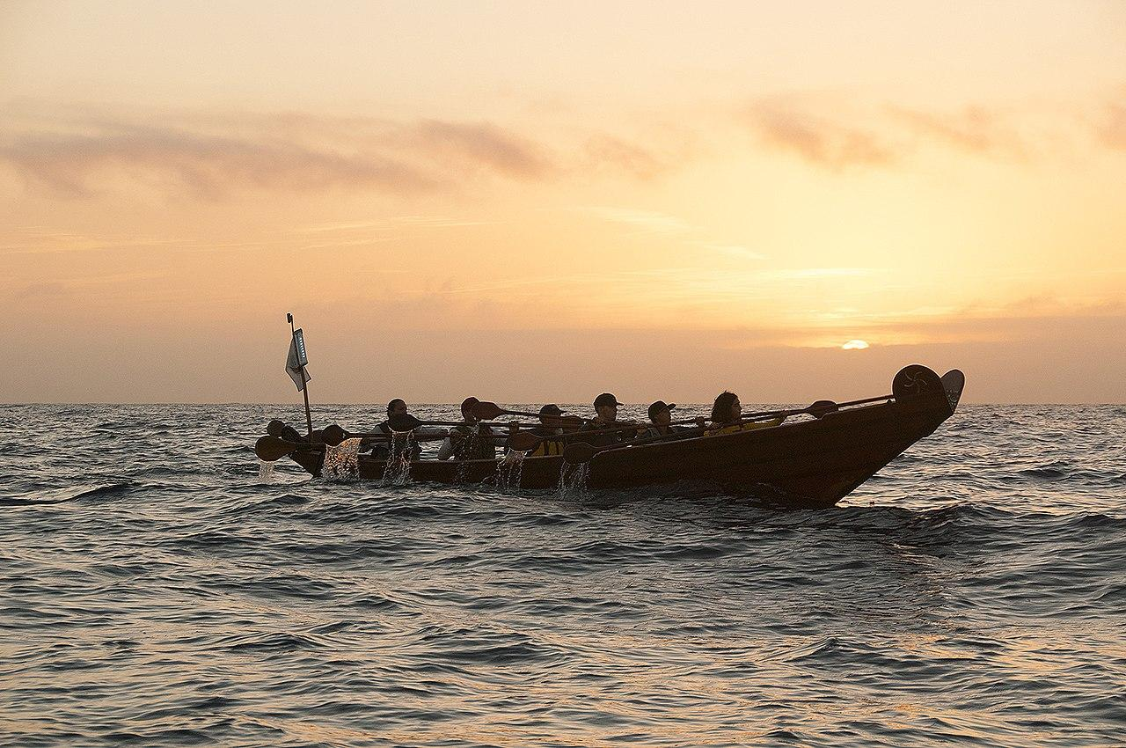
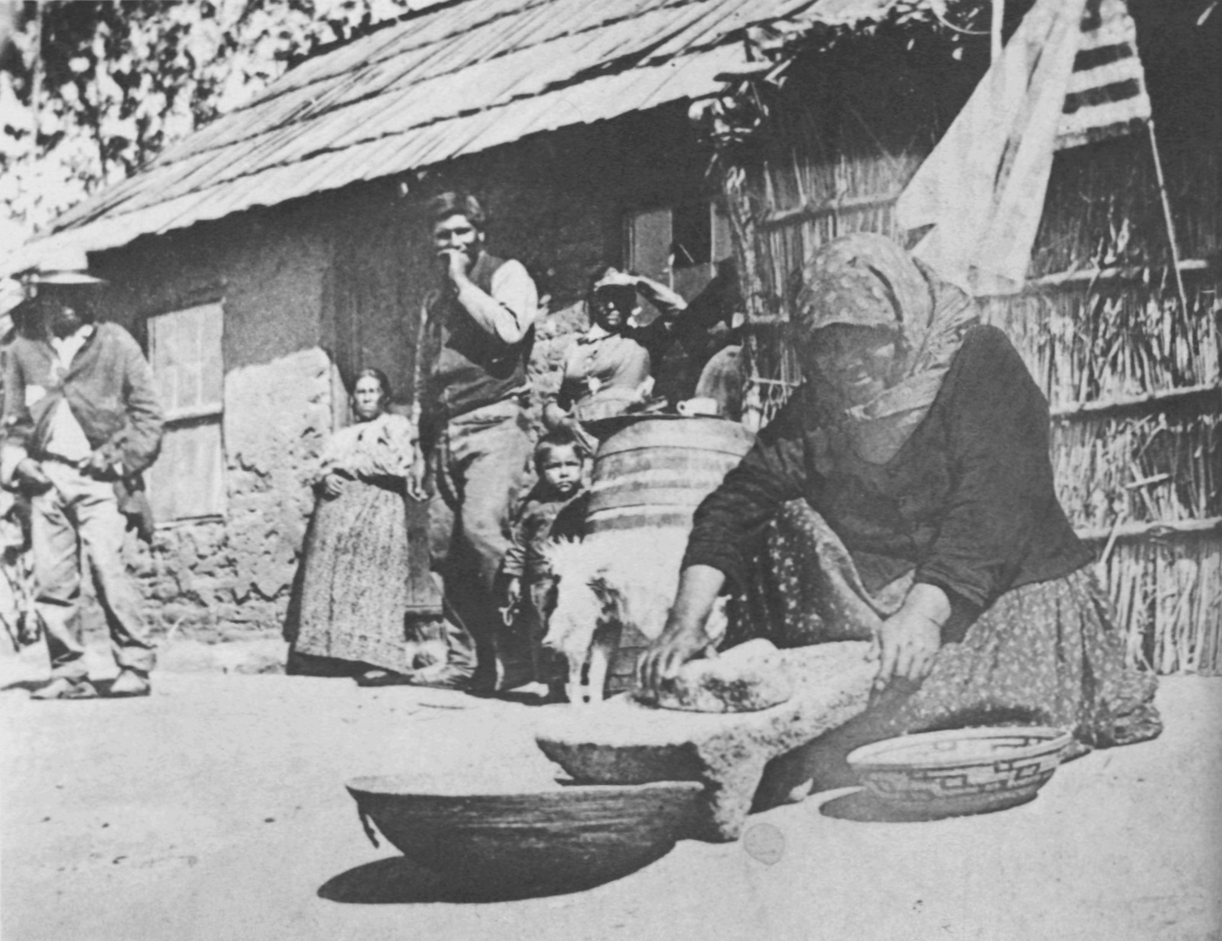
Gabrielino/Tongva Tribe
By Nicholas & Matthew

Slide 2
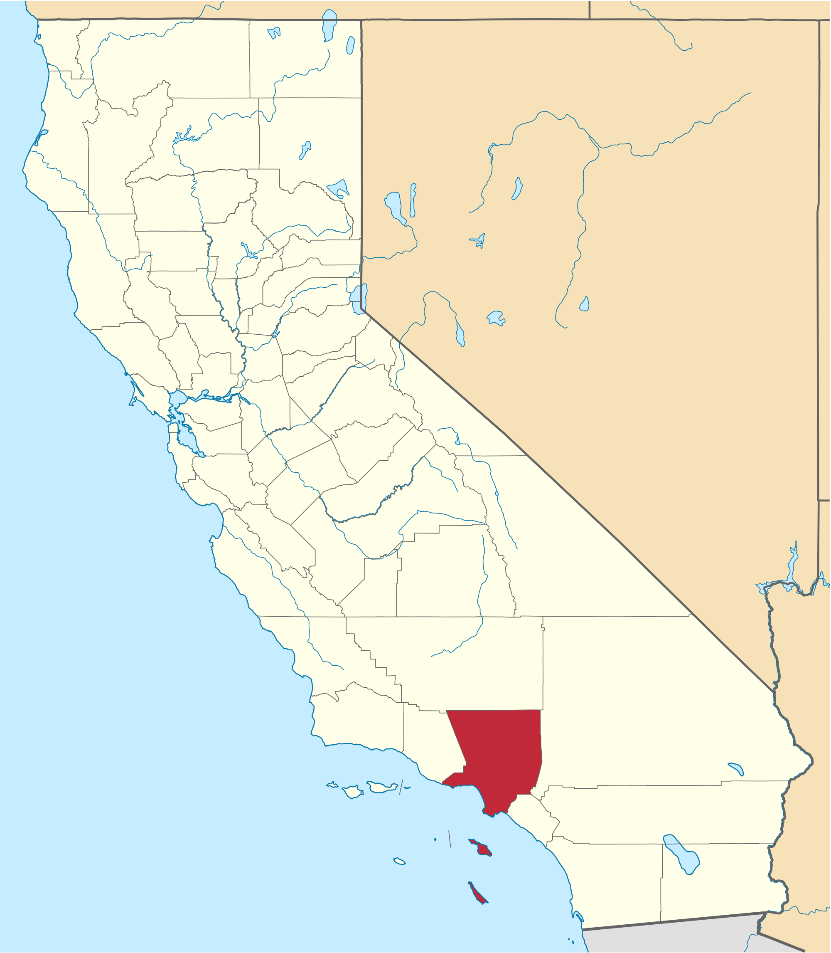
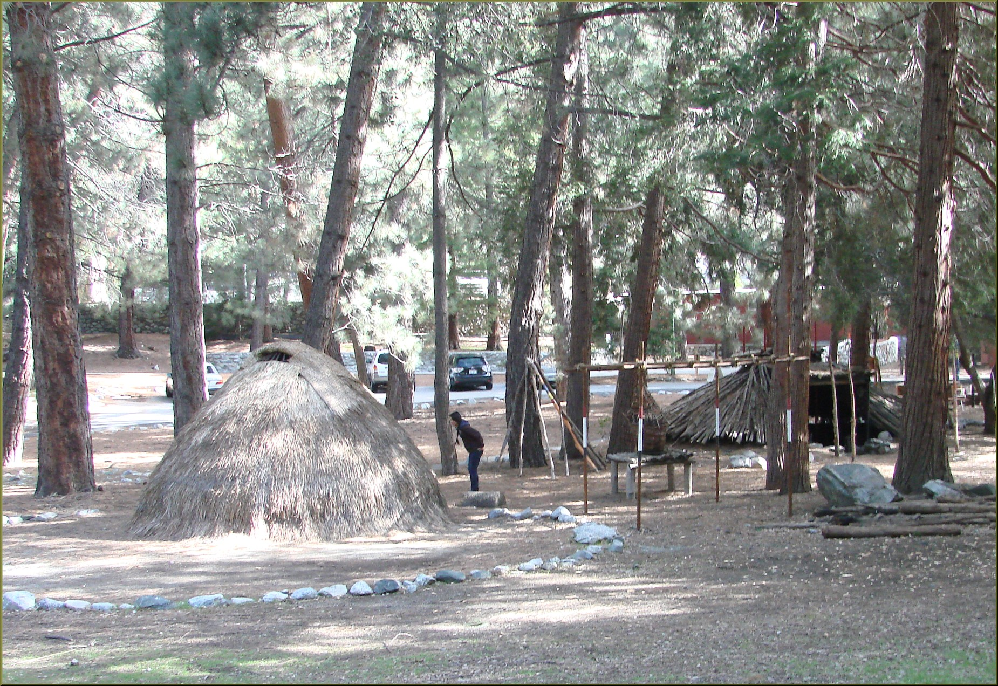
Location
They built villages near the Los Angeles River and on the nearby Channel Islands. Like many California Indians, the Gabrielinos were placed in reservations together with other mission Indians from different tribes.
Notes:
Write about the landforms, geographical location, and climate unique to the area.

Slide 3
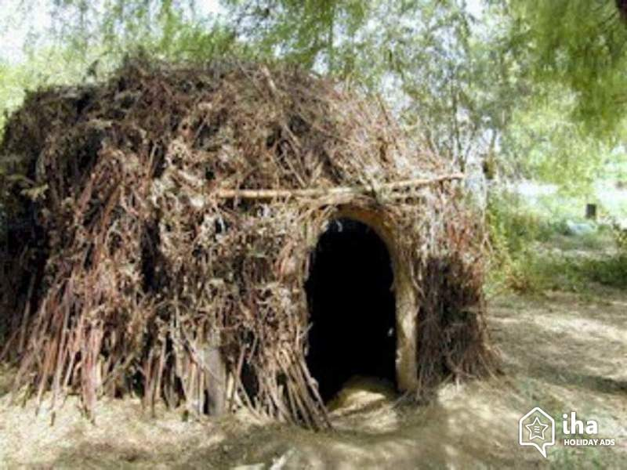
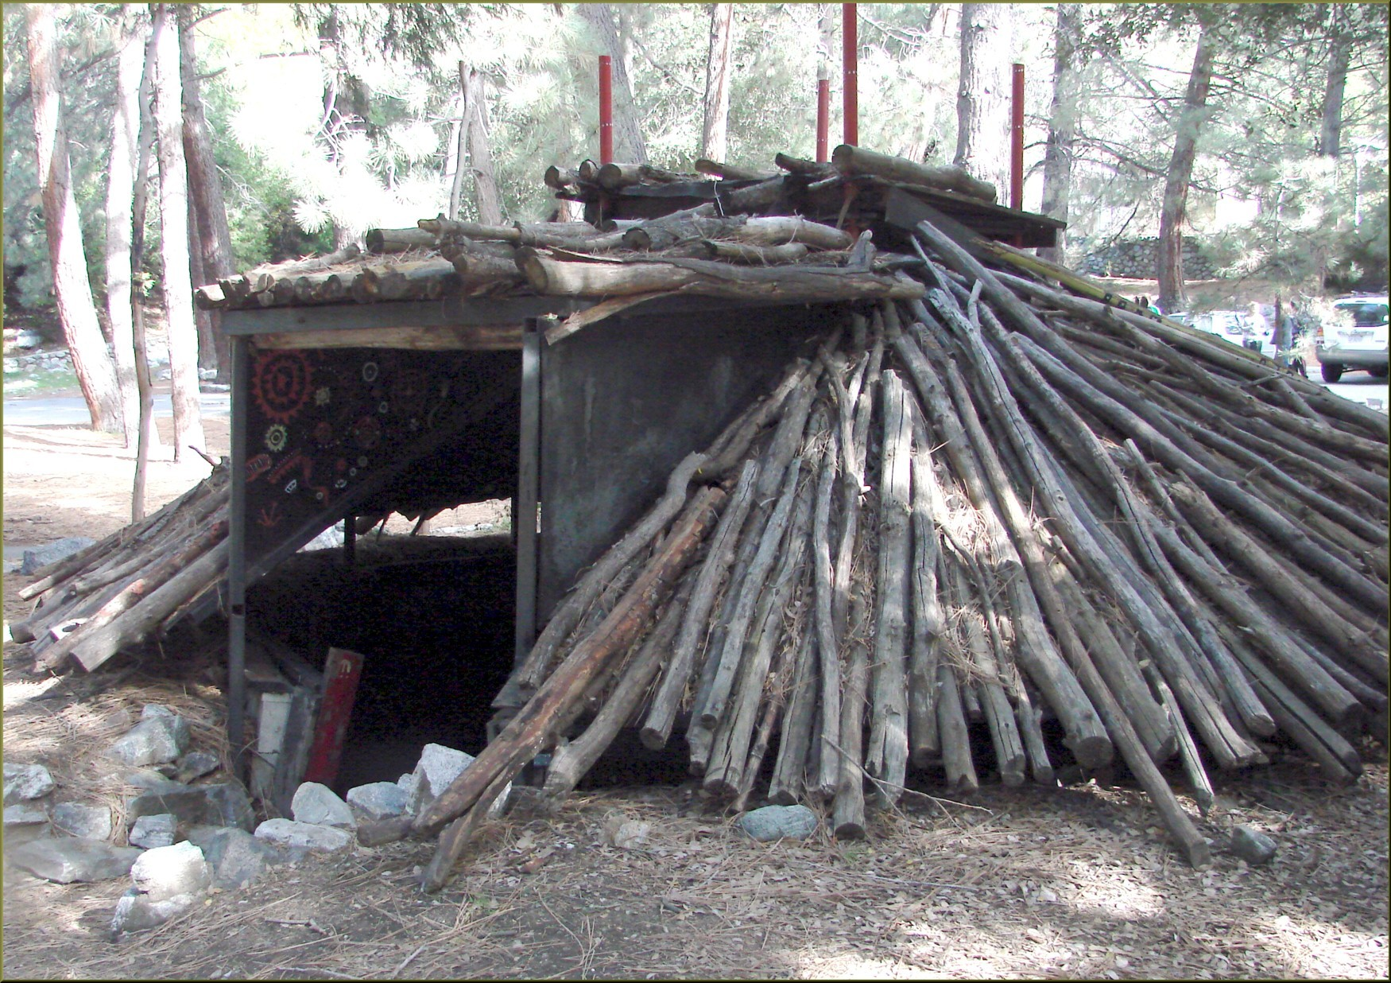
Shelter
The Gabrielino framework of the poles was covered with bundles of tule reeds or ferns or ferns or with mats woven from tules. Most Gabrielino people lived in earth houses, which are made of an underground room covered by a wooden frame packed with clay and brush. The thick earth walls kept this kind of house cool in the heat and warm in the cold, making it good shelter in the desert.
Notes:
Write about the materials, shape, name, and unique features of the structure.

Slide 4
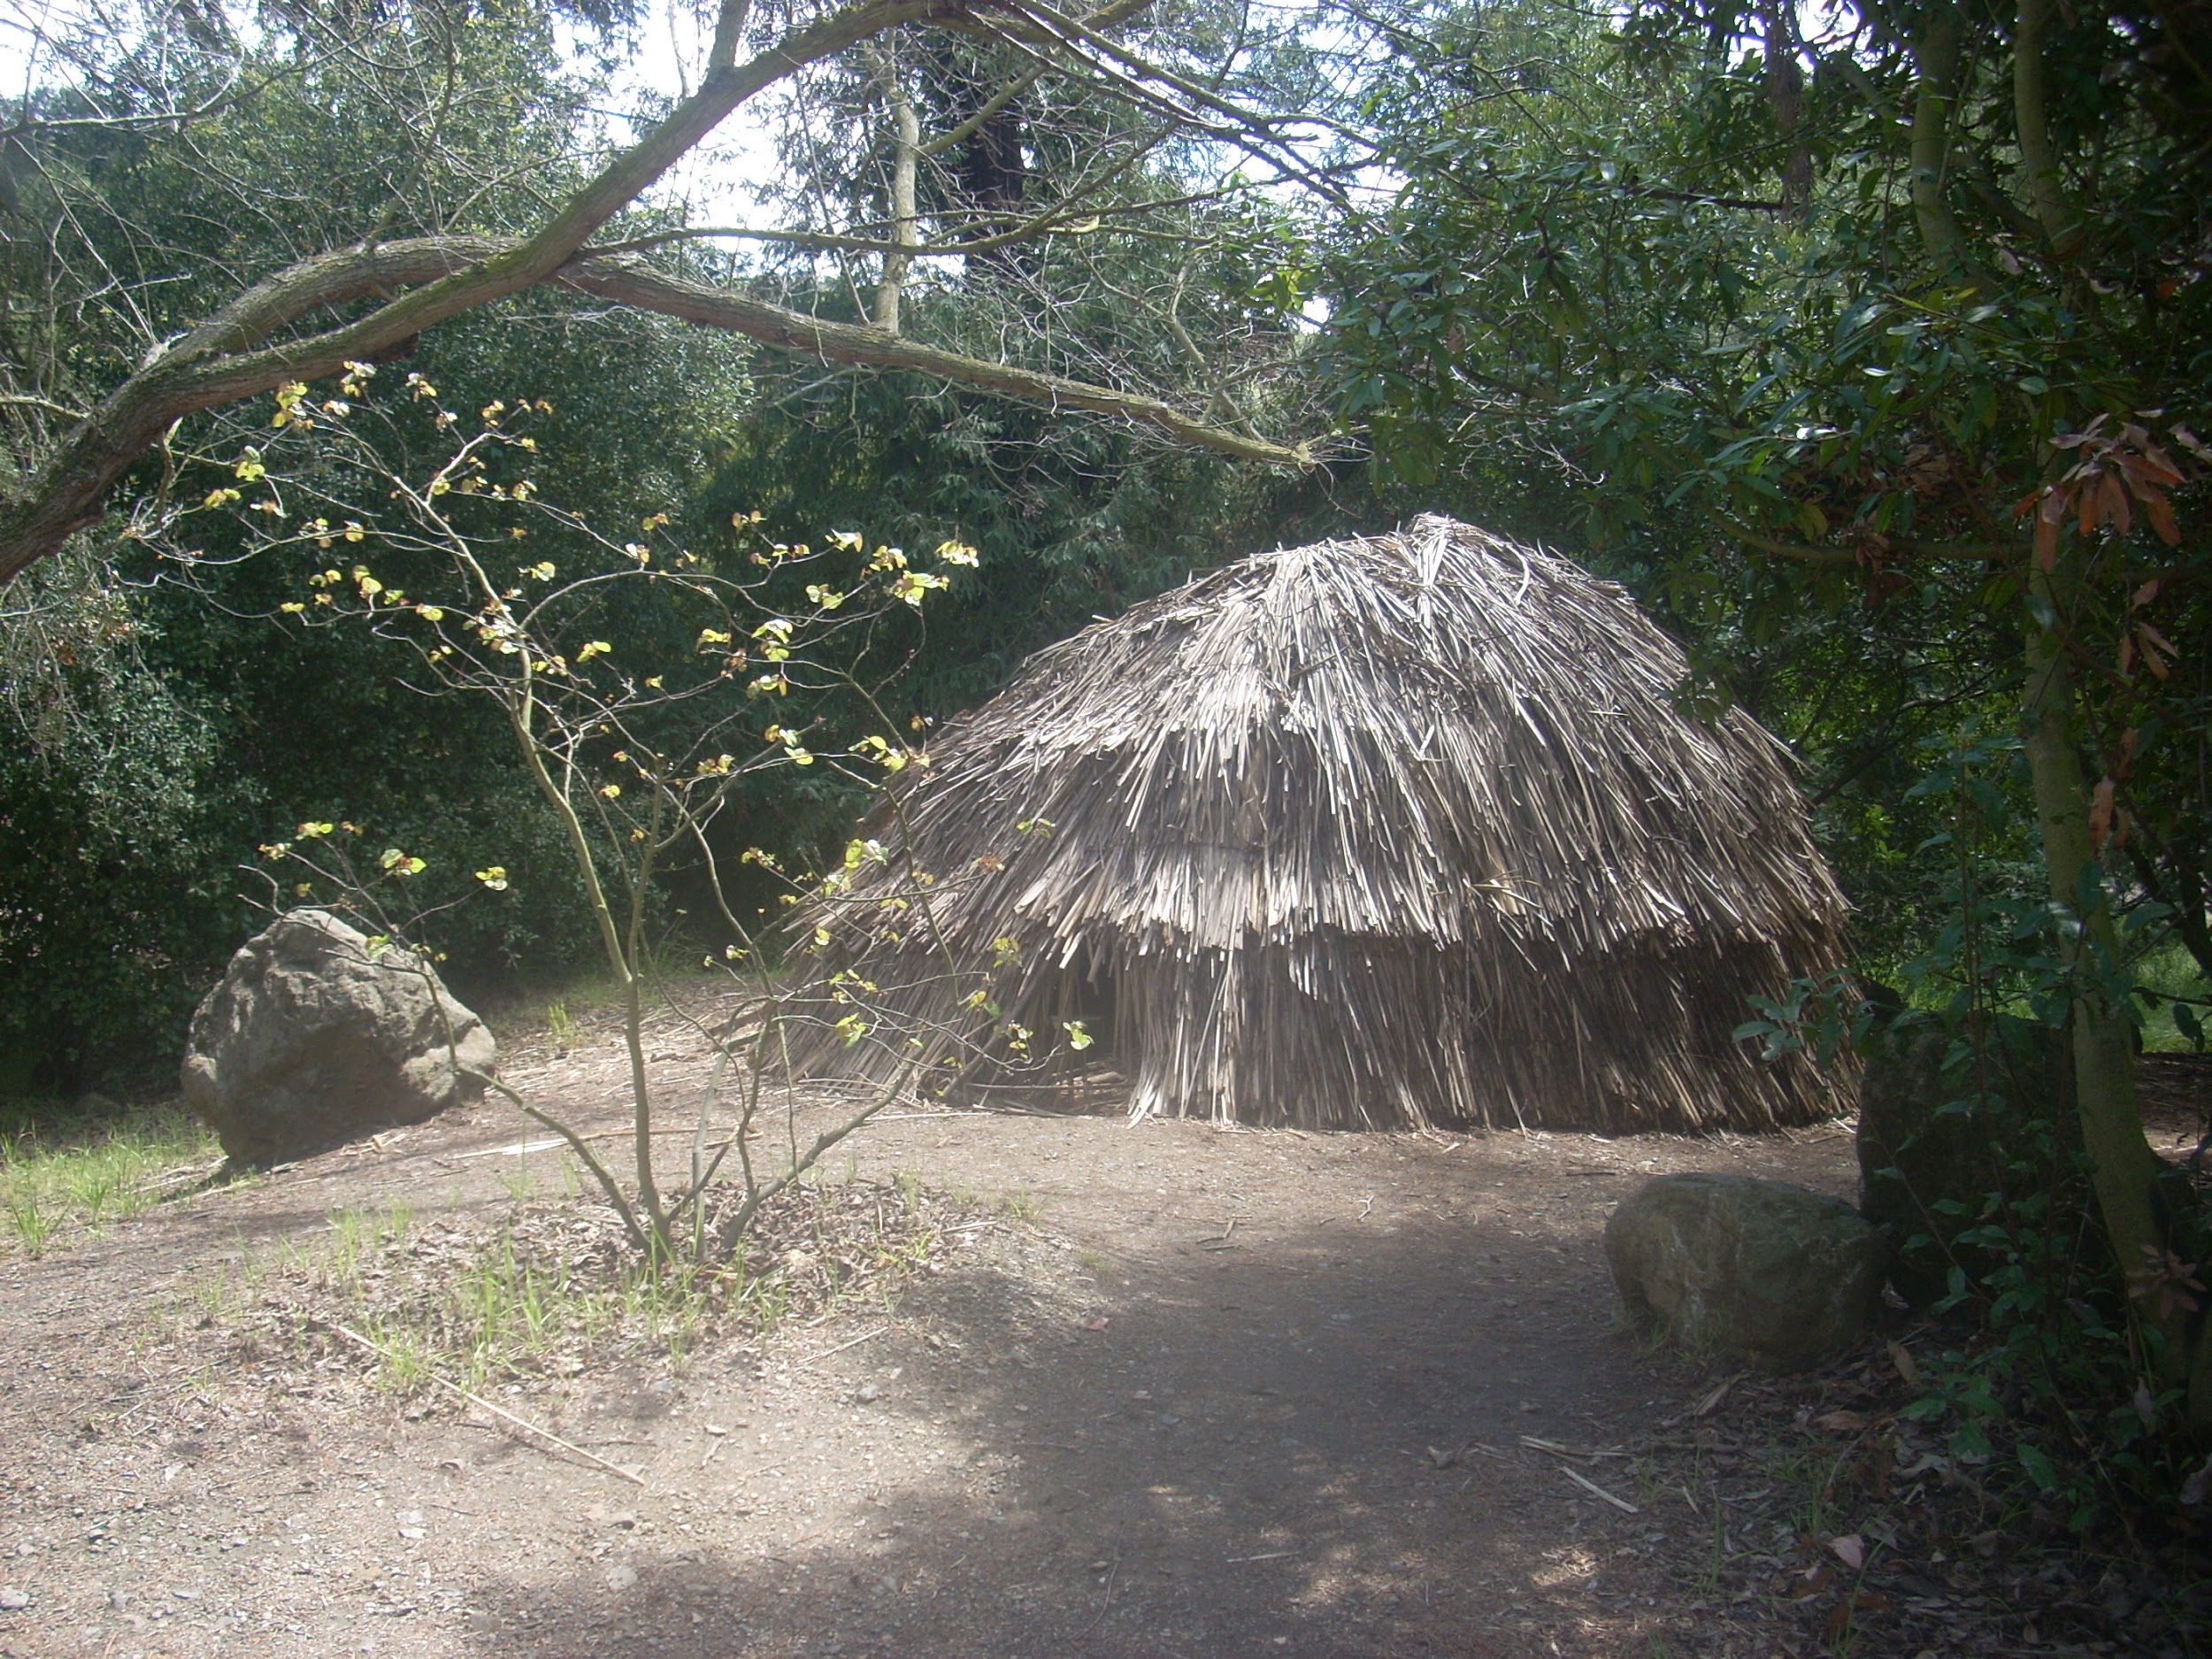

Slide 5
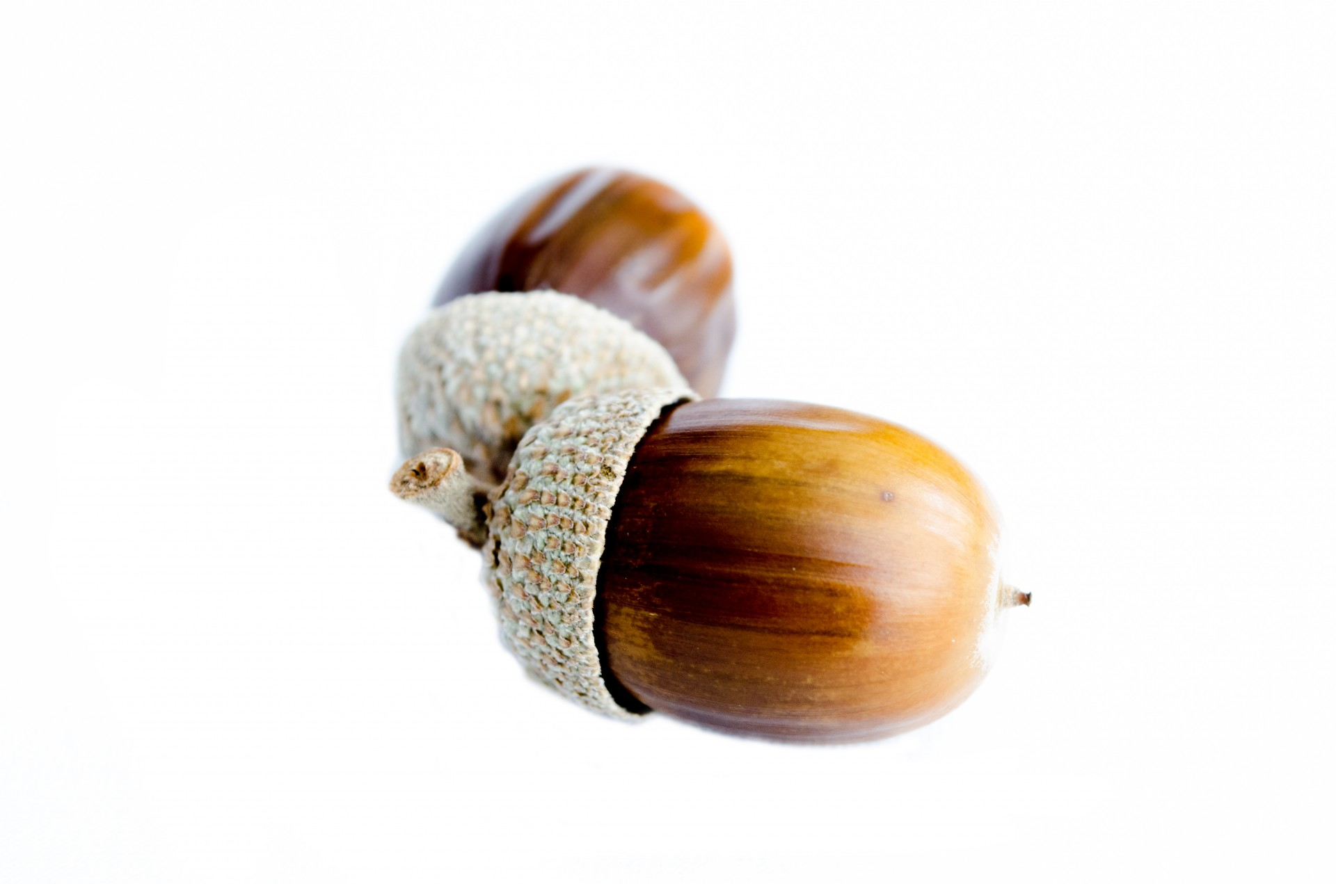
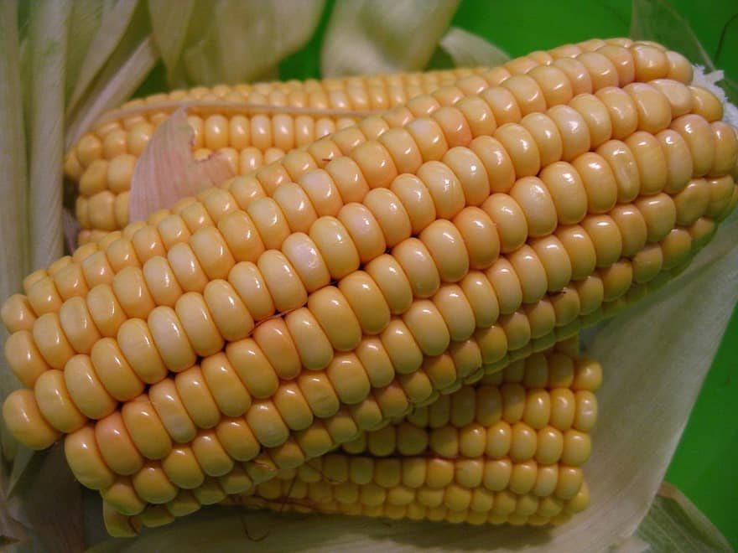
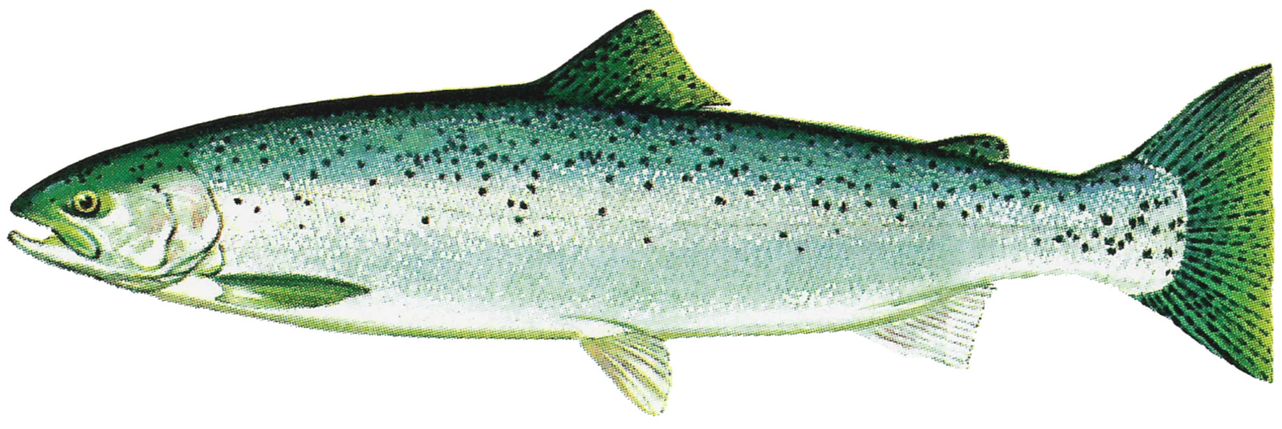
Food
The Gabrielino got their food from the sea. To cook acorn mush, for example, they heated rocks in a fire. Then they dropped the rocks into the mush. They cooked Corn on sticks with heated rocks. The villages near the oceans they got most of their food from the sea. They ate many kinds of fish tuna, swordfish, sharks, shellfish, sea mammals and some birds and turtles.
Notes:
Write about the food the tribe ate, crops they grew, hunting & gathering skills, and ways to prepare meals.

Slide 6
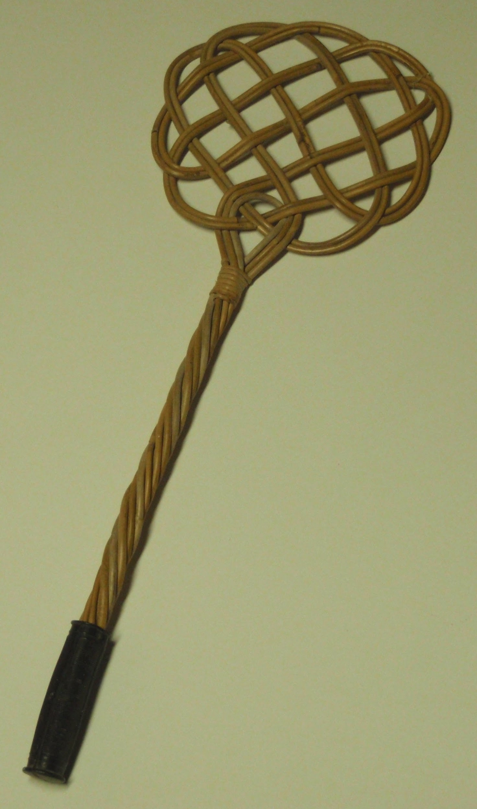
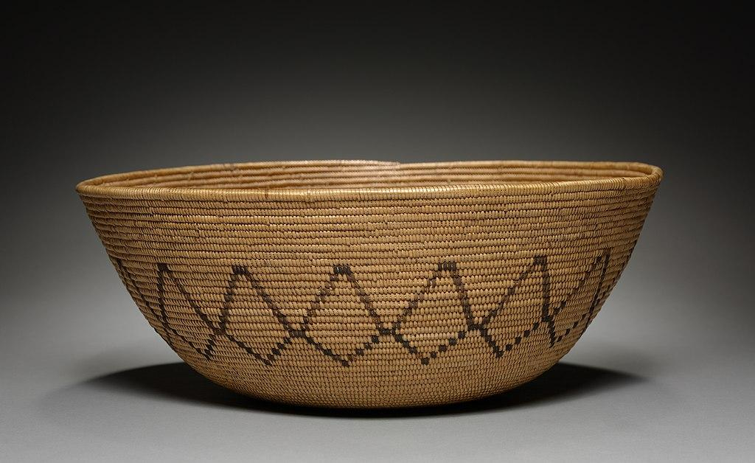
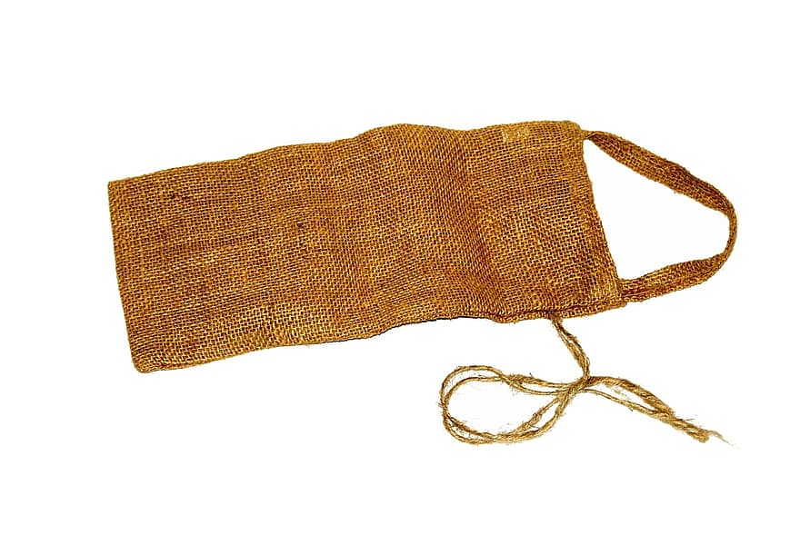
Culture
Wicker seed-beating tool: they hit the plant with not
killing the plant just knocking off the seeds.
Purse or bag woven from plant fiber.
Gabrielino woman were experts basket makers.
Notes:
Write about the art, customs, ceremonies, and responsibilities of the men, women and children.

Slide 7
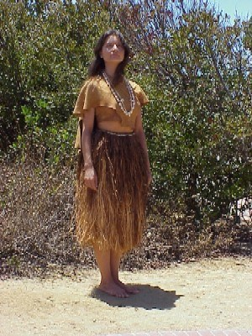
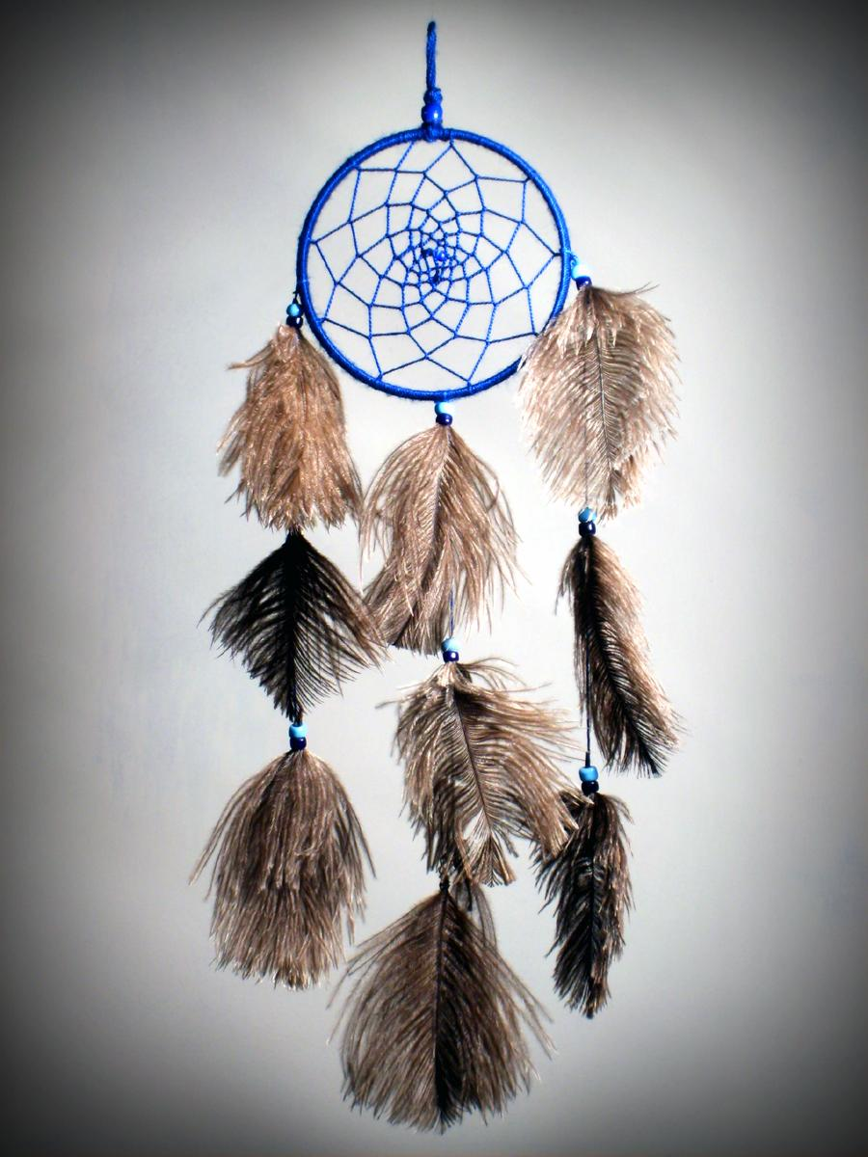
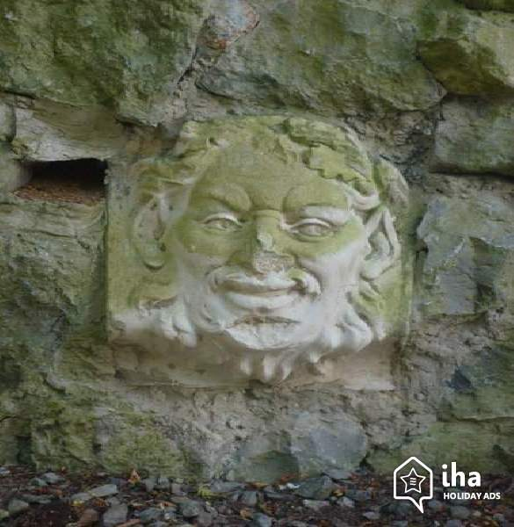
The Gabrielino used a lot of natural resources.
Notes:
This slide is the last slide. You can add a picture or several pictures as an ending to your presentation.

