Slide 1
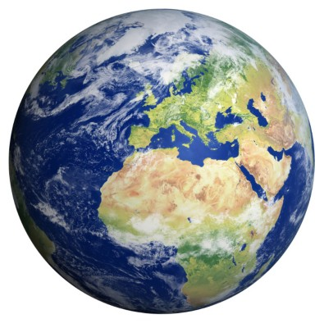
Extreme Weather And Climate
By:Caydence Harnden
& Leonard Diaz

Slide 2
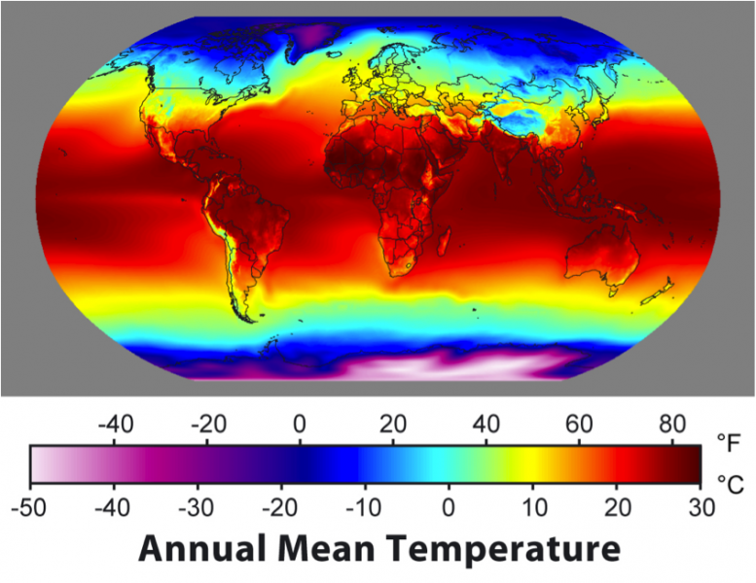
The difference Between Weather And Climate
The differece between weather and climate is weather determines the clothes you wear on any given day.Climate is the weather pattern found in a specific place over many years.

Slide 3
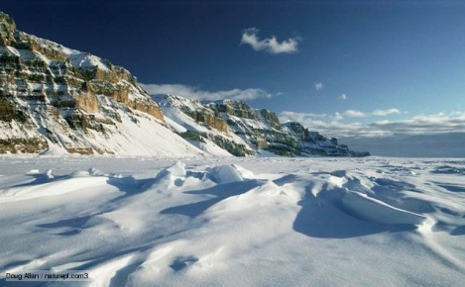
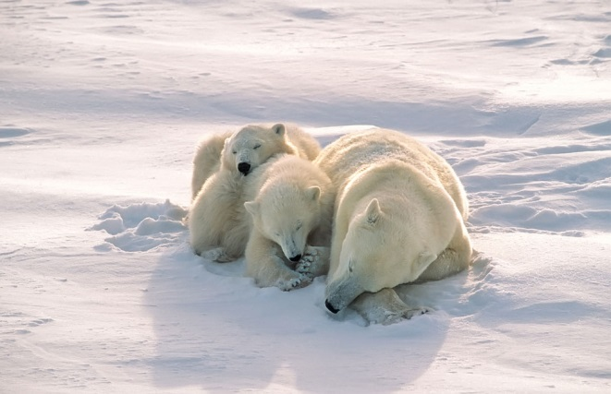
Polar Climate Zone
The polar zone is located in the South Pole and located in the North Pole. The polar is in the Artic circle. Their climate is cold all year around.

Slide 4
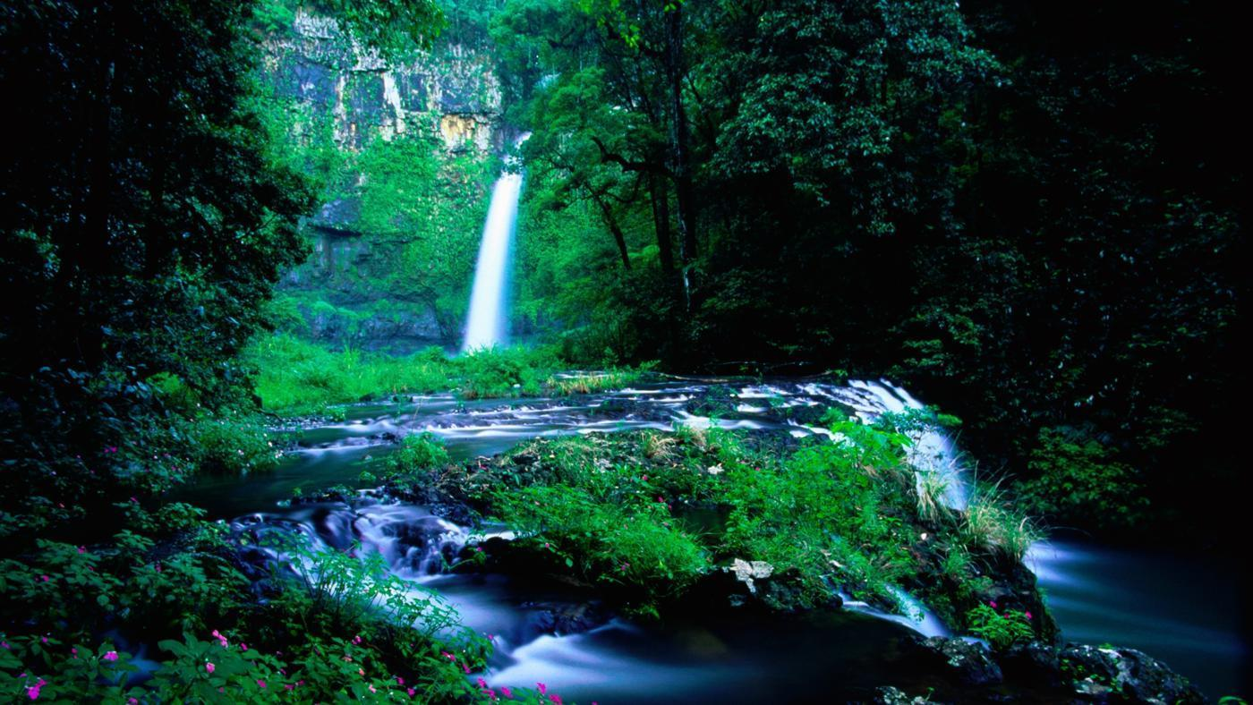
Tropical Climate Zone
The tropical climate zone is located on the equater.It’s very hot, and humid because the sun hits it directly all year long.

Slide 5
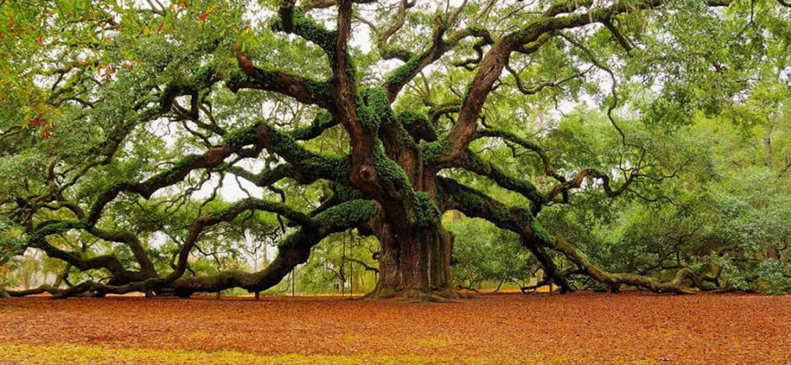
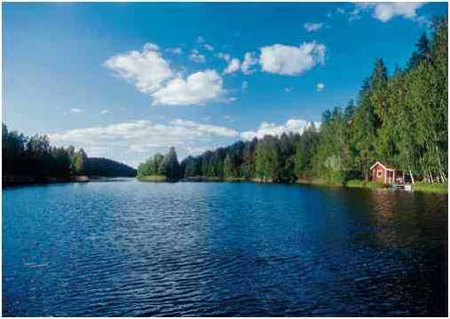
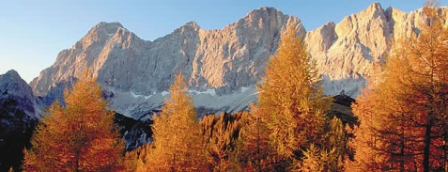
Temperate Climate Zone
The temperate zone is located near the equater. Their summers are warm and their winters are cold.

Slide 6
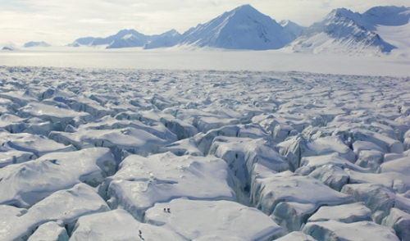
Desert Climate Zone
The desert is located on the other sides of mountains. It’s very hot and dry. They hardly have any water so it’s hard to survive. Deserts can also be frozen.

Slide 7
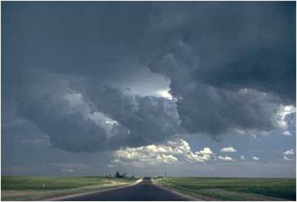
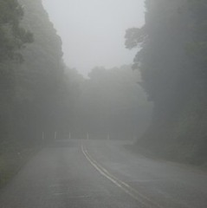
Stratonimbus
Stratonimbus clouds are about 3,000 feet in the sky. Stratonimbus clouds are like stratus but they’re darker, they bring rain, and the storm can last all day.

Slide 8
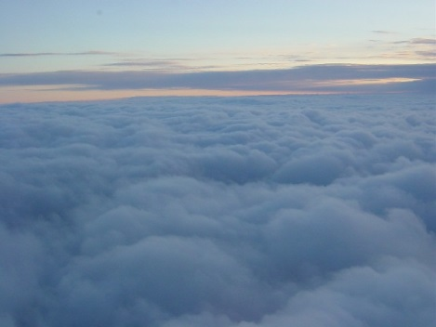
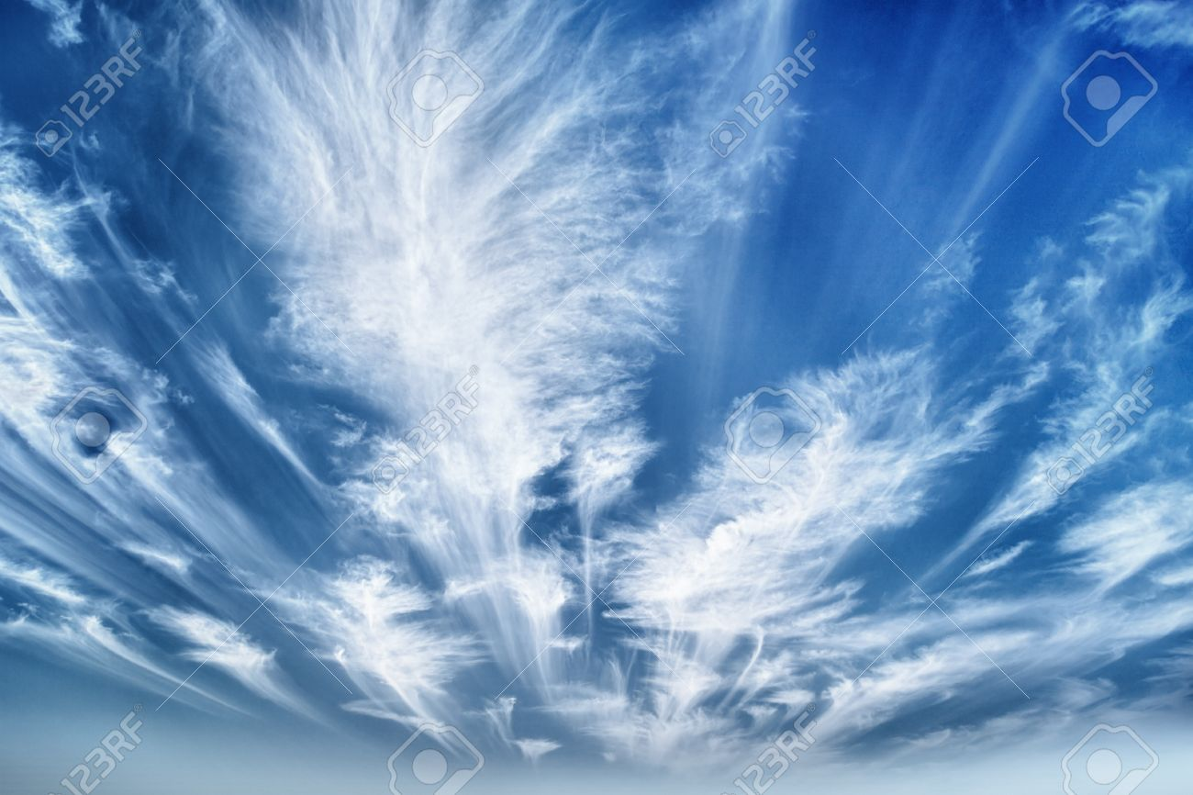
Stratus
Stratus clouds are dark, srpead out, and when you look at them they look gloomy cause of their darkness.

Slide 9
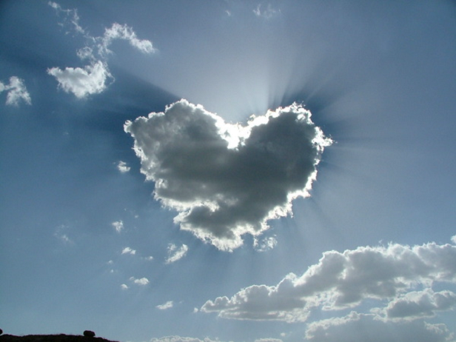
Cumulus
A cumulus cloud is about 10,000 feet in the sky. It’s a fluffy and puffy cloud. Cumulus clouds need space so they can get enough water.

Slide 10
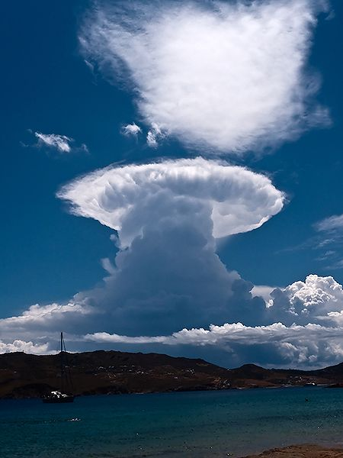
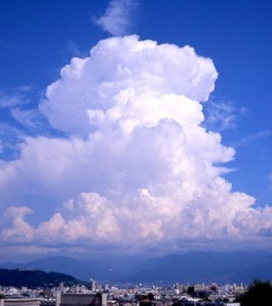
Cumulonimbus
A cumulonimbus cloud is located about 20,000 feet in the air. It brings rain and lightning. The storm lasts under an hour.

Slide 11
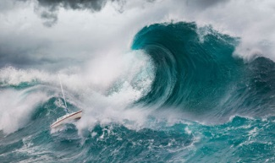
Tsunamis
A Tsunami is a giant wave that only comes in the midle of a Earthquake. A Tsunami is a wave that rises, falls, and rises again. Tsunamis are different waves that are caused by the wind. When a Earthquake happens underwater it causes a Tsunami.

Slide 12
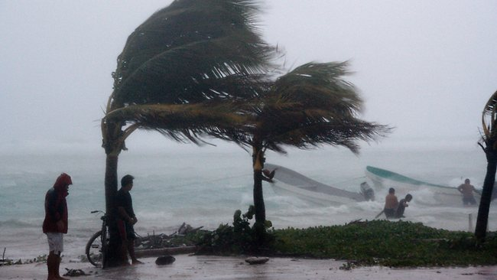
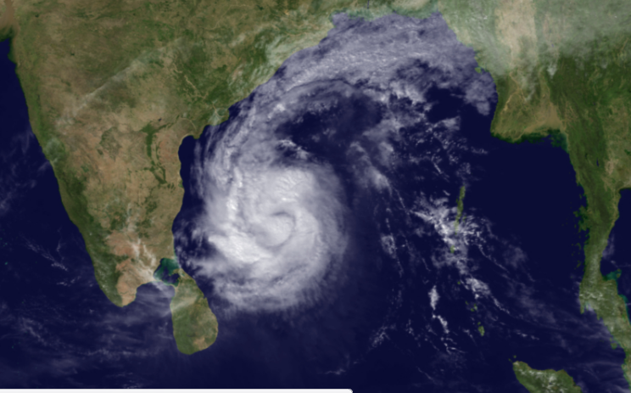
Hurricanes
A Hurricane begins as a tropical storm that reaches land at
74 mph. The clouds pick up warm water from the ocean and dump it on the land . It’s very destructive and causes damage.

Slide 13
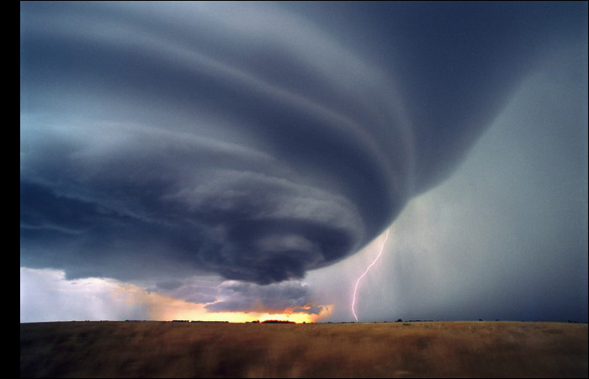
Tornadoes
A Tornado is a funnel of powerful wind caused by warm and cold wind. They occur durring thunderstorms.

Slide 14
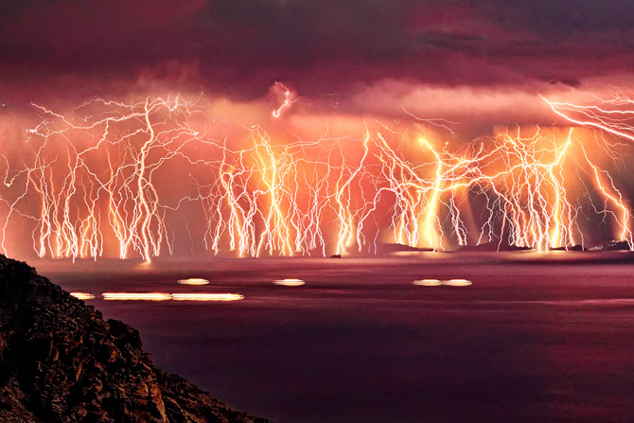
Thunderstorms
Thunderstorms form when warm air meets cooler, dryer air. Small droplets of water in the air come together then form into clouds to make a thunderstorm

Slide 15
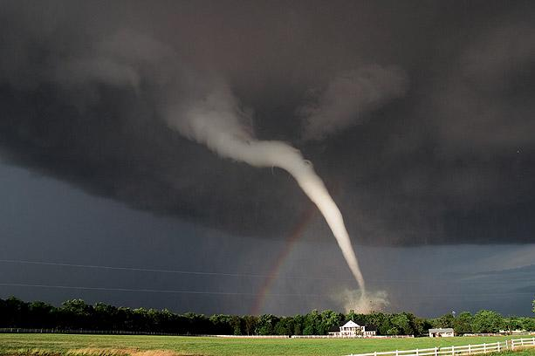
THE END

