Slide 1
Back to School Night
2024-2025
SECOND GRADE
TRACK B
July 24, 2024
Notes:
1

Slide 2
About Me
Ms. Delgado
Professional Experience:
Masters of Education/ Teaching Credential & Bachelor of Arts, University of California, Riverside
1st Year at Cal Aero Preserve School
Notes:
2

Slide 3
Goals for the Year
Have every student reach or exceed Common Core State and District standards.
Provide a safe, fun-filled, nurturing learning environment where children thrive.
Increase each child’s academic success in all subject areas.
Develop students’ organizational skills and sense of responsibility.

Slide 4
Expectations
Get a good night's rest and eat a healthy breakfast.
Students come to school by 7:50 and are with the teacher at 8:00 PREPARED TO LEARN.
Make illness the only excuse for absences.
Complete classwork and homework assignments on time.
Read 20 minutes every day in addition to regularly assigned homework.
Memorize math facts to automaticity (study nightly).

Slide 5
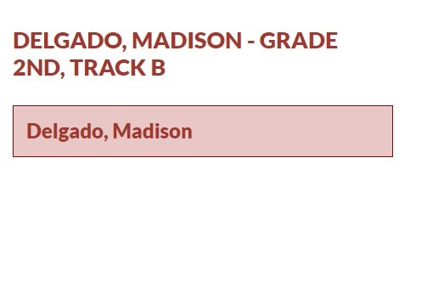
Class Website
Access my website via Cal Aero Website under the classrooms tab.

Slide 6
Classwork
It is important that each student completes his/her classwork.
If classwork is not finished in the time allotted, the student may have to complete it at the during recess or at home.
Make sure to check your child’s unfinished work section of his/her Aviator folder for any unfinished work nightly.
To ensure that students always do their best, they may be asked to do an assignment over.
Notes:
6

Slide 7
McGraw-Hill Reading Wonders
ELA Curriculum
Focus will be on:
Vocabulary Instruction
Reading Comprehension Skill Development
Phonics
Spelling
Grammar
Writing
Writing Domains:
Informational
Narrative
Opinion
Online Access:
Online access for students and parents can be found on your child’s ClassLink account.

Slide 8
Math Curriculum Savvas Envision Math
Focus will be on:
Operation and Algebraic Thinking
Numbers and Operations in Base Ten
Measurement and Data
Geometry
Online Access:
Online access for students and parents can be found on your child’s ClassLink account.
Supplemental programs utilized daily on Chrome books in class.
Prodigy
Xtra Math

Slide 9
Other Core Subjects English Language Development (ELD)​ - Remediation, Intervention & Enrichment​ - Social Studies- Houghton Mifflin-NGSS​ - Science – Twig – NGSS(99999999 - P.E. – Appropriate shoes & bring water bottles M, - Music – Once a week​ (Tuesdays) - Library – Every week (Tuesdays)

Slide 10
Second Step
Please consent to the Second Step curriculum as part of the data confirmation
To preview the Second Step curriculum, use the QR code
July 25 from 8:00-3:15 p.m., Counselor Nguyen will be available to preview the curriculum and answer questions. Counselor email: anhxuan_nguyen@chino.k12.ca.us

Slide 11
Grading Policy
All grades are a combination of class work, tests, quizzes, class participation, homework, and/or teacher observation.
Notes:
11

Slide 12
Grading Scale
Grade/Number | Meaning
4- Excelling | Students at the Excelling level of performance are consistently performing at grade level, can demonstrate independence, and can extend the grade level standards, when applicable, expected at this point of the school year.
3- Achieving | Students at the Achieving level of performance demonstrate an adequate understanding of and ability to apply skills needed to meet grade level standards expected at this point of the school year.
2- Progressing | Students at the Progressing level of performance are partially meeting the grade level standards expected at this point in the school year.
1- Beginning | Students at the Beginning/Standard Not Met are not yet meeting the grade level standards expected at this point of the school year.
Standards Based Grading Report Card, resulting in students receiving the grades of 1, 2, 3, and 4.

Slide 13
Homework*
District guidelines are 20-30 focused minutes daily as well as an additional 20 minutes a day of outside reading.
Homework will be assigned Monday through Thursday
1. Read: 20 minutes. Reading Log due each Friday
2. Math: Math Homework Worksheet due next day
3. Reading/Fluency Passages –To be read to Parent
4. Unfinished classwork
5.Test prep when necessary
Notes:
13

Slide 14
Absences
Please make sure your child is in school unless ill.
ATTENDANCE COUNTS!
Missed tests will be given the next day the student returns or when time permits.
Please try to schedule appointments after school. If you are taking your child out of school, please let me know ASAP. Work missed will need to be completed.
TARDIES do count against perfect attendance!
Notes:
14

Slide 15
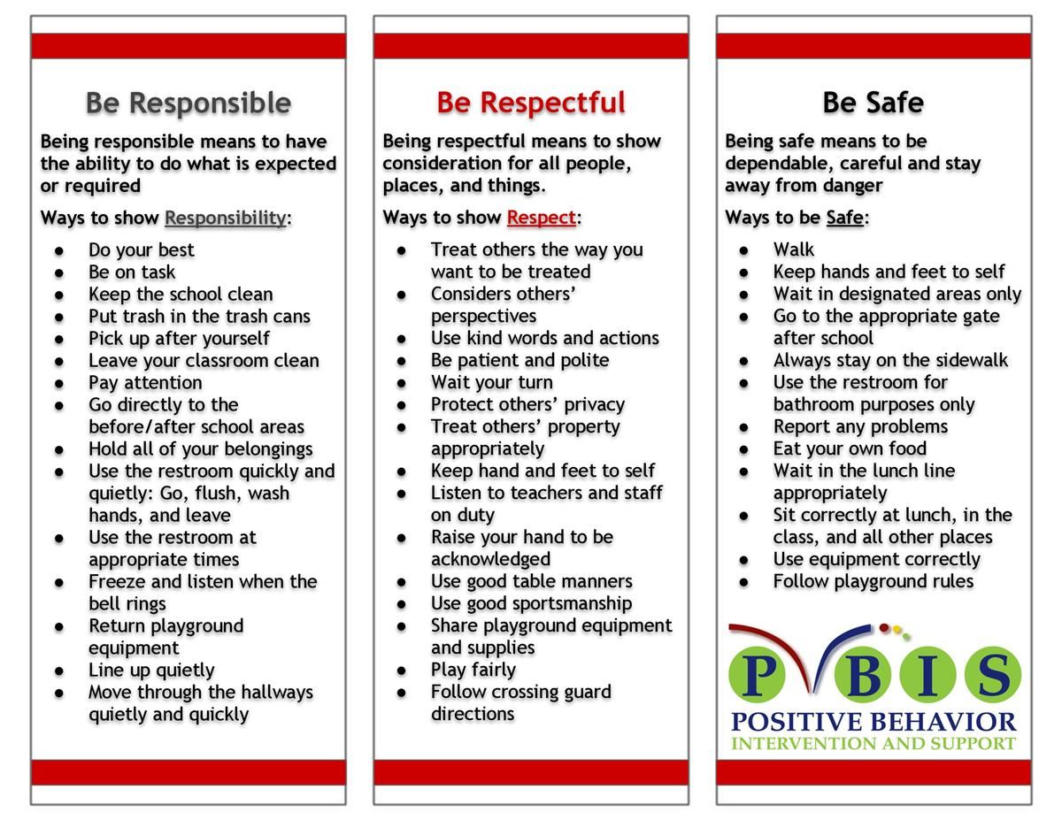
School Wide Behavior Expectations
Rick Morris Behavior Clionstrates exemplary behavior hone call home, email, or notification on daily behavior calendar.

Slide 16
Incident Logs
Incident Logs are used for minor offenses.
Examples: running before, during, or after school, pushing, playing after bell, using bathroom after the bell …
Parent signature REQUIRED
Students return signed slips the following day, or they will miss recess until forms are returned.
Grades 1-6
Incident Logs will warrant the following consequences (per trimester):
1st: Warning
2nd: Loss of a recess and citizenship grade on the report card lowered one level
3rd: Office referral for 1 lunch detention
4th: Parent/Student/Teacher Conference with an Administrator

Slide 17
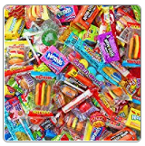
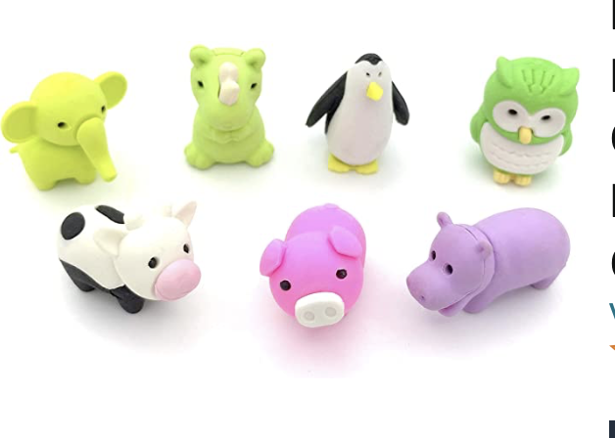
Behavior Expectation Rewards
Student’s will earn AIM High points for positive behavior both in the classroom and on the playground.
Students will be able to redeem points to purchase prizes!

Slide 18
Student Recognition
There will be 3 award assemblies this year- 1 each trimester.
Top Flight
Captain
Lieutenant
Perfect attendance (no absences, and no more than 2 tardies or leaving school early)

Slide 19
We’re College Bound! Graduating Class of 2039!
Weekly Spirit Days:
Wear a College Bound shirt every Monday and
Aviator shirt on Fridays!
Notes:
19

Slide 20
Birthdays
Birthdays will be celebrated in class with a birthday song. Students will be given a birthday pencil & certificate.
ANY treats must be brought with the student or personally delivered by the parent to the classroom. The office WILL not deliver items.
Students will receive the treats right before dismissal. Napkins must be included if treats are given.
Birthday invitations can only be given out before/after school off campus. No invitations will be passed out in the classroom.

Slide 21
Personal School Supplies
Please replenish necessary school supplies throughout the year as needed.
Pencils, Paper, Crayons, Glue Sticks, etc.
3-spiral notebooks for ELA, Math and Science.
Please pack a lip balm in your child’s backpack.
Please pack their sweaters as they do get cold throughout the day.
Notes:
21

Slide 22
Classroom Donations
White and (Pastel) Color Cardstock
Crayons/Color Pencils
Tissue Paper
Pencils
Kleenex
Wet Wipes (hands) & Clorox Wipes (classroom)
Amazon Gift Cards
Amazon Wish List
https://www.amazon.com/hz/wishlist/ls/23PLD8PZ3AKGY?ref_=wl_share

Slide 23
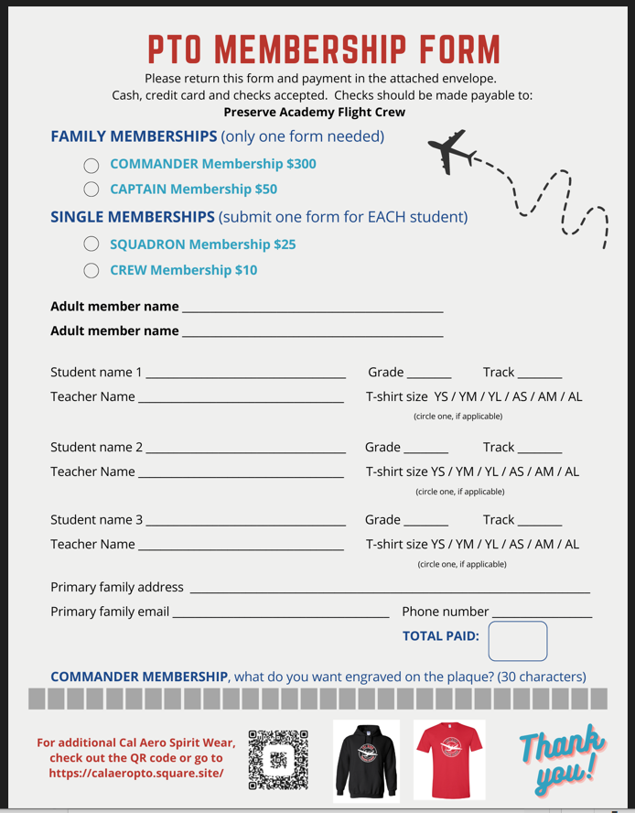
PTO

Slide 24
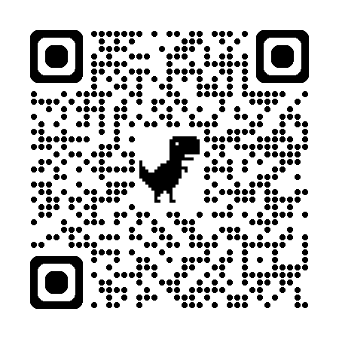
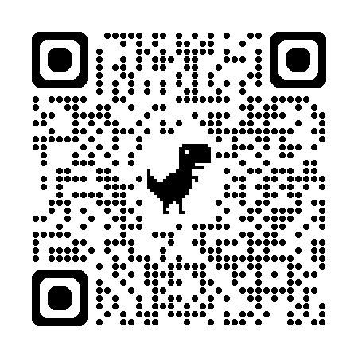
PTO
Follow Cal Aero PTO online:
Facebook
https://www.facebook.com/calaeropto
Instagram
https://www.instagram.com/calaeropto/
Get involved!
If you want to participate, here's how:
Sign up to be a room parent
Room parents work closely with PTO to put on events for the school and communicate information back to other parents.
Be on the lookout for the PTO Membership Drive
The annual PTO Membership Drive will start in August with fun prize giveaways, including t-shirts and water bottles! Classes with over 80% membership participation will receive a party! Please donate what you can to support extracurricular activities on campus!
Come to the next meeting!
The next PTO meeting will be on TUESDAY, August 13th at 6:30pm, at the Parkhouse Movie Theater.
Spirit Wear
Go back to the gym tonight to get your Cal Aero Spirit Wear for Spirit Day Fridays!
Questions or Concerns?
Email us at calaeropto@gmail.com
PTO President: Brandy Jones
Instagram
Facebook
https://www.chino.k12.ca.us/Page/53048

Slide 25
Parent-Teacher Conferences are coming up.
8/19 – 8/21
These are minimum days!
Please sign up for a date/time on Sign-Up Genius.
www.signupgenius.com/go/10C0A4DACAE22A2F8C43-50365702-delgado
Notes:
25

Slide 26
Communication: Parent Square
https://www.chino.k12.ca.us/Page/48972

Slide 27
Contact Information
Please feel free to send me a message on Parent Square or an email regarding any questions or concerns.
Cal Aero Preserve – (909) 606-8531
Madison_Delgado@chino.k12.ca.us
Please contact me if you are interested in volunteering.
***We need a Meet the Masters Parent & Room Parents. Please see sign up sheet.
I’m looking forward to a terrific year!
Thank you ☺
Notes:
27

