Slide 1
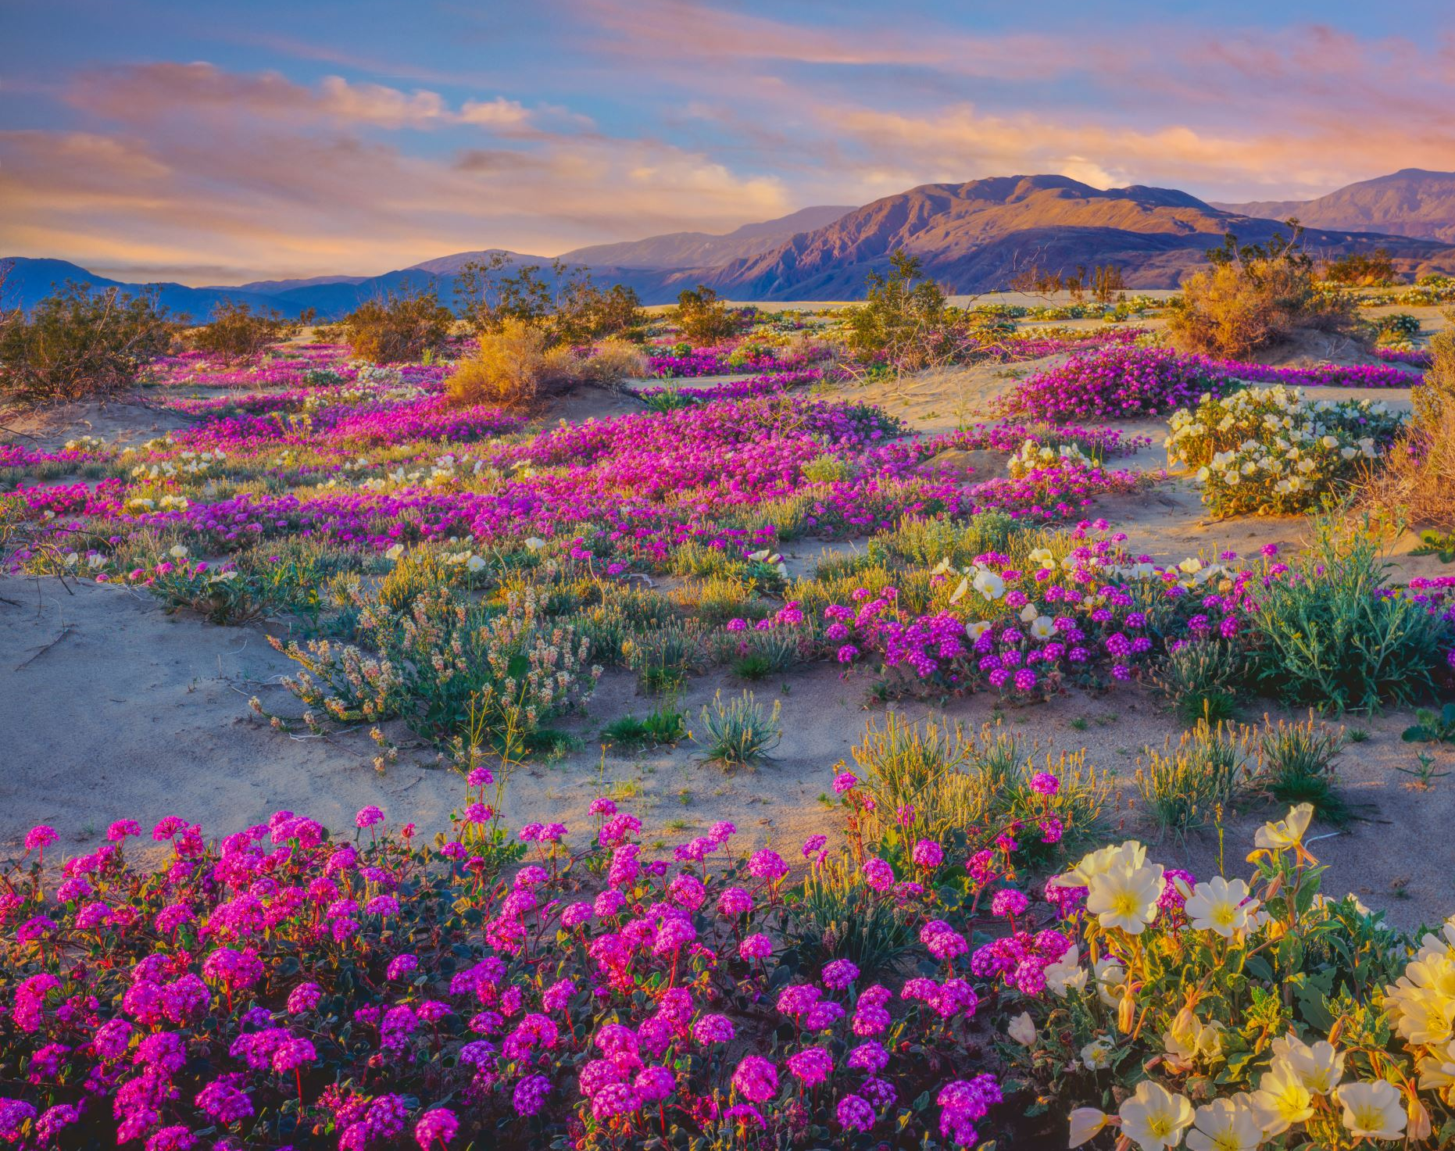
The Mojave
By Albert

Slide 2
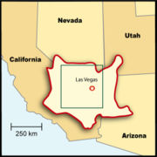
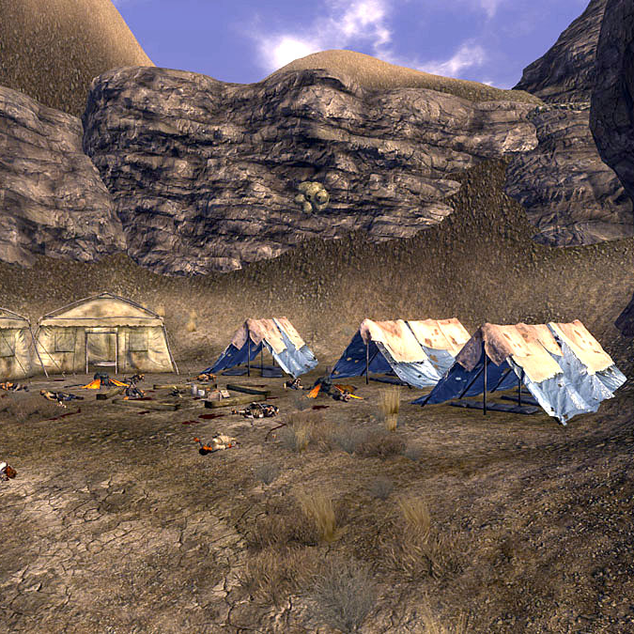
Location
The Mojave lived in the desert part of California. The Mojave tribe lived near the Colorado River. They lived in the desert of California. It was arid and dry but with rivers. It had a mild temperature climate.
This Photo by Unknown athor is licensed under CC BY-SA.
This Photo by Unknown author is licensed under CC BY-NC-ND.

Slide 3
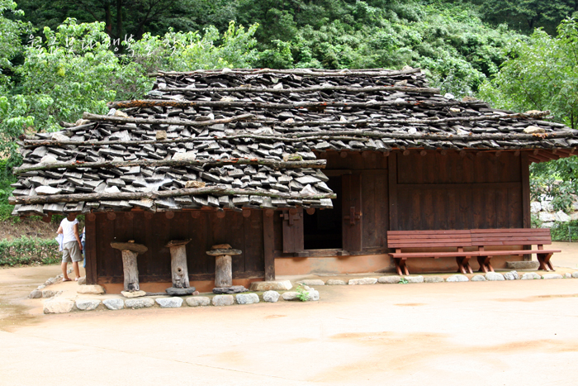
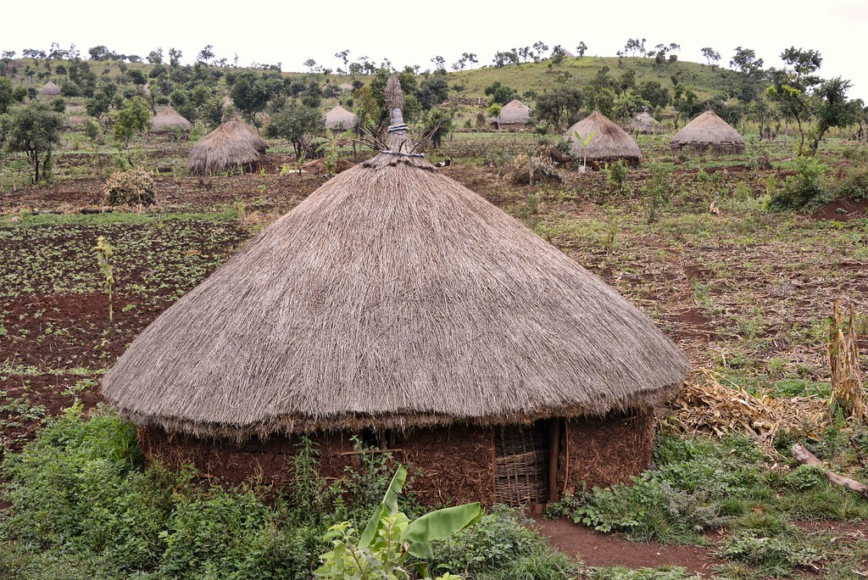
Shelter
The homes of the Mojave tribe protected them from the environment. The rectangular Mojave houses were made from redwood planks with slanted roofs. Redwood logs or cottonwood poles held up the roof. Sometimes there were no walls or doors. They also had temporary grass shelters.

Slide 4
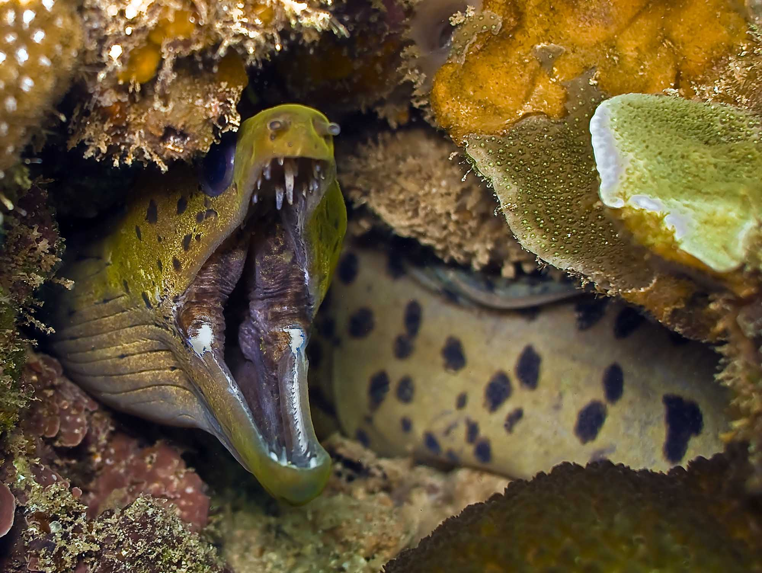
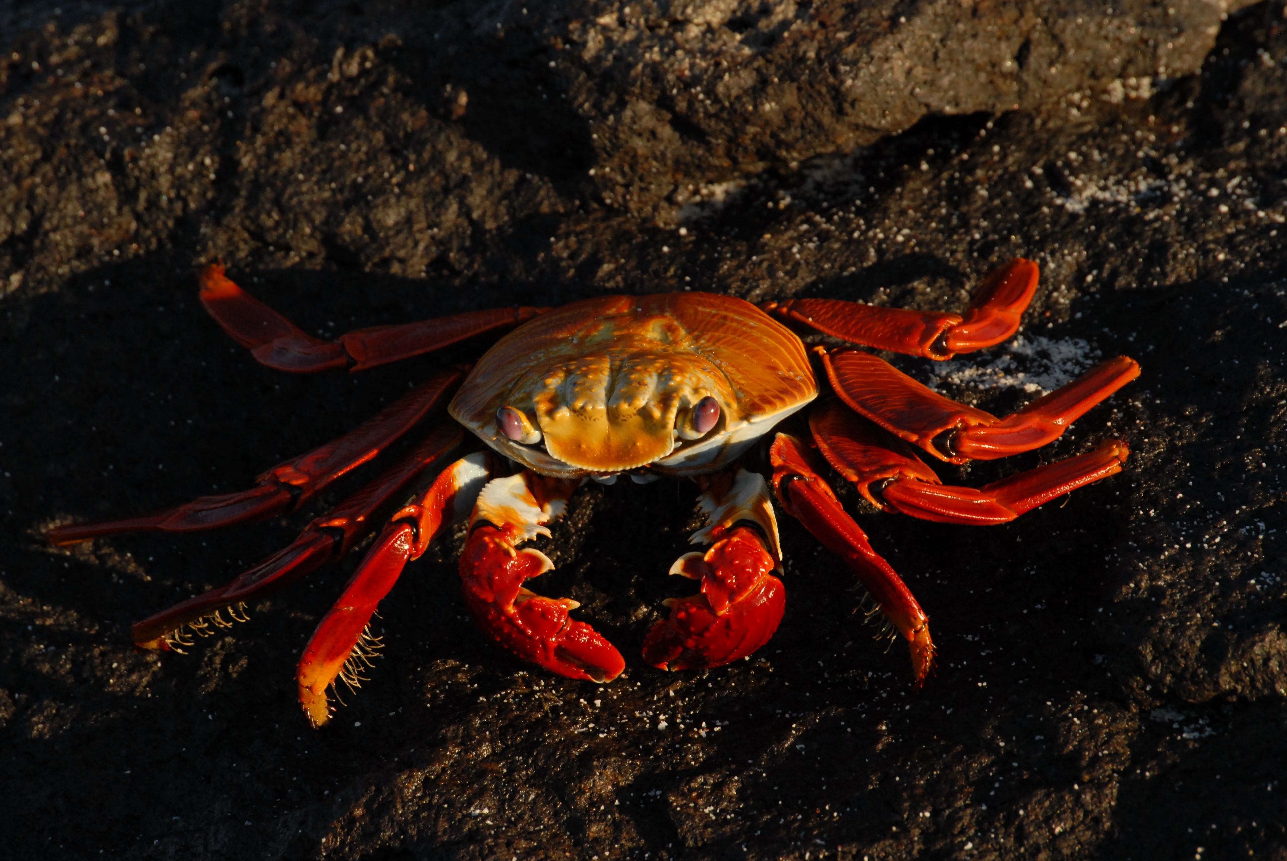
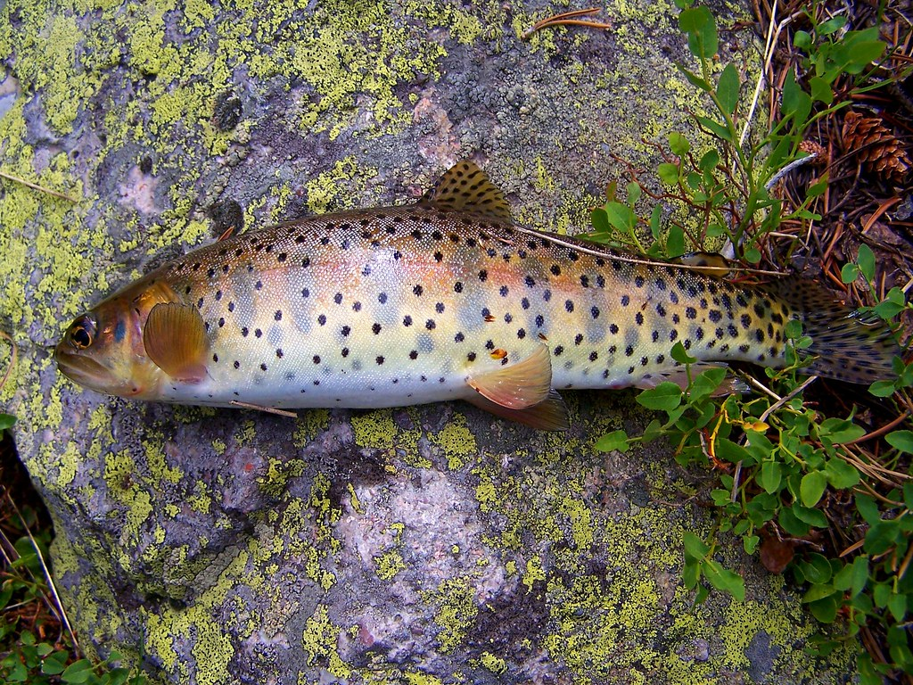
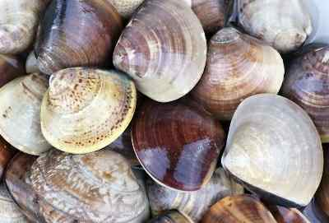
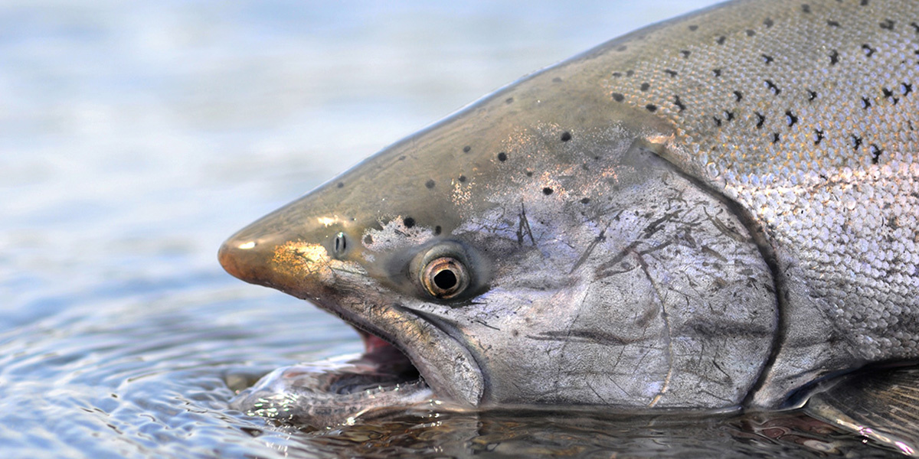
Food
-NC.
-NC.
C BY.
BY-SA.
The Mojave tribe used the land to find food in order to survive. The Mojave tribe fished for their food. Also, they eat a variety of fish and shellfish. They eat salmon, trout, eels, clams, and crabs. The groups that lived near the Colorado river farmed corn, beans, and squash.

Slide 5
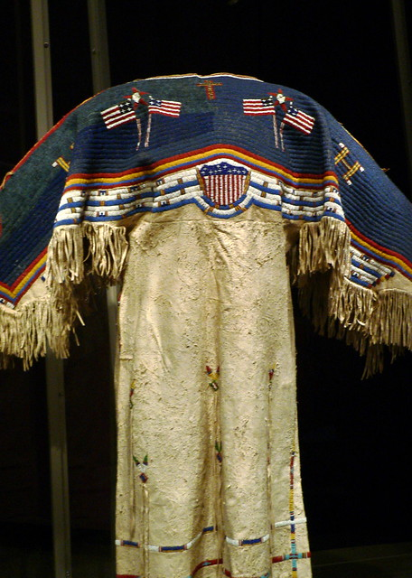
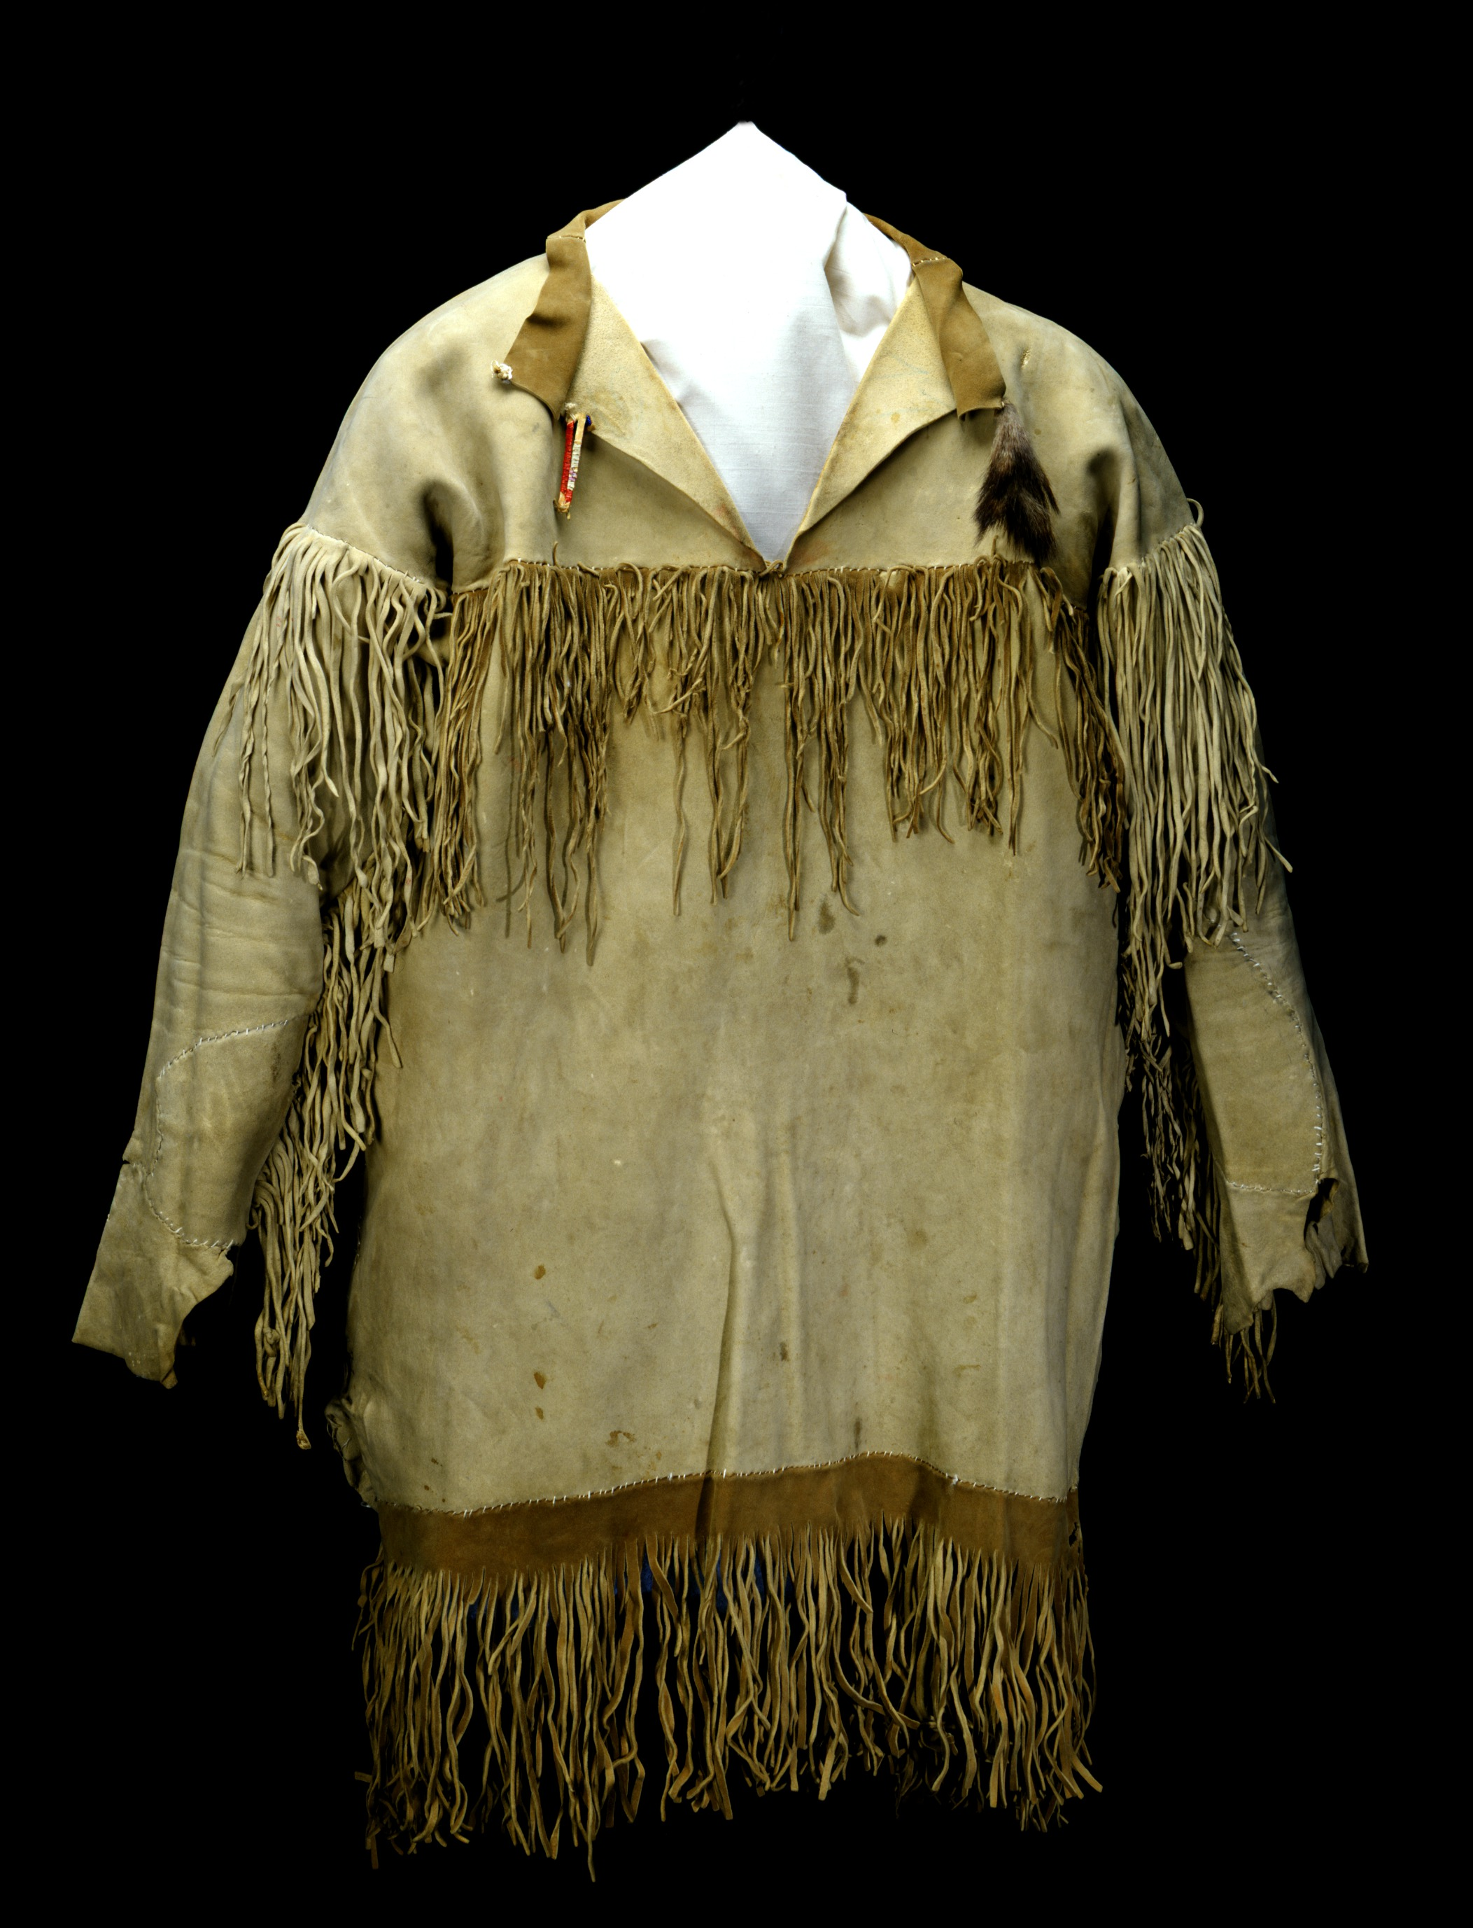
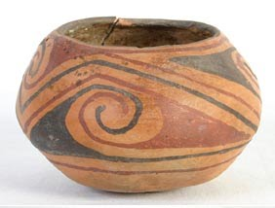
Culture
The culture of the Mojave tribe was unique. In the Mojave tribe men were grass or bark fibers. Also, the women wore willow-bark knee-length skirts. The Mojave tribe used rabbit skins for cloaks at night.
This Photo by Unknown author is licensed under CC BY-SA.

Slide 6



