Slide 1
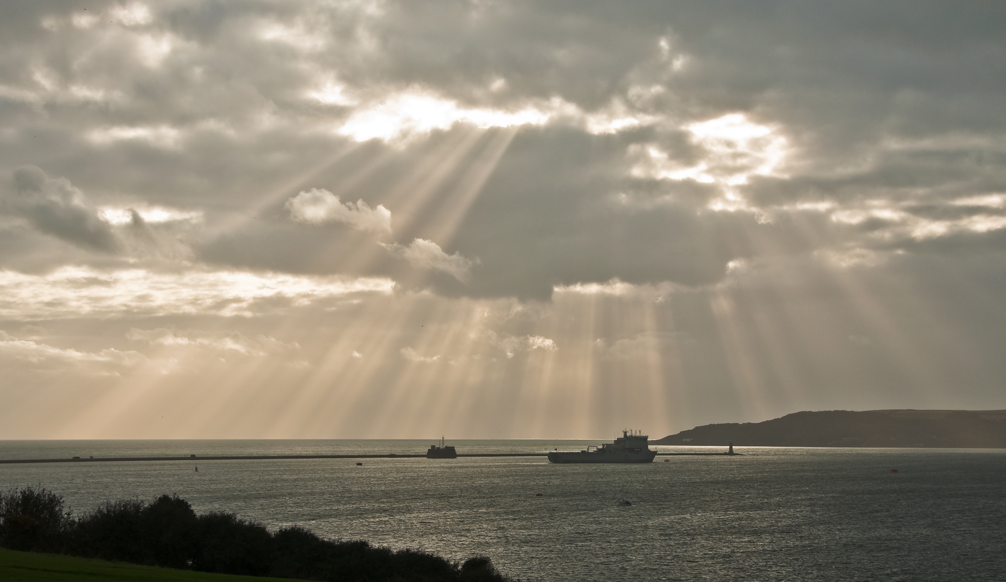
Weather and Climate
By: Stephen Cormack and Antonio Lopez

Slide 2
Tropical climate zone
In the tropical zone it has a lot of trees and plants.
The temperature is always around 80 degrees Fahrenheit.
They tend to be warm.
It's close to the equator.
Snakes, howler monkeys, spider monkeys, sloths, pangolins, deer, jaguar and lemurs.
.
This Photo by Unknown author is licensed under CC BY-NC.

Slide 3
Temperate Climate Zone
Green zone
Occurs in the middle latitudes
Has four seasons
Not too cold or hot
Mild climate
Mid climates are farther away from equator.
Has the widest seasonal changes
Has a north temperate zone and south temperate zone
Ocean and wind help shape the temperatures
This Photo by Unknown author is licensed under CC BY-SA.

Slide 4
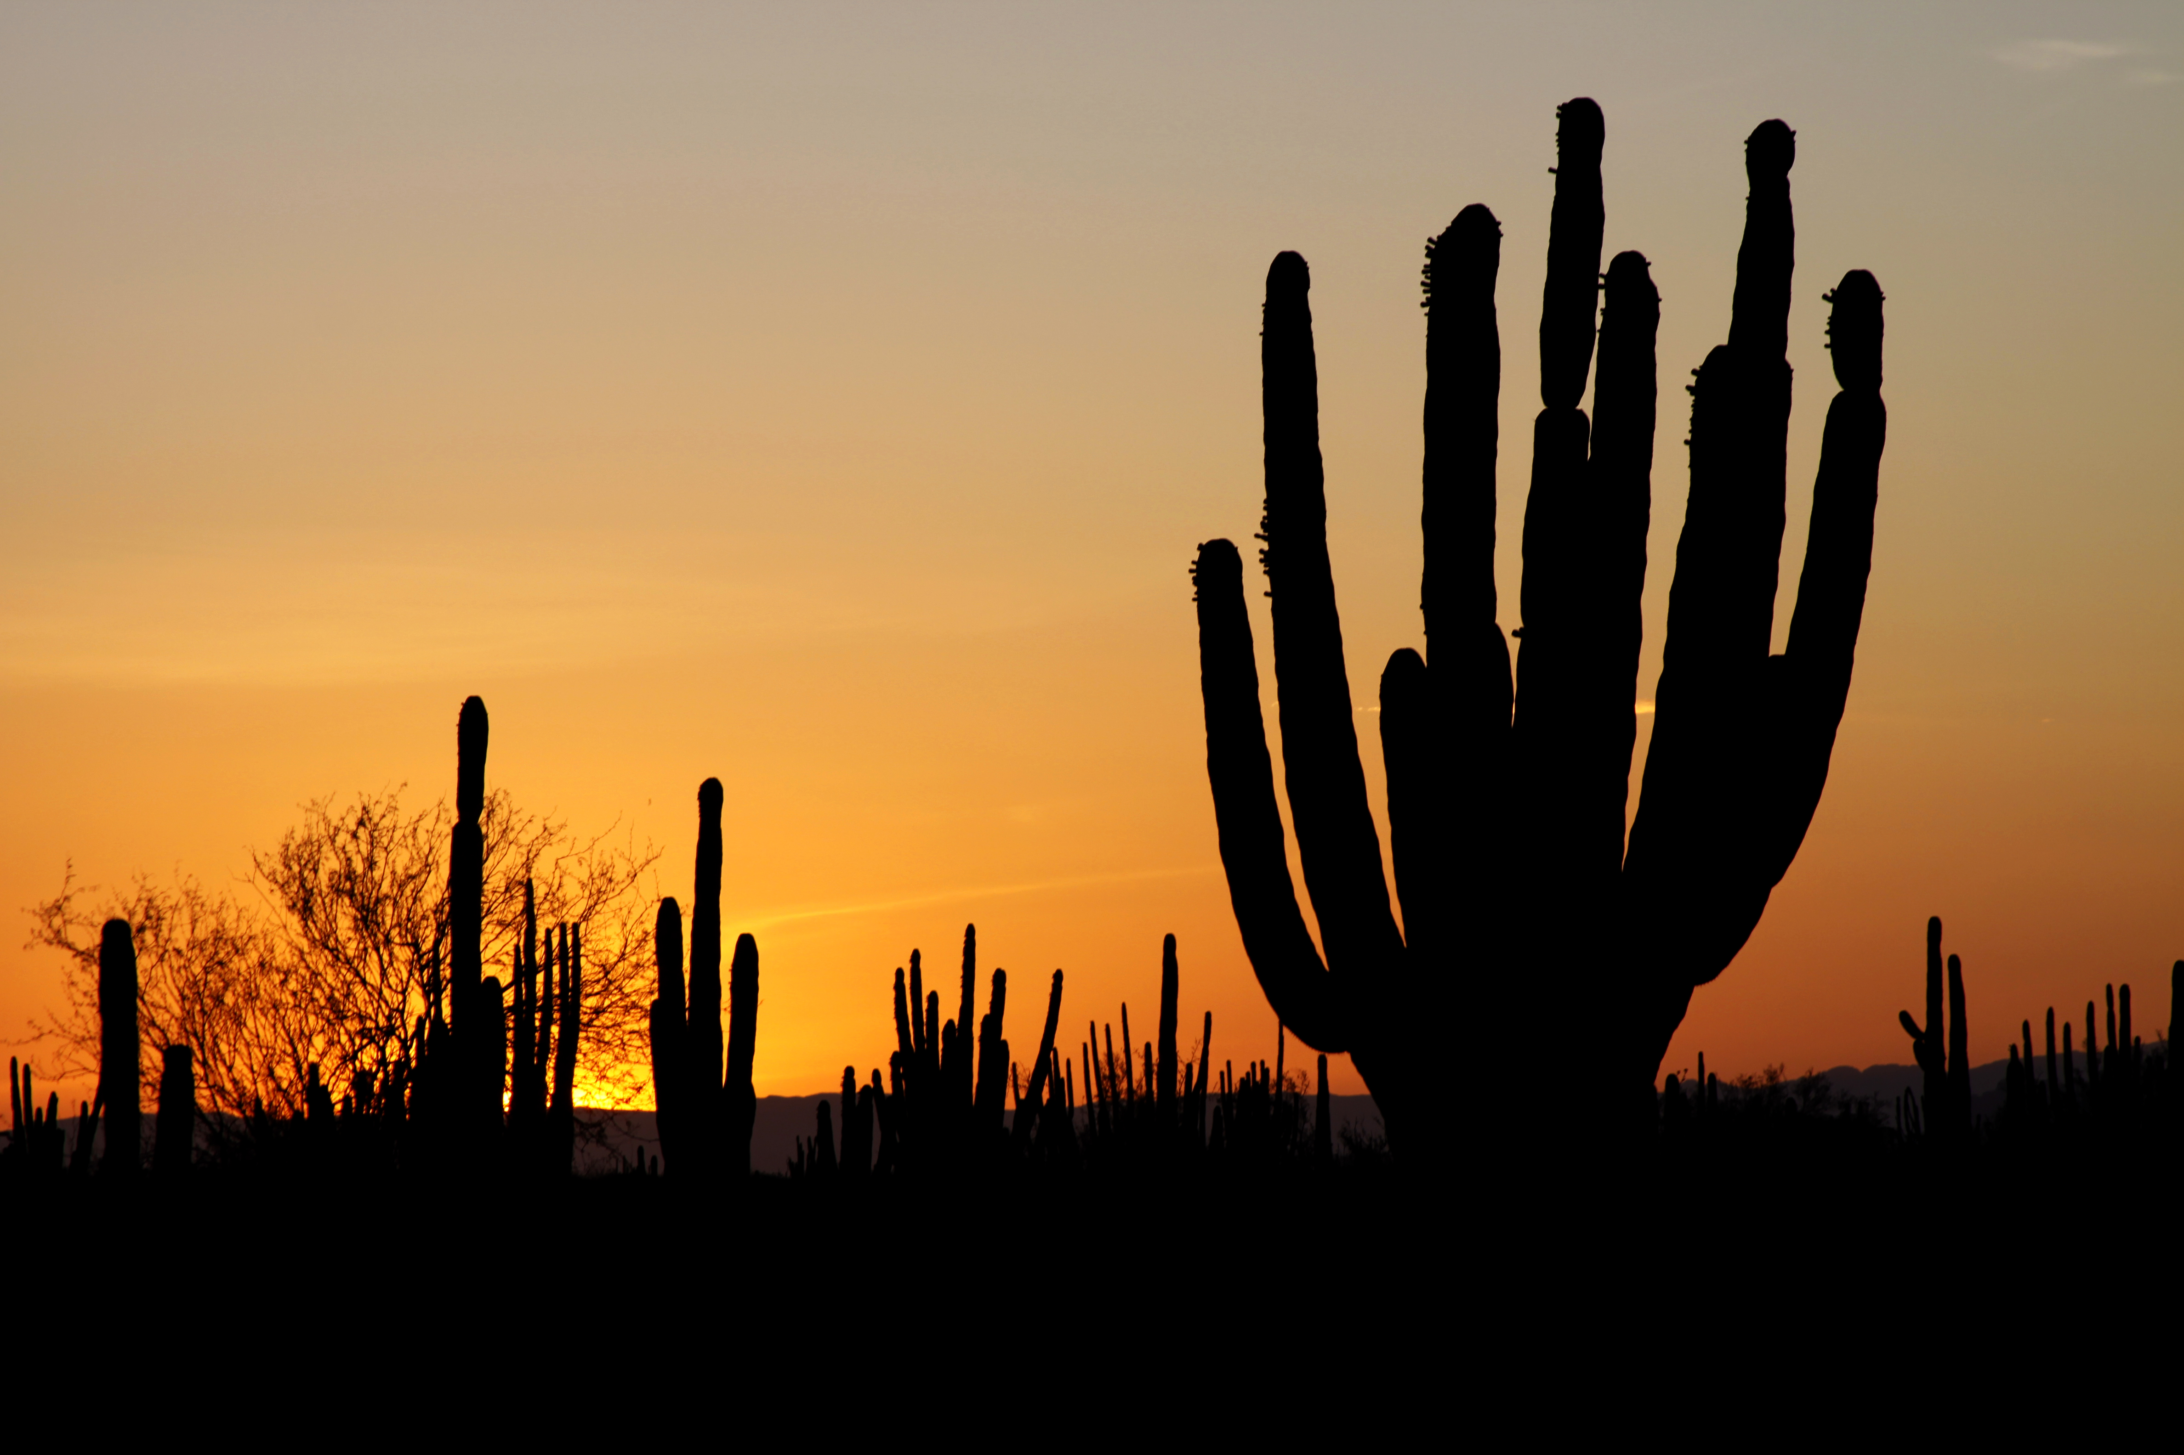
Desert Climate Zone
Dry
Bald, rocky or sandy surfaces
All deserts get less than 10 inches of rain each year
Some states in this zone are California, Arizona, Utah, Nevada
This Photo by Unknown author is licensed under CC BY-SA.

Slide 5
Polar Climate Zone
Lots of snow
Many icebergs
Average temperature is less than 50 F.
They have warm summers.
Reindeers, polar bears, Artic fox, narwhal, walrus, seal, ox, moose, orca, and snowy owl.
This Photo by Unknown author is licensed under CC BY-NC-ND.

Slide 6
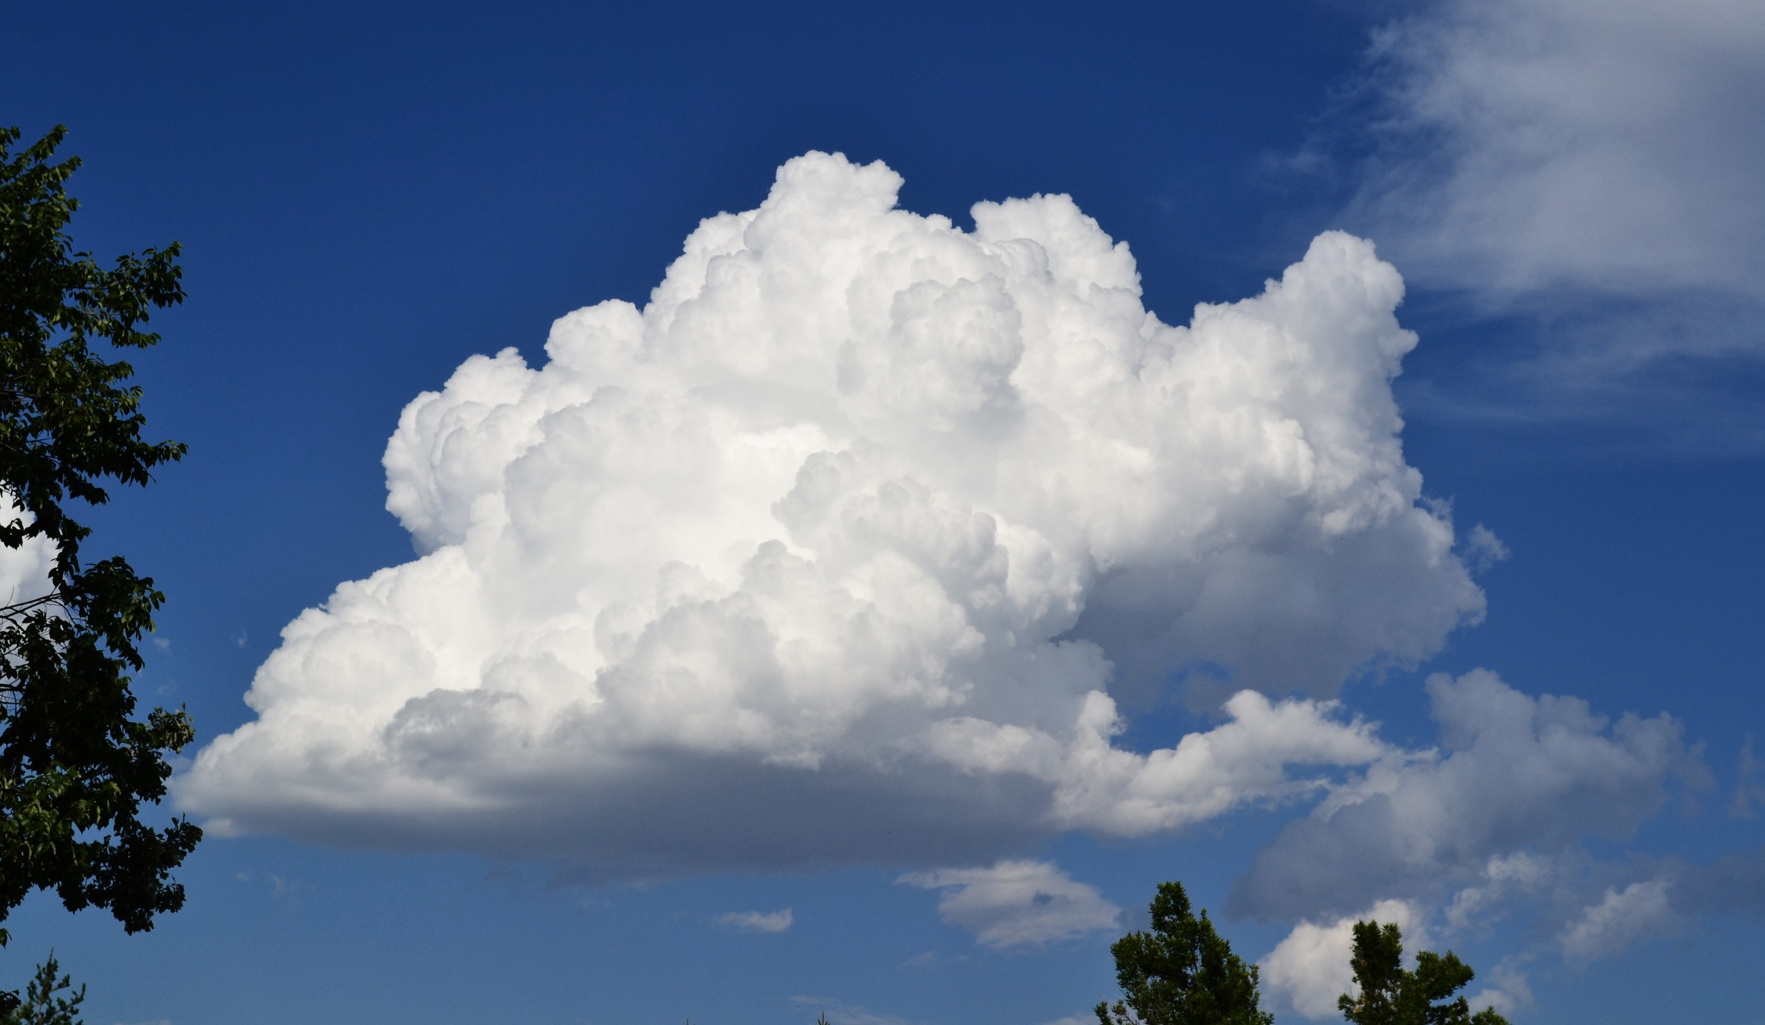
Cumulus Clouds
Cumulus clouds bring nice weather and no storms, but it can change into a storm cloud.
They range from 5,000 to 10,000 feet high in the sky.
They are white and fluffy.
Can billow high in the sky.
Appear in fair weather.
This Photo by Unknown author is licensed under CC BY-SA.

Slide 7
Cumulonimbus Clouds
Cumulonimbus clouds bring rain, make lightning and last under an hour. They are also very big and tall. It takes 45 minutes to go through it.
Dark towering clouds.
They range from 5,000 feet to 20,000 feet.
This Photo by Unknown author is licensed under CC BY-SA.

Slide 8
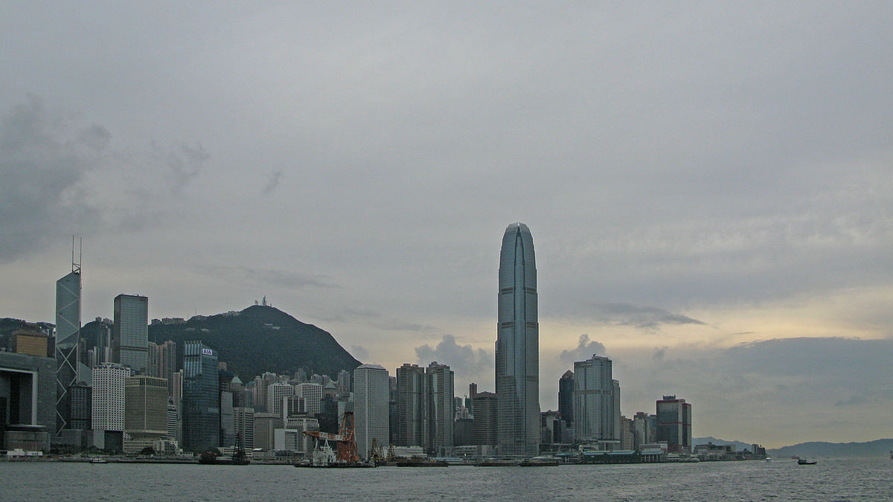
Stratus Clouds
Stratus clouds are long and spread out and they make gloomy skies but no storm. But it can change into a storm cloud.
Low level clouds
They vary in color from dark grey to white.
Flat hazy featureless clouds of low latitude
May produce a light drizzle or small amount of snow.
Some call these "high fog" clouds.
They can be composed of water droplets, supercooled water droplets, or ice crystals
This Photo by Unknown author is licensed under CC BY-SA.

Slide 9
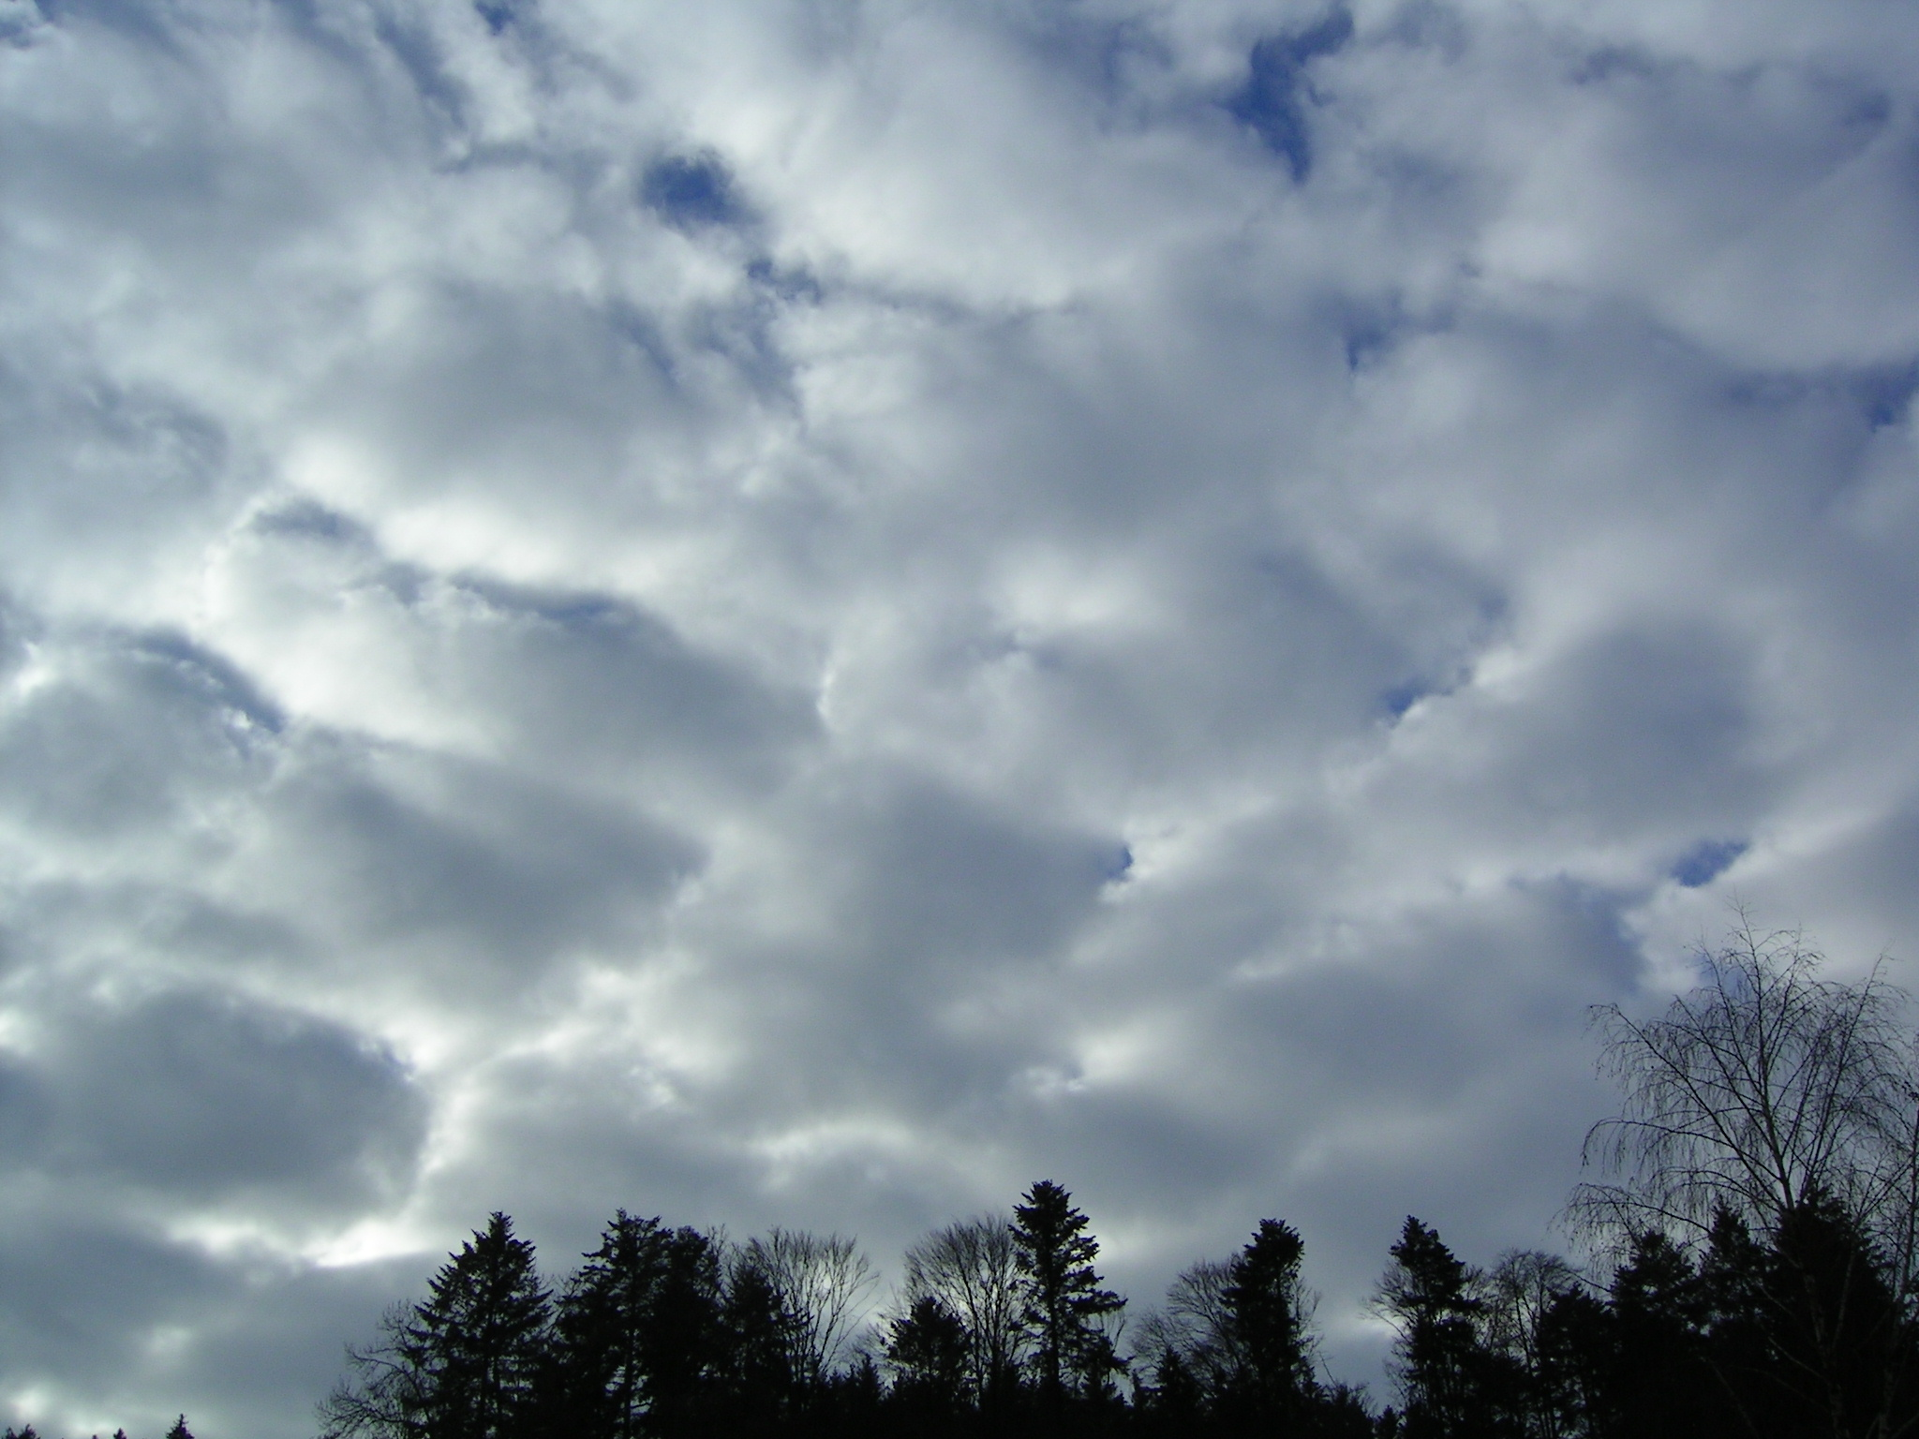
Stratonimbus Clouds
Stratonimbus clouds are dark and spread out like blankets
Produces continuous rain and/or snow
Does not have lightning or thunder
Low level clouds
Mostly found in the middle latitudes .
These clouds are 2,000 meters to 4,000 meters thick.

Slide 10
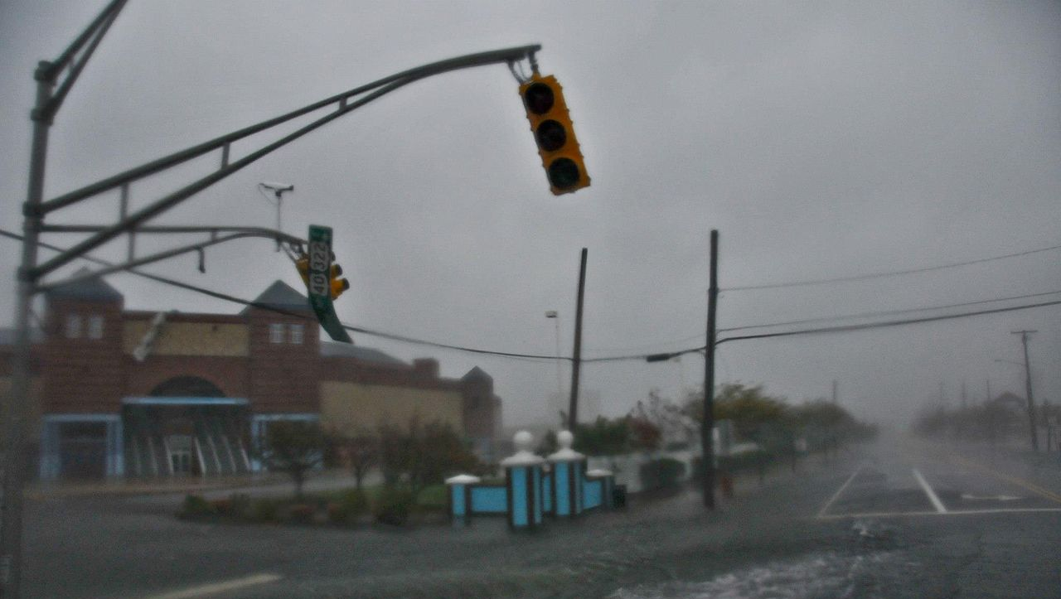
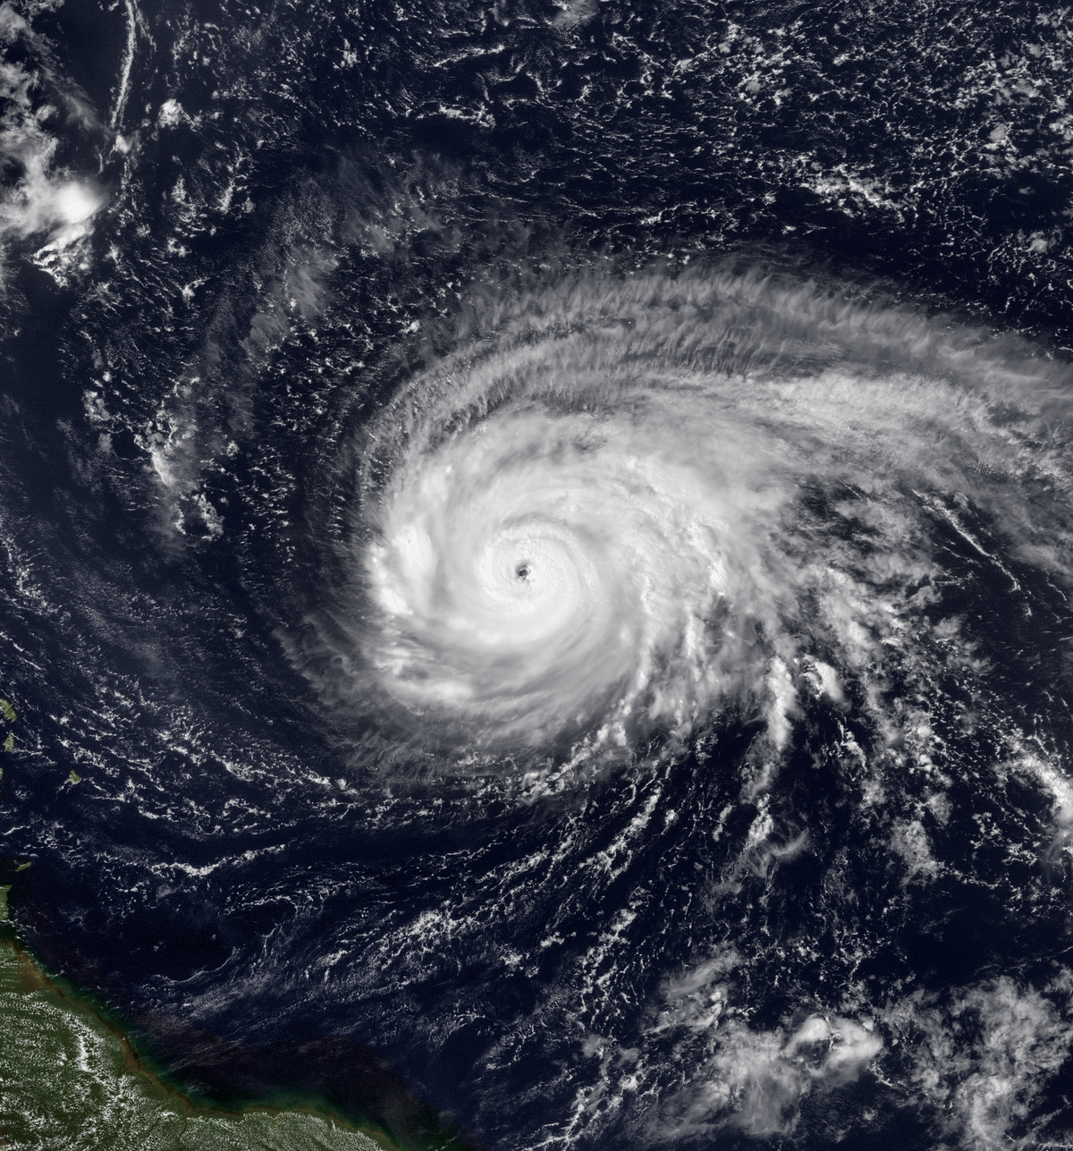
Extreme Weather – Hurricanes
Hurricanes are very destructive when they hit land
Bring heavy rain and winds
Begin as tropical storms-forming mostly in warmer months
With wind speeds of 74 mph or more, it picks up warm water from the ocean which forms clouds which then form a spiral.
The center of the hurricane is called an "eye".
Meteorologists can track hurricanes by using satellites, weather planes, and computers
The biggest hurricane in history affected more than 12 states.
They're rated from category 1 to category 5 being the most powerful.
This Photo by Unknown author is licensed under CC BY-SA.
This Photo by Unknown author is licensed under CC BY-SA.

Slide 11
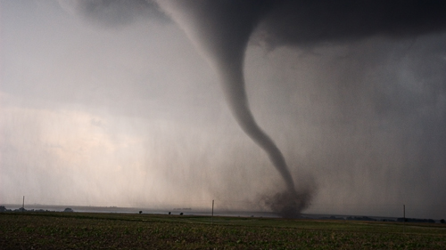
Extreme Weather -Tornado
Tornados can destroy buildings and cities.
Tornados can be 100 km.
Tornados form by warm air and cold air mixed together.
Tornados form in flat surfaces such as Texas.
Smaller tornados can reach up to 3 feet.
When tornados are black that means it's
more dangerous.
This Photo by Unknown author is licensed under CC BY-SA.

Slide 12
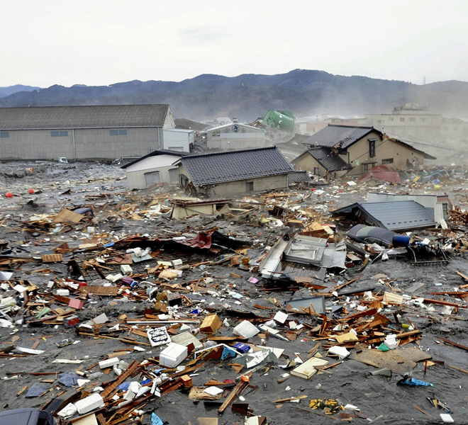
Extreme Weather Tsunami
Tsunamis cause lots of danger and can destroy cities.
Tsunamis can make trees snap or break.
Tsunamis can travel far.
Large ones last a couple of days.
Caused by underwater earthquakes, volcanic eruptions or underwater landslides.
Tsunamis are composed of a series of waves.
Most happen in the Pacific Ocean "Rim of Fire".
This Photo by Unknown author is licensed under CC BY-SA-NC.
This Photo by Unknown author is licensed under CC BY-SA.

