Slide 1
Chapter 2
Part 2

Slide 2
I. Field Studies
Not all experiments are done in labs. When experiments are done outside of a lab they are called field studies, since they are done in the “field”.
For any experiment, there are two different groups that are being tested: the control group and the experimental group.
Notes:
https://ltlatnd.files.wordpress.com/2011/06/ipad-pompeii-2.jpg

Slide 3
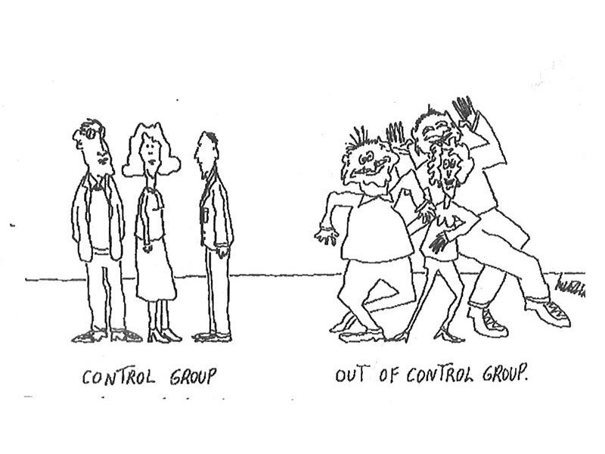
I. Field Studies
The control group is the group that does not have any changes given to it. No variables are changed for the control group.
This gives researchers information about the way the experiment goes when nothing is changed.
Notes:
https://cpb-us-e1.wpmucdn.com/blogs.cornell.edu/dist/5/615/files/2011/04/control-group1.jpg

Slide 4
I. Field Studies
The experimental group has variables that are changed by the researcher, and then they measure or record the reaction to the change.
There can be more than one experimental group, depending if there are more variables that the researcher is looking in to.
Notes:
https://experimentika.de/wp-content/uploads/2016/06/experimente-fuer-kinder-2.jpg

Slide 5
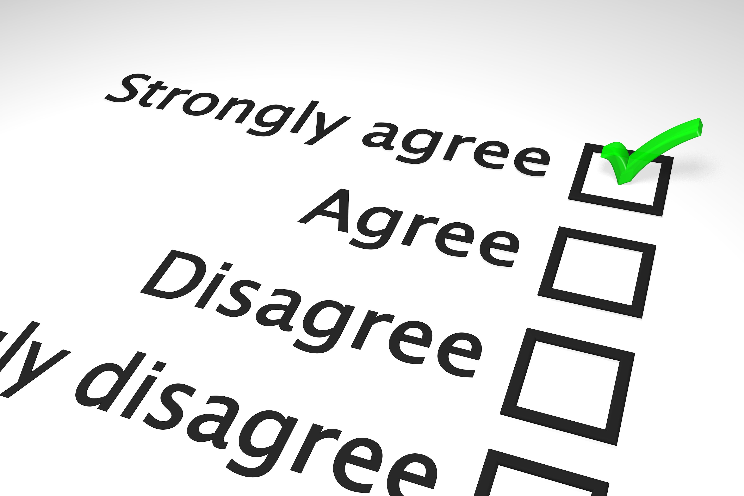
II. Other methods for studying behavior
Survey method is when a small group of people are asked questions about their feelings, opinions, or behaviors.
This experiment depends heavily on who is chosen to participate in the survey. Since it is impossible to ask every single person in the country the questions, a sample must be used.
Notes:
http://piggybankbuilder.com/wp-content/uploads/2012/07/survey2.jpg

Slide 6
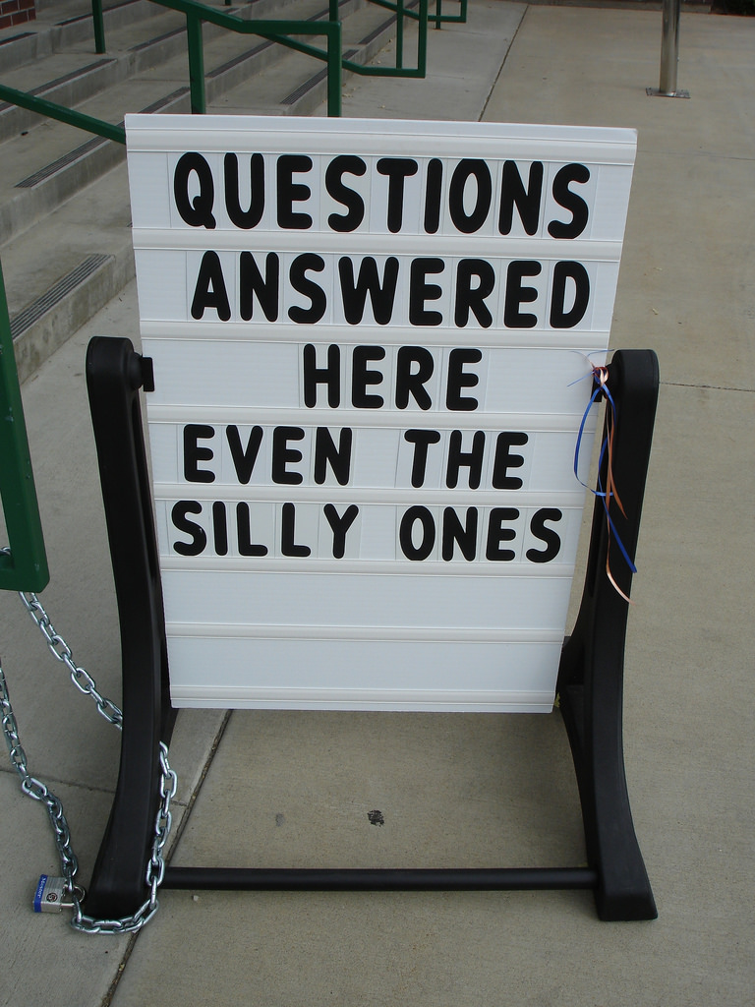
II. Other methods for studying behavior
When the sample truly reflects the larger group, it is a representative sample.
Another major consideration is how the questions are worded. The questions can be phrased in a way to get a specific response, or the data can be used to answer a completely different question.
Notes:
https://c1.staticflickr.com/1/93/223839049_12f0df6d95_b.jpg

Slide 7
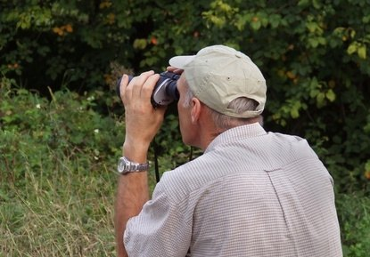
II. Other methods for studying behavior
Naturalistic observation is watching the subjects in their daily activity without interference. The subjects will show their own natural behavior, and that gives the researcher realistic information.
The problem with this is that the observer may interpret actions incorrectly, since they cannot ask the subject why they are acting a certain way or doing a certain thing.
Notes:
http://img.ehowcdn.com/article-new/ehow/images/a07/ec/77/use-naturalistic-observation-antisocial-children-800x800.jpg

Slide 8
II. Other methods for studying behavior
Interviews are directly asking the people for information about themselves. But since the person being interviewed knows they are being studied, they may change their answers to try and make themselves look or sound better.
Another problem is the interviewer bringing in their own bias, and having those prejudices change their interpretation of the answers.
Notes:
https://flatironspi.com/wp-content/uploads/2016/07/interview.jpg

Slide 9
II. Other methods for studying behavior
Case study method is usually about only one person, and is designed to get lengthy, detailed information about that person. It is less about what a person says than about how they approach issues in their lives.
The main problem with this is you cannot generalize the findings, since they are specific to one person.
Notes:
https://www.interez.sk/wp-content/uploads/2016/10/7sekund4.jpg

Slide 10
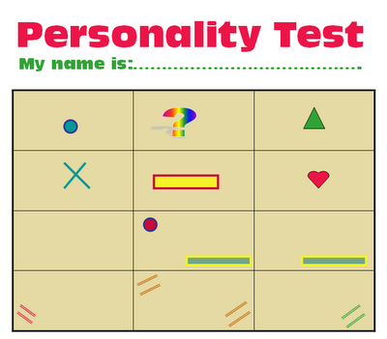
II. Other methods for studying behavior
Psychological tests like IQ tests or personality tests can give information about individuals that may contradict what is generally thought of a person.
These are limited in the amount of information you can get, and they do not tell the whole story of the individual. They should be combined with other pieces of information to get a better picture of the individual.
Notes:
https://bluesyemre.files.wordpress.com/2012/01/personalitytestpsychologytest.gif

Slide 11
II. Other methods for studying behavior
Cross-sectional method looks at different age groups at the same time in order to understand changes that occur over time. So gathering information from toddlers up to old age.
This can be problematic because everyone has not developed the same way or had the same experiences over time.
Notes:
https://study.com/cimages/videopreview/cross-sectional_preview_frame_107696.png

Slide 12
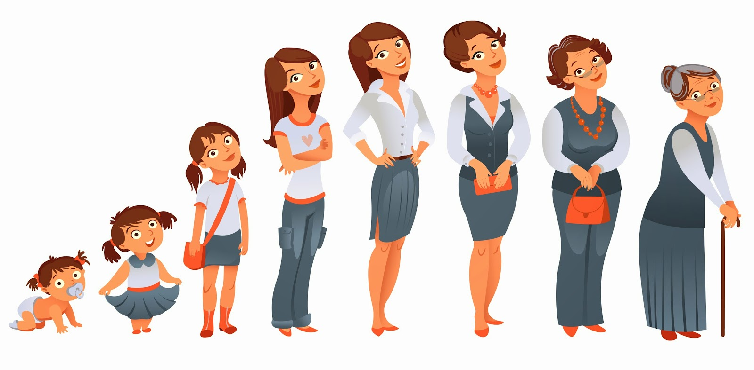
II. Other methods for studying behavior
A better, but more costly and time-consuming, method is the longitudinal study. This is when you follow the same group for a long period of time to observe the changes that happen.
Notes:
http://www.lulumineuse.com/medias/images/age.jpg

Slide 13
In your notebooks
Choose a method of research that you would choose to test out your experiment about which kind of person would be more helpful. Explain why that would be the best method, how the experiment would look, and what problems you will have to deal with in that type of experiment.

