Slide 1
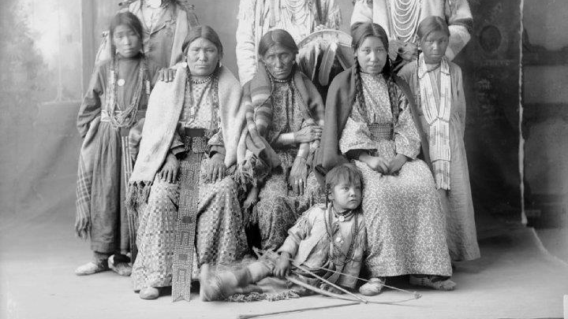
The Gabrielino tribe
By: Ainsley Galvin and Emily Rice

Slide 2
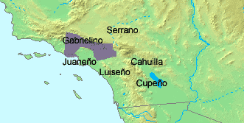
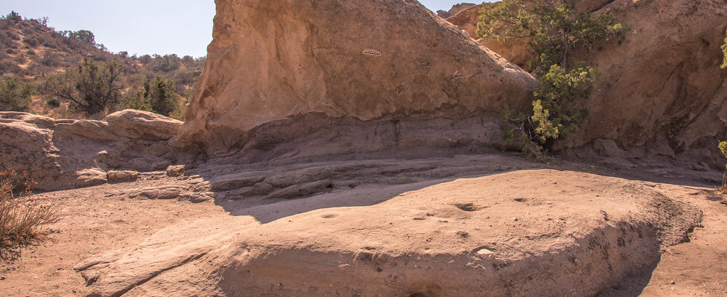
Location
The Gabrielino lived in the Southern coastal part of California. They lived near the Pacific Ocean. They lived in the mainland off the coast. They have hills and grasslands.

Slide 3
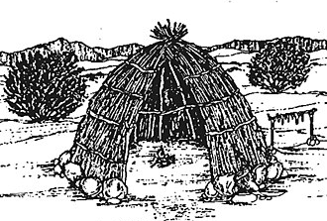
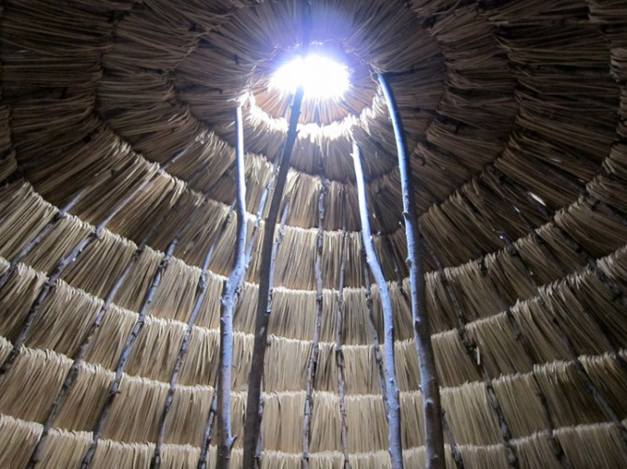
Shelter
The homes of the Gabrielino tribe protected them from the environment. For their houses they put poles upright in a circle. The houses are made of hay and grass. Bunches of tule or fern are woven into mats and placed on poles.

Slide 4
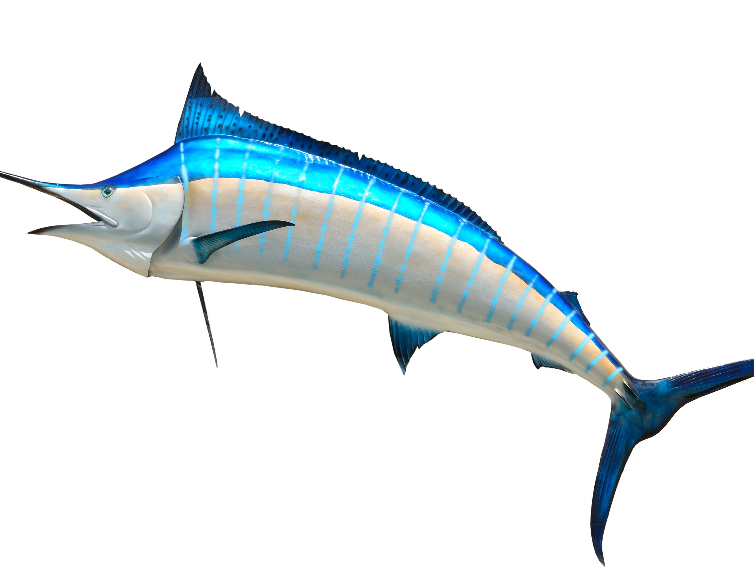
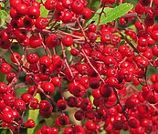
Food
The Gabrielino tribe used their land to find food in order to survive. The gathered wild berries, grapes, and wild cherries. Their main food came from the sea. They fished sharks, swordfish, and they hunted seals.

Slide 5
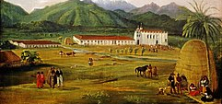
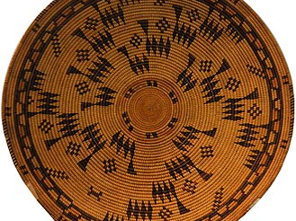
Culture
The culture of the Gabrielino tribe was unique and interesting. The clothes were woven from plants and feathers. The men and children usually did not were any clothes. They had ceremonies like when they honor those who died during the year.

Slide 6
